Slide 1
Adorners
Jonathan Birkholz

Slide 2
About me
Blogs :
theabsentmindedcoder.com
wizardsofsmart.net
Twitter : RookieOne
GitHub : github.com/RookieOne
Email : rookieone@gmail.com

Slide 3
NOT A DESIGNER!
Me != Designer

Slide 4
Conceptually
A UI decorator that provides additional functionality or additional information
Broad definition
Context Menus
Overlays
Tool tips
Popup Windows

Slide 5
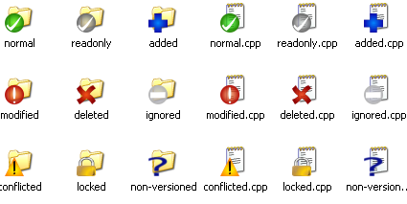
Tortoise SVN

Slide 6
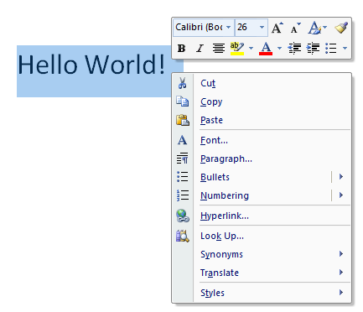
Context Menu + Toolbar

Slide 7
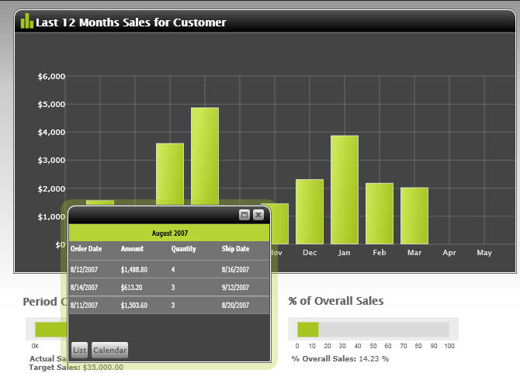
Interactive Tooltip

Slide 8
Power point demo

Slide 9
Visual studio

Slide 10
PP Reminder ☺
Add and Remove Hyperlink
Rotate and resize
Change Font

Slide 11
Adorners in WPF

Slide 12
Technically
A custom FrameworkElement that is bound to a UIElement
Inherits from abstract class Adorner

Slide 13
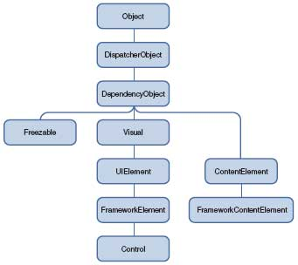
Basic Class Hierarchy

Slide 14
Breakdown
Visual
provides for building a tree of visual objects
UIElement
defines core subsystems including Layout, Input, and Events
Framework Element
builds on the basic layout contract introduced by UIElement and adds the notion of a layout "slot”
Control
Adds the templating feature

Slide 15
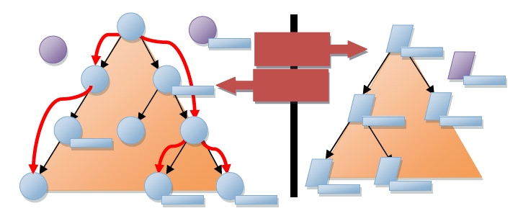
Trees
Visual
Logical

Slide 16
WPF Layout
Basic Layout Contract
Measure
Allows a component to determine how much size it would like to take
Arrange
Allows a parent to position and determine the final size of each child

Slide 17
Tree Revisited
Visual
Logical

Slide 18
Grid demo

Slide 19
Creating a UIElement
Visual Collection
<- pass in parent element into constructor
Override VisualChildrenCount
Override GetVisualChild
Override Measure
Measure child visuals
Override Arrange
Arrange child visuals

Slide 20
Is required demo

Slide 21
Loading demo

Slide 22
Windows 7 preview demo

Slide 23
Drag and drop demo

