Slide 1
Evolve Your Code

Slide 2
Purpose
I would like you to walk away reexamining the way you write your code

Slide 3
Outline
Overview on
Extension Methods
Lambda Expressions
Expression Trees
Fluent Interface

Slide 4
Extension methods

Slide 5
What are they?
Introduced in .Net 3.5 and Visual Studio 2008
Extension methods enable you to "add" methods to existing types without creating a new derived type, recompiling, or otherwise modifying the original type.

Slide 6
Where have I seen them before?
LINQ
Extension method on IEnumerable<T>

Slide 7
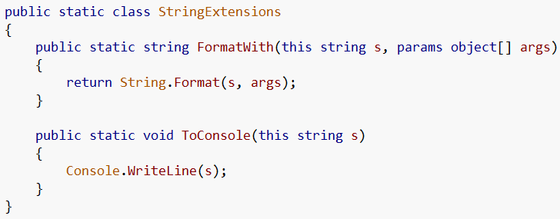
Making an extension method
Make a static class
With a static method
First parameter is the object to extend
1
2
3

Slide 8
Using extensions
Without extensions
With extensions

Slide 9
Lambda expressions

Slide 10
What are Lambda Expressions?
Introduce in .Net 3.5 and Visual Studio 2008
A lambda expression is an anonymous function that can contain expressions and statements, and can be used to create delegates or expression tree types

Slide 11

Where have I seen them before?
Linq uses lambda expressions
Is the same as…

Slide 12
As event handlers as well

Slide 13
How can I use them?
Funcs
Func<(Of <(T, TResult>)>) Delegate
Encapsulates a method that has one parameter and returns a value of the type specified by the TResult parameter.
Actions
Action<(Of <(T>)>) Delegate
Encapsulates a method that takes a single parameter and does not return a value.

Slide 14
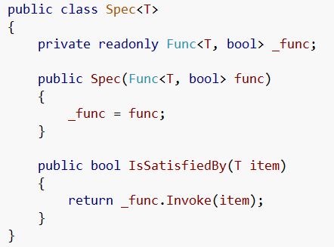
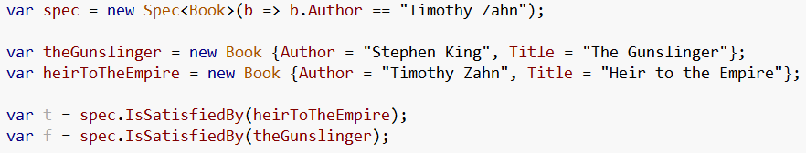
Funcs
We can use the defined Func class
The use a lambda to create the Func to use

Slide 15
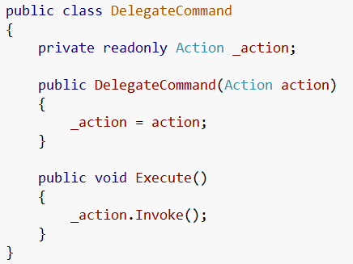

Actions
We can use the defined Action class
The use a lambda to create the action to use

Slide 16
Expression Trees

Slide 17
What are they?
Expression trees represent language-level code in the form of data. The data is stored in a tree-shaped structure. Each node in the expression tree represents an expression, for example a method call or a binary operation such as x < y.

Slide 18
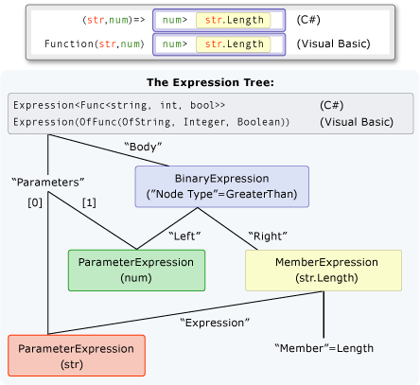
Say what?!

Slide 19
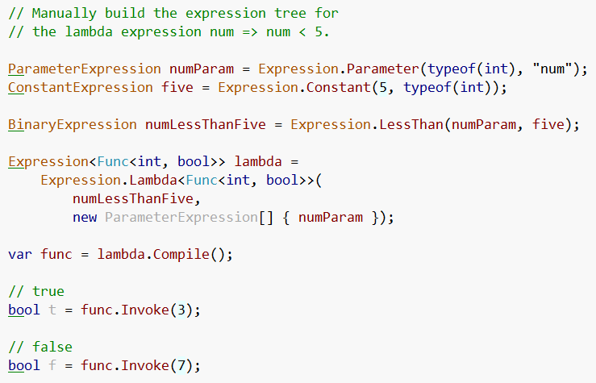
Ok… how about this…

Slide 20
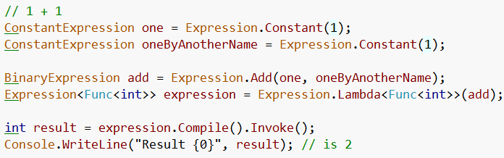
1 + 1

Slide 21
WPF Notify property change demo

Slide 22
Fluent interfaces

Slide 23
What are they?
a fluent interface is a way of implementing an object oriented API in a way that aims to provide for more readable code.
A fluent interface is normally implemented by using method chaining to relay the instruction context of a subsequent call
Term coined by Eric Evans and Martin Fowler

Slide 24
All the rage…
Many frameworks now offer fluent interfaces for configuration and ease of use
Let’s look at some samples

Slide 25
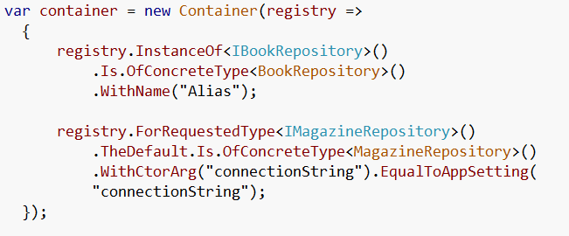
Structure Map

Slide 26
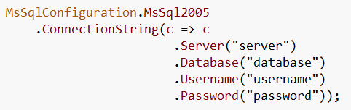
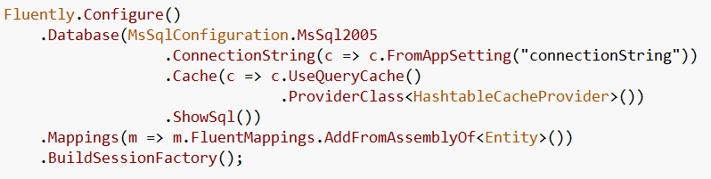
Fluent NHibernate

Slide 27
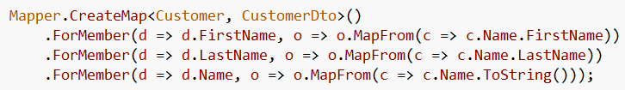
Automapper

Slide 28
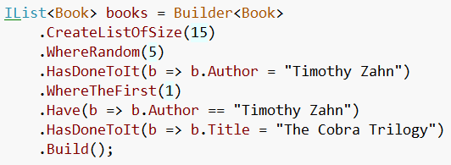
NBuilder

Slide 29
When to use Fluent Interfaces
To turn complex operations into readable ones
Packaging Functionality
Builders
Configuration
Utilities

Slide 30
Is it an API or a DSL?
Whether fluent interface is a form of DSL or not, it's obviously a form of fluent interface. - Scott Bellware

Slide 31
Common Questions
Difficult to set a breakpoint / debug
Violates Law of Demeter
Breaks Command Query Separation

Slide 32

Difficult to set breakpoints
Um… yeah… TRUE

Slide 33
Law of Demeter
“Only talk to your immediate friends.”
the Law of Demeter for functions requires that a method M of an object O may only invoke the methods of the following kinds of objects:
O itself
M's parameters
any objects created/instantiated within M
O's direct component objects

Slide 34
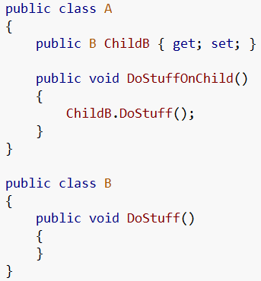


LoD Example
BAD
GOOD

Slide 35
Do fluent interfaces violate LoD?
NO
At first glance… yes
But we need to examine the intent of the Law of Demeter which is to limit the dependency of objects on the structure of other objects
One could say the interaction between objects should be based around behavior and not on state
If we examine the intent of the Law of Demeter, then NO it doesn’t violate the intent

Slide 36
Command Query Separation
It states that every method should either be a
command that performs an action,
or a query that returns data to the caller,
but not both.
In other words, asking a question should not change the answer.

Slide 37
CQS Example - SQL
Query
SELECT
Command
UPDATE
DELETE
INSERT

Slide 38
Do fluent interfaces violate CQS?
YES
But we purposefully violate the principle in order to accomplish a readable DSL
The violation of CQS is a good reason why fluent interfaces tend to work better in builders, configurations, and utilities and not in domain objects (IMHO)

Slide 39
Simple examples of fluent interfaces

Slide 40
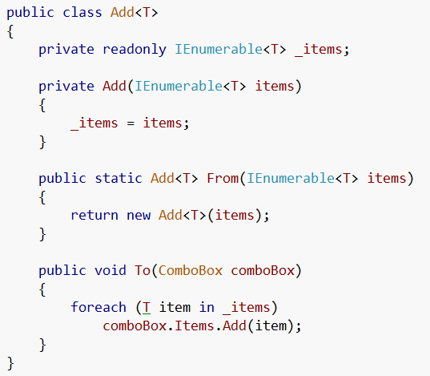

Add Example
Adding items to a combobox
This is what we see everywhere…
Now it turns to…
And we now can manage how items are adding to comboboxes for the entire solution

Slide 41
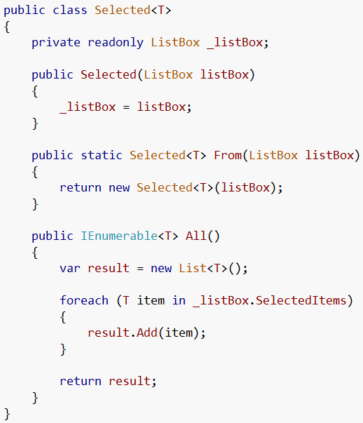
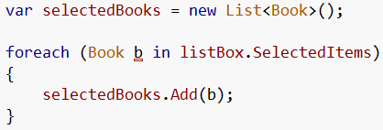

Selected Example
Getting selected items from a listbox
This is what we see everywhere…
Now it turns to…

Slide 42
Builder Pattern
Builder focuses on constructing a complex object step by step
Separate the construction of a complex object from its representation so that the same construction process can create different representations

Slide 43
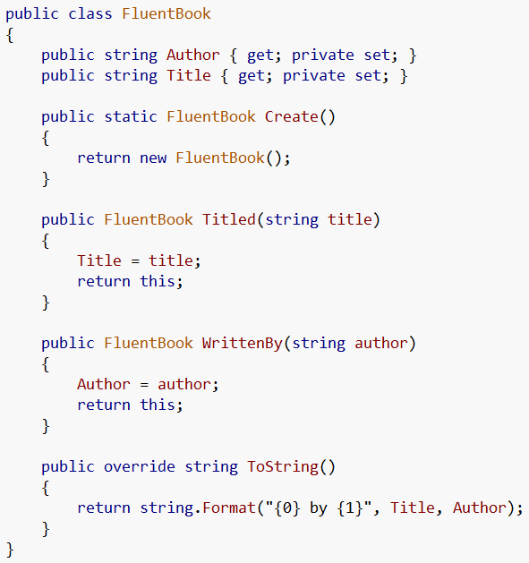

Within the object itself
Now our object is polluted with methods used only for fluent construction!
This violates the Single Responsibility Principle.

Slide 44
Single Responsibility Principle
the single responsibility principle states that every object should have a single responsibility
A class should have one, and only one, reason to change.
FluentBook can change if we need to change the functionality of the FluentBook AND if we want to change how we construct the book fluently

Slide 45
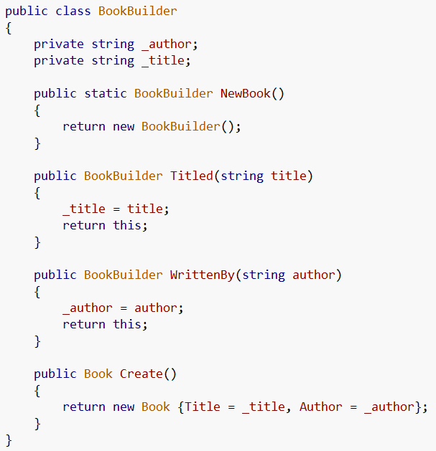
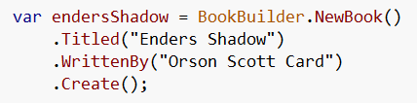
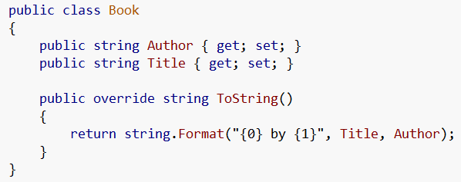
Using a builder
Now our fluent builder is in a separate class and doesn’t affect our book class

Slide 46
Value Objects
A Value Object is an object that describes some characteristic or attribute but carries no concept of identity
Value Objects are recommended to be immutable
So we can use a fluent interface builder to construct a value object

Slide 47
Putting it all together

Slide 48
Expression trees advanced

Slide 49
Expression Tree Visualizer
In order to get this visualizer you need to go to the samples folder where you installed VS and open the visualizer project and build it then copy it to the visualizer folder in Documents and Settings for your user.
My steps
C:\Program Files (x86)\Microsoft Visual Studio 9.0\Samples\1033
Unzip CSharpSamples.zip (I extracted mine to C:\CSharpSamples)
Go to CSharpSamples\LinqSamples\ExpressionTreeVisualizer
Open ExpressionTreeVisualizer solution
Build solution
Copy dll from bin
Paste @ C:\Users\Jonathan Birkholz\Documents\Visual Studio 2008\Visualizers

Slide 50
Brief Reminder

Slide 51
Using the Visitor Pattern
MSDN : http://msdn.microsoft.com/en-us/library/bb882521.aspx

Slide 52
Poco Entity Framework poc

Slide 53
Third Party Frameworks
Fluent Nhibernate
http://fluentnhibernate.org/
NBuilder
http://nbuilder.org/

Slide 54
Resources
MSDN
J.P. Hamilton
http://www.jphamilton.net/post/MVVM-with-Type-Safe-INotifyPropertyChanged.aspx
Wikipedia
Rob Conery
http://blog.wekeroad.com/blog/working-with-linq-s-expression-trees-visually/

Slide 55
Resources II
Barnett
http://weblogs.asp.net/gbarnett/archive/2007/09/15/expression-tree-visualizer.aspx

Slide 56
MISC SLIDES

Slide 57
Lambda Outline
Lambda Expressions
What are they
Linq
WPF Notify Property Change example
Delegate Commands
Event Handlers
EF Example

Slide 58
Fluent Interface
Fluent Interface
What are they
Get Selected Items
Fluent Nhibernate (config)
Open Rasta (config)
Structure Map

