Slide 1
Evolve Your Code

Slide 2
Purpose
I would like you to walk away reexamining the way you write your code

Slide 3
Outline
Overview on
Extension Methods
Lambda Expressions
Expression Trees
Fluent Interface

Slide 4
Extension methods

Slide 5
What are they?
Introduced in .Net 3.5 and Visual Studio 2008
Extension methods enable you to "add" methods to existing types without creating a new derived type, recompiling, or otherwise modifying the original type.

Slide 6
Where have I seen them before?
LINQ
Extension method on IEnumerable<T>

Slide 7
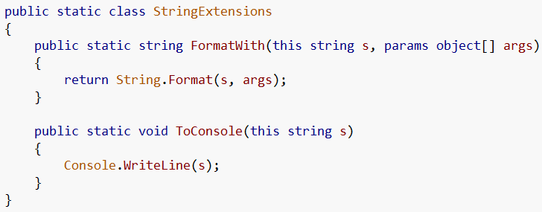
How to make an extension method
1. Make a static class
2. With a static method
3. First parameter is the object to extend

Slide 8
Using those extensions
Without extensions
With extensions

Slide 9
Lambda expressions

Slide 10
What are Lambda Expressions?
Introduce in .Net 3.5 and Visual Studio 2008
A lambda expression is an anonymous function that can contain expressions and statements, and can be used to create delegates or expression tree types

Slide 11

Where have I seen them before?
Linq uses lambda expressions
Is the same as…

Slide 12
As event handlers as well

Slide 13
How can I use them?
Funcs
Func<(Of <(T, TResult>)>) Delegate
Encapsulates a method that has one parameter and returns a value of the type specified by the TResult parameter.
Actions
Action<(Of <(T>)>) Delegate
Encapsulates a method that takes a single parameter and does not return a value.

Slide 14
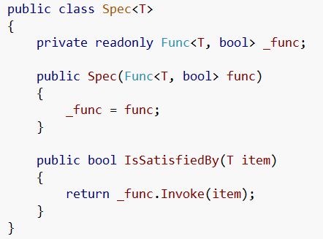
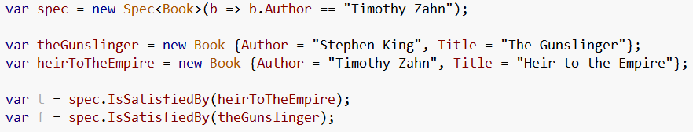
Funcs
We can use the defined Func class
The use a lambda to create the Func to use

Slide 15
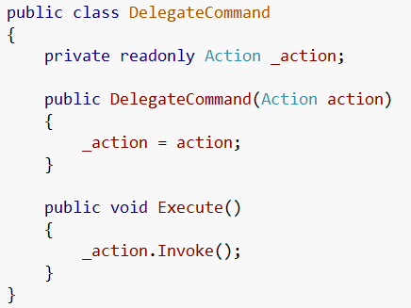

Actions
We can use the defined Action class
The use a lambda to create the action to use

Slide 16
Expression Trees

Slide 17
What are they?
Expression trees represent language-level code in the form of data. The data is stored in a tree-shaped structure. Each node in the expression tree represents an expression, for example a method call or a binary operation such as x < y.

Slide 18
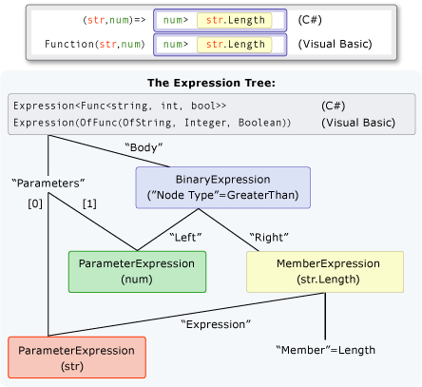
Say what?!

Slide 19
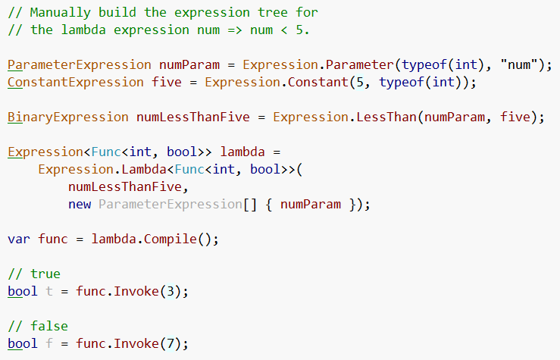
Ok… how about this…

Slide 20
WPF Notify property change demo

Slide 21
Poco Entity Framework poc

Slide 22
Fluent interfaces

Slide 23
What are they?
a fluent interface (as first coined by Eric Evans and Martin Fowler) is a way of implementing an object oriented API in a way that aims to provide for more readable code.
A fluent interface is normally implemented by using method chaining to relay the instruction context of a subsequent call

Slide 24
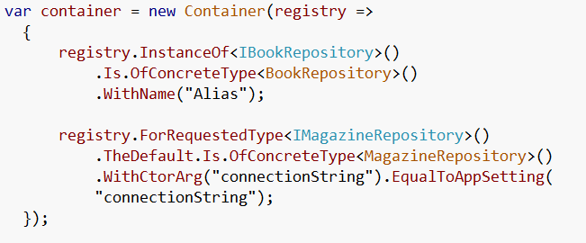
Where – Structure Map

Slide 25
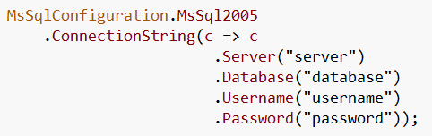
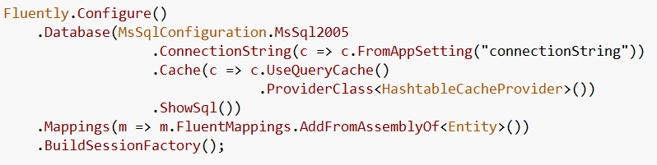
Where – Fluent NHibernate

Slide 26
Where – Open Rasta

Slide 27
When to use Fluent Interfaces
To turn complex operations into readable
Configuration is complex, notice all 3 examples were configuring a component
Packaging Functionality
Builders
Configuration
Utilities

Slide 28
How

Slide 29
Resources
MSDN (too many links to list)
J.P. Hamilton
http://www.jphamilton.net/post/MVVM-with-Type-Safe-INotifyPropertyChanged.aspx
Wikipedia

Slide 30
MISC SLIDES

Slide 31
Lambda Outline
Lambda Expressions
What are they
Linq
WPF Notify Property Change example
Delegate Commands
Event Handlers
EF Example

Slide 32
Fluent Interface
Fluent Interface
What are they
Get Selected Items
Fluent Nhibernate (config)
Open Rasta (config)
Structure Map

