Slide 1
Evolve Your Code

Slide 2
Purpose
I would like you to walk away reexamining the way you write your code

Slide 3
Outline
Overview on
Extension Methods
Lambda Expressions
Expression Trees
Fluent Interface

Slide 4
Extension methods

Slide 5
What are they?
Introduced in .Net 3.5 and Visual Studio 2008
Extension methods enable you to "add" methods to existing types without creating a new derived type, recompiling, or otherwise modifying the original type.

Slide 6
Where have I seen them before?
LINQ
Extension method on IEnumerable<T>

Slide 7
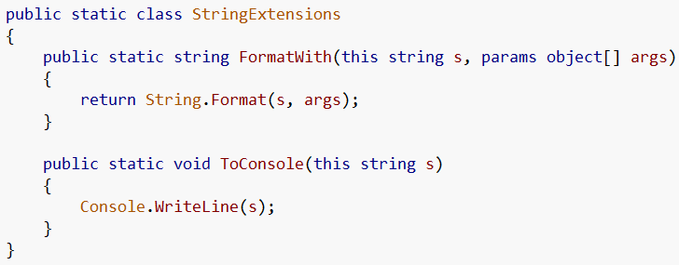
How to make an extension method
Make a static class
With a static method
First parameter is the object to extend
1
2
3

Slide 8
Using those extensions
Without extensions
With extensions

Slide 9
Lambda expressions

Slide 10
What are Lambda Expressions?
Introduce in .Net 3.5 and Visual Studio 2008
A lambda expression is an anonymous function that can contain expressions and statements, and can be used to create delegates or expression tree types

Slide 11

Where have I seen them before?
Linq uses lambda expressions
Is the same as…

Slide 12
As event handlers as well

Slide 13
How can I use them?
Funcs
Func<(Of <(T, TResult>)>) Delegate
Encapsulates a method that has one parameter and returns a value of the type specified by the TResult parameter.
Actions
Action<(Of <(T>)>) Delegate
Encapsulates a method that takes a single parameter and does not return a value.

Slide 14
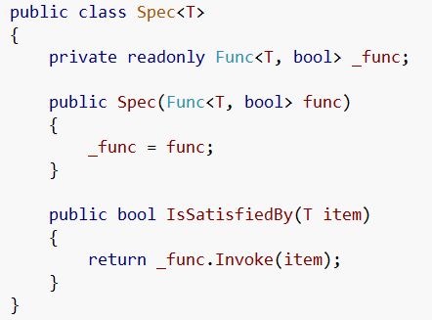
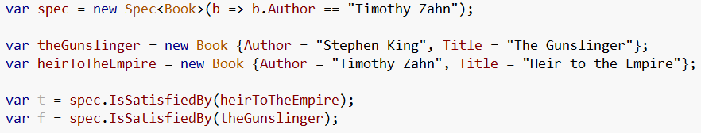
Funcs
We can use the defined Func class
The use a lambda to create the Func to use

Slide 15
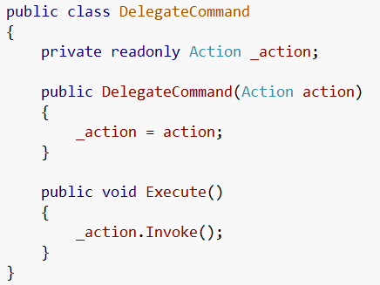

Actions
We can use the defined Action class
The use a lambda to create the action to use

Slide 16
Expression Trees

Slide 17
What are they?
Expression trees represent language-level code in the form of data. The data is stored in a tree-shaped structure. Each node in the expression tree represents an expression, for example a method call or a binary operation such as x < y.

Slide 18
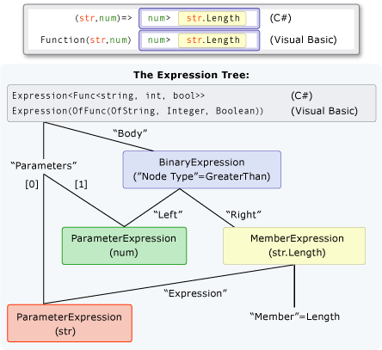
Say what?!

Slide 19
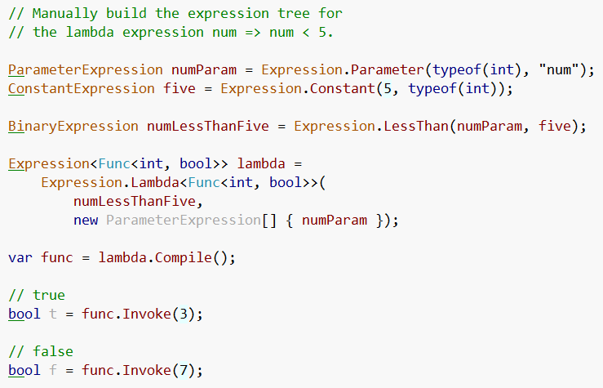
Ok… how about this…

Slide 20
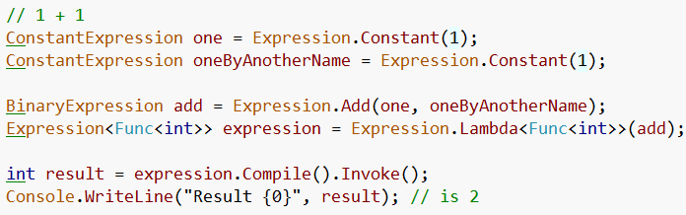
1 + 1

Slide 21
WPF Notify property change demo

Slide 22
Fluent interfaces

Slide 23
What are they?
a fluent interface is a way of implementing an object oriented API in a way that aims to provide for more readable code.
A fluent interface is normally implemented by using method chaining to relay the instruction context of a subsequent call
Term coined by Eric Evans and Martin Fowler

Slide 24
All the rage…
Many frameworks now offer fluent interfaces for configuration and ease of use
Let’s look at some samples

Slide 25
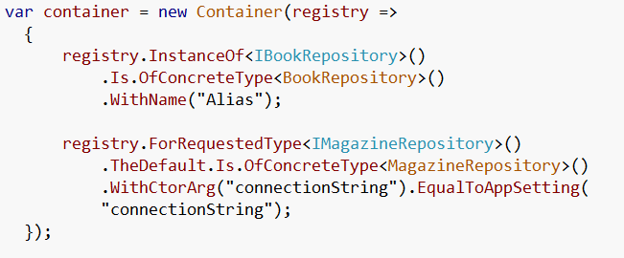
Structure Map

Slide 26
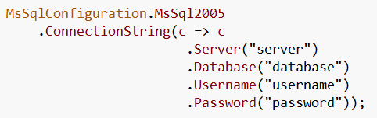
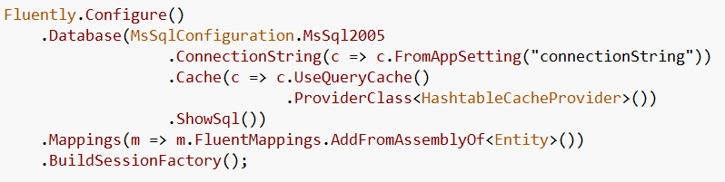
Fluent NHibernate

Slide 27
Open Rasta

Slide 28
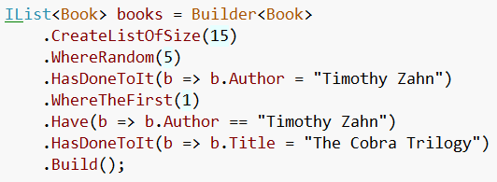
NBuilder

Slide 29
When to use Fluent Interfaces
To turn complex operations into readable ones
Packaging Functionality
Builders
Configuration
Utilities

Slide 30
Pros & Cons
Pros
Easy to read
Intellisense exposes functionality
Cons
Difficult to set a breakpoint / debug

Slide 31
Is it an API or a DSL?
Whether fluent interface is a form of DSL or not, it's obviously a form of fluent interface. - Scott Bellware

Slide 32
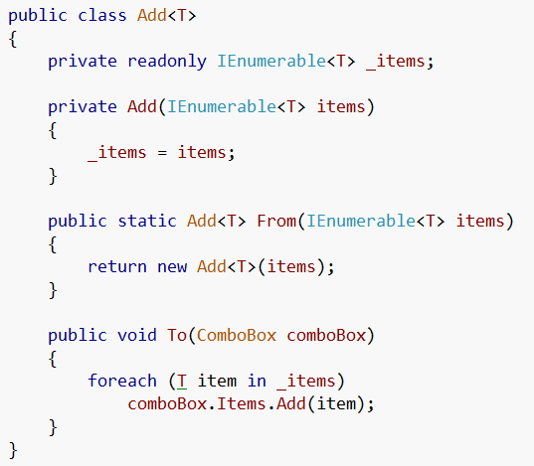

Add Example
Adding items to a combobox
This is what we see everywhere…
Now it turns to…
And we now can manage how items are adding to comboboxes for the entire solution

Slide 33
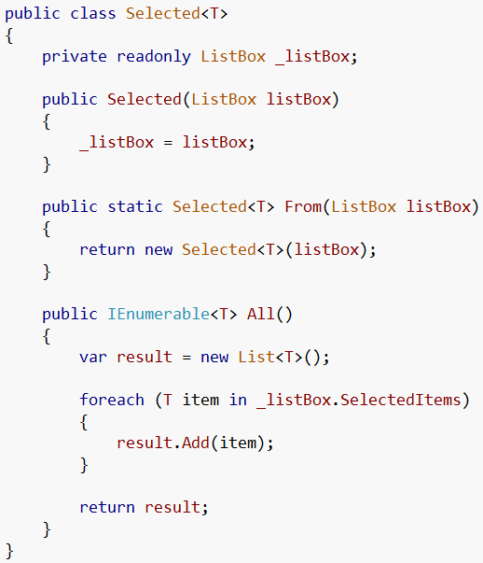
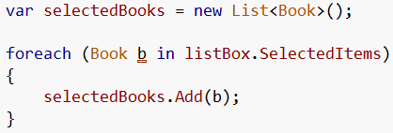

Selected Example
Getting selected items from a listbox
This is what we see everywhere…
Now it turns to…

Slide 34
Putting it all together

Slide 35
Expression trees advanced

Slide 36
Expression Tree Visualizer
In order to get this visualizer you need to go to the samples folder where you installed VS and open the visualizer project and build it then copy it to the visualizer folder in Documents and Settings for your user.
My steps
C:\Program Files (x86)\Microsoft Visual Studio 9.0\Samples\1033
Unzip CSharpSamples.zip (I extracted mine to C:\CSharpSamples)
Go to CSharpSamples\LinqSamples\ExpressionTreeVisualizer
Open ExpressionTreeVisualizer solution
Build solution
Copy dll from bin
Paste @ C:\Users\Jonathan Birkholz\Documents\Visual Studio 2008\Visualizers

Slide 37
Brief Reminder

Slide 38
Using the Visitor Pattern
MSDN : http://msdn.microsoft.com/en-us/library/bb882521.aspx

Slide 39
Poco Entity Framework poc

Slide 40
Third Party Frameworks
Fluent Nhibernate
http://fluentnhibernate.org/
NBuilder
http://nbuilder.org/

Slide 41
Resources
MSDN (too many links to list)
J.P. Hamilton
http://www.jphamilton.net/post/MVVM-with-Type-Safe-INotifyPropertyChanged.aspx
Wikipedia
Rob Conery
http://blog.wekeroad.com/blog/working-with-linq-s-expression-trees-visually/

Slide 42
Resources II
Barnett
http://weblogs.asp.net/gbarnett/archive/2007/09/15/expression-tree-visualizer.aspx

Slide 43
MISC SLIDES

Slide 44
Lambda Outline
Lambda Expressions
What are they
Linq
WPF Notify Property Change example
Delegate Commands
Event Handlers
EF Example

Slide 45
Fluent Interface
Fluent Interface
What are they
Get Selected Items
Fluent Nhibernate (config)
Open Rasta (config)
Structure Map

