Slide 1
Evolve Your Code
presented by
Jonathan Birkholz

Slide 2
About Me
Blogs :
theabsentmindedcoder.com
wizardsofsmart.net
Twitter : RookieOne
GitHub : github.com/RookieOne
Email : rookieone@gmail.com

Slide 3
Virtual Brown Bags
What : Virtual Brown Bags
An online meeting where the attendees share:
Tips and tricks
Tools, shortcuts, articles, books, patterns, languages, you name it
Experiences
Things they’ve learned the hard way
Frustrations or difficulties
Frustrating issues or difficulties they’re facing that somebody else may be able to help them with
When : Every Thursday @ 12pm – 1pm
Where : http://snipr.com/virtualaltnet
Who : Anyone and Everyone

Slide 4
EPS Consulting
Custom Software Development
Consulting / Mentoring
Training
WPF
.NET
CODE Magazine
Hiring Developers, PM’s

Slide 5
Purpose
I would like you to walk away reexamining the way you write your code
Add some tools to your toolkit
Show examples that may inspire you to create your own frameworks

Slide 6
Outline
Extension Methods
Lambda Expressions
Expression Trees
Fluent Interfaces

Slide 7
Extension methods

Slide 8
What are they?
Introduced in .Net 3.5 and Visual Studio 2008
Extension methods enable you to "add" methods to existing types without creating a new derived type, recompiling, or otherwise modifying the original type.

Slide 9
Where have I seen them before?
LINQ
Extension method on IEnumerable<T>

Slide 10
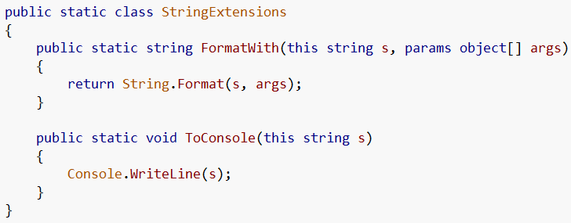
Making an extension method
Make a static class
With a static method
First parameter is the object to extend (aka ‘this’)
1
2
3

Slide 11
Using extensions
Without extensions
With extensions

Slide 12
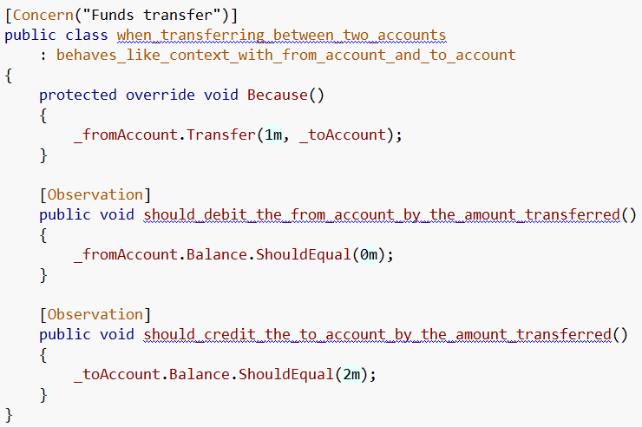
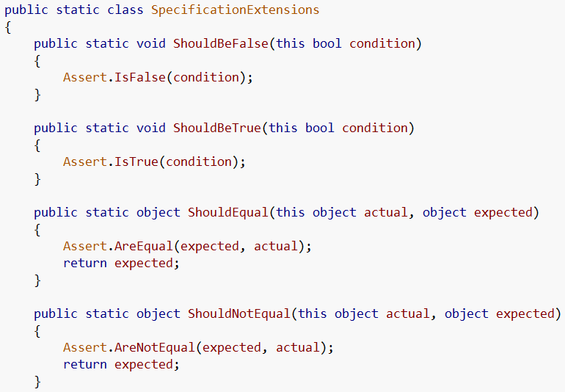
SpecUnit
Testing extensions

Slide 13
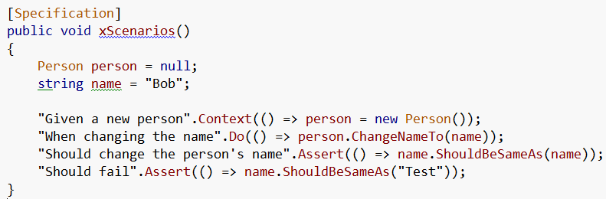
xUnit Extensions
More testing extensions

Slide 14
Assert EXTENSIONs demo

Slide 15
Active Record
the active record pattern is a design pattern found in software that stores for persistence
the interface to such an object generally includes functions such as Insert, Update, and Delete

Slide 16
Active record DEMO

Slide 17
Decorator Pattern
The decorator pattern can be used to make it possible to extend (decorate) the functionality of a certain object at runtime

Slide 18
decorator DEMO

Slide 19
Lambda expressions

Slide 20
What are Lambda Expressions?
Introduce in .Net 3.5 and Visual Studio 2008
A lambda expression is an anonymous function that can contain expressions and statements, and can be used to create delegates or expression tree types

Slide 21

Where have I seen them before?
Linq uses lambda expressions
Is the same as…

Slide 22
As event handlers as well

Slide 23
How can I use them?
Funcs
Func<(Of <(T, TResult>)>) Delegate
Encapsulates a method that has one parameter and returns a value of the type specified by the TResult parameter.
Actions
Action<(Of <(T>)>) Delegate
Encapsulates a method that takes a single parameter and does not return a value.

Slide 24
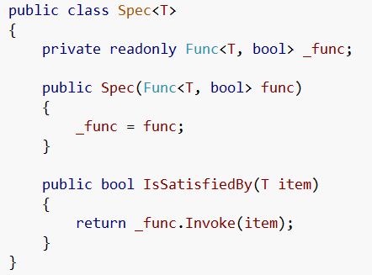
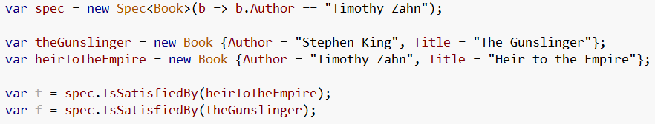
Funcs
We can use the defined Func class
Then use a lambda to create the Func to use

Slide 25
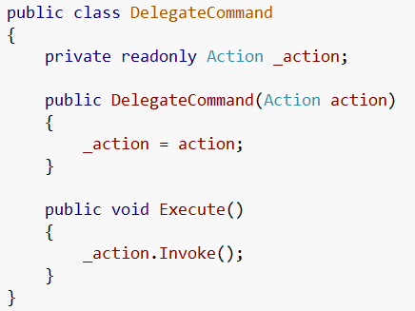

Actions
We can use the defined Action class
Then use a lambda to create the action to use

Slide 26
Lambda demo

Slide 27
Expression Trees

Slide 28
What are they?
Expression trees represent language-level code in the form of data. The data is stored in a tree-shaped structure. Each node in the expression tree represents an expression, for example a method call or a binary operation such as x < y.

Slide 29
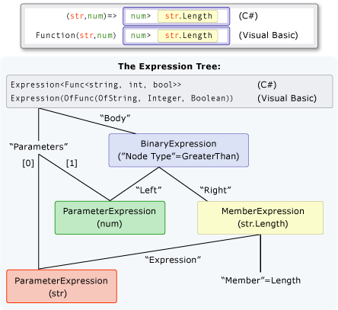
Say what?!

Slide 30
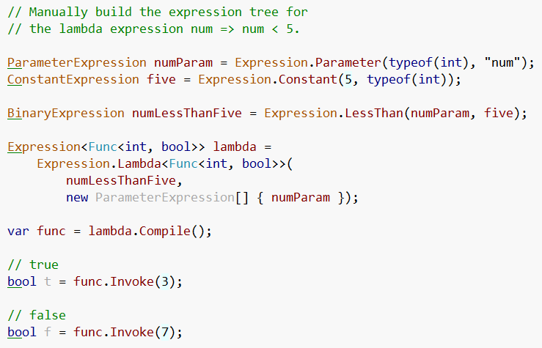
Ok… how about this…

Slide 31
Expression Tree Visualizer
In order to get this visualizer you need to go to the samples folder where you installed VS and open the visualizer project and build it then copy it to the visualizer folder in Documents and Settings for your user.
My steps
C:\Program Files (x86)\Microsoft Visual Studio 9.0\Samples\1033
Unzip CSharpSamples.zip (I extracted mine to C:\CSharpSamples)
Go to CSharpSamples\LinqSamples\ExpressionTreeVisualizer
Open ExpressionTreeVisualizer solution
Build solution
Copy dll from bin
Paste @ C:\Users\Jonathan Birkholz\Documents\Visual Studio 2008\Visualizers

Slide 32
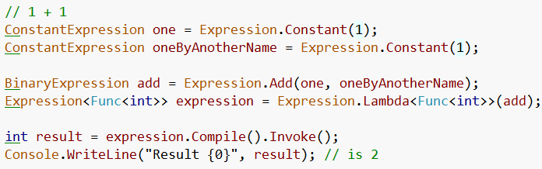
1 + 1

Slide 33
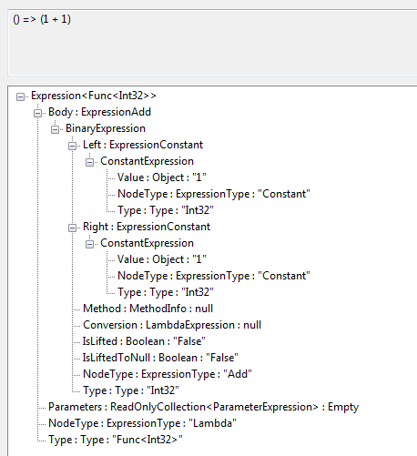
Visualize 1 + 1

Slide 34
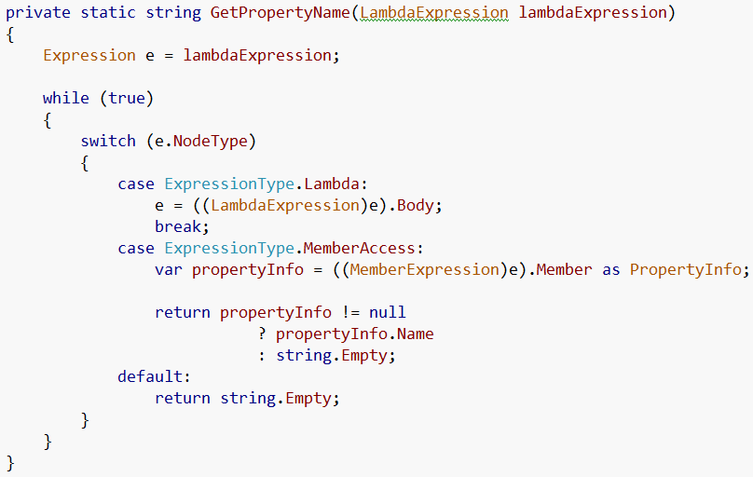
Getting Property Name from Lambda
1
2

Slide 35

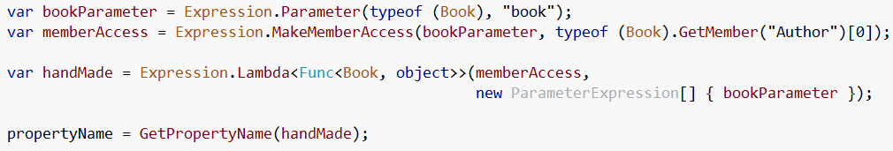
Creating Expression by hand
Using a Lambda

Slide 36
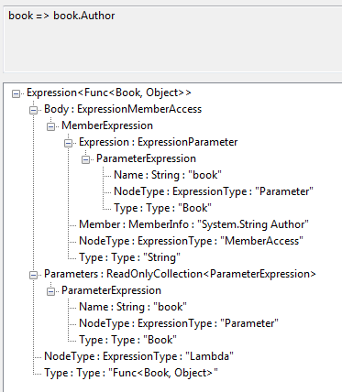
Visualize Property Expression

Slide 37
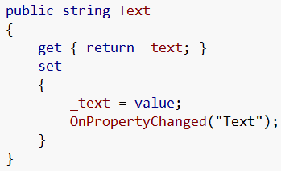
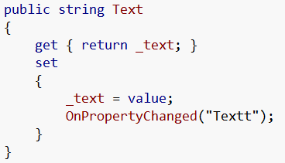
Cool but why would I care?
Notify Property Changed how I hate you…
String is not strongly typed, you can easily mistype the property name and wouldn’t know until runtime
Oops!

Slide 38
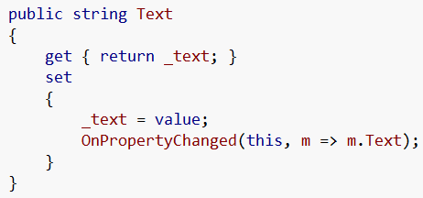
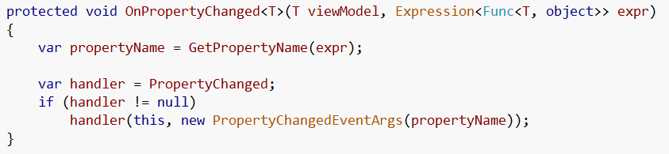
Better NotifyPropertyChange
Now I have compile time checking

Slide 39
Using the Visitor Pattern
The visitor pattern’s primary purpose is to abstract functionality that can be applied to an aggregate hierarchy of “element” objects.
Microsoft provides an Expression Tree Visitor
@MSDN : http://msdn.microsoft.com/en-us/library/bb882521.aspx

Slide 40
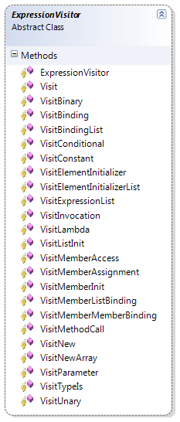
Expression Visitor
To implement our own visitor we just inherit from Expression Visitor
We then can override the virtual methods that are called visiting specific expression elements in the expression tree

Slide 41
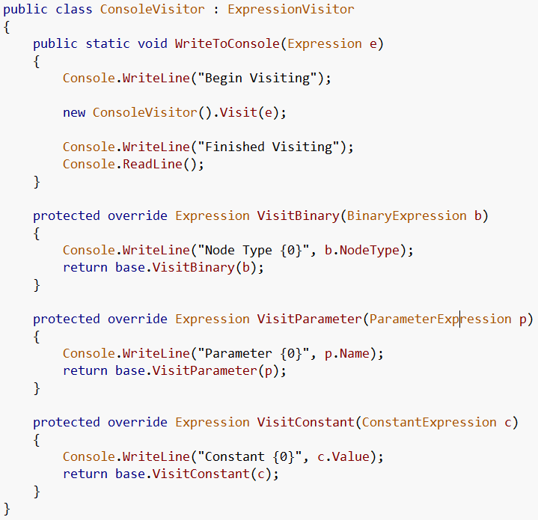
Console Visitor

Slide 42
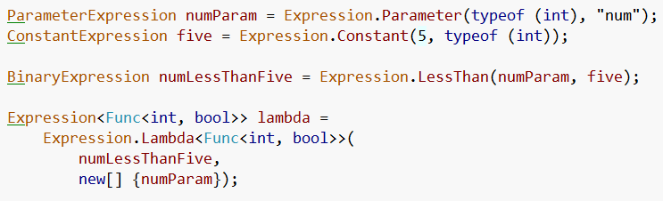

Just visiting

Slide 43
Usage?
I created a POCO Entity Framework prototype using Expression Visitor and mappings
POCO
Plain
Old
CLR
Object

Slide 44
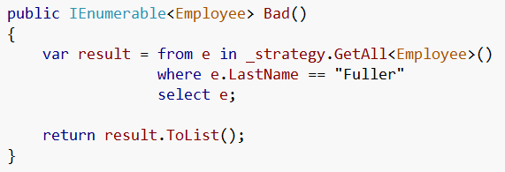
Problem
If I wanted POCO domain objects I had to map the EF entities to the appropriate domain object
What that left me with was
So I had to pull back every Employee from the database so I could map and then check the LastName property on my domain object

Slide 45
Using Expression Visitor
Instead of that horrible solution, lets take the expression and use the visitor to replace all the references to our domain object with references to the EF entity

Slide 46
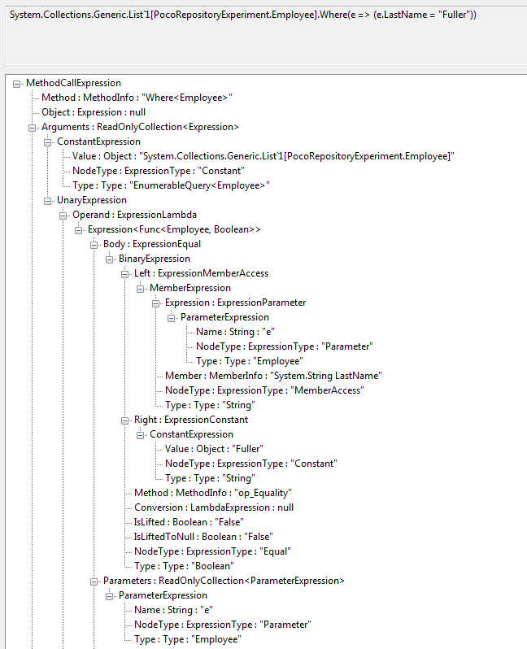
Before
ETC…

Slide 47
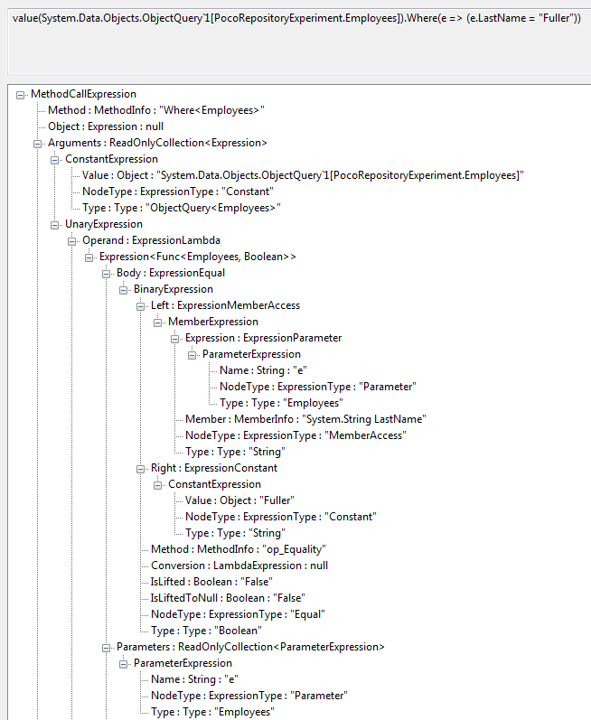
After
So now instead of the POCO Employee
We have the EF entity Employees

Slide 48
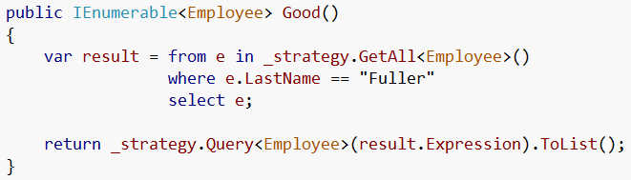
Result
And now our repository method can look like
And we only pull the entities we need because EF can send the correct SQL to the database

Slide 49
Fluent interfaces

Slide 50
What are they?
A fluent interface is
a way of implementing an object oriented API in a way that aims to provide for more readable code.
normally implemented by using method chaining to relay the instruction context of a subsequent call
Term coined by Eric Evans and Martin Fowler

Slide 51
Method Chaining
Typically, method chaining simply consists of many methods on a class, each of which return the current object itself.
It can return a different object, but the more typical method chaining scenarios return the current object

Slide 52
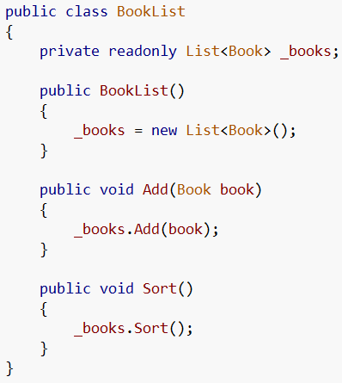

Without Method Chaining
Typical implementation with methods returning void

Slide 53
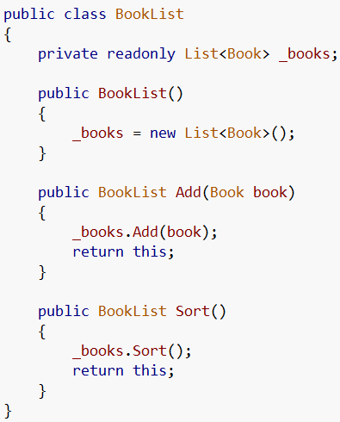

With Method Chaining
Instead of returning void, we return an object to call the next method on

Slide 54
Differences
Method chaining isn’t the same as a fluent interface
A fluent interface is a specific implementation of method chaining to provide a mini-DSL
With strongly typed languages the DSL becomes strongly typed

Slide 55
Square == Fluent Interface
A square is a specific implementation of a rectangle
Fluent interfaces use method chaining but not all method chains are a fluent interface

Slide 56
All the rage…
Many frameworks now offer fluent interfaces for configuration and ease of use
We are seeing more frameworks where fluency is at their core
We are also seeing frameworks whose purpose is to provide a fluent interface to another framework
Let’s look at some samples

Slide 57
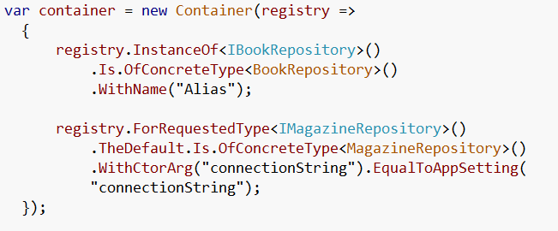
Structure Map
StructureMap is a Dependency Injection / Inversion of Control tool
http://structuremap.sourceforge.net/Default.htm

Slide 58
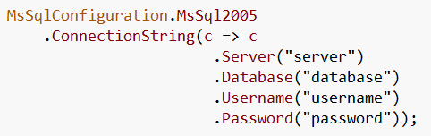
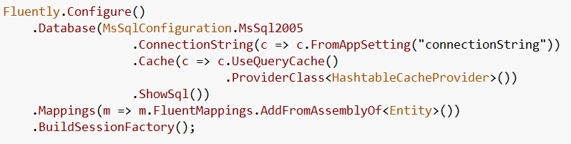
Fluent NHibernate
Fluent, XML-less, compile safe, automated, convention-based mappings for NHibernate
http://fluentnhibernate.org/

Slide 59
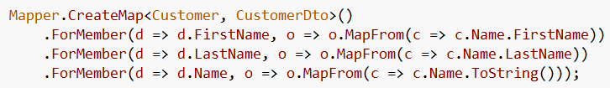
Automapper
AutoMapper uses a fluent configuration API to define an object-object mapping strategy
http://automapper.codeplex.com/

Slide 60
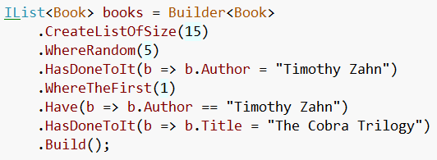
NBuilder
Through a fluent, extensible interface, NBuilder allows you to rapidly create test data, automatically assigning values to properties and public fields that are of type of the built in .NET data types (e.g. ints and strings).
http://nbuilder.org/

Slide 61
When to use Fluent Interfaces
To turn complex operations into readable ones
Packaging Functionality
Builders
Configuration
Utilities

Slide 62
Is it an API or a DSL?
Whether fluent interface is a form of DSL or not, it's obviously a form of fluent interface. - Scott Bellware

Slide 63
Common Concerns
Method chaining is difficult to set breakpoints and debug
Violates Law of Demeter
Breaks Command Query Separation

Slide 64

Difficult to set breakpoints
Um… yeah… TRUE
You can put break points in the methods or just step debug through chain but in the end, it is more difficult to debug

Slide 65
Law of Demeter
“Only talk to your immediate friends.”
the Law of Demeter for functions requires that a method M of an object O may only invoke the methods of the following kinds of objects:
O itself
M's parameters
any objects created/instantiated within M
O's direct component objects

Slide 66
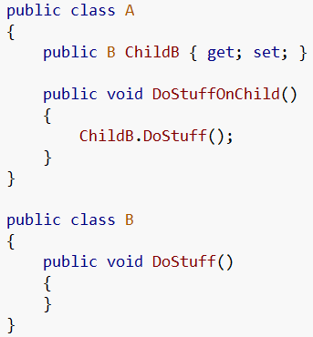


LoD Example
BAD
GOOD

Slide 67
Do fluent interfaces violate LoD?
NO
At first glance… yes
But we need to examine the intent of the Law of Demeter which is to limit the dependency of objects on the structure of other objects
One could say the interaction between objects should be based around behavior and not on state
If we examine the intent of the Law of Demeter, then NO it doesn’t violate the intent

Slide 68
Command Query Separation
It states that every method should either be a
command that performs an action,
or a query that returns data to the caller,
but not both.
In other words, asking a question should not change the answer.

Slide 69
CQS Example - SQL
Query
SELECT
Command
UPDATE
DELETE
INSERT

Slide 70
Do fluent interfaces violate CQS?
YES
But we purposefully violate the principle in order to accomplish a readable DSL
The violation of CQS is a good reason why fluent interfaces tend to work better in builders, configurations, and utilities and not in domain objects (IMHO)

Slide 71
Simple examples of fluent interfaces

Slide 72
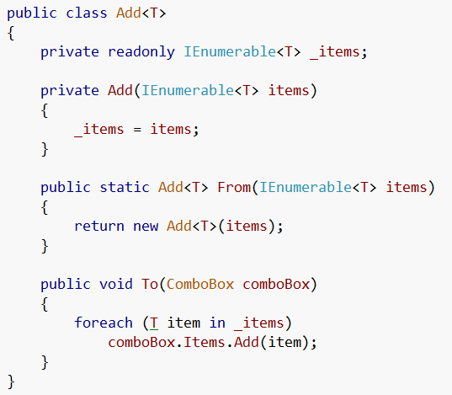

Add Example
Adding items to a combobox
This is what we see everywhere…
Now it turns to…
And we now can manage how items are adding to comboboxes for the entire solution

Slide 73
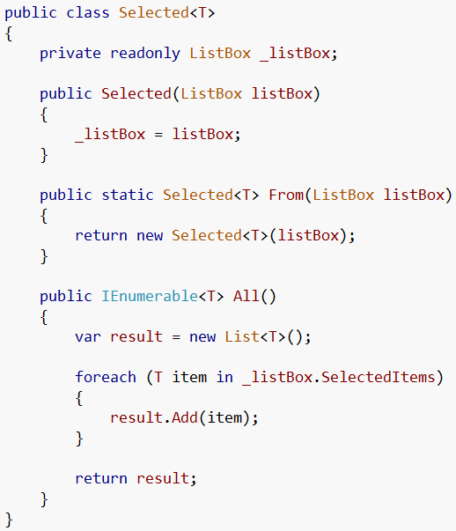
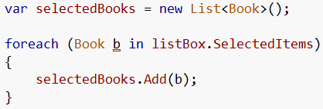

Selected Example
Getting selected items from a listbox
This is what we see everywhere…
Now it turns to…

Slide 74
Builder Pattern
Builder focuses on constructing a complex object step by step
Separate the construction of a complex object from its representation so that the same construction process can create different representations

Slide 75
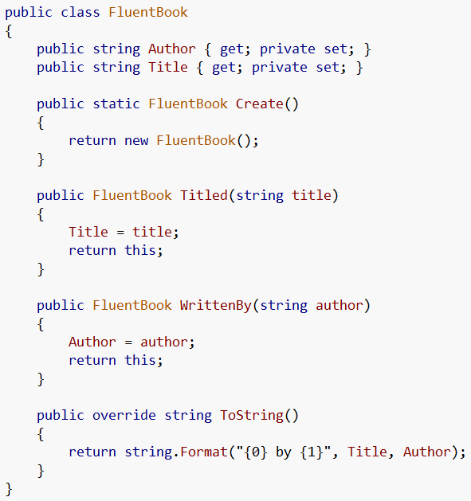

Within the object itself
Now our object is polluted with methods used only for fluent construction!
This violates the
Single Responsibility Principle.

Slide 76
Single Responsibility Principle
the single responsibility principle states that every object should have a single responsibility
A class should have one, and only one, reason to change.
FluentBook can change if we need to change the functionality of the FluentBook AND if we want to change how we construct the book fluently

Slide 77
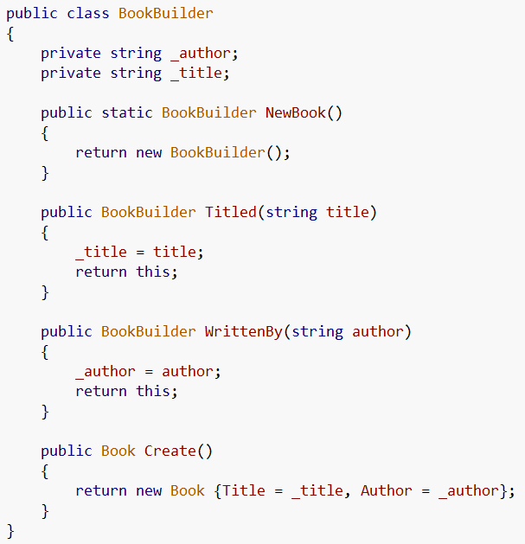
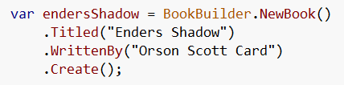
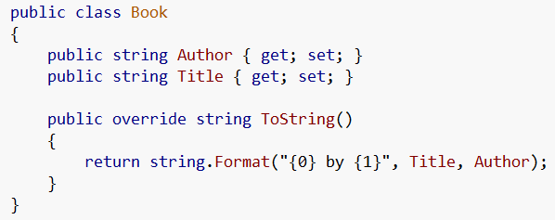
Using a builder
Now our fluent builder is in a separate class and doesn’t affect our book class

Slide 78
Value Objects
A Value Object is an object that describes some characteristic or attribute but carries no concept of identity
Value Objects are recommended to be immutable
So we can use a fluent interface builder to construct a value object

Slide 79

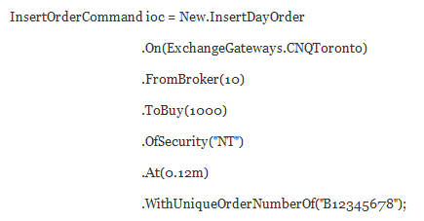
Messages are Value Objects
http://codebetter.com/blogs/gregyoung/archive/2008/04/15/dddd-5-messages-have-fluent-builders.aspx
An unwieldy constructor for a value object
Now with a fluent builder, we can have an immutable value object without the pain of the gigantic constructor

Slide 80
Conclusion
Did you learn anything?
See anything new?
Be sure to check out the frameworks to see everything we talked about today in action
Also play with creating your own extension methods, lambdas, expression trees, and fluent interfaces
When put all together our code can become more readable, easier to learn, and more succinct

Slide 81
Questions
?

Slide 82
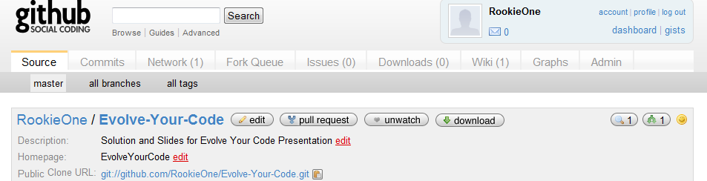
Git Hub Repository
http://github.com/RookieOne/Evolve-Your-Code
Has solution with projects and slide show
Offered as is

Slide 83
Third Party Frameworks
SpecUnit
http://code.google.com/p/specunit-net/
xUnit Extensions
http://code.google.com/p/xunitbddextensions/
Structure Map
http://structuremap.sourceforge.net/Default.htm
Automapper
http://automapper.codeplex.com/
Fluent Nhibernate
http://fluentnhibernate.org/
NBuilder
http://nbuilder.org/

Slide 84
Resources
MSDN
Wikipedia
Martin Fowler
http://www.martinfowler.com/
J.P. Hamilton
http://www.jphamilton.net/post/MVVM-with-Type-Safe-INotifyPropertyChanged.aspx
Rob Conery
http://blog.wekeroad.com/blog/working-with-linq-s-expression-trees-visually/

Slide 85
Resources II
Barnett
http://weblogs.asp.net/gbarnett/archive/2007/09/15/expression-tree-visualizer.aspx
Greg Young
http://codebetter.com/blogs/gregyoung/archive/2007/12/05/a-use-for-extension-methods.aspx
http://sourcemaking.com/design_patterns/visitor

