Slide 1
Design Patterns
http://tinyurl.com/htf2010-patterns
Claudio Lassala
Jonathan Birkholz
Houston Techfest 2010

Slide 2
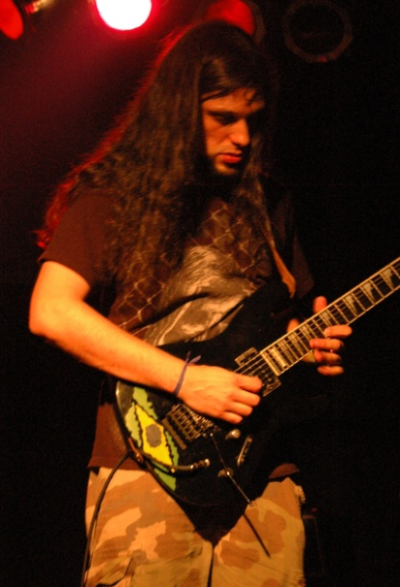


Claudio Lassala
Jonathan Birkholz
claudio@eps-software.com
ClaudioLassala.workpress.com
@claudiolassala
EPS Software Corp
jb@chaione.com
theabsentmindedcoder.com
@rookieone
wizardsofsmart.net
github.com/RookieOne
bitbucket.org/rookieone
Chaione

Slide 3

EPS
The .Net Knowledge Powerhouse
Software Projects
Consulting
Training
Publishers of CODE Magazine
As an attendee to this session, you are entitled to a free CODE subscription! ☺
www.codemag.com/subscribe/htf10

Slide 4




Chaione
Strategy and Planning
User Experience Design
Mobile Solutions
Web Solutions

Slide 5


:url => snipr.com/virtualaltnet
:website => www.virtualbrownbag.com
:when => every Thursday from 12pm – 1pm
Where everyone can come talk and learn about software development

Slide 6
Learn
something about design patterns
Apply
Teach
your knowledge at your day job
others what you have learned

Slide 7



Same Problems
Different Backgrounds

Slide 8
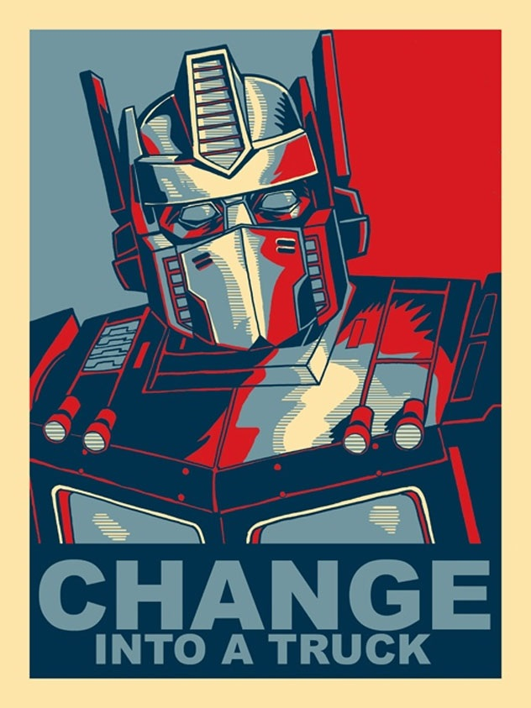
Change
is the only constant in software development

Slide 9


change in software is
time consuming
expensive
and is why projects
fail

Slide 10

best practices
if only there were some
on how to manage change so that our software projects can be
successful

Slide 11
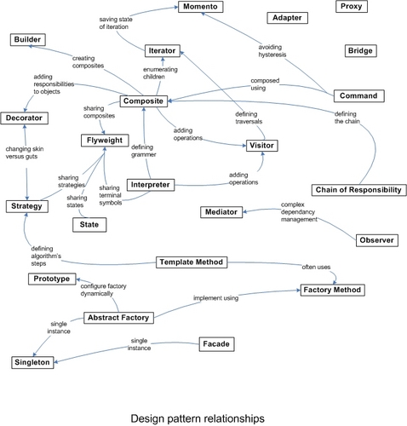
Design Patterns
describe a concept or process on an abstract level. These patterns arose from repeated successful applications on how to design software to adapt to change

Slide 12

concise
Design patterns also provide a
form of communication among professionals

Slide 13

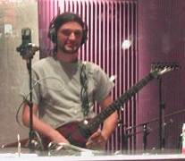
Every song has structure…
Intros
Verses
Bridges
Choruses
Interludes

Slide 14
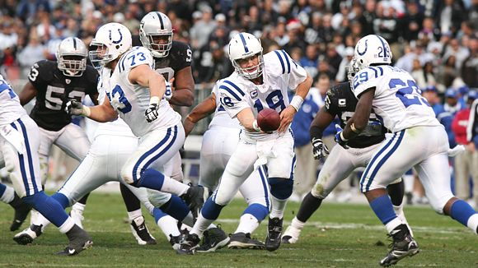
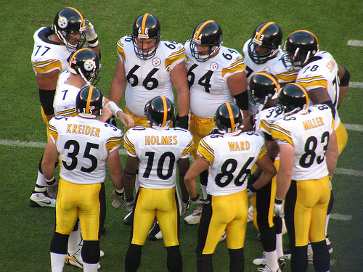
Ok… so…. I’m going to pretend to hand off the ball but really I am going to pass it. The hope is the defense will be confused for a few seconds so that can create an opening and one of you guys can get open
More effective communication
meanwhile a well organized team is already running their play
Play Action Pass?

Slide 15
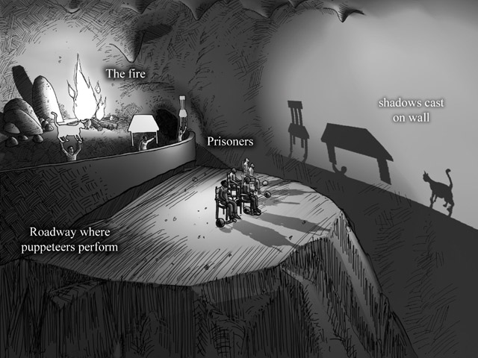
If design patterns are known best practices why are there no frameworks or libraries for design patterns?
more about form and context than code
allegory of the cave

Slide 16
Object Oriented Programming
Abstraction
Polymorphism
Inheritance
Encapsulation

Slide 17
Principles
Program to interface, not to implementation
Strive for loosely coupled designs between objects that interact
Favor composition over inheritance
SOLID
Principles => form => design pattern

Slide 18
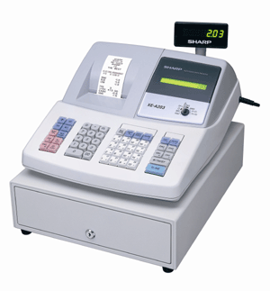
Cash Register
Learning through code is best

Slide 19
LOOK AT CODE

Slide 20
REFACTOR

Slide 21
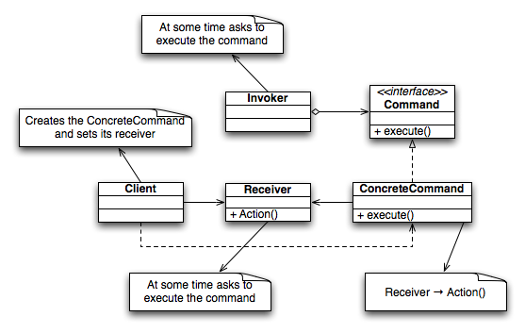
Command Pattern
is a design pattern in which an object is used to represent and encapsulate all the information needed to execute an operation at a later time

Slide 22
with commands you can also…
Queue
commands in the form of a macro command thereby handling complexity through composition
Log
command execution for future diagnosis of problems and bugs
Undo
more easily support

Slide 23
Experiences with Command Pattern
Where the Command Pattern can be found in .Net

Slide 24
REFACTOR

Slide 25
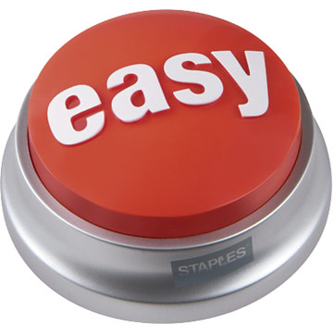
Façade Pattern
provides a unified interface to a set of interfaces in a subsystem. To put it simply, it makes the complex easy.

Slide 26

inside Claudio’s house

Slide 27
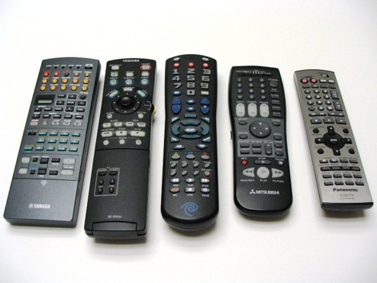

Too many remotes! Ugh!
Ah… one remote to rule the all
subsystems
facade

Slide 28
Experiences with Façade Pattern
Where the Façade Pattern can be found in .Net

Slide 29
REFACTOR

Slide 30
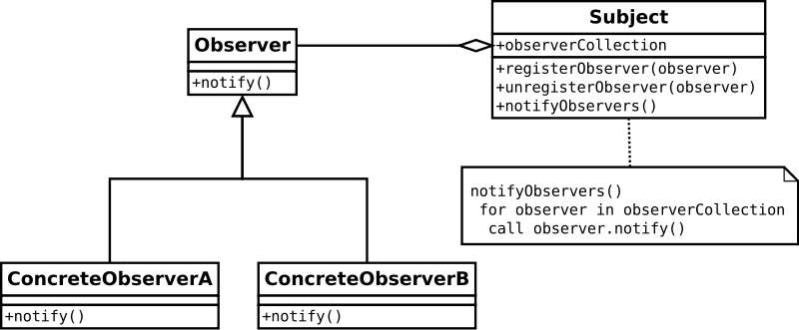
Observer Pattern
defines a dependency between objects so that when one object changes, dependent objects can be notified
Publishers + Subscribers = Observer Pattern

Slide 31
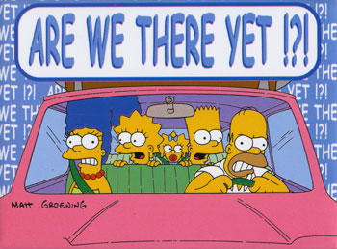
Stop Pestering…
actively querying state on subject
Let subject call observers
passive

Slide 32

Hollywood Principle
Don’t call us, we’ll call you.
Register
add item
item scanned
Scanner

Slide 33
Experiences with Observer Pattern
Where the Observer Pattern can be found in .Net

Slide 34
REFACTOR

Slide 35

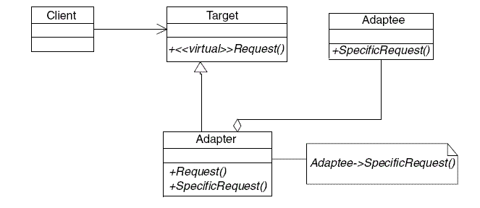
Adapter Pattern
converts the interface of a class into another interface the clients expect

Slide 36
Experiences with Adapter Pattern
Where the Adapter Pattern can be found in .Net

Slide 37
Facade
Adapter
versus
intent

Slide 38

Proxy Pattern
provides a surrogate or placeholder for another object to control access to it.
Proxy
Real

Slide 39
REFACTOR

Slide 40
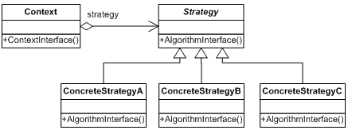
Strategy Pattern
defines a family of algorithms, encapsulates each one, and makes them interchangeable.
This lets the algorithm vary independently from clients that use it.

Slide 41
Strategies
Switch
Texas
Texas
Lousiana
Lousiana
Oklahoma
Oklahoma
Default
Default

Slide 42
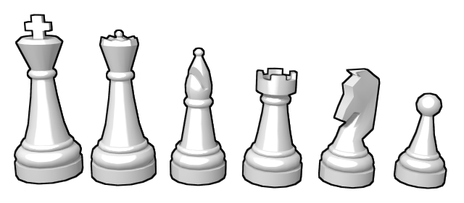
King
Queen
Bishop
Rook
Knight
Pawn
how are they different?

Slide 43
Experiences with Strategy Pattern
Where the Strategy Pattern can be found in .Net

Slide 44
REFACTOR

Slide 45
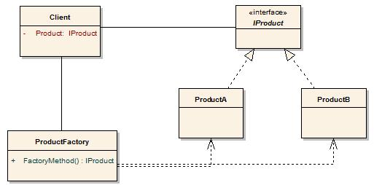

Factory Pattern
provides an interface for creating families of related or dependent objects

Slide 46
Types of Factories
Factory Method
Factory Class
Abstract Factory

Slide 47
Experiences with Factory Pattern
Where the Factory Pattern can be found in .Net

Slide 48
Other Patterns
Decorator
Mediator
Iterator
Builder
Composition
Visitor
Chain of Responsibility
Presentation Patterns
MVC
MVVM
MVP

Slide 49
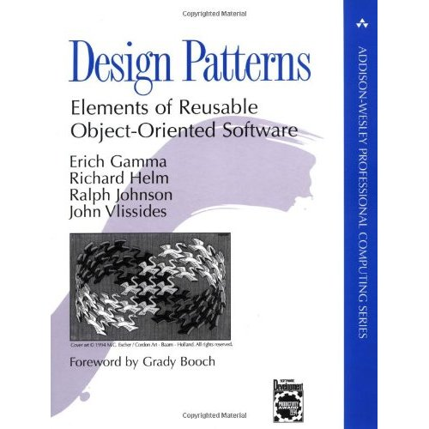
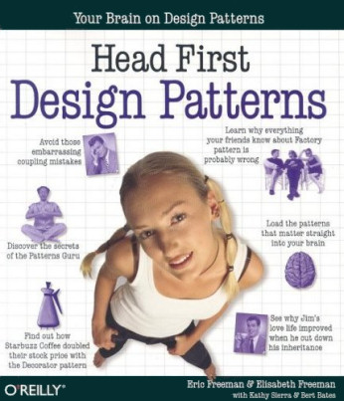
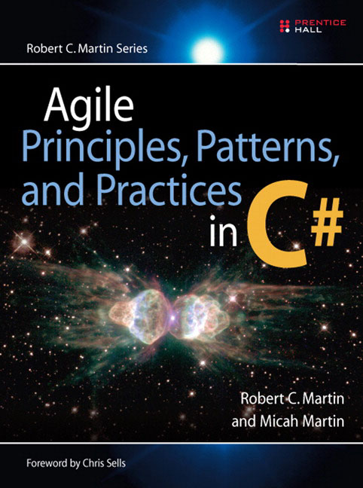
Bookshelf

Slide 50
Questions
http://tinyurl.com/htf2010-patterns
claudio@eps-software.com
ClaudioLassala.workpress.com
@claudiolassala
EPS Software Corp
jb@chaione.com
theabsentmindedcoder.com
@rookieone
wizardsofsmart.net
github.com/RookieOne
bitbucket.org/rookieone
Chaione
Join us at www.VirtualBrownBag.com every Thursday 12pm -1pm

