Slide 1
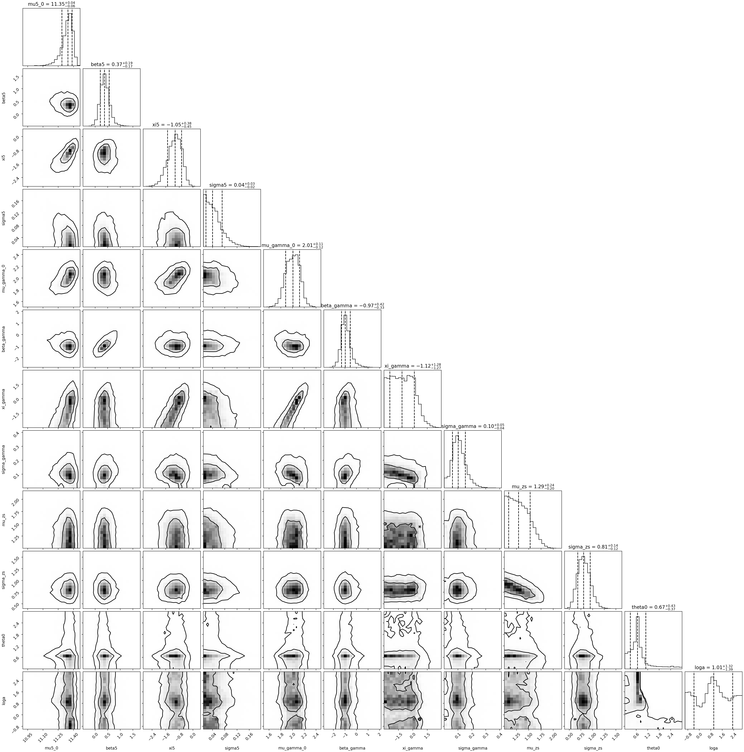
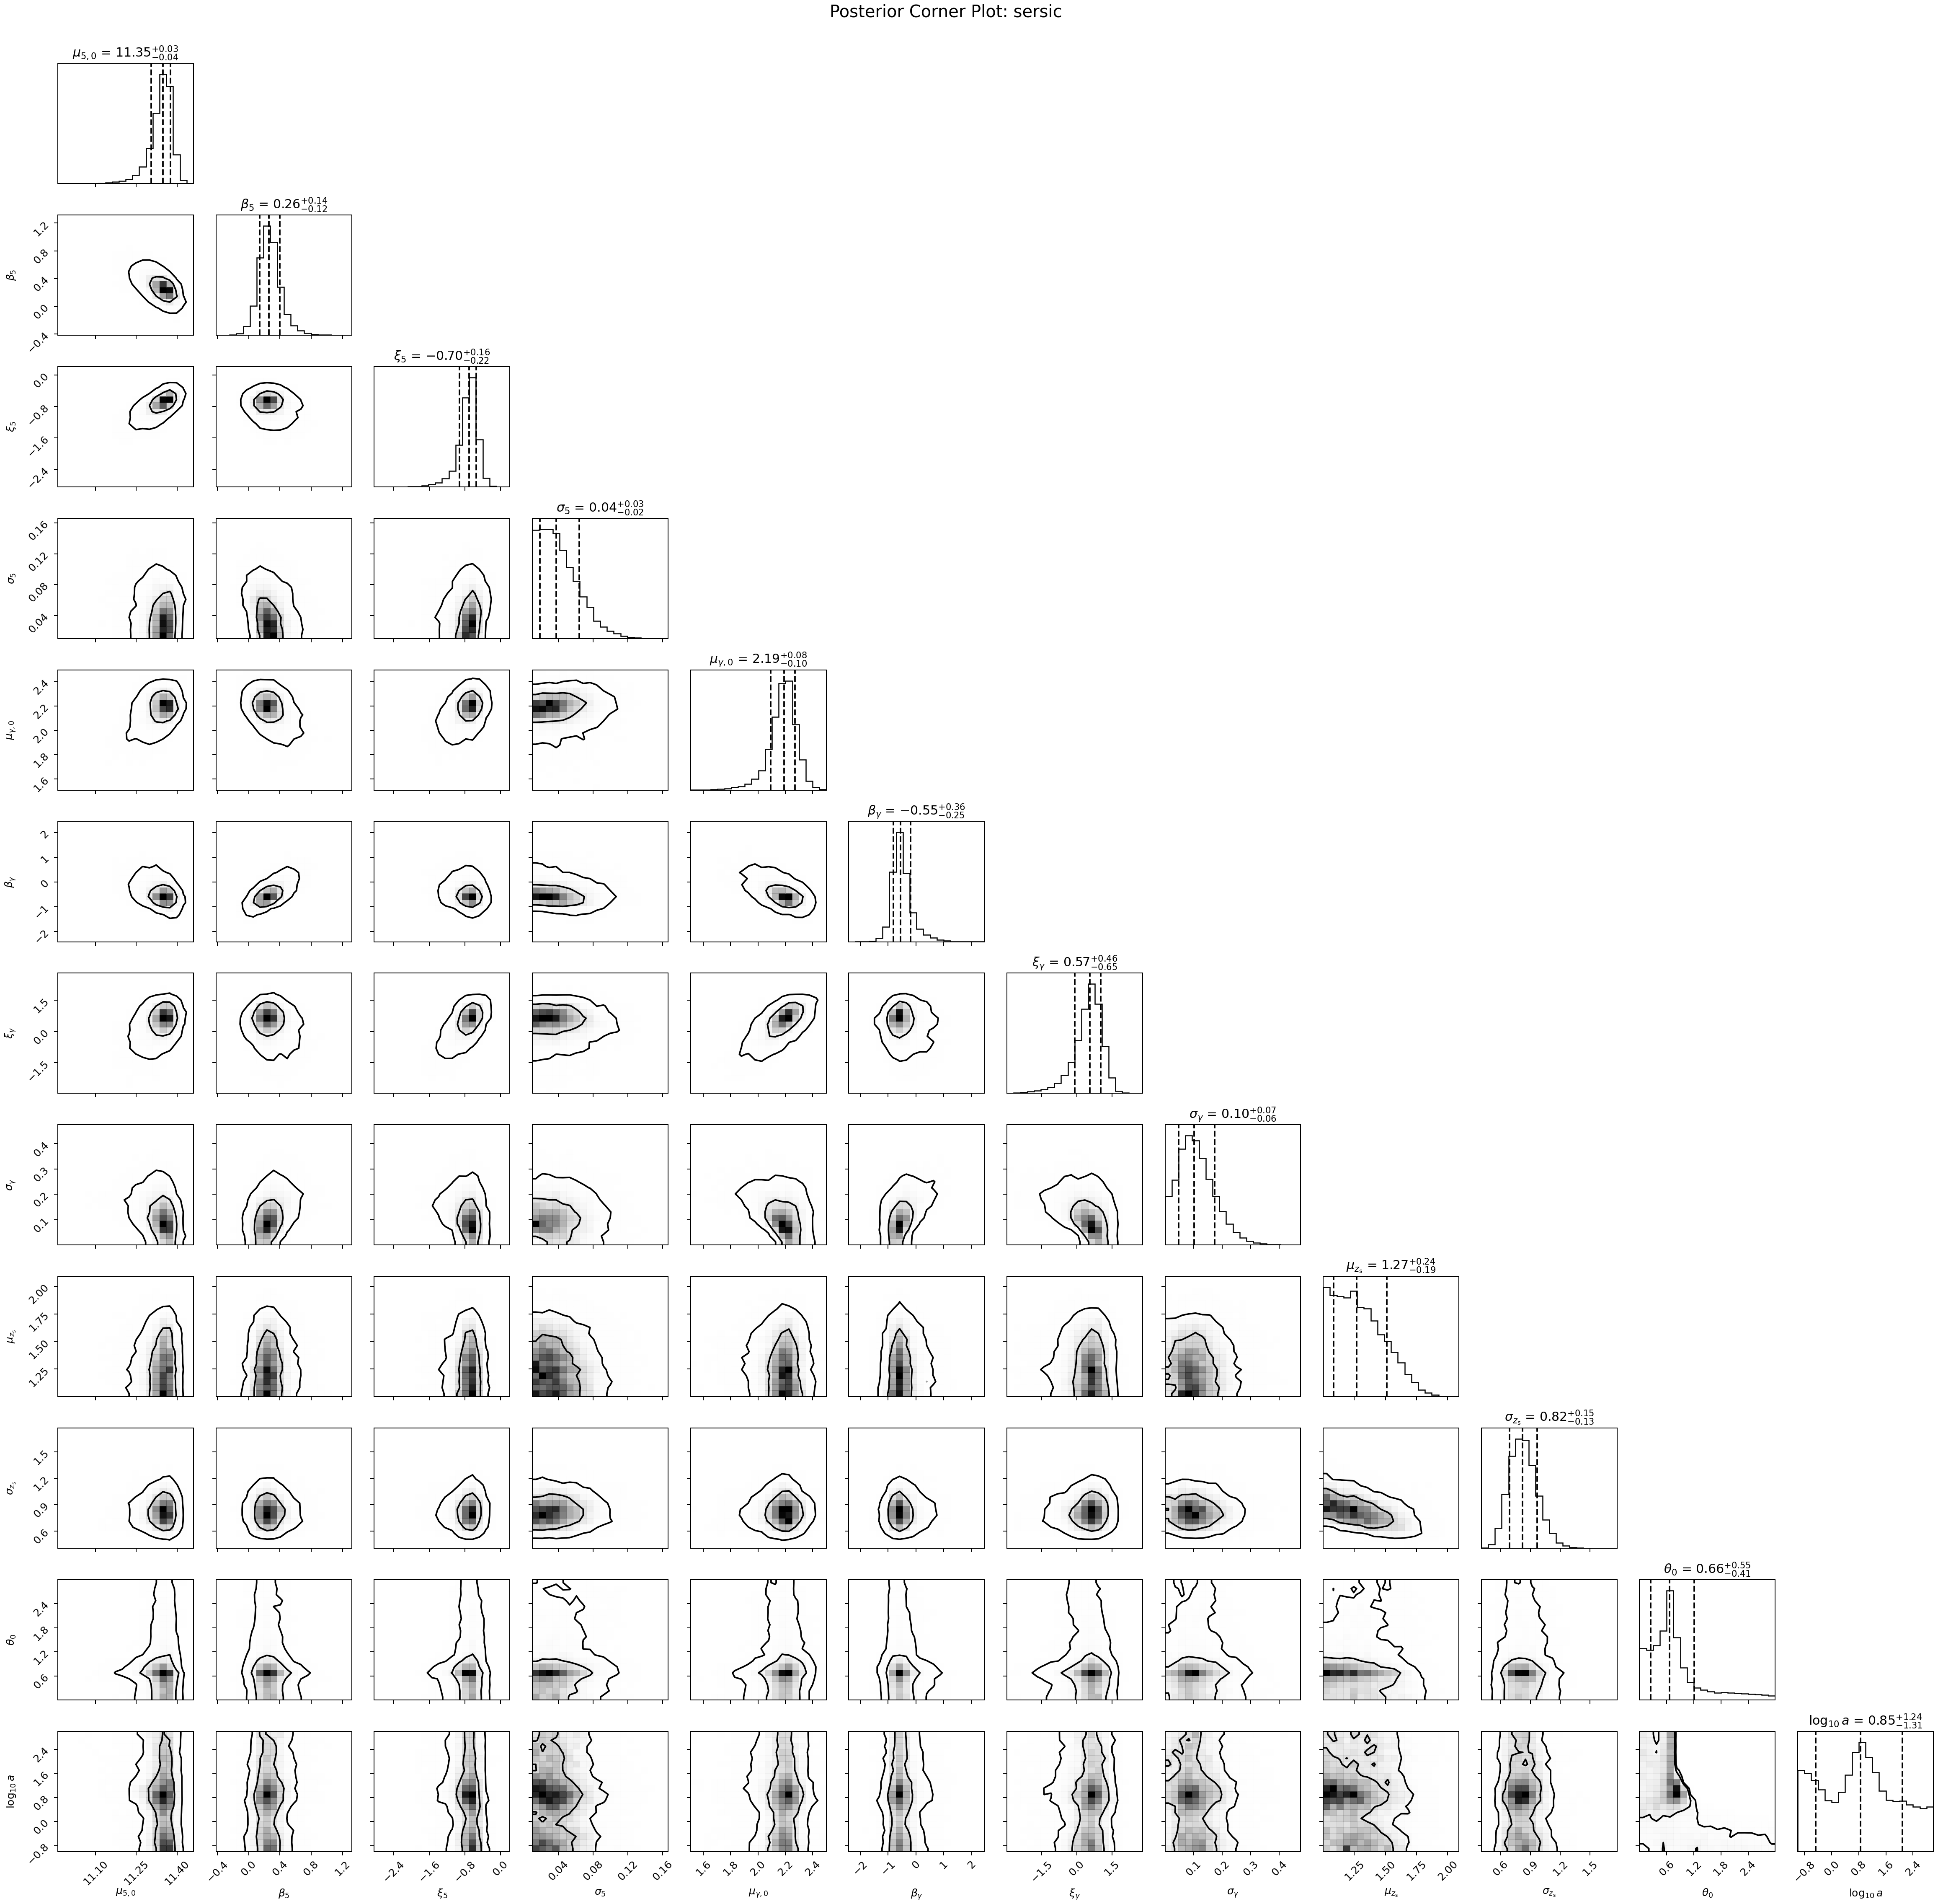
Posterior Corner Plots
Slide 1 / 3
Latest production posterior corners created on 2026-03-11; these runs also feed the canonical PPC and posterior-trend summaries.
de Vaucouleurs
20260308_215643_devauc_devauc_prod_20260308
Sersic
20260308_221211_sersic_sersic_prod_20260308
Profile-specific model note: n is fixed to 4 in the de Vaucouleurs branch.
Profile-specific model note: Sersic carries n-dependent structure in the full workflow.
Shared 12D hyper-parameter family; profile difference enters through the light-profile treatment. These exact runs are the sources for the canonical PPC and Fig. 8-like summaries shown next.

Slide 2
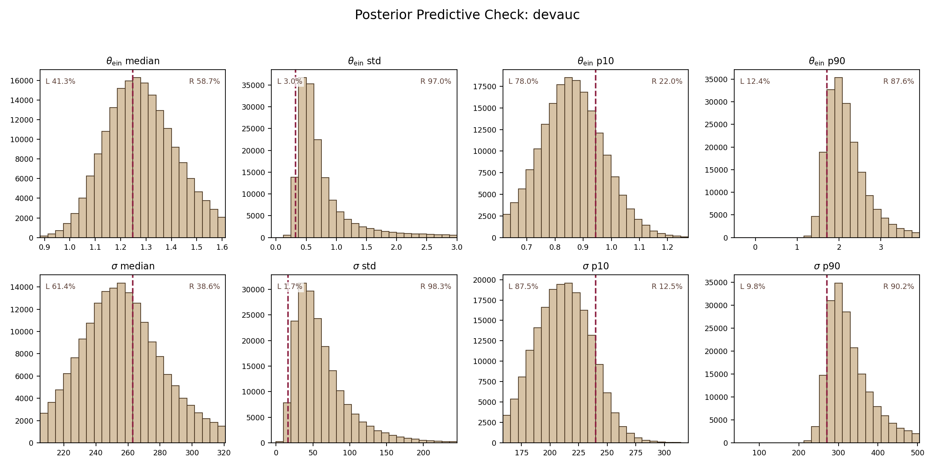
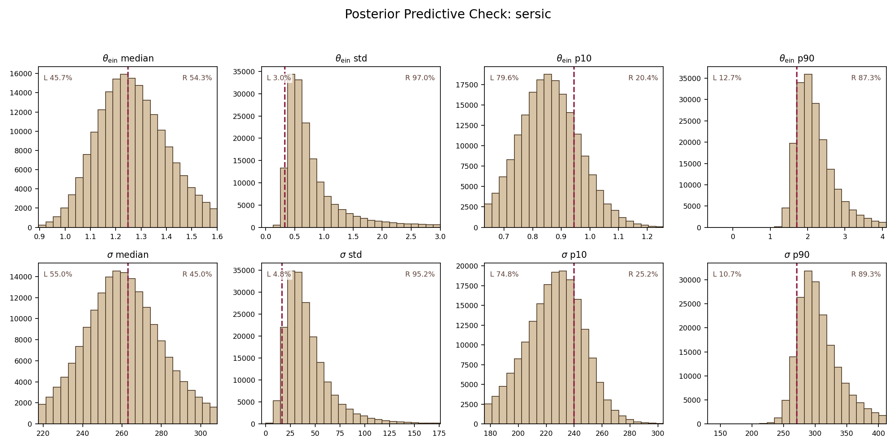
Canonical Posterior Predictive Check
Slide 2 / 3
2026-03-10 canonical rerun: tail-capped full chain, burn-in 2000, 192000 posterior draws, candidate pool 100000, process-pool workers 12.
de Vaucouleurs
20260308_215643_devauc_devauc_prod_20260308
Sersic
20260308_221211_sersic_sersic_prod_20260308
theta_E median at 41.3% of the replicated distribution.
sigma median at 61.4%; central location is reproduced well.
sigma std is the strongest mismatch: observed sits at the 1.7% left-tail percentile.
theta_E median at 45.7% of the replicated distribution.
sigma median at 55.0%; central location is reproduced well.
sigma std is the strongest mismatch: observed sits at the 4.8% left-tail percentile.
Observed medians land near the bulk of the replicated distributions for both profiles. The most persistent tension is the unusually small observed sigma scatter relative to the replicated sigma std panel.

Slide 3
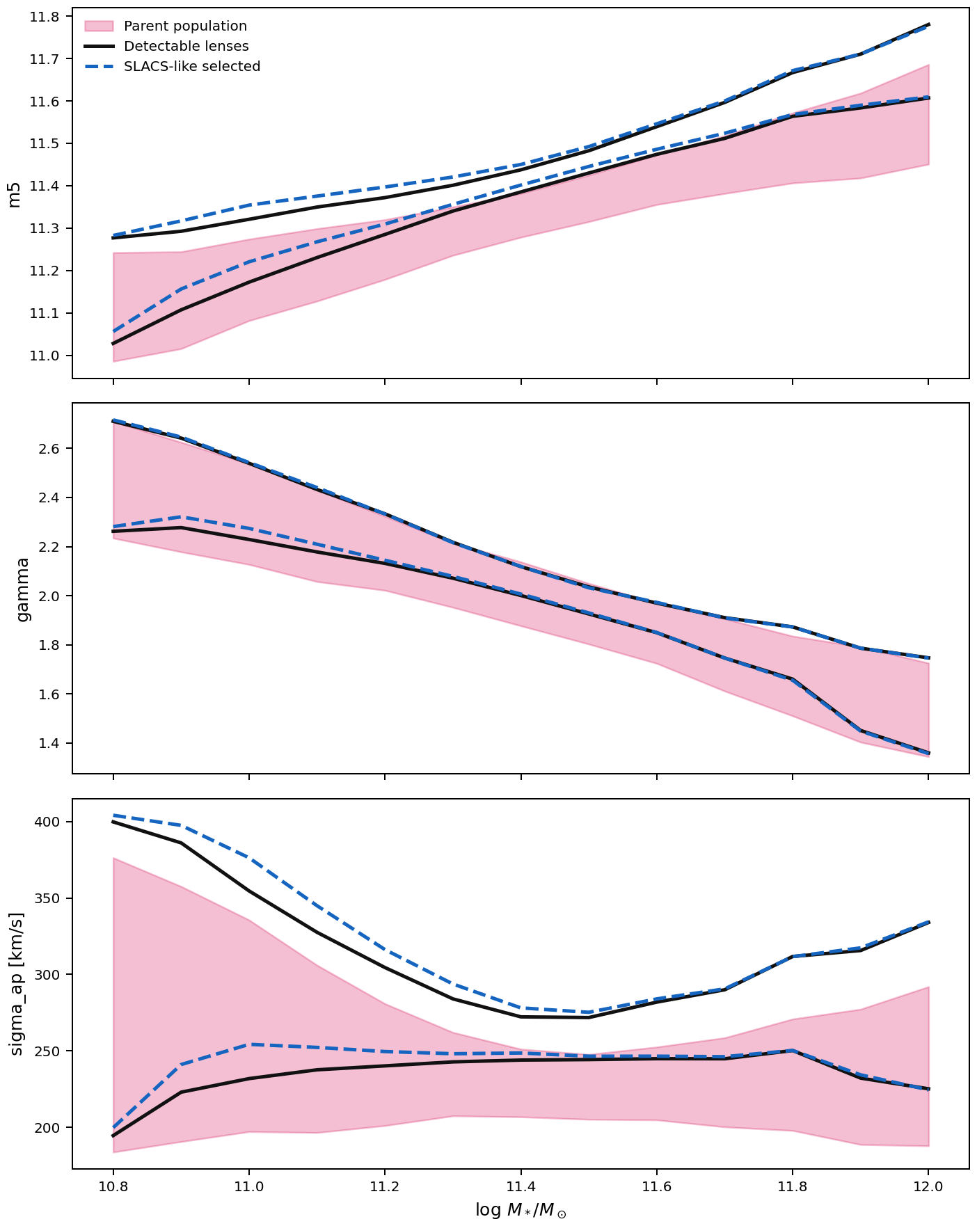
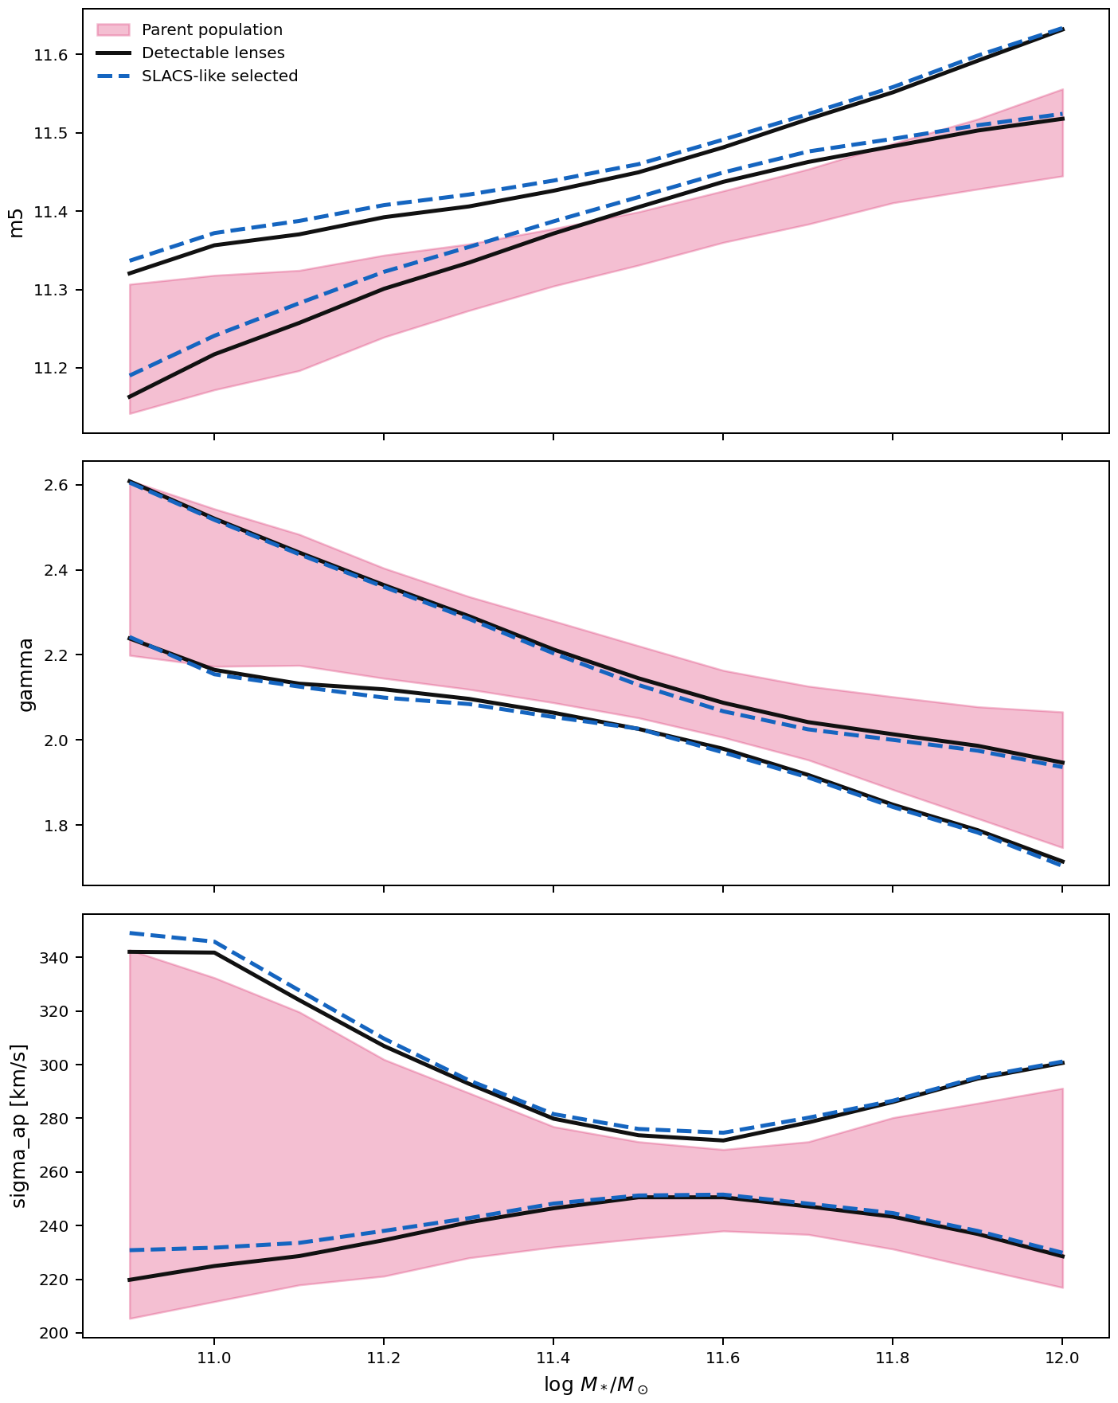
Fig. 8-like Posterior Trends
Slide 3 / 3
Separate evaluator from histogram PPC: fixed mass-grid conditional means for m5, gamma, and sigma_ap with parent / detectable / SLACS-like selected populations.
de Vaucouleurs
20260308_215643_devauc_devauc_prod_20260308
Sersic
20260308_221211_sersic_sersic_prod_20260308
m5 selection uplift: +0.05 -> +0.12 dex from low to high mass.
gamma selection shift: +0.04 -> +0.02; sign tells whether selection pushes the curve above or below parent.
sigma_ap boost: +24.0 -> +31.1 km/s across the mass range.
m5 selection uplift: +0.03 -> +0.08 dex from low to high mass.
gamma selection shift: +0.01 -> -0.06; sign tells whether selection pushes the curve above or below parent.
sigma_ap boost: +12.0 -> +11.3 km/s across the mass range.

