Slide 1
Data Mining for Diabetes Readmission Prediction
ADM PROJECT
By Rooksana Sultana

Slide 2
Agenda
Abstract
Introduction
Data Description
Problem Statement
Methodology
Results
Conclusion
Recommendation

Slide 3
Abstract
Background: Hospital readmission for diabetic patients is a major concern in the United States and reflects the inadequacies in health care system.
Goal: Identify the factors contributing to hospitals readmissions.
Methods: Decision Tree, Data Balancing, Random Forest.
Results: Most frequent readmissions are emergency readmissions.
Conclusion: effective prediction on readmissions enables hospitals to target patients at the highest risk and provide better care.

Slide 4
Introduction
Topic: Diabetes Readmission Prediction
What Is Readmission Rate?
A hospitalization that occurs within 30 days after a discharge
Why Is Readmission Important ?
Reduce cost of care and medical disputes.
Improve patients’ safety.

Slide 5
Data Description
Data Set Information:
The dataset represents 10 years (1999-2008) of clinical care at 130 US hospitals and integrated delivery networks. It includes101,766 instances and 55 features representing patient and hospital outcomes.
Attribute | Description
Admission type | patient's admission type: emergency, urgent, elective, newborn, not available, etc.
Time in hospital | Integer number of days between admission and discharge
Number of lab procedures | Number of lab tests performed during the encounter
Number of outpatient visits | Number of outpatient visits of the patient in the year preceding the encounter
Number of emergency visits | Number of emergency visits of the patient in the year preceding the encounter
Number of inpatient visits | Number of inpatient visits of the patient in the year preceding the encounter
Number of diagnoses | Number of diagnoses entered to the system
A1c test result | The range of the result or if the test was not taken
Diabetes medications | Whether there was any diabetic medication prescribed or not
Readmitted | Days to inpatient readmission

Slide 6
Problem Statement
Data Pre-processing
Data Analysis-Models Building
Evaluation Accuracy Comparison
Recommend-ation
Methodology

Slide 7
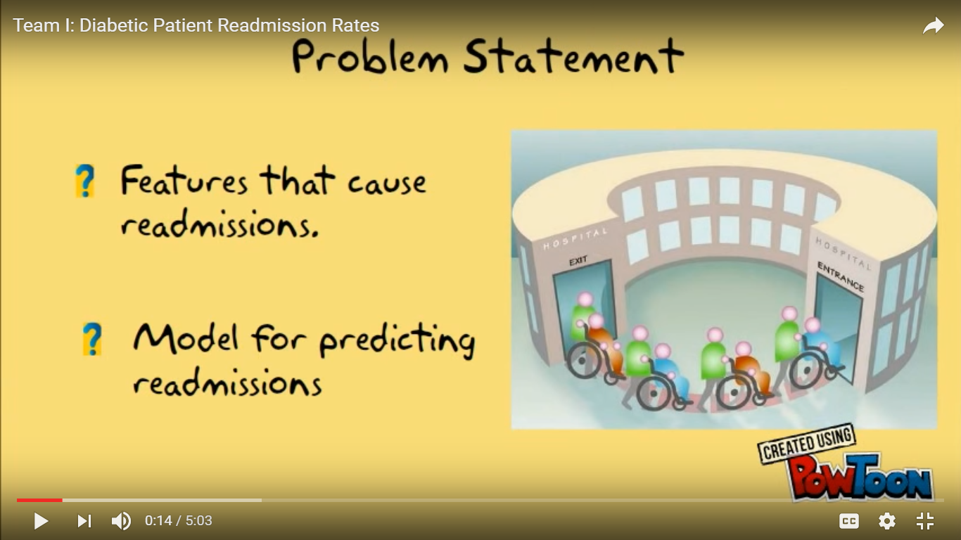
Problem Statement
Identify the major factors that contribute to hospital readmissions rate for diabetes.

Slide 8
Data Preprocessing
Removing variables with high missing values: Weight has missing 97% of observations and payer code for 47% of observations
Binarize the data: (target variable) readmitted within 30 days using if else statement.

Slide 9
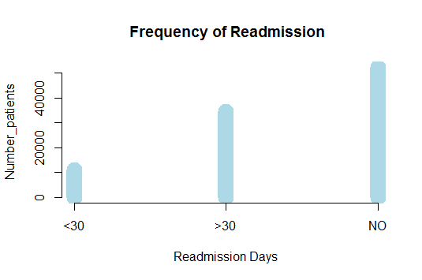
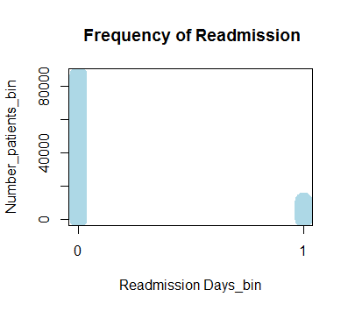
Exploratory Data Analysis
This data set contains only 11% of cases of readmission within 30 days and 89% of cases with readmission after 30 days or No readmission. This is a severely imbalanced data set.
Sampling method:
Under Sampling.
Over Sampling.
Both and
Synthetic Balancing method

Slide 10
Models Created:
Decision Trees using rpart:
Decision Tree using Under sampling, Over sampling and
Decision Tree using both (under and over sampling)
Decision Trees using Synthetic Balancing method.
Random Forest

Slide 11
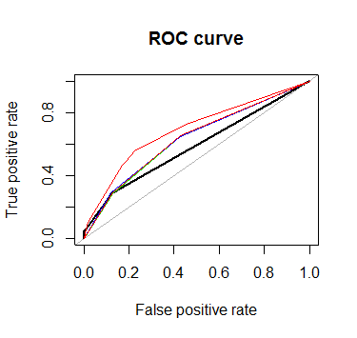
Imbalanced data
Balanced method | Number of Observations | AUC | Color used
Unbalanced | 19612 | 58% | Black
Under Sampling | 2214 | 63% | Blue
Over Sampling | 17398 | 64% | Green
Both-Under and Over sampling | 9847 | 62% | Red-white
ROSE synthetic method | 9848 | 69% | Red

Slide 12
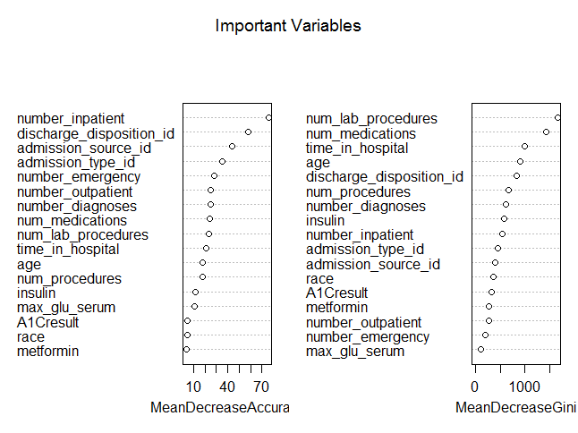
Random Forest
OOB Error rate=43.37%

Slide 14
Preferred Model
Decision tree using Synthetic balanced method, as it has high accuracy(46%) and Sensitivity (44%) and it is better in predicting readmission rates within 30 days when compared to other model.

Slide 15
Conclusion
The results obtained by random forest and decision tree on the actual imbalanced data set are similar.
I used synthetic data balancing techniques and improved model accuracy.

Slide 16
RECOMMENDATIONS:
The readmission groups are related to number of inpatient visits, discharge disposition, admission source and admission type.
Instead of tracking all 55 attributes, hospitals are suggested to focus on number of patient’s inpatient visits, admission source, admission type, discharge disposition.
Focus on admission source of the patients that is, who had emergency encounters and who came in from Physicians referral, Clinic referral, transferred from another hospital.
Hospitals are advised to focus not only inpatient treatment but also continue care after discharge.

Slide 17


