Slide 1
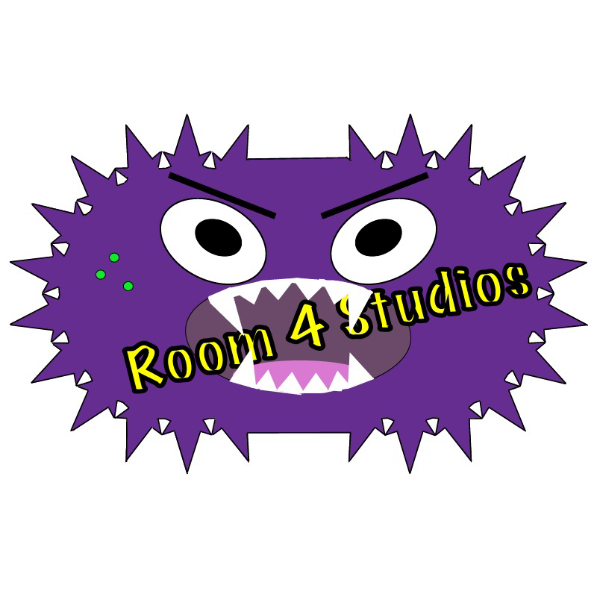
Software Analysis
Room 4 Studios

Slide 2
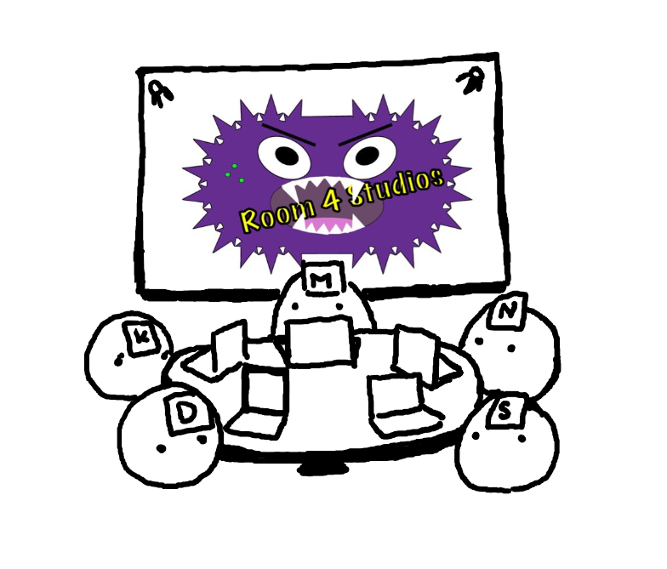
Team Members
IT Manager: Nathan V.
Software Architect: Kim H.
Quality Assurance Manager: Scott M.
AI Specialist: Matt M.
Version Control: Dawson H.

Slide 3
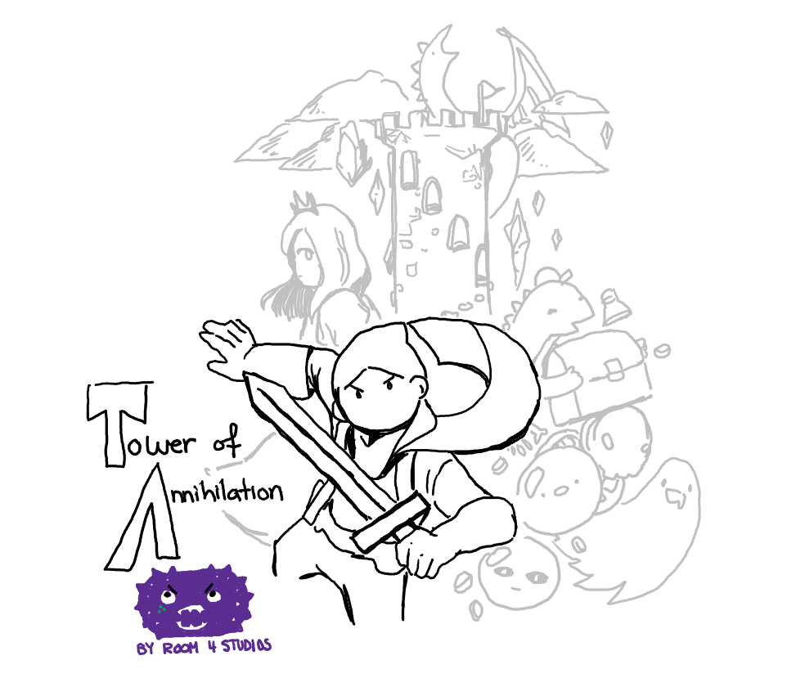
Tower of Annihilation
The player must ascend a tower filled with puzzling obstacles, dangerous enemies, and sassy vendors. The player has a choice of entering the final boss floor at any level or can challenge themselves to reach the higher levels of the tower.

Slide 4
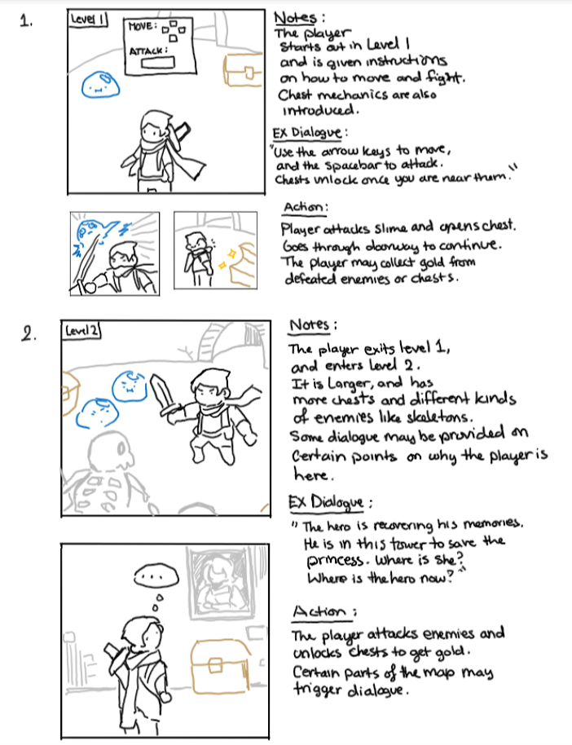
Storyboard, Pt1
In the case of death, player will simply respawn at start of current level.

Slide 5
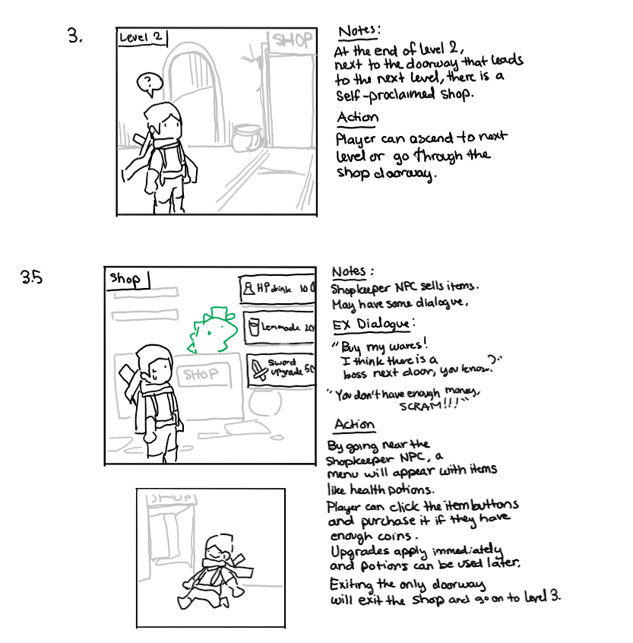
Storyboard, Pt2

Slide 6
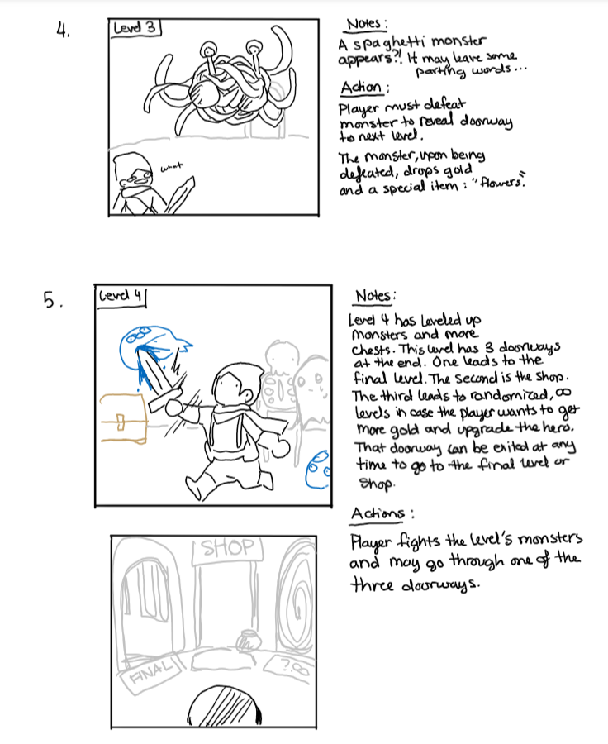
Storyboard, Pt3
Some features subject to change.

Slide 7
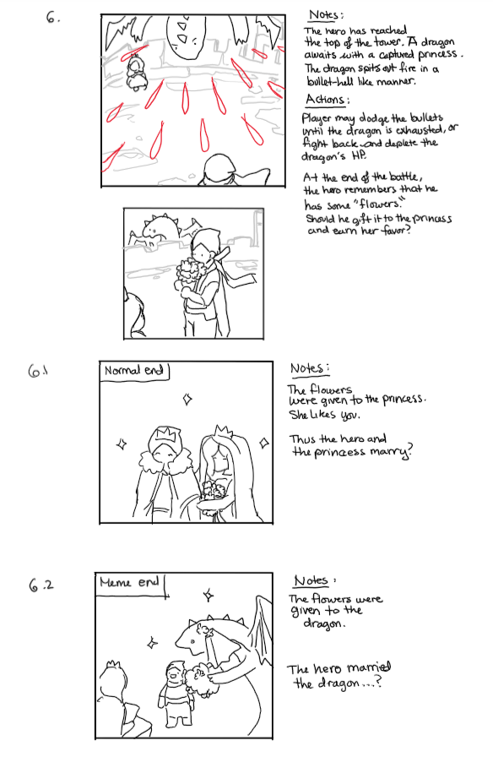
Storyboard, Pt4

Slide 8
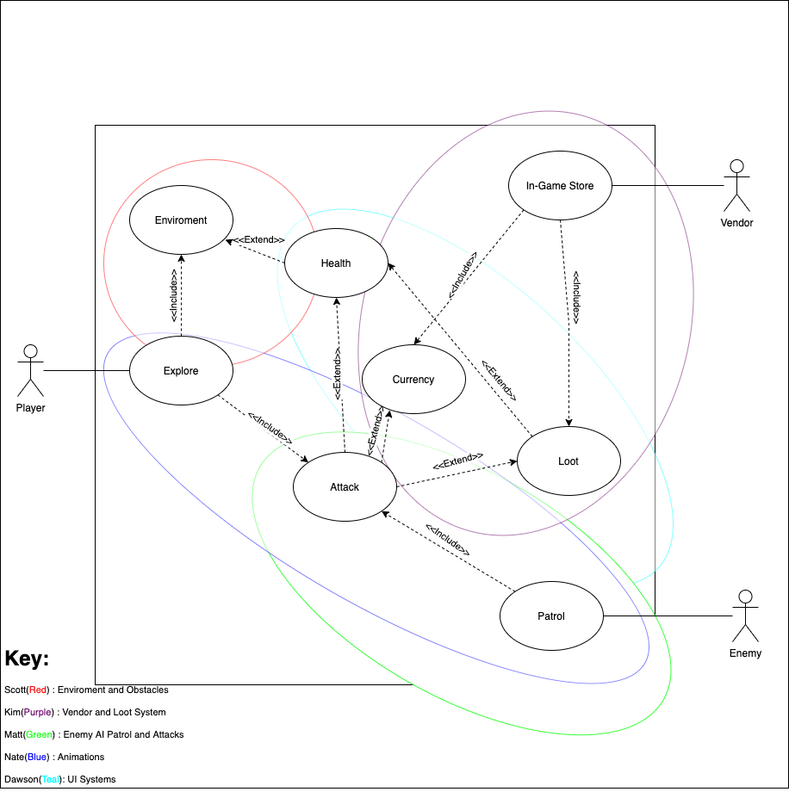
Global Use Case

Slide 9
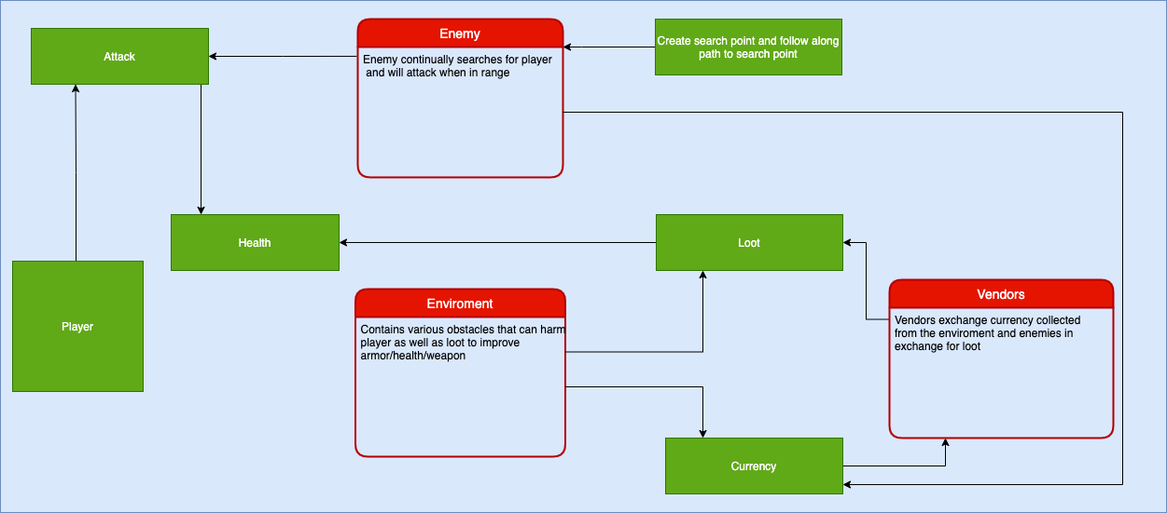
Context Diagram

Slide 10
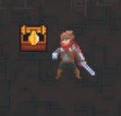
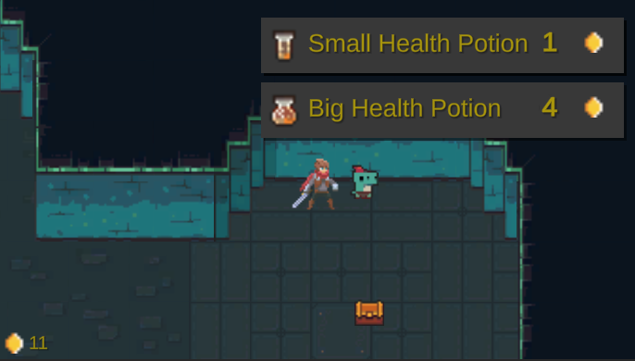
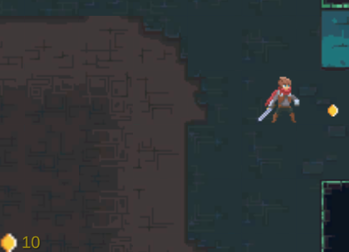
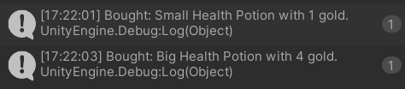
Example of an environment item (chest) that contains loot/ currency.
Currency can be found scattered in the map or dropped by monsters or chests.
Example of vendor function with item menu to purchase loot.
Currency system is also displayed.

Slide 11
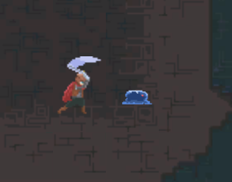
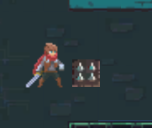
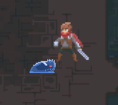
Player can attack the enemy.
Potential environmental traps.
Enemy attacks player once they are in range and can follow the player via Astar Pathfinding.

Slide 12
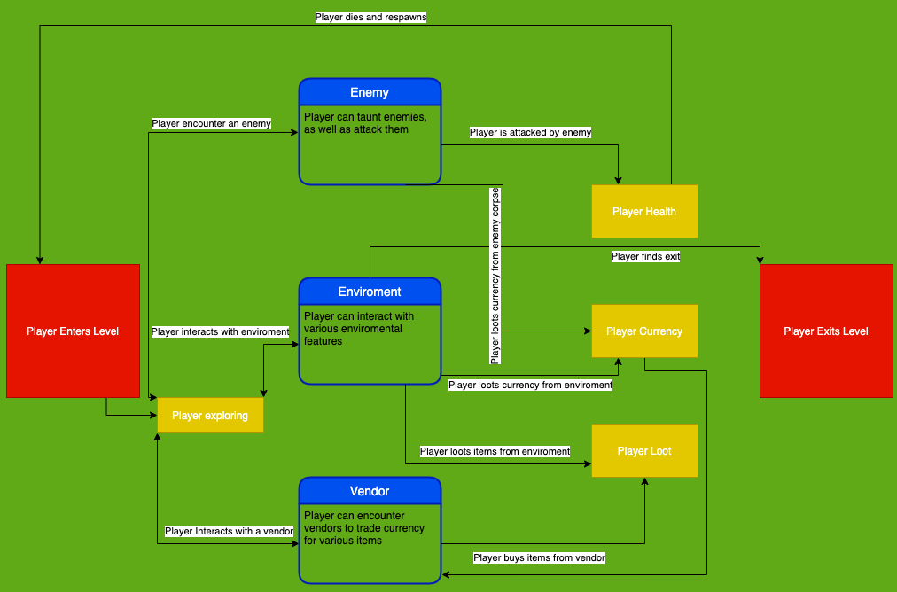
Diagram 0

Slide 13
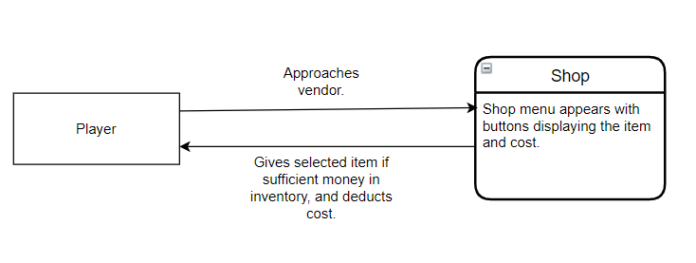
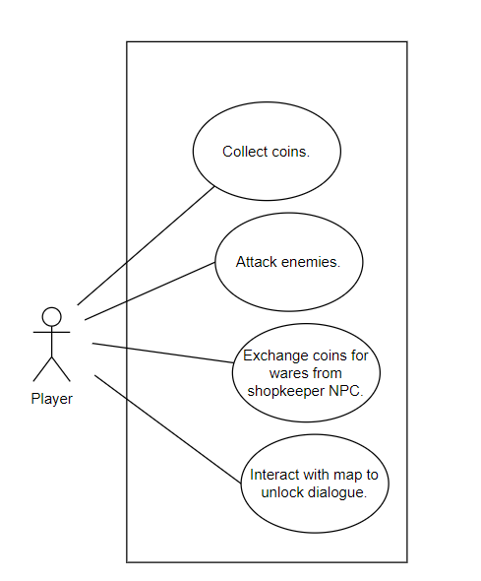
Kim H.
-Vendor/ Loot System: High Priority
-Dialogue System: Low Priority
-Player Attack Basics: Medium Priority

Slide 14
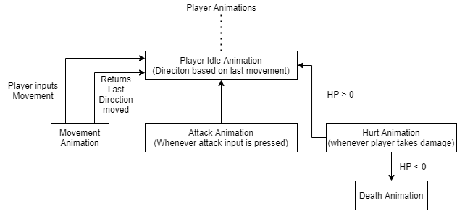
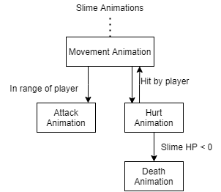
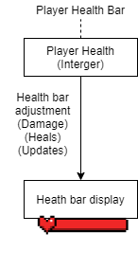
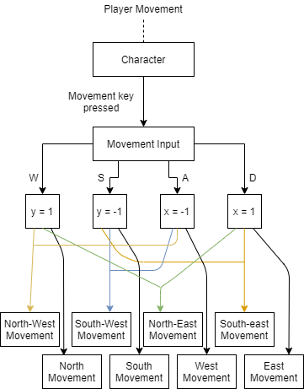
Nathan V.
- Player Movement (High Priority)
- Animations (Medium Priority)
- Health Bars (Low Priority)
- Sprites (Low Priority)
- Tile-set (Low Priority)

Slide 15
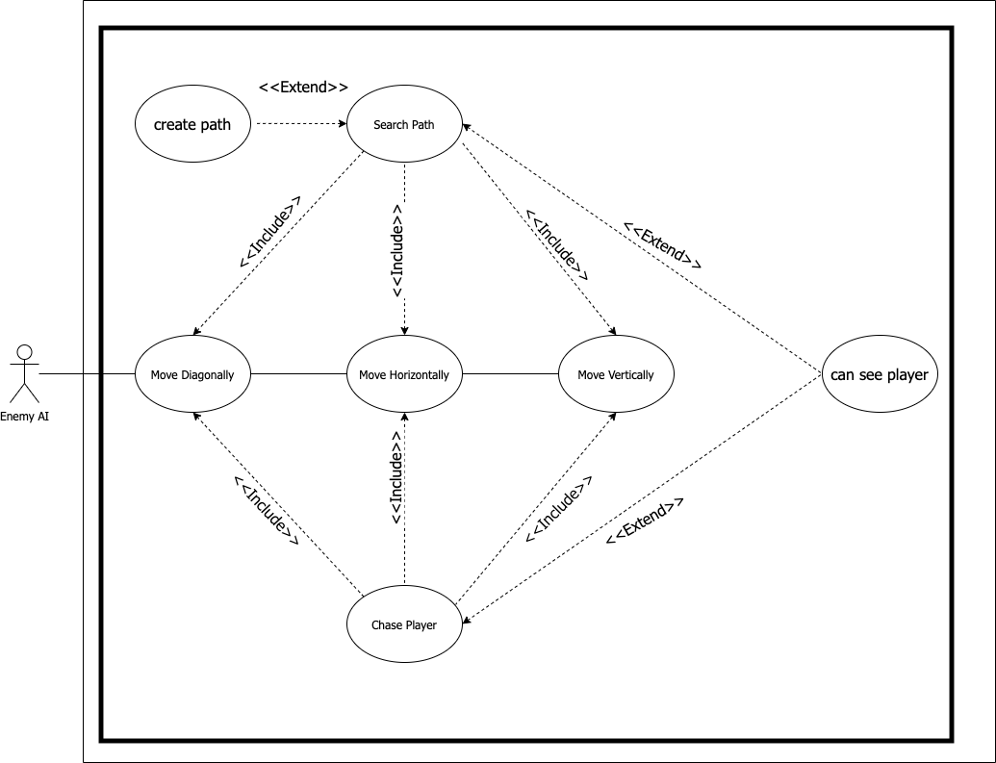
Matt M.
Enemy AI patrol and detection
Top Priority given the necessity to have interactable enemies in a game
The Enemy AI can move in all directions dictated by whether it is following its search path or chasing a player.
The work was a learning curve but once a foundation was established it was easy to implement more features onto it

Slide 16
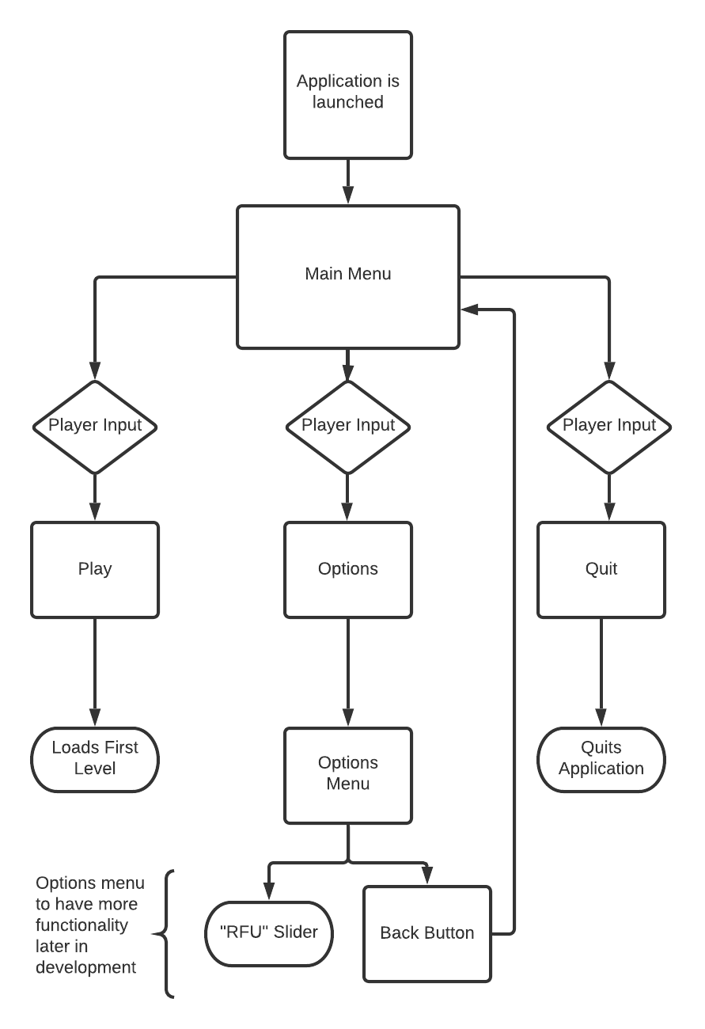
Dawson H.
Main Menu (Medium Priority)
Play
Launches Level 1.
Options
"RFU" slider represents anything added to options menu in further development.
Quit
Quits application.
** More functionality to be determined as game develops, such as saved games, volume level, and "Dr. BC Mode".

Slide 17
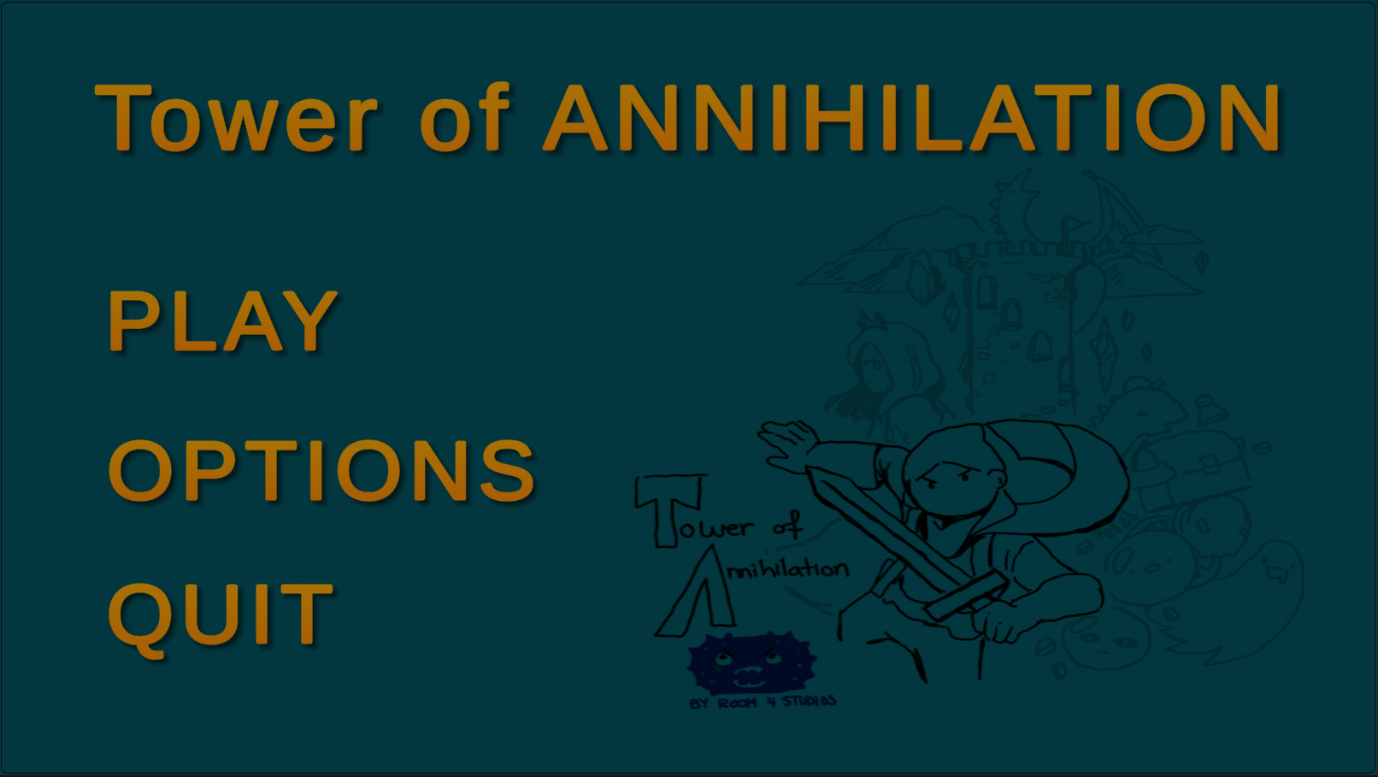


Slide 18
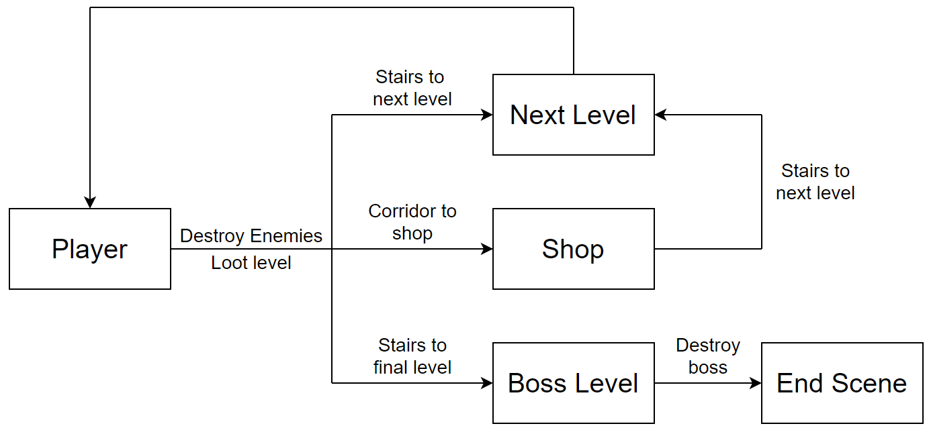
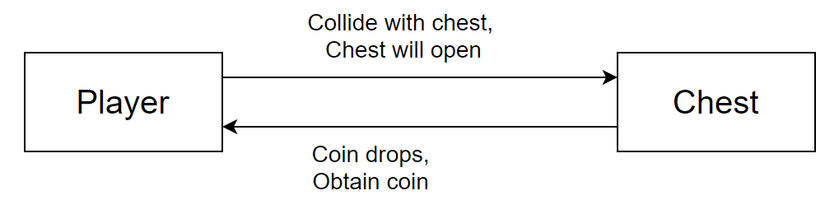
Scott M.
- Change Level: High Priority
- Open Chest: Medium Priority
- Obstacles: Low Priority

Slide 19
Known Limitations
Necessary time to complete development of game.
The development of the game needs to be completed by April 29, 2021. Including any UI, scripts, design inside of Unity.
Limited software for game development (Unity)
Our team has decided that Unity best fits the need for the game to be implemented.
Code implementation
Must use C# to work with Unity.
Any compatible editor may be used.

Slide 20
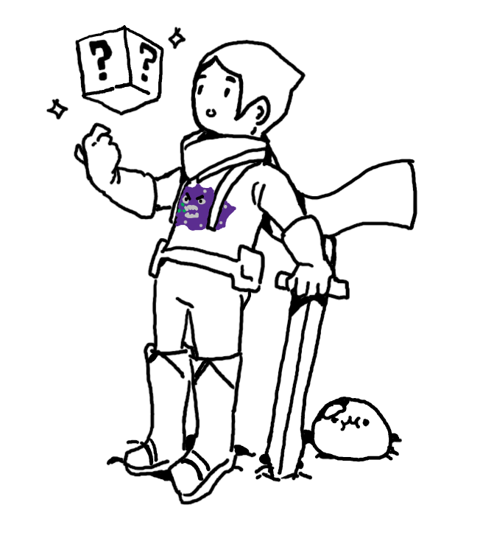
Final Questions?

