Slide 1
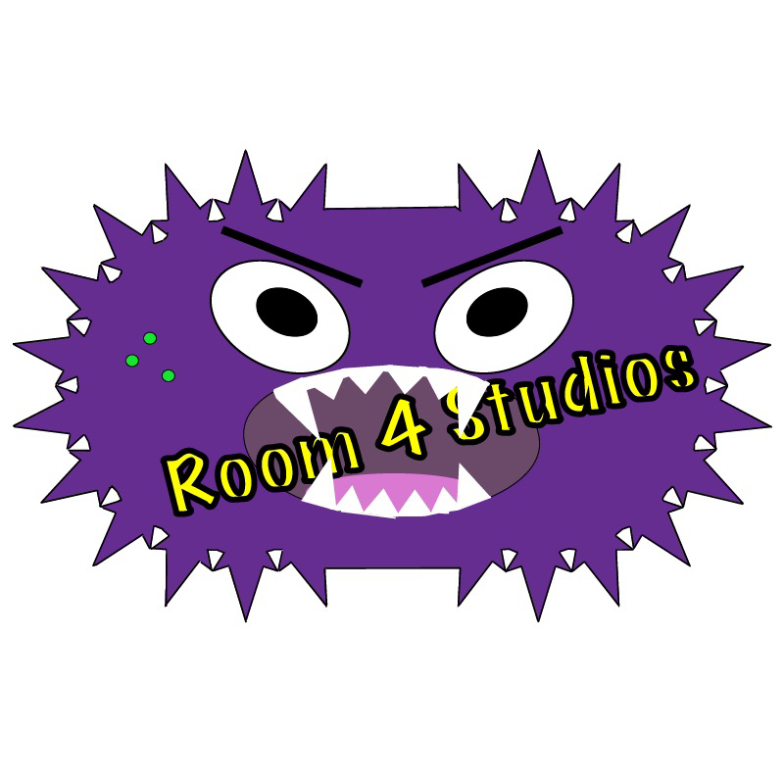
Software Analysis
Room 4 Studios

Slide 2
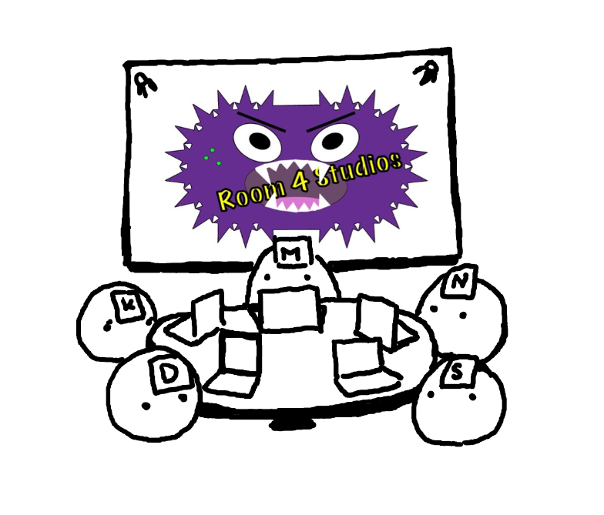
Team Members
IT Manager: Nathan V.
Software Architect: Kim H.
Quality Assurance Manager: Scott M.
AI Specialist: Matt M.
Version Control: Dawson H.

Slide 3
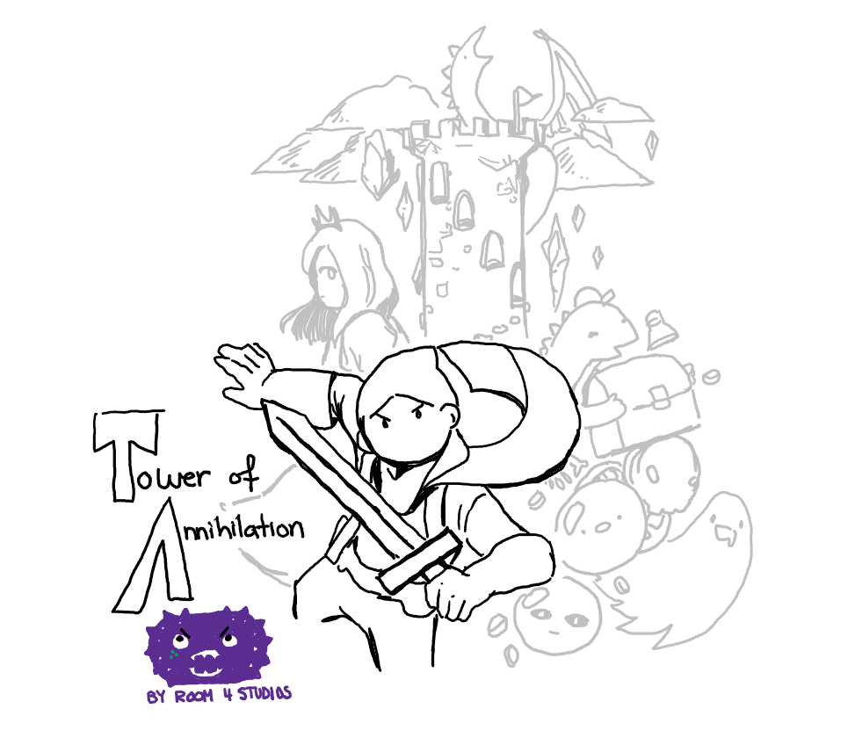
Tower of Annihilation
The player must ascend a tower filled with puzzling obstacles, dangerous enemies, and sassy vendors. The player has a choice of entering the final boss floor at any level or can challenge themselves to reach the higher levels of the tower.

Slide 4
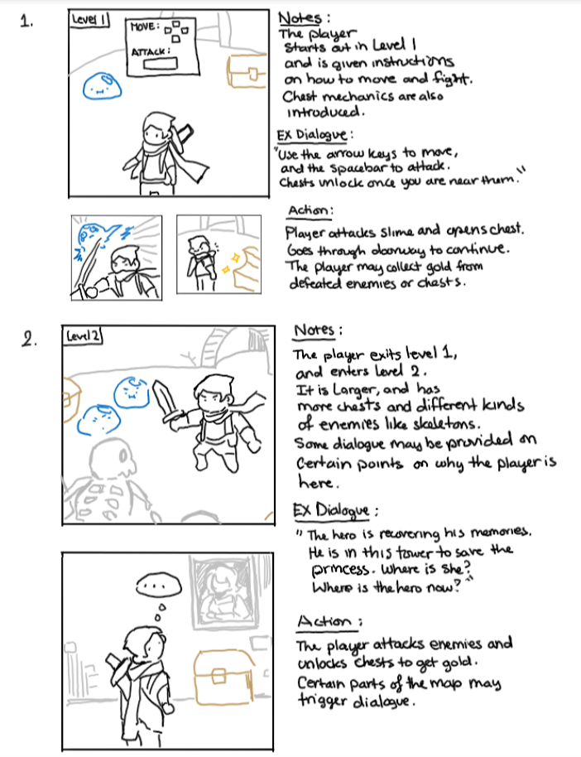
Storyboard, Pt1
In the case of death, player will simply respawn at start of current level.

Slide 5
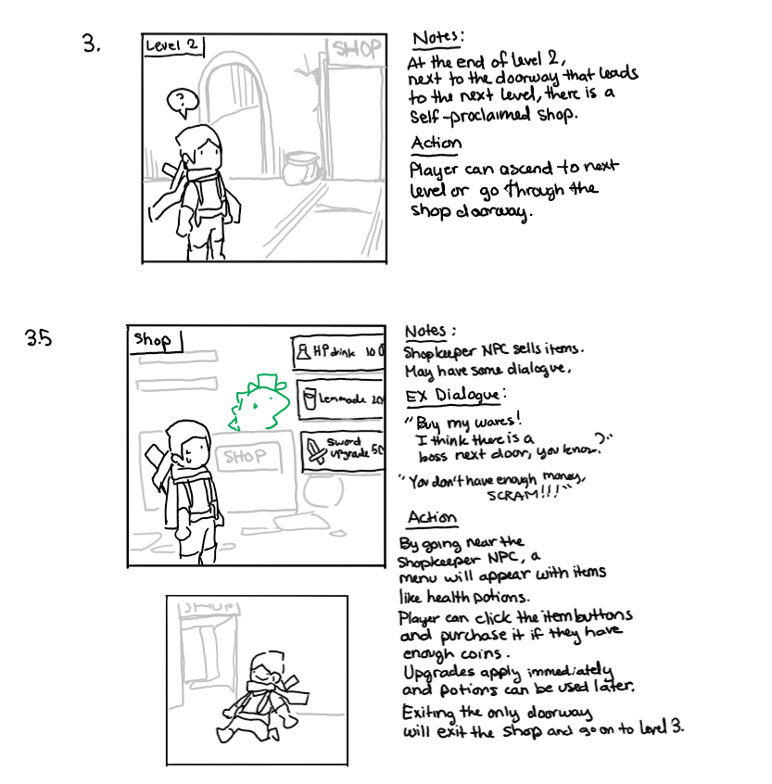
Storyboard, Pt2

Slide 6
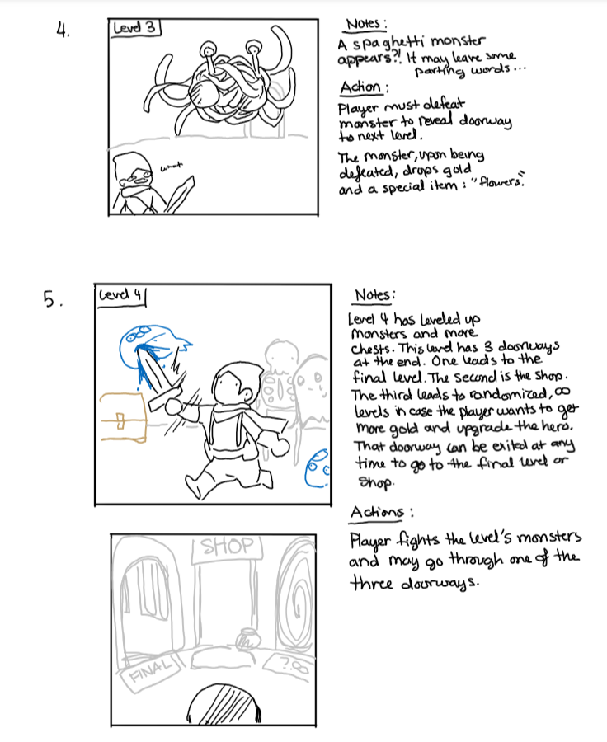
Storyboard, Pt3
Some features subject to change.

Slide 7
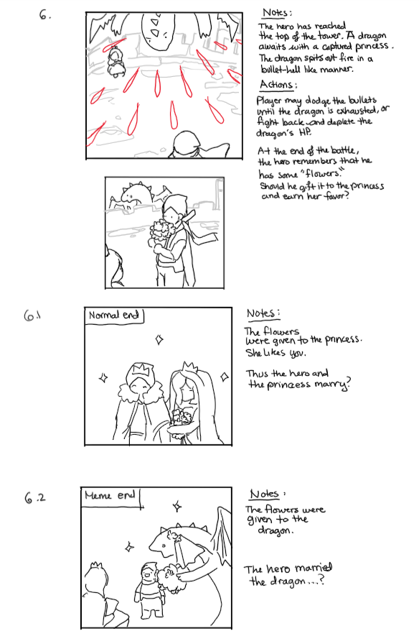
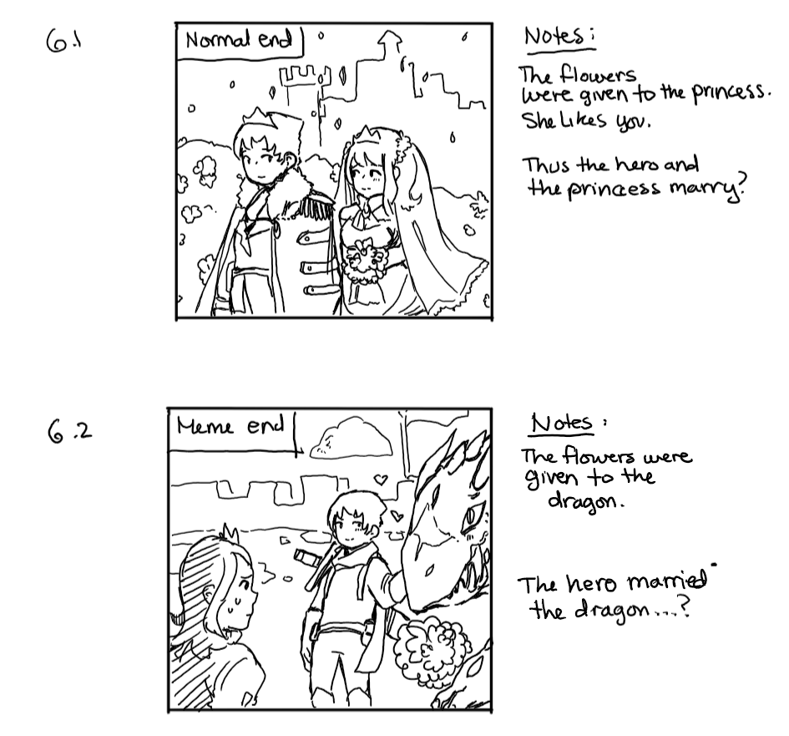
Storyboard, Pt4

Slide 8
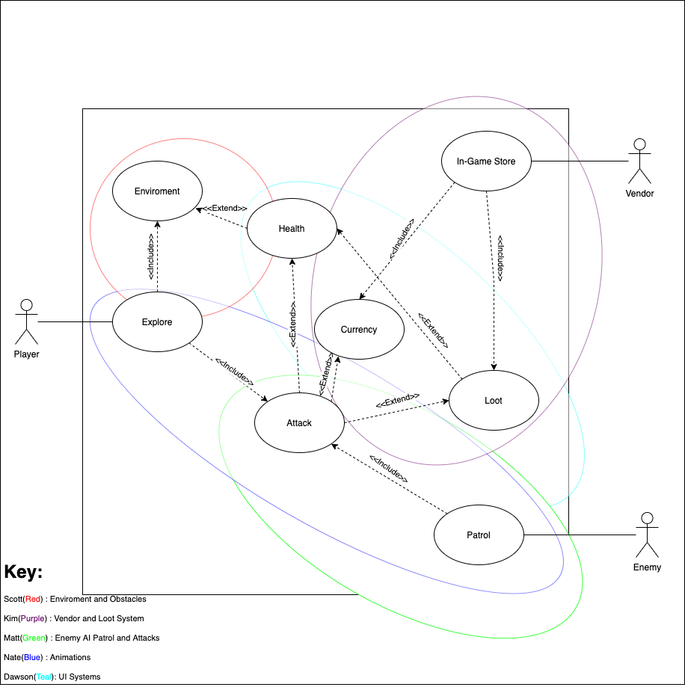
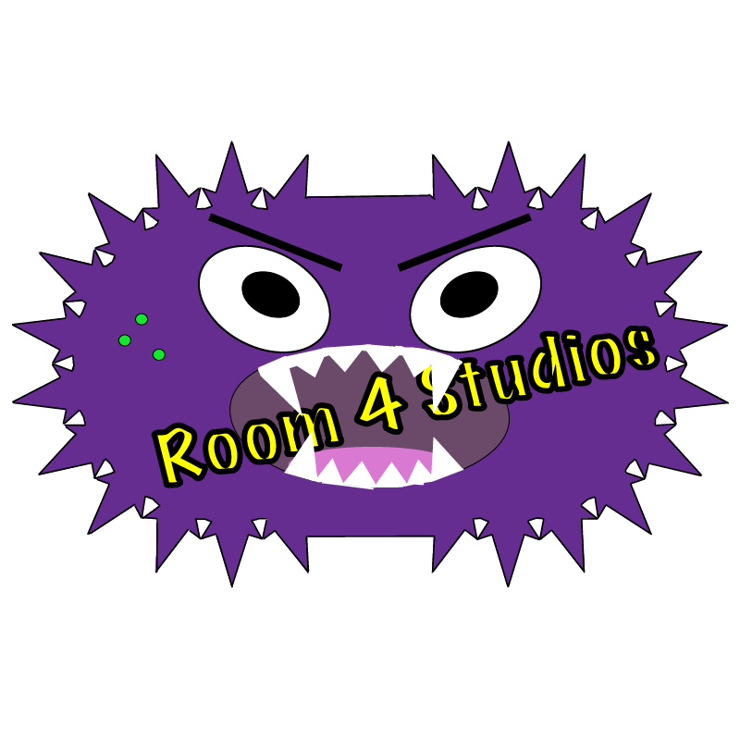
Global Use Case

Slide 9

Context Diagram

Slide 10
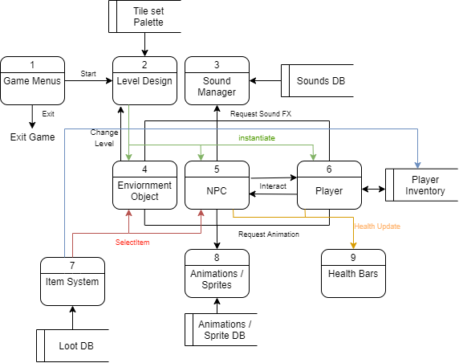
Diagram 0

Slide 11
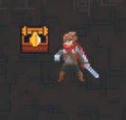
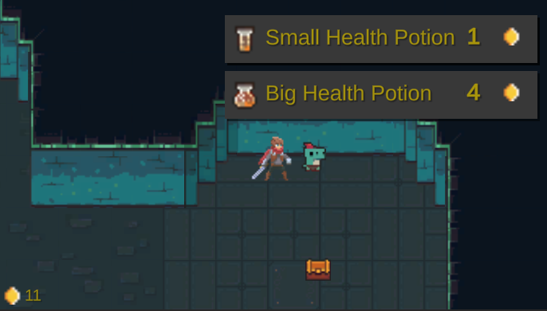
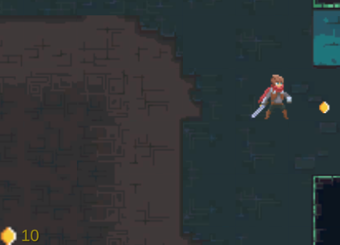
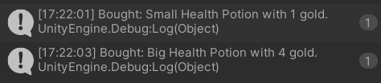
Example of an environment item (chest) that contains loot/ currency.
Currency can be found scattered in the map or dropped by monsters or chests.
Example of vendor function with item menu to purchase loot.
Currency system is also displayed.

Slide 12
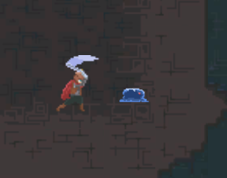
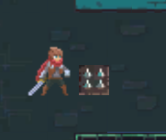
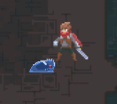
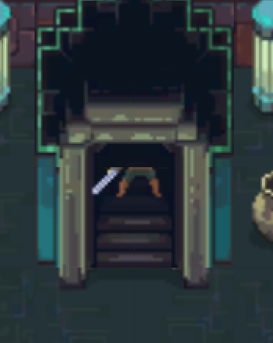
Player can attack the enemy.
Potential environmental traps.
Enemy attacks player once they are in range and can follow the player via Astar Pathfinding.
Player can interact with stairs to change levels.

Slide 13
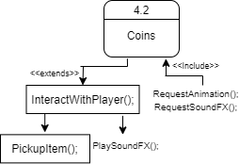
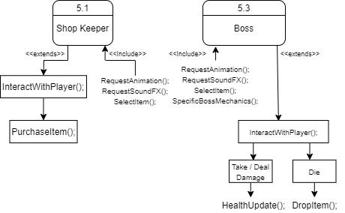
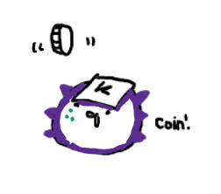
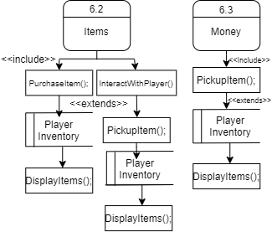
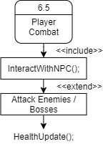
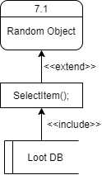
Kim H.
-Vendor/ Loot System: High Priority
-Dialogue System: Low Priority
-Player Attack Basics: Medium Priority
-Boss Patterns: High Priority

Slide 14
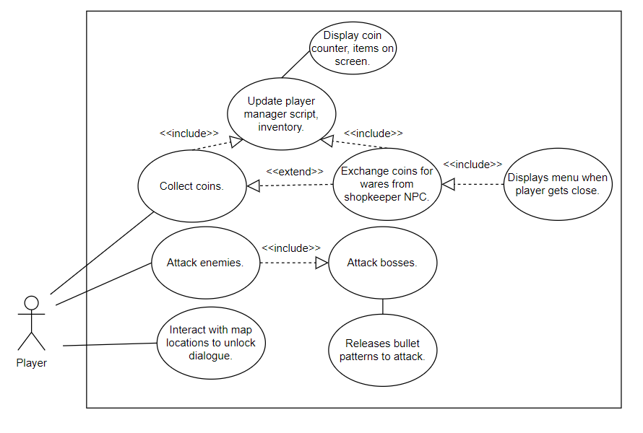
Kim H.
Complexity level:
-Vendor/ Loot System: Medium-High
-Dialogue System: Low(?)
-Player Attack Basics: Low
-Boss Patterns: High

Slide 15
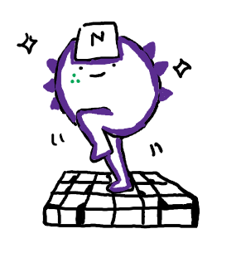
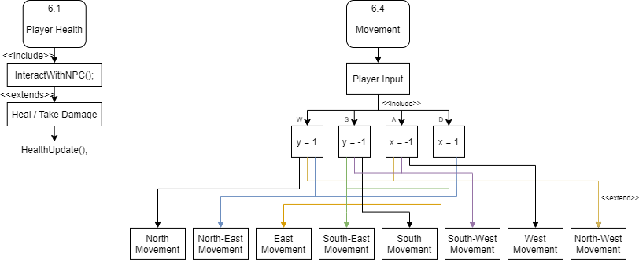
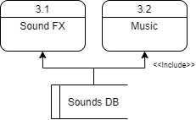
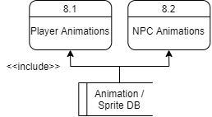
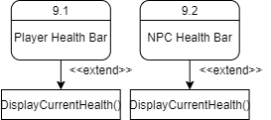
Nathan V.
- Player Movement (High Priority)
- Player Manager (High Priority)
- Health Bars (Low Priority)
- Animations (Low Priority)
- Sprites (Low Priority)
- Tile-set (Low Priority)

Slide 16
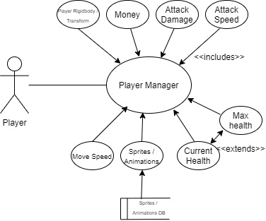
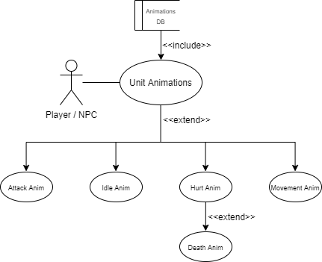
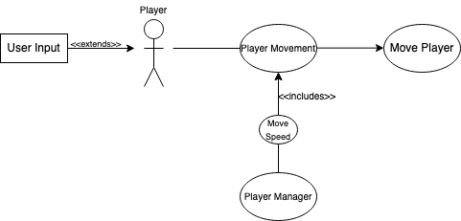
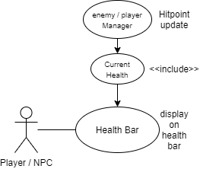
Nathan V.
- Player Movement (High Priority)
- Player Manager (High Priority)
- Health Bars (Low Priority)
- Animations (Low Priority)
- Sprites (Low Priority)
- Tile-set (Low Priority)

Slide 17





















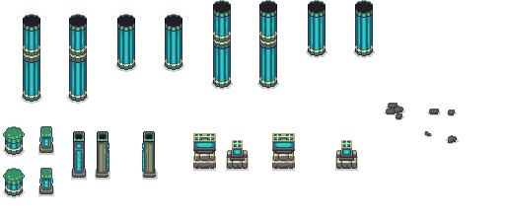
Nathan V.
Player Animations:
Slime Animations:
Tile-Set:
- Player Movement (High Priority)
- Player Manager (High Priority)
- Health Bars (Low Priority)
- Animations (Low Priority)
- Sprites (Low Priority)
- Tile-set (Low Priority)

Slide 18
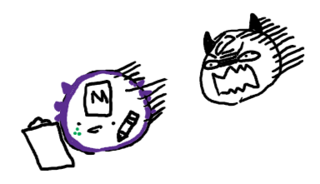
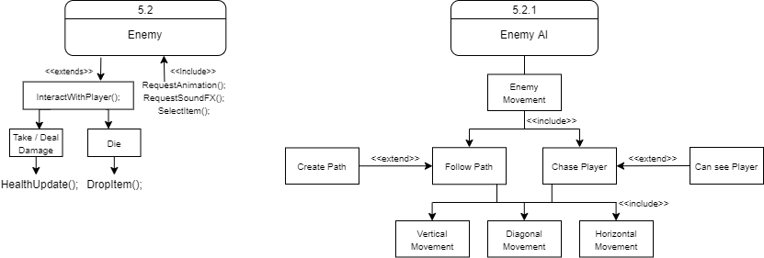
Matt M.
Enemy AI patrol and detection
Top Priority given the necessity to have interactable enemies in a game
The work was a learning curve but once a foundation was established it was easy to implement more features onto it

Slide 19
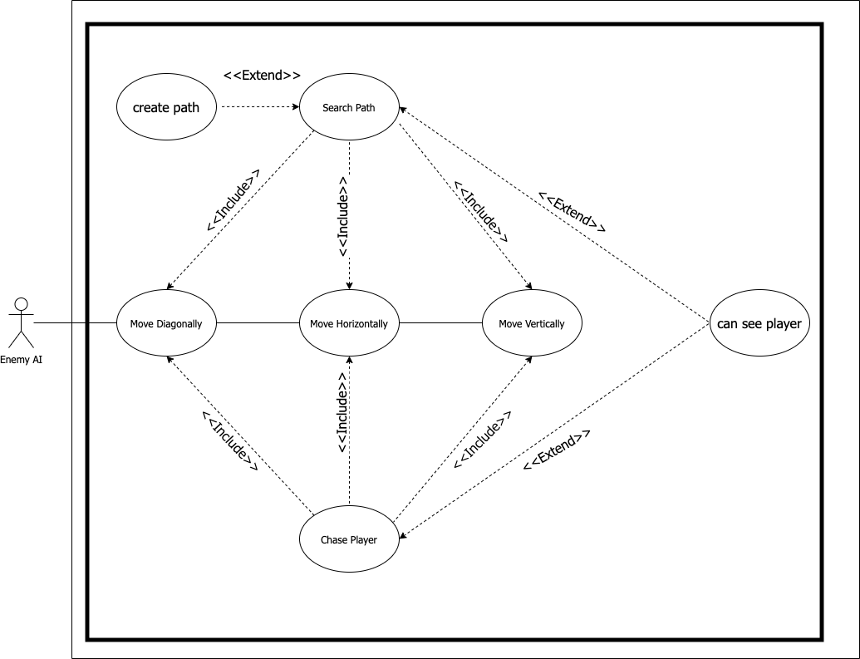
Matt M.
The Enemy AI can move in all directions dictated by whether it is following its search path or chasing a player.
This is determined by the “can see player” function
Uses a rotational ray cast to detect player from any approach

Slide 20
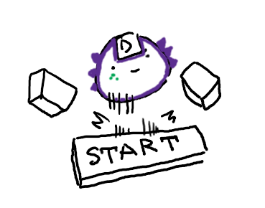
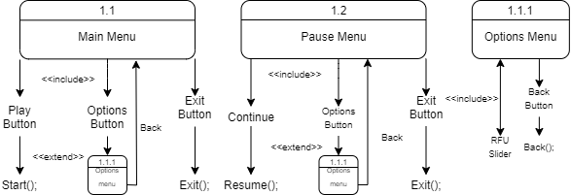
Dawson H.
Main Menu/Game Menu (Medium)
Main Menu
Play: Launches Level 1.
Options: "RFU" slider represents anything added to options menu in further development.
Quit: Quits application.
In-Game Menu (needs implementation)
Options: Player can change options during gameplay
Save Game: Saves player progress
** More functionality to be determined as game develops, such as load saved games, volume level, and "Dr. BC Mode".

Slide 21
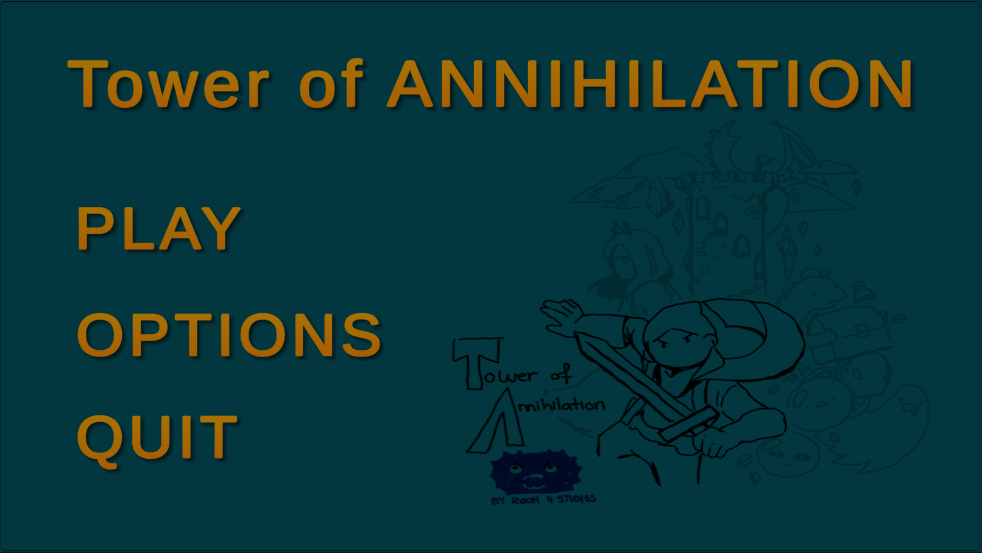
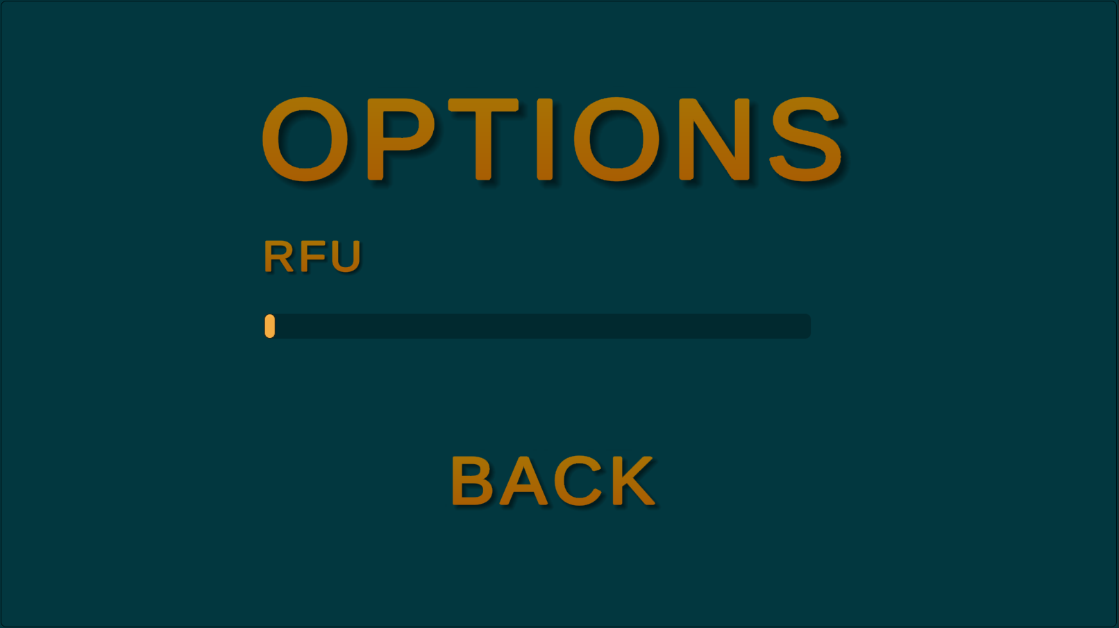

Slide 22
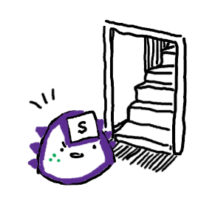
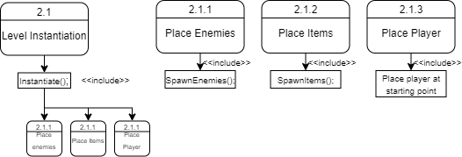
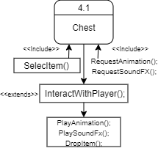
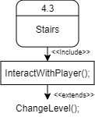
Scott M.
- Change Level: High Priority
- Chest: Medium Priority

Slide 23
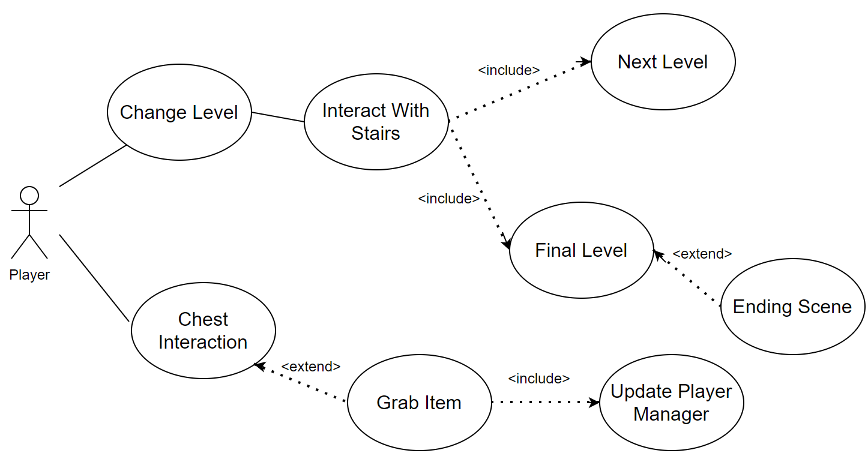
Scott M.
Change Level: High Priority
Chess: Medium Priority

Slide 24
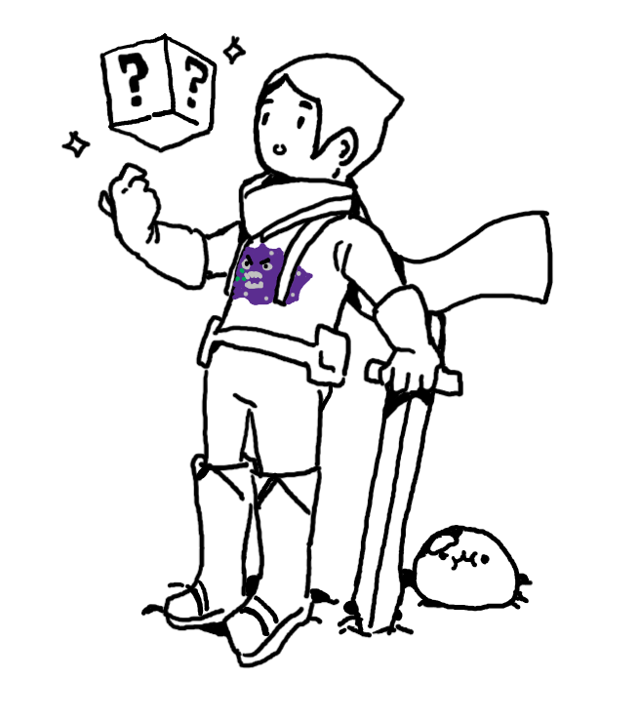
Final Questions?

