Slide 1
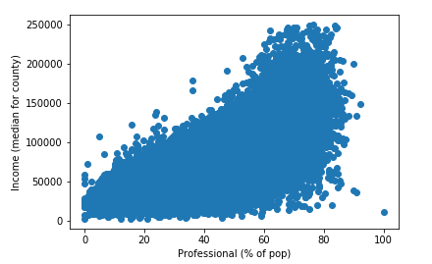
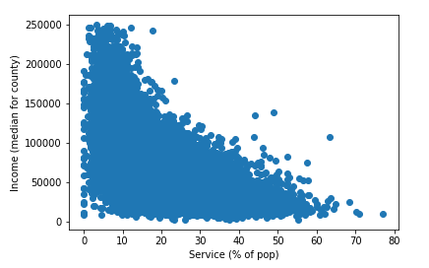
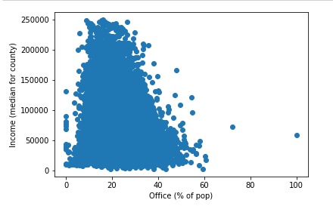
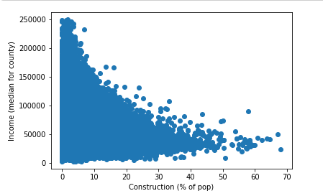
US Census: Predicting Median Income Andrew Hoskins
Introduction
Results
Conclusion
This project is the culmination of the machine learning that I have been working on for the past semester. The purpose is to take demographic information from the US Census and determine a county's median income based on the percentage of the population being in difference fields of work
The model suggests that the Professional jobs have the most impact on median income. This is likely due to Professional jobs having a tendency to pay higher wages/salaries than jobs in the other categories. Office was the next most important feature with Service and Construction being the least of the features in terms of impact.
Methods
The model used was a linear regression model. This model fit the data better than the other models tested.
Resources
Acknowledgements
Links
Dataset: kaggle.com
Coffee and late nights
https://github.com/44-599-machine-learning-S19/machine-learning-project-Roonicorn1

