Slide 1
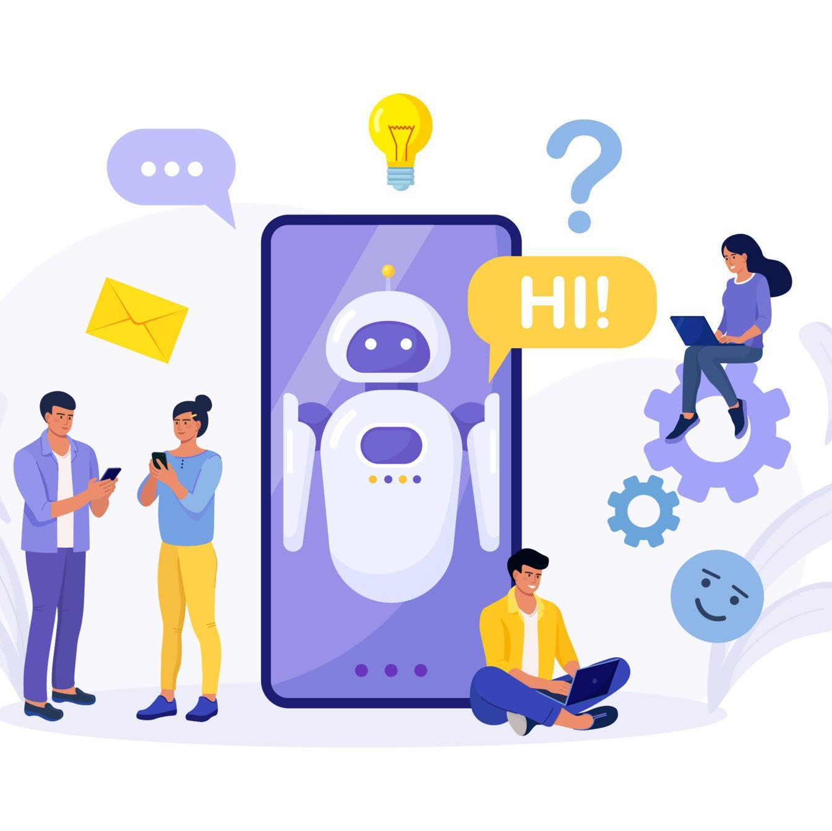
AUTOMATED CHATBOT SYSTEM
Kaivalya Reddy Maddireddy - 00760616 Roop Hima Vaishnavi Kantimahanthu - 00748293 Poojitha Mandapati - 00797556

Slide 2

What is a Chat Bot?
A chatbot, at its most basic, is a computer software that mimics and interprets human interaction (spoken or typed), enabling users to converse with digital gadgets as if they were speaking to real people. Chatbots may be as basic as one-line programs that respond to straightforward questions, or they can be as complex as digital assistants that learn and develop over time to provide ever more individualized service as they acquire and analyze more data.

Slide 3
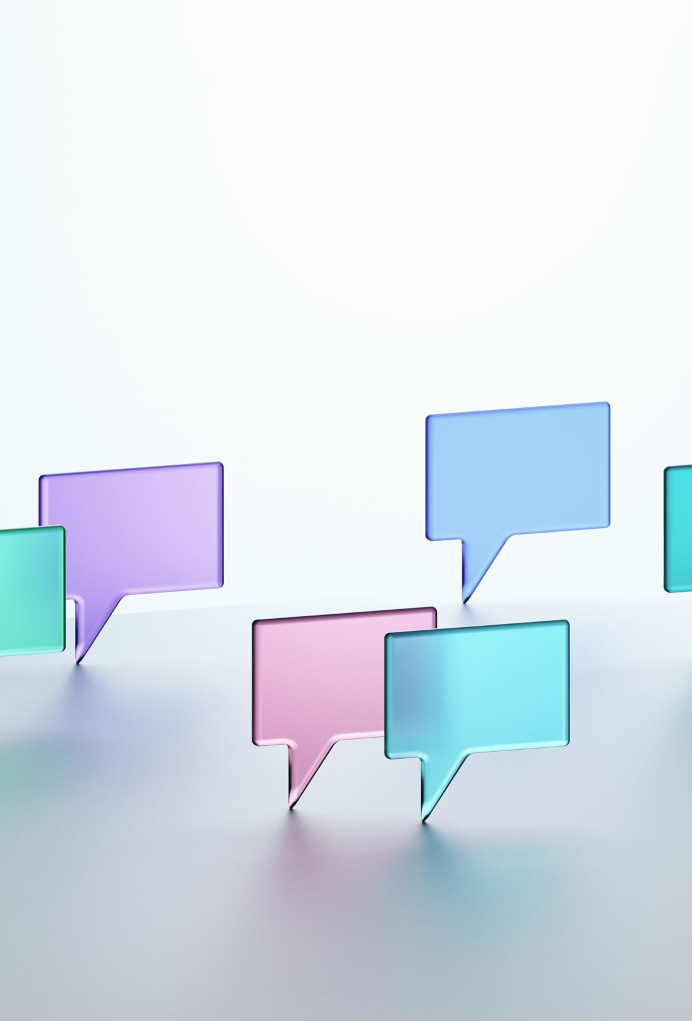
Purpose of Chat Bot
Chat bots are built to simulate a conversation with a user through a messaging applications, websites, mobile apps or through the telephone.
With as little effort from the user as possible, chatbots can comprehend what a person wants and direct them toward their goals.

Slide 4
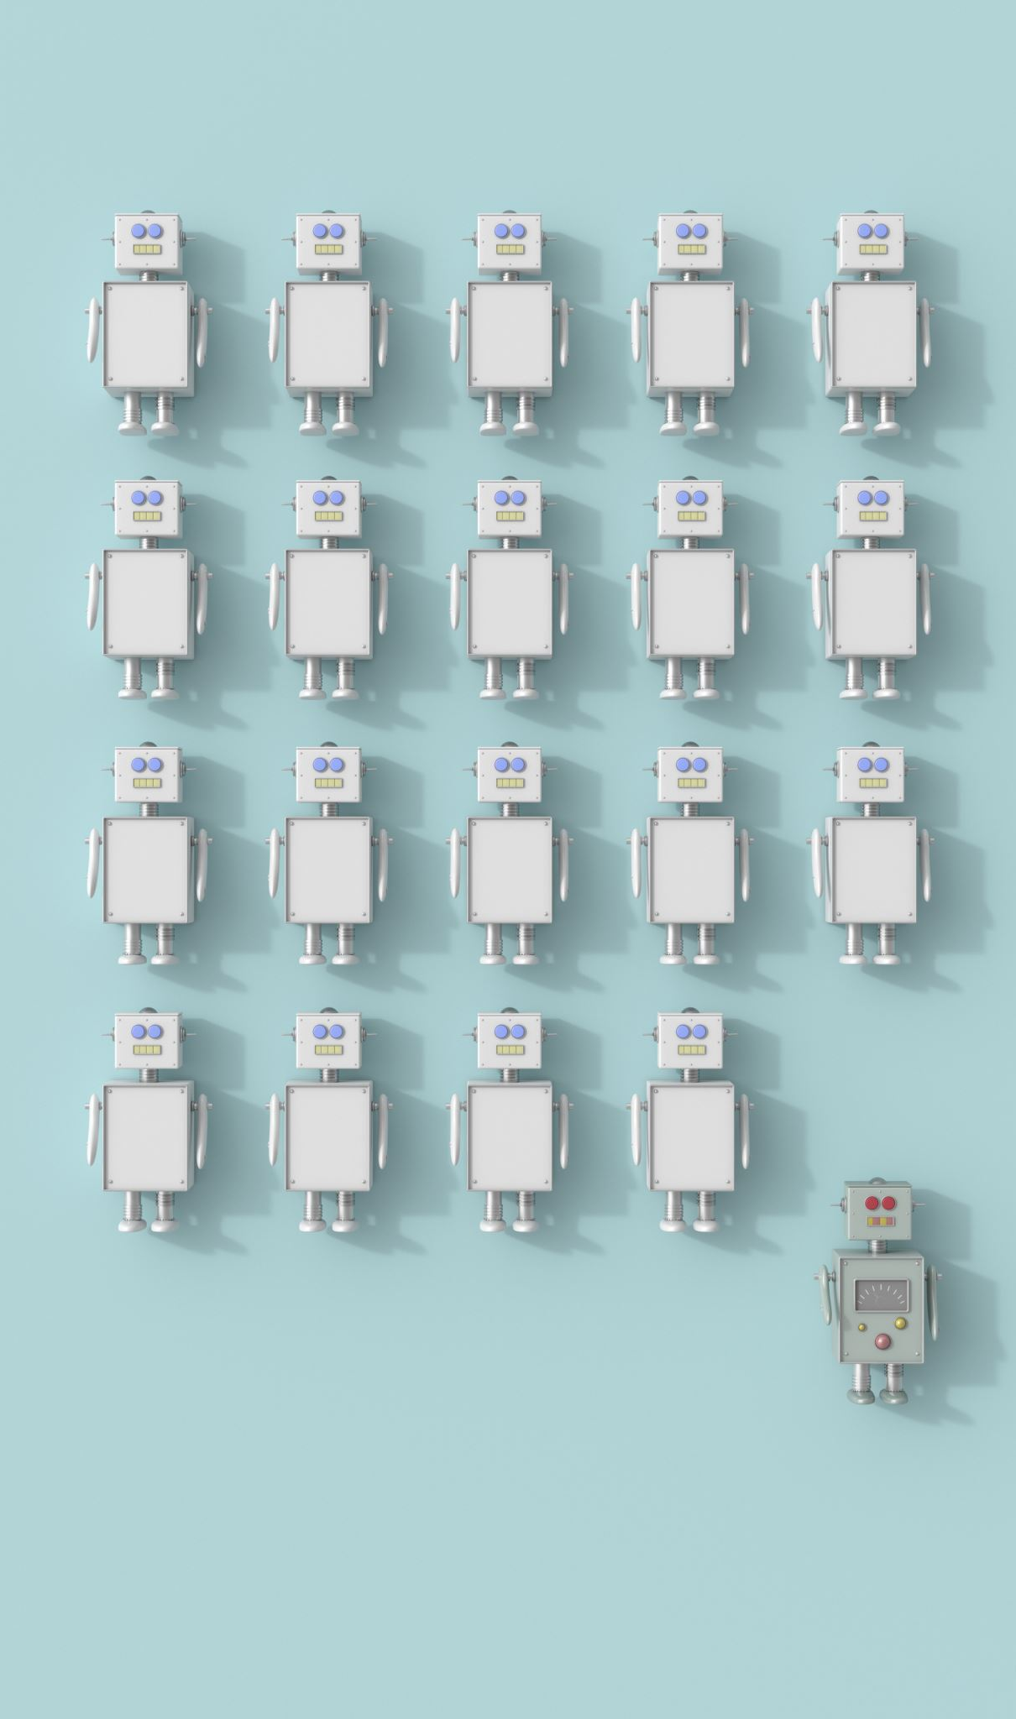
What can Chat Bots do?
To understand the kind of input that is supplied, examine prior conversation data or learn from experience.
Analyze the right answers to the inputs using a model and training time.
Utilize machine learning and natural language processing to better yourself step-by-step or response-by-response with every engagement.

Slide 5
How does a ChatBot work?
Users communicate on a messaging platform using a device.
NLP (Natural Language Processing) is used to process messages.
An action is started by a chatbot that uses current data from a database or API to respond.
Supervised learning occurs which is the process when humans occasionally assist a chatbot in learning.
The Chat Bot gets better with the greater number of messages it gets.

Slide 6
Tasks Performed by a ChatBot
It obtains the relevant properties and entities from the user's request after analyzing it to determine the user's intent.
The chatbot responds to the user's request with the best relevant response once the user and context have been confirmed or recognized.

Slide 7
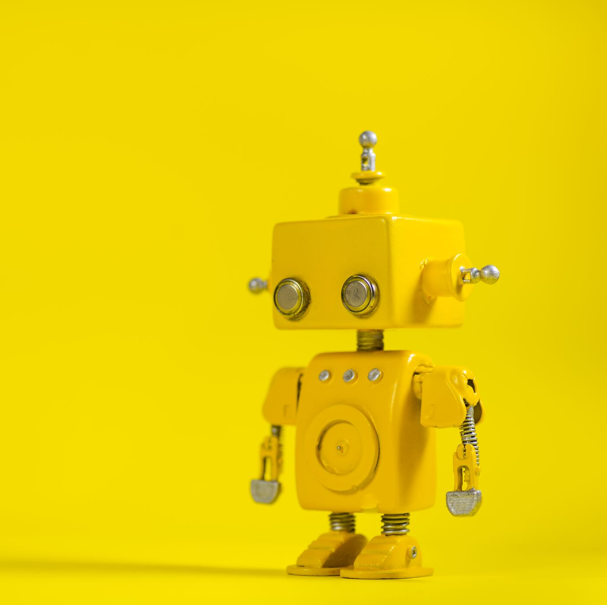
Objective
To create a workable prototype of a chat bot system that can respond to customer inquiries automatically.

Slide 8
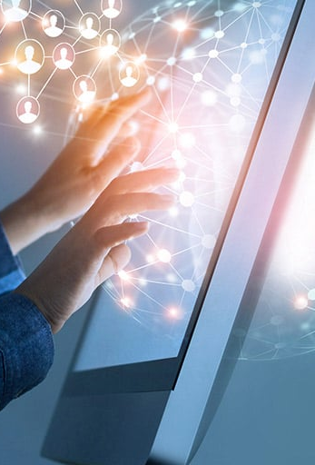
Approach
Computers do not communicate languages in the same way that humans do. They converse in machine code or machine language, whereas we speak English, Spanish, French, or another human language. The millions of zeros and one's computers speak in are a language most of us don't grasp. In turn, unless they have been instructed to do so, computers cannot understand human language. Natural language processing (NLP) enters the picture in this situation.

Slide 9
Implementation Technique
We are planning to use deep learning concepts like NLP(Natural Language Processing) in order to achieve our goal.
To implement our idea, we are using Python language using which we will train the system to detect the pattern of questions and deliver the responses accordingly.
In order to train the system, we will be using Packages like tensor flow, nltk, NumPy

Slide 10
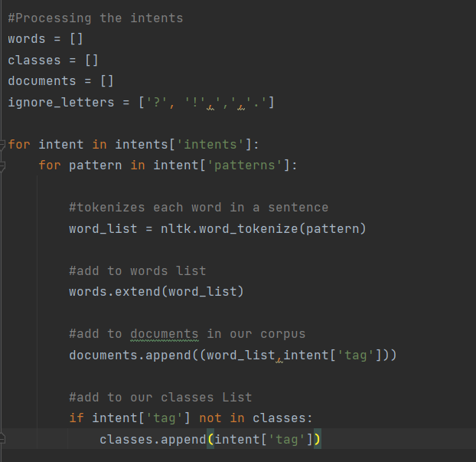
Snippet of how the intents are processed
Here nltk package is used to tokenize each word in a sentence.
These words are added to the list and then appended to the document for future use.

Slide 11
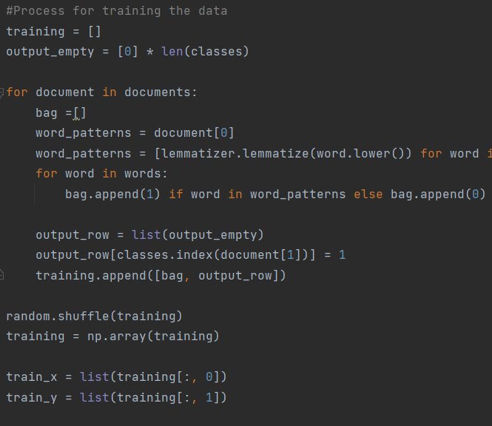
Training the Chatbot with the input data
Training.py is used to find out the key word in the question asked by the user.
And map it to the appropriate response given in the intents.py file.

Slide 12
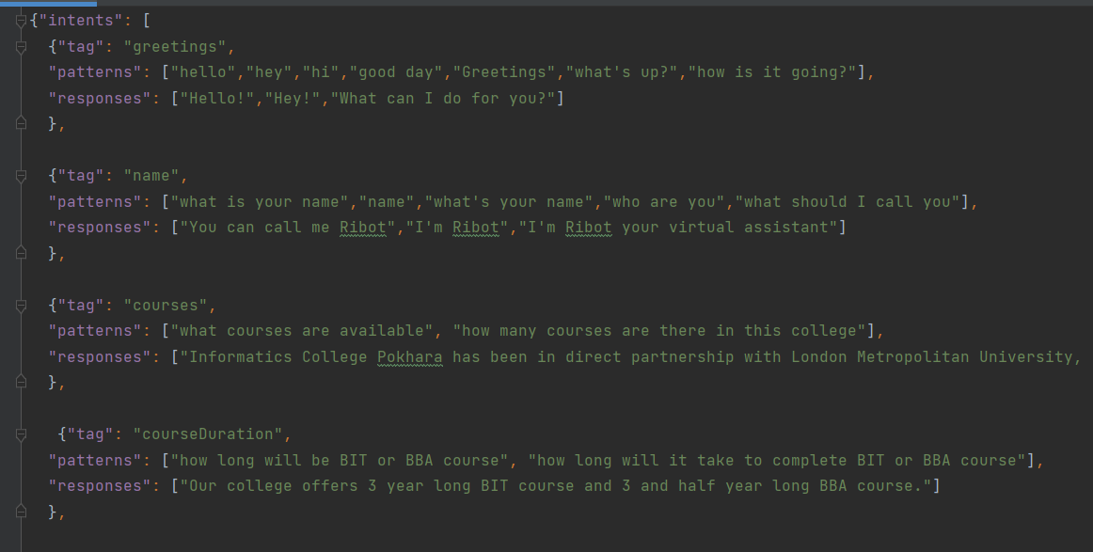
Sample of intents
This is returning the response according to retrieved keyword.

Slide 13
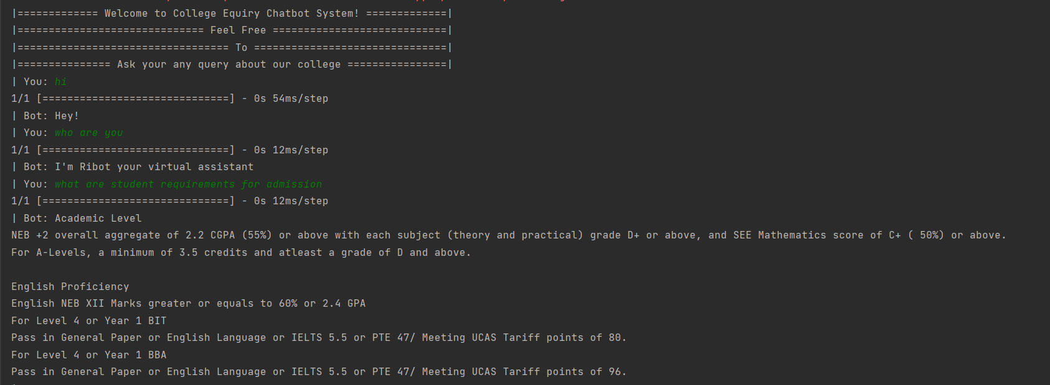
Snippet of the responses given by the Chatbot

Slide 14
Thank You

