Slide 1

Python
Raghu Prasad K S

Slide 2
Course Outline
Introduction to Python
Installation of Python and getting started with python
Introduction to IDE and Installation of Anaconda
Features of Python
Object Orientation
File Operations
Networked Programs
Using Webservices
Using Database and SQL

Slide 3
Objectives
Learn Python
Understand the usages of Python
Understand the applications built on Python
Understand the domains
Hands-on coding

Slide 4
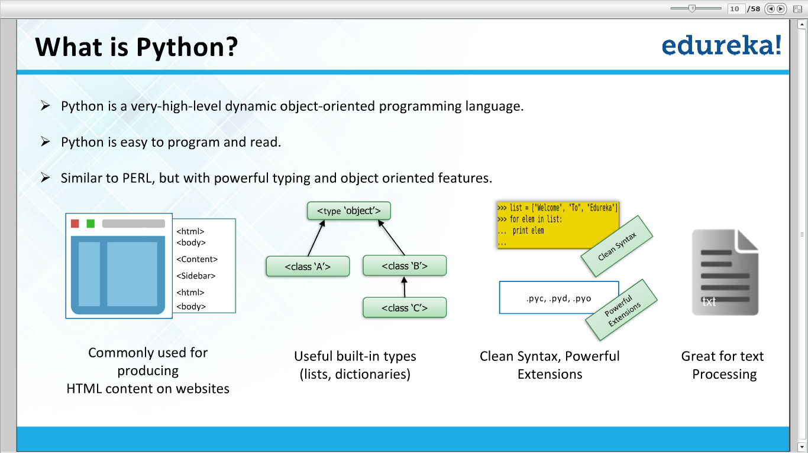

Slide 5
Python extensions
.py – This is normally the input source code that you have written
.pyc – This is the compiled bytecode.If you import a module,python will build a *.pyc file that contains the bytecode to make importing it again later easier (and faster)
.pyo – This is a *.pyc file that was created with optimizations (-O) was on
.pyd – This is basically a windows dll file
https://stackabuse.com/differences-between-pyc-pyd-and-pyo-python-files/

Slide 6
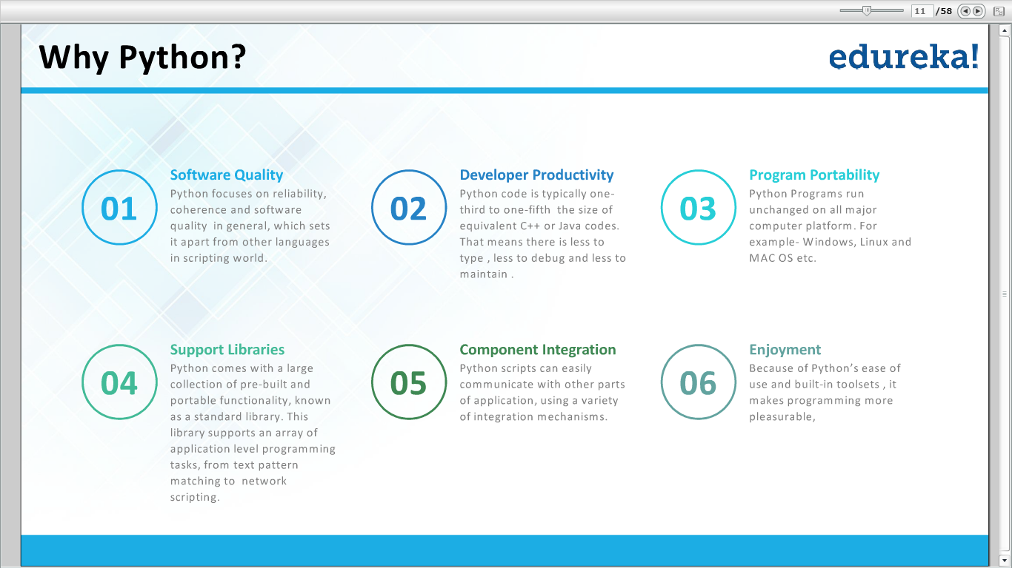

Slide 7
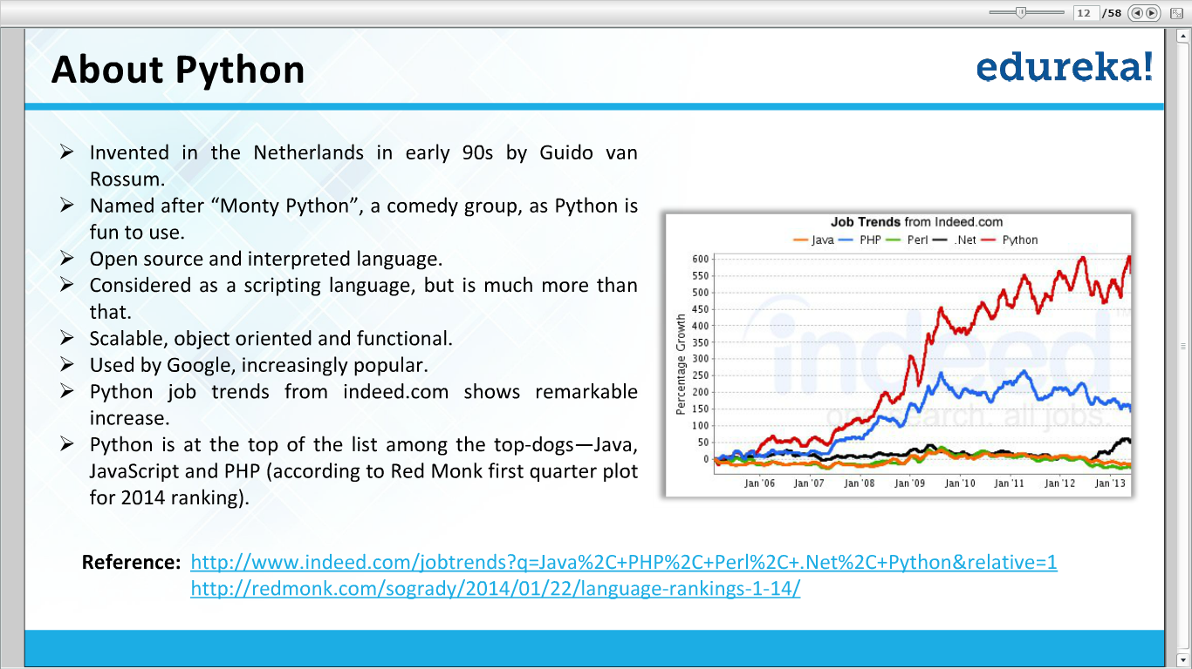

Slide 8
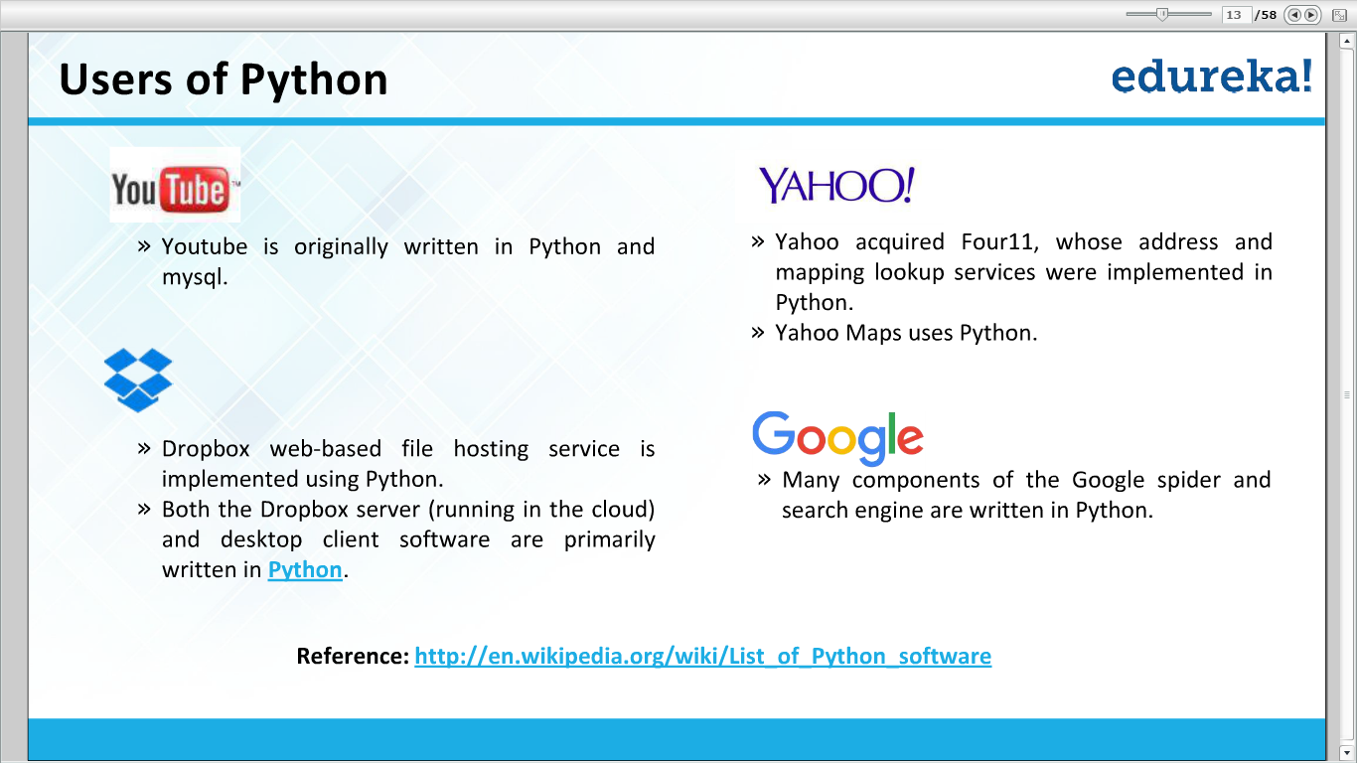

Slide 9
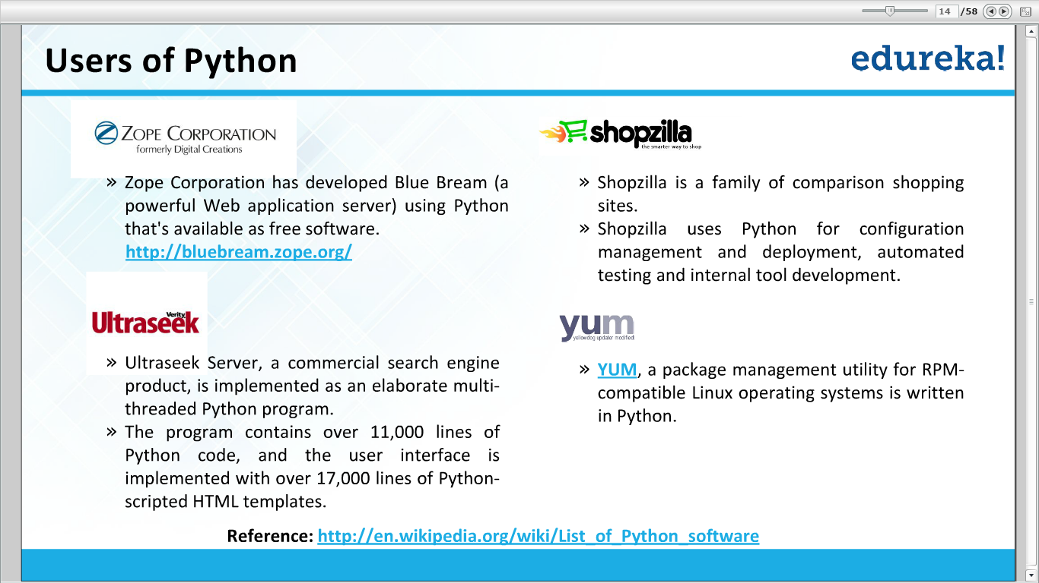

Slide 10
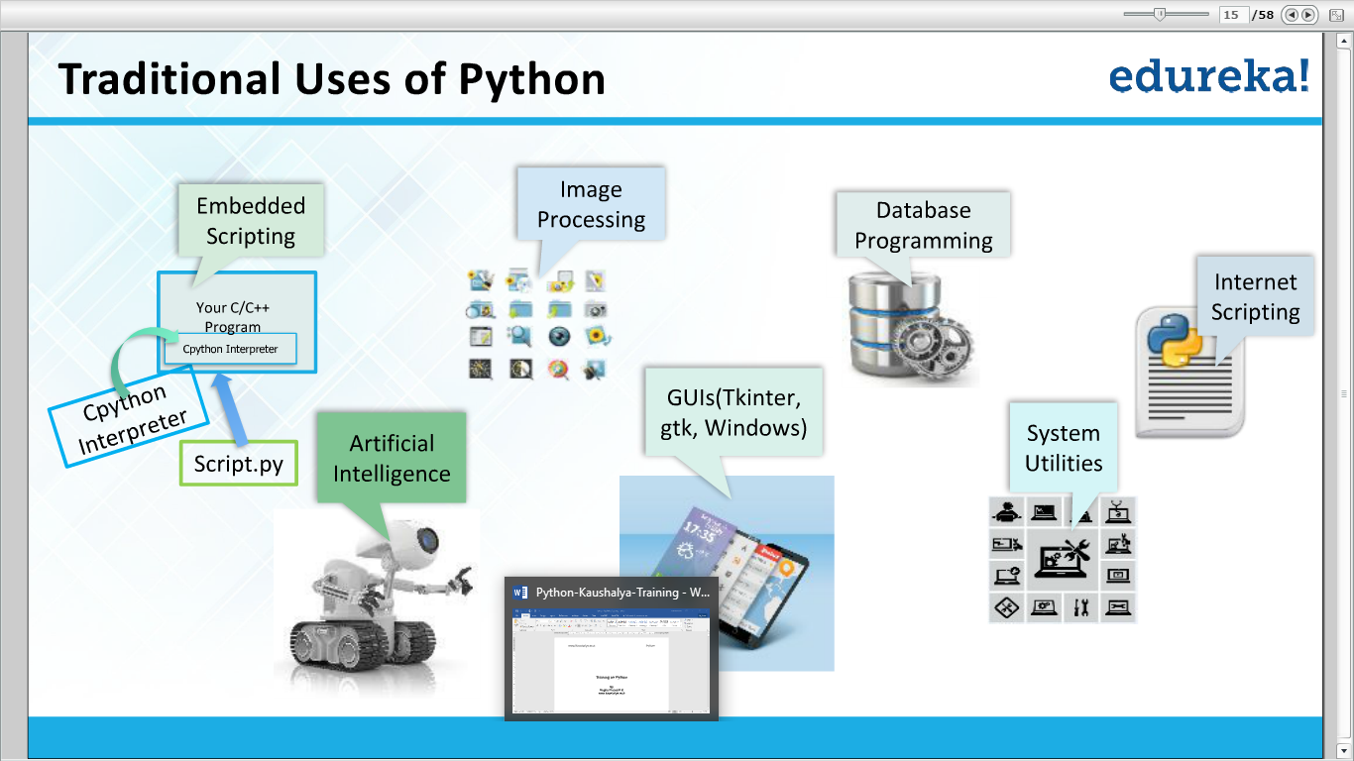

Slide 11
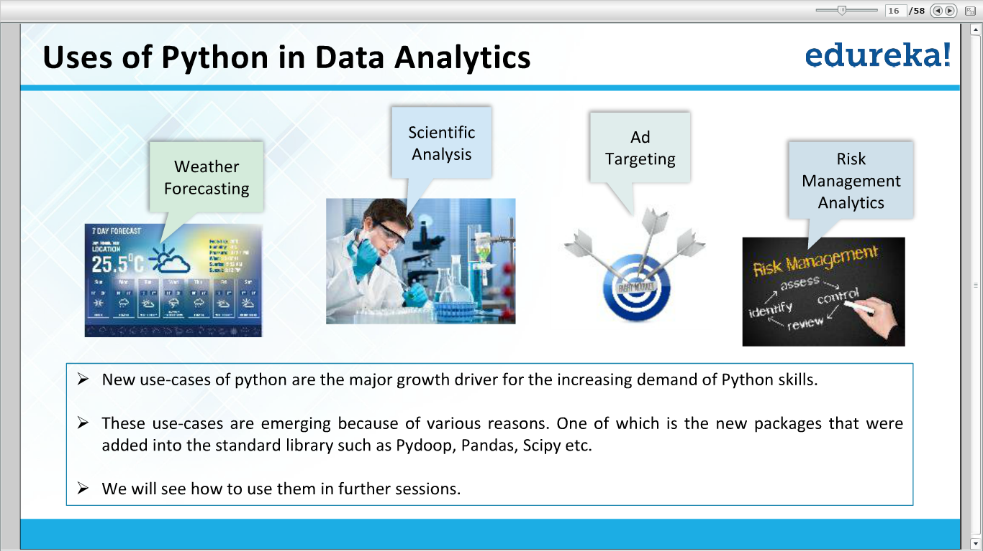

Slide 12
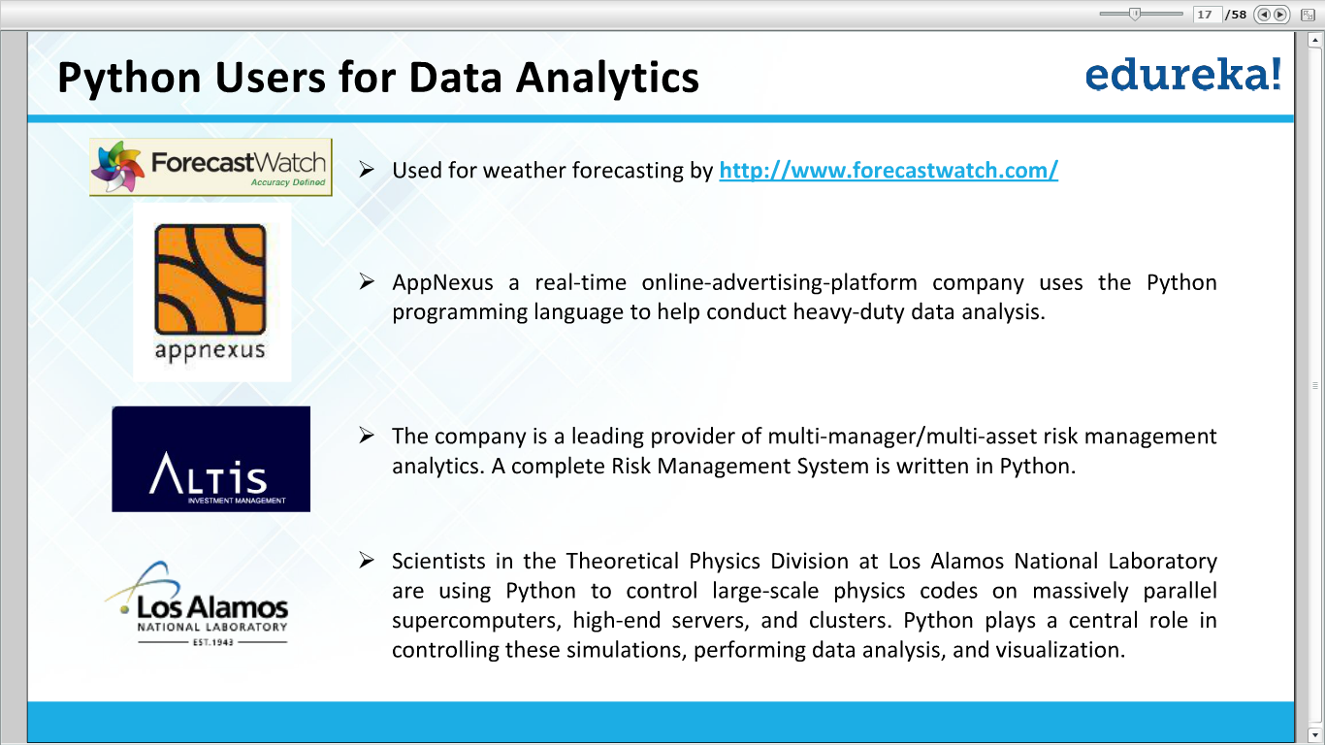

Slide 13
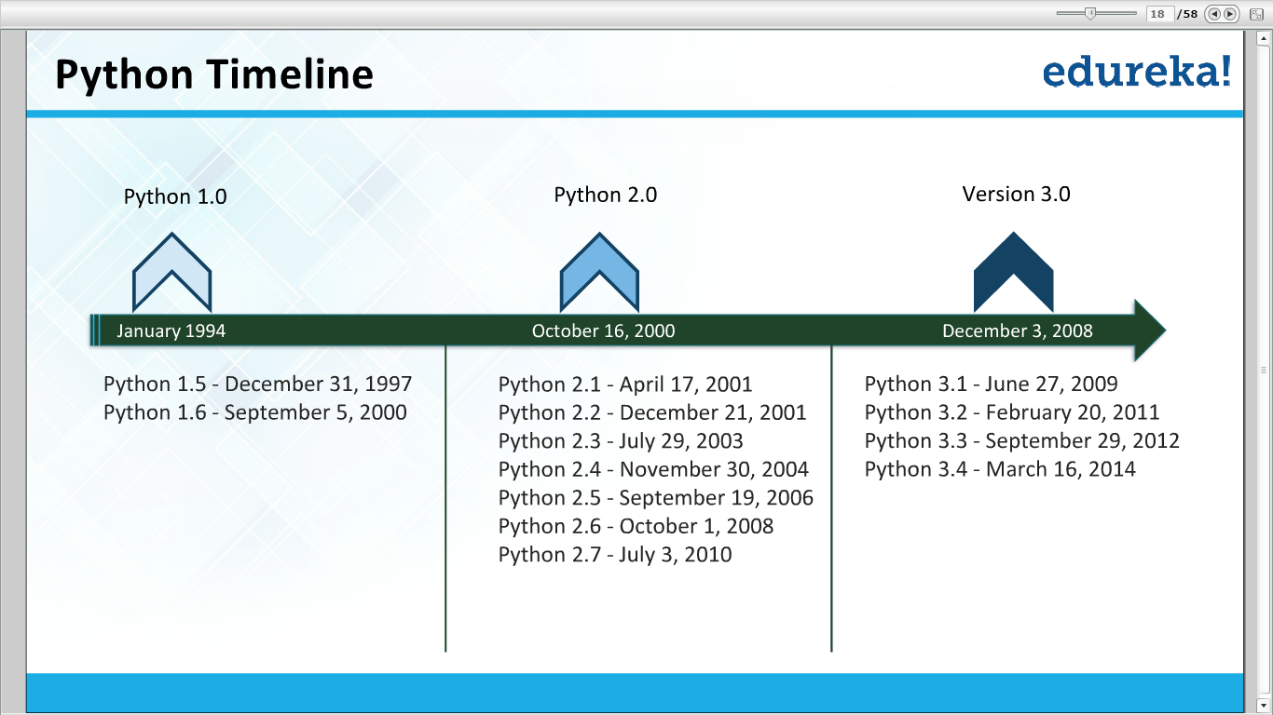

Slide 14
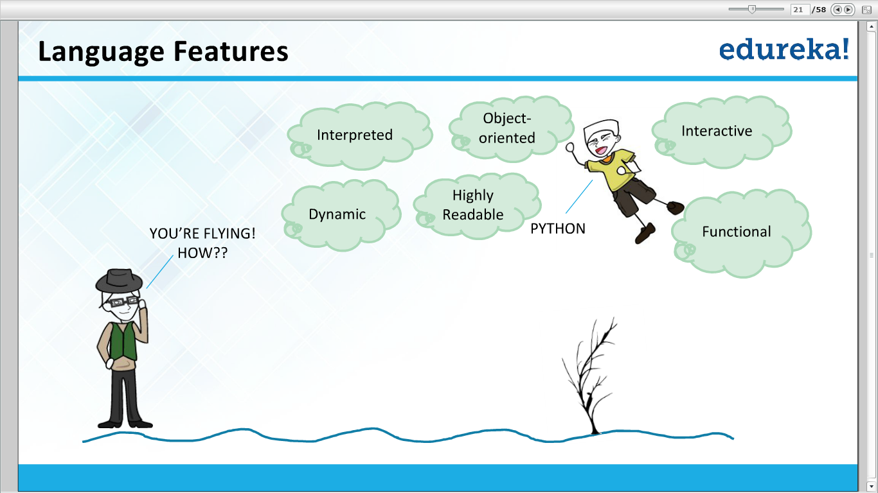

Slide 15
Thank You

