Slide 1
MVC
Shubhradeep Mallik
Suhail Khan

Slide 2
Introduction
MVC stands for Model, View and Controller. MVC separates application into three components - Model, View and Controller.
Model: Model represents shape of the data and business logic. It maintains the data of the application. Model objects retrieve and store model state in a database.
Model is a data.
View: View is a user interface. View display data using model to the user and also enables them to modify the data.
View is a User Interface.
Controller: Controller handles the user request. Typically, user interact with View, which in-tern raises appropriate URL request, this request will be handled by a controller. The controller renders the appropriate view with the model data as a response.
Controller is a request handler.

Slide 3
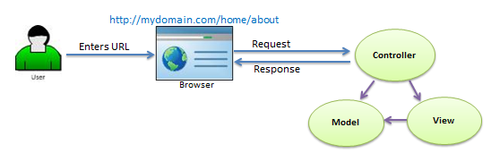
As per the above figure, when the user enters a URL in the browser, it goes to the server and calls appropriate controller. Then, the Controller uses the appropriate View and Model and creates the response and sends it back to the user. We will see the details of the interaction in the next few sections.

Slide 4
Folder Structure
App_Data: App_Data folder can contain application data files like LocalDB, .mdf files, xml files and other data related files. IIS will never serve files from App_Data folder.
App_Start: App_Start folder can contain class files which will be executed when the application starts. Typically, these would be config files like AuthConfig.cs, BundleConfig.cs, FilterConfig.cs, RouteConfig.cs etc.
Content: Content folder contains static files like css files, images and icons files. MVC 5 application includes bootstrap.css, bootstrap.min.css and Site.css by default.
Controllers: Controllers folder contains class files for the controllers. Controllers handles users' request and returns a response. MVC requires the name of all controller files to end with "Controller".
Models: Models folder contains model class files. Typically model class includes public properties, which will be used by application to hold and manipulate application data.
Scripts: Scripts folder contains JavaScript files for the application. MVC 5 includes javascript files for bootstrap, jquery 1.10 and modernizer by default.

Slide 5
Continued..
Views:
Views folder contains html files for the application. Typically view file is a .cshtml file where you write html and C# code.
Views folder includes separate folder for each controllers. For example, all the .cshtml files, which will be rendered by HomeController will be in View > Home folder.
Shared folder under View folder contains all the views which will be shared among different controllers e.g. layout files.
Global.asax:
Global.asax allows you to write code that runs in response to application level events, such as Application_BeginRequest, application_start, application_error, session_start, session_end etc.
Packages.config:
Packages.config file is managed by NuGet to keep track of what packages and versions you have installed in the application.
Web.config:
Web.config file contains application level configurations.

Slide 6
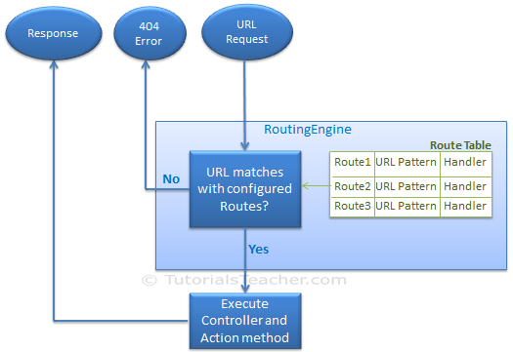
Routing in MVC
Route:
Route defines the URL pattern and handler information. All the configured routes of an application stored in RouteTable and will be used by Routing engine to determine appropriate handler class or file for an incoming request.
The following figure illustrates the Routing process.

Slide 7
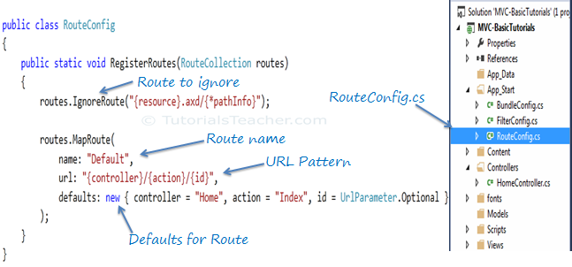
Continued..
Configure Route:
Every MVC application must configure (register) at least one route, which is configured by MVC framework by default. You can register a route in RouteConfig class, which is in RouteConfig.cs under App_Start folder. The following figure illustrates how to configure a Route in the RouteConfig class .

Slide 8
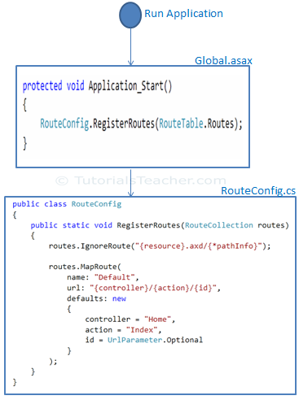
Continued..
Register Routes:
Now, after configuring all the routes in RouteConfig class, you need to register it in the Application_Start() event in the Global.asax. So that it includes all your routes into RouteTable.

Slide 9
Controller
A Controller handles incomming URL requests. MVC routing sends request to appropriate controller and action method based on URL and configured Routes.
All the public methods in the Controlle class are called Action methods.
A Controller class must be derived from System.Web.Mvc.Controllerclass.
A Controller class name must end with "Controller".

Slide 10
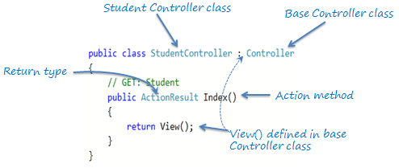
Action method
All the public methods of a Controller class are called Action methods. They are like any other normal methods with the following restrictions:
Action method must be public. It cannot be private or protected
Action method cannot be overloaded
Action method cannot be a static method.
The following is an example of Index action method of StudentController

Slide 11
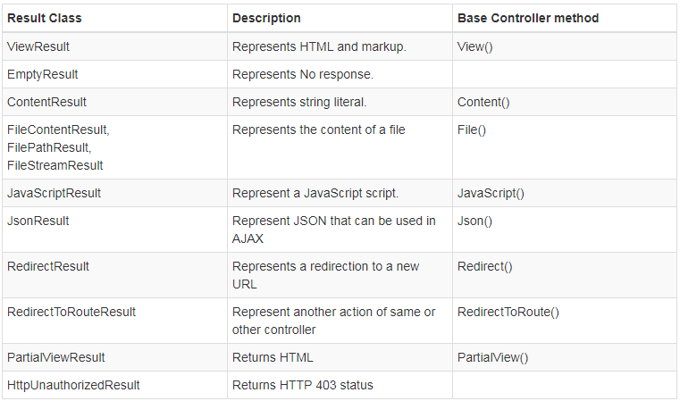
ActionResult
MVC framework includes various result classes, which can be return from an action methods. There result classes represent different types of responses such as html, file, string, json, javascript etc. The following table lists all the result classes available in ASP.NET MVC.
Base Controller class contains methods that returns appropriate result type e.g. View(), Content(), File(), JavaScript() etc.

Slide 12
Action Selectors
Action selector is the attribute that can be applied to the action methods. It helps routing engine to select the correct action method to handle a particular request. MVC 5 includes the following action selector attributes:
ActionName
NonAction
ActionVerbs

Slide 13
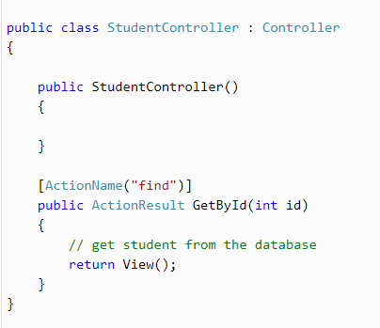
ActionName
ActionName attribute allows us to specify a different action name than the method name. Consider the following example.
http://localhost/student/find/1

Slide 14
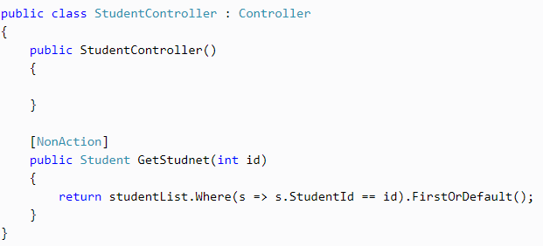
NonAction
NonAction selector attribute indicates that a public method of a Controller is not an action method. Use NonAction attribute when you want public method in a controller but do not want to treat it as an action method.

Slide 15
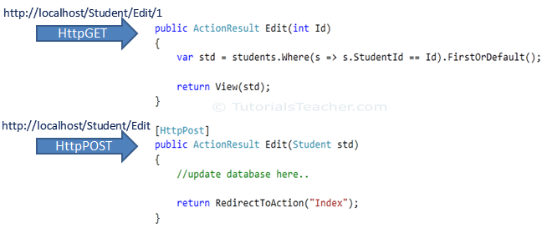
ActionVerbs
The ActionVerbs selector is used when you want to control the selection of an action method based on a Http request method
MVC framework supports different ActionVerbs, such as HttpGet, HttpPost, HttpPut, HttpDelete, HttpOptions & HttpPatch.
The following figure illustrates the HttpGET and HttpPOST action verbs.

Slide 16
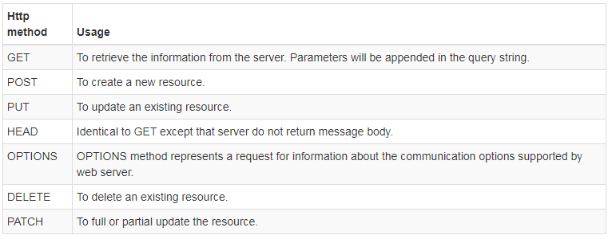
Continued..
The following table lists the usage of http methods:

Slide 17
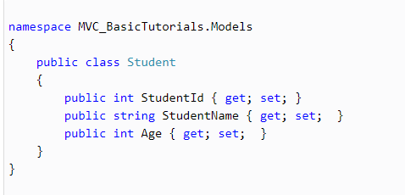
Model in ASP.NET MVC
Model represents domain specific data and business logic in MVC architecture. It maintains the data of the application. Model objects retrieve and store model state in the persistance store like a database.
Model class holds data in public properties. All the Model classes reside in the Model folder in MVC folder structure.

Slide 18
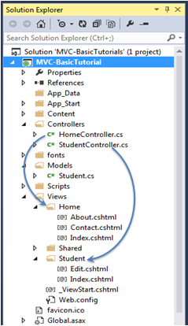
View in ASP.NET MVC
View is a user interface. View displays data from the model to the user and also enables them to modify the data.
Views folder contains a separate folder for each controller with the same name as controller, in order to accommodate multiple views.
Shared folder contains views, layouts or partial views which will be shared among multiple views.

Slide 19
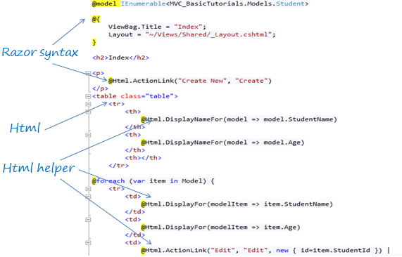
Razor view engine
Microsoft introduced the Razor view engine and packaged with MVC 3. You can write a mix of html tags and server side code in razor view. Razor uses @ character for server side code instead of traditional <% %>. You can use C# syntax to write server side code inside razor view. Razor views files have .cshtml or vbhtml extension.

Slide 20
HTML Helpers
HtmlHelper class generates html elements using the model class object in razor view. It binds the model object to html elements to display value of model properties into html elements and also assigns the value of the html elements to the model properties while submitting web form
@Html is an object of HtmlHelper class . (@ symbol is used to access server side object in razor syntax). Html is a property of type HtmlHelper included in base class of razor view WebViewPage.
HtmlHelper class generates html elements. For example, @Html.ActionLink("Create New", "Create")would generate anchor tag <a href="/Student/Create">Create New</a>.
The following table lists HtmlHelper methods and html control each method generates.

Slide 21
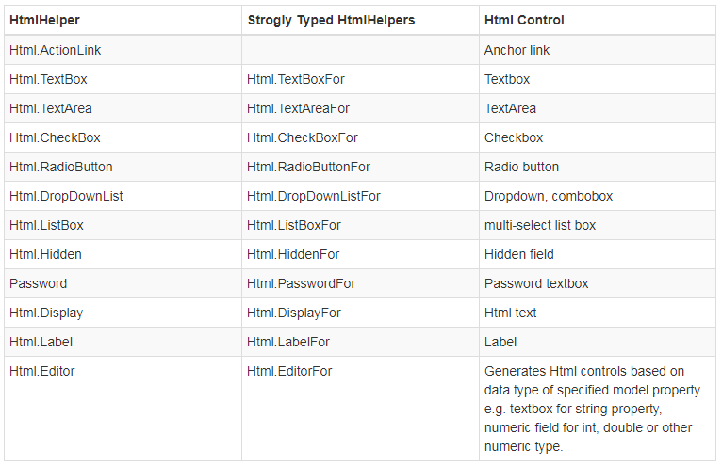
Continued..
The following table lists HtmlHelper methods and html control each method generates.

Slide 22
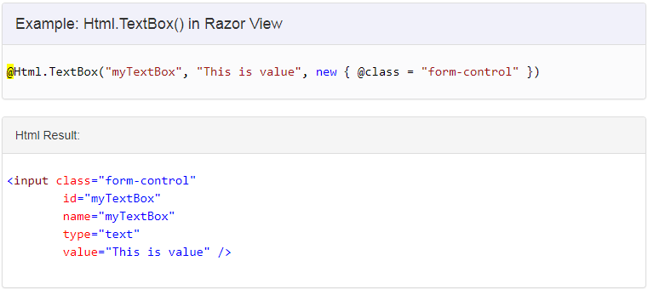
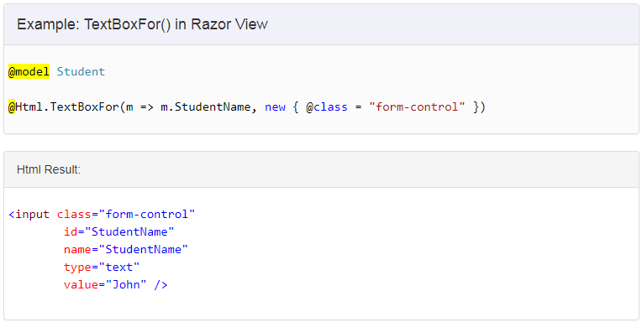
Examples
TextBox

Slide 23
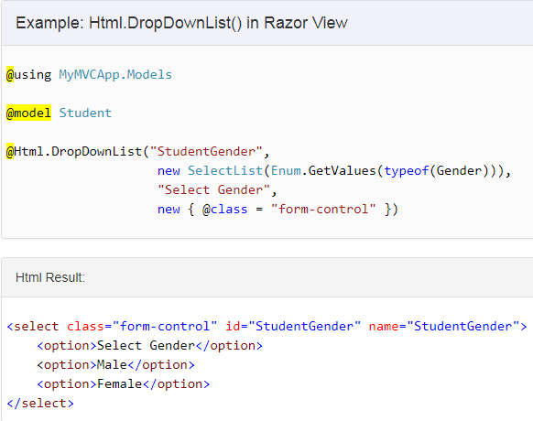
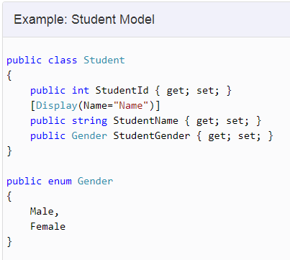
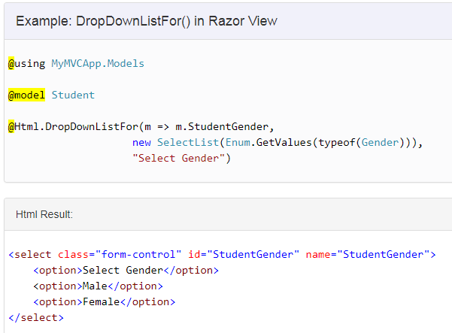
Continued..
Dropdown

Slide 24
Shared Views
The Layout view contains common parts of a UI. It is same like masterpage of ASP.NET webforms.
_ViewStart.cshtml file can be used to specify path of layout page, which in turn will be applicable to all the views of the folder and its subfolder.
You can set the Layout property in the individual view also, to override default layout page setting of _ViewStart.cshtml
Layout view uses two rendering methods: RenderBody() and RenderSection().
RenderBody can be used only once in the layout view, whereas the RenderSection method can be called multiple time with different name.
RenderBody method renders all the content of view which is not wrapped in named section.
RenderSection method renders the content of a view which is wrapped in named section.
RenderSection can be configured as required or optional. If required, then all the child views must included that named section.

Slide 25
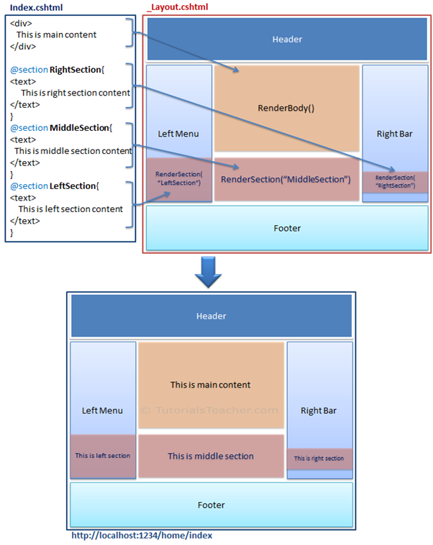

Slide 26
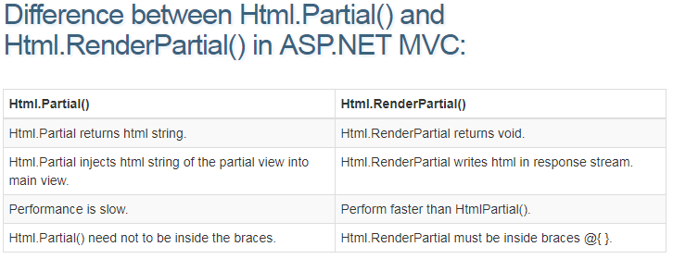
Partial Views
Partial view is a reusable view, which can be used as a child view in multiple other views. It eliminates duplicate coding by reusing same partial view in multiple places. You can use the partial view in the layout view, as well as other content views
Partial view can be rendered using Html.Partial(), Html.RenderPartial() method.

Slide 27
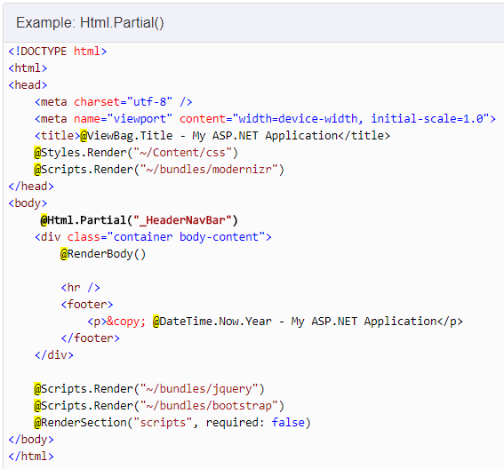
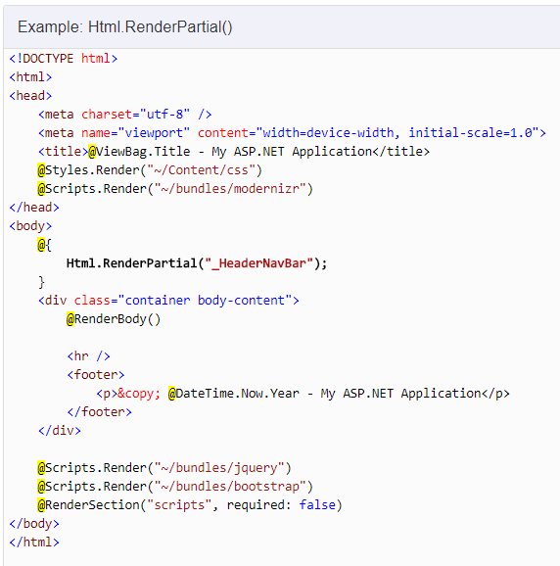
Example

Slide 28
THANK YOU

