Slide 1
BUAN 6356.503 Group D
Emily Le
Ming Hui Chang

Slide 2

Data Exploration

Slide 3

Data Transformation

Slide 4
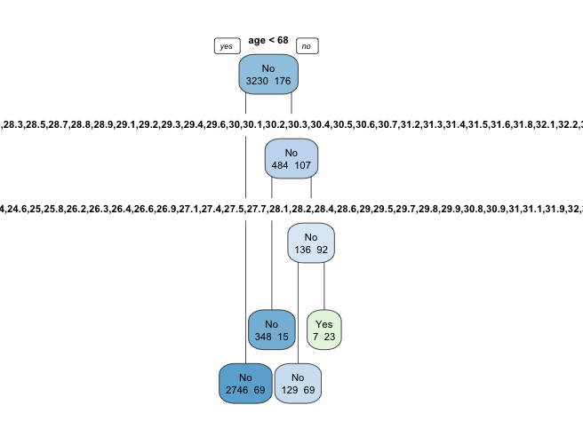
BMI Gender Age Hypertension Heart Disease Glucose Level Marriage Work type Residence Type Smoking Status
Data Classification: Decision Tree
Notes:
BodyMassIndex is measurement for Obesity
Obesity is a primary risk factor cause of Stroke
The higher BMI = Overweight = Higher risk of Stroke
Decision Tree analysis: BMI variable overshadowed other independent variables. It indicates BMI is statically significant cause for Stroke

Slide 5
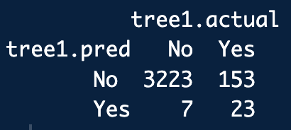
Interpretation
Accuracy on train data is 0.95
Error Rate is 0.05
Sensitivity(TPR) is 0.13
Specificity(TNR) is 0.99

Slide 6
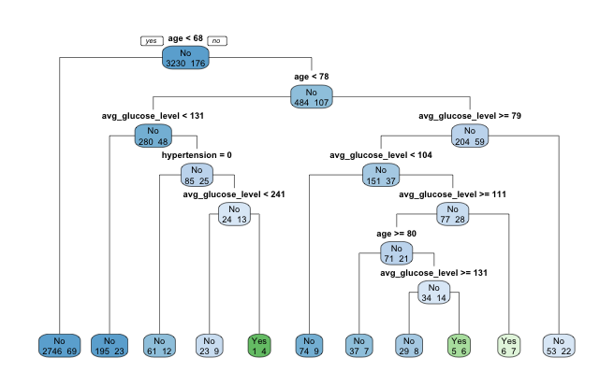
Focus only on Health Conditions
Age: Vary
Glucose Level: Vary
Hypertension: Yes/No
Heart Disease: Yes/No
Smoking Status: Never smoke, unknown, Formerly smoked, smokes

Slide 7
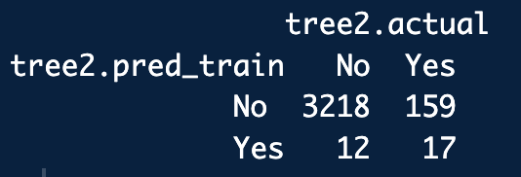
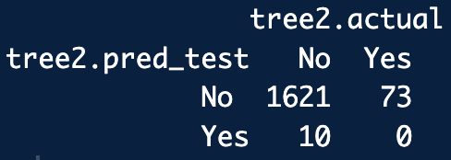
Performance
Accuracy on Train Data = 0.949
NO OVER FITTING ISSUE !!!
Accuracy on Test Data = 0.953

Slide 8
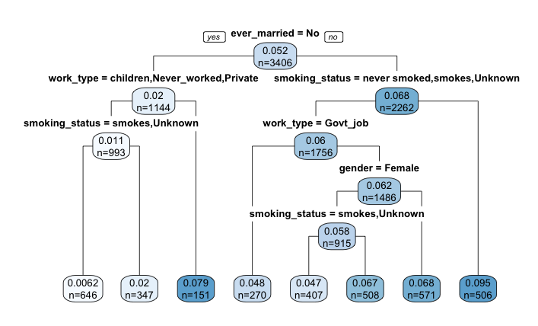
Focus only on Social Factors
Marriage: Yes/No
Work Type: Govt Job, Private, never work, self-employed, Children
Smoking Status: Never smoke, unknown, Formerly smoked, smokes
Residence Type: Rural, Urban
Gender: Male, Female

