Slide 1
Personalized Medicine using Python
Roopam Seal
Roll- 30059922005
Semester 5
Theme: Application of Python in Bioinformatics

Slide 2
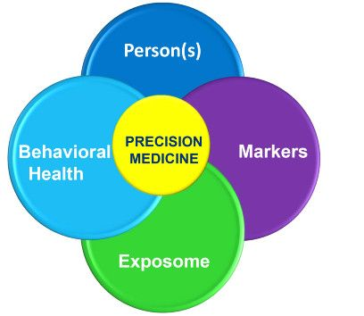
Personalized Medicine
Patient-centric treatment through the integration of multi-omics data from an individual.
Gives importance to preventive mode of treatment rather than reactive mode.
Focus on genomic profiling of the patient to understand the single nucleotide variations that may influence the drug efficacy and toxicity.

Slide 3
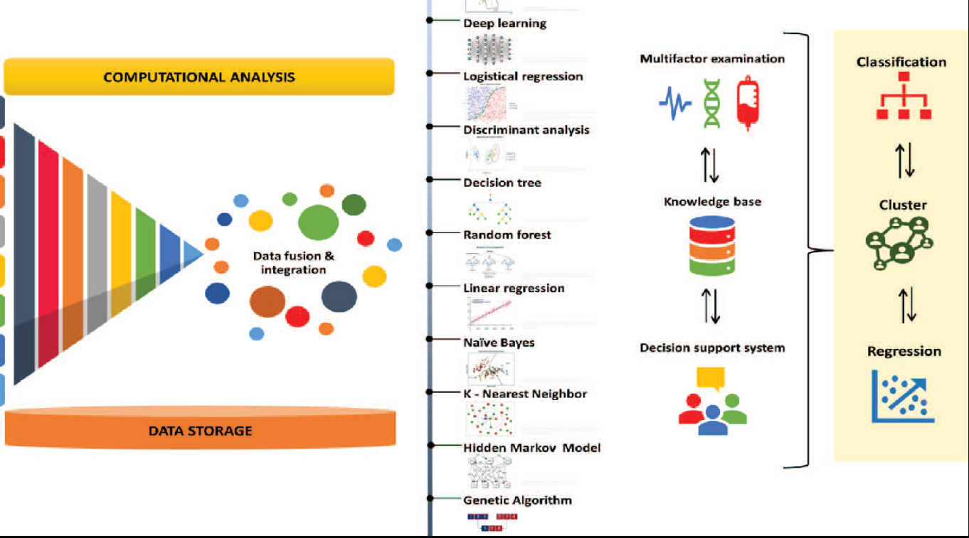
Role of Python in Targeted Therapy
Python uses algorithms on genomic datasets to predict the individual changes in the genomic sequences. It can further be used to understand the changes in RNA and protein content of the patient cells.
The use of multi-modal data helps in deeper analysis of large datasets which help us predict diseases with more accuracy.
Advancement in the field of “in silico” experimental systems would improve the efficiency of clinical trials which would reduce the time and cost associated with clinical trials. The experimental system “in silico” refers to using computers to run various experiments.
Integration of the subject's genomic polymorphism helps in screening of the patients.

Slide 4
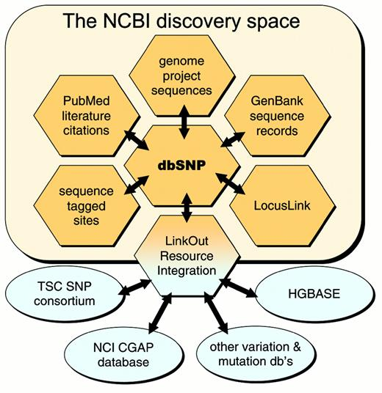
Data Acquisition and Preprocessing
Collection of genomic data: Utilize APIs from databases like dbSNP, ClinVar, and GTEx to fetch relevant genetic variations and their associated phenotypes.
Preprocessing of data: Employ Python libraries like Pandas and NumPy to handle missing values, outliers, and normalize data for subsequent analysis.

Slide 5
Feature Engineering
Extract relevant features: Identify genetic variations, gene expression levels, and other biological features that may impact drug response.
Encode categorical variables: Use techniques like one-hot encoding or label encoding to represent categorical features numerically.

Slide 6
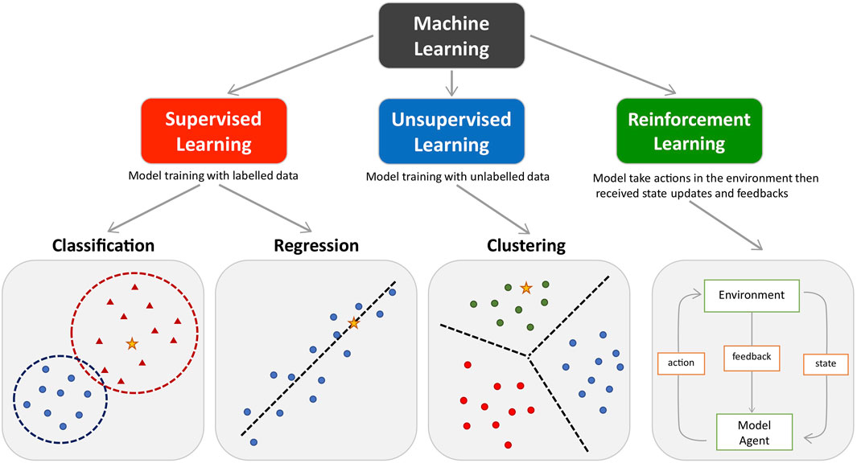
Machine Learning Tools
Classification
Predicting disease risk: Identify individuals at high risk for specific diseases based on genetic and environmental factors.
Drug response prediction: Determine how patients will respond to specific medications based on their genetic makeup.
Regression
Quantifying disease risk: Estimate the probability of developing a disease based on multiple risk factors.
Predicting disease progression: Forecast the progression of a disease over time.
Clustering
Identifying patient subgroups: Group patients with similar characteristics to optimize treatment strategies.
Discovering novel drug targets: Identify groups of genes or proteins that are associated with a particular disease.
Reinforcement Learning
Optimizing treatment plans: Develop adaptive treatment strategies that learn from patient responses over time.
Personalizing drug dosing: Determine the optimal dosage for individual patients based on their physiological response.

Slide 7
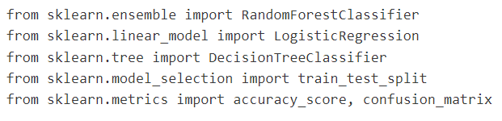
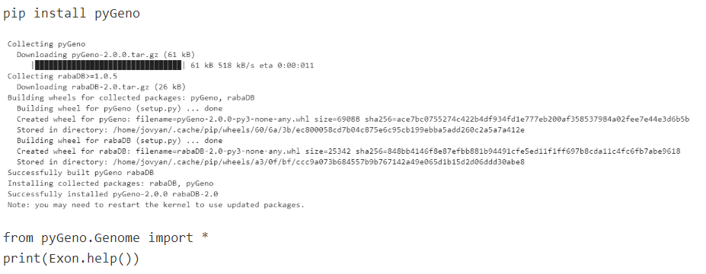
Python packages and tools for precision medicine
Scikit-learn: open-source library that aids in both supervised as well as unsupervised learning. From Scikit-learn various estimators or predictors are imported to model a particular dataset. Scikit provides us numerous models and ML algorithms.
PyGeno: It is a Python package that pertains to precision medicine applications with a special focus on genomics and proteomics. It is easy to use, has highly efficient memory, and has a fast framework that allows users to easily explore subject-specific genomes and proteomes. PyGeno has been developed by creating a Python module that fully integrates within the Python environment making it user-friendly. The users can make use of functionalities like SciPy, NumPy 11, pandas, and matplotlib 13.

Slide 8
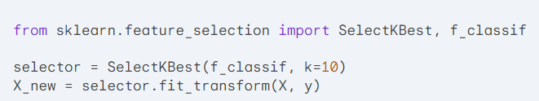

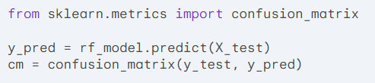
Scikit-learn- design and implementation
Model Selection:
Classification: Random Forest, Support Vector Machines (SVM), Logistic Regression
Regression: Linear Regression, Ridge Regression, Lasso Regression
Clustering: K-Means, Hierarchical Clustering, DBSCAN
Model Evaluation: Cross-validation, Confusion Matrix, ROC Curve
Feature Engineering:
Feature selection: Identifying the most relevant features
Feature scaling: Normalizing features to a common scale
Feature transformation: Creating new features from existing ones
Model Training and Optimization:
Hyperparameter tuning: Finding the optimal settings for model parameters
Regularization: Preventing overfitting
Model evaluation and selection: Choosing the best-performing model

Slide 9
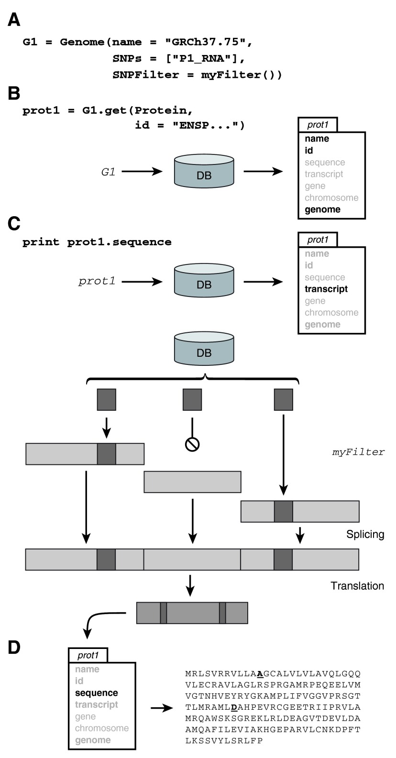
Introduction to PyGeno
PyGeno is a Python library designed to streamline the analysis of complex genomic and proteomic data.
Provides a user-friendly interface to create a personalized genome with an user-defined filter, along with access to genomic information, including reference sequences, gene annotations, and genetic variations.
Integration with databases like Ensembl and dbSNP, pyGeno enables researchers to efficiently analyze large-scale datasets and gain insights into the genetic basis of disease.

Slide 10
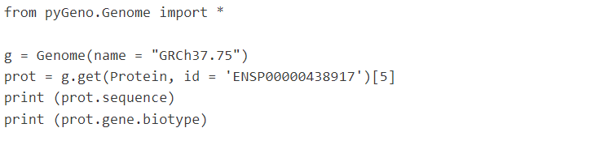
PyGeno – simple demonstration of design
This library works by defining a personalized genome. After that we have to add the BioMart attributes which will fetch the Ensembl ID of the related protein.
The protein sequence is extracted from the database using a proper extraction tool which is used as a reference sequence, which is then used to compare the query sequence.
The polymorphisms and indels are identified and the personalized genome is created for the individual. The therapy procedure is then planned.

Slide 11
Applications of Python
Predictive Modeling: Python can be used to build predictive models that anticipate disease risk based on genetic and environmental factors. This allows for early intervention and preventive measures.
Drug Discovery and Development: Python-based tools can analyze vast amounts of genomic data to identify novel drug targets and predict drug efficacy and toxicity, accelerating the drug discovery process.
Personalized Treatment Plans: By analyzing individual patient data, Python can help create tailored treatment plans, including optimal drug dosages and combination therapies.
Disease Diagnosis and Prognosis: Python can be used to develop accurate diagnostic tools and prognostic models that predict disease progression and patient outcomes.
Precision Medicine Research: Python is essential for conducting large-scale genomic studies, analyzing complex datasets, and identifying genetic markers associated with disease susceptibility and drug response.

Slide 12
Future Directions of Personalized Medicine
Interactive Data Visualization: Integrate libraries like D3.js to create user-friendly interactive visualizations of complex biological data.
Scalable Data Management: Explore NoSQL databases for efficient storage and retrieval of massive datasets.
Cloud Architecture: Building databased on cloud platforms and integration of ML on those servers will make the process smoother.
Data Scaling: Scaling and normalization of the statistical measures will help better analysis of the data.
Drug Discovery: Python packages can be used for virtual screening of ligands for drug design.

Slide 13
Conclusion
Personalized Medicine: Personalized medicine offers the potential to revolutionize healthcare by tailoring treatments to individual patients based on their unique genetic makeup.
Data Processing and Machine Learning: Python, coupled with powerful machine learning libraries, enables the analysis of vast amounts of genomic data to identify patterns and correlations that can inform personalized treatment strategies.
Python Packages and Databases: A rich ecosystem of Python packages like scikit-learn, TensorFlow, and PyTorch, along with databases like dbSNP and ClinVar, provide the tools to build sophisticated models and extract meaningful insights.
Applications: From drug discovery to patient risk assessment, Python-powered bioinformatics tools are transforming various aspects of healthcare, leading to more effective and targeted therapies.
A Collaborative Future: As technology continues to advance, collaboration between bioinformaticians, clinicians, and data scientists is essential to unlock the full potential of personalized medicine and improve patient outcomes.

