Slide 1
CSN-371 Artificial Intelligence
Research Paper Implementation
Deepfake Video Detection Using Convolutional Vision Transformer
Implementation of the paper by Deressa Wodajo and Solomon Atnafu: arXiv.
The source code for this implementation is available at: GitHub.
Roopam Taneja
22125030

Slide 2

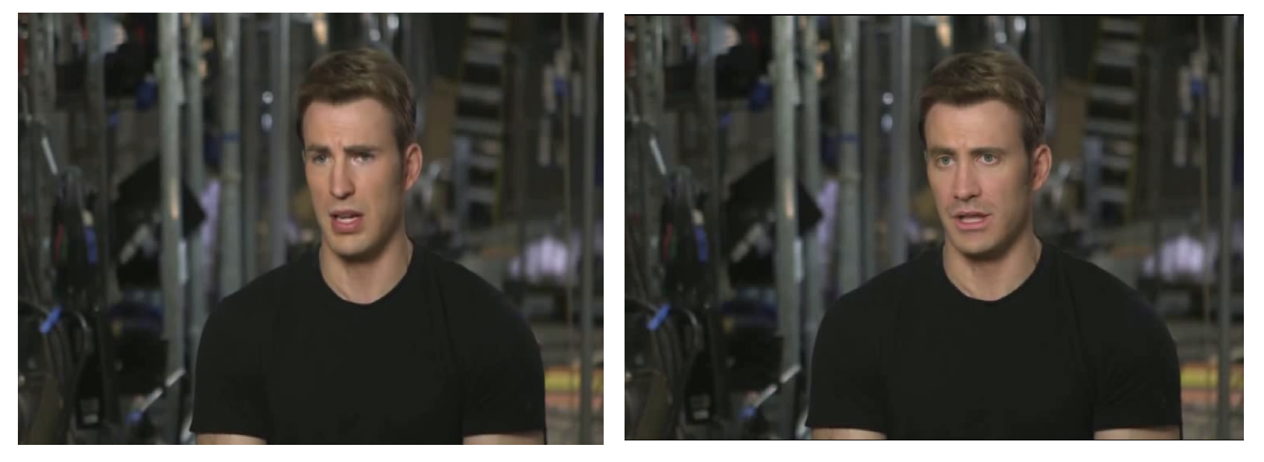
What are Deepfakes?
Original: Image of Chris Hemsworth Deepfake: Face-swapped with Ryan Reynolds
Original: Image of Chris Evans Deepfake: Face-swapped with Jake Gyllenhaal
Deepfakes refer to hyper-realistic videos synthesized using deep learning models.
While they may have potential benefits in fields like entertainment and education, deepfakes pose significant threats like identity theft and spreading misinformation.

Slide 3
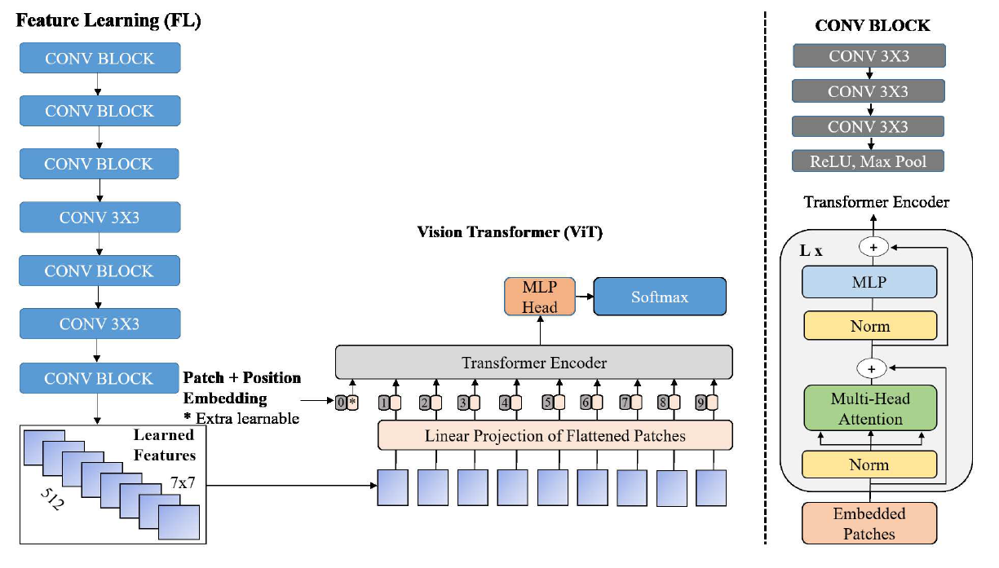
Proposed Model for Deepfake Detection
Convolutional Neural Networks (CNNs)
+
Vision Transformers
= Convolutional Vision Transformers

Slide 4
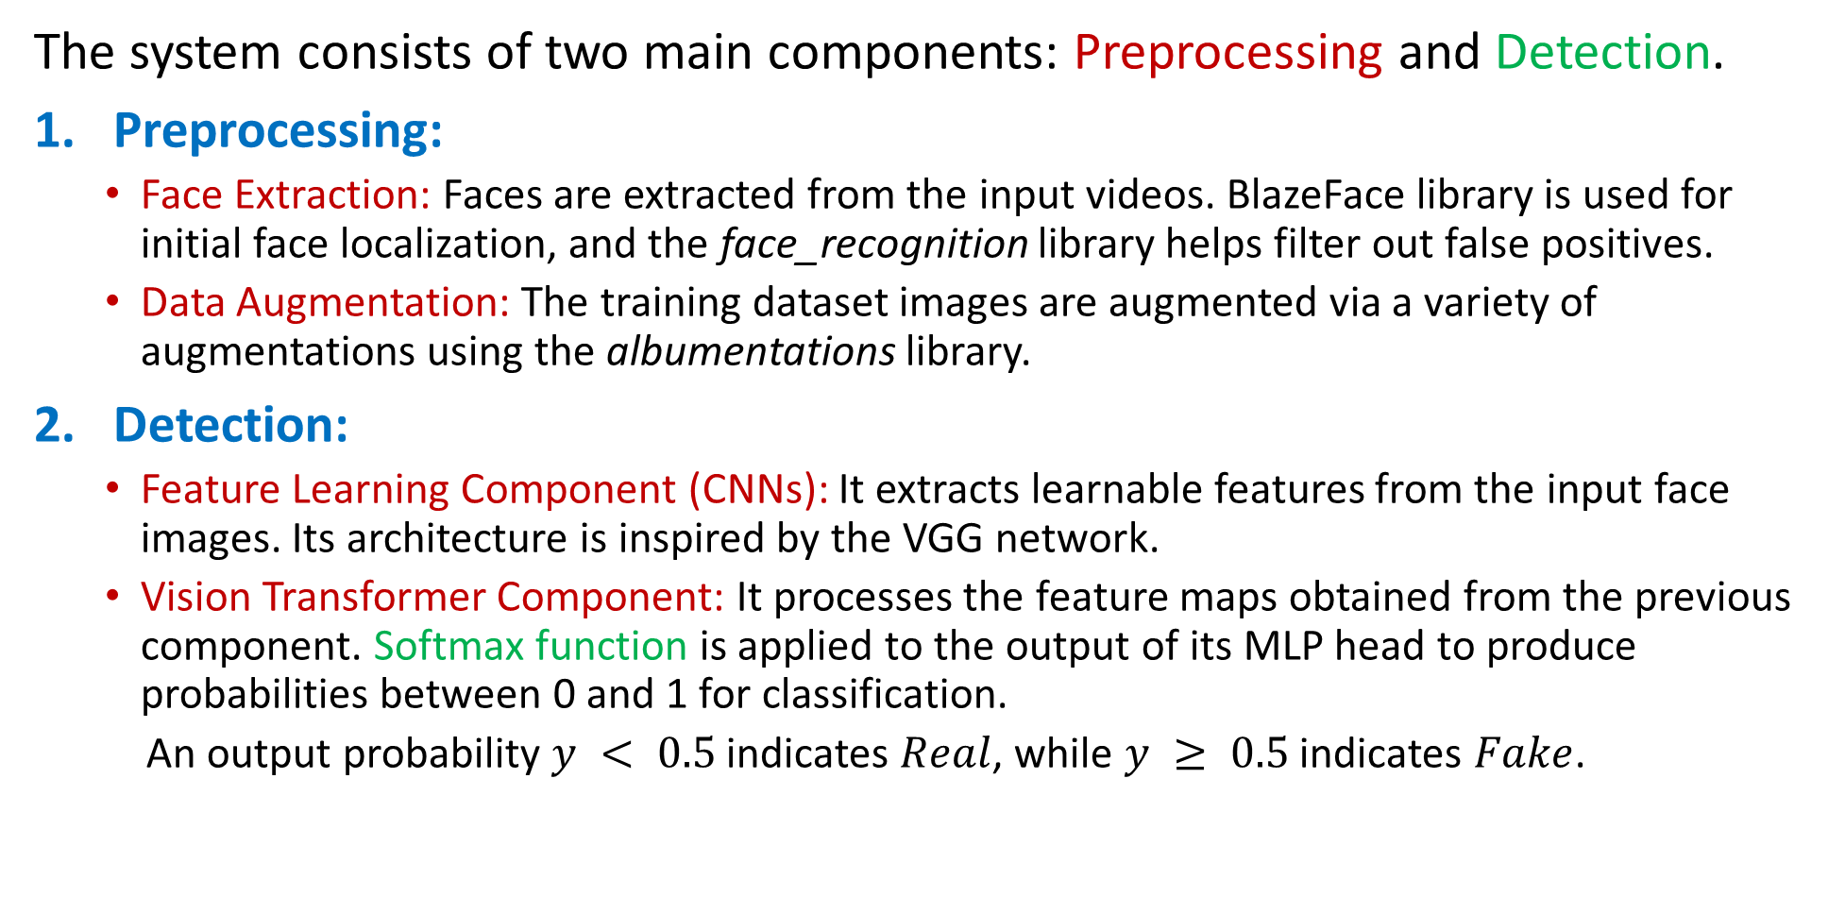
Convolutional Vision Transformer
The system consists of two main components: Preprocessing and Detection.
Preprocessing:
Face Extraction: Faces are extracted from the input videos. BlazeFace library is used for initial face localization, and the face_recognition library helps filter out false positives.
Data Augmentation: The training dataset images are augmented via a variety of augmentations using the albumentations library.
Detection:
Feature Learning Component (CNNs): It extracts learnable features from the input face images. Its architecture is inspired by the VGG network.
Vision Transformer Component: It processes the feature maps obtained from the previous component. Softmax function is applied to the output of its MLP head to produce probabilities between 0 and 1 for classification.
An output probability $y < 0.5$indicates $Real$, while $y ≥ 0.5$ indicates $Fake$.

Slide 5
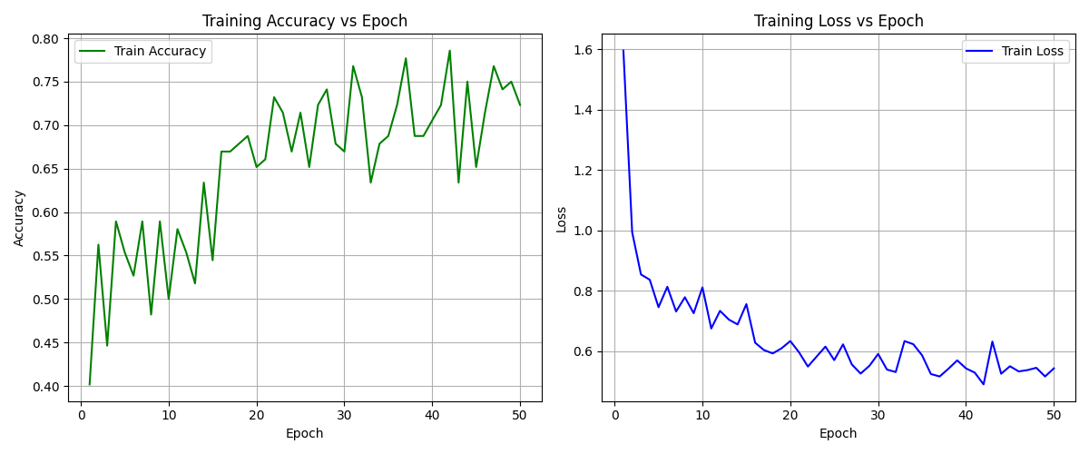
Training the Model
The model is implemented and trained using hyperparameters as specified in the paper.
The model is trained for 50 epochs with a batch size of 32. Binary cross entropy loss function and Adam optimizer are used.
Plots of Training Accuracy and Training Loss with epochs:

Slide 6
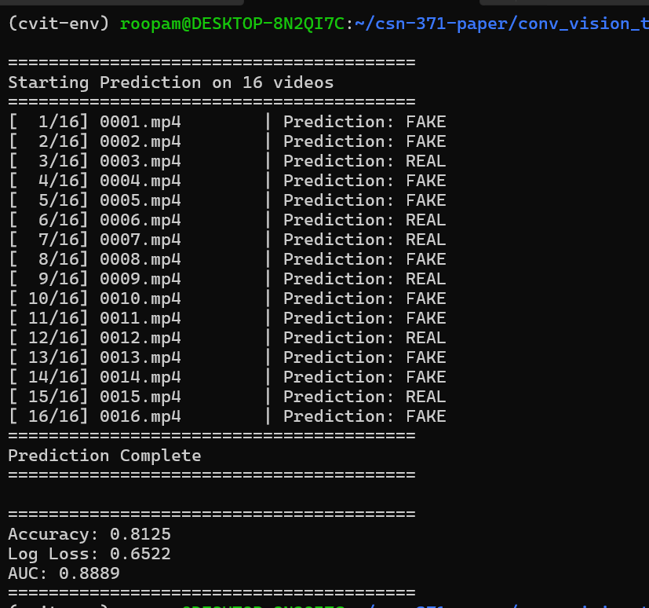
Evaluating the Model
The performance of the trained model was evaluated on the test dataset consisting of DFDC and Celeb-DF datasets.
Computed metrics:
Accuracy: 81.25%
Log Loss: 0.6522
AUC Score: 0.8889

Slide 7
References
Deressa Wodajo and Solomon Atnafu. Deepfake Video Detection Using Convolutional Vision Transformer. 2021. arXiv: 2102.11126 [cs.CV]. url: https://arxiv.org/abs/2102.11126 .
Joshua Brockschmidt, Jiacheng Shang, and Jie Wu. “On the Generality of Facial Forgery Detection”. In: 2019 IEEE 16th International Conference on Mobile Ad Hoc and Sensor Systems Workshops (MASSW). 2019, pp. 43–47. doi: 10.1109/MASSW.2019.00015.
Polychronis Charitidis et al. Investigating the Impact of Pre-processing and Prediction Aggregation on the DeepFake Detection Task. 2020. arXiv: 2006.07084 [cs.CV]. url: https://arxiv.org/abs/2006.07084 .
Brian Dolhansky et al. The DeepFake Detection Challenge (DFDC) Dataset. 2020. arXiv: 2006.07397 [cs.CV]. url: https://arxiv.org/abs/2006.07397 .
Yuezun Li et al. “Celeb-DF: A Large-scale Challenging Dataset for DeepFake Forensics”. In: IEEE Conference on Computer Vision and Patten Recognition (CVPR). 2020.
Valentin Bazarevsky et al. BlazeFace: Sub-millisecond Neural Face Detection on Mobile GPUs. 2019. arXiv: 1907.05047 [cs.CV]. url: https://arxiv.org/abs/1907.05047.
Karen Simonyan and Andrew Zisserman. Very Deep Convolutional Networks for Large-Scale Image Recognition. 2015. arXiv: 1409.1556 [cs.CV]. url: https://arxiv.org/abs/1409.1556.
Alexey Dosovitskiy et al. An Image is Worth 16x16 Words: Transformers for Image Recognition at Scale. 2021. arXiv: 2010.11929 [cs.CV]. url: https://arxiv.org/abs/2010.11929 .

