Slide 1

TIME SERIES FORECASTING OF BITCOIN PRICE BASED ON EXCHANGE RATES OF CURRENCIES USING MACHINE LEARNING
Roopashree ramachandraiah
u2177053

Slide 2
Introduction
Bitcoins are virtual currencies whose transactions are recorded on decentralized ledgers.
Has gained interest from investors and financial organizations.
Exhibit high volatility.
Price reached an all-time high during the last quarter of 2021 and exhibited high fluctuations during the pandemic.
Difficult to understand underlying price models.
A speculative asset.
Returns depend on accurate forecasting using available information

Slide 3
Objective and contribution
To build multivariate predictive models using Machine Learning techniques.
To forecast bitcoin price.
Independent features are historical exchange rates of major currencies like Great Britain Pounds, Australian Dollars, Chinese Yuan, Euro, Canadian Dollars, New Zealand Dollars, Singapore Dollars and Japanese Yen along with bitcoin price.
Contribution:
To build multivariate predictive models based on XGBoost, Random Forest, SVR and LSTM are built.
To build models which can be used to forecast the next day’s price based on different lags (lag1, lag 3 and lag 7).
To perform exploratory data analysis to interpret the behaviour of bitcoin prices with respect to other currencies.
Tune the hyperparameters to optimize the results.
Compare the result of the models built to look for their performance and determine the best model for the problem statement.

Slide 4
Research Questions
Aligning with the objective and contribution of the research, the study aims at addressing the following questions.
How accurately the models built in the study can forecast the bitcoin price by considering historical currency exchange rates and bitcoin price?
Which model performs the best in predicting bitcoin price?
What is the time lag to be considered for efficient forecasting?

Slide 5
Literature Review
Author | Independent Features | Dependent Feature(s) | Timeframe | Frequency | Method/algorithms | Main findings/ Performance | Identified Gap
Mohamed Khalil BENZEKRİ, Hatice Şehime ÖZÜTLER. | Historical bitcoin prices | BTC price | 2014Q1 to 2020Q2 – Train data 2020Q3 and Q4 test data | Quarterly data | Univariate Arima | MAPE 4.24% | A univariate model based on only historical BTC price.
Gowtham Saini, Dr. M. Shobana | Historical bitcoin prices (adjusted close price) | BTC price | 2017-2021 | Daily | Univariate Arima & FG Prophet | R² Arima- 0.94 R² FB Prophet- 0.93. Arima performed better than FB Prophet | A univariate model based on only historical BTC price
Mohammed Mudassir, Shada Bennbaia, Devrim Unal & Mohammad Hammoudeh | Technical indicators derived from raw features (ex., transactions, Block size, sent address etc.) of bitcoin price and transactions | BTC price | April 2013- July 2016 and April 2013 – April 2017 | Daily | ANN, Stacked ANN, SVM and LSTM multivariate models | LSTM performed better. Bitcoin price could be forecasted with less error, however predicting its raise or fall seemed difficult | Only features related to bitcoin are used.
Mohammad J. Hamayel, Amani Yousef | Historical data of BTC, ETH and LTC (Open, High, Low, and close price of each currency) | BTC, ETH and LTC prices | Jan 2018- Jun 2021 | Daily | LSTM, BiLSTM and GRU | GRU performed well compared to other models | Only historical features of BTC, ETH and LTC are used to predict their prices
Ioannis E. Livieris, Niki Kiriakidou, Stavros Stavroyiannis and Panagiotis Pintelas. | Historical mixed data of BTC, ETH and XRP | BTC, ETH and XRP price movement | Jan 2017 – Oct 2020 | Daily | CNN-LSTM based Multi-Input Deep neural network | The new hybrid approach of exploiting different currency data separately for their movement prediction resulted in reduced overfitting | Though multiple cryptocurrency data are considered, the main aim was to predict the movement(raise or fall in price). Other features like open, close, low, trade volumes are not considered

Slide 6
Literature Review contd.,
Nayak, S.K., Nayak, S.C. and Das, S | Historical closing price of BTC, LTC, Ripple, CMC 200 and Thether | Multiple cryptocurrencies | Jan 2019 – Mar 2021 | Daily | RA+ANN, GA+ANN, PSO+ANN, MLP, SVM and ARIMA | RA+ANN model performed good overall | Only closing price was used for forecasting. Scope for using other technical determinants
Pratiksha Patil | Day transactions having high, low, open features | Bitcoin price | Oct 2020 to Aug 2020 | Hourly | Linear Regression and LSTM | LSTM performed | Only bitcoin features are considered
Monisha Mittal, G. Geetha. | Various bitcoin featured like open, low, high, close, volume | Bitcoin price | 2014 to 2020 | Daily | Multivariate GRU model | Resulted MAPE 18.4905% and RMSE 1987.1057 | Only bitcoin features are considered
Ninuk Wiliani, Rizki Hesananda, Nidya Sari Rahmawati and Erdham Hestiadhi Prianggara. | Various bitcoin featured like open, low, high, close, volume | Bitcoin price | July 2021 to Nov 2021 | Daily | Multivariate linear regression and ANN | ANN performed better | Only featured related to bitcoin exchange rates in USD are considered
Chunxiao Yan, Mengze Li, and Shengao Zhang | Historical bitcoin features like block size, number of transactions, search volume etc along with gold price and dollar index | Bitcoin price | Nov 2014 to Mar 2020 | Daily | Multivariate model- SDAE-B, an integration of deep neural network and bagging technique | Results compared with traditional LSSVM and BP and found that the integrated model SDAE-B performed good | Though a few extra features like gold rate and dollar index were considered, other currency exchange rates are not considered

Slide 7
Dataset used
Extracted historical bitcoin prices and other currency rates in USD are extracted from Bloomberg.
Period: 02/Jan/2017 to 21/Jul/2022 consisting of 1836 daily observations.
Other currencies considered in the study are, AUD, CAD, CNY, EUR, GBP, JPY, NZD and SGD in USD.
First 80% of data consisting of 1468 records are used for training and remaining 20% consisting of 367 records are used for testing the models built.

Slide 8
Data pre-processing
Extracted data was in reverse chronological order. Sorted in chronological order.
Currency exchange rates had missing values for weekends.
These values are substituted with Friday’s close value.
The entire time series data is converted to have different lags using shift operation on dataframes

Slide 9
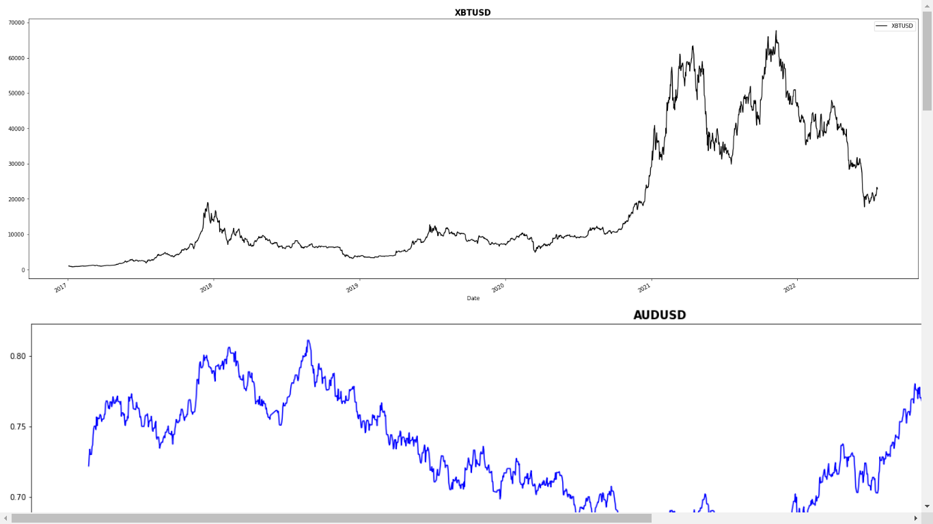
Exploratory Data Analysis

Slide 10
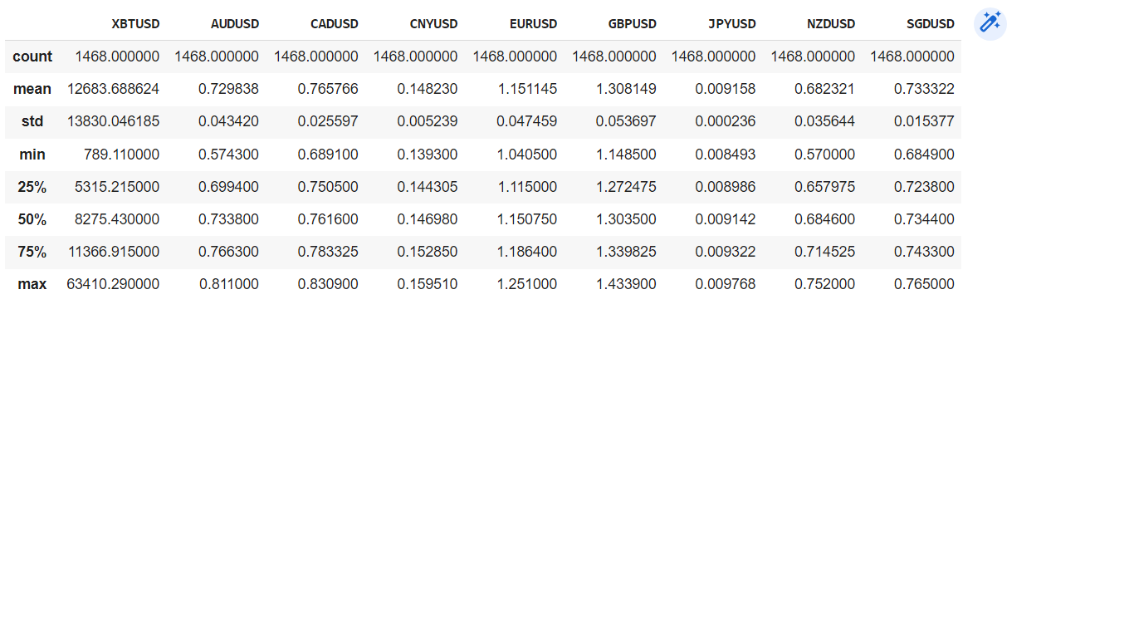
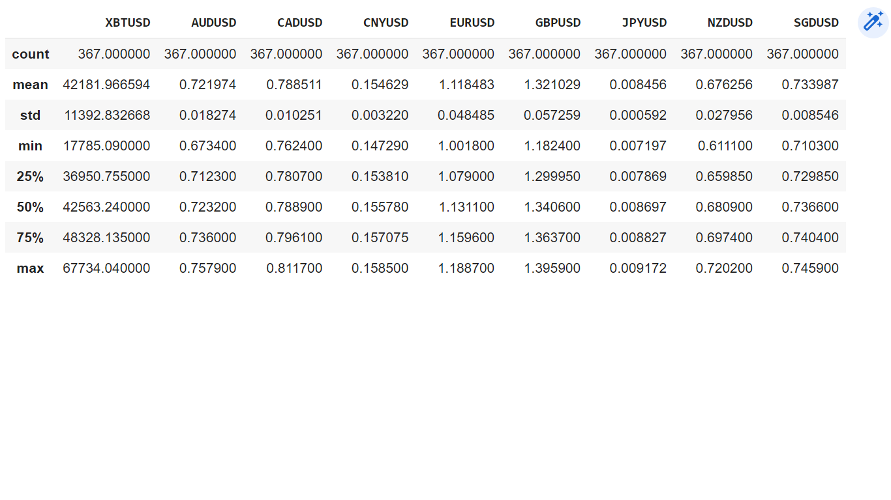
Exploratory Data Analysis contd.,

Slide 11
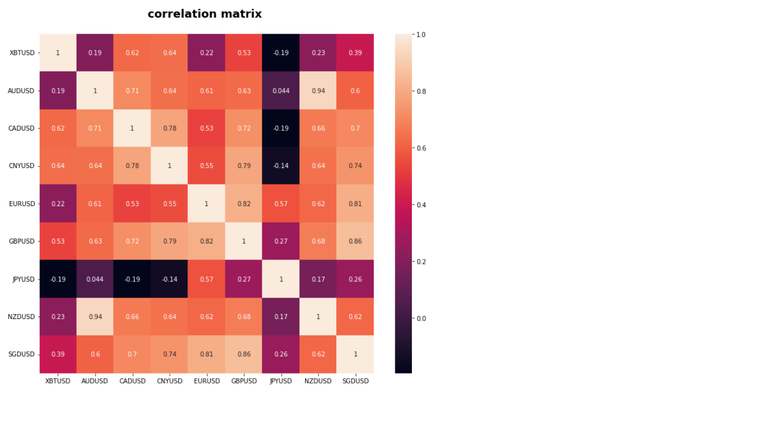
Exploratory Data Analysis contd.,

Slide 12
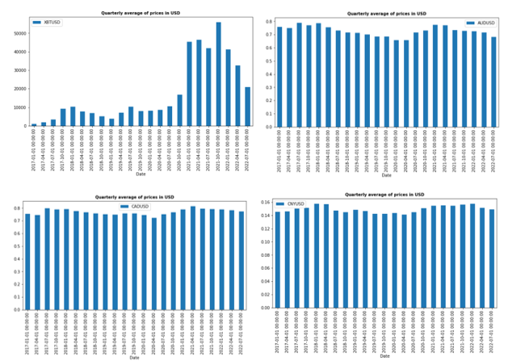
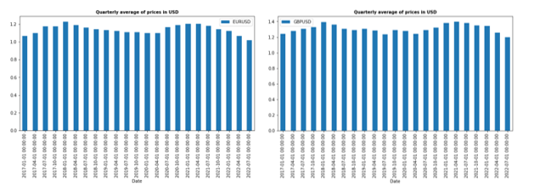
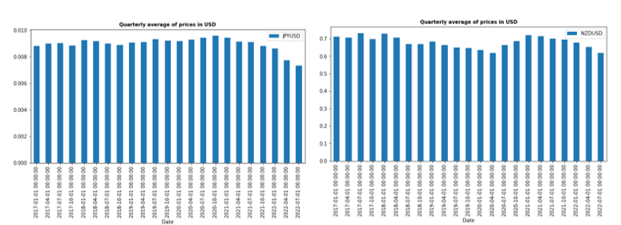
Exploratory Data Analysis contd.,

Slide 13
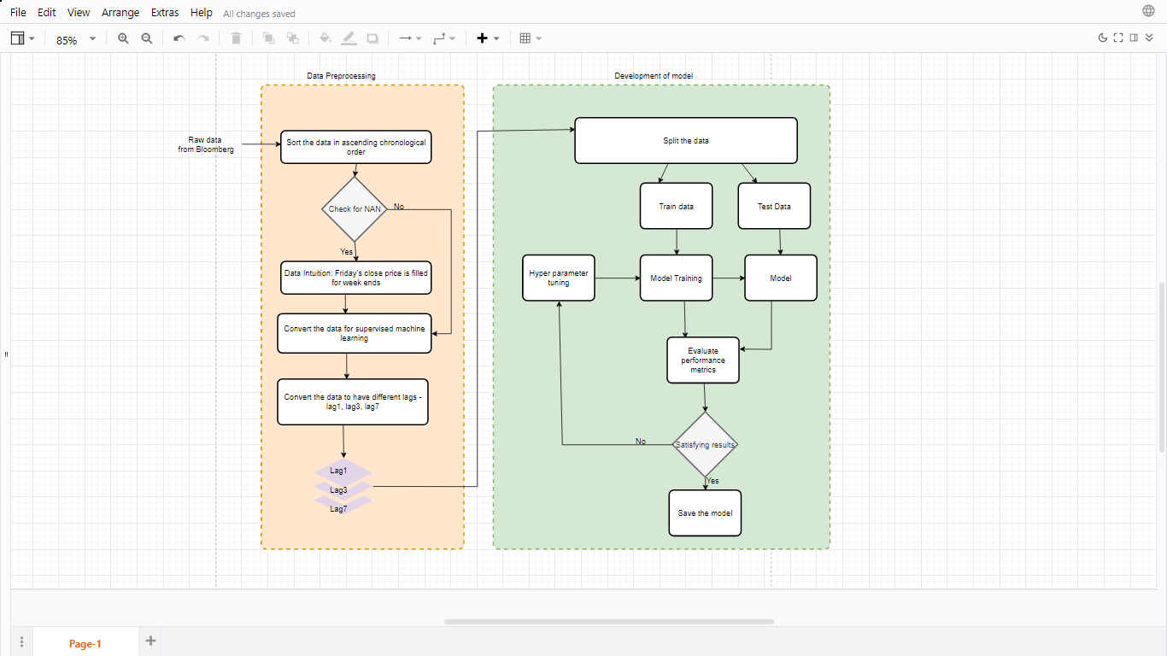
Methodology

Slide 14
Algorithms
XGBoost : An ensemble and tree-based boosting technique algorithm where the error or residual from each tree is fed as input to the next tree to minimize the error.
Random Forest: An ensemble and tree-based bagging technique algorithm where the inputs are randomly split into subsets. The aggregation of predictions from each estimator/tree gives the overall prediction of the model.
Support Vector Regression: Extension of linear regression where a hyper plane is fit to the data points in such a way that it maximizes the boundary of insensitive tube formed by upper and lower margin.
LSTM: Long Short Term Memory algorithm is a deep learning based machine learning algorithm. It works based on memory blocks that decide the amount of information to be retained in current state and the amount of information to be passed to the next state.

Slide 15
Hyper-parameter tuning
The randomsearchCV is used for hyperparameter tuning.
a technique that uses a random combination of hyperparameters to find the best ones to build an optimal model.
Efficient in terms of time complexity and performance as well [11].

Slide 16

Performance measures
The performance of the models are measured using the below parameters.
Mean Absolute Error (MAE): The average magnitude of errors in the predictions irrespective of the direction.
$\boxed{Mean Absolute Error= \frac{1}{n}\sum_{i=1}^{n}{|Y_{i}−Y_{i}^{^}}|}$
Mean Absolute Percentage Error (MAPE): It is the average of absolute percentage errors of a forecast.
$$\boxed{Mean Absolute Percentage Error=\frac{1}{n}\sum_{i=1}^{n}{\left\|\frac{A_{i}−P_{i}}{A_{i}}\right\|}}$$

Slide 17

Performance measures contd.,
Root Mean Squared Error (RMSE): The standard deviation of the residuals or errors of the forecast of the model.
$$\boxed{Root mean Squared Error=\sqrt{\frac{\sum_{i=1}^{n}{{||(Y_{i}−Y_{i}^{^})||}^{2}}}{n}}}$$
Scaled RMSE: The scaled RMSE is the normalized value of RMSE. The value is normalized between 0 and 1.
$$\boxed{Scaled RMSE=\frac{RMSE}{(\max\left(actual\right)−\min\left(actual\right))}}$$
Value close to 0 means the model is good at predicting task.

Slide 18
Results in terms of MAE
Algorithm | Hyperparameter tuning | Lag1 MAE | Lag3 MAE | Lag7 MAE
XGBoost | N | 1800.807 | 1871.2265 | 2005.5028
 | Y | 1051.628 | 1093.0044 | 1111.3384
Random Forest | N | 1950.7505 | 2018.0528 | 2269.9888
 | Y | 1856.7038 | 1924.5841 | 2251.7415
SVR | N | 1663.3167 | 1854.7759 | 2287.7362
 | Y | 1383.9007 | 1515.0595 | 1676.6268
LSTM | N | 2208.5275 | 2782.1207 | 3774.286
 | Y | 1566.5123 | 1604.9684 | 2001.9859

Slide 19
Results in terms of MAPE in %
Algorithm | Hyperparameter tuning | Lag1 MAPE | Lag3 MAPE | Lag7 MAPE
XGBoost | N | 4.497 | 4.8023 | 5.2266
 | Y | 2.5797 | 2.6802 | 2.7165
Random Forest | N | 4.9514 | 5.111 | 5.7289
 | Y | 4.6943 | 4.9045 | 5.6312
SVR | N | 3.5917 | 4.0892 | 5.1055
 | Y | 3.1379 | 3.491 | 3.8663
LSTM | N | 5.2224 | 6.5498 | 9.0144
 | Y | 3.7254 | 3.9735 | 5.0681

Slide 20
Results in terms of RMSE
Algorithm | Hyperparameter tuning | Lag1 RMSE | Lag3 RMSE | Lag7 RMSE
XGBoost | N | 2328.165 | 2396.4732 | 2590.4579
 | Y | 1475.9624 | 1519.9507 | 1534.9107
Random Forest | N | 2375.114 | 2496.7564 | 2779.6151
 | Y | 2294.4461 | 2400.4814 | 2765.9959
SVR | N | 2794.0275 | 2910.3755 | 3334.3208
 | Y | 2161.4242 | 2236.684 | 2407.6039
LSTM | N | 2573.0993 | 3213.5568 | 4319.0396
 | Y | 1926.3234 | 2313.5768 | 2694.1189

Slide 21
Results in terms of Scaled RMSE
Algorithm | Hyperparameter tuning | Scaled RMSE Lag1 | Scaled RMSE Lag2 | Scaled RMSE Lag3
XGBoost | N | 0.0466 | 0.048 | 0.0519
 | Y | 0.0295 | 0.0304 | 0.0307
Random Forest | N | 0.0476 | 0.05 | 0.0556
 | Y | 0.0471 | 0.0481 | 0.0554
SVR | N | 0.0559 | 0.0583 | 0.0668
 | Y | 0.0433 | 0.0448 | 0.0482
LSTM | N | 0.0515 | 0.0643 | 0.0865
 | Y | 0.0386 | 0.0423 | 0.0539

Slide 22
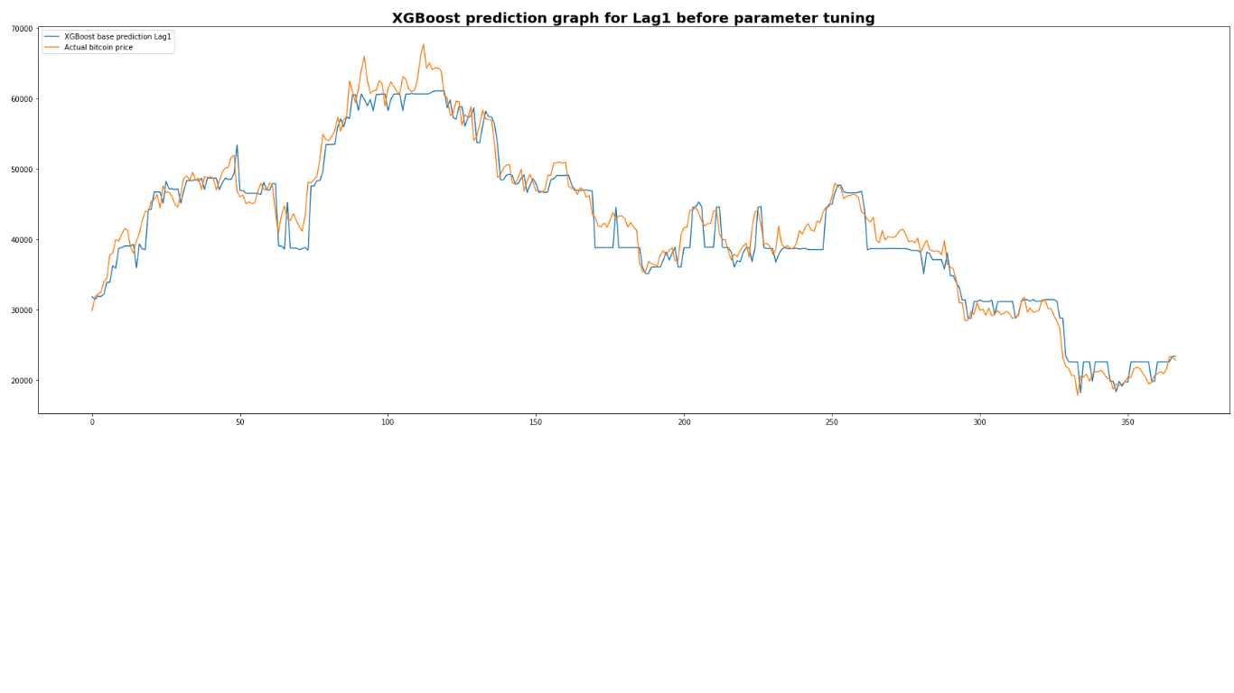
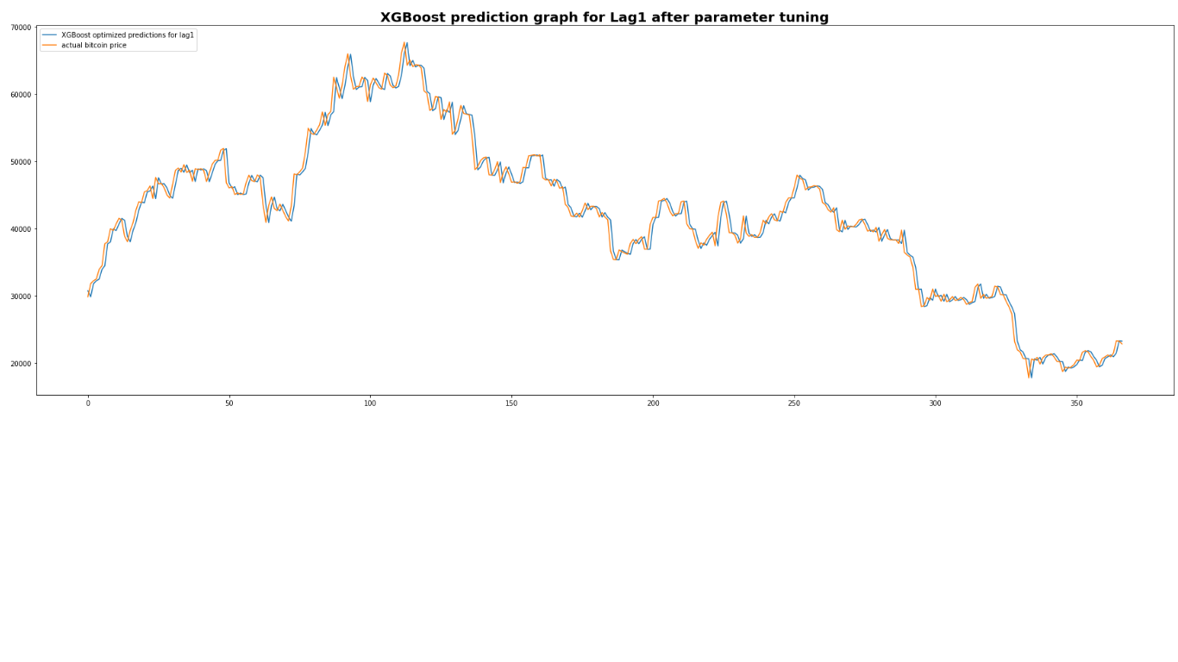
Graphs for lag1
XGBoost

Slide 23
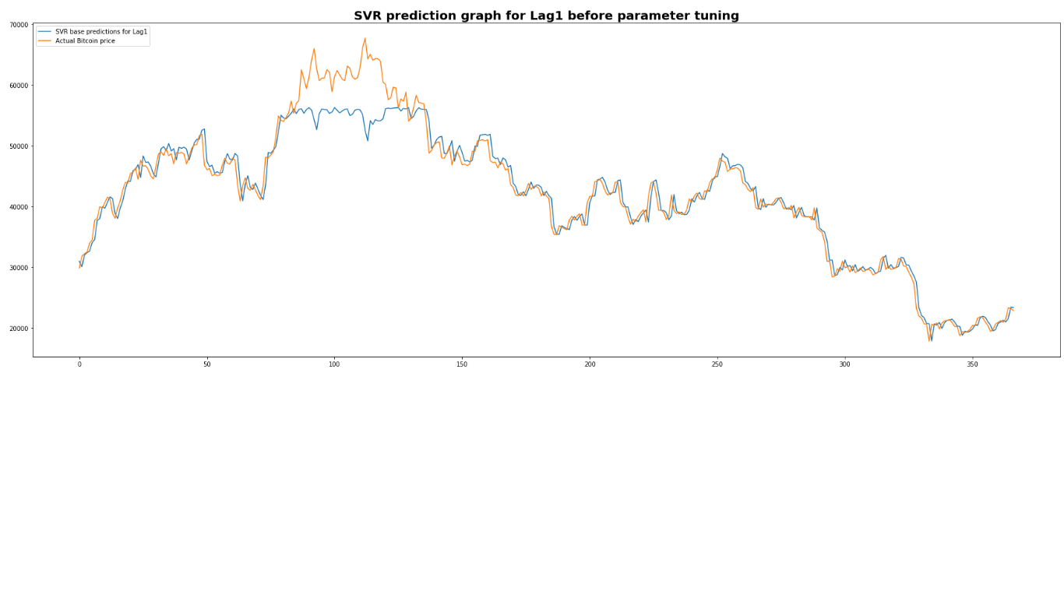
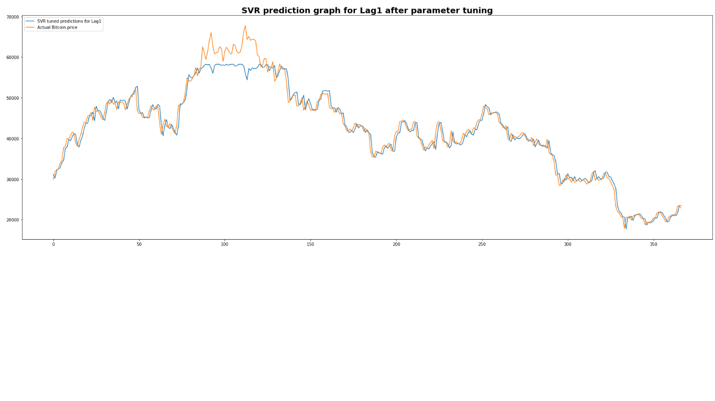
Graphs for lag1 contd.,
SVR

Slide 24
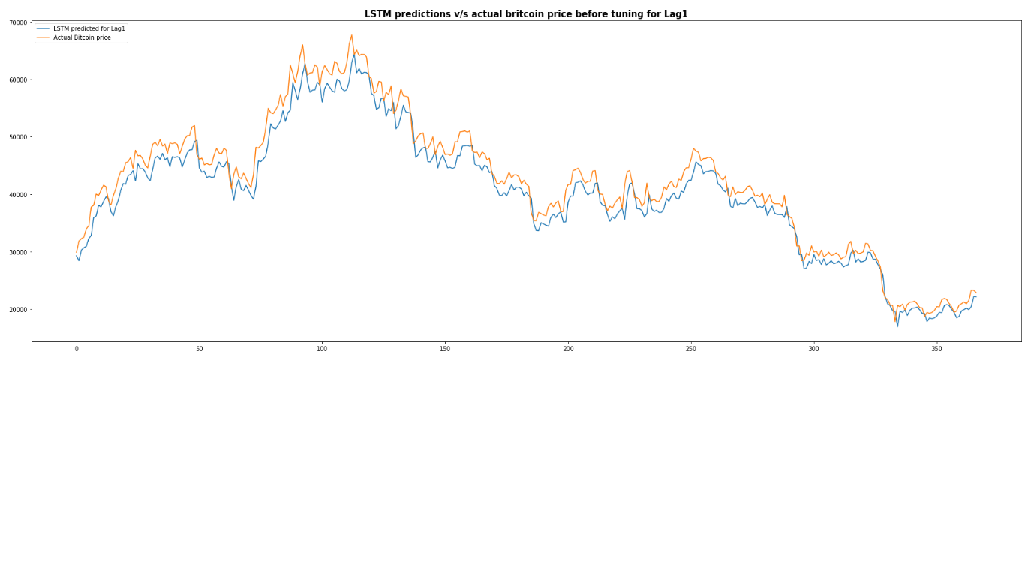
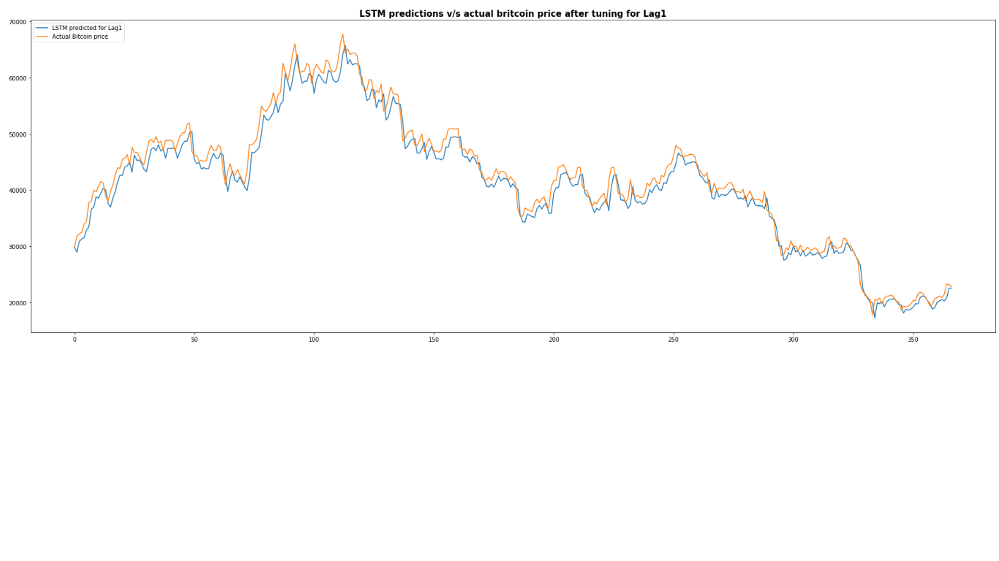
Graphs for lag1 contd.,
LSTM

Slide 25


Graphs for lag1 contd.,
Random Forest

Slide 26
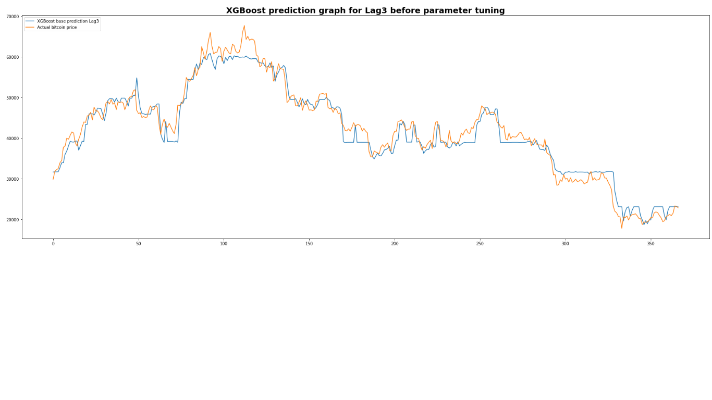
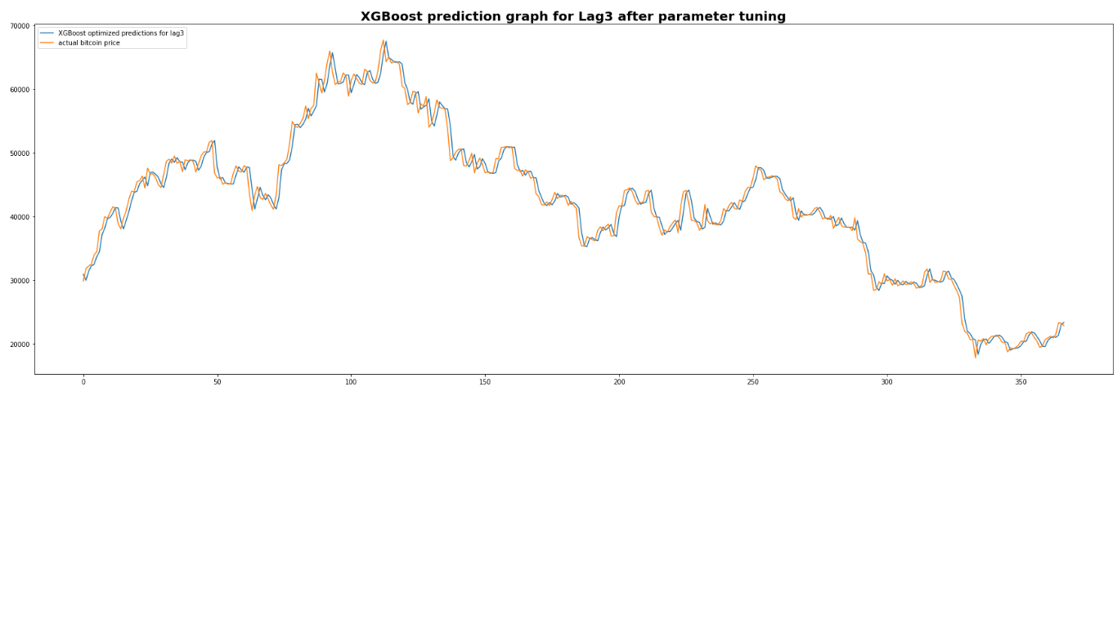
Graphs for lag3
XGBoost

Slide 27
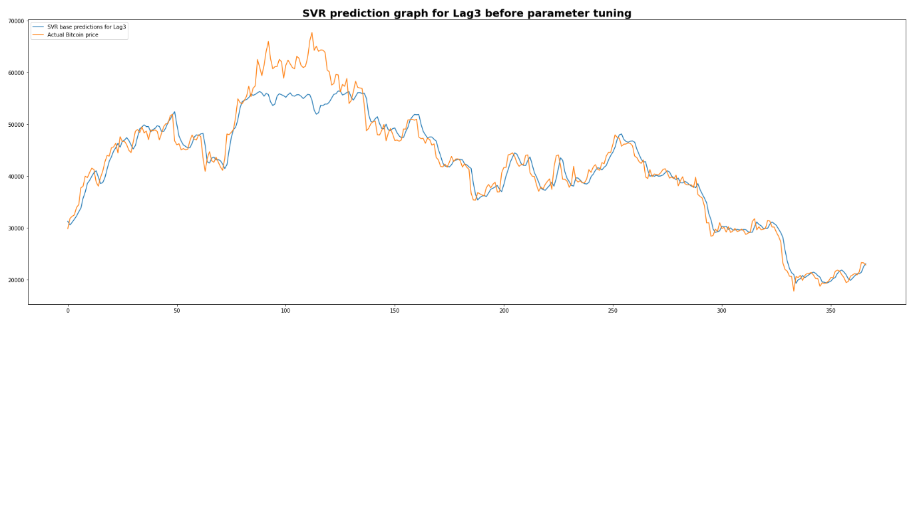

Graphs for lag3 contd.,
SVR

Slide 28
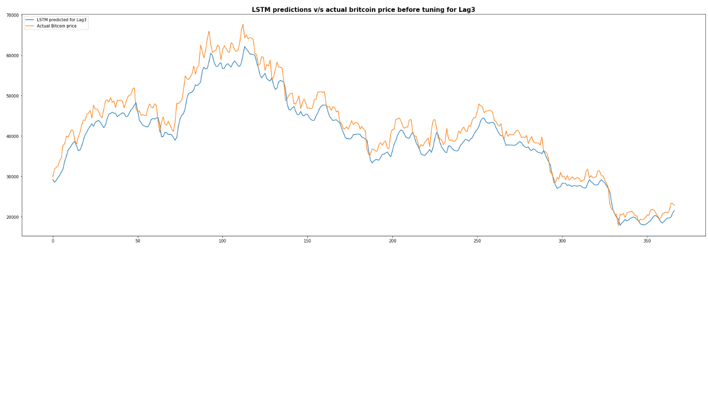
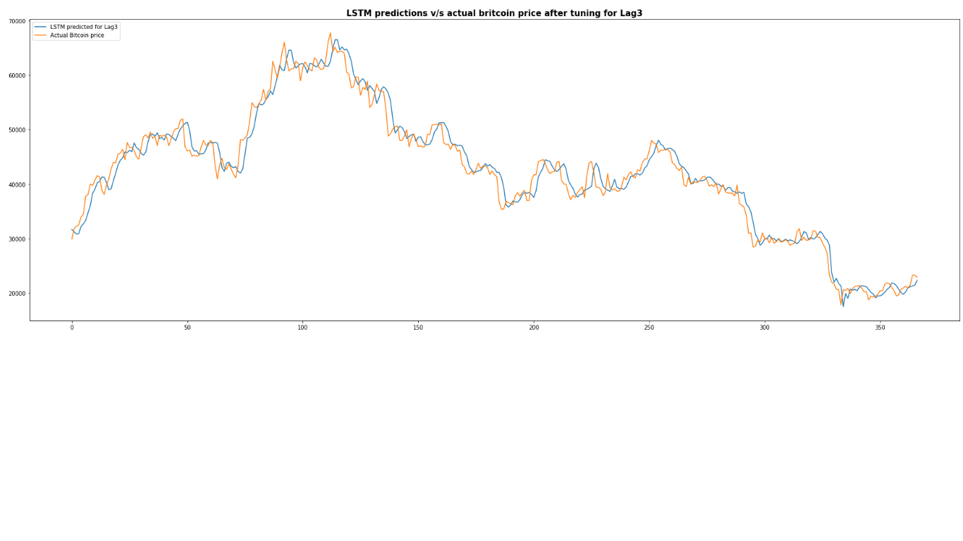
Graphs for lag3 contd.,
LSTM

Slide 29
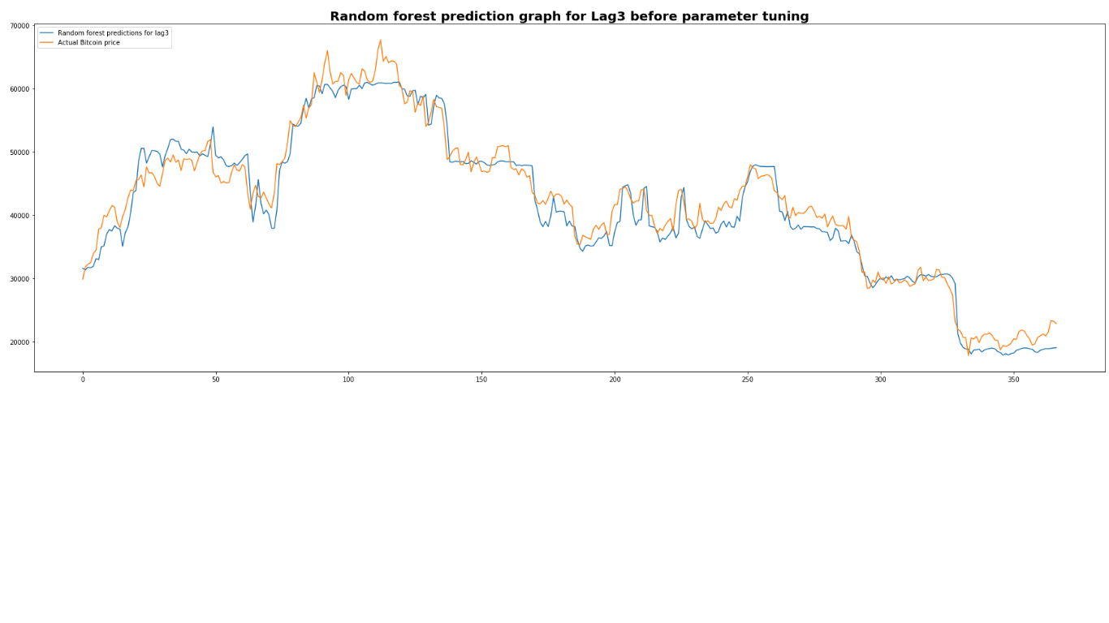
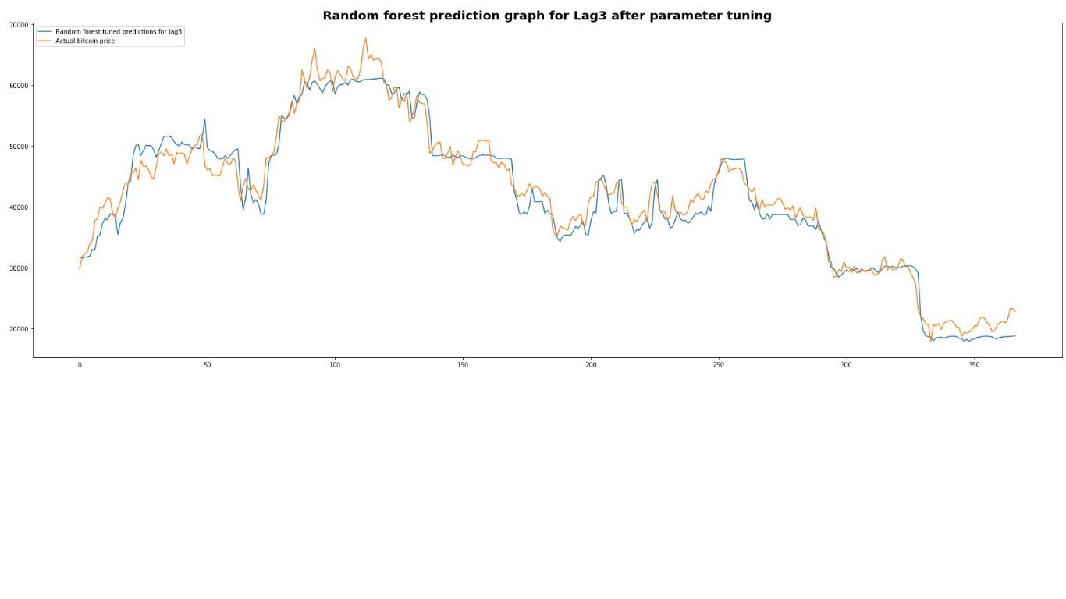
Graphs for lag3 contd.,
Random Forest

Slide 30
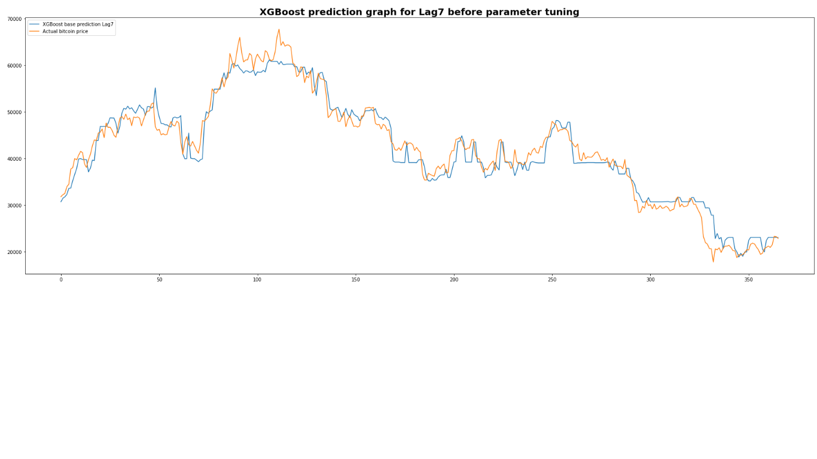

Graphs for lag7
XGBoost

Slide 31


Graphs for lag7 contd.,
SVR

Slide 32
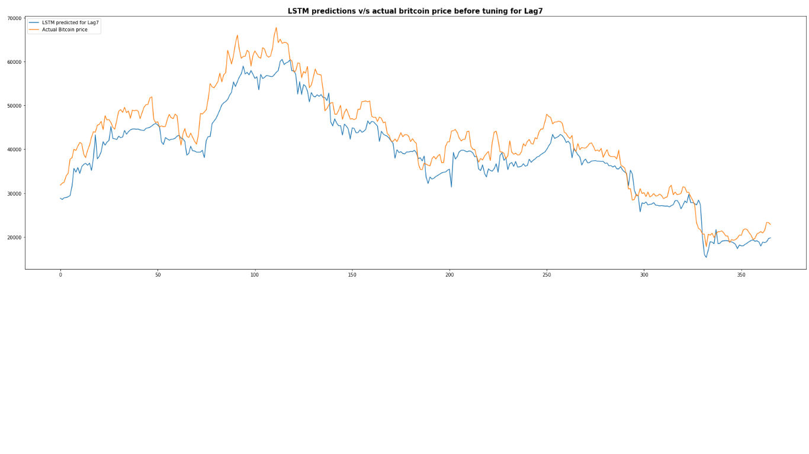
Graphs for lag7 contd.,
LSTM

Slide 33
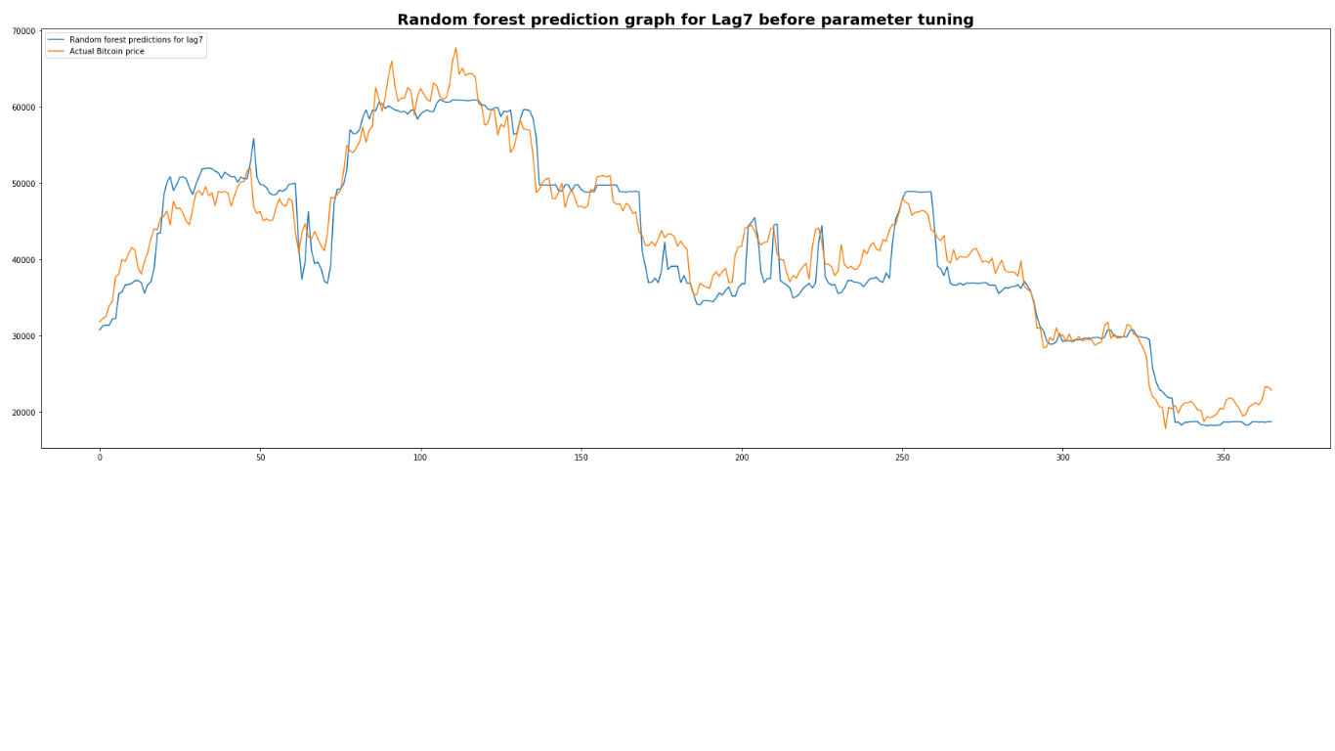
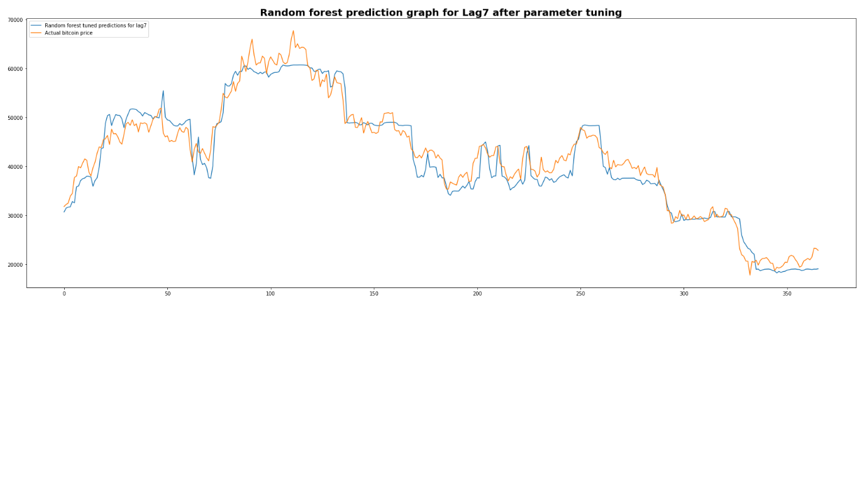
Graphs for lag7 contd.,
Random Forest

Slide 34
Conclusion
All the models performed better with MAPE less than 5% for all lags after parameter tuning.
All models performed better for lag1; which means considering lag1 in the independent time series features resulted in better forecasting.
Compared to all models, XGBoost performed better in terms of all performance measures for all lags.
XGBoost is followed by SVR, LSTM and then Random Forest in terms of performance.
Future scope:
Since Bitcoin exhibit high volatility, the study can be extended to hourly data and check how accurately the models can forecast the bitcoin prices.
Can be extended to include other financial factors like stock market indices, commodities and sentiment analysis of tweets and other social media mentions about bitcoin prices and their impact on the forecast.

Slide 35
Appendix
Code repository:
https://github.com/RoopashreeRamachandraiah/Bitcoin-price-prediction
References:
Mohamed Khalil BENZEKRİ, Hatice Şehime ÖZÜTLER. (2021). “On the Predictability of Bitcoin Price Movements: A Short-term Price Prediction with ARIMA”. https://doi.org/10.26650/JEPR.946081
Gowtham Saini, Dr. M. Shobana.(2022). “cryptocurrency price prediction using prophet and Arima time series”. https://www.irjmets.com/uploadedfiles/paper/issue_4_april_2022/21042/final/fin_irjmets1650284252.pdf
Mohammed Mudassir, Shada Bennbaia, Devrim Unal & Mohammad Hammoudeh. (2020). “Time-series forecasting of Bitcoin prices using high-dimensional features: a machine learning approach”. https://link.springer.com/article/10.1007/s00521-020-05129-6
Mohammad J. Hamayel, Amani Yousef Owda (2021). “A Novel Cryptocurrency Price Prediction Model Using GRU, LSTM and bi-LSTM Machine Learning Algorithms”. https://doi.org/10.3390/ai2040030
Ioannis E. Livieris, Niki Kiriakidou, Stavros Stavroyiannis and Panagiotis Pintelas. (2021). “An Advanced CNN-LSTM Model for Cryptocurrency Forecasting”. https://www.mdpi.com/2079-9292/10/3/287

Slide 36
Appendix
Nayak, S.K., Nayak, S.C. and Das, S. (2021) . “Modeling and Forecasting Cryptocurrency Closing Prices with Rao Algorithm-Based Artificial Neural Networks: A Machine Learning Approach”. https://doi.org/10.3390/fintech1010004
Pratiksha Patil. (2022). “Bitcoin Price Prediction Using Machine Learning and Neural Network Model”. http://ijaem.net/issue_dcp/Bitcoin%20Price%20Prediction%20Using%20Machine%20Learning%20and%20Neural%20Network%20Model.pdf
Monisha Mittal, G. Geetha. (2022). "Predicting Bitcoin Price using Machine Learning". https://ieeexplore.ieee.org/stamp/stamp.jsp?tp=&arnumber=9740772
Ninuk Wiliani, Rizki Hesananda, Nidya Sari Rahmawati and Erdham Hestiadhi Prianggara. (2022). "APPLICATION OF MACHINE LEARNING FOR BITCOIN EXCHANGE RATE PREDICTION AGAINST US DOLLAR". http://ejournal.nusamandiri.ac.id/index.php/jitk/article/view/2880/895
Chunxiao Yan, Mengze Li, and Shengao Zhang. (2022). "The Empirical Analysis of Bitcoin Price Prediction Based on Deep Learning Integration Method". https://doi.org/10.1155/2022/1265837
James Bergstra, Yoshua Bengio. (2012). “Random Search for Hyper-Parameter “. https://jmlr.csail.mit.edu/papers/volume13/bergstra12a/bergstra12a.pdf.

Slide 37
Thank You

