Slide 1

Financial Analytics
Application of Financial Data Science
Submitted By: Roopesh

Slide 2
Part 1
General modern financial analytics use cases using auto-modelling (data science platform)

Slide 3
Data Problem Statement
In market economies, banks play a critical role. They choose who is eligible for financing and on what terms, and they have the power to make or break investment choices. Individuals and businesses require credit for markets and society to function.
Banks utilize credit scoring algorithms to decide whether a loan should be issued, which make a close guess at the likelihood of default.
Dataset Description
This Dataset is sourced from the Kaggle repository for Show My Score Competition and dataset has 11 Variable column and 150000 Records each.
Resource: https://www.kaggle.com/c/GiveMeSomeCredit

Slide 4
Dataset Description
Serious Dlqin2yrs : Person experienced 90 days past due delinquency or worse.(Yes/No) Boolean
Revolving Utilization of Unsecured Lines : Total balance on credit cards and personal lines of credit except real estate and no instalment debt like car loans divided by the sum of credit limits.
age : Age of borrower in years.
Number Of Time 30-59 Days Past Due Not Worse : Number of times borrower has been 30-59 days past due but no worse in the last 2 years.
Debt Ratio : Monthly debt payments, alimony, living costs divided by monthly gross income.
Monthly Income : Monthly income.
Number Of Open Credit Lines And Loans : Number of Open loans (instalment like car loan or mortgage) and Lines of credit (e.g., credit cards).
Number Of Times 90 Days Late : Number of times borrower has been 90 days or more past due.
Number Real Estate Loans Or Lines : Number of mortgage and real estate loans including home equity lines of credit.
Number Of Time60-89DaysPastDueNotWorse : Number of times borrower has been 60-89 days past due but no worse in the last 2 years.
Number of Dependents : Number of dependents in family excluding themselves (spouse, children etc.).

Slide 5
Stakeholders:
Customer and the Banker are the key stake holders in this Given problem statement and once we go deep onto the dataset the main stakeholders are the Age, SeriousDlqin2yrs, NumberOfOpenCreditLinesAndLoans, NumberOfTimes30-59DaysPastDueNotWorse
What is the Benefit from this Analysis ?
This Shows the best Scoring algorithm for the Loan Issue Process, with hassle-free and not for people with Bad Credit Scores.
Identifies the Potential Lender with Good Credit line

Slide 6
Rapid Miner
Data loading and transformation (ETL), data preparation and visualization, predictive analytics and statistical modelling, evaluation, and deployment are key important techniques of the data mining and machine learning operations, which are provided by RapidMiner. In that we are going to use the Product called Auto Model which does the entire work for the Production and deployment.
Auto Model
In Auto model it has several algorithms incorporated and we can pick Deep-Learning, Decision Tree, Random Forest, Gradient Boosting Trees, Support Vector Machine, Linear Algorithm. Are the few Important algorithms has been used by the Auto Model for the complete Analysis. In this Auto model Algorithm, we have chosen the Random Forest, Deep-Learning Models, Gradient Boosting Tree Models, Decision Tree Model and Generalized Linear Model.
We Are going to predict the SeriousDlqin2yrs - Person experienced 90 days past due delinquency or worse.(Yes/No) Boolean. And the dependent variable Age, Numberof OpenCreditLinesAndLaons, NumOfTime30-50DaysPastDueNotWorse.

Slide 7
Rapid Miner
Exploratory Data Analysis :
Steps to be carried out : As this Rapid Miner tool is complete Autonomous, we, just need to select the Dataset, Once the dataset is laded and we have selected the Prediction and the dependent variable , now we must look for the Feature engineering part, unlike normal Python here al the Feature engineering, Missing, values, Correlation, Statistics, and weight by Correlation has been calculated automatically.
Model Selection:
Selection of the Models, is important task and we must select from the available models in the Dashboard,(There are few Optimizers available to tune the Models) Based on the Tree size, Learning Rate, and other critical tuning parameters. Based upon the Complexity ( Size of the data ), results take longer, And then finally the deployment of the models after results and best Model
Once the results have been popped , we can now compare with the several model available and we have selected, and each model shows the Model, for example ( Gradient Boosting, Random Forest) shows the entire trees which it has computed.

Slide 8
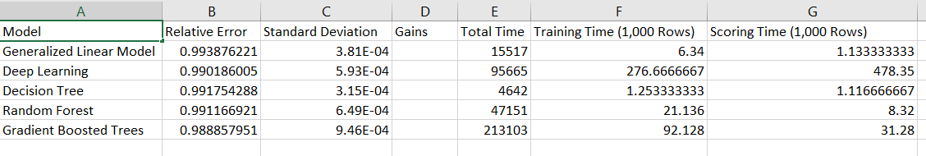
Rapid Miner
Result Validation:
Once the results are out, we have monitored each algorithm performance and there will be a best Performer model, we can now choose which is the best based upon our given circumstances, financially, or other. Results are achieved and calculated by the RMSE Values(Root-Mean Square Error), Absolute Error, Relative Error, Squared Error, Correlation.
Result of our Dataset:
We have our results the best Model is the Gradient Boosting Algorithm ( Most Effective) and next is the Deep -Learning Model (Best)

Slide 9
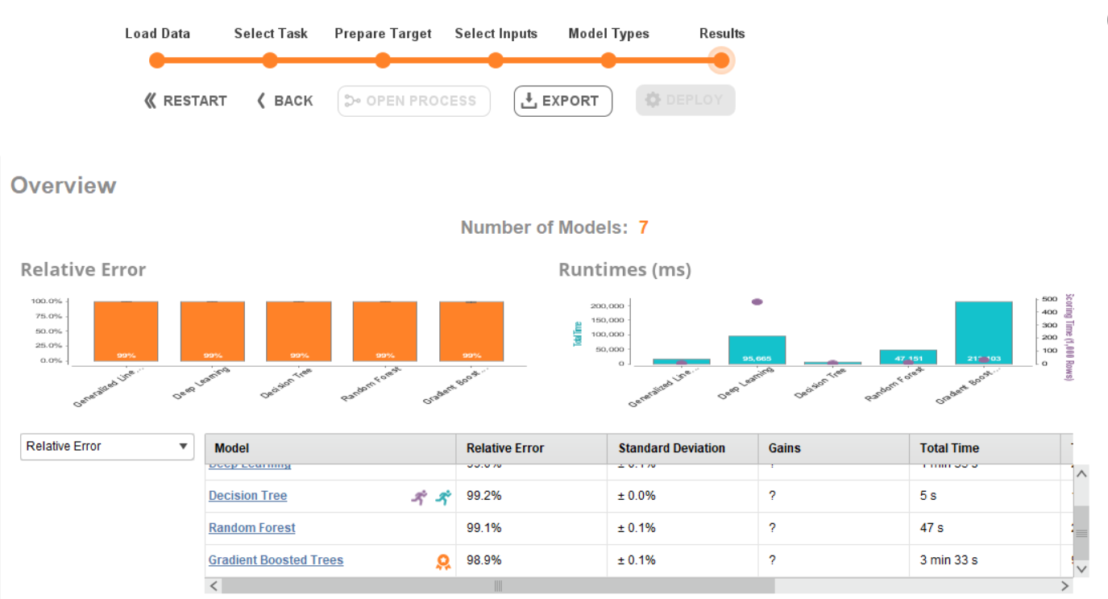
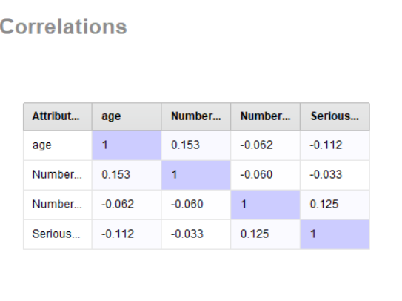
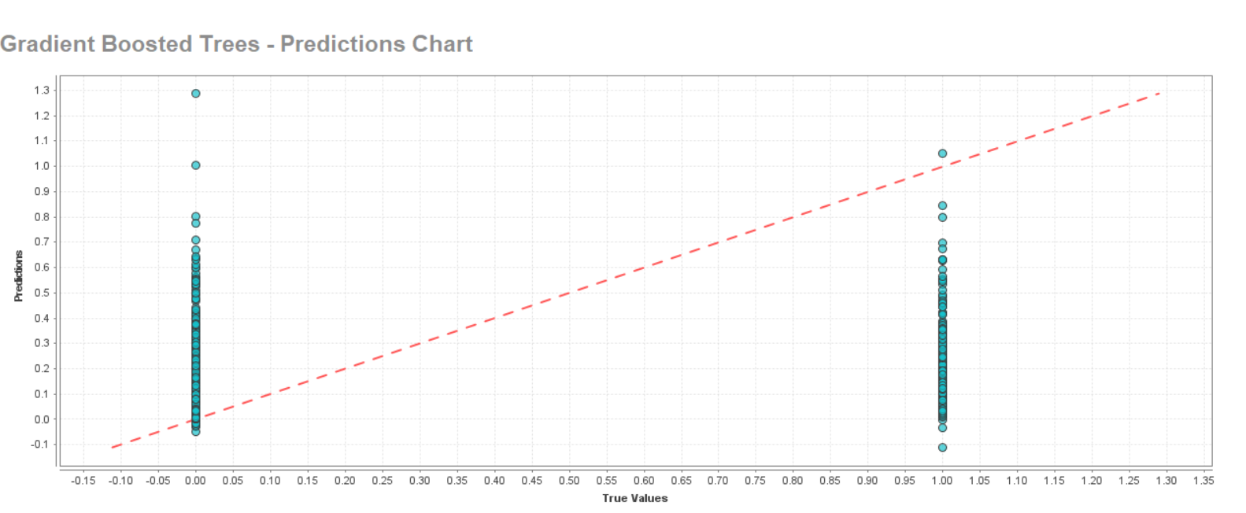
Results of the Gradient Boosting Algorithm

Slide 10
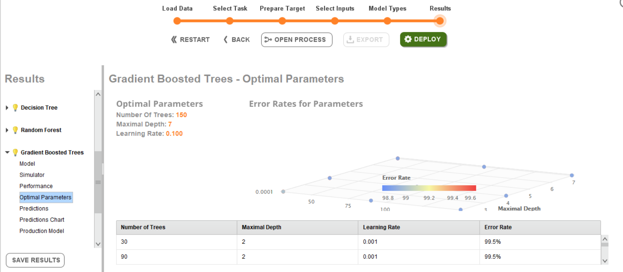
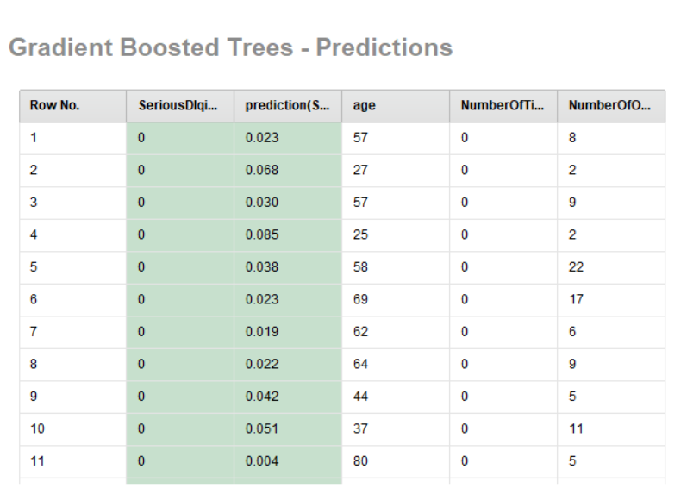
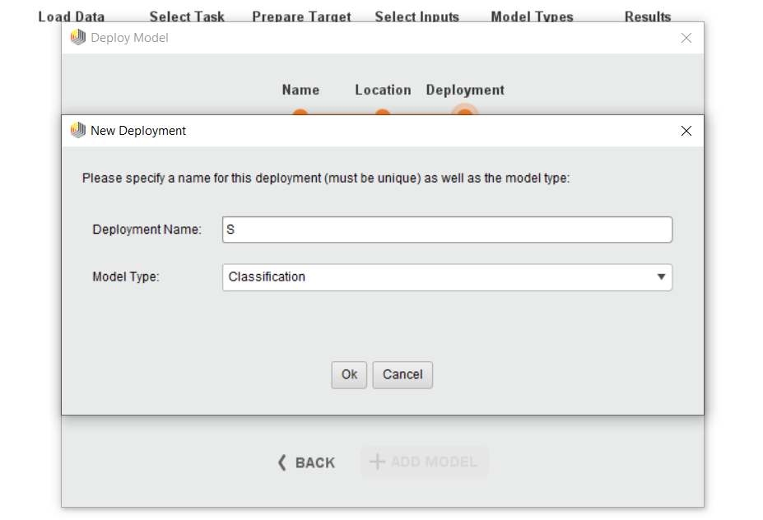
Results of the Gradient Boosting Algorithm

Slide 11
Part-2
Applying data science to trading strategies using Python.

Slide 12
CRISP DM
Business Understanding
The Need of the Business is to find the Prediction of the Amazon Stock (Adjusted Close Price) Euro /USD
Preparing the Essential data for Past 4 Years( As Mentioned) from The Yahoo Finance or the Nasdaq Stock Exchange for the Exact Prices and the Market Cap.
Understand the Pre Historical Stock data and Building of the Model
Evaluation of the Model and Selecting the Best among them for Production and Deployment.
Data Preparation
Exploratory Data Analysis
This helps to find if there is any missing values, duplicates, or null Values, finding the basic structure of the dataset and understanding them, Doing Normalisation of the data, here in our case we have done the standard Scaling of Normalisation

Slide 13
CRISP DM
Data Understanding
Dataset: Amazon Stock Date (start and end): 1st September, 2017 till 20th September 2021.
Dataset Description: This Dataset consist of 5 different variables,
Index- Dates of the stock registered
Open: Open value of the stock on the particular date (Index)
Close: Close Value of the Stock on the Particular date (Index).
High: Highest value of the Stock on the Particular date.
Adj Close: Adjusted Closing price of the particular stock on the day, it amends the stock’s closing price to reflect that stock value after accounting for any corporate actions.
Volume: Volume of the Particular stock at the end of the business hours.

Slide 14
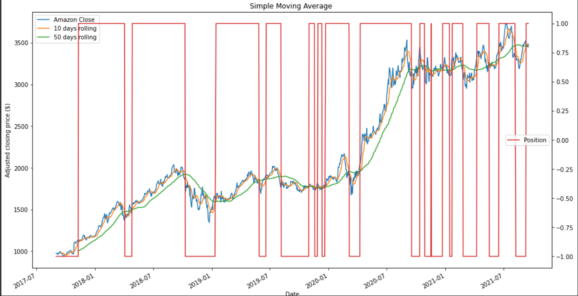
Simple Moving Average :
A simple moving average (SMA) is an arithmetic moving average calculated by adding recent prices and then dividing that figure by the number of time periods in the calculation average. ... Short-term averages respond quickly to changes in the price of the underlying security, while long-term averages are slower to react.
In python it done easily using the rolling function and the window time of number of days we can give an estimate, for example like (7, 30, 60, 90, 120) days.
And in our Dataset, we have calculated the Simple Moving Average based on the 10 and 50 Days and we have found out the position of difference when it crosses the original close (Diamond and Dead Cross) and the red lines mark it.

Slide 15
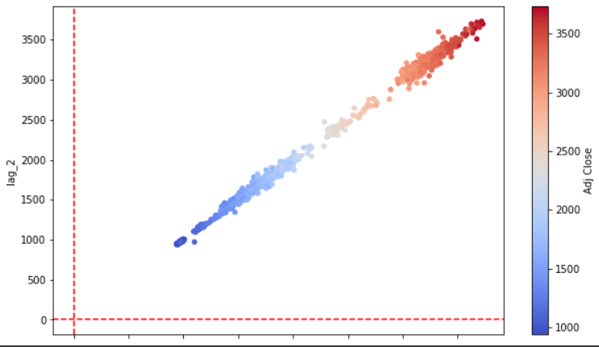
Random Walk Hypothesis
The random walk hypothesis is a financial model that implies the stock market moves in an unpredictably random manner.
According to the hypothesis, each stock's future price is unaffected by its own previous movement or the price of other securities.
Outperformance should not be expected from predictive tactics. The expected value at any point in the future is the same as the current value.
Scatter Plot of the Lag2 and the Adj Close of Amazon

Slide 16
Data Modelling
Choosing the Models like
Regression Task : OSL Regression,
Classification: Decision Trees, Naïve Bayes, Logistic Regression
Clustering: K-Means, KNN
Deep Learning: MLP Classifier, Perceptron

Slide 17
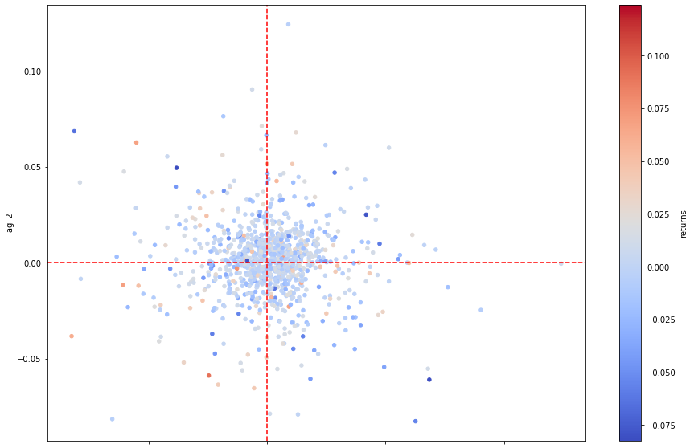
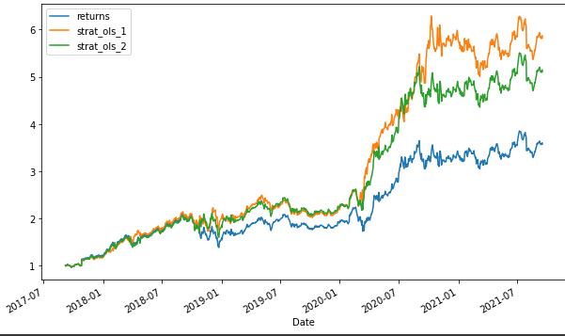
OLS Regression:
Scatter Plot based on Features and the Label Data
We have Created the features by lagging the log returns and visualized with the combination of the returns data
Performance of the Regression Algorithm
Below we can see the performance of the Linear OLS Regression based on the strategies over the time period, and we can see that the results are very accurate

Slide 18
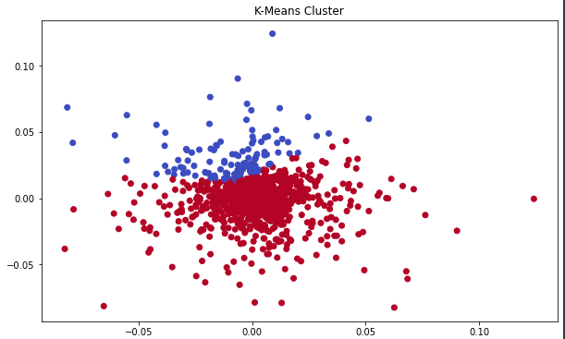
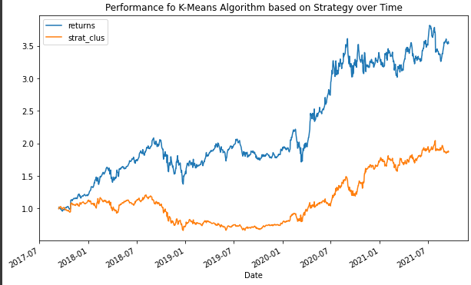
Clustering –K Means Algorithm
In our assessment we have taken 4 clusters and we have predicted the model
Performance of the K-Means Algorithm based on the strategy and the time

Slide 19
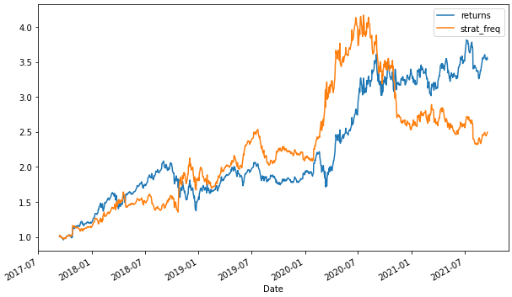
Frequency Approach:
Given the frequency data, Two feature value combinations hint at an upward movement while one lets a downward movement seem more likely. This translates into a trading strategy the performance of which is shown.

Slide 20
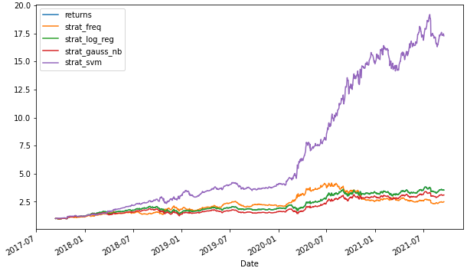
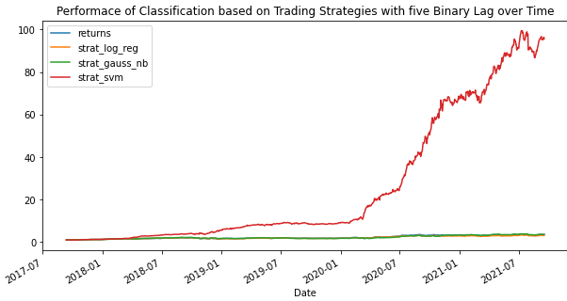
Classification Algorithm
Performance of classification with 2 binary lags
Performance of Classification with 5 binary Lags:

Slide 21
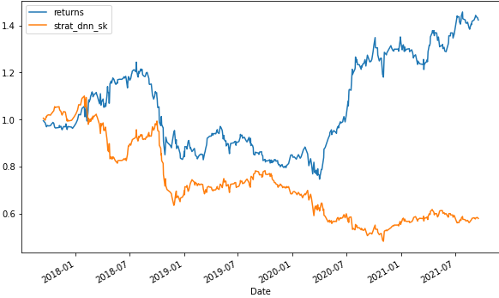
Deep-Learning- Scikit Learn- MLP Classifier
MLP Classifier algorithm from scikit-learn, as introduced in “Deep neural networks”. First, it is trained and tested on the whole data set, using the algorithm achieves exceptional performance in-sample which illustrates the power of DNNs for this type of problem. It also hints at strong overfitting, since the performance indeed seems unrealistically good.
Increases the number of hidden
layers and hidden units.

Slide 22
Part-3
Analysing the computational complexity of Python code.

Slide 23
K-Means Complexity
How is Complexity defined ?
For algorithms defined by for-loops such analysis is straightforward. The depth of the nesting of these loops defines the complexity of the algorithm. A single loop from 1 to n defines a linear-time or algorithm, while two nested loops define a quadratic-time or algorithm. Two sequential for loops that do not nest are still linear, because steps are used instead of ² such operations.
Finding Complexity of the K-Means Algorithm
Step 1 – Initiate Centroids Initiate k random centroids
Step 2 – Assign Data Points All data points are assigned to “nearest” (in this case Euclidean distance) centroid to form a cluster.
Step 3 – Calculate New Centroids For each cluster, calculate a new centroid by minimising the sum of squared errors (SSE) of all data points in a cluster to the centroid of the cluster. The centroid with minimal SSE is the new mean of the cluster
Step 4 – Repeat Assignment and Calculate New Centroids
Step 5 – Termination once iteration shows no significant change in centroids
When cluster is 4 , this K-Means will be of n2.

