Slide 1

E-Commerce Sales Analysis
Financial Intelligence and Data Visualisation
Design and Development of Business data Storage solution for Analysis
Submitted By-
Roopesh Bharatwaj K R

Slide 2
Description of the Work
This is a Real-Time dataset of a Leading E-commerce company in India, and this data has been sourced from the Kaggle repository on a challenge., The dataset has 65000 records of 18 variables, dated from September 2013 till January 2014.
We going to study the sales Analysis of the E-Commerce data
In-Depth Analysis on the places of concentration(Geographically) how can we improve with certain recommendations
Visualisations using Tableau for the Effective Results and Analysis

Slide 3
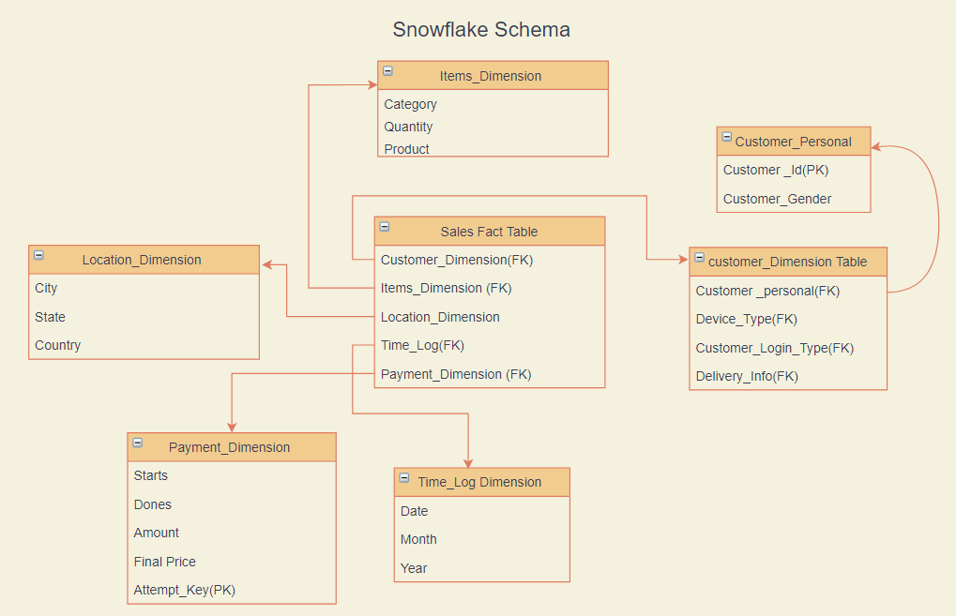
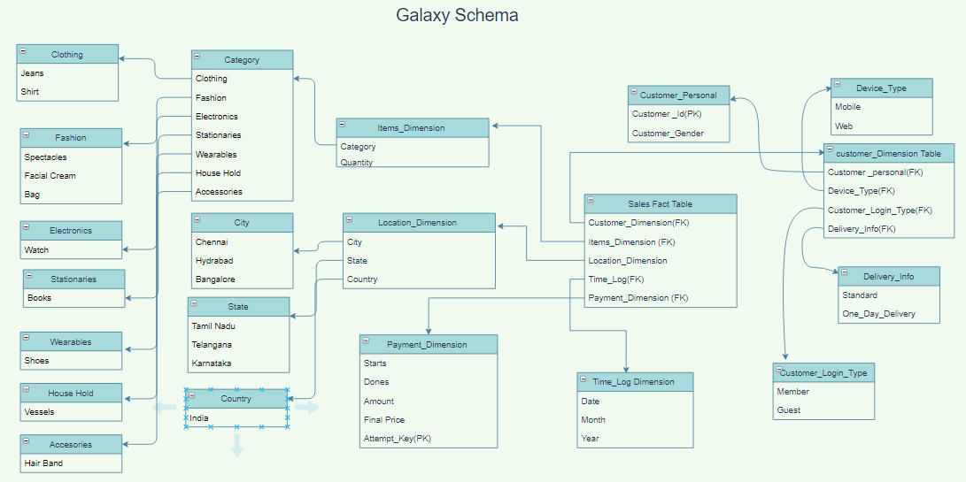
Schema Representation
With Overall dimension table
With the Detailed Dimension table

Slide 4
How Was E-Commerce Standing back in 2013-14 in India?

Slide 5
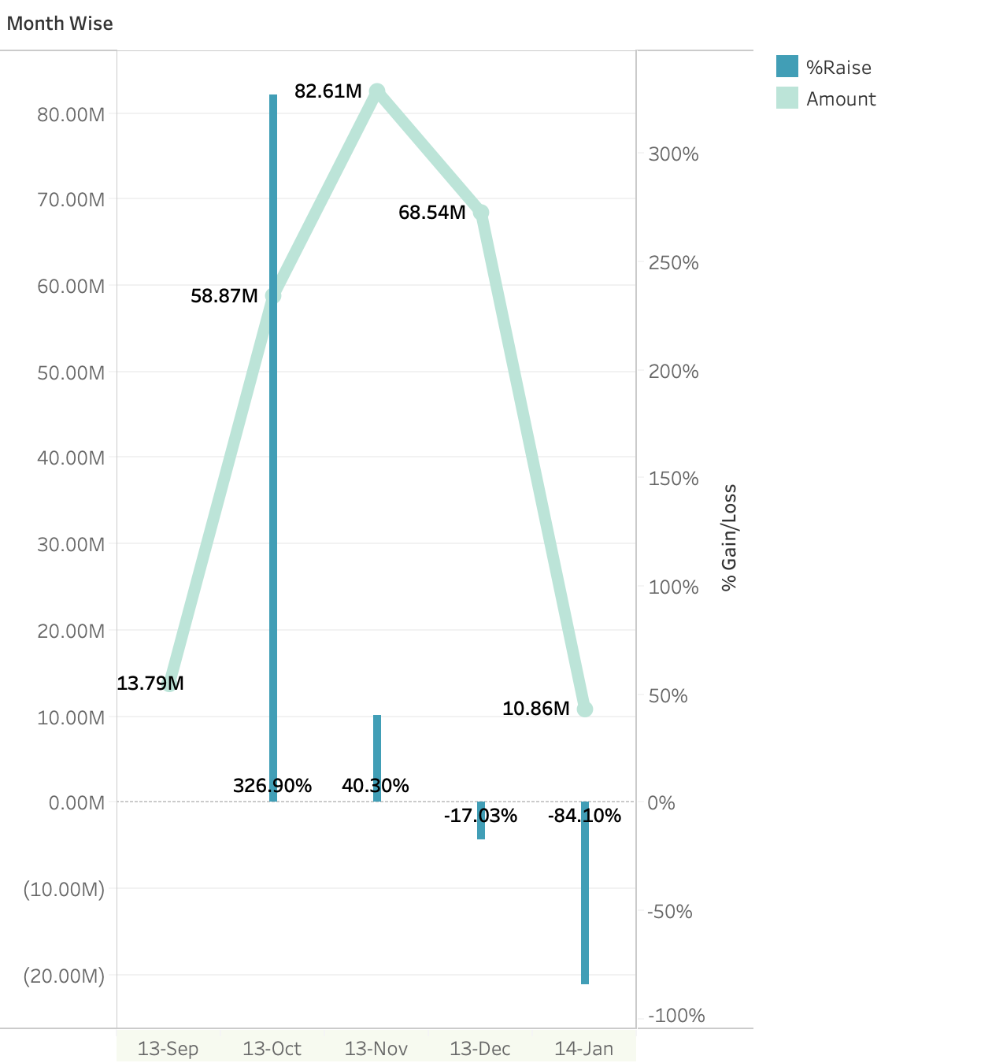
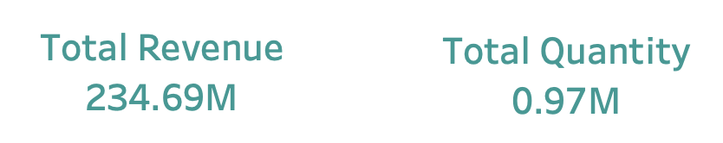
E-Commerce Sales With Successful Checkout (Sep-13 to Jan-14) (1/5)
More fluctuations in Revenue by month
Maybe
- Seasonal Products
- End of Holiday season
- Inventory
- Out of Stock on Clearance Products

Slide 6
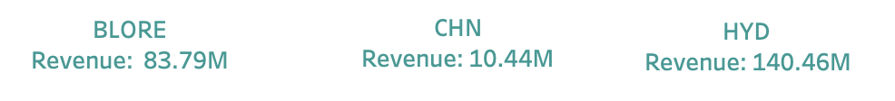
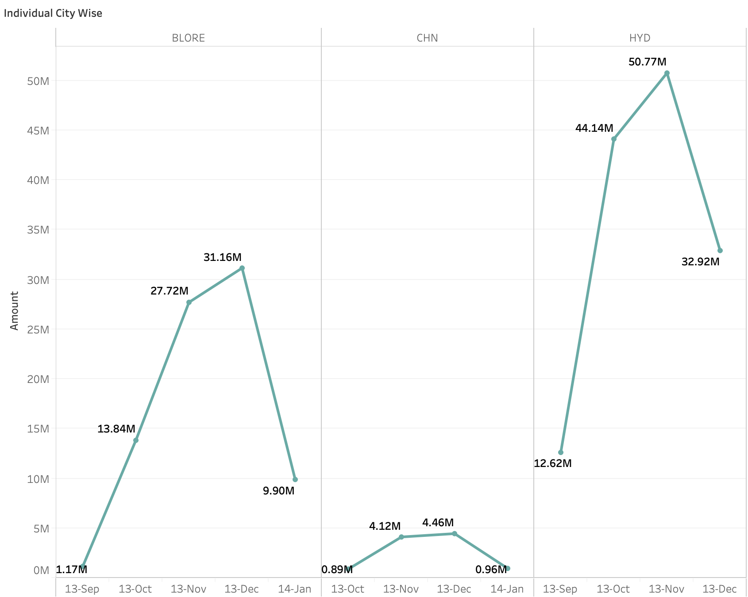
E-Commerce Sales With Successful Checkout (Sep-13 to Jan-14) (2/5)
Less Revenue in Chennai Compared to other Cities
- Might be due to usage of more traditional
Clothing
- Not much effective change in inventory between
seasons
- There can be failure in 4P’s of marketing
strategies
- Maybe people are tending to buy in local
stores due to less local products available on the
e-commerce website
Hyderabad had no revenue in Jan maybe due to the state division moments
Recommendations:
- Traditional Products matching local store prices
- Review prior year sales
- Plan discounts ahead of time
- Focusing on Delivery time
- Wider Reach/More Traffic

Slide 7
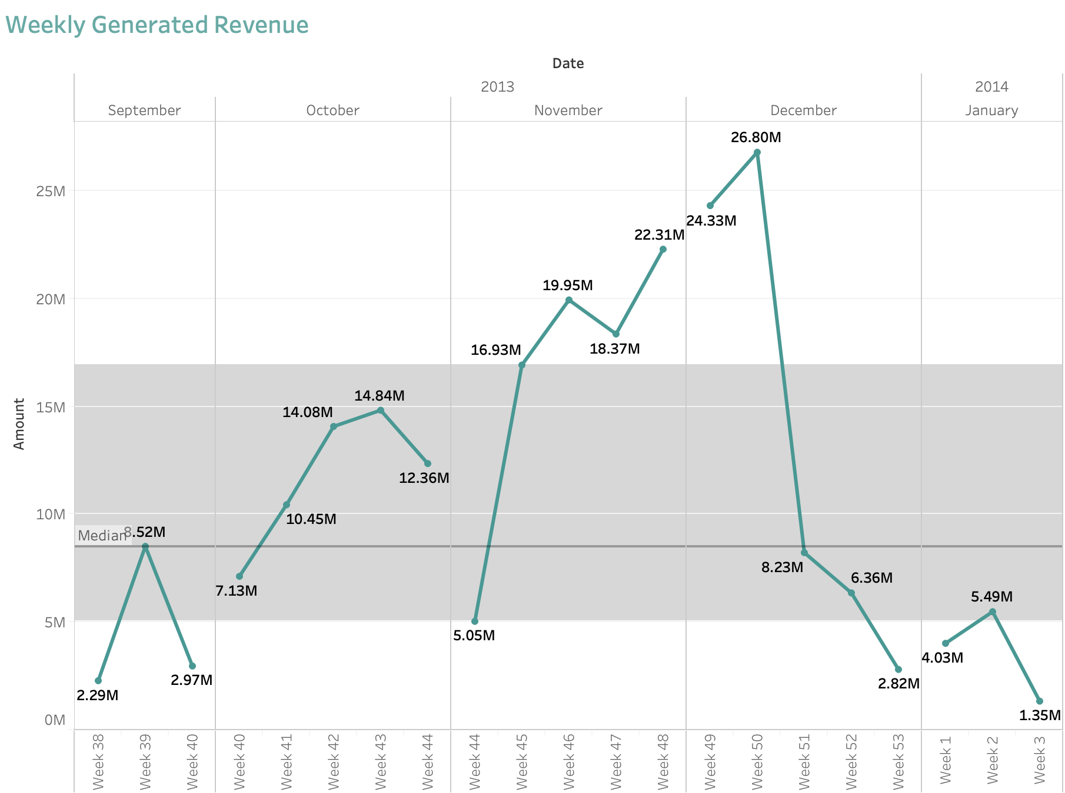
E-Commerce Sales With Successful Checkout (Sep-13 to Jan-14) (3/5)

Slide 8
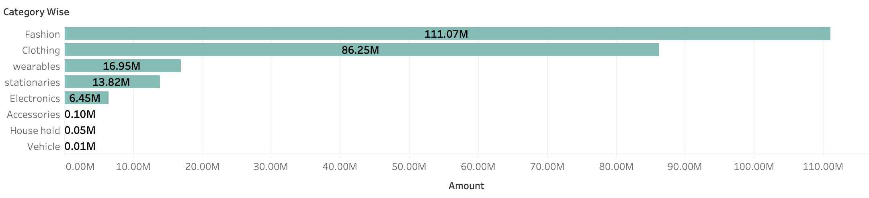
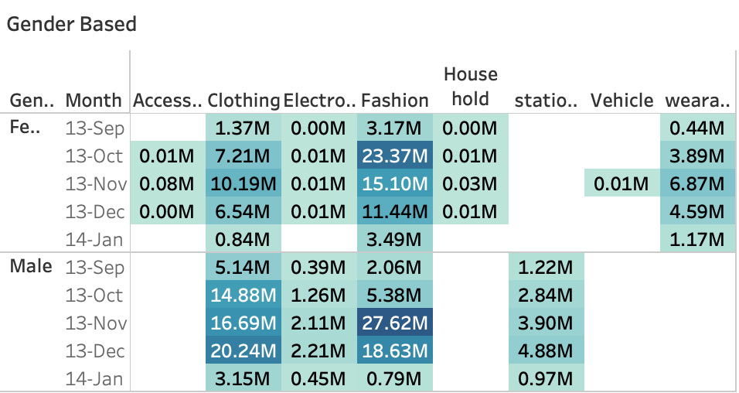
E-Commerce Sales With Successful Checkout (Sep-13 to Jan-14) (4/5)
Fashion & Clothing has more popularity compared to rest of the products maybe because of more graduates, People in Early 30’s in these areas (three cities are largest metropolitan & IT fields in India)
Focusing more on female gender products due to less sales compared to males
Creating the trust on the other category products
Using Video presentations & testimonials
Easy Return policy

Slide 9
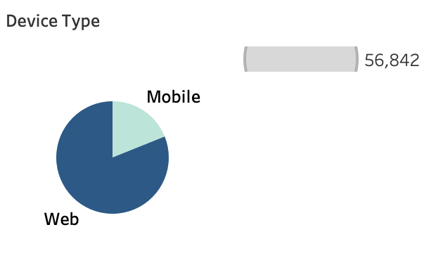
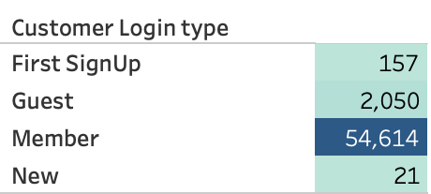
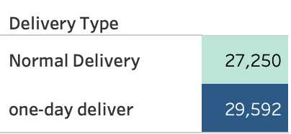
E-Commerce Sales With Successful Checkout (Sep-13 to Jan-14) (5/5)
Confirming the product emergency at checkout
Introducing monthly subscriptions
Supply Chain
More Warehouses
Predicting Product Demand
User friendly interface with easy navigation
Comparing products
In-Mobile Purchase offers
Real Time Order tracking
Offering discounts for signups
Loyalty Programs
Enabling Wishlist's for users after creating accounts

Slide 10

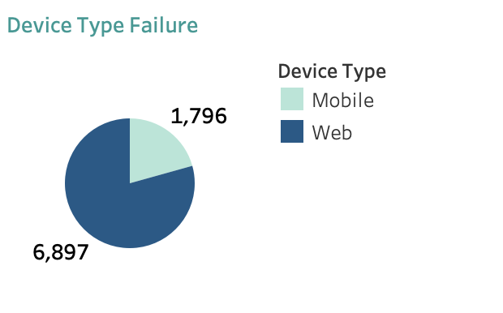
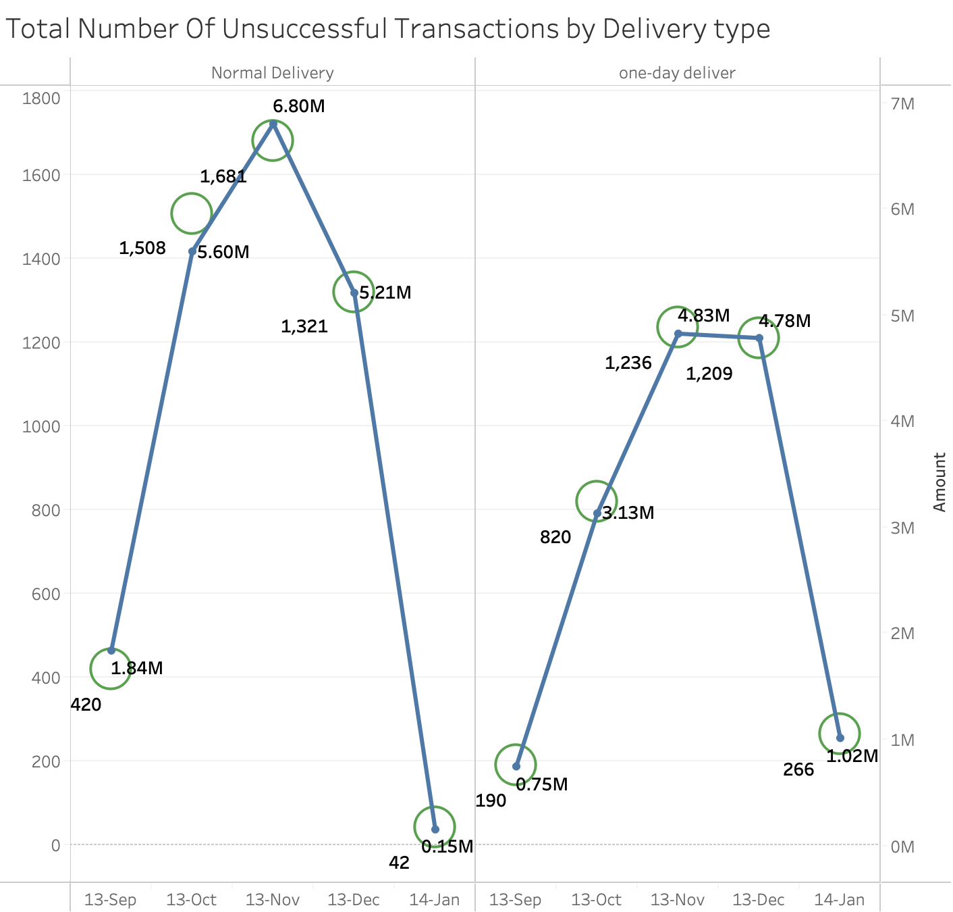
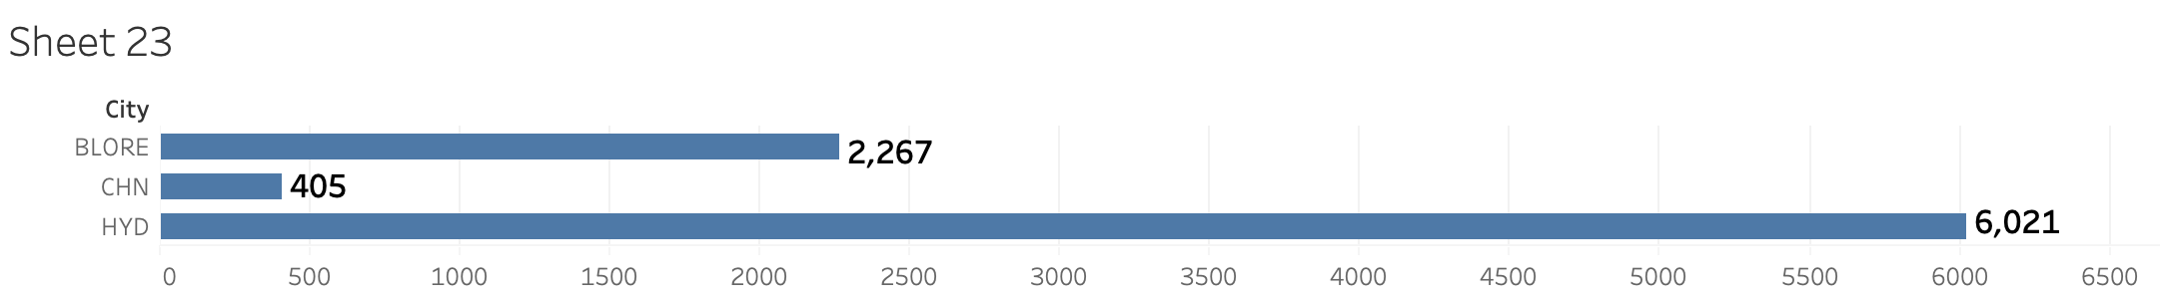
Unsuccessful Checkouts
Friendly Checkout process with wide range of payment options
Payment gateway errors & Bank servers are major problems in India
Making sure the payment doesn’t navigate to different domain
Real Time customer service (Phone Call/Live Chat)
Displaying Coupon Codes right at the checkout

Slide 11
How Future Holds for E-Commerce in India?

Slide 12
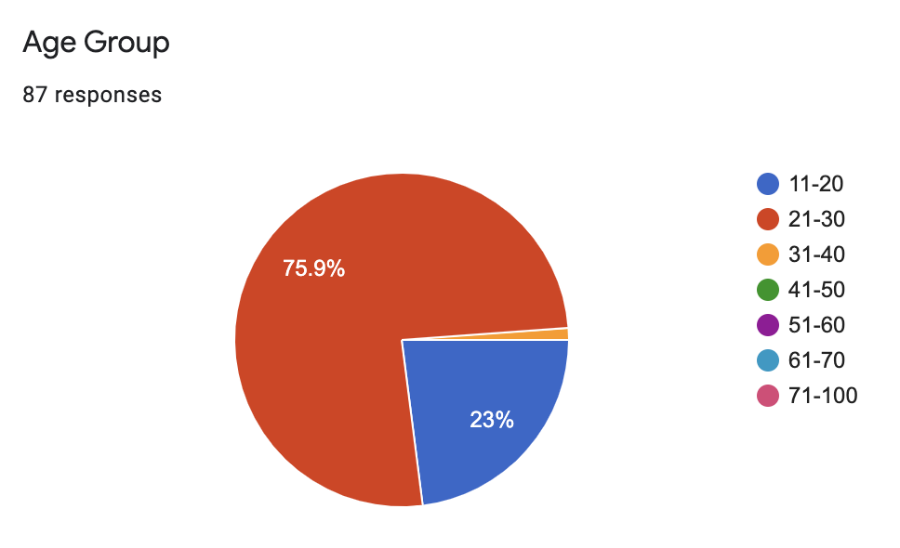
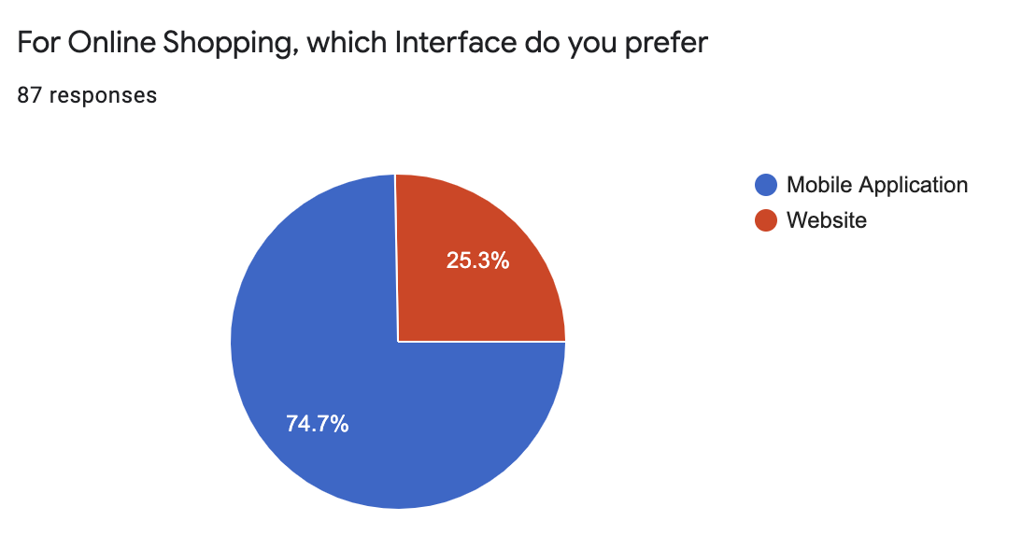
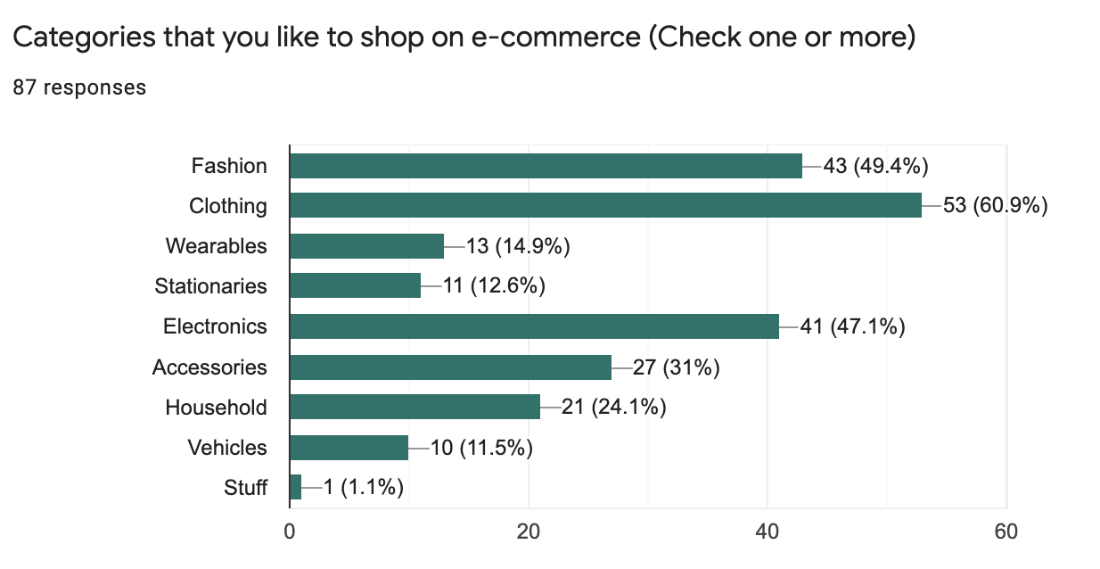
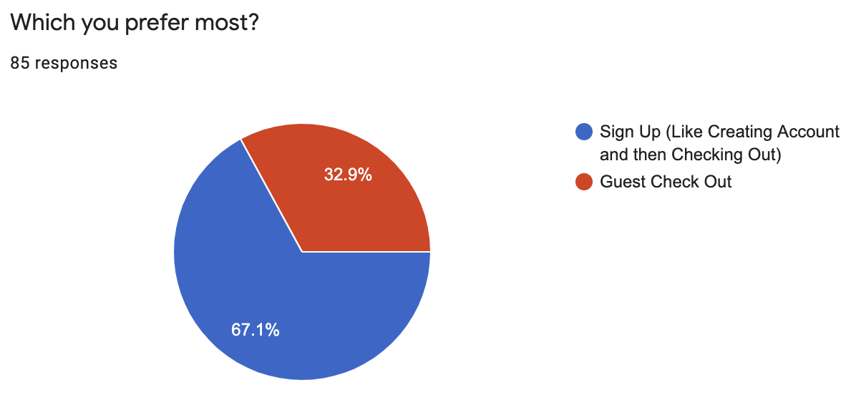
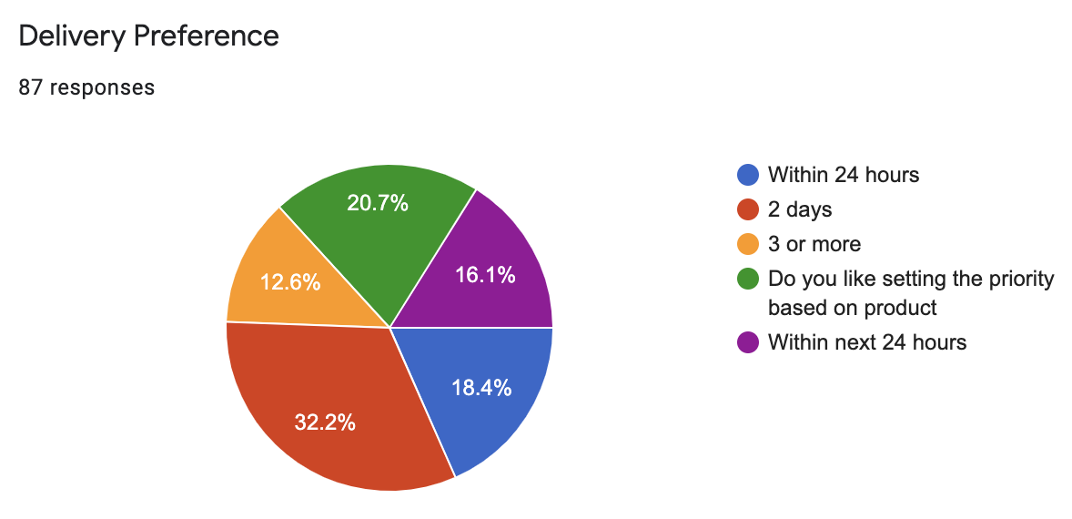
A Survey has been Created Online for this Particular Analysis among 87 Responses in Google Form

Slide 13
Recommendations:
On the Age Group Classification most people were from 21 to 30 Years Interested in the Online shopping a maximum point of view,
on the Question of which Interface is the most preferable one , for that we received a response of 74.7 % mobile Application,
For the Category of the Shopping , most people prefer Clothing, Fashion, Electronics to purchase online.
For the Delivery Preference most people prefer for the less time delivery and in short period: 18.4 % for less than 1-day delivery time, 32% for 2-day delivery time and 20% like to set their priority based on the order items.
For the Sign-Up or Guest question Most prefer for Sign-Up -67.15% and rest for Guest Option.
From this analysis we can understand the Mood of the end-Point Customer who face this problems during Purchasing online. More Interactive Mobile Application can support the Sales with all security features, Based on Targeting the specific age group can increase in revenue , as they tend to purchase more Fashion, Clothing, Electronics, and other next percentage of items on list, we must have specific criteria for marketing and additional discounts offer can booster the sales and increase revenue, with less delivery time and good software application as well.

Slide 14
Conclusion
From this Overall Analysis we can tell that the deep understanding of the data has been studied , Schematic Diagram of the Snowflake and Galaxy has been performed and then the loading of the dataset in the SQL Server Management,
And then the In-Depth Visualization using the Tableau has been carried out to showcase the best and constructive feedback and the state of the E-Commerce company at the current dataset provided date position and the Future improvement Recommendations has been provided.
And moreover this was a good assignment to learn deep and understand the Financial Situation and its implied co- conditioning ( Sales/Products/ Customer) state of E-Commerce Company in India from September 2013 to January 2014.

