Slide 1
Respiratory Disease
Prediction using Machine Learning
Lung Auscultation Sound Classification
Machine Learning Mini Project
SVM • Random Forest • ANN • CNN

Slide 2
Project Overview
From respiratory audio to disease classification
Problem
Approach
Outcome
Respiratory sounds contain patterns that can help distinguish different disease categories.
Reduce noise, extract MFCC features, train four classification models, and compare their performance.
The final models were evaluated using accuracy, precision, recall, F1-score, confusion matrices, ROC and precision-recall curves.
• Focus: simple, requirement-based ML/DL pipeline
• Dataset: respiratory sound recordings with patient diagnosis labels
• Best final accuracy: 86.96% — Random Forest and CNN
Respiratory Disease Prediction using Machine Learning • 2

Slide 3
Dataset
Respiratory Sound Database
920
126
920
8
Audio recordings
Patients
Annotations
Disease classes*
• Each recording is paired with respiratory-cycle annotation information.
• Patient diagnosis information is used to assign disease labels to audio recordings.
• Class distribution is highly imbalanced: COPD is the dominant class.
• * One Asthma sample was excluded before stratified train-test splitting because a single sample cannot be distributed across both sets.
Respiratory Disease Prediction using Machine Learning • 3

Slide 4
System Workflow
End-to-end processing pipeline
01
02
03
04
05
06
Audio
Preprocess
Features
Split
Models
Evaluate
Load WAV recordings
Noise reduction
MFCC extraction + normalization
80% training / 20% testing
SVM • RF • ANN • CNN
Metrics + diagnostic curves
Respiratory Disease Prediction using Machine Learning • 4

Slide 5
Audio Preprocessing
Preparing respiratory sounds for machine learning
1. Noise Reduction
2. MFCC Extraction
3. Normalization
The noisereduce library is used to reduce unwanted background noise while preserving the audio signal length.
13 Mel-Frequency Cepstral Coefficients are extracted to represent the spectral characteristics of the respiratory sound.
MFCC values are standardized using mean and standard deviation so that the feature scale is suitable for model training.
• Traditional ML models use a fixed 13-value MFCC feature vector obtained by averaging across time.
• CNN uses the MFCC time-frequency representation.
Respiratory Disease Prediction using Machine Learning • 5

Slide 6
Models Implemented
Four models required by the project
SVM — Support Vector Machine
Random Forest
Finds a decision boundary that separates classes in the feature space.
Combines 100 decision trees and uses their collective prediction.
ANN — Artificial Neural Network
CNN — Convolutional Neural Network
A feed-forward neural network with dense layers learns nonlinear relationships between MFCC features and disease classes.
Learns local patterns from the MFCC time-frequency representation using convolution and pooling layers.
Respiratory Disease Prediction using Machine Learning • 6

Slide 7
Training and Testing
Fixed split used for all final comparisons
Training set
Testing set
735 recordings
80% of the usable dataset
184 recordings
20% of the usable dataset
• Stratified splitting was used so the class distribution is preserved as far as possible.
• The dataset is strongly imbalanced, with COPD accounting for most test samples.
• Therefore, accuracy alone does not fully describe minority-class performance.
Respiratory Disease Prediction using Machine Learning • 7

Slide 8
Final Model Performance
Test-set accuracy after the required preprocessing pipeline
Model | Accuracy
SVM | 86.41%
Random Forest | 86.96%
ANN | 86.41%
CNN | 86.96%
Highest accuracy: Random Forest and CNN — 86.96%
Respiratory Disease Prediction using Machine Learning • 8

Slide 9
Results Interpretation
What the final evaluation shows
• Random Forest and CNN achieved the highest overall accuracy at 86.96%.
• SVM and ANN achieved 86.41% accuracy.
• All models perform much better on the majority COPD class than on minority classes.
• The weighted metrics are more informative than accuracy alone because the dataset is highly imbalanced.
• The project demonstrates a complete audio-to-classification workflow, but it is not a clinical diagnostic system.
Respiratory Disease Prediction using Machine Learning • 9

Slide 10
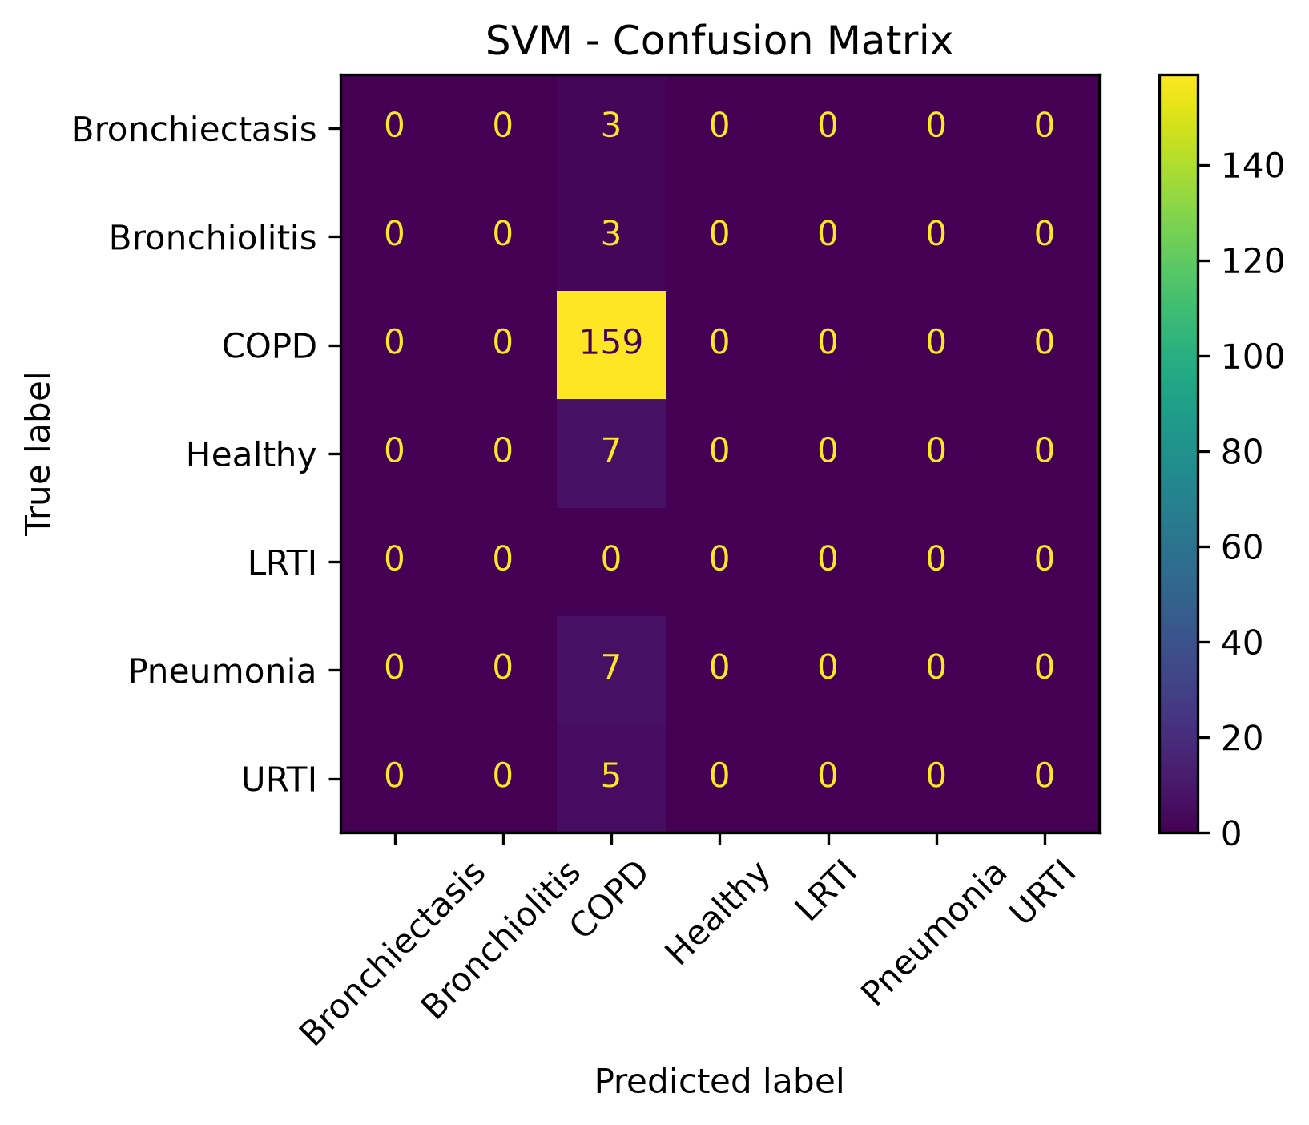
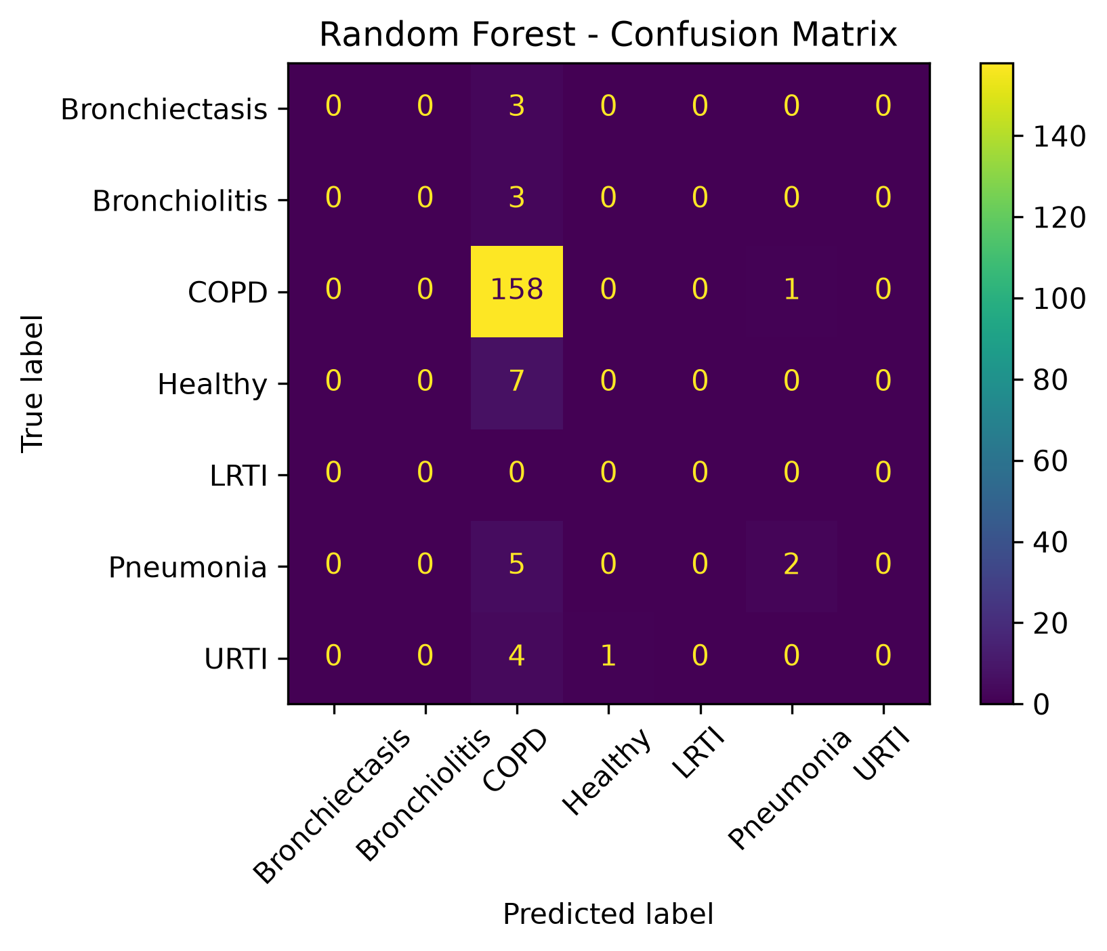
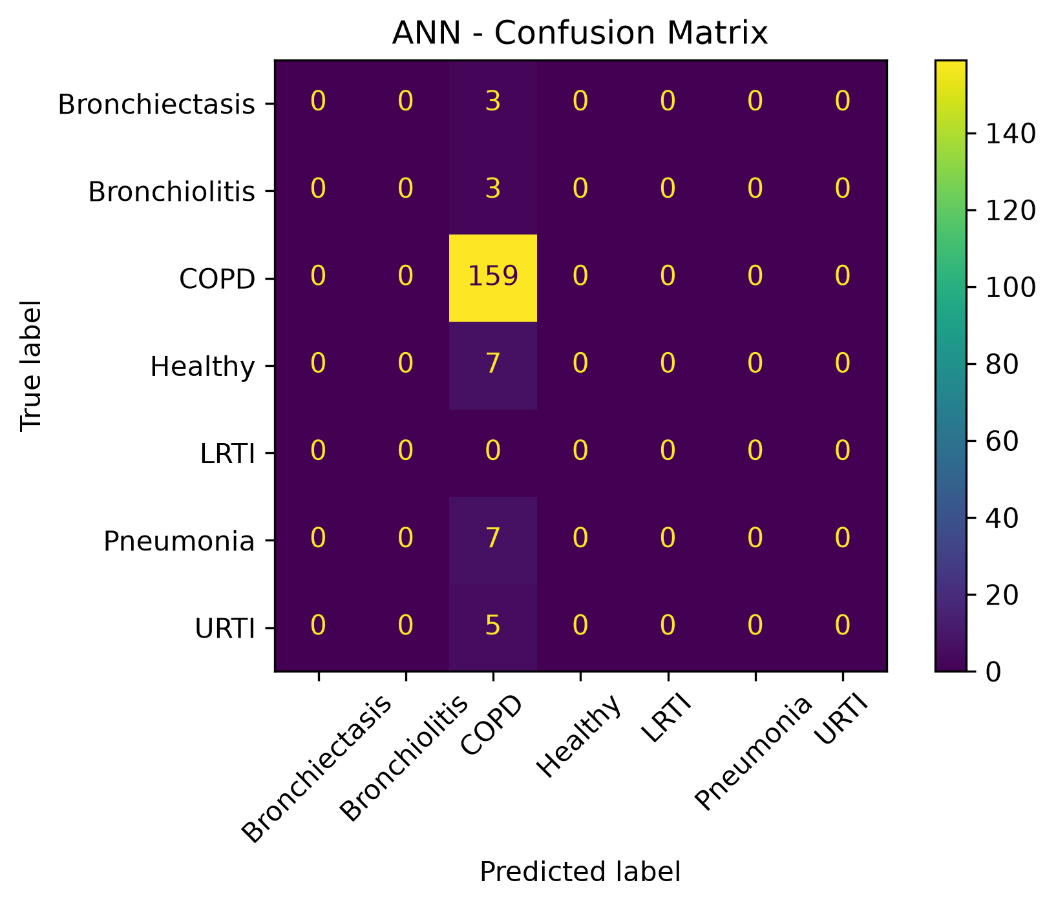

Confusion Matrices
Insert the four final confusion-matrix images here
SVM
Random Forest
PASTE FINAL GRAPH HERE
PASTE FINAL GRAPH HERE
ANN
CNN
PASTE FINAL GRAPH HERE
PASTE FINAL GRAPH HERE
Respiratory Disease Prediction using Machine Learning • 10

Slide 11
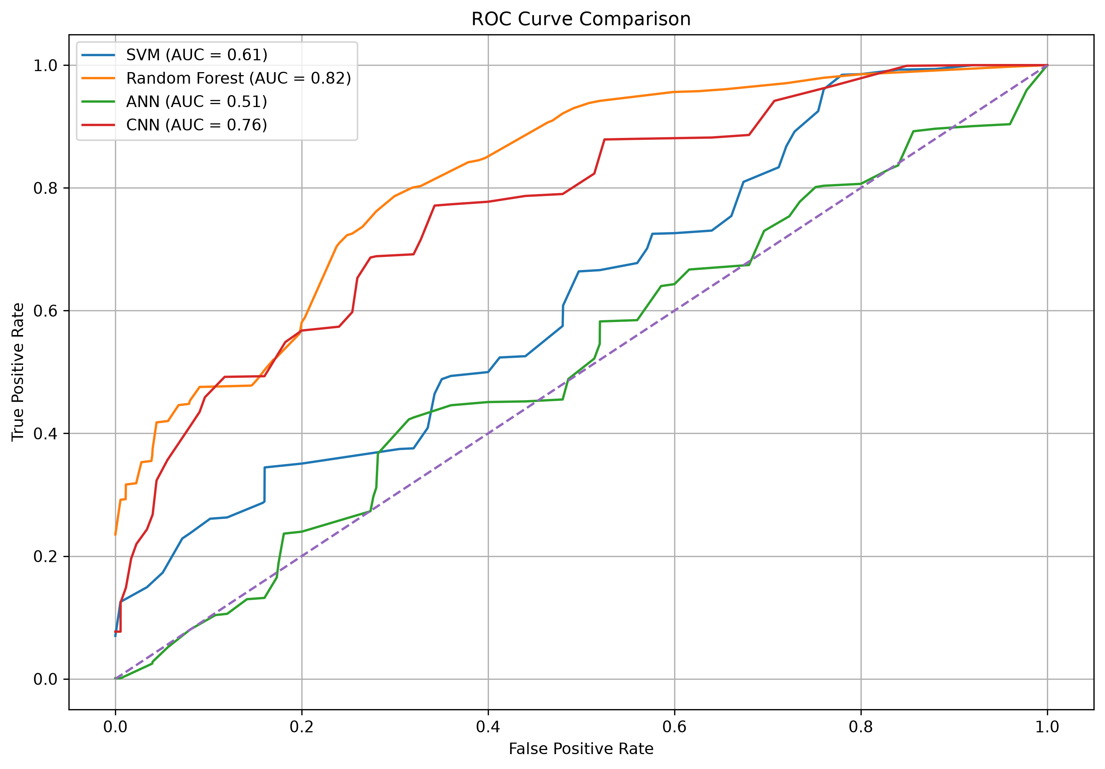
ROC Curve Comparison
Insert your final ROC curve image here
PASTE FINAL ROC CURVE HERE
Respiratory Disease Prediction using Machine Learning • 11

Slide 12
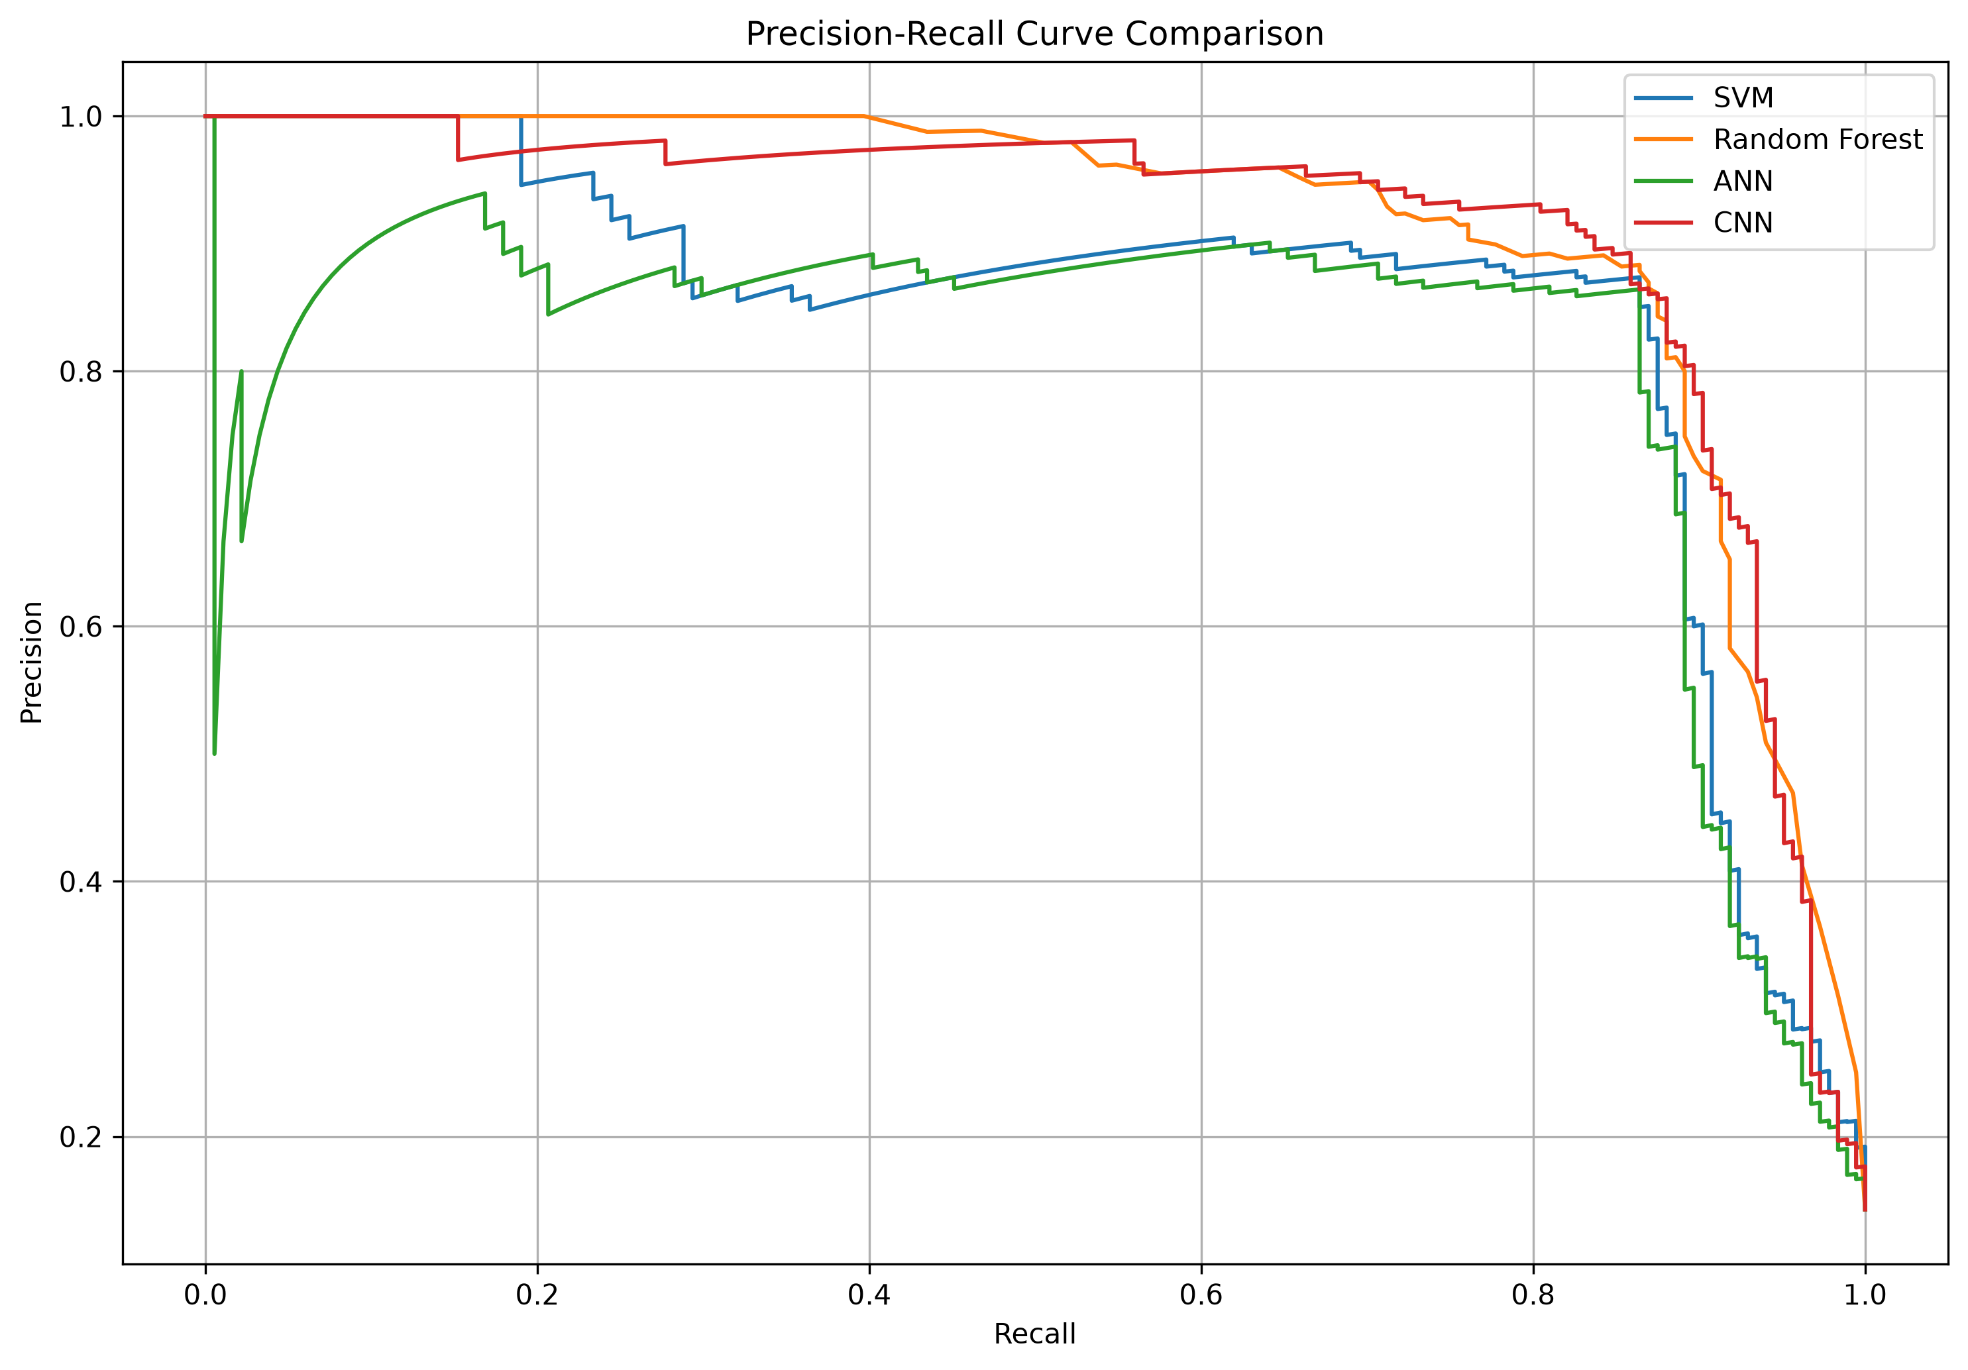
Precision–Recall Curve Comparison
Insert your final precision-recall curve image here
PASTE FINAL PRECISION–RECALL CURVE HERE
Respiratory Disease Prediction using Machine Learning • 12

Slide 13
Model Comparison
Overall performance and practical interpretation
SVM
Random Forest
ANN / CNN
Accuracy: 86.41%
Simple and effective baseline model.
Performance is strongly influenced by the class imbalance.
Accuracy: 86.96%
Highest overall accuracy with CNN.
Good baseline for tabular MFCC features.
ANN: 86.41%
CNN: 86.96%
CNN benefits from retaining the MFCC time-frequency structure.
Respiratory Disease Prediction using Machine Learning • 13

Slide 14
Limitations
Important points for a responsible interpretation
• The dataset is highly imbalanced, with COPD dominating the recordings.
• Several minority classes have very few samples, which limits reliable class-specific learning.
• The single Asthma sample was excluded before stratified splitting.
• Reported results are experimental machine-learning results and should not be interpreted as clinical diagnosis.
• Performance may change with a larger, more balanced dataset and additional recordings.
Respiratory Disease Prediction using Machine Learning • 14

Slide 15
Future Scope
Possible improvements without changing the current project scope
Better Balance
Preprocessing
Evaluation
Use a larger and more balanced respiratory sound dataset.
Explore improved audio cleaning and feature preparation.
Use stronger validation and class-aware evaluation on larger datasets.
• The current project intentionally focuses on the required SVM, Random Forest, ANN and CNN models.
Respiratory Disease Prediction using Machine Learning • 15

Slide 16
Conclusion
• The project successfully builds an end-to-end respiratory sound classification pipeline.
• Noise reduction, MFCC extraction and normalization prepare the audio for model training.
• Four required models were implemented and evaluated.
• Random Forest and CNN achieved the highest final accuracy of 86.96%.
• Because of class imbalance, the results must be interpreted using multiple evaluation metrics.
Thank you
Respiratory Disease Prediction using Machine Learning • 16

