Slide 1
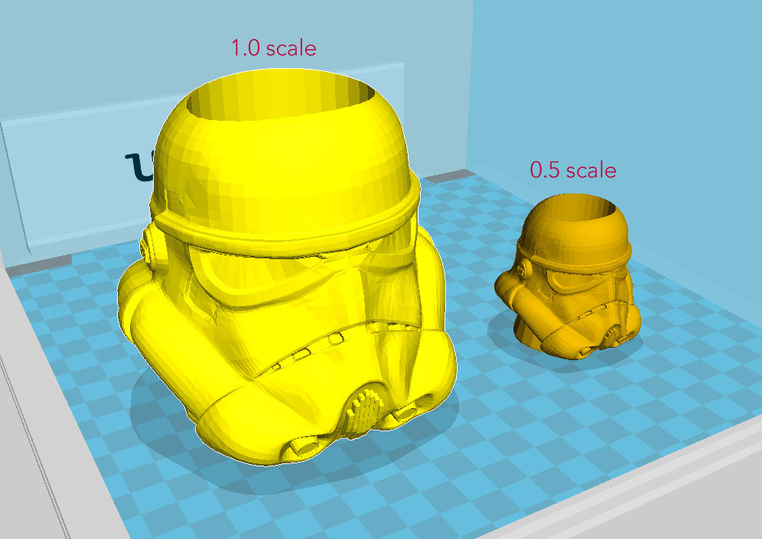
3D-Scaling
Project by:
Wilson Shrestha
Aayush Dhakal
Rupesh Bhasima
Dipesh OIi

Slide 2
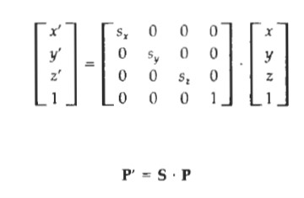
The matrix expression tor the scaling transformation of a position P = (x, y, z) relative
to the coordinate origin can be written as:
Eq. 1:
where scaling parameters s_{x}, s_{y}, and s_{z}, are assigned any positive values. Explicit
expressions for the coordinate transformations for scaling relative to the origin
a re
x' = x . s_{x} , y' = y . s_{y}, z’ = z . s_{z}

Slide 3
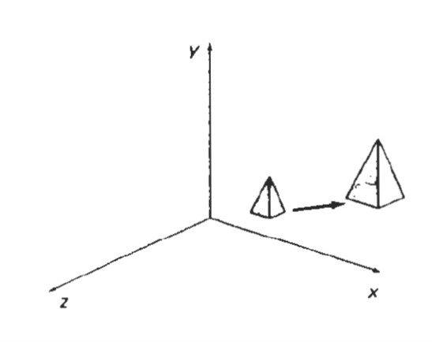
Scaling an object with transformation by previous equation changes the size of the object and repositions the object relative to the coordinate origin. Also, if the transformation parameters are not all equal, relative dimensions in the object are changed: We preserve the original shape of an object with a uniform scaling (s_{x}, = s_{y}, = s_{z},). The result of scaling an object uniformly with each scaling parameter set to 2 is shown in next figure.
Doubling the size of an object with transformation Fig. a also moves the
object farther from the origin

Slide 4
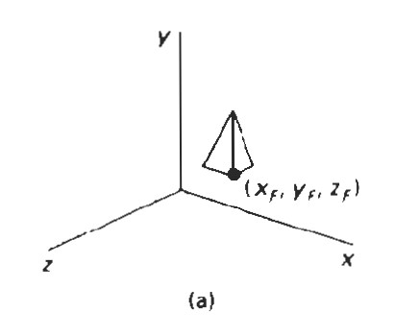
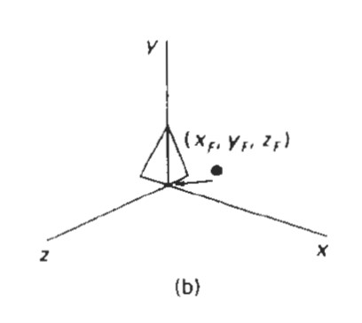
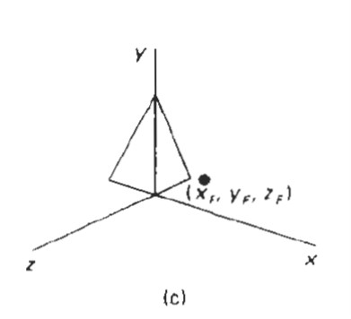
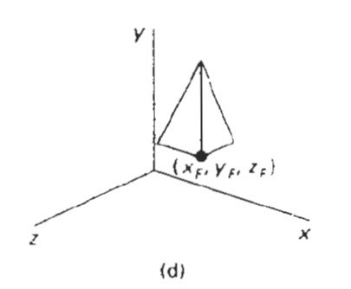
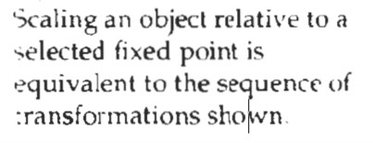
Scaling with respect to a selected fixed position (x_{j},y_{j},z_{j}) can be represented
with the following transformation sequence:
1. Translate the fixed point to the origin.
2. Scale the object relative to the coordinate origin using previous equation.
3. Translate the fixed point back to its original position.
This sequence of transformations is demonstrated in Fig. below.

Slide 5
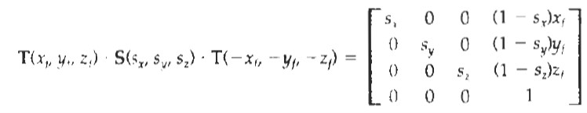
This sequence of transformations is demonstrated in previous figures. The matrix representation for an arbitrary fixed-point scaling can then be expressed as the concatenation of these translate-scale-translate transformations as Eq 2:
We form the inverse scaling matrix for either Eq. 1 or Eq. 2 by
replacing the scaling parameters s_{x},s_{y}, and s_{z} : with their reciprocals. The inverse matrix generates an opposite scaling transformation, so the concatenation of any scaling matrix and its inverse produces the identity matrix.

Slide 6
THE END
“There are three responses to a piece of design – yes, no, and WOW! Wow is the one to aim for.”
-Milton Glaser

