Slide 1
Chapter 4
Visible-Surface Detection Methods OR Hidden Line and Hidden Surface Removal Techniques

Slide 2
Visible-Surface Detection Methods OR (Hidden Line and Hidden Surface Removal Techniques)
Process of realistic graphics for identifying those parts of a scene that are visible from a chosen viewing position
Numerous algorithms have been invented for efficient identification of visible objects for different types of applications
Some methods require more memory, some involve more processing time, and some apply only to special types of objects

Slide 3
Types
a. Object-Space methods:
An object-space method compares objects and parts of objects to each other within the scene definition to determine which surfaces, as a whole, we should label as visible.
It deals with object definition directly. E.g. Back-Face Detection method.
b. Image-Space methods:
Visibility is decided point by point at each pixel position on the projection plane.
It deals with projected image of an object. E.g. Z-Buffer (Depth-Buffer) method, A-Buffer method, Scan-line method etc.
Object space Image space

Slide 4
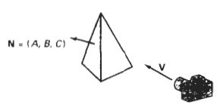
Back-Face Detection (Plane-Equation method)
Fast and simple object shape method for identifying the back face of a polyhedron.
A point (x, y, z) is inside a polygon surface with the plane parameters A,B,C & D if Ax+By+Cz+D < 0.
When an inside point is along the line of sight to the surface , the polygon must be a back face.
To simplify the test, Consider normal vector N to a polygon surface, which has Cartesian components (A, B, C).
If V is a vector in the viewing direction from the eye (or "camera") position, then this polygon is a back face if
V.N > 0
If V.N < 0, the surface is visible.

Slide 5
Back-Face Detection (Plane-Equation method)
We cannot see the back-face of solid objects:
Hence, these can be ignored
N
V

Slide 6
Back-Face Detection (Plane-Equation method)
We can see the front-face of solid objects:
Hence, these cannot be ignored
V
N

Slide 7
Back-Face Detection (Plane-Equation method)
Works fine for convex polyhedra: ±50% removed
Concave or overlapping polyhedra: require additional processing
Interior of objects can not be viewed
Partially visible front faces

Slide 8
Back-Face Detection (Plane-Equation method)
Q. Consider a rectangular pyramid defined by A(1,0,0), B(0,0,-1), C(-1,0,0), D(0,0,1) and E(0,1,0). If the observer is at
(5,5,5)
(0,0.5,0)
(5,1,5)
Is the face AED visible?
See in class room note.

Slide 9
Depth-Buffer (Z-Buffer) Method
Commonly used image space method for detecting visible surfaces.
Compares surface depth at each pixel position on the projection plane.
Also called Z -Buffer method as object depth is usually measured from the view plane along the z-axis of a viewing plane.
Each surface of a scene is processed separately, one point at a time.
Suitable for scene containing polygon surface only, not applied to non planar surface.
For each pixel position (x , y) on the view plane, object depth can be compared by comparing the z values.

Slide 10
Depth-Buffer (Z-Buffer) Method
Three surfaces at varying distance from view plane x_{v}y_{v} , the projection along (x, y) surface S₁ is closest to the view-plane, so surface intensity value of S₁ at (x, y) is saved.
Normalized view volume
y_{v}
x_{v}
z_{v}
front =
visible
pixel
View plane

Slide 11
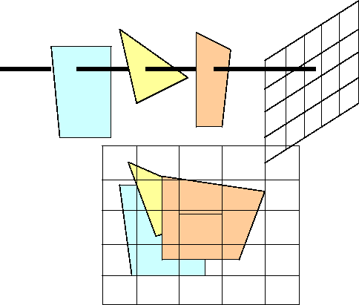
Depth-Buffer (Z-Buffer) Method
In Z-buffer method, two buffers area are required.
Depth buffer (z-buffer): stores the depth value for each (x, y) position as surfaces are processed.
Refresh buffer (Image buffer or Frame Buffer): stores the intensity value for each position.

Slide 12
Algorithm: Z-buffer
1. Initialize depth buffer and refresh buffer so that for all buffer position (x, y)
depth (x, y) = 0, refresh (x, y) = I_{background.}
2. For each position on each polygon surface, compare depth values to previously stored value in depth buffer to determine visibility.
Calculate the depth z for each (x, y) position on polygon
If z > depth (x, y) then
depth (x, y) = z, refresh (x, y) = I_{surface}(x, y)
where, I_{background} = Intensity value for background
I_{surface} (x, y) = Intensity value for surface at pixel position (x, y) on projected plane.
3. After all pixels and surfaces are processed (compared), the depth buffer contains the depth value of the visible surface and refresh buffer contains the corresponding intensity values for those surface. Calculate depth value compared to the value stored in depth buffer and then draw the object.

Slide 13
Algorithm: Z-buffer
The depth values of the surface position (x, y) are calculated by plane equation of surface.
Let Depth Z' at position (x+1, y) along the scan line is,
is constant for each surface so succeeding depth value across a scan line are obtained from preceding values by single addition.
first determine y coordinate extents of each polygon y scan line and process from top scan to bottom scan starting y-1 scan line at a top vertices we can recursively calculate ‘x’ position down a left edge of the polygon as

Slide 14
Algorithm: Z-buffer
polygon
scan line
y
x’ = x - 1/ m where m is the slope of edge fig
‘z’ values down the edge are then obtained
recursively as figure.
z’ = z + (a/m + b) /c or z’ = z + b/c as ‘m’ is infinite for vertical edge
x
x+1
display
Drawback:
It deals only with opaque surface, but not with transparent surface.
It can only find visible surface of each pixel position. So A-buffer described below solves this problem.
High memory requirement (depth buffer + refresh buffer).

Slide 15
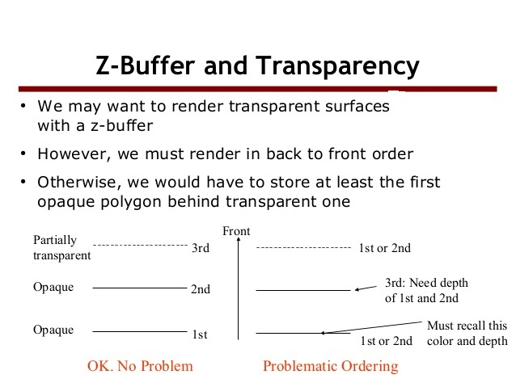

Slide 16
A-Buffer Method
A-buffer expands z-buffer so that each position in the buffer can reference a linked list of surfaces. So, more than one surface intensity can be taken into consideration at each pixel.
The key data structure in it is the accumulation buffer so called as A- buffer.
Efficient because it uses logical bitwise operators.
Each pixel position in the A-buffer has two fields:
Depth field: stores a + ve or – ve real number.
i. If + ve, single surface contributes to pixel intensity.
ii. If - ve, multiple surfaces contribute to pixel intensity.
Intensity field: stores surface intensity value or a pointer value
i. Surface intensity if single surface (stores the RGB components of the surface color at that point and percent of pixel coverage)
ii. Pointer value if multiple surfaces.

Slide 17
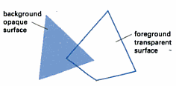
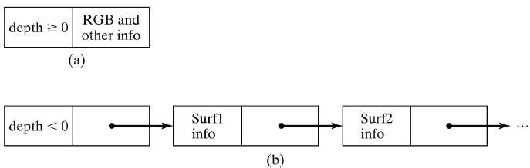
A-Buffer Method
If depth field >= 0, the number stored at that position is the depth of a single surface overlapping the corresponding pixel area.
If depth field < 0, this indicates multiple surface contributions to the pixel intensity.

Slide 18
Scan-Line Method
This is image-space method for removing hidden surface which is extension of the scan line polygon filling for polygon interiors.
Instead of filling one surface we deal with multiple surfaces here.
In this method, as each scan line is processed, all polygon surfaces intersecting that line are examined to determine which are visible.
Across each scan line, depth calculations are made for each overlapping surface to determine which is nearest to the view plane.
When the visible surface has been determined, the intensity value for that position is entered into the image buffer.

Slide 19
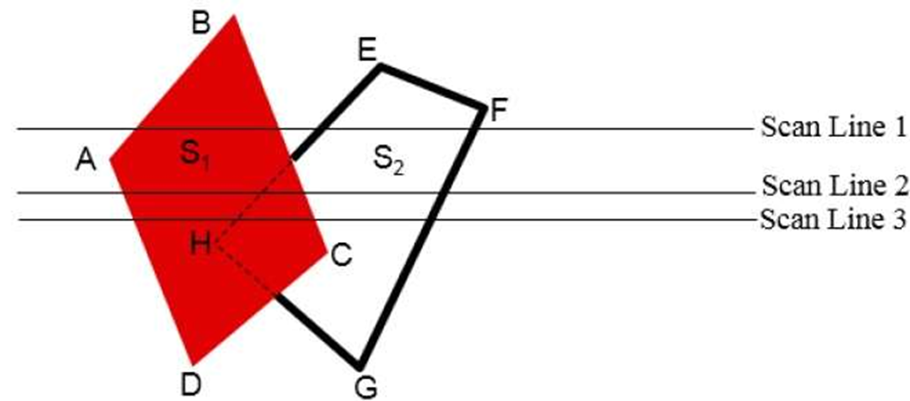
Scan-Line Method
Scan line crossing the projection of two surfaces s1 and s2, in the view plane. Dashed lines indicate the boundaries of hidden surfaces.

Slide 20
Scan-Line Method
Figure above illustrates the scan-line method for locating visible portions of surfaces for pixel positions along the line.
The active edge list for scan line 1 contains information from the edge table for edges AB, BC, EH, and FG. For positions along this scan line between edges AB and BC, only the flag for surface S₁ is on.
Therefore, no depth calculations are necessary, and intensity information for surface S₁ is entered from the polygon table into the refresh buffer.
Similarly, between edges EH and FG, only the flag for surface S₂ is on. No other positions along scan line 1 intersect surfaces, so the intensity values in the other areas are set to the background intensity. The background intensity can be loaded throughout the buffer in an initialization routine.
For scan lines 2 and 3, the active edge list contains edges AD, EH, BC, and FG. Along scan line 2 from edge AD to edge EH, only the flag for surface S₁ is on. But between edges EH and BC, the flags for both surfaces are on. In this interval, depth calculations must be made using the plane coefficients for the two surfaces.
For example, the depth (Z) of surface S₁ is assumed to be less than that of S₂, so intensities for surface S₁ are loaded into the refresh buffer until boundary BC is encountered. Then the flag for surface S₁ goes off, and intensities for surface S₂ are stored until edge FG is passed.

Slide 21
Depth-Sorting Method (Painter’s Algorithm)
This method uses both object space and image space methods.
In this method the surface representation of 3D object are sorted as decreasing depth from viewer.
Then sorted surface are scan converted in order starting with surface of greatest depth for the viewer.
This method is also called as "Painter's Algorithm" as it simulates how a painter typically produces his painting.

Slide 22
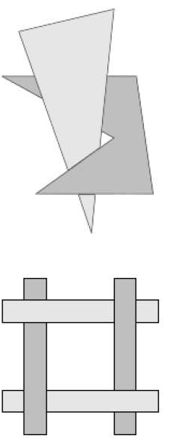
Depth-Sorting Method (Painter’s Algorithm)
In creating painting, an artist first paints the background colors. Next, the most distant objects are added, then the nearer objects and so on. Finally, foreground objects are painted on the canvas over the background and other objects that have been painted on the canvas. Each layer of the paint covers up the previous layer. Using similar technique,
We first sort surfaces according to their distances from the view plane.
Intensity values for the farthest surface are then entered into the refresh buffer.
Taking each succeeding surface in turn (in decreasing depth order), we “paint” the surface intensities onto the frame buffer over the intensities of previously processed surfaces.

Slide 23
Depth-Sorting Method (Painter’s Algorithm)
The conceptual steps that performed in depth-sort algorithm are
Surfaces are sorted in order of decreasing depth (z-coordinate).
Resolve any ambiguity that may cause when the polygons depth(z) extents overlap, splitting polygons if necessary.
Surfaces are scan converted in order, starting with the surface of greatest depth.
Sorting operations are carried out in both image and object space, and the scan conversion of the polygon surfaces is performed in image space.

Slide 24
Depth-Sorting Method (Painter’s Algorithm)
Problem: One of the major problems in this algorithm is intersecting polygon surfaces. As shown in fig. below.
Different polygons may have same depth.
The nearest polygon could also be farthest.
We cannot use simple depth-sorting to remove the hidden-surfaces in the images.
Solution: For such intersecting polygons, we can split one polygon into two or more polygons which can then be painted from back to front. This needs more time to compute intersection between polygons. So it becomes complex algorithm for such surface existence.

Slide 25
Area-Subdivision Method
The quick test that determine or tells us either the current area is part of one surface or further sub division is needed.
The area-subdivision method takes advantage by locating those view areas that represent part of a single surface.
Divide the total viewing area into smaller and smaller rectangles until each small area is the projection part of a single visible surface or no surface at all.
Continue this process until the subdivisions are easily analyzed as belonging to a single surface or until they are reduced to the size of a single pixel.
An easy way to do this is to successively divide the area into four equal parts at each step.

Slide 26
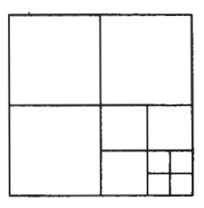
Area-Subdivision Method
Dividing a square area into equal-sized quadrants at each step.

Slide 27
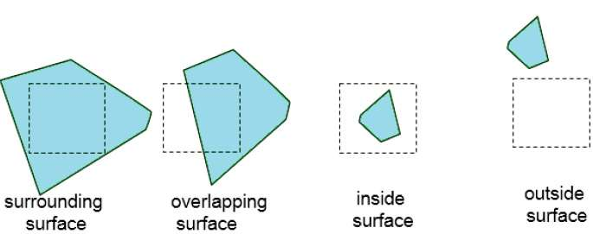
Area-Subdivision Method
There are four possible relationships that a surface can have with a
specified area boundary.
Surrounding surface − One that completely encloses the area.
Overlapping surface − One that is partly inside and partly
outside the area.
Inside surface − One that is completely inside the area.
Outside surface − One that is completely outside the area.

Slide 28
Area-Subdivision Method
No further subdivisions of a specified area are needed if one of the following conditions is true −
All surfaces are outside surfaces with respect to the area.
Only one inside, overlapping or surrounding surface is in the area.
A surrounding surface complicates all other surfaces within the area boundaries.

Slide 29
BSP-Tree Method(binary space partitioning)
A binary space partitioning (BSP) tree is an efficient method for determining object visibility by painting surfaces onto the screen from back to front as in the painter's algorithm.
The BSP tree is particularly useful when the view reference point changes, but object in a scene are at fixed position.
Identify the surfaces that are "inside" or "outside" the partitioning plane at each step of space subdivision relative to viewing direction.
It is useful and efficient for calculating visibility among a static group of 3D polygons as seen from an arbitrary viewpoint.

Slide 30
BSP-Tree Method(binary space partitioning)
P₂
C
P₁
P₁
b
View
f
D
A
P₂
P₂
f
b
f
b
Front
B
Back
A
C
B
D
Back.
(b)
(a)
Front
(BSP-TREE)Binary space partitioning

Slide 31
BSP-Tree Method(binary space partitioning)
Here plane P₁ partitions the space into two sets of objects, one set of object is back and one set is in front of partitioning plane relative to viewing direction.
Since one object is intersected by plane P₁, we divide that object into two separate objects labeled A and B. Now, object A and C are in front of P₁, B and D are at back of P₁.
We next partition the space with plane P₂ and construct the binary tree as fig (a). In this tree, the objects are represented as terminal nodes, with front object as left branches and behind object as right branches.
When BSP tree is complete, we process the tree by selecting surface for displaying in order back to front. So foreground object are painted over back ground objects.

Slide 32
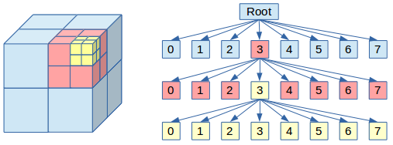
Octree Method
When an octree representation is used for viewing volume, hidden surface elimination is accomplished by projecting octree nodes into viewing surface in a front to back order.

Slide 33
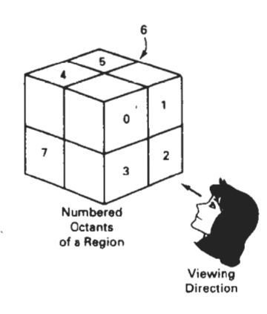
Octree Method
Objects in octants 0,1,2 and 3 obscure objects in the back octants (4,5,6,7) when the viewing
direction is as shown.

Slide 34
Octree Method
The front face of a region space is formed with octants 0,1,2,3 whose Surface are visible to the viewer.
But the back octants 4,5,6,7 are not visible.
After octant sub-division and construction of octree, entire region is navigated by depth first search method.
Figure depicts the octants in a region of space and the corresponding quadrants on the view plane.
Contributions to quadrant 0 come from octants 0 and 4.
Color values in quadrant 1 are obtained from surfaces in octants 1 and 5, and values in each of the other two quadrants are generated from the pair of octants aligned with each of these quadrants.

Slide 35
Ray-Casting Method(Ray-Tracing Method)
Ray-Tracing also known as Ray-Casting is efficient method for visibility detection in the objects.
Ray casting is a visibility detection tool which is based on geometric optics methods, which trace the paths of light rays.
Since there are an infinite number of light rays in a scene and we are interested only in those rays that pass through pixel positions, we can trace the light-ray paths backward from the pixels through the scene.
The ray-casting approach is an effective visibility-detection method for scenes with curved surfaces, particularly spheres.

Slide 36
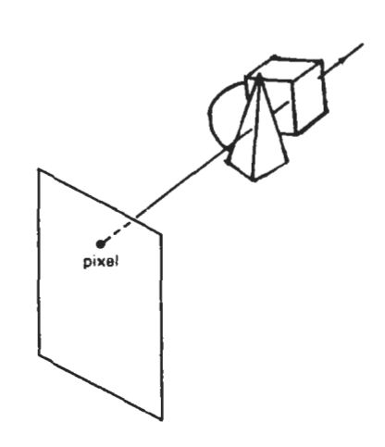
Ray-Casting Method(Ray-Tracing Method)
Trace the path of an imaginary ray from the viewing position (eye) through viewing plane to object in the scene.
Identify the visible surface by determining which surface is intersected first by the ray.
Can be easily combined with lightning algorithms to generate shadow and reflection.
It is good for curved surface but too slow for real time application.
ray.
observer
window
A ray along the line of sight from a pixel position through a scene.

Slide 37
Light, Color and Shading

Slide 38
Illumination and Surface Rendering
Realistic displays of a scene are obtained by perspective projections and applying natural lighting effects to the visible surfaces of object.
An illumination model is also called lighting model and sometimes called as a shading model which is used to calculate the intensity of light that we should see at a given point on the surface of a object.
A surface-rendering algorithm uses the intensity calculations from an illumination model.

Slide 39
Light Sources
Sometimes light sources are referred as light emitting object and light reflectors. Generally light source is used to mean an object that is emitting radiant energy e.g. Sun.
Point Source: Point source is the simplest light emitter e.g. light bulb.
Distributed light source: Fluorescent light
Fig: Diverging ray paths from the Fig: An object illuminated with a
Point light source distributed light source

Slide 40
Light Sources
When light is incident on an opaque surface part of it is reflected and part of it is absorbed.
Surface that are rough or grainy, tend to scatter the reflected light in all direction which is called diffuse reflection.
When light sources create highlights, or bright spots, called specular reflection
Specular reflection
Diffuse reflection

Slide 41
Illumination Models
Illumination models are used to calculate light intensities that we should see at a given point on the surface of an object.
Lighting calculations are based on the optical properties of surfaces, the background lighting conditions and the light source specifications.
All light sources are considered to be point sources, specified with a co-ordinate position and an intensity value (color).
Some illumination models are:
Ambient Light (Background Light)
Diffuse Reflection
Specular Reflection and the Phong Model

Slide 42
1. Ambient Light (Background Light)
This is a simplest illumination model. A surface that is not exposed directly to light source still will be visible if nearby objects are illuminated.
The combinations of light reflections form various surfaces to produce a uniform illumination called ambient light or background light.
Ambient light has no spatial or directional characteristics and amount on each object is a constant for all surfaces and all directions.
In this model, illumination can be expressed by an illumination equation in variables associated with the point on the object being shaded.
We can think of this model, which has no external light source-self-luminous objects.

Slide 43
1. Ambient Light (Background Light)
The equation expressing this simple model is
K_{a} ranges from 0 to 1.
where I is the resulting intensity and K_{a} ranges from 0 to 1.
If we assume that ambient light impinges equally on all surfaces from all direction, then
where is intensity of ambient light. The amount of light reflected from an object's surface is determined by , the ambient-reflection coefficient.

Slide 44
2. Diffuse Reflection
Objects illuminated by ambient light are uniformly illuminated across their surfaces even though light are more or less bright in direct proportion of ambient intensity.
Illuminating object by a point light source, whose rays enumerate uniformly in all directions from a single point.
The object's brightness varies from one part to another, depending on the direction of and distance to the light source.

Slide 45
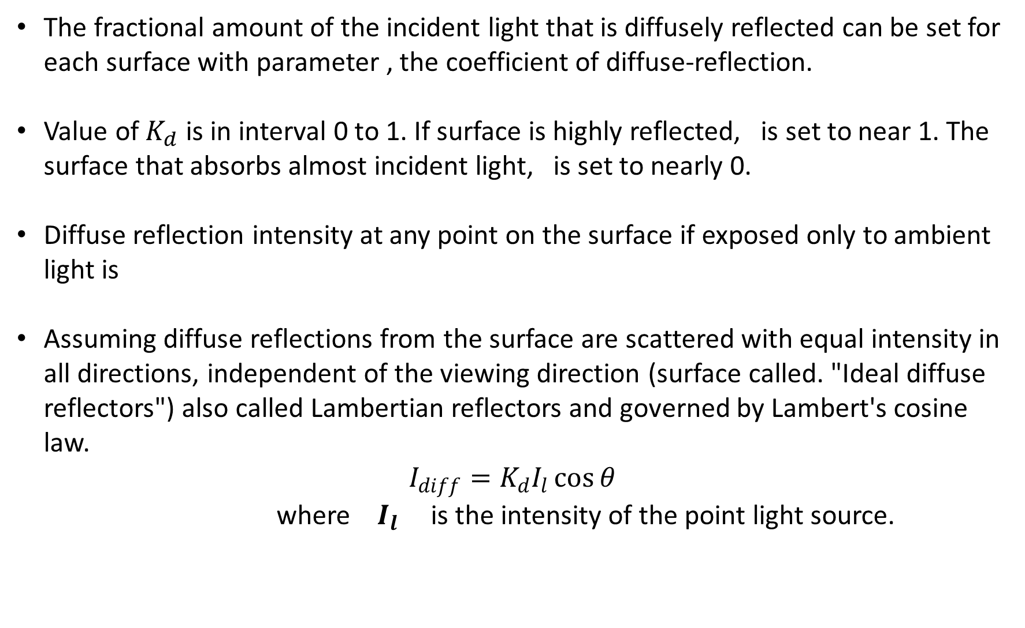
2. Diffuse Reflection
The fractional amount of the incident light that is diffusely reflected can be set for each surface with parameter , the coefficient of diffuse-reflection.
Value of $K_{d}$ is in interval 0 to 1. If surface is highly reflected, is set to near 1. The surface that absorbs almost incident light, is set to nearly 0.
Diffuse reflection intensity at any point on the surface if exposed only to ambient light is
Assuming diffuse reflections from the surface are scattered with equal intensity in all directions, independent of the viewing direction (surface called. "Ideal diffuse reflectors") also called Lambertian reflectors and governed by Lambert's cosine law.
$$I_{diff}=K_{d}I_{l}\cos{θ}$$
where $I_{l}$ is the intensity of the point light source.

Slide 46
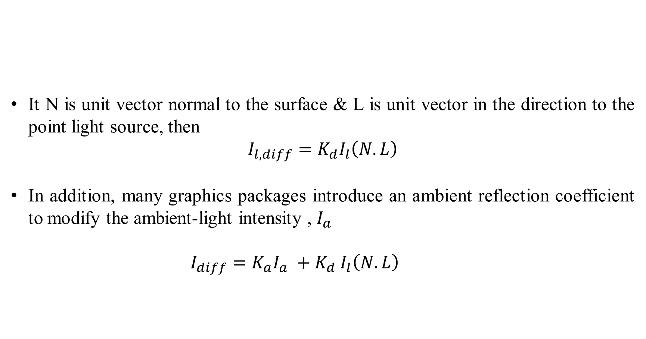
2. Diffuse Reflection
It N is unit vector normal to the surface & L is unit vector in the direction to the point light source, then
$$I_{l,diff}=K_{d}I_{l}\left(N.L\right)$$
In addition, many graphics packages introduce an ambient reflection coefficient to modify the ambient-light intensity , $I_{a}$
$$I_{diff}=K_{a}I_{a} {+ K}_{d}I_{l}\left(N.L\right)$$

Slide 47
3. Specular Reflection and the Phong Model
When we look at an illuminated shiny surface, such as polished metal, a person's forehead, we see a highlight or bright spot, at certain viewing direction. Such phenomenon is called specular reflection.
It is the result of total or near total reflection of the incident light in a concentrated region around the specular reflection angle.
N - Unit vector normal to surface at incidence point
R - Unit vector in the direction of ideal specular reflection.
L - Unit vector directed to words point light source.
V - Unit vector pointing to the viewer from surface.
Viewing angle relative to the specular reflection direction.
Fig: Specular-Reflection equals the angle of incidence θ

Slide 48
3. Specular Reflection and the Phong Model
Fig: Modeling specular reflections (shaded area) with parameter n_{s}

Slide 49
3. Specular Reflection and the Phong Model

Slide 50
3. Specular Reflection and the Phong Model

Slide 51
Polygon-Rendering Methods (Surface-Rendering Methods)
Application of an illumination model to the rendering of standard graphics objects those formed with polygon surfaces are key technique for polygon rendering algorithm
Calculating the surface normal at each visible point and applying the desired illumination model at that point is expensive.
We can describe more efficient shading models for surfaces defined by polygons and polygon meshes.
Scan line algorithms typically apply a lighting model to obtain polygon surface rendering in one of two ways.
Each polygon can be rendered with a single intensity, or the intensity can be obtained at each point of the surface using an interpolating scheme.

Slide 52
1.Constant-Intensity Shading (Flat-Shading)
The simplest model for shading for a polygon is constant intensity shading also called as Faceted Shading or flat shading.
This approach implies an illumination model once to determine a single intensity value that is then used to render an entire polygon.
Constant shading is useful for quickly displaying the general appearance of a curved surface.
This approach is valid if several assumptions are true:
The light source is sufficiently far so that N.L is constant across the polygon face.
The viewing position is sufficiently far from the surface so that V.R is constant over the surface
The object is a polyhedron and is not an approximation of an object with a curved surface.
Even if all of these conditions are not true, we can still reasonably approximate surface-lighting effects using small polygon facets with flat shading and calculate the intensity for each facet, say, at the center of the polygon.

Slide 53
2. Interpolated Shading
An alternative way to evaluating the illumination equation at each point on the polygon.
we can use the interpolated shading, in which shading information is linearly interpolated across a triangle from the values determined for its vertices.
Gouraud generalized this technique for arbitrary polygons.
Three types
Gouraud Shading
Phong Shading
Fast Phong Shading

Slide 54
1. Gouraud Shading
Gouraud shading, also called intensity interpolating shading or color interpolating shading.
This intensity interpolation scheme is developed by Gouraud which renders a polygon surface by linearly interpolating intensity values across the surface.
Intensity values for each polygon are matched with the values of the adjacent polygon along the common edge thus eliminating the intensity discontinuities occur in “flat shading”

Slide 55
1. Gouraud Shading
Advantages: Removes intensity discontinuities at the edge as compared to constant shading.
Disadvantages: Highlights on the surface are sometimes displayed with anomalous shape and linear intensity interpolation can cause bright or dark intensity streak called mach-bands.
Intensity Calculation for each polygon surfaces
Determine the average unit normal vector at each polygon vertex.
Apply an illumination model to each vertex to calculate the vertex intensity
Linearly interpolate the vertex intensities over the surface of the polygon

Slide 56
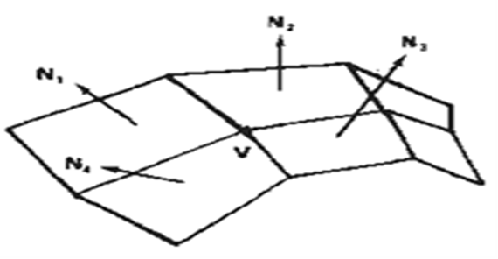
1. Gouraud Shading
Step 1: At each polygon vertex, we obtain a normal vertex by averaging the surface normals of all polygons sharing the vertex as:
Step 2: Once we have the vertex normal (N_{v}), we can determine the intensity at the vertices from a lighting model.
Step 3: Now to interpolate intensities along the polygon edges, we consider following figure:

Slide 57
1. Gouraud Shading
In figure, the intensity of vertices 1, 2, 3 are I₁, I_{2,} I₃, which are obtained by averaging normal of each surface sharing the vertices and applying a illumination model.
For each scan line, intensity at intersection of line with Polygon edge is linearly interpolated from the intensities at the edge end point.
So intensity at point 4 is to interpolate between intensities I₁ and I₂ using only the vertical displacement of the scan line:

Slide 58
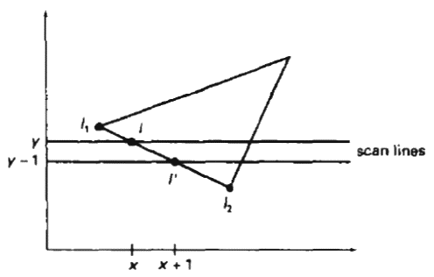
1. Gouraud Shading
Similarly, the intensity at point 5 is obtained by linearly interpolating intensities at I₂ and I₃ as
The intensity of a point P in the polygon surface along scan-line is obtained by linearly interpolating intensities at I₄ and I₅ as,
Then incremental calculations are used to obtain Successive edge intensity values between scan-lines as and to obtain successive intensities along a scan line.
As shown in Fig. above, if the intensity at edge position (x, y) is interpolated as:
Then, we can obtain the intensity along this edge for next scan line at y-1 position as
Similar calculations are made to obtain intensity successive on horizontal pixel.

Slide 59
2. Phong Shading
A more accurate method for rendering a polygon surface is to interpolate normal vector and then apply illumination model to each surface point.
This method is called Phong shading or normal vector interpolation shading.
It displays more realistic highlights and greatly reduces the mach-band effect.
A polygon surface is rendered with Phong shading by carrying out following calculations.
Determine the average normal unit vectors at each polygon vertex.
Linearly interpolate vertex normal over the surface of polygon.
Apply illumination model along each scan line to calculate projected pixel intensities for the surface points

Slide 60
2. Phong Shading
In figure, N_{1,} N_{2,} N₃ are the normal unit vectors at each vertex of polygon surface.
For scan-line that intersect an edge, the normal vector N can be obtained by vertically interpolating normal vectors of the vertex on that edge as.
Incremental calculations are used to evaluate normal between scan lines and along each individual scan line as in Gouraud shading.
Phong shading produces accurate results than the direct interpolation but it requires considerably more calculations.

Slide 61
3. Fast Phong Shading
Surface rendering with Phong shading can be speeded up by using approximations in the illumination-model calculations of normal vectors.
Fast Phong shading approximates the intensity calculations using a Taylor series expansion and Triangular surface patches.
Since Phong shading interpolates normal vectors from vertex normals, we can express the surface normal N at any point (x, y) over a triangle as:
N = Ax + By + C
Where A, B, C are determined from the three vertex equations.
N_{k} = Ax_{k} + By_{k} + C, k = 1, 2, 3 for (x_{k} , y_{k} ) vertex.
Omitting the reflectivity and attenuation parameters, we can write the calculation for light-source diffuse reflection from a surface point (x, y) as

Slide 62
3. Fast Phong Shading
Re writing this,
-------------------- (1)
Where parameters a, b, c, d… are used to represent the various dot products as
and so on.
Finally, denominator of equation (1) can be expressed as Taylor series expansions and retains terms up to second degree in x and y. This yields
Where each T_{­k} is a function of parameters a, b, c, d, and so forth.
This method still takes twice as long as in Gouraud shading. Normal Phong shading takes six to seven times that of Gouraud shading.

Slide 63
Chapter End
Thank you

