Slide 1
Unit 4: Database Programming using JDBC

Slide 2
Unit 4: Database Connectivity (4 Hrs.)
4.1. JDBC Architecture, JDBC Driver Types, JDBC Configuration, Managing Connections, Statements, Result Set, SQL Exceptions
4.2. DDL and DML Operations using Java, Prepared Statements, Multiple Results, Scrollable Result Sets, Updateable Result Sets, Row Sets and Cached Row Sets, Transactions, SQL Escapes.

Slide 3

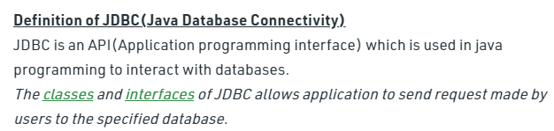
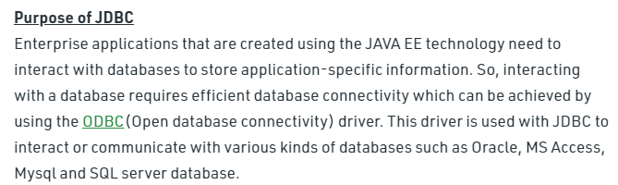
JDBC or Java Database Connectivity is a specification from Sun microsystems that provides a standard abstraction(that is API or Protocol) for java applications to communicate with various databases. It provides the language with java database connectivity standard. It is used to write programs required to access databases. JDBC along with the database driver is capable of accessing databases and spreadsheets. The enterprise data stored in a relational database(RDB) can be accessed with the help of JDBC APIs.

Slide 4

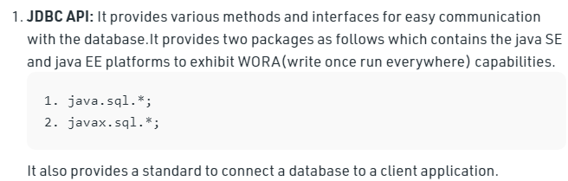

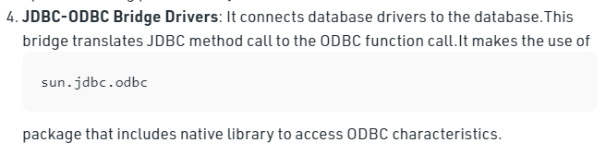

Slide 5

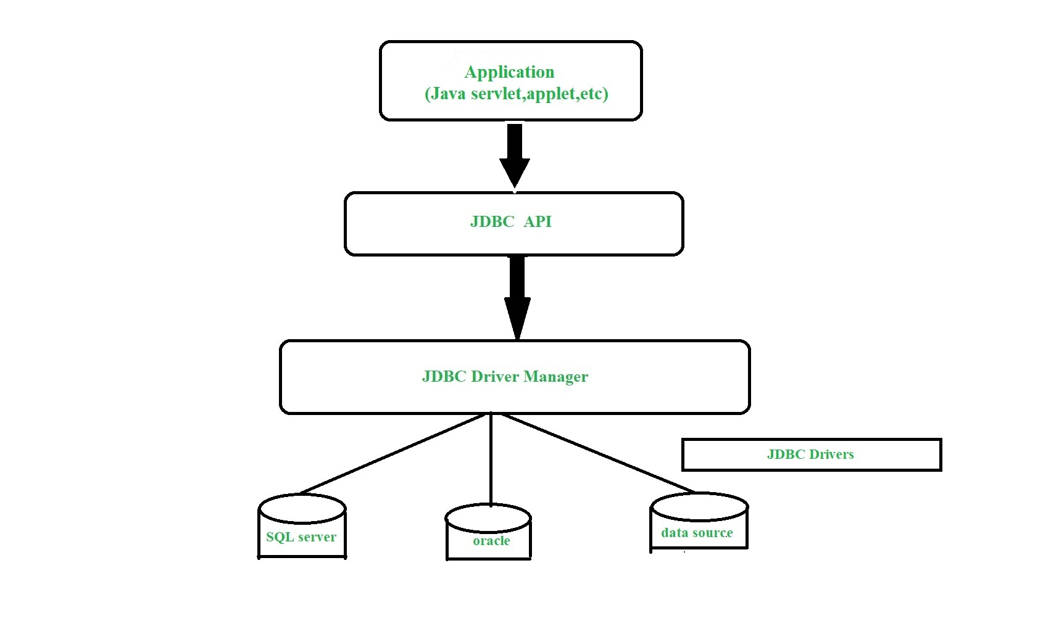

Slide 6
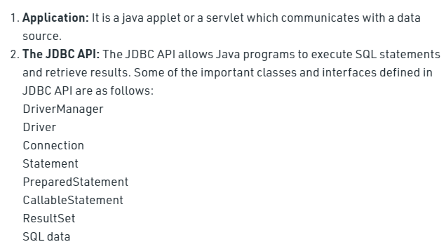
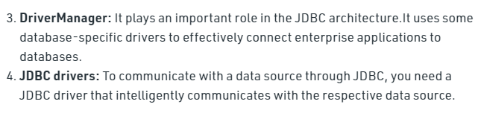

Slide 7

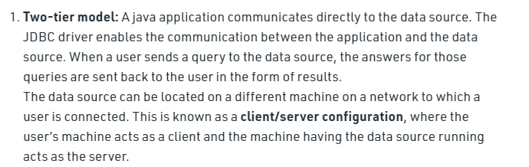
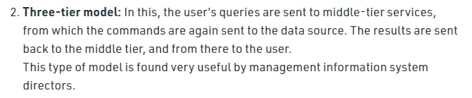

Slide 8

Java Database Connectivity (JDBC) is an application programming interface (API) for the programming language Java, which defines how a client may access any kind of tabular data, especially relational database. It is part of Java Standard Edition platform, from Oracle Corporation. It acts as a middle layer interface between java applications and database.
The JDBC classes are contained in the Java Package java.sql and javax.sql.
JDBC helps you to write Java applications that manage these three programming activities:
Connect to a data source, like a database.
Send queries and update statements to the database
Retrieve and process the results received from the database in answer to your query

Slide 9
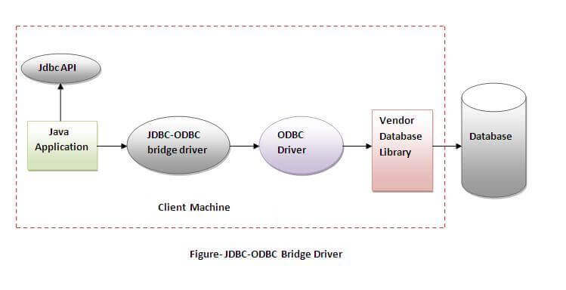
JDBC drivers are client-side adapters (installed on the client machine, not on the server) that convert requests from Java programs to a protocol that the DBMS can understand. There are 4 types of JDBC drivers:
Type-1 driver or JDBC-ODBC bridge driver
Type-2 driver or Native-API driver
Type-3 driver or Network Protocol driver
Type-4 driver or Thin driver
Type-1 driver
Type-1 driver or JDBC-ODBC bridge driver uses ODBC driver to connect to the database. The JDBC-ODBC bridge driver converts JDBC method calls into the ODBC function calls. Type-1 driver is also called Universal driver because it can be used to connect to any of the databases.
Advantages:
easy to use.
can be easily connected to any database.
Disadvantages:
Performance degraded because JDBC method call is converted into the ODBC function calls.
The ODBC driver needs to be installed on the client machine.
In Java 8, the JDBC-ODBC Bridge has been removed. Oracle does not support the JDBC-ODBC Bridge from Java 8. Oracle recommends that you use JDBC drivers provided by the vendor of your database instead of the JDBC-ODBC Bridge.

Slide 10
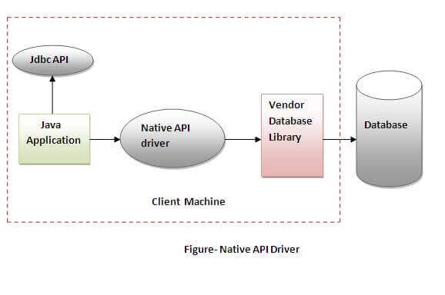
Type-2 driver
The Native API driver uses the client -side libraries of the database. This driver converts JDBC method calls into native calls of the database API. In order to interact with different database, this driver needs their local API, that’s why data transfer is much more secure as compared to type-1 driver.
Advantage:
performance upgraded than JDBC-ODBC bridge driver.
Disadvantage:
The Native driver needs to be installed on the each client machine.
The Vendor client library needs to be installed on client machine.

Slide 11

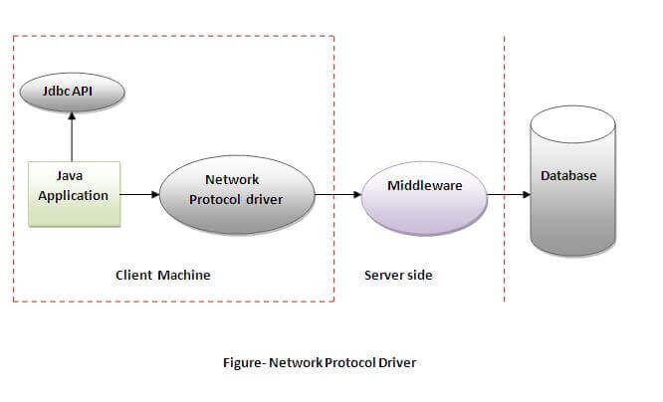
The Network Protocol driver uses middleware (application server) that converts JDBC calls directly or indirectly into the vendor-specific database protocol. Here all the database connectivity drivers are present in a single server, hence no need of individual client-side installation.
Advantage:
No client side library is required because of application server that can perform many tasks like auditing, load balancing, logging etc.
Disadvantages:
Network support is required on client machine.
Requires database-specific coding to be done in the middle tier.
Maintenance of Network Protocol driver becomes costly because it requires database-specific coding to be done in the middle tier.

Slide 12

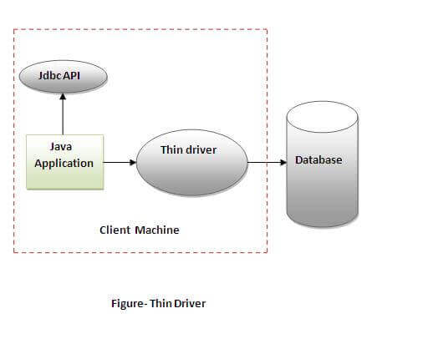
Type-4 driver is also called native protocol driver. This driver interact directly with database. It does not require any native database library, that is why it is also known as Thin Driver.
Does not require any native library and Middleware server, so no client-side or server-side installation.
It is fully written in Java language, hence they are portable drivers.
Advantage:
Better performance than all other drivers.
No software is required at client side or server side.
Disadvantage:
Drivers depend on the Database.
Which Driver to use When?
If you are accessing one type of database, such as Oracle, Sybase, or IBM, the preferred driver type is type-4.
If your Java application is accessing multiple types of databases at the same time, type 3 is the preferred driver.
Type 2 drivers are useful in situations, where a type 3 or type 4 driver is not available yet for your database.
The type 1 driver is not considered a deployment-level driver, and is typically used for development and testing purposes only.

Slide 13

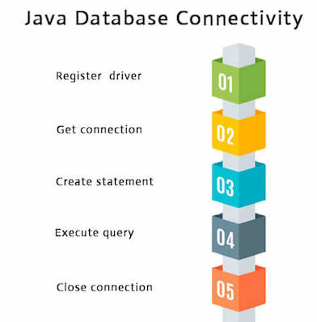

There are 5 steps to connect any java application with the database using JDBC.
Register the Driver class
Create connection
Create statement
Execute queries
Close connection
1) Register the driver class
The forName() method of Class class is used to register the driver class. This method is used to dynamically load the driver class.
Note: Since JDBC 4.0, explicitly registering the driver is optional. We just need to put vender's Jar in the classpath, and then JDBC driver manager can detect and load the driver automatically.
Here, Java program is loading oracle driver to esteblish database connection.

Slide 14

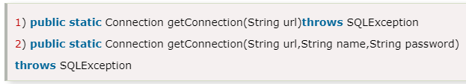
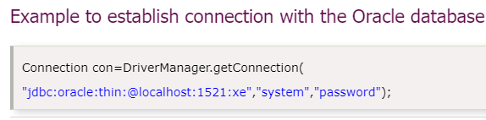



The getConnection() method of DriverManager class is used to establish connection with the database.

Slide 15

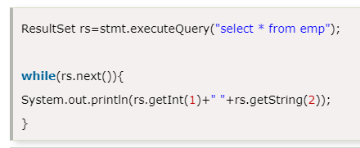





Slide 16
Example to Connect Java Application with mysql database
import java.sql.*;
class MysqlCon{
public static void main(String args[]){
try{
Class.forName("com.mysql.cj.jdbc.Driver");
Connection con=DriverManager.getConnection(
"jdbc:mysql://localhost:3306/nccs","root","");
//here nccs is database name, root is username and password
Statement stmt=con.createStatement();
ResultSet rs=stmt.executeQuery("select * from csitSeven");
while(rs.next())
System.out.println(rs.getInt(1)+" "+rs.getString(2)+" "+rs.getString(3)); con.close();
}catch(Exception e){ System.out.println(e);}
}
}

Slide 17
A Java MySQL INSERT example
import java.sql.*;
public class JavaMysqlInsertExample
{
public static void main(String[] args)
{
try
{
String myDriver = "org.gjt.mm.mysql.Driver";
String myUrl = "jdbc:mysql://localhost/test";
Class.forName(myDriver);
Connection conn = DriverManager.getConnection(myUrl, "root", "");
Statement st = conn.createStatement();
st.executeUpdate("INSERT INTO users (first_name, last_name, is_admin, num_points) "
+"VALUES ('Fred', 'Flinstone', false, 10000)");
conn.close();
}
catch (Exception e)
{
System.err.println("Got an exception!");
System.err.println(e.getMessage());
}
}
}

Slide 18
Classtest
Make a registration page, login page and listing page. Insert data from registration page, check it in login and display listing page.

Slide 19


The PreparedStatement interface is a subinterface of Statement. It is used to execute parameterized query.
As you can see, we are passing parameter (?) for the values. Its value will be set by calling the setter methods of PreparedStatement.
Methods of PreparedStatement interface
Why use PreparedStatement?
Improves performance: The performance of the application will be faster if you use PreparedStatement interface because query is compiled only once.
public void setInt(int paramIndex, int value) | sets the integer value to the given parameter index.
public void setString(int paramIndex, String value) | sets the String value to the given parameter index.
public void setFloat(int paramIndex, float value) | sets the float value to the given parameter index.
public void setDouble(int paramIndex, double value) | sets the double value to the given parameter index.
public int executeUpdate() | executes the query. It is used for create, drop, insert, update, delete etc.
public ResultSet executeQuery() | executes the select query. It returns an instance of ResultSet.
How to get the instance of PreparedStatement?
The prepareStatement() method of Connection interface is used to return the object of PreparedStatement.
public PreparedStatement prepareStatement(String query)throws SQLException{}

Slide 20
Example of PreparedStatement interface that inserts the record
create table emp(id number(10),name varchar2(50));
import java.sql.*;
class InsertPrepared{
public static void main(String args[]){
try{
Class.forName("oracle.jdbc.driver.OracleDriver");
Connection con=DriverManager.getConnection("jdbc:oracle:thin:@localhost:1521:xe","system","oracle");
PreparedStatement stmt=con.prepareStatement("insert into Emp values(?,?)");
stmt.setInt(1,101);//1 specifies the first parameter in the query
stmt.setString(2,"Ratan");
int i=stmt.executeUpdate();
System.out.println(i+" records inserted");
con.close();
}catch(Exception e){ System.out.println(e);}
}
}

Slide 21
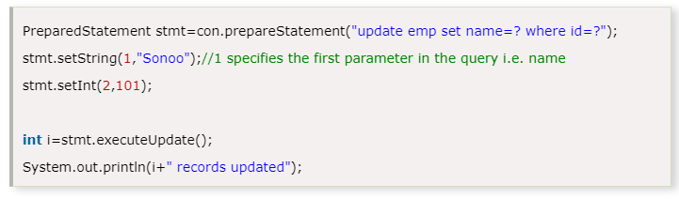
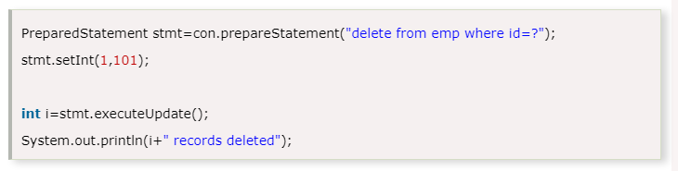
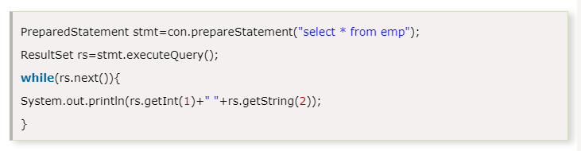
Example of PreparedStatement interface that updates the record
Example of PreparedStatement interface that deletes the record
Example of PreparedStatement interface that retrieve the records of a table

Slide 22
PreparedStatement is called as “pre compiled statement”. An SQL statement is compiled beforehand and stored in the PreparedStatement object.
The purpose of precompiled statement is that the statement can be executed repeatedly.
The required parameter values are to be substituted from time to time.
What is PreparedStatement?
A PreparedStatement Object would be faster than a Statement Object where repeated execution of SQL statements is required.
The reason is that the creation of a PreparedStatement object causes it to be precompiled within the database.
So, it does not have to be recompiled during the execution again and again.
Usually, these objects are used when SQL statements take parameters.
What is the advantage of using a PreparedStatement?
What is the difference between Statement and PreparedStatement?
PreparedStatement
The parameter can be supplied at run time
Precompiled ( compiled once ) and executes once for n number of parameter values.
Statement
The parameter value is fixed
Compiles and executes every time

Slide 23
Reading and Writing LOBs
In addition to numbers, strings, and dates, many databases can store large objects (LOBs) such as images or other data. In SQL, binary large objects are called BLOBs, and character large objects are called CLOBs.
To read a LOB, execute a SELECT statement and call the getBlob or getClob method on the ResultSet. You will get an object of type Blob or Clob.
String sql =
"insert into image_data (image_id, image)
values (?,?)";
PreparedStatement pstmt = null;
pstmt = con.prepareStatement(sql);
pstmt.setInt(1, 101);
File f1 = new File("pic1.jpg");
Blob blob = con.createBlob();
FileInputStream fis = new FileInputStream(f1);
OutputStream out = blob.setBinaryStream(1);
int i = -1;
while ((i = fis.read()) != -1) {
out.write(i);
}
pstmt.setBlob(3, blob);
pstmt.executeUpdate();

Slide 24
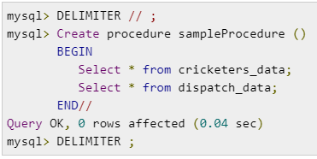
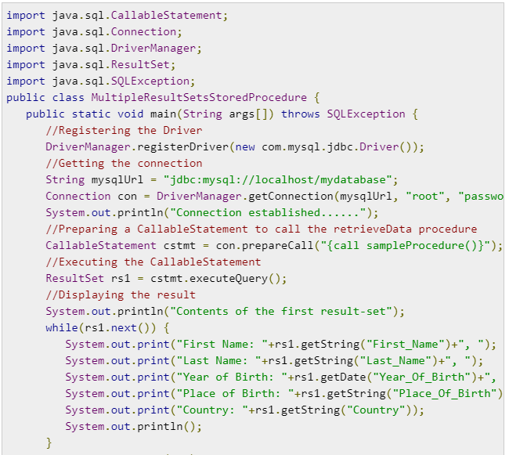
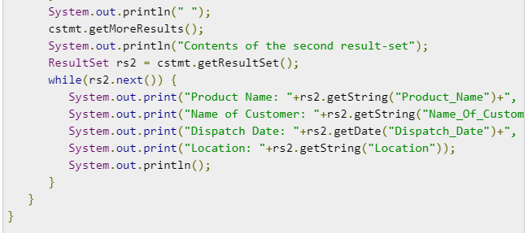
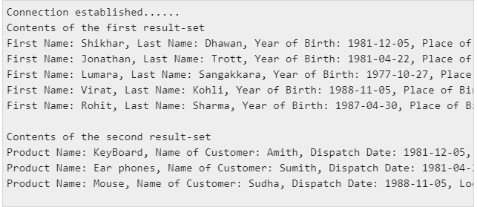
Using multiple result sets

Slide 25


LIKE wildcard literals
Function handling
Date and time literals
Stored procedure calls
Outer joins
Limit escape syntax
The Microsoft JDBC Driver for SQL Server supports the use of SQL escape sequences, as defined by the JDBC API. Escape sequences are used within an SQL statement to tell the driver that the escaped part of the SQL string should be handled differently. When the JDBC driver processes the escaped part of an SQL string, it translates that part of the string into SQL code that SQL Server understands. There are five types of escape sequences that the JDBC API requires, and all are supported by the JDBC driver:
LIKE wildcard literals
Note
The escape sequence must be at the end of the SQL statement. For multiple SQL statements in a command string, the escape sequence needs to be at the end of each relevant SQL statement.
ResultSet rst = stmt.executeQuery("SELECT col3 FROM test1 WHERE col2 LIKE '\\_%' {escape '\\'}");

Slide 26
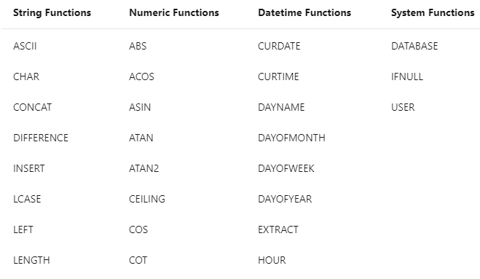
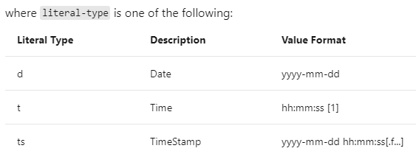
The JDBC driver supports function escape sequences in SQL statements with the following syntax:
Function handling
Syntax: {fn functionName} where functionName is a function supported by JDBC Driver
SELECT {fn UCASE(Name)} FROM Employee
Date and time literals
{literal-type 'value'}
UPDATE Orders SET OpenDate={d '2005-01-31'} WHERE OrderID=1025

Slide 27

Stored procedure calls
A procedure is an executable object stored in the database. Generally, it is one or more SQL statements that have been precompiled. The escape sequence syntax for calling a stored procedure is the following:
{[?=]call procedure-name[([parameter][,[parameter]]...)]}
Outer joins
table-reference {LEFT | RIGHT | FULL} OUTER JOIN
{table-reference | outer-join} ON search-condition
SELECT Customers.CustID, Customers.Name, Orders.OrderID, Orders.Status
FROM {oj Customers LEFT OUTER JOIN
Orders ON Customers.CustID=Orders.CustID}
WHERE Orders.Status='OPEN'
The following outer join escape sequences are supported by the JDBC driver:
Left outer joins
Right outer joins
Full outer joins
Nested outer joins
Limit escape syntax
LIMIT <rows> [OFFSET <row offset>]
The LIMIT escape syntax is only supported by Microsoft JDBC Driver 4.2 (or higher) for SQL Server when using JDBC 4.1 or higher.

Slide 28

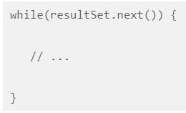
When fetching a list of records through queries, we often need to store them in an object that allows back and forth traversing, updating as needed.
The ResultSet is an interface defined in the java.sql package. It represents a table of data returned by a Statement object. A Statement object is used to execute SQL queries to the database. The ResultSet object maintains a cursor pointing to the current record in the database table. As a result, it can be effectively used to position at different rows, back and forth using first(), previous(), next(), and last() methods as per requirements. Initially, the ResultSet object is positioned at a location before the first row. This is the reason a ResultSet traversal always begins as follows:
Note that the ResultSet object is positioned at the first row by executing the next() method when entering the loop, because, as already mentioned, the ResultSet object is initially located at a position just before the first row. So, it must be put to at least the first row, for example, to get a valid record. It may be deemed as a value -1 in an array position a pointer/index is pointing to. It must be first relocated to at least the 0th location to get any kind of valid value from the array.
Now, as we have mentioned, we can scroll through records with the help of the ResultSet object. But, this ability does not come by default. The default behavior of the ResultSet object is that it is not updatable and the cursor it owns actually moves in one direction, forward only. This means that we can iterate through the records only once and in a forward direction only. However, there are ways to make it flexible so that the ResultSet is not only updatable but also scrollable.

Slide 29
JDBC Scrollable ResultSet :
Whenever we create an object of ResultSet by default, it allows us to retrieve in the forward direction only and we cannot perform any modifications on ResultSet object. Therefore, by default, the ResultSet object is non-scrollable and non-updatable ResultSet.
A scrollable ResultSet is one which allows us to retrieve the data in forward direction as well as backward direction but no updations are allowed. In order to make the non-scrollable ResultSet as scrollable ResultSet we must use the following createStatement() method which is present in Connection interface.
public Statement createStatement(int Type, int Mode);
Here type represents the type of scrollability and mode represents either read only or updatable. The
value of Type and the Modes are present in ResultSet interface as constant data members and they are:
TYPE_FORWARD_ONLY -> 1
TYPE_SCROLL_INSENSITIVE -> 2
CONCUR_READ_ONLY -> 3
We can pass the above constants to ResultSet as below:
Statement st=con.createStatement ( ResultSet.TYPE_SCROLL_INSENSITIVE, ResultSet.CONCUR_READ_ONLY );
ResultSet rs=st.executeQuery (“select * from empleyee”);
Whenever we create a ResultSet object, by default, constant-1 as a Type and constant-3 as mode will be assigned.

Slide 30
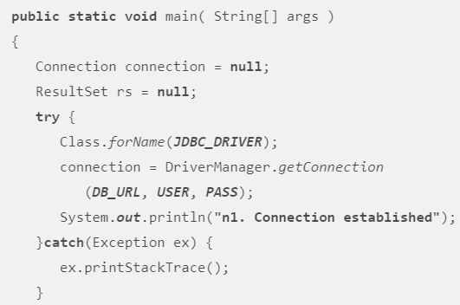
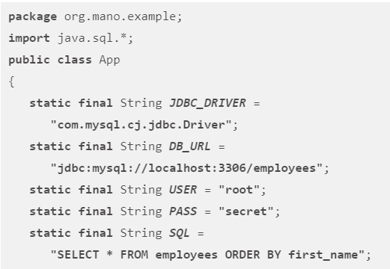
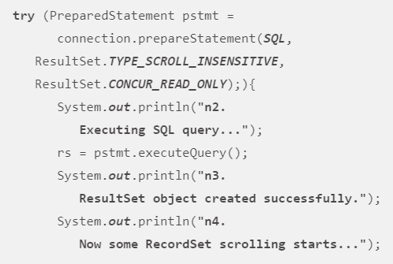
Let’s first make the ResultSet object scrollable. Scrollable means that once the ResultSet object has been created, we can traverse through fetched records in any direction, forward and backward, as we like. This provides the ability to read the last record, first record, next record, and the previous record.

Slide 31
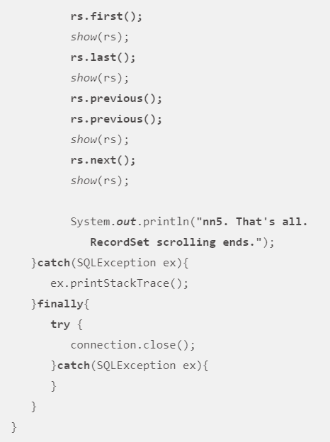
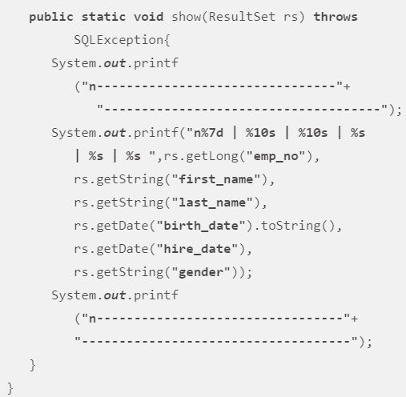
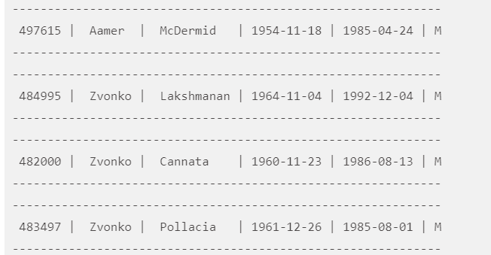

Slide 32
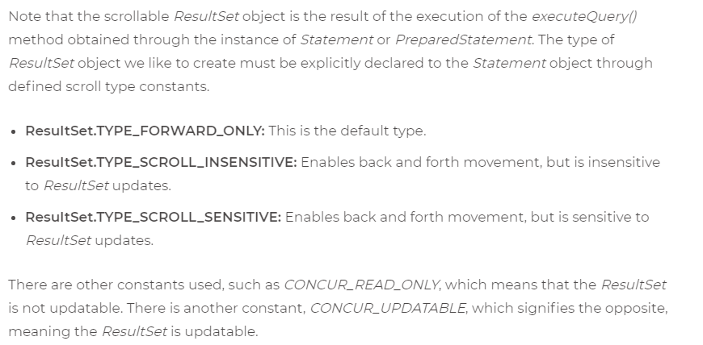

Slide 33
rs.first();
System.out.println("FIRST RECORD...");
System.out.println(rs.getInt(1) + " -> " + rs.getString(2));
rs.absolute(3);
System.out.println("THIRD RECORD...");
System.out.println(rs.getInt(1) + " -> " + rs.getString(2));
rs.last();
System.out.println("LAST RECORD...");
System.out.println(rs.getInt(1) + " -> " + rs.getString(2));
rs.previous();
rs.relative(-1);
System.out.println("LAST TO FIRST RECORD...");
System.out.println(rs.getInt(1) + " -> " + rs.getString(2));
con.close();
}
}
package com.onlinetutorialspoint.jdbc;
import java.sql.Connection;
import java.sql.DriverManager;
import java.sql.ResultSet;
import java.sql.Statement;
public class ScrollResultSet {
public static void main(String[] args) throws Exception {
Class.forName("sun.jdbc.odbc.JdbcOdbcDriver");
Connection con = DriverManager.getConnection(
"jdbc:mysql://localhost:3306/onlinetutorialspoint", "root", "123456");
Statement st = con.createStatement(ResultSet.TYPE_SCROLL_INSENSITIVE,
ResultSet.CONCUR_READ_ONLY);
ResultSet rs = st.executeQuery("select * from student");
System.out.println("RECORDS IN THE TABLE...");
while (rs.next()) {
System.out.println(rs.getInt(1) + " -> " + rs.getString(2));
}

Slide 34
RECORDS IN THE TABLE...
28 -> Chandra Shekhar
30 -> Chandra Shekhar
101 -> Rajesh
102 -> rajesh
202 -> chandrashekhar
2002 -> Rahul
2003 -> chandrashekhar
2004 -> Rahul
2005 -> chandrashekhar
3002 -> Bhargav
3005 -> Rahul
3006 -> Bharat
FIRST RECORD...
28 -> Chandra Shekhar
THIRD RECORD...
101 -> Rajesh
LAST RECORD...
3006 -> Bharat
FIRST RECORD...
3002 -> Bhargav

Slide 35
JDBC - Updatable ResultSet
you can use the ResultSet.CONCUR_UPDATABLE concurrency to create an updatable result set object. An updatable ResultSet object allows us to update a column value, insert column values and delete a row.
Here the code snippet that makes a scrollable and updatable result set object.
PreparedStatement stmt = conn.prepareStatement(sql,
ResultSet.TYPE_SCROLL_INSENSITIVE, ResultSet.CONCUR_UPDATABLE);
ResultSet rs = stmt.executeQuery();

Slide 36
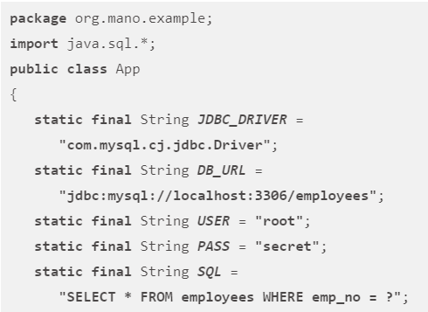
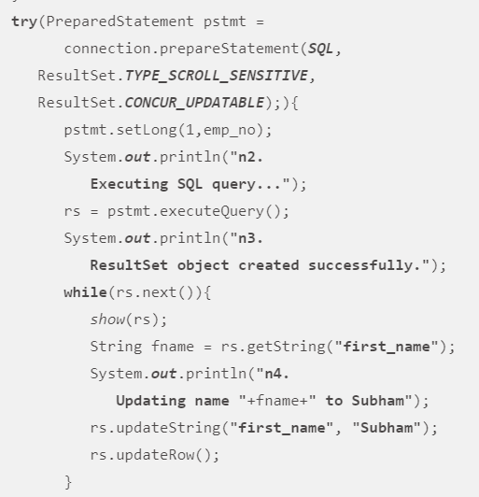
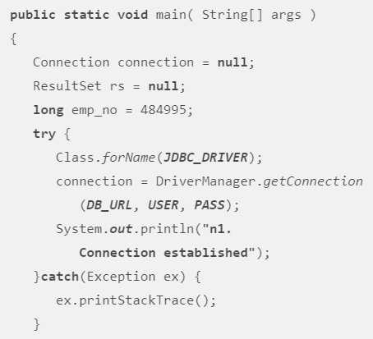

Slide 37
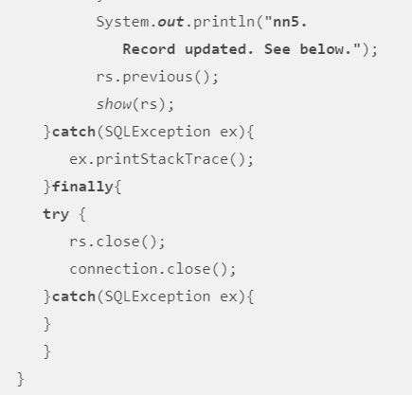
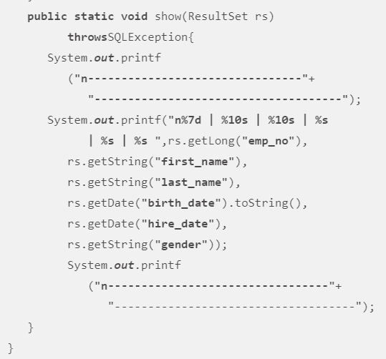
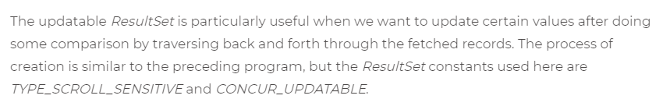

Slide 38
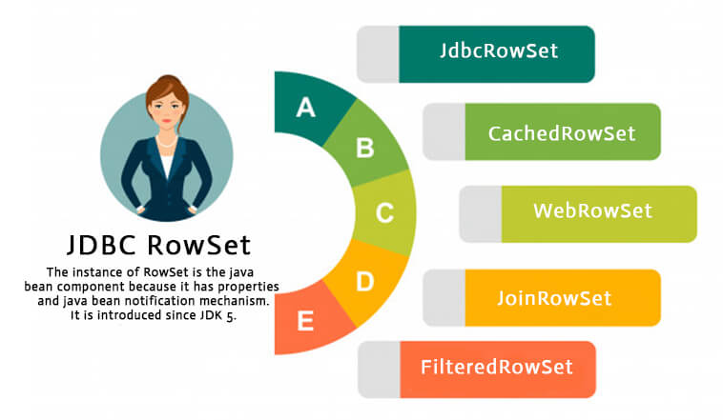
JDBC RowSet
It is the wrapper of ResultSet. It holds tabular data like ResultSet but it is easy and flexible to use.
The advantages of using RowSet are given below:
It is easy and flexible to use
It is Scrollable and Updatable bydefault

Slide 39
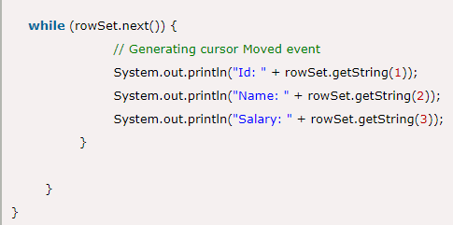
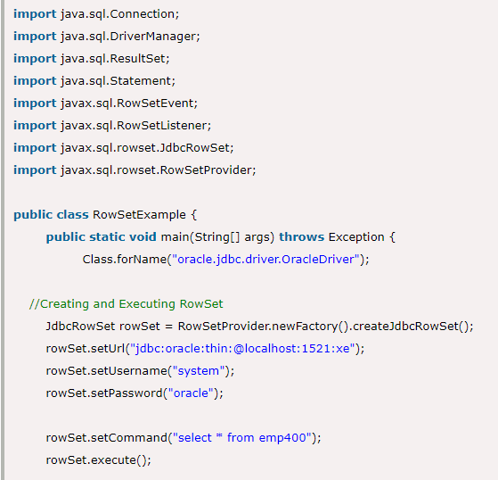
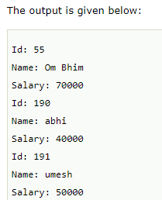

Slide 40
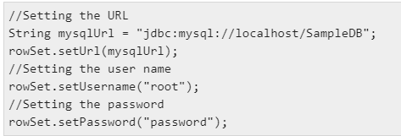


What is a CachedRowSet in JDBC? Explain?
The CachedRowSet is the base implementation of disconnected row sets. It connects to the data source, reads data from it, disconnects with the data source and the processes the retrieved data, reconnects to the data source and writes the modifications.
Creating a CachedRowSet
You can create a Cached RowSet object using the createCachedRowSet() method of the RowSetFactory.
You can create a RowSetFactory object using the newfactory() method of the RowSetProvider method.
Create a CachedRowSet object using the above-mentioned methods as shown below −
Connecting to the data source
After creating a RowSet object you need to connect it to the required DataSource.
You can connect to a DataSource by setting values to the properties such as username, password, url and, data source name as −
Preparing and executing the command statement
A cached row set has a command property to which you can pass the queries. Set the required query to this property using the setCommand() method.
You can execute the query that the RowSet object holds using the execute() method.

Slide 41
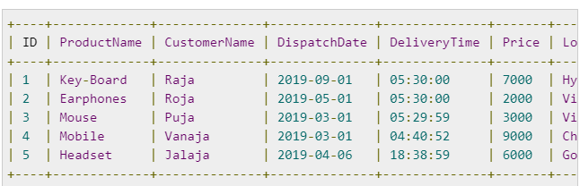
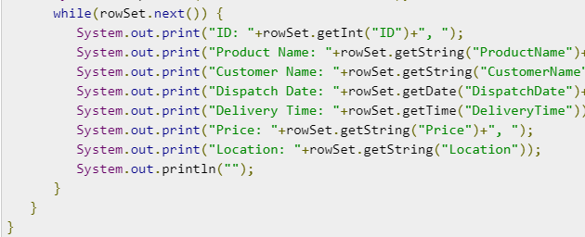
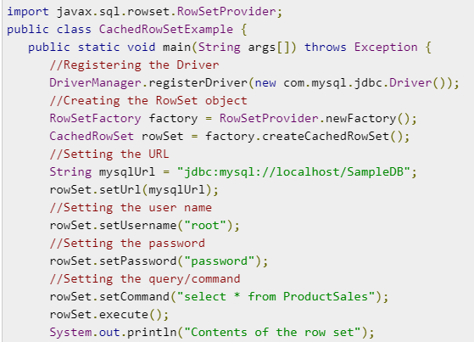
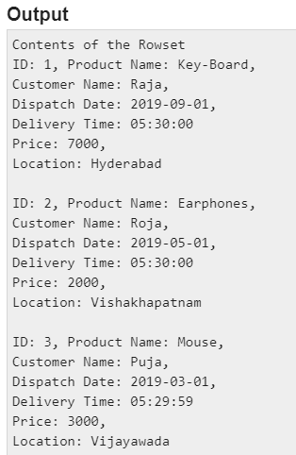

Slide 42

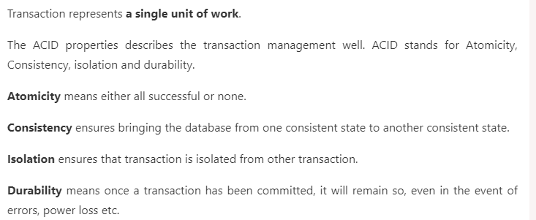


Advantage of Transaction Mangement
fast performance It makes the performance fast because database is hit at the time of commit.

Slide 43
Let's see the simple example of transaction management using Statement.
import java.sql.*;
class FetchRecords{
public static void main(String args[])throws Exception{
Class.forName("oracle.jdbc.driver.OracleDriver");
Connection con=DriverManager.getConnection("jdbc:oracle:thin:@localhost:1521:xe","system","oracle");
con.setAutoCommit(false);
Statement stmt=con.createStatement();
stmt.executeUpdate("insert into user420 values(190,'abhi',40000)");
stmt.executeUpdate("insert into user420 values(191,'umesh',50000)");
con.commit();
con.close();
}}

