Slide 1
UNIT-I Introduction to Software Project Management (SPM)
Compiled by:Er. Loknath Regmi

Slide 2
Project Definition:
The dictionary definitions put a clear emphasis on the project being a planned activity.
Planning is in essence thinking carefully about something before you do it.
Planning defines how we are going to carry out the given activities.
Set of interrelated tasks to be executed over a fixed period and within certain costs and other limitations.

Slide 3
What Is a Project?
A project is “a temporary endeavor undertaken to accomplish a unique product or service”
Attributes of projects
unique purpose
temporary
require resources, often from various areas
should have a primary sponsor and/or customer
involve uncertainty

Slide 4
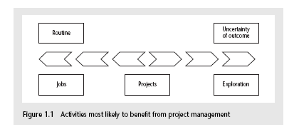
Jobs versus projects
‘Jobs’ – repetition of very well-defined and well understood tasks with very little uncertainty
‘Exploration’ – e.g. finding a cure for cancer: the outcome is very uncertain
‘Projects’ – in the middle!
Notes:
On the one hand there are repetitive jobs a similar task is carried out repeatedly, for example Kwikfit replacing a tyre on a car or a lecturer giving an introductory talk on project management. The task is well-defined and there is very little uncertainty. In some organizations, software development might tend to be like this – in these environments software process management might be more important than software project management
On the other hand some exploratory activities are very uncertain. Some research projects can be like this – we may not be sure what the outcome will be, but we hope that we will learn some things of importance. It may be very difficult to come up with precise plans, although we would probably have some idea of a general approach.
Projects seem to come somewhere between these two extremes. There are usually well-defined hoped-for outcomes but there are risks and uncertainties about achieving those outcomes.

Slide 5
The characteristics of projects are as follows:
non-routine tasks are involved; planning is required;
specific objectives are to be met or a specified product is to be created;
the project has a pre-determined time span;
work is carried out for someone other than yourself;
work is carried out in several phases;
the resources that are available for use on the project are constrained;
The project may be large or complex.
Notes:
work involves several specialisms;

Slide 6
Software project
Software project is collection and integration of various components of the software.
It begins with early investigation and ends with implementation.
Management
It includes activities such as:
Planning
Organizing
Staffing
Directing
Monitoring(checking progress)
Controlling
Innovating
representing

Slide 7
Management Functions
Planning Predetermining a course of action for accomplishing organizational Objectives
Organizing Arranging the relationships among work units for accomplishment of objectives and the granting of responsibility and authority to obtain those objectives
Staffing Selecting and training people for positions in the organization
Directing Creating an atmosphere that will assist and motivate people to achieve desired end results
Controlling Establishing, measuring, and evaluating performance of activities toward planned objectives

Slide 8
The Triple Constraint
Every project is constrained in different ways by its
Scope goals: What is the project trying to accomplish?
Time goals: How long should it take to complete?
Cost goals: What should it cost?
It is the project manager’s duty to balance these three often competing goals

Slide 9
Software projects versus other types of project
Many of the techniques of general project management are applicable to software project management,
Certain characteristics make them different. The characteristics are:
Invisibility
When a physical artefact such as a bridge or road is being constructed the progress being made can actually be seen.
With software, progress is not immediately visible.

Slide 10
Complexity
software products contain more complexity than other engineered artefacts as it cannot be calculated or evaluated per dollar, rupee spent.
Conformity
Software developers have to conform to the requirements of human clients.
However, the requirements of the human clients keeps on fluctuating..
Flexibility
This means the software systems are likely to be subject to a high degree of change.
Notes:
It is not just that individuals can be inconsistent. Organizations, because of lapses in collective memory, in internal communication or in effective decision-making can exhibit remarkable ‘organizational stupidity’ that developers have to cater for

Slide 11
Activities covered by software project management
A software project is not only concerned with the writing or developing of the software.
It includes the following activities:
The feasibility study
This is an investigation into whether a prospective (probable) project is worth starting.
Information is gathered about the requirements of the proposed application.
The probable developmental and operational costs, along with the value of the benefits of the new system, are estimated.

Slide 12
2. Planning
If the feasibility study produces results which indicate that the prospective project appears viable, planning of the project can take place.
However, for a large project, we would not do all our detailed planning right at the beginning.
We would formulate an outline plan for the whole project and a detailed one for the first stage.
More detailed planning of the later stages would be done as they approached.
This continues till the end of the project.

Slide 13
3. Project execution
The project can now be executed.
The execution of a project often contains design and implementation sub-phases.

Slide 14
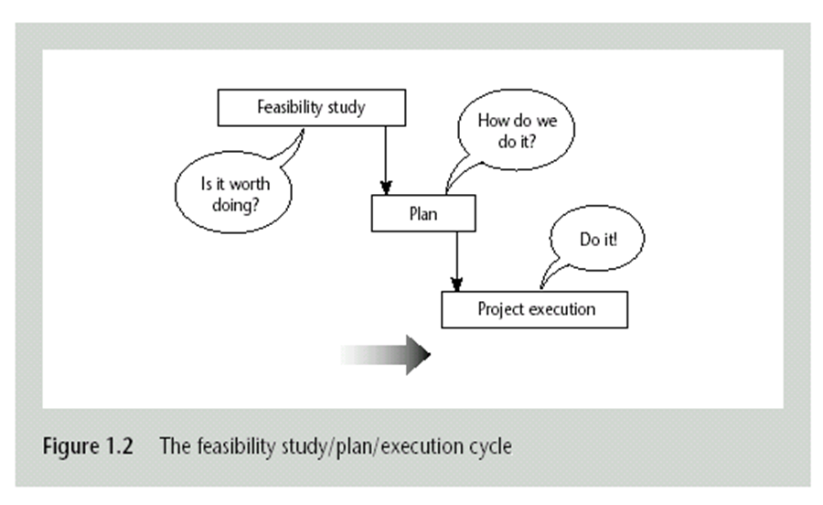

Slide 15
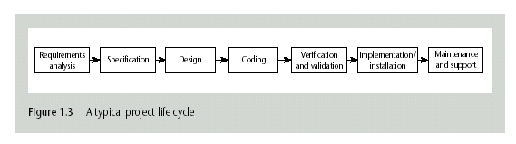
A classic project life cycle

Slide 16
Requirements analysis
This is finding out in detail what the users require of the system that the project is to implement.
Original information obtained needs to be updated and supplemented.
Several different approaches to the users’ requirements may be explored.

Slide 17
Specification
Detailed documentation of what the proposed system is to do.
Design
A design has to be drawn up which meets the specification.
Design will be in two stages.
One will be the external or user design concerned with the external appearance of the application eg: menus, forms, reports etc.
The other produces the physical design which tackles the way that the data and software procedures are to be structured internally.

Slide 18
Coding
This may refer to writing code in some programming language.
Even where software is not being built from scratch, some modification to the base package could be required to meet the needs of the new application.
Verification and validation
Whether software is developed specially for the current application or not, careful testing will be needed to check that the proposed system meets its requirements.
Notes:
Validation is the process of checking whether the specification captures the customer’s needs. “Did I build what I said I would?”
Verification is the process of checking that the software meets the specification. “Did I build what I need?”
4. Verification uses methods like inspections, reviews, walkthroughs, and Desk-checking etc.
4. Validation uses methods like black box (functional) testing, gray box testing, and white box (structural) testing etc.
5. Verification is to check whether the software conforms to specifications.
5. Validation is to check whether software meets the customer expectations and requirements.
9. verification generally comes first-done before validation.
9. validation generally follows after verification.

Slide 19
Implementation/installation
Some system development practitioners refer to the whole of the project after design as ‘implementation’ (that is, the implementation of the design)
while others insist that the term refers to the installation of the system after the software has been developed.
In this latter case it includes setting up operational data files and system parameters, writing user manuals and training users of the new system.

Slide 20
Maintenance and support
Once the system has been implemented there is a continuing need for the correction of any errors that may be into the system and for extensions and improvements to the system.
Maintenance and support activities may be seen as a series of minor software projects.
In many environments, most software development after implementation is in fact maintenance.

Slide 21
Problems with software projects
from the manager's point of view
poor estimates and plans;
lack of quality standards and measures;
lack of guidance about making organizational decisions;
lack of techniques to make progress visible;

Slide 22
Stakeholder’s view of the software problems
lack of up-to-date documentation;
earlier activities not completed on time - including late delivery of equipment;
lack of communication between users and technicians;
lack of communication leading to duplication of work;
Lack of technical expertise;
changing statutory(legal) requirements;
changing software environment;
deadline pressure;
lack of quality control;

Slide 23
project plan

Slide 24
Introduction
The key to a successful project is in the planning.
Planning is the first thing that is done when one undertakes a project.
Often project planning is ignored to rush in for the work.
The value of project planning is
saving money.
saving time.
quality output.
Note: If you fail to plan, you plan to fail.

Slide 25
Essential Elements For Project Planning
Aim of project
- What do we want to produce?
Outputs
- What do we actually need to get there?
Quality criteria
What is the quality of the output?
We need the completed output to be of certain quality and we need to define what that quality is (we define it using the SMART principle: Specific, Measurable, Achievable, Realistic, Timely).

Slide 26
Contd..
Resources
- Includes staff time, particular knowledge or skill sets, money, time.
Management structure
- How are we going to manage the work.
Milestones
A defined milestone will help to identify when each section is completed.
Tolerances
How far can we let the project stray from the defined targets before sounding the alarm.

Slide 27
Contd..
Dependencies
Understanding dependencies will help understand the impact of changes in any part of the project.
Risks
What could happen that may affect our ability to deliver the project on time?
What can we do to avoid them?
Scheduling
There is no perfect schedule.
Schedule is not engraved on stone. One should expect changes .

Slide 28
Project Planning Process

Slide 29
Steps in Planning
Specification
Project Goals
Global Structure
Project Breakdown
Task Delegation
Time Estimation
Supporting Plans
Setting Controls

Slide 30
Specification
A written definition of requirements and deadlines.
Should be clear, complete and could eliminate misunderstandings, contradictions of technical difficulties.

Slide 31
Project goals
Identify the stakeholders of the project.
Stakeholder is any body impacted directly or indirectly by the project.
Establish their needs by interviewing or having consolidated meetings.
Prioritize stakeholders needs.
Create a set of goals that can be easily measured (you may use the SMART technique for this)
S – specific
M – measurable
A – achievable
R – realistic
T – timely

Slide 32
Global Structure
Includes tasks that must be accomplished.
Who will do what?
When will it be done?

Slide 33
Project Breakdown
Break project down into a series of task.
Break each task down into subtasks.
Continue until all items are doable and understandable.

Slide 34
Task Delegation
Assign tasks to specific people (or teams).
Order tasks so that they occur in a logical sequence.
Match tasks to abilities of the team.

Slide 35
Time Estimation
Times are based on previous experience.
They are always wrong so one must plan accordingly.
Example
How long should it take you to climb the statue of Liberty?
Estimate the number of steps.
Estimate the time per steps.

Slide 36
Supporting plans
Human resource plan
Identify by name the individuals with a leading role in the project and describe roles and responsibilities.
Describe the number and type of people needed to carryout the project.
Include SME’s (subject matter experts) and specific trades of the market.
The above will help establishing the project budget

Slide 37
Contd..
Communications plan
Who needs to be informed about the project?
How will they receive the information ?
Weekly/monthly progress reports to include performance, status, milestones achieved, work planned for next periods etc.

Slide 38
Contd..
Risk Management Plan
Identify as many risks as possible.
Be prepared if something bad happens.
Common project risks
Time and costs estimates too optimistic.
Unexpected budget cuts.
Scope changes.
Atmospheric events.

Slide 39
Types Of Project Plan
Quality plan
Describes the quality procedures and standards that will be used in a project.
Validation plan
Describes the approach, resources and schedule used for system validation.
Configuration management plan
Describes the configuration management procedures and structures to be used.

Slide 40
Maintenance plan
Predicts the maintenance requirements of the system, maintenance costs and effort required.
Staff development plan.
Describes how the skills and experience of the project team members will be developed.

Slide 41
Spm framework:
Project management framework contains sets of processes, tools, techniques and templates designed to be used together to manage a project through its life cycle.
It ensure that all major development processes will be under control.
To achieve all development process must be continuously monitored.

Slide 42
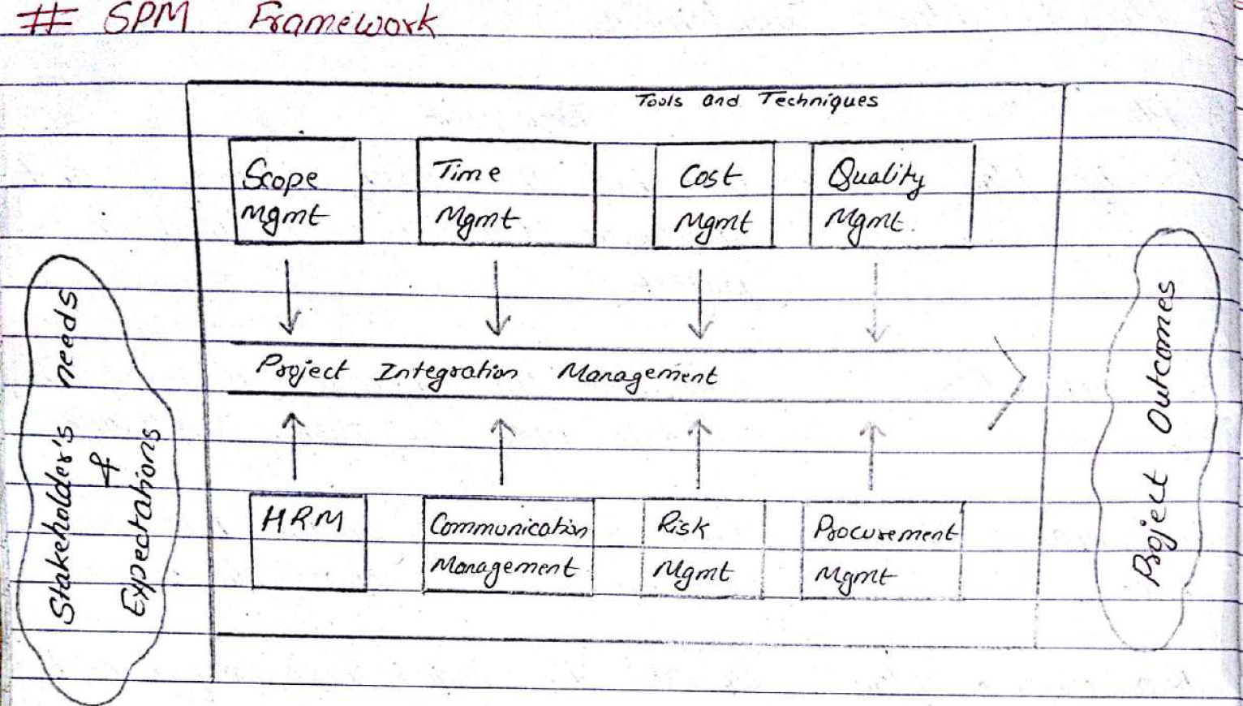

Slide 43
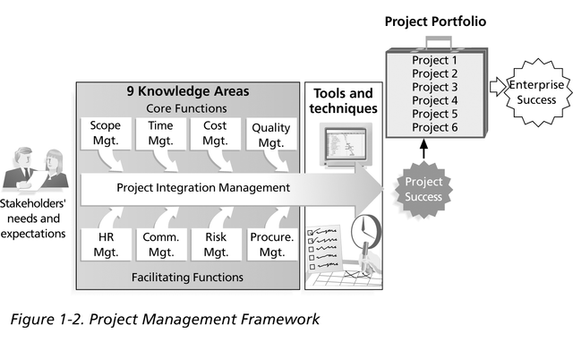
Project Management Framework

Slide 44
Project Stakeholders
Stakeholders are the people involved in or affected by project activities
Stakeholders include
the project sponsor and project team
support staff
customers
users
suppliers
opponents to the project

Slide 45
Project Management Tools and Techniques
Project management tools and techniques assist project managers and their teams in various aspects of project management
Some specific ones include
Project Agreement, scope statement, and WBS (work breakdown structure) (scope)
Gantt charts, network diagrams, critical path analysis, critical chain scheduling (time)
Cost estimates and earned value management (cost)

Slide 46
Categorizing Software Projects:
Compulsory Vs Voluntary systems (projects):
Compulsory systems are the systems which the staff of an organization have to use if they want to do a task.
Voluntary systems are the systems which are voluntarily used by the users eg. computer gaming etc.
Information Vs Embedded systems (projects):
Information systems are used by staff to carry out office processes and tasks eg. stock control system.
Embedded systems are used to control machines eg. a system controlling equipment in a building.

Slide 47
Objective-based Vs Product-based systems (projects):
With objective-based projects, a general objective or problem is defined, and there are several different ways in which that objective could be reached. The project team have freedom to select what appears to be the most appropriate approach.
With product-based projects, the product is already very strictly defined and the development team’s job is to implement the specification with which they have been presented. the details of which have been specified by the client, is product-based project.
Projects can also be:
In-house: clients and developers are employed by the same organization
Out-sourced: clients and developers employed by different organizations

