Slide 1
Unit 2. Project Organization, Scheduling and management issues

Slide 2
What is a Project??
A project is a unique endeavor(work) to produce a set of deliverables within clearly specified constraints of time, cost and quality.
Projects are different from business operations, in terms of uniqueness, timescale, budget, resources, risk and change.
Uniqueness:
Every project is different from the last, whereas operational activities typically involve repetitive (if not identical) processes.
Timescale:
A project has clearly specified start and end dates within which deliverables are produced to meet the customer’s requirements.

Slide 3
Budget:
A project has a maximum limit to the expenditure within the deliverables must be produced, to meet the customer’s requirement.
Resources:
A project is allocated a specified amount of labor, equipment and materials at the start.
Risk:
A project involves uncertainty and therefore carries business risk.
Change:
The purpose of a project is typically to improve an organization through the implementation.

Slide 4
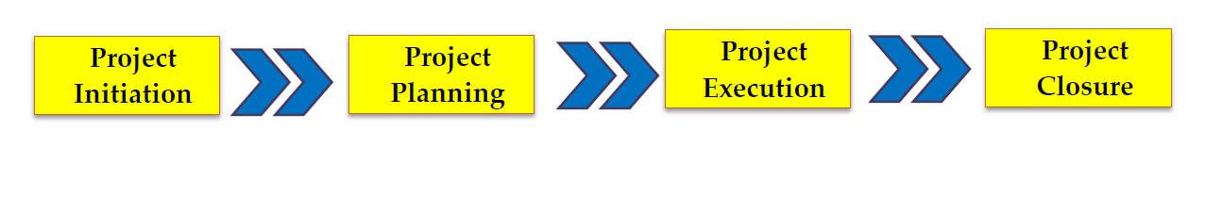
Project Life Cycle

Slide 5
Project Initiation Phase
The Project Initiation Phase is the 1st phase in the Project Life Cycle, as it involves starting up a new project.
One can start a new project by defining its objectives, scope, purpose and deliverables to be produced.
One will also hire project team, setup the Project Office and review the project.
Notes:
One will also hire project team, setup the Project Office and review the project, to gain approval to begin the next phase.

Slide 6
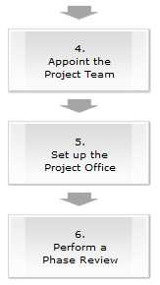
Project Initiation Phase

Slide 7
Project Planning Phase
The Project Planning Phase is the second phase in the project life cycle.
It involves creating of a set of plans to help guide the team through the execution and closure phases of the project.
The plans created during this phase will help to manage time, cost, quality, change, risk and issues.
They will also help manage staff and external suppliers, to ensure that you deliver the project on time and within budget.

Slide 8
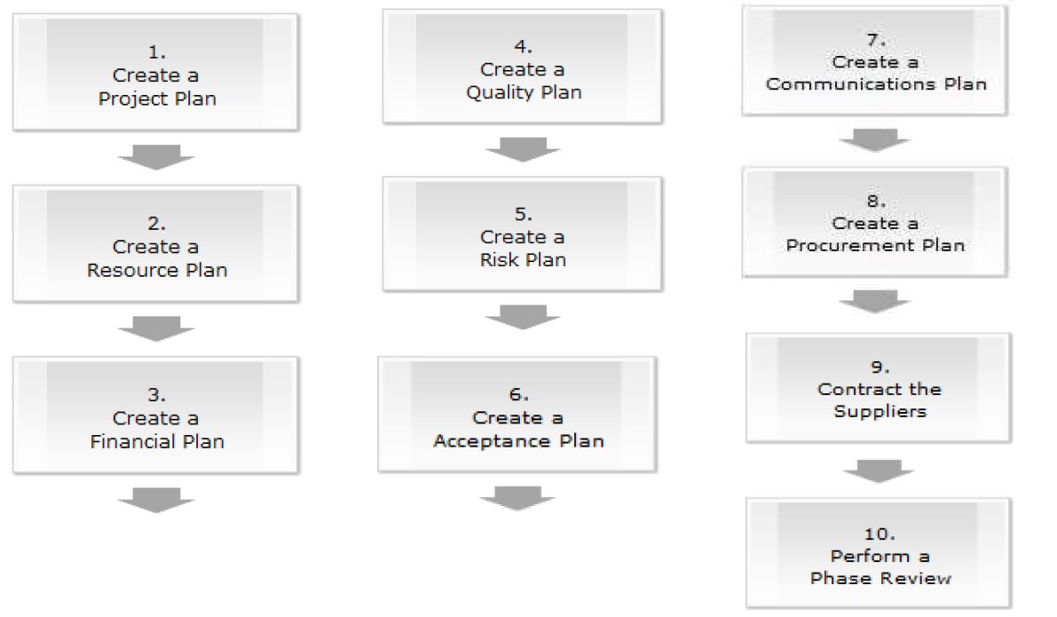
Project Planning Phase

Slide 9
Project Execution Phase
The Project Execution Phase is the third phase in the project life cycle.
One will build the physical project deliverables and present them to the customer.
This is usually the longest phase in the project life cycle and it typically consumes the most energy and the most resources.

Slide 10
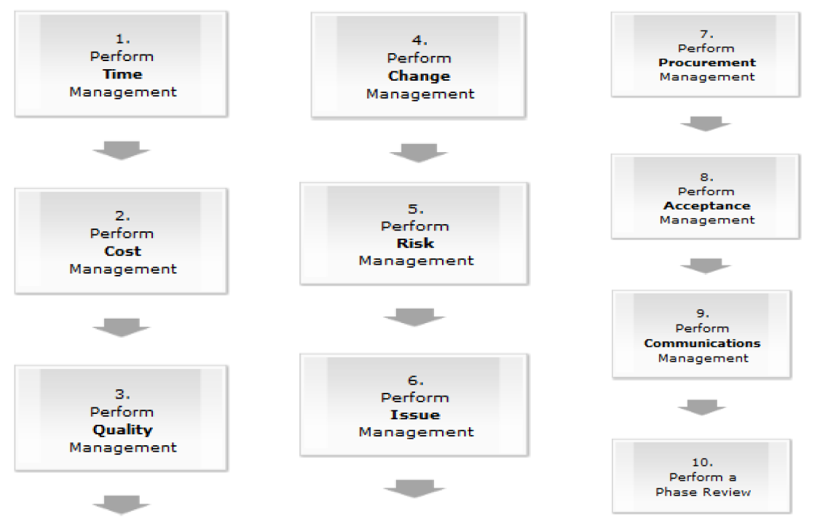
Project Execution Phase

Slide 11
Project Closure Phase
The Project Closure Phase is the fourth and last phase in the project life cycle.
In this phase, one will formally close the project and then report its overall level of success to the sponsor.
Project Closure involves handing over the deliverables to the customer, passing the documentation to the business, cancelling supplier contracts, releasing staff and equipment, and informing stakeholders of the closure of the project.

Slide 12
Project Life Cycle : An Overview

Slide 13
Product Life Cycle
The product life cycle starts with the idea of a new product in an organization that gets evaluated during the innovation phase which is followed by the product development phase.
After the initial market introduction the product is adapted and then sustained and finally reaches its end of life
Notes:
A product is anything that can be offered to a market to solve a problem, or to satisfy a want or need.
Products have a life cycle that consists of multiple stages. First the product is conceived, then developed, then introduced and managed in the market, and finally the product is retired when the need for it diminishes.
A project is a temporary endeavor that is undertaken to create a unique product or service. With a project, there is a clear definition of what needs to be delivered by a specified date in time.
It’s important to note that a product can only be developed within the context of a project, and multiple projects can occur within a product’s life cycle.

Slide 14
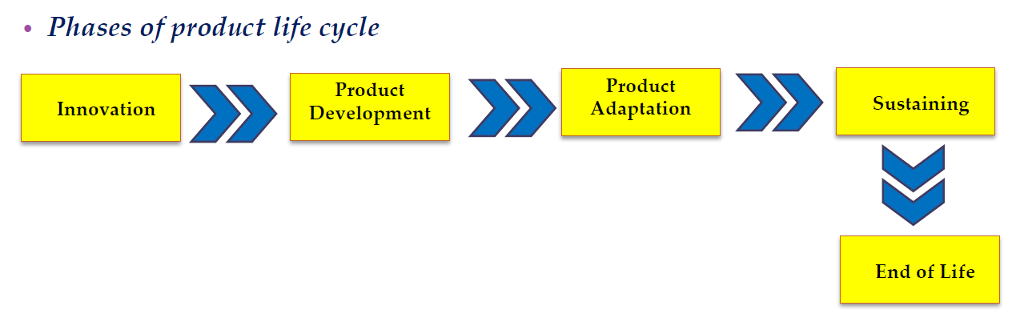

Slide 15
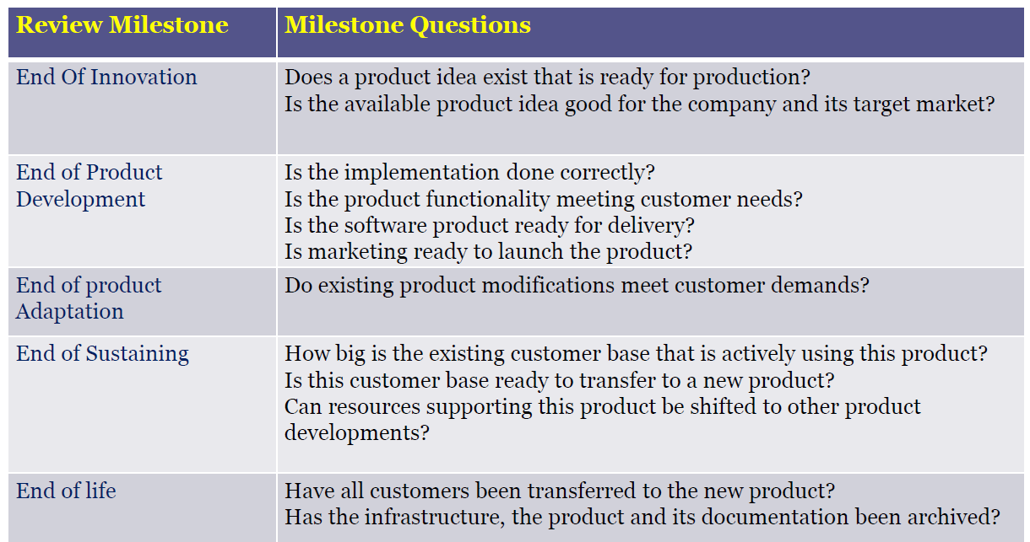
Product Life Cycle

Slide 16
Stepwise Project Planning Process
Step 0: Select project
Step 1: Identify project scope and objectives
Step 2: Identify project infrastructure
Step 3: Analyze project characteristics
Step 4: Identify project products and activities
Step 5: Estimate effort for each activity
Step 6: Identify activity risks
Step 7: Allocate resources
Step 8: Review/publicize plan
Step 9: Execute plan
Step 10: Execute lower levels of planning

Slide 17
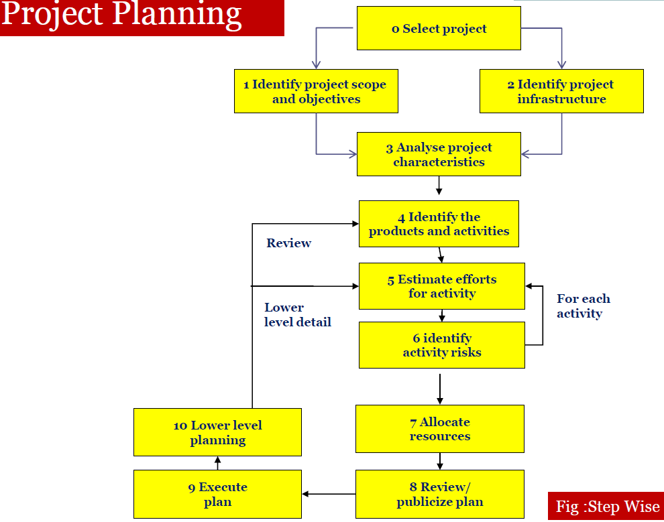


Slide 18
Step 1: Identify project scope and objectives
Identify objectives and measures of the effectiveness in meeting those objectives
Identify all stakeholders in the project and their interests
Modify objectives in the light of stakeholder analysis if necessary
Establish methods of communication between all parties

Slide 19
Step 2:Identify Project Infrastructure
Identify the order of related projects (in the organization) being carried out
Identify the hardware and software requirements
Identify installation standards and procedures
Identify project team organization

Slide 20
Step 3: Analyze Project Characteristics
Analyze other project characteristics (including quality-based ones)
Identify high level project risks
Take into account user requirements concerning implementation
Review overall resource estimates
Up to this stage,
▫ the major risks of the project are identified
▫ the overall approach of the project is decided
So, it is a good place to re-estimate the required effort and other resources for the project

Slide 21
Step 4: Identify Project Products and Activities
Recognize product instances
Produce an ideal activity network
▫ Activity network shows the tasks that have to be carried out as well as their sequence of execution for the creation of a product from another

Slide 22
Step 5: Estimate Effort for Each Activity
need to estimate staff effort, time for each activity, and other resources
need to break a task into a series of manageable sub-tasks

Slide 23
Step 6: Identify Activity Risks
Identify and quantify the risks of each activity
Plan risk reduction and likelihood measures where appropriate.

Slide 24
Step 7: Allocate Resources (Staffing)
type of staff needed for each activity are identified
staff availabilities are identified, staff are conditionally allocated to task
Revise plans and estimates to take into account resource constraints

Slide 25
Step 8: Review/publicize Plan
Review quality aspects of the project plan
To ensure each activity is completed with a quality product
Document plans and obtain agreement
all parties understand and agree to the commitments in the plan

Slide 26
Step 9: Execute Plan
Build the physical project deliverables and present them to the customer.

Slide 27
Scheduling
The purpose of the scheduling is to plan how the activities will perform over the period of time.
Project scheduling indicates what needs to be done, which resources must be utilized and when.
Some scheduling technique used are: Gantt chart, network diagram, CPM(critical path method), PERT(program evaluation and review technique)
Scheduling manages:
Parallelism (tasks can be undertaken simultaneously)
Dependency (task has an effect on subsequent tasks)
Bad Scheduling is a very destructive influence

Slide 28
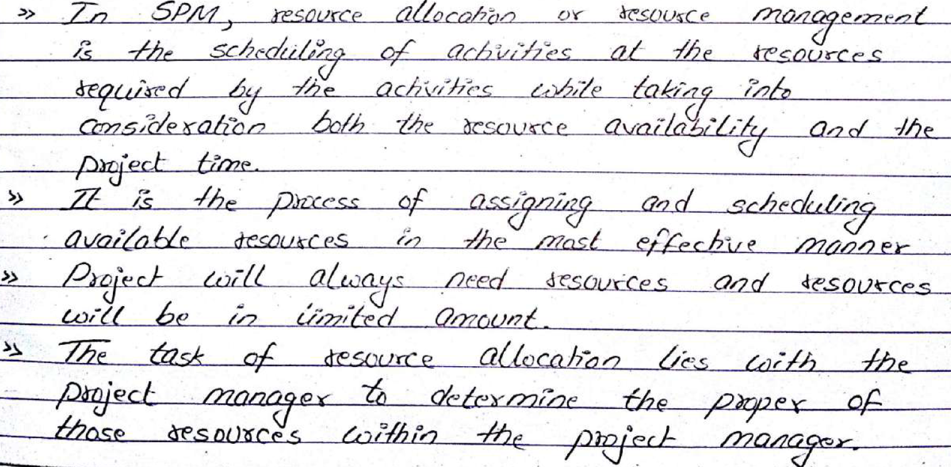
Resource Allocation

