Slide 1
Acoustic Scene Classification using Frequency-aware CNN with Metric-based Few-Shot Learning
Submitted by,
Name: K. Roopteja,
Roll No.: 22376005,
Project Guide: Dr. S. L. Jayalakshmi.

Slide 2
Problem Definition
Acoustic Scene Classification (ASC): a field of audio signal processing that involves the categorization of an audio recording into predefined acoustic scenes or environments.
The scenes comprise the categories such as
indoor (residence, restaurant/cafe)
outdoor (park, metro station)
transportation (metro, bus, tram)
Applications:
Surveillance and Security
Emergency Response
To enhance the performance of ASC model using the few shot learning to classify different overlapping classes of various acoustic scenes.
Notes:
1)Imagine you close your eyes and listen carefully to the sounds around you. Based on the traffic rumble, birdsong, or chatter of voices, you can probably guess whether you're in a busy city street, a quiet park, or a crowded restaurant. ASC does the same thing, but with the help of sophisticated algorithms.
4) Acoustic scenes could be pre-recorded or live streaming audio.
5) For example airport scenario, having announcement, footsteps, clinking of glasses, Sounds of aircraft engines, takeoffs, and landings, etc..;
6) Example: Like Classroom is a scene, the AS are like footsteps, fan sound, bike horn, etc., these are comes under classroom Scene. Based on this analysis, the ASC system classifies the acoustic scene as a “Classroom”.
7) Appli: Security personnel can be alerted if the system detects unusual acoustic patterns in restricted or sensitive zones.
8) identifying emergency situations based on distinct acoustic patterns. Emergency response systems can be triggered automatically, and relevant personnel can be alerted promptly.
9)Overlapping classes involves situations where sounds from different classes overlap in time.
Overlapping sounds between two classes involves situations where sounds from different classes overlap in time.
Overlapping sounds within a class refers to situations where different sound signals belonging to the same class occur simultaneously or overlap in time.
10) Example: airports and metro station Scene, Both environments share similar sounds like people talking, walking, and using wheeled luggage or bags, regular announcements, escalators whirring etc..

Slide 3
Base Paper
Title: A novel acoustic scene classification model using the late fusion of convolutional neural networks and different ensemble classifiers [Applied Acoustics 175 (2021) 107829]
Authors: [Mahmoud A. Alamir]
To enhance ASC accuracy by introducing late fusion models that combine convolutional neural networks (CNNs) with ensemble classifiers
Data Augmentation:
Splitting 10sec sample to 10 one sec samples.
Mix-up
Feature extraction:
Mel-spectrograms
wavelet scattering
Classifier
Late fusion model – CNN and ensemble classifier models

Slide 4
Related works
Publish Year | Refer- Ence | Features | Classification | Merits | Demerits | Research Gap
2022 | [1] | DA: Mixup FE: Mel- spectrograms, wavelet Scattering | CNN, Ensemble Classifiers | Improved Accuracy | High complexity, High resource requirement | Exploration of Hybrid Models
2023 | [3] | DA: Mix-up FE: Log- Mel spectrograms | FACNN | Device Mismatch Mitigation | Noisy Environments Consideration | Determine the optimum timeframe
2022 | [8] | DA: - FE: Log- Mel spectrograms | Transfer Few-Shot Learning | Real-World Relevance, Baseline System | Generalizability to Challenging Acoustic Conditions | Adding more challenging acoustic conditions in the dataset
2020 | [9] | DA: - Inference- time FE: Log- Mel spectrograms | CNN, Metric- based few- shot learning | Automation of Sound Event Detection, Enhanced Detection Accuracy | Limited Validation Beyond Speech, Only Fixed context-window | Dynamic context- window
Notes:
A baseline system is a profile configuration based on the minimum recommended configuration parameters.
A baseline identifies an agreed-to description of the attributes of a {system} at a point in time and provides a known configuration to which changes are addressed.

Slide 5
Few-Shot Learning techniques
S. No. | Technique | Used in | Applications
1 | Transfer Learning | Sparse Data Availability, Adaptability to New Classes | Audio Classification, Speech Recognition
2 | Siamese Networks | Measuring Similarity within a Small Dataset | Audio Similarity Detection, Speaker Verification
3 | Metric-based Few-Shot Learning | Discriminating Between Examples in Embedding Space | Audio Classification, Speaker Recognition
4 | Triplet Networks | Embedding Triplets for Discriminative Learning | Audio Retrieval, Speaker Embedding

Slide 6
Proposed System
To propose a model to classify the different overlapping classes in an acoustic environmental scene with the help of Few-shot learning technique.
Proposed Methodology
Metric-based Few-shot learning
Feature Extraction
Log-Mel spectrogram
Classification
Frequency-aware CNN

Slide 7
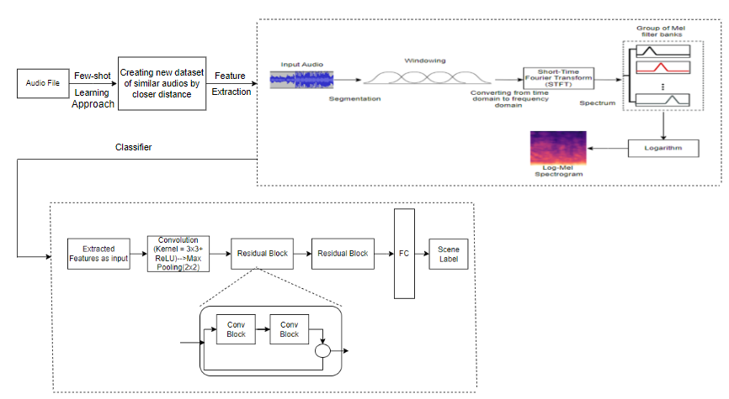
Design
Notes:
Key parameters influencing log-mel spectrogram generation:
Number of Mel frequency bins: Defines the resolution of the frequency scale.
Sampling frequency: Determines the range of frequencies captured.
Window length: Controls the time resolution of the spectrogram.
Frame overlap: The degree of overlap between consecutive windows.
Window function: Minimize spectral leakage in the spectrogram.

Slide 8
Metric-based Approach
Representing the audio file as waveform.
Checking the sampling rate of the selected 2 audio files
Same then calculate the Euclidean distance between the raw audio waveforms of the two files.
Different then the comparison cannot proceed.
Calculating Euclidean distance between two audio files as:
Updating the new dataset by closer distance range.
Notes:
sampling rate refers to the number of times a continuous signal is measured or sampled per unit of time, typically per second. It essentially tells you how much information is being captured from the original signal.
raw audio waveform refers to the most basic representation of sound. It is essentially a visual depiction of how air pressure changes over time, capturing the essence of every sound wave captured by a microphone, speaker, etc..
Raw Audio Waveform: This term can be seen as an emphasis on the unprocessed nature of the waveform. It signifies that the presented waveform is the original, uncompressed data captured by a microphone or similar device, before any modifications or processing like filtering or compression.
Waveform: A general term for a visual representation of a wave-like pattern, applicable to various phenomena like sound, light, or electrical signals. In audio, it depicts the continuous variations in sound pressure over time.
A smaller Euclidean distance suggests more similarity, while a larger distance indicates greater dissimilarity.
Here, n represents the length of the audio waveforms, and audio_1[i] and audio_2[i] are the amplitude values of the two waveforms at the i-th sample.

Slide 9
Log-mel Spectrogram
Input Audio: Raw audio files from reduced dataset.
Windowing: Helps to reduce spectral leakage, which can occur when the signal is abruptly truncated.
Short-Time Fourier Transform (STFT): breaks down the signal into its component frequencies over time.
Mel Filter Banks: Set of filters that are designed to mimic the human auditory system's perception of frequency. These filters divide the spectrogram into a number of Mel-frequency bands.
Logarithm: because the human auditory system perceives sound intensity on a logarithmic scale.
Output: As Log- Mel spectrogram.
Notes:
In framing, the input speech signal is segmented as small duration block known as frames and this process is essential in speech because of speech is time varying signals.
Voice Activity Detection (VAD) technique is employed for segmentation, his means the system first identifies and separates portions of the audio containing actual speech from non-speech segments like silence, background noise, or music.
windowing refers to the process of dividing the continuous audio signal into smaller segments, or frames.
Hamming window strikes a balance between several crucial factors:
Moderate spectral leakage: It suppresses unwanted "leakage" between frequency components better than the Rectangular window.
Decent frequency resolution: Its main lobe width is narrower than Hann and Hanning windows, allowing for better separation of close frequencies.
Computational efficiency: It's relatively simple to implement compared to windows
STFT is used to convert a signal from its time-domain representation to a frequency-domain representation. It calculates the Fourier transform of small, overlapping windows of the signal over time. This is particularly useful in analyzing signals that may vary in frequency content over time, such as audio signals.
Mel Filterbanks: After obtaining the STFT, the next step is to apply Mel filterbanks to the magnitude spectrum of the STFT. Mel filterbanks are a set of triangular filters spaced out on the Mel scale, which is a perceptual scale of pitches. These filters help to represent the signal in a way that approximates human auditory perception.

Slide 10
FACNN
Detects temporal patterns in sequential data like audio or text.
Frequency Sensitivity: FACNNs are explicitly designed to be sensitive to frequency information, making them more suitable for tasks where the frequency content of the signal is crucial, such as in acoustic scene classification.
Introduce residual connections to facilitate the flow of information across layers. These connections can help mitigate the vanishing gradient problem and improve the training of deep networks.
Notes:
1)Learns local patterns and features, such as edges, textures, and shapes in images.
Frequency Sensitivity: Audio signals are characterized by both temporal and frequency components. Standard CNNs designed for image classification may not capture the specific frequency patterns present in audio data. FACNNs are explicitly designed to be sensitive to frequency information, making them more suitable for tasks where the frequency content of the signal is crucial, such as in acoustic scene classification.

Slide 11
Dataset
TAU Urban Acoustic Scenes 2022 Mobile development dataset consists of 1-seconds audio segments acoustic scenes:
Airport - airport
Indoor shopping mall - shopping_mall
Metro station - metro_station
Audio data was recorded in Lisbon, Prague, Paris, etc.
Audio is provided in a single-channel 44.1kHz 24-bit format.

Slide 12
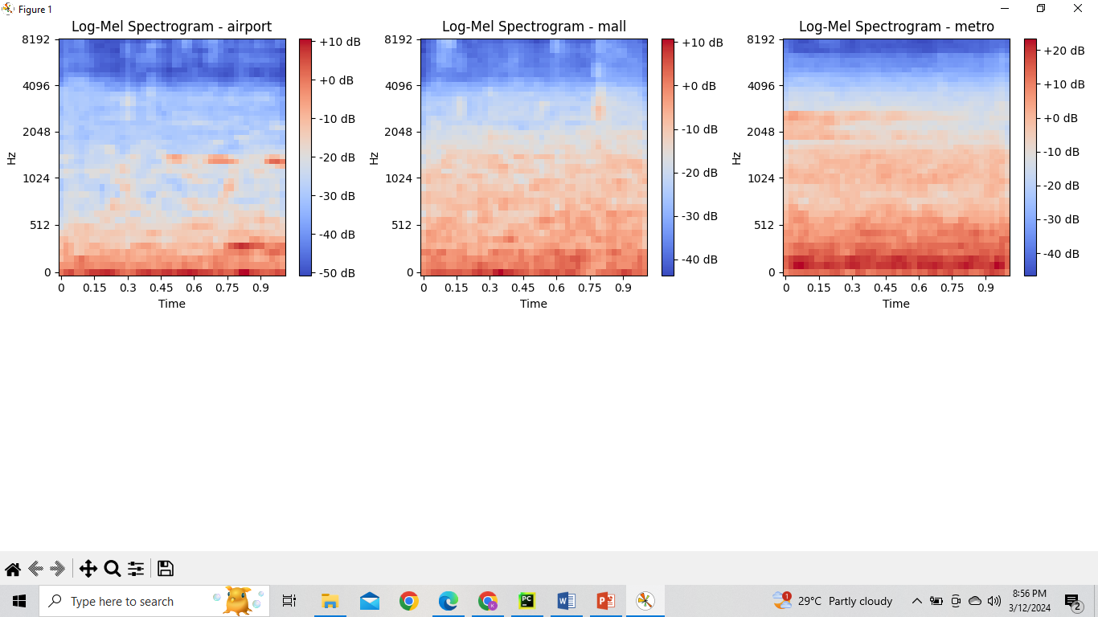
Results

Slide 13
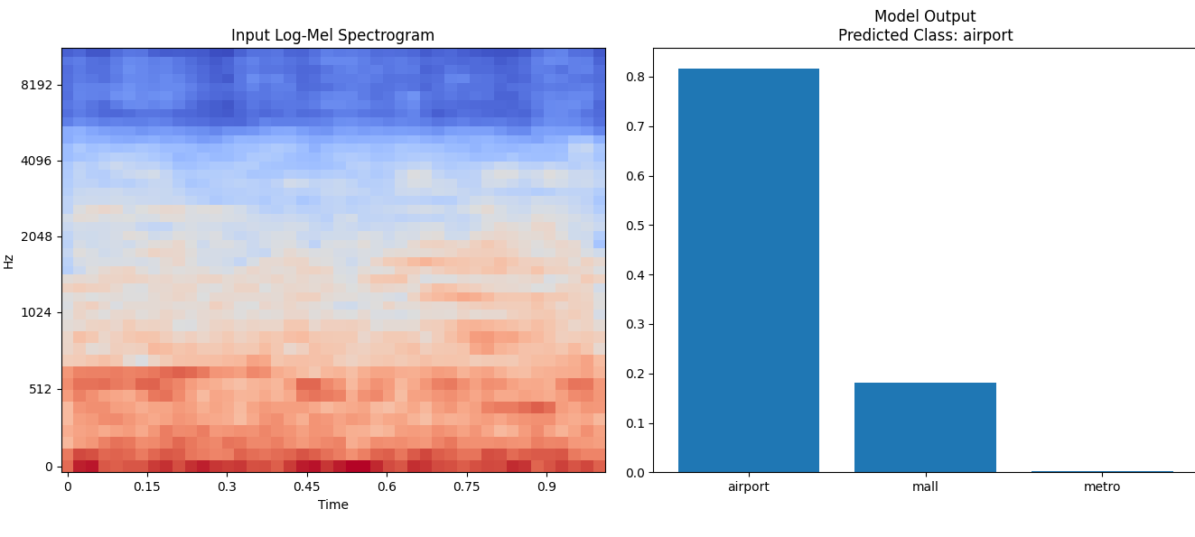
Cntd..

Slide 14
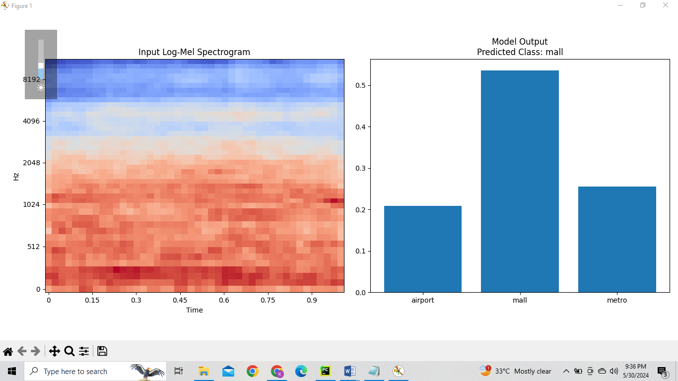
Cntd..

Slide 15
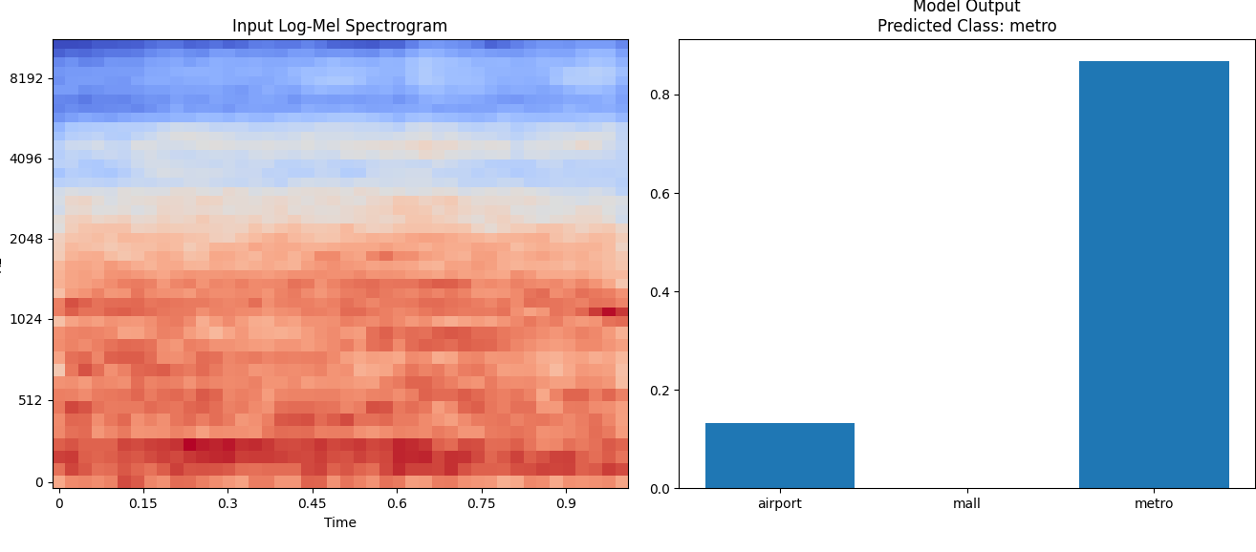
Cntd..

Slide 16
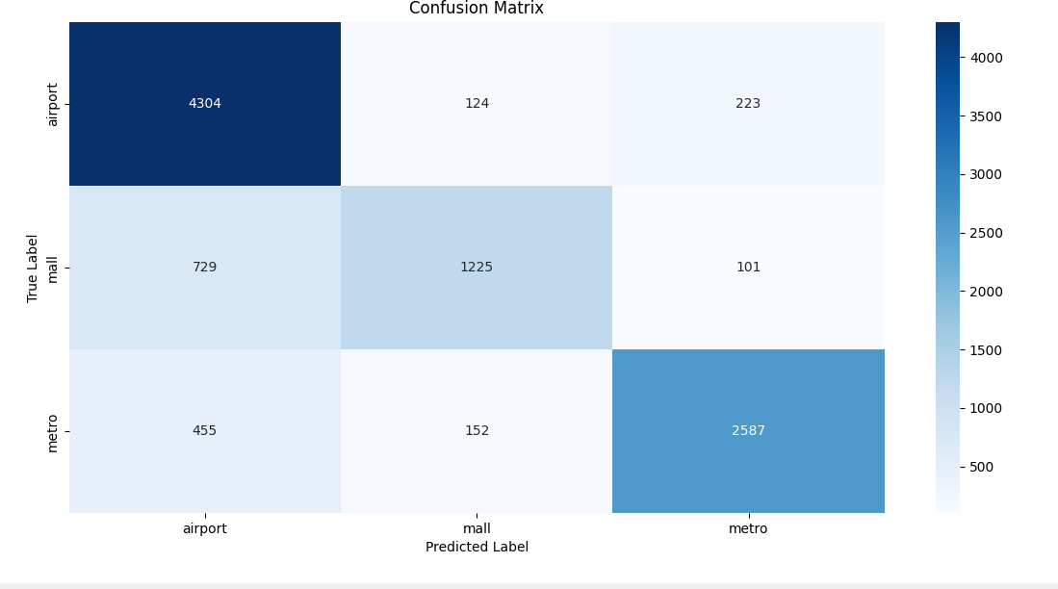
Confusion Matrix

Slide 17
Comparison of different systems
Features | System | Accuracy(%)
Log-Mel | CNN | 77.45
MFCC | CNN | 75.7
Spectrogram | CNN | 74.95
Log-Mel | FACNN | 81.97

Slide 18
Conclusion
These techniques will improve classification accuracy, capture important audio features, and perform better with less labelled data.
High classification accuracy was demonstrated using the TAU Urban Acoustic Scenes 2022 Mobile dataset and demonstrated resilience in diverse environments.

Slide 19
Future Work
Practical implementation in real-world scenarios, such as audio surveillance, emergency response needs to be explored.
Enhancing the performance in complex acoustic environments.
Research to extend model performance across larger and more diverse datasets.

Slide 20
Reference
Mahmoud A. Alamir, “A novel acoustic scene classification model using the late fusion of convolutional neural networks and different ensemble classifiers”, Applied Acoustics 175 (2021)
Tao Zhang, Jinhua Liang, Biyun Ding, “Acoustic scene classification using deep CNN with fine-resolution feature”, Expert Systems With Applications 143 (2020) 113067
Nisan Aryal a, Sang-Woong Lee, “Frequency-based CNN and attention module for acoustic scene classification”, Applied Acoustics 210 (2023) 109411
T. Zhang and J. Wu, “Constrained learned feature extraction for acoustic scene classification”, IEEE/ACM Transactions on Audio, Speech, and Language Processing, Vol. 27, No. 8, pp. 1216-1228, 2019.
Paseddula C, Gangashetty SV. Late fusion framework for Acoustic Scene Classification using LPCC, SCMC, and log-Mel band energies with Deep Neural Networks. Appl Acoust 2021;172:107568. https://doi.org/10.1016/j.apacoust.2020.107568
Kosmider M. Spectrum correction: Acoustic scene classification with mismatched recording devices. Proc. Interspeech 2020 2020:4641–5.
Mie Mie Oo, Nu War, “Acoustic Scene Classification using Attention based Deep Learning Model”, International Journal of Intelligent Engineering and Systems, Vol.15, No.6, 2022
Javier Naranjo-Alcazar, Sergi Perez-Castanos, Pedro Zuccarello, Ana M. Torres, Jose J. Lopez, Francesc J. Ferri, Maximo Cobos, “An Open-Set Recognition and Few-Shot Learning Dataset for Audio Event Classification in Domestic Environments”, Pattern Recognition Letters 164 (2022) 40–45
Wang, Y., Salamon, J., Bryan, N. J., & Pablo Bello, J. (2020). Few-Shot Sound Event Detection. ICASSP 2020 - 2020 IEEE International Conference on Acoustics, Speech and Signal Processing (ICASSP). doi:10.1109/icassp40776.2020.9054708
Biyun Ding, Tao Zhang, Ganjun Liu, Lingguo Kong, Yanzhang Geng, “Late fusion for acoustic scene classification using swarm intelligence”, Applied Acoustics 192 (2022) 108698

