Slide 1

Survey on Group Collaboration Among Students in SUSTech
1PPT.COM
Group1 Members:
11812532 骆镒玲 11812136 齐馨月 11811634 叶可欣 11812232 陶昕冉 11812432 范馨 11610129 李子闻

Slide 2
0 1
Background and Basic Information
0 2
Attitudes and Views towards Group Collaboration
CONTE NT
0 3
1PPT.COM
Participation, Efficiency and Impact of Group Collaboration
0 4
Interesting Findings and Discussions
0 5
Conclusions and Suggestions
06 66
Supplementary Information

Slide 3

Part one
01.Background and Basic Information

Slide 4
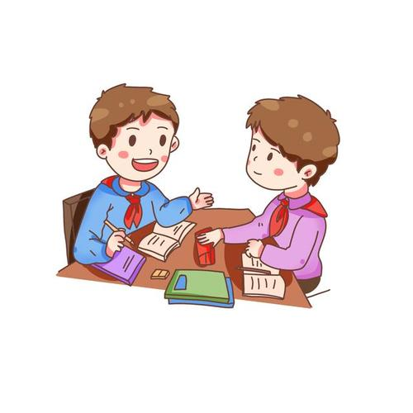
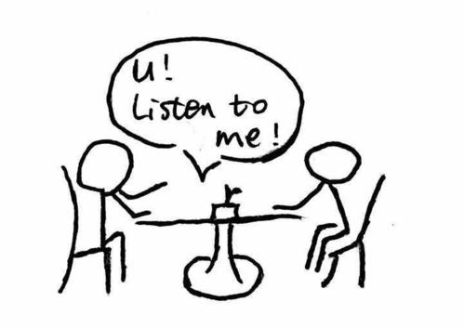
Background
Recent years, the phenomenon of group cooperation and group discussion is more common in university courses. Group cooperation ability, impressive ability and leadership ability are the necessary skills for innovative students. In order to study the preference habit of college students about group discussion. We have carried out a survey on College Students' attitudes and opinions towards group cooperation, and the participation and efficiency of group cooperation.
Notes:
This is very intuitive, too

Slide 5
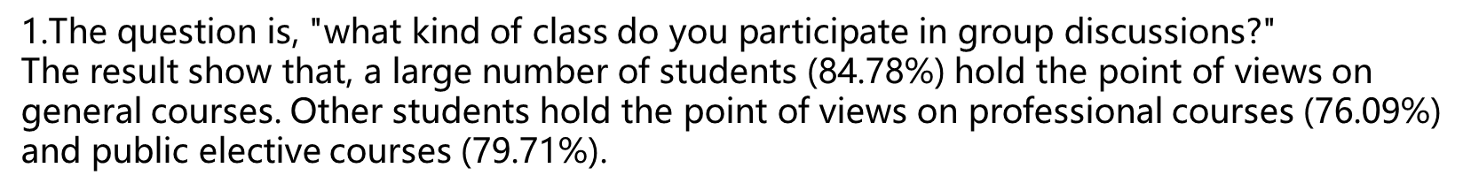
Groups and targets

Slide 6
2. " How many courses have group cooperation?"
The result shows that, a small number of students (7.97%) have no courses with group cooperation. Other students hold the point of views 1 courses (16.67%) ,2 courses (31.16%).
The majority of students hold the point of views of 3 and more courses(44.2%).
Notes:
This is very intuitive, too

Slide 7
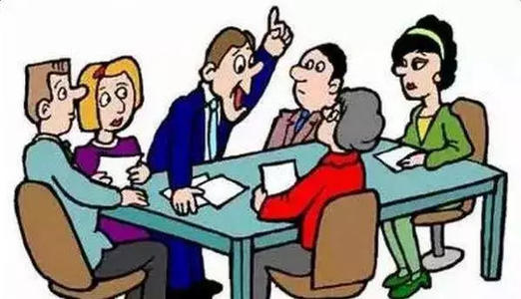
3. "Is there a team leader on your team?" 84 students (60.87%) said ‘Yes’, while 54 students(39.13%) said ‘No’. Most of the teams have team leaders.

Slide 8
Gender & Grade
Gender
89 male students (64.49%) completed the survey, while 49 female students (35.51%) completed the survey.
Options | Frequency | Percentage
freshmen | 21 | 15.22%
sophomore | 30 | 21.74%
junior | 61 | 44.2%
senior | 22 | 15.94%
others | 4 | 2.89%
Total | 138 | 100%
1PPT.COM
Grade
21 freshmen (15.22%), 30 sophomores (21.74%), 61 juniors (44.2%), and 22 seniors (15.94%) completed the survey.

Slide 9

Major
The major of the survey participants covers a wide range.
There are 24 majors in total.
Notes:
This is very intuitive, too

Slide 10
Part two
02. Attitudes and Views towards Group Collaboration
Visualization & Tests

Slide 11
Views and Attitudes

Slide 12
Views and Attitudes
The fisher test p-value: 0.36
(multiple choice)
What qualities should a group leader have?
Good communication skills | 87
Solid professional competence | 33
Outstanding leadership | 76
Responsibility | 72
Chi-square test p-value: 1.695e-05

Slide 13
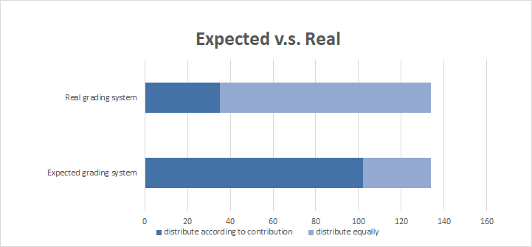
Views and Attitudes

Slide 14
Part three
03. Participation, Efficiency and Impact of Group Collaboration
Results Display

Slide 15
Participation and Efficiency
Q11: In the last group work, did your team members take part in the discussion on time?
1PPT.COM
Options | Frequency | %
All group members participated on time | 32 | 23%
Some group members were rarely unpunctual (under 30%) | 89 | 64%
Some group members were often unpunctual (30%-60%) | 12 | 9%
Some group members were always unpunctual (over 60%) | 5 | 4%
Total | 138 | 100%

Slide 16
Participation and Efficiency
Q12: Was your last group work evenly distributed?
Q13: What do you think is the main reason for unevenly distributed tasks?
1PPT.COM
Options | Frequency | %
Yes | 76 | 55%
No | 62 | 45%
Total | 138 | 100%

Slide 17
Participation and Efficiency
Q14: Which part takes much time and effort in group discussion?
1PPT.COM

Slide 18
Participation and Efficiency
Q15: Did your group make a plan before performing the task in the last collaboration without requirements from the course?
Q16: Did your team complete the plan?
1PPT.COM
Options | Frequency | %
Stick to their plan | 23 | 31%
Fulfilled their plan most of the time | 48 | 65%
Hardly finished their plan | 3 | 4%
Options | Frequency | %
Yes | 74 | 54%
No | 64 | 46%
Total | 138 | 100%
[0.45, 0.62]

Slide 19
Participation and Efficiency
Q17: Do you prioritize group tasks over individual tasks?
1PPT.COM
Options | Frequency | %
Personal task first | 10 | 7%
Personal task first most of the time | 46 | 33%
Group task first most of the time | 57 | 41%
Group task first | 25 | 18%
Total | 138 | 100%

Slide 20
Participation and Efficiency
Q18: When was your task completed before DDL in the last groupwork?
Q19: When will your tasks be completed before DDL for regular independent assignments?
1PPT.COM

Slide 21
Participation and Efficiency
Q20: How much does group collaboration affect your schedule?
1PPT.COM
Options | Frequency | %
Completely no effect | 27 | 20%
A little effect on schedule | 64 | 46%
Big impact on schedule | 35 | 25%
Severely affect schedule | 12 | 9%
Total | 138 | 100%

Slide 22
Impact
Q21: What aspect do you think you have improved most by working in a group?
1PPT.COM

Slide 23
Part four
04. Interesting Findings & Discussions

Slide 24
Grading system
n = 134
From the Fisher’s test, we discover that the p-value is less than 2.2 × 10⁻¹⁶

Slide 25
So we ask some students from different genders, majors and grades.
Many students had faced a situation when their groupmates paid less attention to their team work.
Expected
It’s difficult to measure the contribution.
They don’t want to have conflict with friends.
Reality
They don’t care about the grades or just want to keep things simple.
Some classes are forced to be distributed equally.

Slide 26
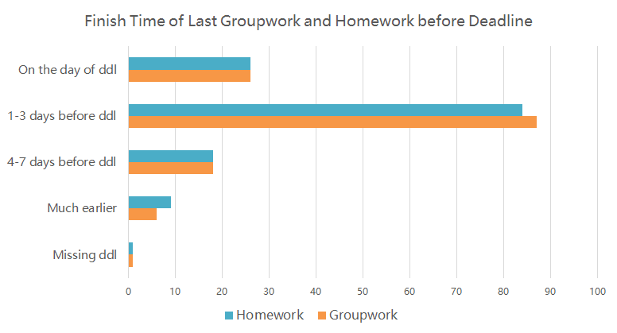
Finish Time
Homework
 | On the day of ddl | 1-3 days before ddl | earlier
On the day of ddl | 8 | 17 | 1
1-3 days before ddl | 16 | 56 | 14
earlier | 2 | 10 | 12
Groupwork
n = 138
From the Chi-square test, we discover that the p-value is 0.0005

Slide 27
Non-significant test
· Tendency to be a group leader/member & Selection criteria for team members(ability, participation)
· Tendency to be a group leader/member & Gender
· Tendency to be a group leader/member & Priority of the work
· Selection criteria for team members(ability, participation) & Gender
· Expected grading system & Whether the last groupwork was evenly distributed
· The impact on work-and-rest system & the finish time of teamwork
· The impact on work-and-rest system & grades
……

Slide 28
Tendency to be a group leader/member & Selection criteria for team members
From the Chi-square test, we discover that the p-value is 0.3521 > 0.05
Which means, no matter the person wants to be a team leader or team member, he/she prefers “enthusiasm” as the more important factor.

Slide 29
Part five
05.Conclusions and Suggestions

Slide 30
Group Structure
Participation and Efficiency
Suggestions
How to build an ideal group?
Influences

Slide 31
Summary
Group Structure
Participation and Efficiency
Influences
Most people prefer a group consists of 3 members.
The qualities they want the leader and team member to possess are their personal choices, independent of their genders, majors or preference of roles in the group.
the grading ways differ significantly between expectation and reality.
Unpunctual problem is widespread among group collaboration.
More than 40% of the students made a plan in their last group cooperation according to our estimation and most students fulfilled their plan quite well which reflects a relative high efficiency in this aspect.
Group collaboration do have certain influence on schedule.
Social skills and presentation skills are the two main aspects of development.
Notes:
This is very intuitive, too

Slide 32
Ideal
Highly Involved
Fair
Efficient

Slide 33
Group Size
According to reference, 3-4 is a preferrable group size.
Too large – may cause loafing effect.
Too small – too much workload for a single group member.
Notes:
This is very intuitive, too

Slide 34
Fairness
Task Allocation
Grading
Our target: every group member plays his/her strengths, and roughly allocate task evenly.
Combine task allocation with grading.
Grade with distinction.
Evaluate group work from both the final work and the process.
Replace penalty with bonus.
High engagement rate
Notes:
This is very intuitive, too

Slide 35
Part six
06.Supplementary Information

Slide 36
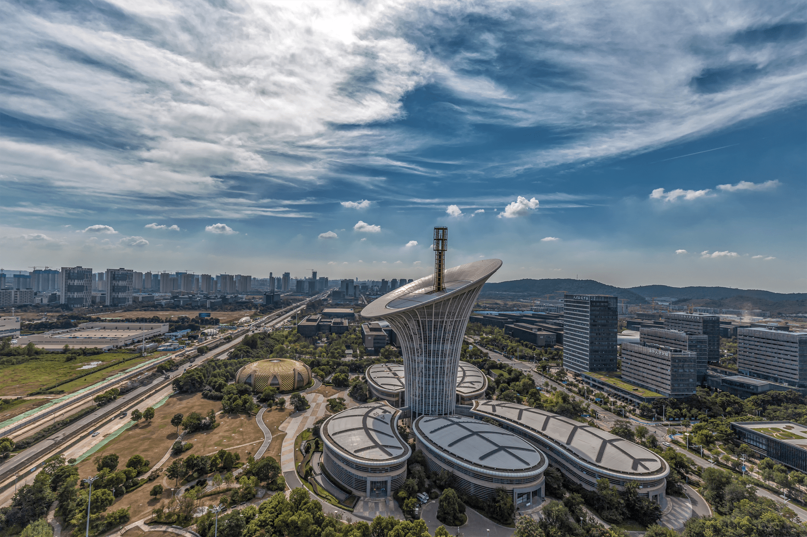
What we can also ask?
Methods of Study
e.g. brainstorm, think-discuss-exchange, etc.
0 1
0 2
Group collaboration pattern
e.g. all/one or two of the group members participate
What will influence the efficiency of group collaboration?
e.g. good atmosphere of collaboration
Have there been ‘free-riders’ and how do you think of them?
e.g. never/sometimes, etc.
Say nothing and do more things, etc.
0 4
0 3

Slide 37
Why the group cooperation becomes noneffective?
‘Free-riders’
Immature group collaboration pattern due to short collaboration time
Groupthink (All the group members think about things similarly)
Ambiguous division of work due to large group size

Slide 38
Reference
[1]徐玲丽,何景伟.高校小组作业中的社会惰性行为研究[J].特区经济,2016(11):174-176.
[2]Felder R M,Brent R.Effective Strategies for Cooperative Learning.[J]. Journal of Cooperation&Collaboration in College Teaching,2010,10:69-75.
[3]张鸽,杨晨.大学生合作学习现状调查[J].中国教育技术装备,2017(18):24-26.
[4]Johnson D W. Impact of Goal and Resource Interdependence on Problem-Solving Success[J]. Journal of Social Psychology,1989,129(5):621-629.

Slide 39
Thanks
1PPT.COM

