Slide 1
Machine Learning Classification for Human Activity Recognition (HAR)
Andy Malinsky, Dheemanth Rajakumar, Greg Moore
University of San Diego
AAI-501: Introduction to Artificial Intelligence
Professor Andrew Van Benschoten, PhD.
Professor David Friesen, MS
08/12/2024

Slide 2
Table of Contents
Introduction
Data Cleaning and Preparation
Exploratory Data Analysis
Model Selection
Support Vector Machine (SVM) Model
Convolutional Neural Network (CNN) Model
Bidirectional Long Short-Term Memory (LSTM) Model
Model Analysis
Conclusion and Recommendations
Collaboration Chart

Slide 3
Introduction

Slide 4
Data Preparation

Slide 5
Data Preparation

Slide 6
Exploratory Data Analysis

Slide 7
Model Selection

Slide 8
Support Vector Machine Model (SVM)
Insert picture here
sklearn.linear_model.SGDClassifier

Slide 9
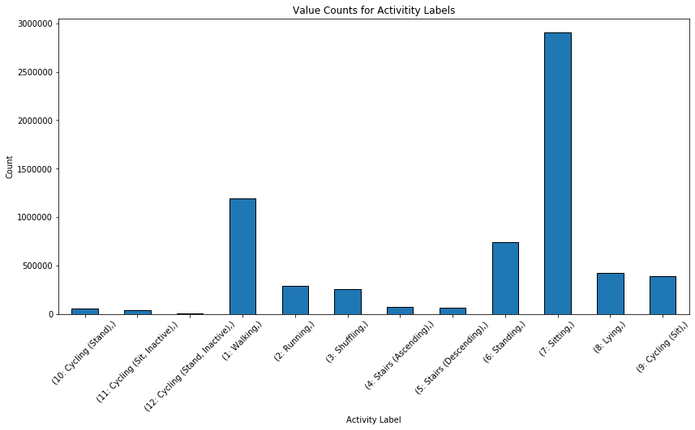
SVM: Data Preparation
Insert image here data pre standardization
Insert image here data post standardization

Slide 10
SVM: Model Training
Results of baseline model
List default parameters

Slide 11
SVM: Hyperparameter Grid Search
Results of adjusted model
List grid parameters figure

Slide 12
SVM: Calorie Burn Experiment
Figure: cosine sim vs label variance

Slide 13
SVM: Calorie Burn Experiment
Figure: cosine sim vs total absolute error

Slide 14
SVM: Calorie Burn Experiment
Figure: total absolute error vs label variance

Slide 15
Convolutional Neural Network Model

Slide 16
Bidirectional Long Short-Term Memory Model

Slide 17
Model Analysis

Slide 18
Conclusion & Recommendations

Slide 19
Collaboration Chart
Team Member 1 (Andy Malinsky) | Team Member 2 (Dheemanth Rajakumar) | Team Member 3 (Greg Moore)
List of contributions: Pre-processing Dataset Model implementation and code Final project technical report Presentation slides Presentation | List of contributions: Pre-processing Dataset Model implementation and code Final project technical report Presentation slides Presentation | List of contributions: Pre-processing Dataset Model implementation and code Final project technical report Presentation slides Presentation

Slide 20
References
Aleksej Logacjov, Atle Kongsvold, Kerstin Bach, Hilde Bremseth Bårdstu, & Paul Jarle Mork. (2023). HARTH [Dataset]. UCI Machine Learning Repository. https://doi.org/10.24432/C5NC90
Attal, F., Mohammed, S., Dedabrishvili, M., Chamroukhi, F., Oukhellou, L., & Amirat, Y. (2015). Physical Human Activity Recognition Using Wearable Sensors. Sensors, 15(12), 31314–31338. https://doi.org/10.3390/s151229858
Bach, K., Kongsvold, A., Bårdstu, H., Bardal, E. M., Kjærnli, H. S., Herland, S., Logacjov, A., & Mork, P. J. (2022). A Machine Learning Classifier for Detection of Physical Activity Types and Postures During Free-Living. Journal for the Measurement of Physical Behaviour, 5(1), 24–31. https://doi.org/10.1123/jmpb.2021-0015
Logacjov, A., Bach, K., Kongsvold, A., Bårdstu, H. B., & Mork, P. J. (2021). HARTH: A Human Activity Recognition Dataset for Machine Learning. Sensors, 21(23), 7853. https://doi.org/10.3390/s21237853
Russell, S. J., & Norvig, P. (2021). Artificial intelligence: A modern approach (4th ed.). Pearson.

