Slide 1
Machine Learning Classification for Human Activity Recognition (HAR)
Andy Malinsky, Dheemanth Rajakumar, Greg Moore
University of San Diego
AAI-501: Introduction to Artificial Intelligence
Professor Andrew Van Benschoten, PhD.
Professor David Friesen, MS
08/12/2024

Slide 2
Table of Contents
Introduction
Data Cleaning and Preparation
Exploratory Data Analysis
Model Selection
Support Vector Machine (SVM) Model
Convolutional Neural Network (CNN) Model
Bidirectional Long Short-Term Memory (LSTM) Model
Model Analysis
Conclusion and Recommendations
Collaboration Chart

Slide 3
Introduction

Slide 4
Data Preparation

Slide 5
Data Preparation

Slide 6
Exploratory Data Analysis

Slide 7
Model Selection

Slide 8
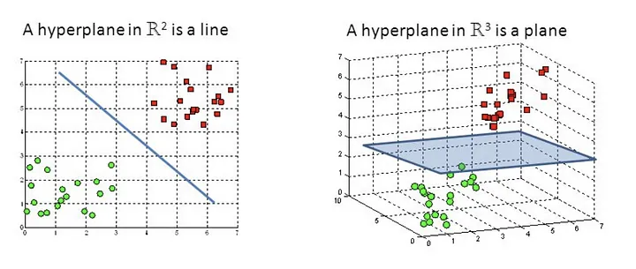
Support Vector Machine Model (SVM)
Sklearn: SGDClassifier
Supervised learning task
Classification

Slide 9
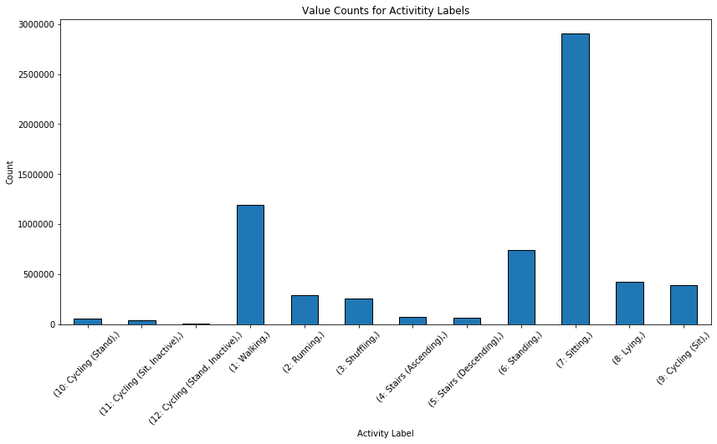
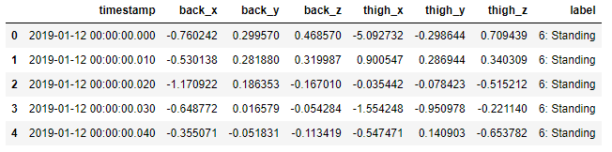
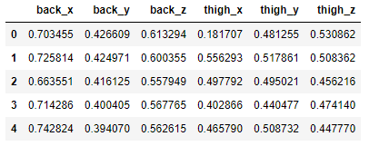
SVM: Data Preparation
Before Scaling
After Scaling

Slide 10
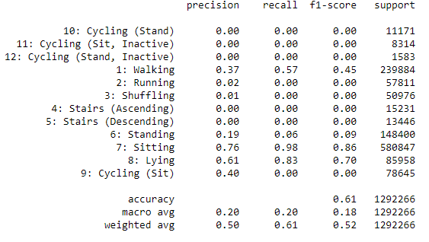
SVM: Model Training
Default parameters
loss: hinge
alpha: 1e-4
penalty: L2
learning_rate: optimal
max_iter: 1000
early_stopping: False
random_state: 24
n_jobs: -1
Results of baseline model

Slide 11
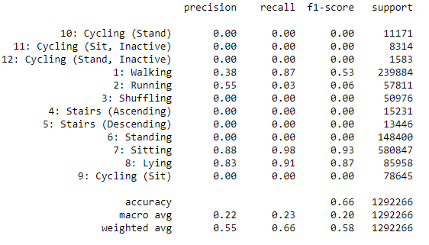
SVM: Model Training
Parameter Grid
Results of baseline model
alpha | loss | early_stopping
1e-1 | hinge | False
1e-4 | log | True
1e-7

Slide 12
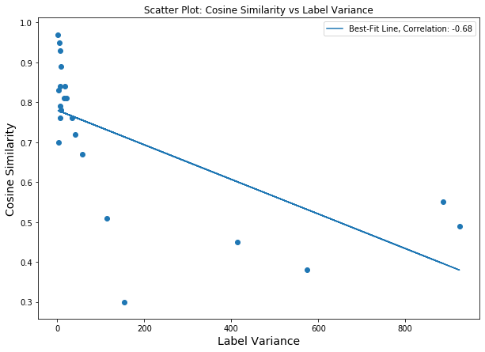
SVM: Calorie Burn Experiment

Slide 13
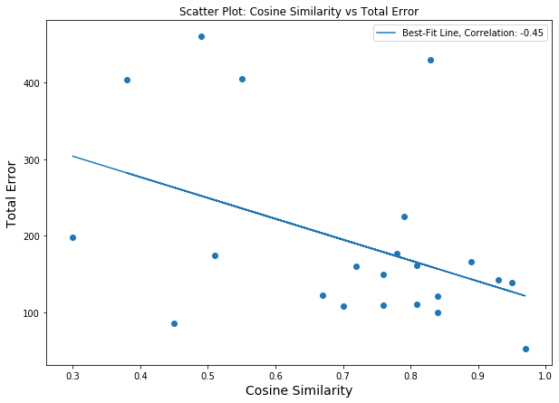
SVM: Calorie Burn Experiment

Slide 14
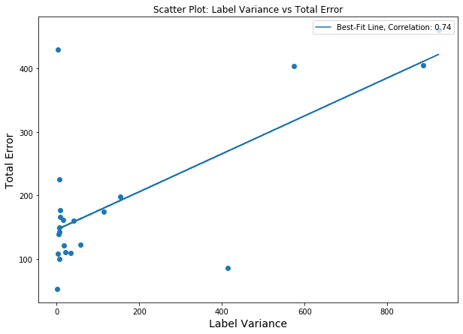
SVM: Calorie Burn Experiment

Slide 15
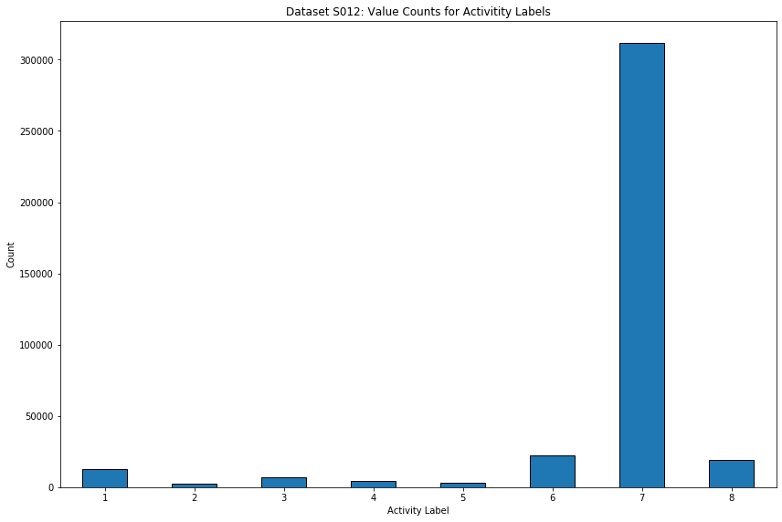
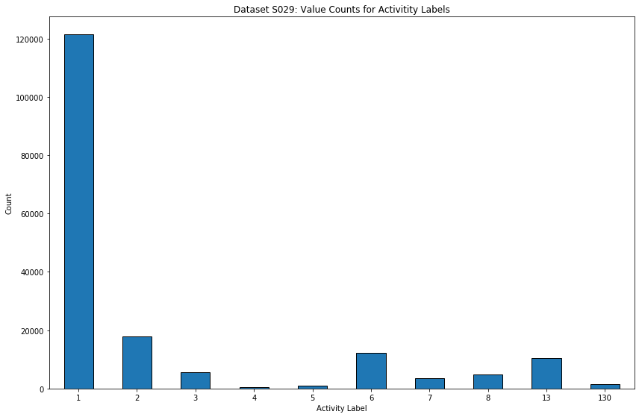
SVM Conclusion and Future Steps
Dataset ‘012’: 311,722 sitting samples, 0.97 accuracy
Dataset ‘029’: 3,406 sitting samples, 0.3 accuracy
Potential model overfitting with bias toward Sitting (7) label
Increase performance with bootstrapping and data augmentation/generation
Accuracy: 0.97
Accuracy: 0.3

Slide 16
Convolutional Neural Network Model

Slide 17
Bidirectional Long Short-Term Memory Model

Slide 18
Model Analysis

Slide 19
Conclusion & Recommendations

Slide 20
Collaboration Chart
Team Member 1 (Andy Malinsky) | Team Member 2 (Dheemanth Rajakumar) | Team Member 3 (Greg Moore)
List of contributions: Pre-processing Dataset Model implementation and code Final project technical report Presentation slides Presentation | List of contributions: Pre-processing Dataset Model implementation and code Final project technical report Presentation slides Presentation | List of contributions: Pre-processing Dataset Model implementation and code Final project technical report Presentation slides Presentation

Slide 21
References
Aleksej Logacjov, Atle Kongsvold, Kerstin Bach, Hilde Bremseth Bårdstu, & Paul Jarle Mork. (2023). HARTH [Dataset]. UCI Machine Learning Repository. https://doi.org/10.24432/C5NC90
Attal, F., Mohammed, S., Dedabrishvili, M., Chamroukhi, F., Oukhellou, L., & Amirat, Y. (2015). Physical Human Activity Recognition Using Wearable Sensors. Sensors, 15(12), 31314–31338. https://doi.org/10.3390/s151229858
Bach, K., Kongsvold, A., Bårdstu, H., Bardal, E. M., Kjærnli, H. S., Herland, S., Logacjov, A., & Mork, P. J. (2022). A Machine Learning Classifier for Detection of Physical Activity Types and Postures During Free-Living. Journal for the Measurement of Physical Behaviour, 5(1), 24–31. https://doi.org/10.1123/jmpb.2021-0015
Logacjov, A., Bach, K., Kongsvold, A., Bårdstu, H. B., & Mork, P. J. (2021). HARTH: A Human Activity Recognition Dataset for Machine Learning. Sensors, 21(23), 7853. https://doi.org/10.3390/s21237853
Russell, S. J., & Norvig, P. (2021). Artificial intelligence: A modern approach (4th ed.). Pearson.

