Slide 1
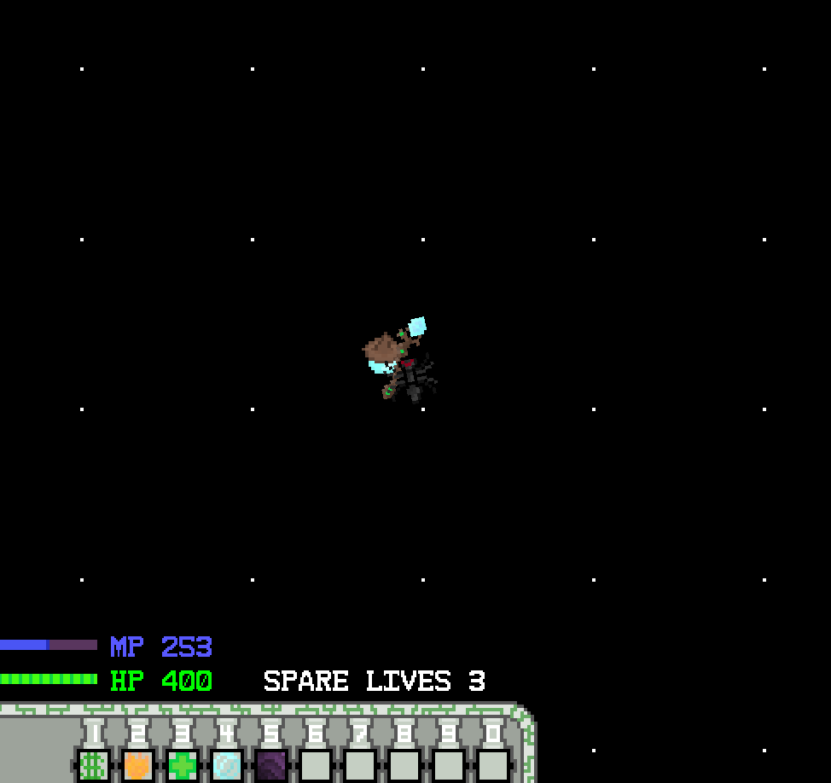
Wizard Game
Using olcPixelGameEngine
Darian Marvel
Nathan Damon
Aleks McCormick
Uddeep Karki

Slide 2
Goals
Aleks
Original goal was to make a game where the player is a wizard that fights waves of enemies
Bosses
Decent graphics with sprites
9 spells for the player to cast (healing, fireballs, explosion effects, pet summons, etc.)
Fallback plans if things didn’t work

Slide 3
Design
Darian
Team
olc::PixelGameEngine
Player/Wizard
Example (main.cpp)
Text
Mob
Different Mobs
Random
Level
Entity
Spells
DecalMap
Projectiles

Slide 4
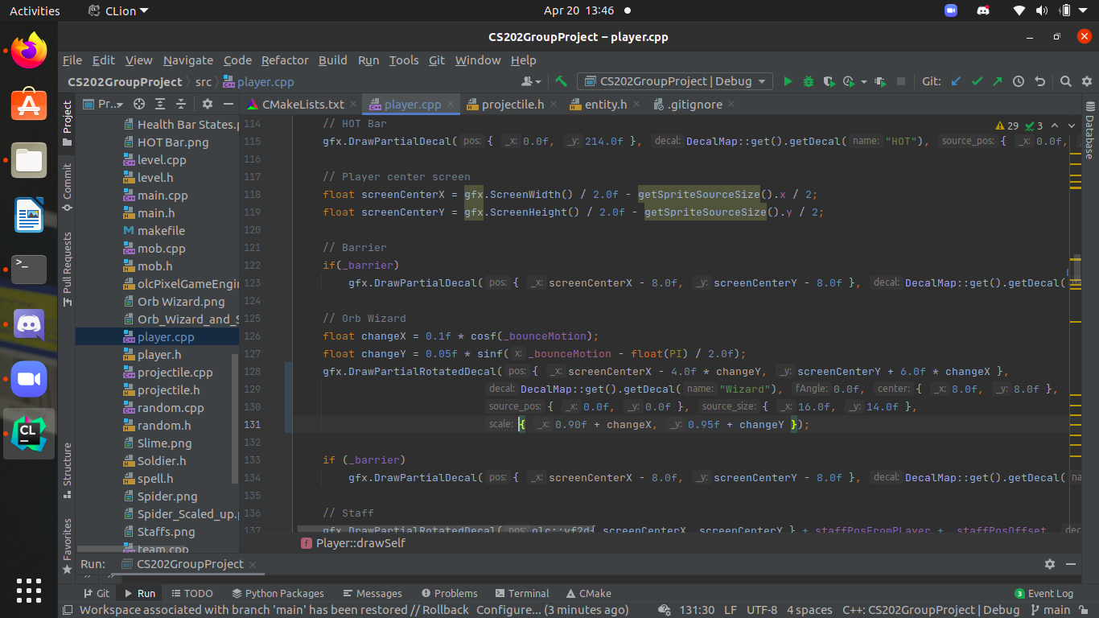
Code Highlights
Nathan
Declared Classes, and used pointers in main and Level header
Fixed circular dependency issues
Enabled Example& to access library methods of base class olc::PixelGameEngine
Bouncing motion
Std::map containers to house sprite*, decal* and text sprites: easy access
Inheritance and virtual methods
Level add, remove methods, pendingMobSpawns, pendingMobRemoval. Lets object add itself to the lists.
Projectile Factory,( and Mob Factory for future)

Slide 5
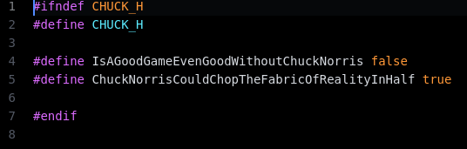
Slight Easter Egg....
Nathan

Slide 6
Post Mortem
Uddeep
Our ambition was great, but there were too many things we wanted to get done for this project. However, the fact that we were both interested in the project and wanted to work on it, helped immensely with achieving some of the goals we set out for.
First hurdle: Different IDEs/Project setup
Second hurdle: Committing changes/Separate branches/Branch merging/merge conflicts/ Same Idea but different implementation
Third Hurdle: Lack of Time.

Slide 7
Now, to Demo...
Darian

