Slide 1
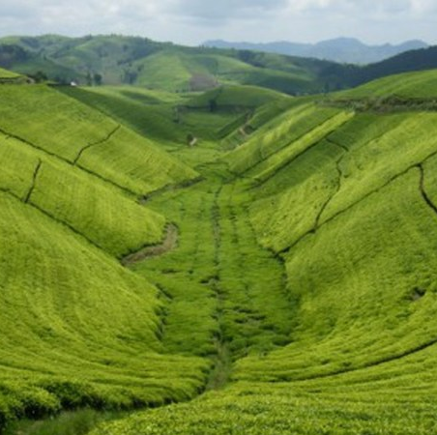
SAS And RLFS Insights Presentation By Bright TEAM

Slide 2

AGENDA
INTRODUCTION
INTENDED AUDIENCE
AIMS OF THE DASHBOARD
WORKLOAD SHARE
SAS AND RLFS INSIGHTS PRESENTATION
CONCLUTION

Slide 3
Intended audience
Government Agencies: Departments or ministries related to agriculture might use this data for policy-making, resource allocation, and planning.
Agricultural NGOs and Rwanda Agricultural Research Institute (ISAR): Organizations focused on agricultural development, research, and advocacy could utilize this data to understand trends, identify challenges, and devise strategies to improve agricultural practices.
Farmers and Agricultural Communities: Farmers may find this data helpful in understanding trends in input usage, land use patterns, and market dynamics to make informed decisions about their farming practices.

Slide 4
Intended audience
Agribusinesses and Suppliers: Companies involved in supplying agricultural inputs (seeds, fertilizers, pesticides), agricultural machinery, or processing industries could use this data to identify market opportunities and trends.
International Organizations: Entities like the United Nations' Food and Agriculture Organization (FAO) or World Bank may use this data to analyze agricultural trends in Rwanda for developmental purposes.

Slide 5
Aims of the Dashboard
Facilitating Informed Decision-Making: By providing real-time or periodic updates on various aspects of agriculture, the dashboard aims to empower stakeholders—government agencies, farmers, businesses, etc.—to make informed decisions regarding resource allocation, crop planning, market strategies, and policy formulation.
Monitoring and Evaluation: The dashboard can serve as a monitoring tool to track the performance and progress of agricultural activities, allowing stakeholders to assess the effectiveness of interventions, programs, or policies over time.

Slide 6
Aims of the Dashboard
Improving Agricultural Productivity and Efficiency: By analyzing trends in inputs, land use, crop production, and yields, the dashboard aims to identify opportunities to enhance productivity and efficiency in agriculture, potentially leading to better yields and economic growth.
Supporting Policy Formulation and Planning: Government bodies can use the data to craft agricultural policies, development plans, and initiatives that are evidence-based and responsive to the needs and challenges identified in different regions or sectors of agriculture.

Slide 7
Workload Share
1. Data Cleaning:
Robert: Takes the lead in data cleaning efforts (60%).
Meddy: Supports data cleaning tasks (40%).
2. Data Manipulation:
Robert: Conducts a significant portion of data manipulation tasks (55%).
Meddy: Contributes to data manipulation but to a lesser extent (45%).
3. Data Analysis:
Robert: Participates in performing data analysis (50%).
Meddy: Contributes equally to data analysis tasks (50%).
4. Data Visualization:
Robert: Engages in data visualization activities (35%).
Meddy: Specializes and leads most of the data visualization tasks (65%).

Slide 8
SAS And RLFS Insights Presentation

Slide 9
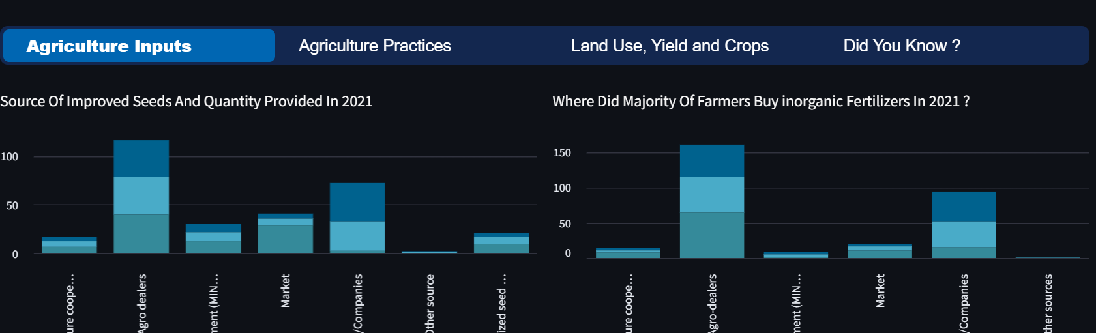
1. Agriculture Inputs
This tab communicates the following insights
what was the major and least source/supplier of improved seeds in 2021 and 2022?
where did most farmers buy inorganic fertilizers in 2021 and 2022?
Seasonal change in adoption to the agriculture inputs like:
fertilizers
pesticides
improved seeds

Slide 10
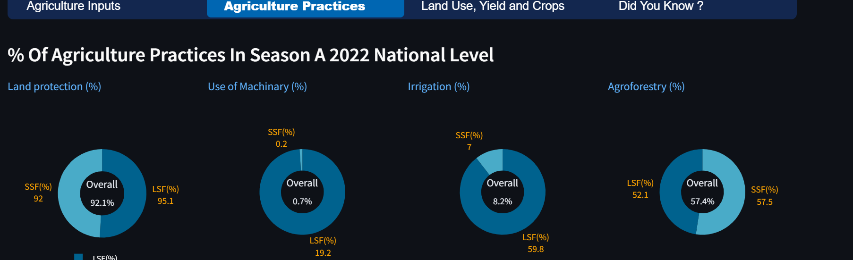
2. Agriculture Practices
This tab presents this insights
what was the district's seasonal and national % of agricultural practices in 2022?
what are modern irrigation methods and % adoption of their use in 2022 per district?
what are the sources of water for irrigation and % of their use in 2022 per district?
seasonal change in area under agriculture practices (Ha) in 2022

Slide 11
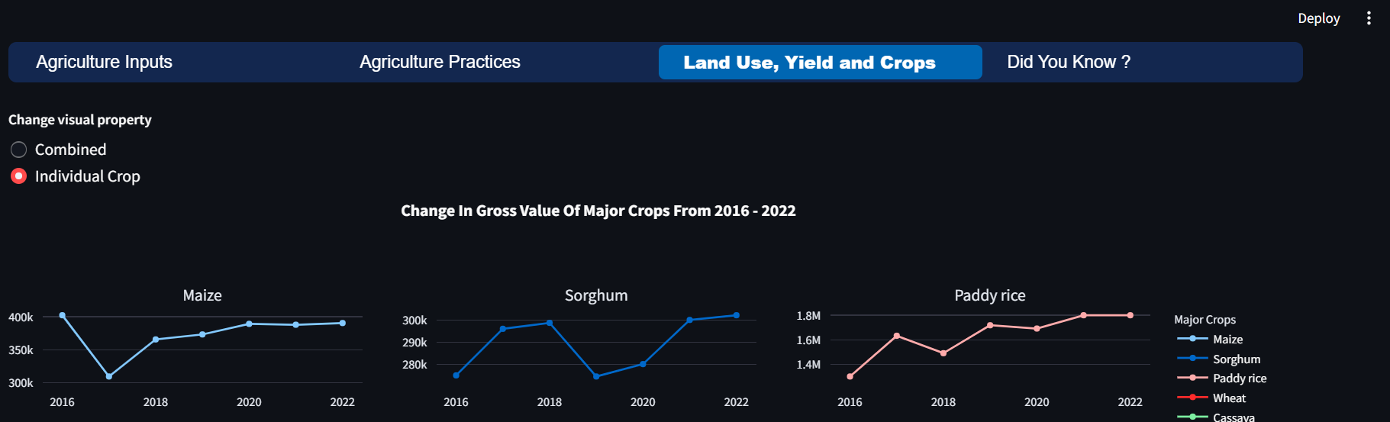
3. Agriculture Land Use, Crop production And Yields
This tab visualize the following insights
Change In Cross Value Of Major Crops from 2016-2022
seasonal change in agriculture land and it's percentage per district in 2022
Average Yield Of Major crops Per Season In 2022
Change In Major Crops production Per Season 2021 – 2022

Slide 12
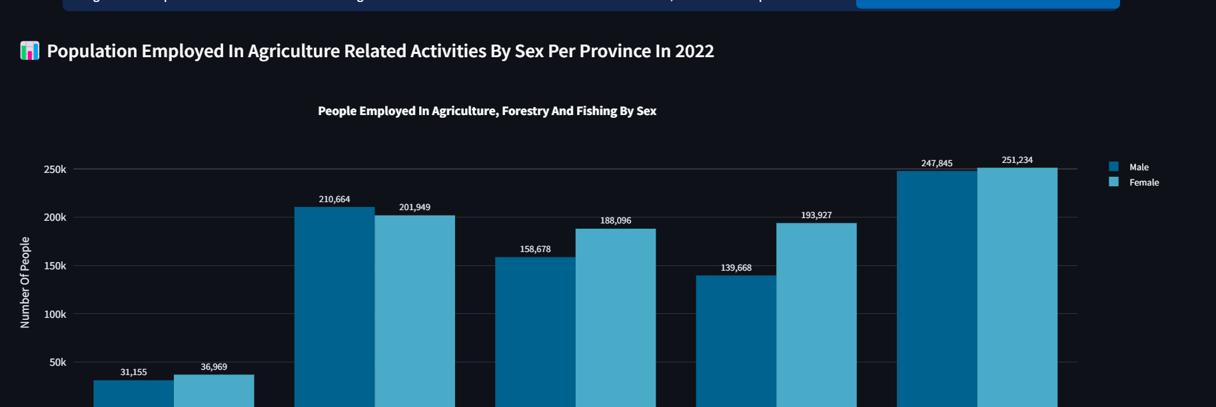
4. Did you know
This tab presents insights from RLFS that are related to agriculture, forestry and fishing
how were population employed in agriculture, forestry and fishing by sex per province in 2022?
number of migrants involved in agriculture, forestry and fishing
average hour spent per week in agriculture, forestry and fishing by sex as their main job
how level of education affected people's decision to involve in agriculture, forestry and fishing.

