Slide 1


Slide 2
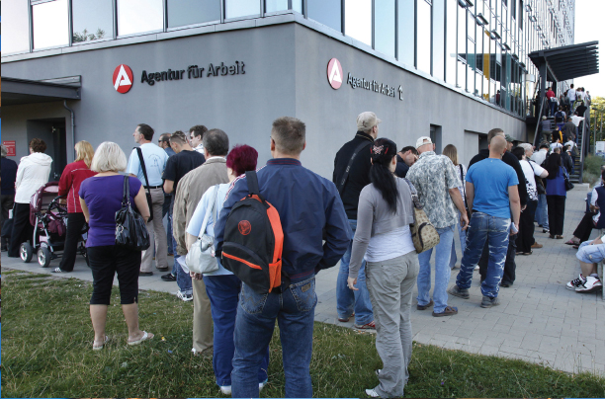
28
THE BUSINESS CYCLE, INFLATION, AND DEFLATION
Notes:
Notes and teaching tips: 4, 19, 20, 22, 25, 31, 40, 56, 57, 58, and 67.
To view a full-screen figure during a class, click the expand button.
To return to the previous slide, click the shrink button.
To advance to the next slide, click anywhere on the full screen figure.
Applying the principles of economics to interpret and understand the news is a major goal of the principles course. You can encourage your students in this activity by using the two features: Economics in the News and Economics in Action.
(1) Before each class, scan the news and select two or three headlines that are relevant to your session today. There is always something that works. Read the headline and ask for comments, interpretation, discussion. Pose questions arising from it that motivate today’s class. At the end of the class, return to the questions and answer them with the tools you’ve been explaining.
(2) Once or twice a semester, set an assignment, for credit, with the following instructions:
(a) Find a news article about an economic topic that you find interesting.
(b) Make a short bullet-list summary of the article.
(c) Write and illustrate with appropriate graphs an economic analysis of the key points in the article.
Use the Economics in the News features in your textbook as models.

Slide 3
After studying this chapter, you will be able to:
Explain how aggregate demand shocks and aggregate supply shocks create the business cycle
Explain how demand-pull and cost-push forces bring cycles in inflation and output
Explain the causes and consequences of deflation
Explain how the short-run and long-run tradeoff between inflation and unemployment

Slide 4
Inflation Cycles
In the long run, inflation occurs if the quantity of money grows faster than potential GDP.
In the short run, many factors can start an inflation, and real GDP and the price level interact.
To study these interactions, we distinguish two sources of inflation:
Demand-pull inflation
Cost-push inflation
Chapter 26, slide 44
Notes:
Inflation: persistent increase in price level, not one time increase in price level

Slide 5
Inflation Cycles
Demand-Pull Inflation
An inflation that starts because aggregate demand increases is called demand-pull inflation.
Demand-pull inflation can begin with any factor that increases aggregate demand.
Examples are a cut in the interest rate, an increase in the quantity of money, an increase in government expenditure, a tax cut, an increase in exports, or an increase in investment stimulated by an increase in expected future profits.
Y = C + I + G + X - M
Notes:
The potential difficulty with both demand-pull and cost-push inflation stories is how the one-time increase translates into an inflationary process. It is relatively easy to come up with stories as to why aggregate demand might shift continuously to the right, for example because of persistent and growing government budget deficits. What is a little harder is to provide a plausible story as to why the monetary authorities would continue to accommodate this with continuous increases in the quantity of money. Point out that this has been rare in Canada, and has tended to happen when the political situation was such that the Bank of Canada was not willing to be blamed for an increase in unemployment. In other countries, particularly where the central bank is less independent than the Bank of Canada, it has been more common.
---------------------------------------------------------------------------------
If one more of the individual demands increase, the aggregate demand increases

Slide 6
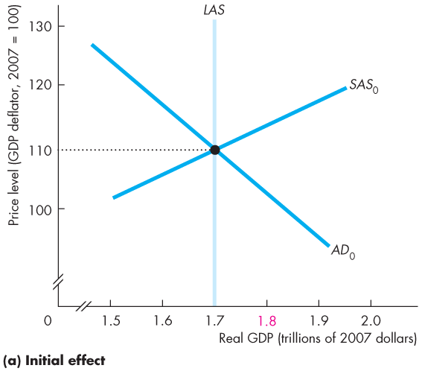
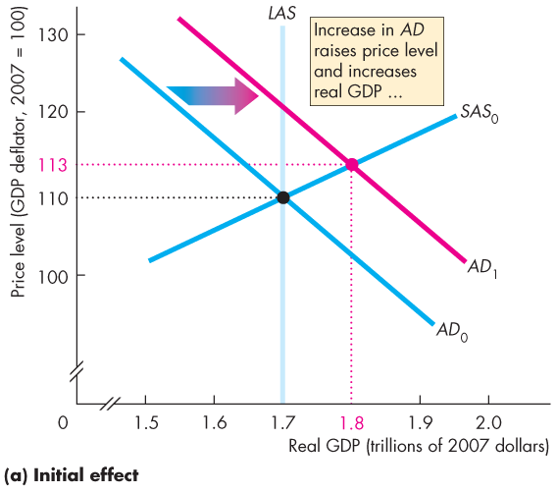
Inflation Cycles
Initial Effect of an Increase in Aggregate Demand
Figure 28.3(a) illustrates the start of a demand-pull inflation.
Starting from full employment, an increase in aggregate demand shifts the AD curve rightward.

Slide 7

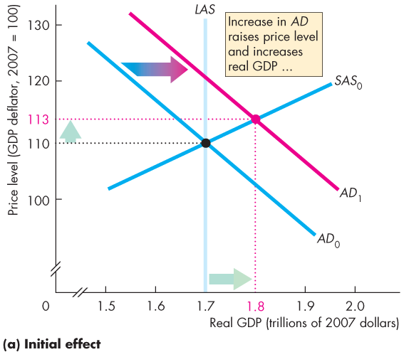
Notes:
Downward sloping aggregate demand
Vertical LAS
Upward sloping SAS
* DETAILED EXPLANATION ON SLIDE 34 *
Starting from long run equilibrium where SAS intersects LAS, and AD crossing through
AD increases
Now at point B
Real GDP is higher, price level is higher, in short run equilibrium
Is this inflation?
If it stops at point B, no. it is merely an increase in price level

Slide 8
Inflation Cycles
Increase in Aggregate Demand – Fig. 28.3(a), pg 683
Initial Effect
Start in long-run equilibrium at point A
The AD curve shifts to the right
The initial effect is increase in real GDP and increase in price level
Real DP > Potential GDP → Inflationary gap

Slide 9

Inflation Cycles
The price level rises, real GDP increases, and an inflationary gap arises.
The rising price level is the first step in the demand-pull inflation.
Chapter 26, slide 44
Notes:
If this is going to develop into an inflation, AD shifting to the right (price level goes up) is the first step
Goes from point A to point B
We know that the SAS can get us back to long run equilibrium
SAS shifts to left
Meaning money wages will start to rise
Producing more than potential, wages is short in supply, labour goes up

Slide 10
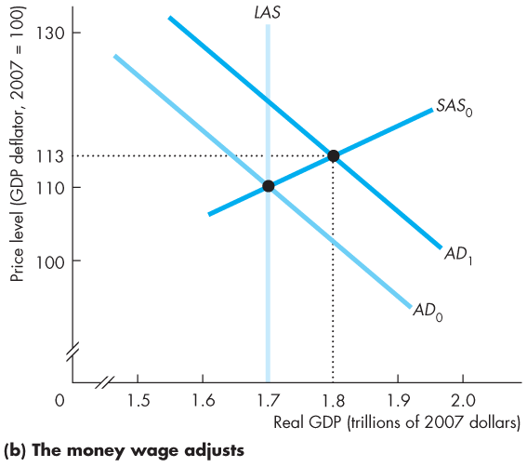
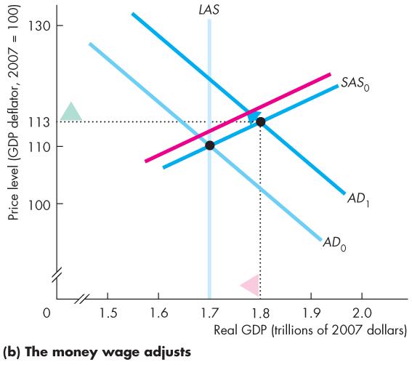
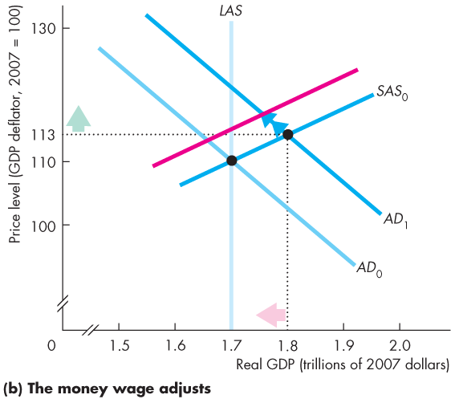
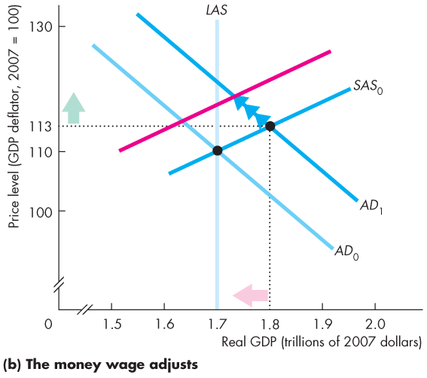
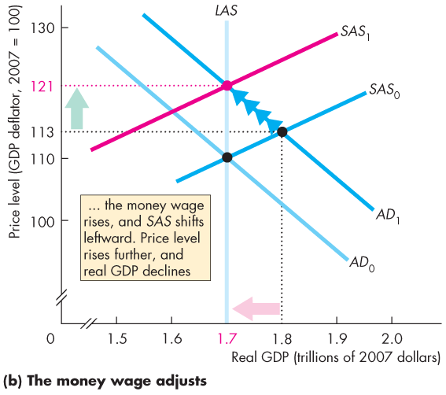
Inflation Cycles
Money Wage Rate Response
Figure 28.1(b) shows that the money wage rate rises and the SAS curve shifts leftward.
The price level rises and real GDP decreases back to potential GDP.

Slide 12
(b) The Money Wage Adjust
Fig. 28.3(b), pg 678
Since real GDP > potential GDP, unemployment < natural rate of unemployment
Labour is in short supply so the money wage will begin to rise
SAS decreases and shifts to the left
Real GDP returns to the level of potential GDP and the price level increases further
NOTE
This outcome is a one-time price increase and NOT an inflation
For an inflation to take place, this process (increase AD decrease SAS) would have to persist

Slide 13
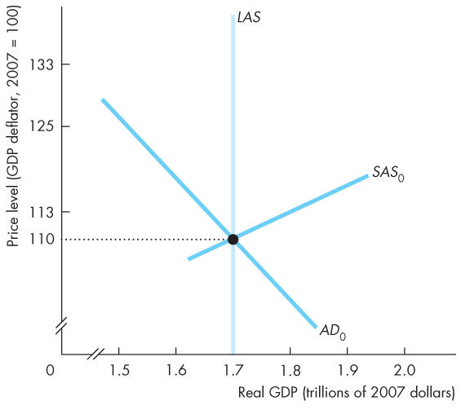
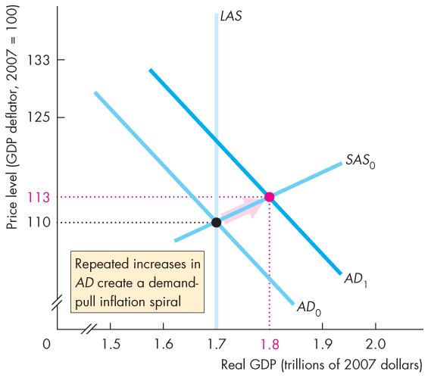
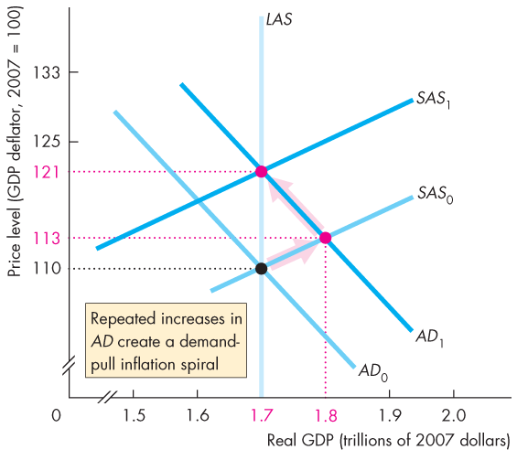
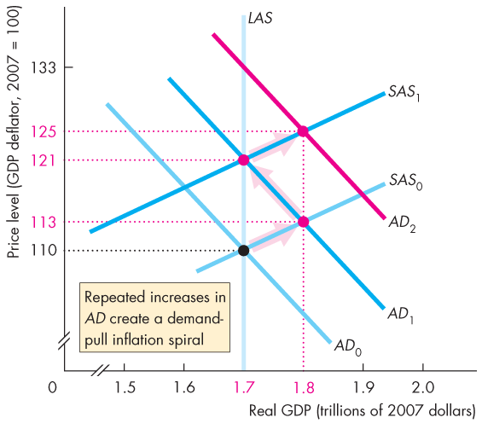
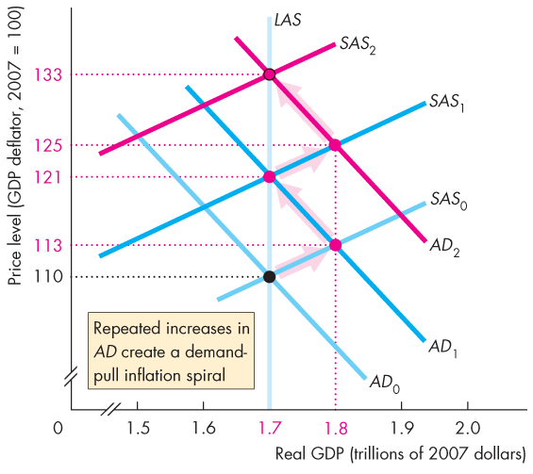

Inflation Cycles
A Demand-Pull Inflation Process
Figure 28.4 illustrates a demand-pull inflation spiral.
Aggregate demand keeps increasing and the process just described repeats indefinitely.

Slide 14
Notes:
If it stops at point C, it would not be called inflation

Slide 15
Inflation Cycles
Several factors can increase aggregate demand to start a demand-pull inflation, …
but only an ongoing increase in the quantity of money can sustain it.
A demand-pull inflation occurred in Canada in the 1960s.
https://uwaterloo.ca/forms/undergraduate-studies/plan-modification-or-internalfaculty-transfer-application
Notes:
Increase in money supply increases AD
- Steady inflation is not a bad thing, volatile inflation is

Slide 16
A Demand-Pull Inflation Process
Fig 28.4, Pg 684
Question: What would cause an on-going demand-pull process?
Answer: A persistent increase in the quantity of money by the Bank
Increase in money supply, increase in AD

Slide 17
Inflation Cycles
Cost-Push Inflation
An inflation that starts with an increase in costs is called cost-push inflation.
There are two main sources of increased costs:
1. An increase in the money wage rate
2. An increase in the money price of raw materials, such as oil
→ Decrease in SAS
Notes:
The text gives a good description of the first oil price increase in the 1970s as a cost-push inflation, and contrasts it well with the Bank of Canada’s refusal to accommodate the second oil price increase in 1979. An explanation of how cost-push can be a more widespread cause of inflation in other countries can be given in terms of countries where labour is highly unionized, and in effect there are attempts by different interest groups to obtain shares of GDP that add up to more than 100 percent, with accommodation by a weak monetary authority. Such a process of repeated wage increases, inflation, and monetary accommodation can give rise to continuing inflation.
Analysts often “explain” the cause of inflation by focusing attention on the good or service whose price increased the most during the most recent time period. This is incorrect; inflation is cased by monetary growth. One way to point out the fallacy is to use a baseball analogy. Several years ago the average number of home runs hit during major league baseball games increased. Virtually every commentator asked whether the ball had been doctored to make it livelier. No one explained the additional home runs by saying “home runs are higher because Parkin is hitting more home runs than last year.” To explain inflation, economists are looking for an explanation similar to the “doctored ball” explanation of the additional home runs, not an explanation that focuses on the performance of specific players.

Slide 18
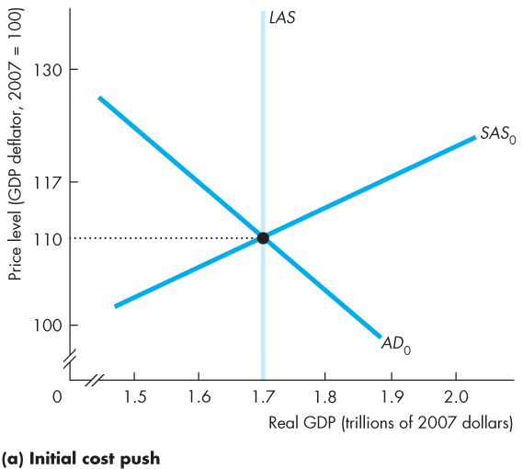
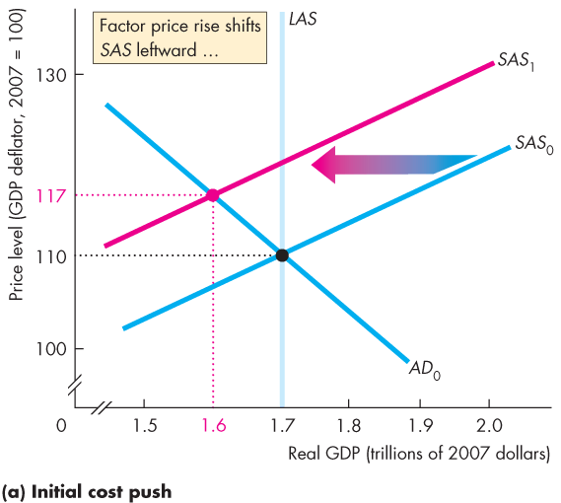
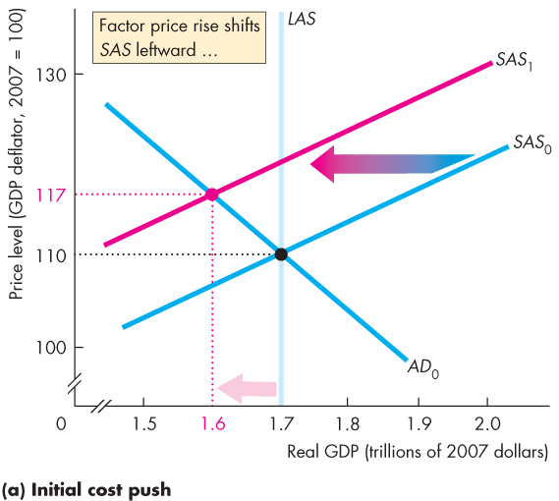
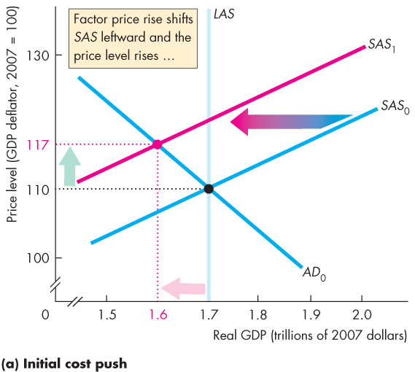
Inflation Cycles
Initial Effect of a Decrease in Aggregate Supply
Figure 28.5(a) illustrates the start of cost-push inflation.
If oil producers cut production and raise the price of oil short-run aggregate supply decreases and the SAS curve shifts leftward.
Real GDP decreases and the price level rises.

Slide 20
Inflation Cycles 2
Decrease in Aggregate Supply – Fig. 28.5(a), pg 686
Initial effect
Start in long-run equilibrium at point A
Costs of production increase and SAS decreases, shifts to the left
The initial effect is decrease in real GDP and increase in price level
Real GDP < Potential GDP → recessionary gap
NOTE
The increased costs lead to a one-time increase in the price level, NOT inflation

Slide 21
Inflation Cycles
Aggregate Demand Response
The initial increase in costs creates a one-time rise in the price level, not inflation.
To create inflation, aggregate demand must increase.
That is, the Bank of Canada must increase the quantity of money persistently.

Slide 22
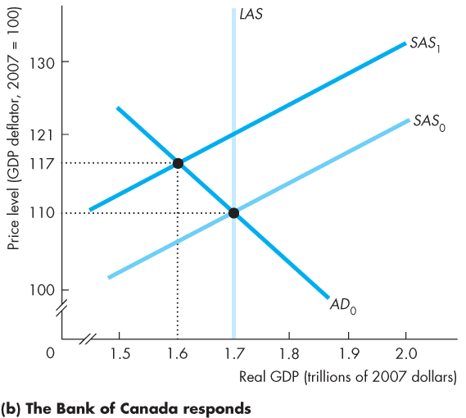
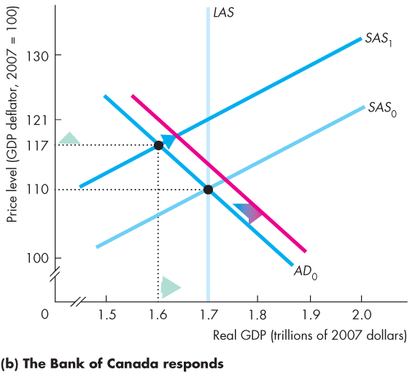
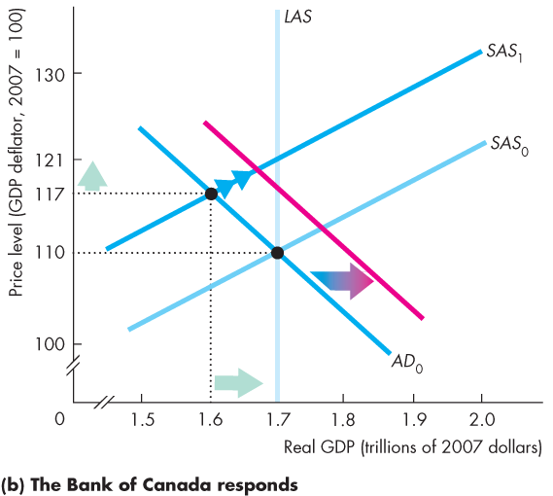
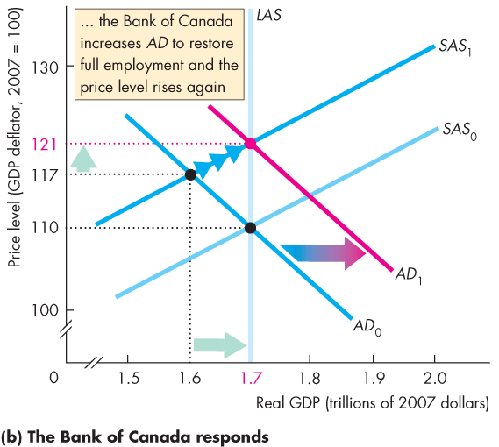
Inflation Cycles
Figure 28.5(b) illustrates an aggregate demand response.
The Bank of Canada stimulates aggregate demand to counter the higher unemployment.
Real GDP increases and the price level rises again.

Slide 23

Notes:
Point B is not a good place to be → hard to get to long-run equilibrium, if we get there at all
If there is an effort to close to the recessionary gap
The bank of Canada is willing to help → go to point C

Slide 24
(b) Response
Fig. 28.5(b), pg 686
Since real GDP < potential GDP, unemployment > natural rate of unemployment
In an attempt to restore full-employment, the Bank could increase the money and supply and increase the AD
Now, real GDP = potential GDP, price level increases further

Slide 25
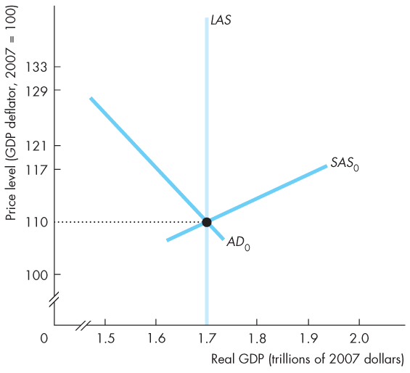
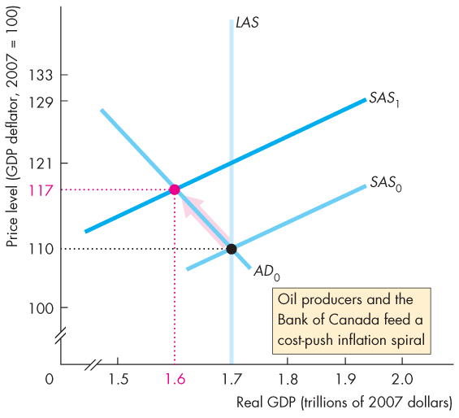
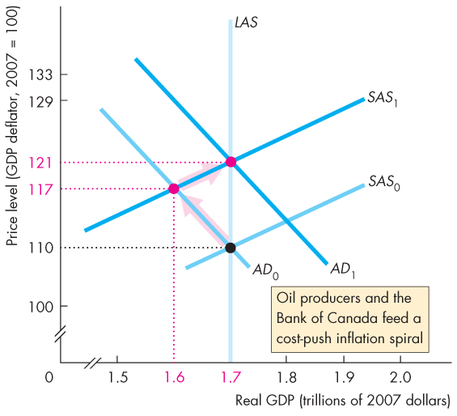
Inflation Cycles
A Cost-Push Inflation Process
If the oil producers raise the price of oil to try to keep its relative price higher, …
and the Bank of Canada responds by increasing the quantity of money, …
a process of cost-push inflation continues.

Slide 26
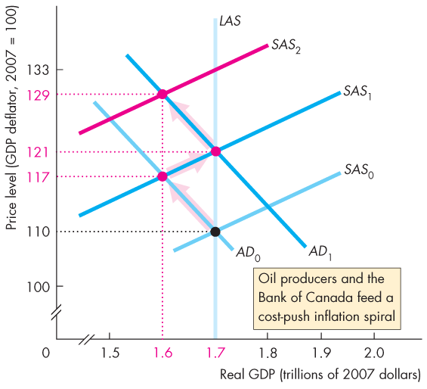
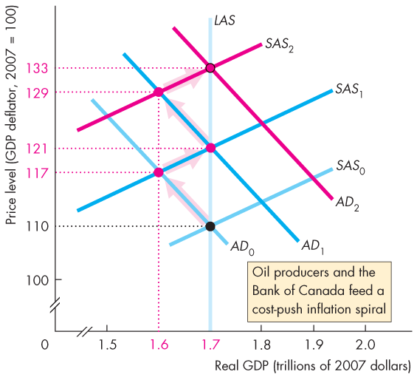

Notes:
Oil prices goes up → SAS shifts left
The Bank throws money in → AD shifts right
And keeps going → cost-push inflation

Slide 27
Inflation Cycles
The combination of a rising price level and a decreasing real GDP is called stagflation.
Cost-push inflation occurred in Canada during the 1970s when the Bank responded to the OPEC oil price rise by increasing the quantity of money.

Slide 28
To create an inflationary process, costs of production (eg. Oil prices) would have to increase again, and the Bank would have to respond with M again
This would have to persist to create an inflation

Slide 29
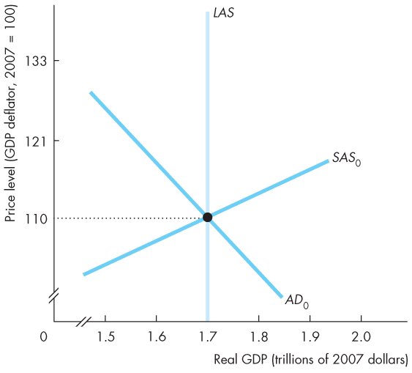
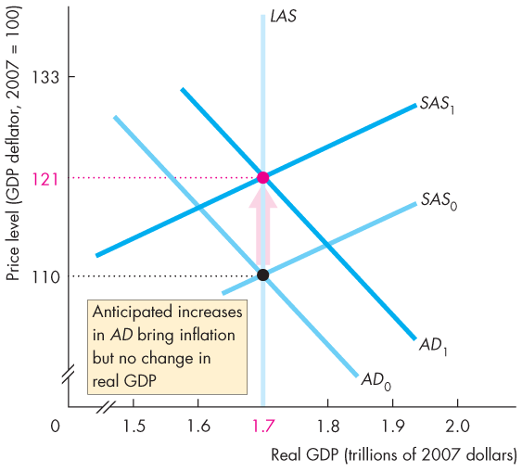
Inflation Cycles
Expected Inflation
Aggregate demand increases, but the increase is expected, so its effect on the price level is expected.
The money wage rate rises in line with the expected rise in the price level.
Figure 28.7 illustrates.

Slide 30
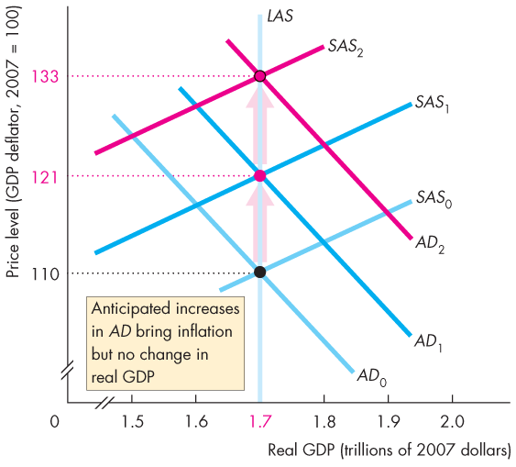
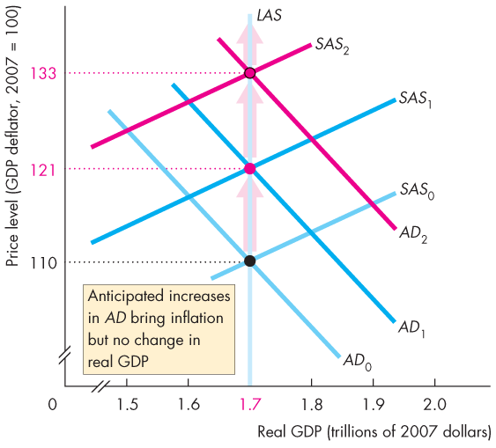
Notes:
If AD increases, but that increase is expected, then our behaviour will dictate that we increase our wage demands by the same proportion
In another words, imagine AD and SAS are moving at same rate. Therefore the intersection never shifts sideways, it only moves up (not in a zig zag)
Increase AD and decrease SAS at the same time
We measure expectations along the vertical

Slide 31
Inflation Cycles 3
Expected Inflation – Fig. 28.7, pg 688
If AD is expected to , and the price level is expected to , the money wage will in anticipation
If P = money wage, real GDP will not change

Slide 32
Inflation Cycles
The price level rises as expected and real GDP remains at potential GDP.
The process repeats.

Slide 33
Inflation Cycles
Forecasting Inflation
To expect inflation, people must forecast it.
The best forecast available is one that is based on all the relevant information and is called a rational expectation.
A rational expectation is not necessarily correct, but it is the best available.

Slide 34
Inflation Cycles
Inflation and the Business Cycle
When the inflation forecast is correct, the economy operates at full employment.
If aggregate demand grows faster than expected, real GDP moves above potential GDP, …
the inflation rate exceeds its expected rate and the economy behaves like it does in a demand-pull inflation.
If aggregate demand grows more slowly than expected, …
real GDP falls below potential GDP, inflation slows, and the economy behaves like it does in a cost-push inflation.
Notes:
MAKE SURE YOU CAN DRAW THESE THREE SCENARIOS

Slide 35
Deflation
An economy experiences deflation when it has a persistently falling price level.
What causes deflation?
What are the consequences of deflation?
How can deflation be ended?

Slide 36
Deflation
What Causes Deflation
The price level falls persistently if aggregate demand increases at a persistently slower rate than aggregate supply.
The Quantity Theory and Deflation
Inflation rate = Money growth rate + Rate of velocity change – Real GDP growth rate
Deflation occurs if
Money growth rate < Real GDP growth rate – Rate of velocity change.
Notes:
What causes deflation
AS is shifting more, AD is shifting less
After time, points of intersection will create a falling price line
The quantity theory and deflation
Repeated in slide 63

Slide 37
Quantity Theory of Money
%∆M + %∆V = %∆P + %∆Y
%∆P = %∆M - %∆Y
If Y <M
Growth rate of money supply
+ 0 = Inflation + Economic Growth
Solve for %P = Inflation

Slide 38
Deflation
For example in Japan, real GDP growth rate was 0.8 percent a year, the money growth rate was 2.5 percent a year, and the rate of velocity change was –3 percent a year.
Inflation rate = Money growth rate + Rate of velocity change – Real GDP growth rate
Inflation rate = [2.5 + (– 3) – 0.8] percent a year.
Deflation rate = 1.3 percent a year.
Notes:
Classroom activity
Check out Economics in Action: Fifteen Years of Deflation in Japan

Slide 39
Deflation
What are the Consequences of Deflation?
Unanticipated deflation redistributes income and wealth, lowers real GDP and employment, and diverts resources from production.
How can deflation be ended?
By increasing the growth rate of money.
Make the money growth rate exceed the growth rate of real GDP minus the rate of velocity change.
Notes:
Classroom activity
Check out Economics in the News: The Stagnating Eurozone
----------------------------------------------------------------------
What are the consequences of deflation
Why is it unanticipated?
Bc it is rare. Deflation has not happened since the 1930s
DETAILED EXPLANATION ON SLIDE 66
How can deflation be ended?
To end deflation, you start inflating
How to start inflation?

Slide 40
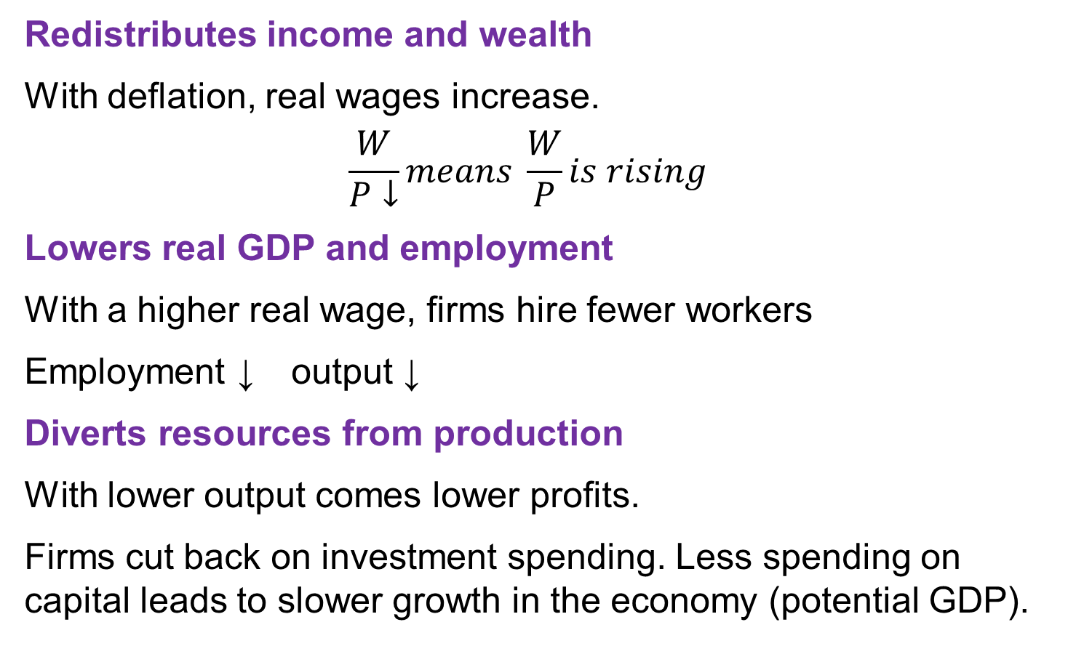
Consequences of Deflation
Redistributes income and wealth
With deflation, real wages increase.
$$\frac{W}{P↓}means \frac{W}{P}is rising$$
Lowers real GDP and employment
With a higher real wage, firms hire fewer workers
Employment ↓ output ↓
Diverts resources from production
With lower output comes lower profits.
Firms cut back on investment spending. Less spending on capital leads to slower growth in the economy (potential GDP).
Notes:
- Deflation can be a much bigger problem than inflation

