Slide 1


Slide 2
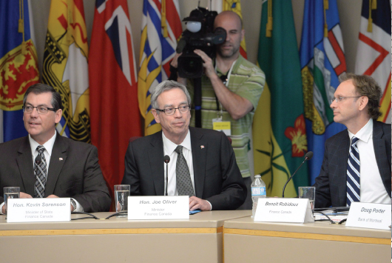
29
FISCAL POLICY
Notes:
Notes and teaching tips: 7, 9,13, 16, 21, 33, 38, 39, and 44.
To view a full-screen figure during a class, click the expand button.
To return to the previous slide, click the shrink button.
To advance to the next slide, click anywhere on the full screen figure.
Applying the principles of economics to interpret and understand the news is a major goal of the principles course. You can encourage your students in this activity by using the two features: Economics in the News and Economics in Action.
(1) Before each class, scan the news and select two or three headlines that are relevant to your session today. There is always something that works. Read the headline and ask for comments, interpretation, discussion. Pose questions arising from it that motivate today’s class. At the end of the class, return to the questions and answer them with the tools you’ve been explaining.
(2) Once or twice a semester, set an assignment, for credit, with the following instructions:
(a) Find a news article about an economic topic that you find interesting.
(b) Make a short bullet-list summary of the article.
(c) Write and illustrate with appropriate graphs an economic analysis of the key points in the article.
Use the Economics in the News features in your textbook as models.

Slide 3
After studying this chapter, you will be able to:
Describe the federal budget process and the recent history of outlays, revenues, deficits, and debt
Explain the supply-side effects of fiscal policy
Explain how fiscal stimulus is used to fight a recession

Slide 4
The Federal Budget
The federal budget is the annual statement of the federal government’s outlays and revenues.
The federal budget has two purposes:
1. To finance the activities of the federal government
2. To achieve macroeconomic objectives
Fiscal policy is the use of the federal budget to achieve macroeconomic objectives, such as full employment, sustained economic growth, and price level stability.

Slide 5
The Federal Budget
Budget Making
The federal government and Parliament make fiscal policy.
After a long, draw-out process of consultations, the Minister of Finance presents a budget plan to Parliament.
Parliament debates the plan and enacts the laws necessary to implement it.

Slide 6
The Federal Budget
Highlights of the 2013 Budget
The projected fiscal 2013 federal budget has revenues of $262 billion, outlays of $276 billion, and a projected deficit of $14 billion.
Revenues come from personal income taxes, corporate income taxes, indirect taxes, and investment income.
Personal income taxes are the largest revenue source.
Outlays are transfer payments, expenditure on goods and services, and debt interest.
Transfer payments are the largest item of outlays.

Slide 7
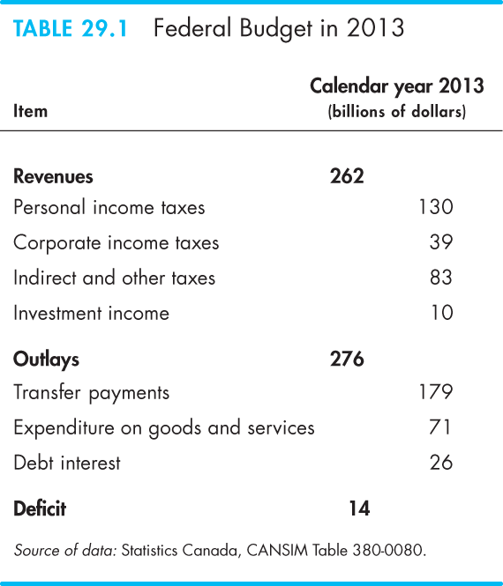
Notes:
Classroom activity
Check out Economics in Action: Provincial and Local Governments

Slide 8
The Federal Budget
Budget Balance
The federal government’s budget balance equals revenues minus outlays.
If revenues exceed outlays, the government has a budget surplus.
If outlays exceed revenues, the government has a budget deficit.
If revenues equal outlays, the government has a balanced budget.
The projected budget deficit in 2013 is $14 billion.

Slide 9
The Federal Budget
The Budget in Historical Perspective
Figure 29.1 shows the government’s revenues, outlays, and budget balance for the period 1960 to 2013.
During the 1960s, outlays and revenues increased.
During the late 1970s and through the 1980s, outlays continued to rise but revenues fell and then remained steady. A large budget deficit arose.
During the 1990s, expenditure cuts eliminated the budget deficit, and after 1997, the budget returned to surplus.
A deficit re-emerged during the 2008–2009 recession.
Notes:
Classroom activity
Check out Economics in Action: The Canadian Budget in Global Perspective

Slide 10
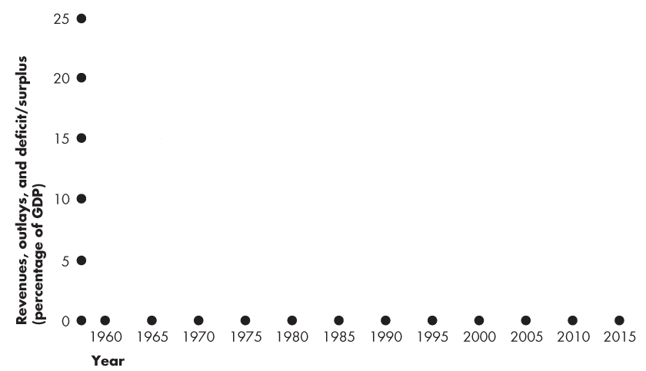
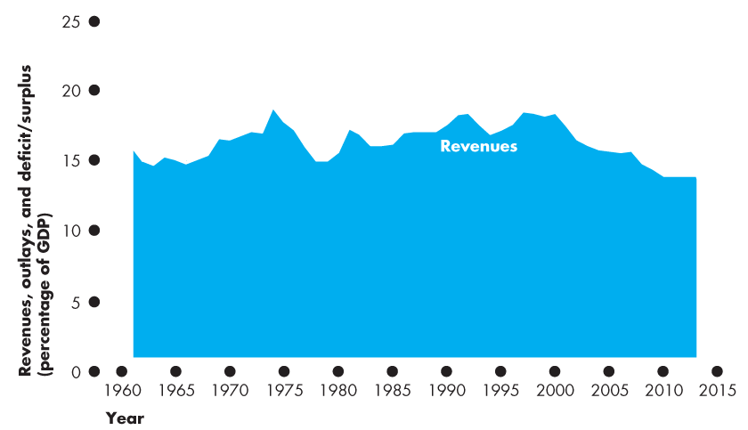
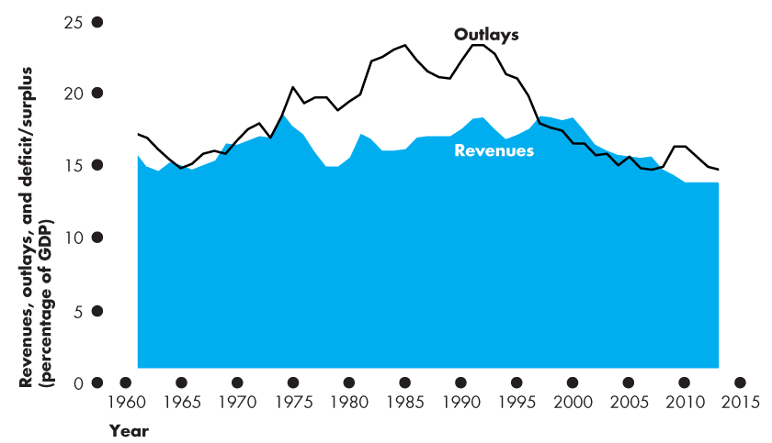
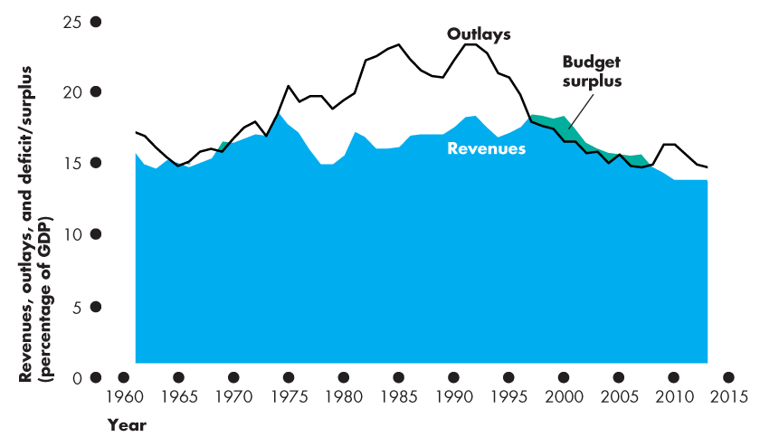
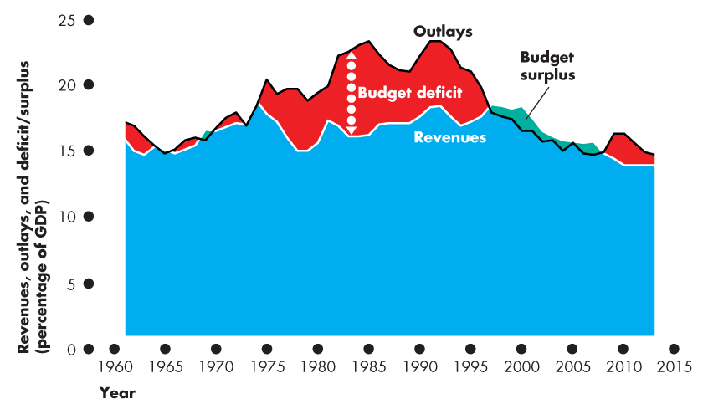
The Federal Budget
Budget Balance

Slide 11
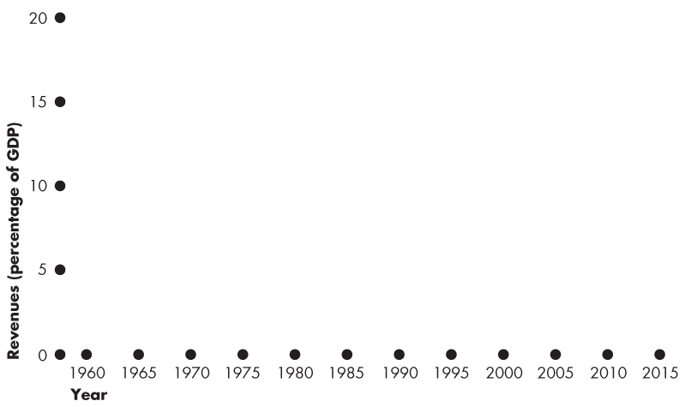
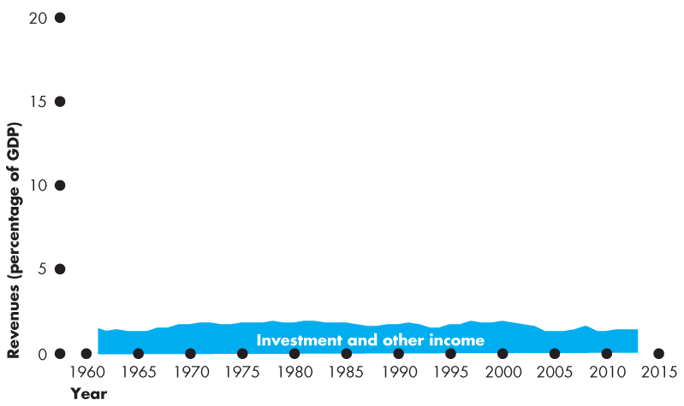
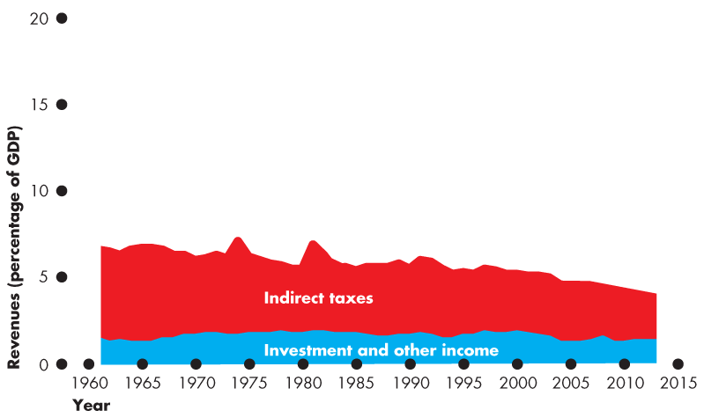
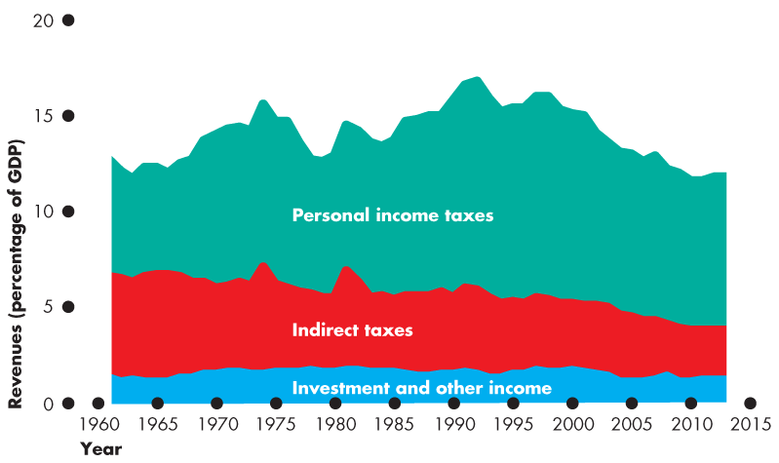
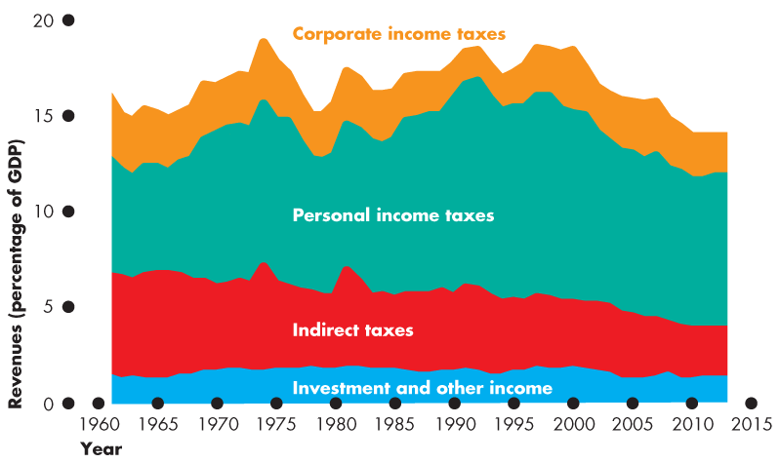
The Federal Budget
Revenues
Figure 29.3(a) shows revenues as a percentage of GDP.

Slide 12
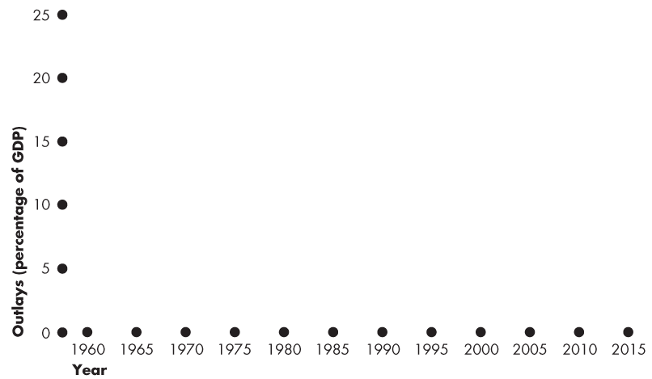
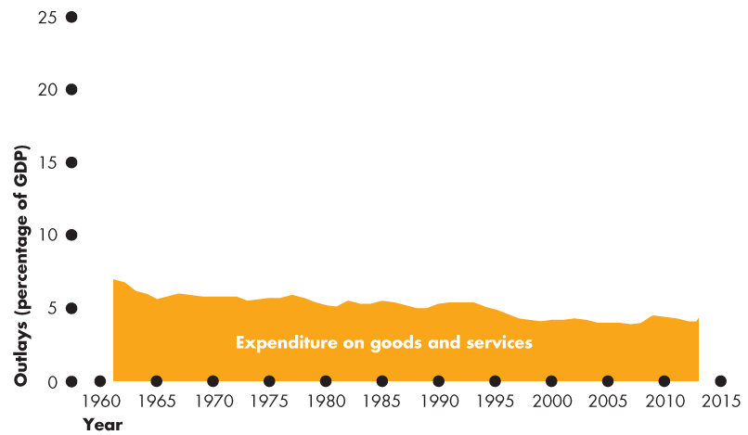
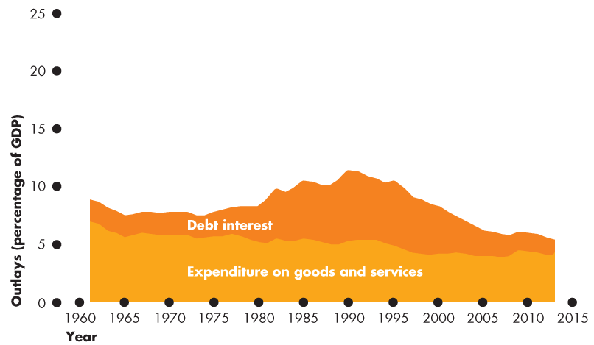
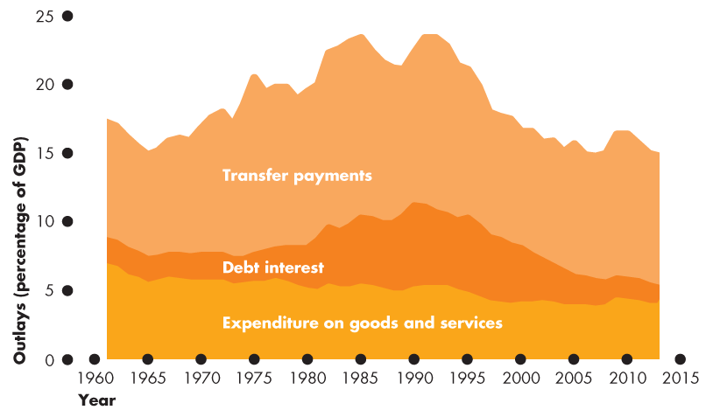
The Federal Budget
Outlays
Figure 29.3(b) shows outlays as a percentage of GDP.

Slide 13
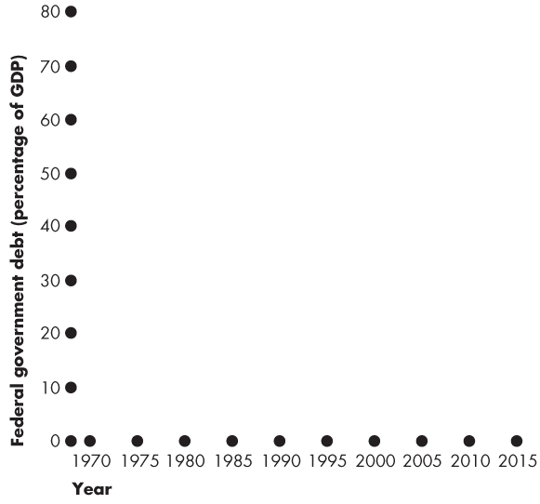
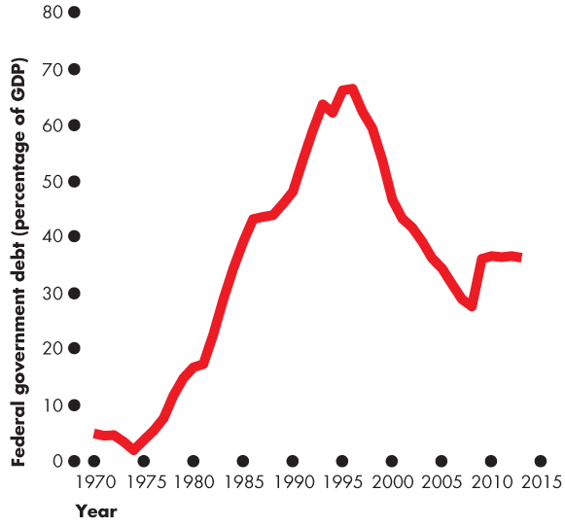
The Federal Budget
Deficit and Debt
Government debt is the total amount that the government borrowing.
It is the sum of past deficits minus past surpluses.
Figure 29.4 shows the federal government’s debt as a percentage of GDP.
Notes:
Deficit and debt. Many students need help with the distinction between the deficit and the debt (and with what happens to the debt when there is a surplus). Use the student loan or credit card analogy. Explain that the budget balance—the deficit or surplus—is just like a personal budget balance—the amount that a student borrows or pays back during a given year. The debt—the amount owed by the government—is like the balance on a student loan or credit card account. Students (usually) have a budget deficit and increasing debt. And graduates with a job (usually) have a budget surplus and decreasing debt.
Does the debt matter? You can have endless fun debating this question. If you do engage your students in this question, you will want to point them to thinking about:
1. The distinction between domestically held debt and foreign held debt.
2. No matter how much the government owes every single year, Y = C + I + G + X – M, so the resources available depend on productive capacity, not on paper claims.

Slide 15
The Supply-Side Effects of Fiscal Policy
Fiscal policy has important effects employment, potential GDP, and aggregate supply—called supply-side effects.
An income tax changes full employment and potential GDP.

Slide 16
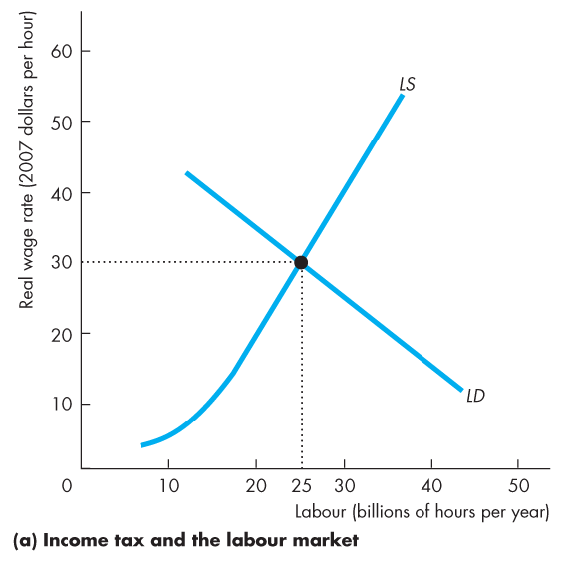
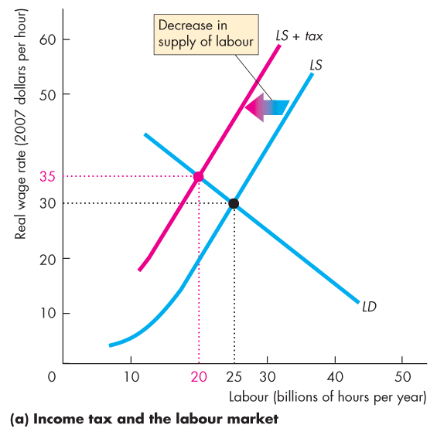
The Supply-Side Effects of Fiscal Policy
Full Employment and Potential GDP
Figure 29.5(a) illustrates the effects of an income tax in the labour market.
The supply of labour decreases because the tax decreases the after-tax wage rate.
Notes:
This section builds on the micro chapters that discuss the effects of taxes. If your students have not yet done a micro course and you want to cover this material, you’ll need to take it slowly and carefully.

Slide 17
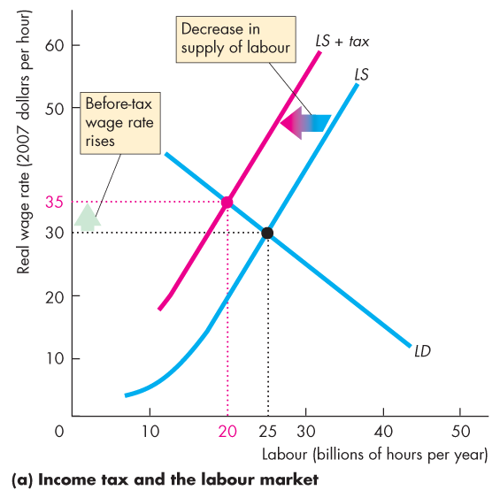
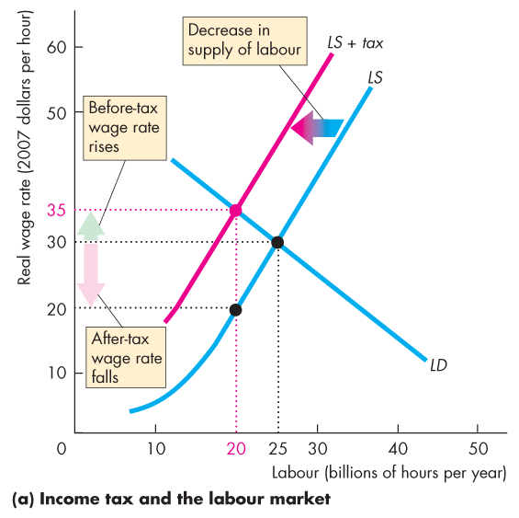
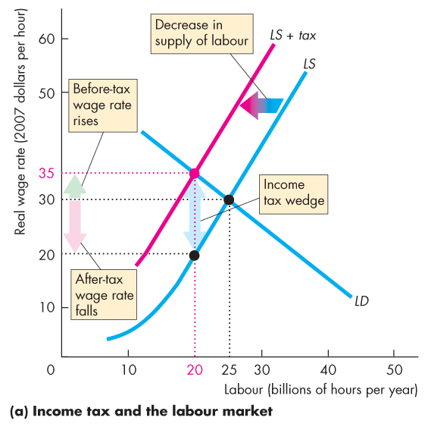
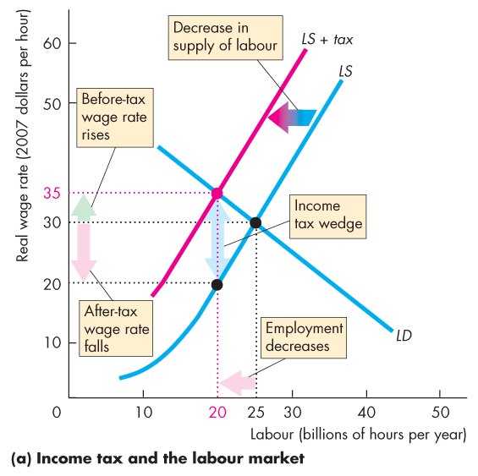
The vertical distance between the LS curve and the LD curve measures the amount of the income tax
full-employment decreases the quantity of labour (?)

Slide 18
The Supply-Side Effects of Fiscal Policy
The before-tax real wage rate rises but the after-tax real wage rate falls.
The gap created between the before-tax and after-tax wage rates is called the tax wedge.
The quantity of labour employed decreases.

Slide 19
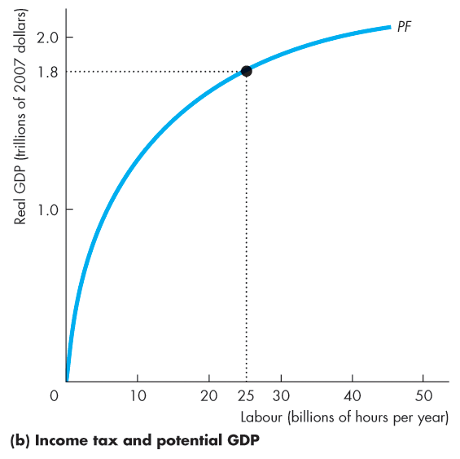
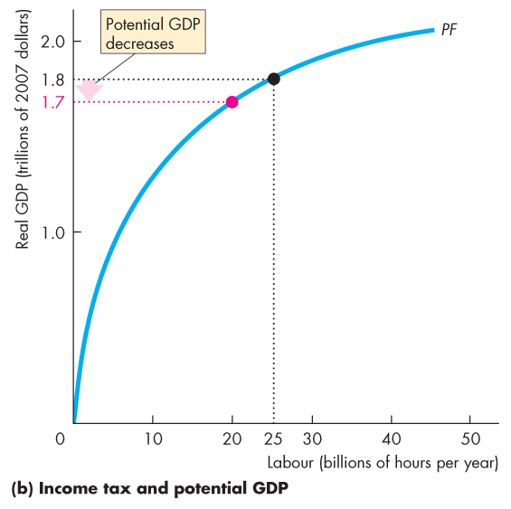
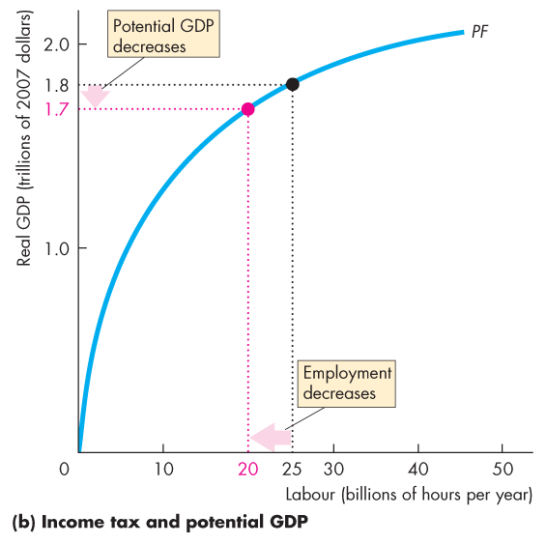
The Supply-Side Effects of Fiscal Policy
When the quantity of labour employed decreases, potential GDP decreases.
The supply-side effect of a rise in the income tax decreases potential GDP and decreases aggregate supply.

Slide 21
The Supply-Side Effects of Fiscal Policy
Taxes on Expenditure and the Tax Wedge
Taxes on consumption expenditure add to the tax wedge.
The reason is that a tax on consumption raises the prices paid for consumption goods and services and is equivalent to a cut in the real wage rate.
If the income tax rate is 25 percent and the tax rate on consumption expenditure is 10 percent, a dollar earned buys only 65 cents worth of goods and services.
The tax wedge is 35 percent.
Notes:
Classroom activity
Check out Economics in Action: Some Real-World Tax Wedges

Slide 22
The Supply-Side Effects of Fiscal Policy
3) Taxes and the Incentive to Save and Invest
A tax on capital income lowers the quantity of saving and investment and slows the growth rate of real GDP.
The interest rate that influence saving and investment is the real after-tax interest rate.
The real after-tax interest rate subtracts the income tax paid on interest income from the real interest.
Taxes depend on the nominal interest rate. So the true tax on interest income depends on the inflation rate.
Notes:
Less investment by firms will slow down economic curve
NOTES START HERE FOR THIS CHAPTER******

Slide 23
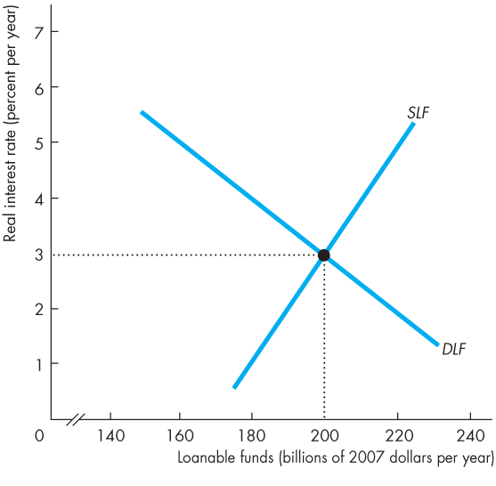
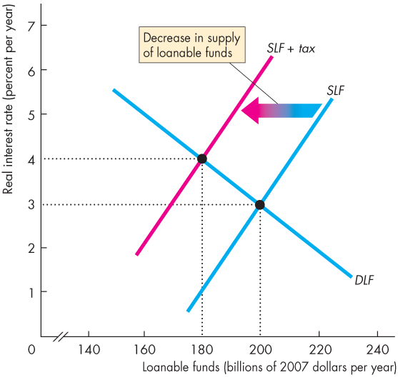
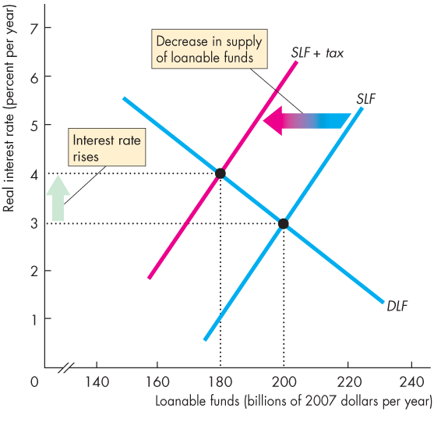
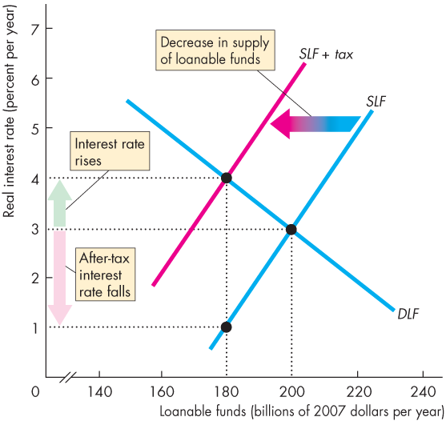
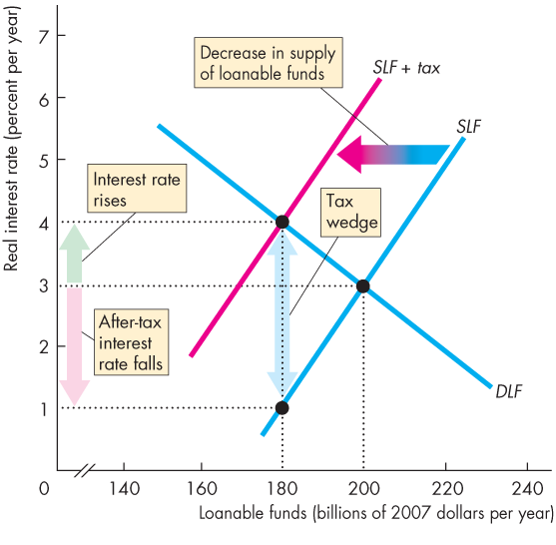
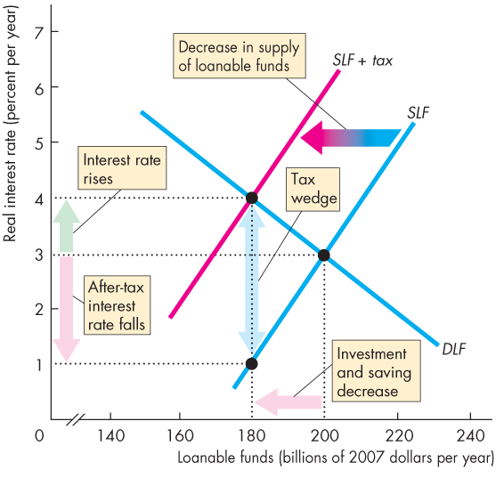
The Supply-Side Effects of Fiscal Policy
Figure 29.6 illustrates the effects of a tax on capital income.
A tax decreases the supply of loanable funds …
a tax wedge is driven between the real interest rate and the real after-tax interest rate.
Investment and saving decrease.
(interest income)

Slide 24


A Tax on Interest Income
The tax payable is measured by the vertical distance between the LSF and the SLF + tax curve
Notes:
Downward DLF
Upward SLF
Primary source of supply is saving
People save their money to earn interest so they have more money to spend in the future
Now government comes along and will tax the income
How are people going to respond to that?
Will be a disincentive to save; might as well just spend
Would model this with a shift to the left of the SLF
Less saving
On account of the tax
Starting from some equilibrium (A) and some initial interest rate (3%)
We shift the supply curve to the left, and in equilibrium, the interest rate went up to 4%
We may think people may start saving like crazy
This is before tax
Going from real equilibrium (B) to original SLF, the interest rate is only 1%
Therefore people save less

Slide 25
The Effects of a Tax on Capital Income (Fig 29.6, Pg 712)
A tax on capital (interest) income is a disincentive to save (SLF)
SLF shifts left
Outcomes
At point B, the equilibrium real interest rises
The quantity of loanable funds is smaller
Savers look at the after-tax real interest rate when deciding how much to save
Real interest rate – income tax paid on interest income = real after-tax interest rate
In this example, the equilibrium interest rate rises to 4% but the after-tax interest rate falls to 1%
However, only nominal amounts are taxed so we must also consider the inflation rate
Notes:
Outcomes are read right off the graph
Equilibrium real interest rises: 3% to 4%
Quantity smaller: 200 to 180
We have a complication here: only nominal amounts are taxed, not real amounts

Slide 26
Interest Rate
Given:
Real interest rate = 4%
Tax rate = 40%
Inflation = 0
Nominal interest rate = real interest rate + inflation
Nominal interest rate = 4% + 0
Nominal interest rate = 4%
After-tax real interest rate = Nominal interest rate (1 – tax rate) – inflation
= 0.4 (1 – 0.40) – 0
= 0.024
= 2.4%
Notes:
ON FINAL EXAM****

Slide 27
Given:
Real interest rate = 4%
Tax rate = 40%
Inflation = 6%
Nominal interest rate = real interest rate + inflation
Nominal interest rate = 4% + 6%
Nominal interest rate = 10%
After-tax real interest rate = Nominal interest rate (1 – tax rate) – inflation
= 0.10 (1 – 0.40) – 0.06
= 0.60 – 0.60
= 0
With inflation, in this example, the true tax rate is not 40% but 100%
Notes:
- Even though the interest rate is 4%, after taxes, I am no better off (I have earned nothing)

Slide 28
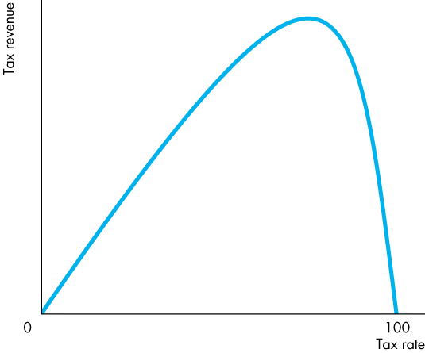
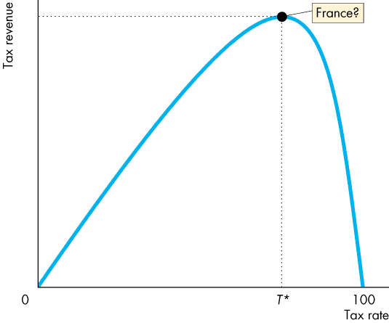
The Supply-Side Effects of Fiscal Policy
Tax Revenues and the Laffer Curve
The relationship between the tax rate and the amount of tax revenue collected is called the Laffer curve.
At the tax rate T*, tax revenue is maximized.
Notes:
Tax rate can go from 0 to 100%
Not a graph, just a sketch, a depiction of an idea
As you increase your tax rate, you can increase tax revenue, until you get to some theoretical maximum

Slide 29
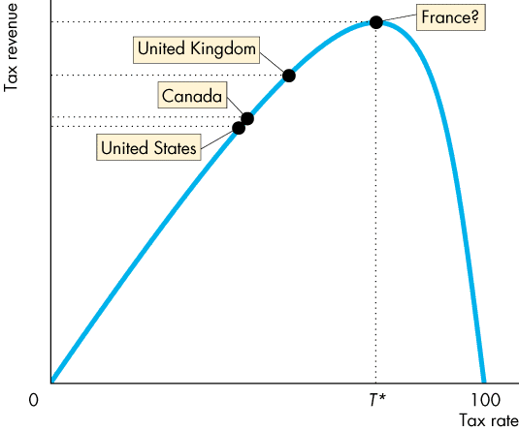
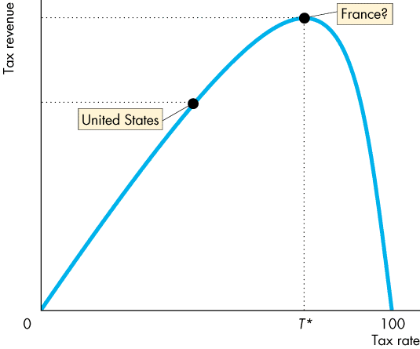
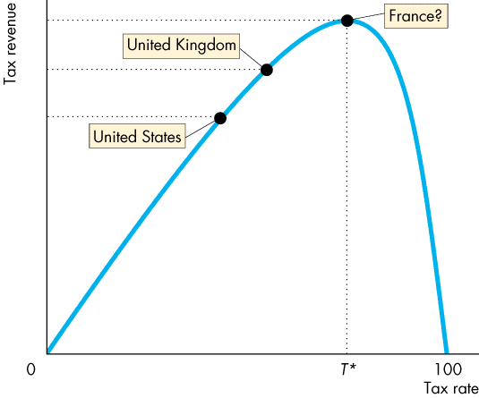
The Laffer Curve

Slide 30
The Supply-Side Effects of Fiscal Policy
For a tax rate below T*, a rise in the tax rate increases tax revenue.
For a tax rate above T*, a rise in the tax rate decreases tax revenue.
Notes:
T* = theoretical maximum

Slide 31
The Laffer Curve (Fig 29.7, g 713)
This graph is named after the economist who introduced it, Arthur Laffer
The high point of the graph shows the revenue-maximizing tax rate
If the economy were at point A, a tax cut would decrease revenue
If the economy were at point B, a tax cut would actually raise revenue
Though we can observe that there is some revenue-maximizing tax rate, we cannot observe whether the economy is actually at any given point

Slide 32
Fiscal Stimulus
A fiscal stimulus is the use of fiscal policy to increase production and employment.
Fiscal stimulus can be either
Automatic
Discretionary
Automatic fiscal policy is a fiscal policy action triggered by the state of the economy with no government action.
Discretionary fiscal policy is a policy action that is initiated by an act of Parliament.
Notes:
Fiscal policy = government spending + tax revenue
Fiscal policy can affect economy
Fiscal policy is used to engage fiscal stimulus
Fiscal Stimulus
Automatic – no government action
There are things that will occur whether the government wants them to or not
Not a planned policy – simply the economy doing its own thing

Slide 33
Fiscal Stimulus
1) Automatic Fiscal Policy and Cyclical and Structural Budget Balances
Two items in the government budget change automatically in response to the state of the economy.
Tax revenues
Transfer payments
Notes:
State of the economy: when the economy goes into a recession/expansion, certain things will happen automatically
Where are we on that business cycle?
Tax revenues: the amount of taxes that the government can collect
Transfer payments: the government’s largest outlays

Slide 34
Fiscal Stimulus
Automatic Changes in Tax Revenues
Parliament sets the tax rates that people must pay.
The tax dollars people pay depend on tax rates and incomes.
But incomes vary with real GDP, so tax revenues depend on real GDP.
When the real GDP increases in an expansion, tax revenues increase.
When real GDP decreases in a recession, tax revenues decrease.
Notes:
When real GDP increases, tax revenues increase
In expansion, more people are working, more businesses are in business
Makes sense that we collect more tax
When real GDP decreases, tax revenues decrease
In recession, fewer people are working, fewer people are paying taxes
Businesses go out of business, they are not paying taxes
Makes sense that we collect less tax

Slide 35
Fiscal Stimulus
II. Transfer Payments
The government creates programs that pay benefits to qualified people and businesses.
These transfer payments depend on the economic state of the economy.
When the economy is in an expansion, unemployment falls, so (un)employment benefits decrease.
When the economy is in a recession, unemployment rises, so (un)employment benefits increase.
Notes:
government’s largest outlay
Includes employment insurances, pensions, etc
When economy is well, unemployment is low, so benefits decrease
In recession, more people are out of work, more people will qualify, government will pay more transfers
Government proposes a budget, a budget is a plan
Government assumes they will pay x number of payments, they cannot foresee, with precision, what will happen to the economy in the meantime
They may plan to pay $1000 in employment insurance, but we go into a recession, and they end up paying $3000
It is not planned, but if people qualify, they can get their cheque
In expansion, they may plan to pay $1000, but they may not pay that much
Yay, there’s money left over

Slide 36
Fiscal Stimulus
Automatic Stimulus
In a recession, tax revenues decrease and outlays increase.
So the budget provides an automatic stimulus that helps shrink the recessionary gap.
In a boom (expansion), tax revenues increase and outlays decrease.
So the budget provides automatic restraint that helps shrink the inflationary gap.
Notes:
Outlays = transfer payments

Slide 37
Automatic Fiscal Stimulus
Price level
In a recession,
T → C → real GDP
G → real GDP
Real GDP
Recessionary gap
Notes:
Starting point (A) is in recession
Tax revenue decreases, government spending increases
Both contribute to increasing real GDP
Just due to the state of the economy, aggregate demand curve starts to shift
Without any policy change, AD1 will start shifting to the right (where we want it to go)
It is drawn this way bc it is never the case that we believe that automatic stimulus can get us back to full-employment
Just kicking the AD curve in the direction we want to go

Slide 38
Price level
In a boom,
T → C → real GDP
G → real GDP
Real GDP
Inflationary gap
Notes:
The state of economy will start the push the aggregate demand curve in the direction that we want to go
But will not be enough to push us back to full-employment

Slide 39
Fiscal Stimulus
Cyclical and Structural Balances
The structural surplus or deficit is the budget balance that would occur if the economy were at full employment and real GDP were equal to potential GDP.
The cyclical surplus or deficit is the actual surplus or deficit minus the structural surplus or deficit.
That is, a cyclical surplus or deficit is the surplus or deficit that occurs purely because real GDP does not equal potential GDP.
Notes:
Cyclical and structural budget balances. Cyclical and structural budget balances are a difficult concept for many students, but important because of the appropriate measure of fiscal stance.
An effective way to help students see that revenues and outlays will vary as depicted in Figure 29.9 is to remind them that potential GDP corresponds to full employment, and employment (and so the number of tax payers and recipients of unemployment compensation) changes when real GDP varies.
Classroom activity
Check out Economics in Action: Canada’s 2013 Budget Deficit
---------------------------------------------------------------------------------------------------
Structural surplus/deficit
Only if the economy were at full employment
Real GDP = Potential GDP
If we are at full employment, we look at the budget (surplus/deficit), whichever one, we are at structural
Cyclical surplus/deficit
A calculation
Actual surplus/deficit – structural surplus/deficit
What we actually have – what we think we have

Slide 40
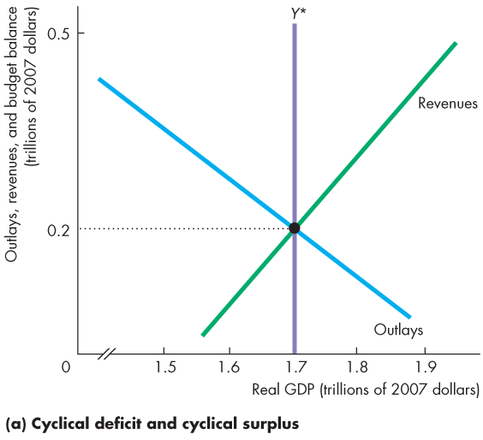
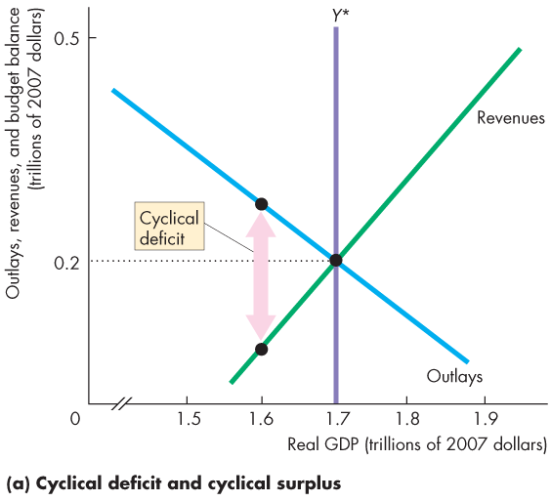
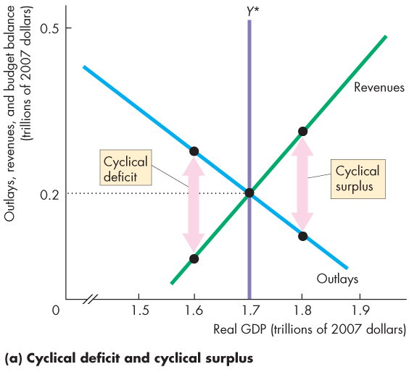
Fiscal Stimulus
Figure 29.8 illustrates the distinction between a structural and cyclical surplus and deficit.
In part (a), potential GDP is $1.7 trillion.
As real GDP fluctuates around potential GDP, a cyclical deficit or cyclical surplus arises.

Slide 41
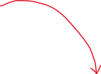

outlays
revenues
outlays
revenues
Real GDP ≠ Potential GDP
Actual deficit – Structural deficit
Actual Surplus – Structural surplus
Notes:
On Exam
Must be told what the structural part is
So we can make the subtraction
Look at difference between outlays and revenues to determine deficit/surplus

Slide 42
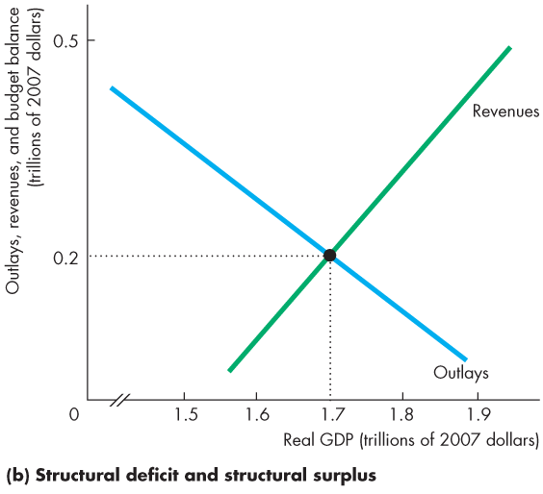
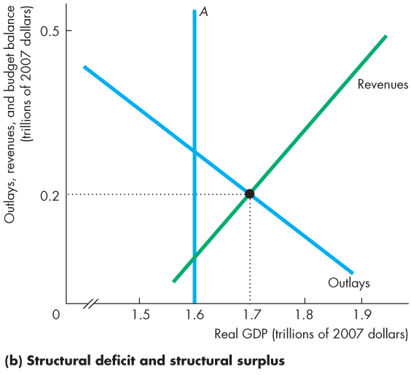
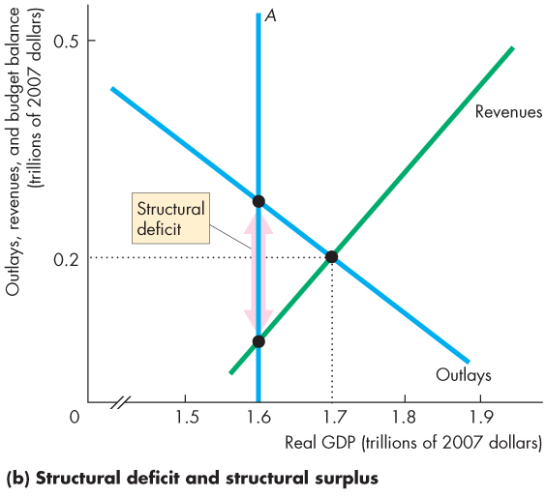
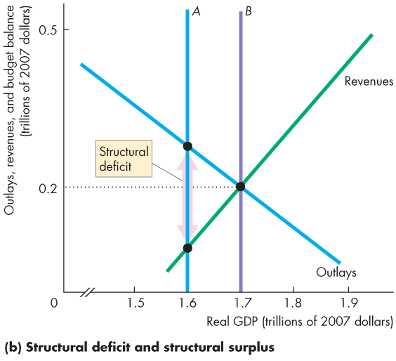
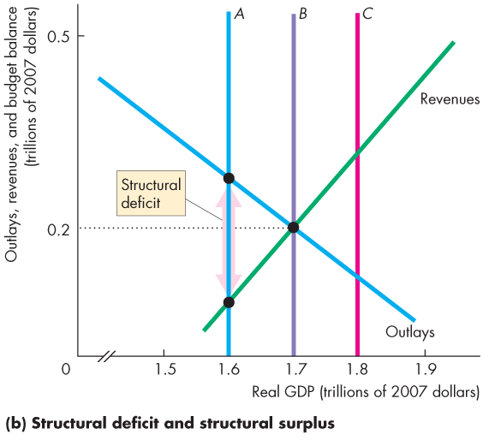
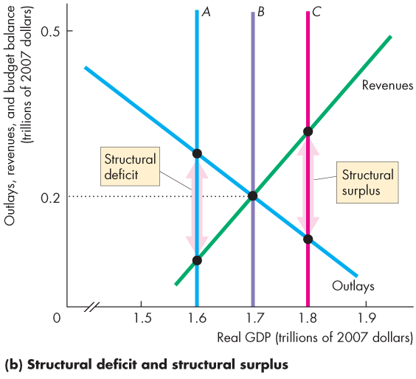
Fiscal Stimulus
In part (b), if real GDP and potential GDP are $1.6 trillion, the budget deficit is a structural deficit.
If real GDP and potential GDP are $1.7 trillion, the budget is balanced.
If real GDP and potential GDP are $1.8 trillion, the budget surplus is a structural surplus.

Slide 43
Revenues
outlays
outlays
Revenues
Real GDP = Potential GDP
Notes:
In real-life, we can only estimate the structural deficit/surplus
By calculating the cyclical, it gives an idea of which direction we should be going to reach full employment
Difference between what we actual have vs what we think we have
KEY
Does Real GDP equal to Potential GDP???

Slide 44
Fiscal Stimulus
Discretionary Fiscal Stimulus
Most discretionary fiscal stimulus focuses on its effects on aggregate demand.
Fiscal Stimulus and Aggregate Demand
Changes in government expenditure and taxes change aggregate demand and have multiplier effects.
Two main fiscal multipliers are
Government expenditure multiplier
Tax multiplier
Notes:
Classroom activity
Check out Economics in Action: Fiscal Stimulus in the United States

Slide 45
Fiscal Stimulus
The government expenditure multiplier is the quantity effect of a change in government expenditure on real GDP.
Because government expenditure is a component of aggregate expenditure, an increase in government expenditure increases real GDP.
When real GDP increases, incomes rise and consumption expenditure increases. Aggregate demand increases.
If this were the only consequence of the increase in government expenditure, the multiplier would be >1.
Notes:
Classroom activity
Check out Economics in Action: How Big are the Fiscal Stimulus Multipliers

Slide 46
Fiscal Stimulus
But an increase in government expenditure increases government borrowing and raises the real interest rate.
With the higher cost of borrowing, investment decreases, which partly offsets the increase in government expenditure.
If this were the only consequence of the increase in government expenditure, the multiplier would be < 1.
Which effect is stronger?
The consensus is that the crowding-out effect dominates and the multiplier is <1.

Slide 47
Fiscal Stimulus
The tax multiplier is the quantity effect a change in taxes on aggregate demand.
The demand-side effects of a tax cut are likely to be smaller than an equivalent increase in government expenditure.

Slide 48
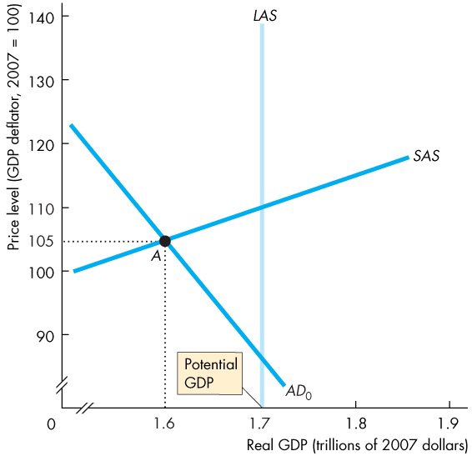
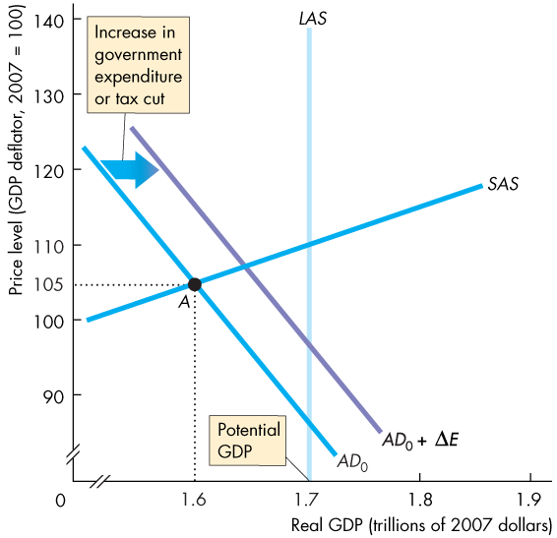


Fiscal Stimulus
Graphical Illustration of Fiscal Stimulus
Figure 29.9 shows how fiscal policy is supposed to work to close a recessionary gap.
An increase in government expenditure or a tax cut increases aggregate expenditure.
The multiplier process increases aggregate demand.

Slide 50
Fiscal Stimulus
Fiscal Stimulus and Aggregate Supply
Taxes drive a wedge between the cost of labour and the take-home pay and between the cost of borrowing and the return on lending.
Taxes decrease employment, saving, and investment and decrease real GDP and its growth rate.
A tax cut decreases these negative effects and increases real GDP and its growth rate.
The supply-side effects of a tax cut probably dominate the demand-side effects and make the multiplier larger than the government expenditure multiplier.
Notes:
Fiscal policy in practice. Most economists acknowledge that, in principle, discretionary fiscal policy can be used for stabilization purposes, but in practice such stabilization is extremely difficult because of long legislative lags. It is worth reminding the students that the equilibrium in the AS-AD model takes time to work out. The multiplier is a long drawn out process. An increase in government expenditures shifts the AD curve rightward but the new equilibrium price level and real GDP take time to occur. It is also useful to discuss the differences between the potential of fiscal policy under a parliamentary system and under the more rigid U.S. system; the length of time it took the congress to pass the 2002 ‘stimulus’ package, compared to almost immediate executive-initiated changes to fiscal policy in Britain, make the point that discretionary fiscal policy is feasible under some governmental systems but only in extreme circumstances in the world’s largest economy.
Classroom activity
Check out Economics in the News: A Fiscal Policy Challenge

Slide 51
Fiscal Stimulus
Time Lags
The use of discretionary fiscal policy is seriously hampered by three time lags:
Recognition lag—the time it takes to figure out that fiscal policy action is needed.
Law-making lag—the time it takes Parliament to pass the laws needed to change taxes or spending.
Impact lag—the time it takes from passing a tax or spending change to its effect on real GDP being felt.

