Slide 1


Slide 2

20
MEASURING GDP AND ECONOMIC GROWTH

Slide 3
After studying this chapter, you will be able to:
Define GDP and explain why GDP equals aggregate expenditure and aggregate income
Explain how Statistics Canada measures GDP and real GDP
Describe how real GDP is used and explain its limitations as a measure of economic well-being

Slide 4
Gross Domestic Product
GDP Defined
  GDP or gross domestic product is the market value of all final goods and services produced in a country in a given time period.
  This definition has four parts:
  Market value
  Final goods and services
  Produced within a country
  In a given time period

Slide 5
Gross Domestic Product
  Market Value
  GDP is a market value—goods and services are valued at their market prices.
  To add apples and oranges, computers and popcorn, we add the market values so we have a total value of output in dollars.

Slide 6
Gross Domestic Product
  Final Goods and Services
  GDP is the value of the final goods and services produced.
  A final good (or service) is an item bought by its final user during a specified time period.
  A final good contrasts with an intermediate good, which is an item that is produced by one firm, bought by another firm, and used as a component of a final good or service.
  Excluding the value of intermediate goods and services avoids counting the same value more than once.

Slide 7
Gross Domestic Product
  Produced Within a Country
  GDP measures production within a country—domestic production.
  In a Given Time Period
  GDP measures production during a specific time period, normally a year or a quarter of a year.

Slide 8
Gross Domestic Product
GDP and the Circular Flow of Expenditure and Income
  GDP measures the value of production, which also equals total expenditure on final goods and total income.
  The equality of income and value of production shows the link between productivity and living standards.
  The circular flow diagram in Figure 20.1 illustrates the equality of income and expenditure.

Slide 9

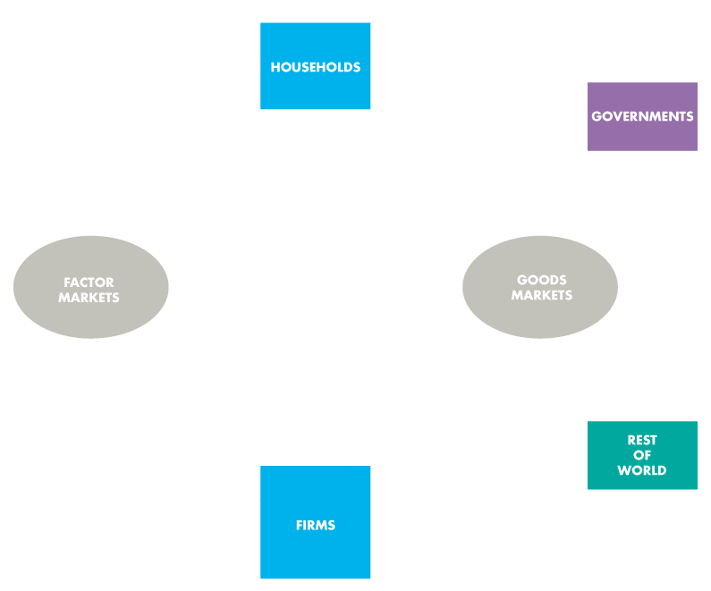
Gross Domestic Product
  The circular flow diagram shows the transactions among households, firms, governments, and the rest of the world.

Slide 10
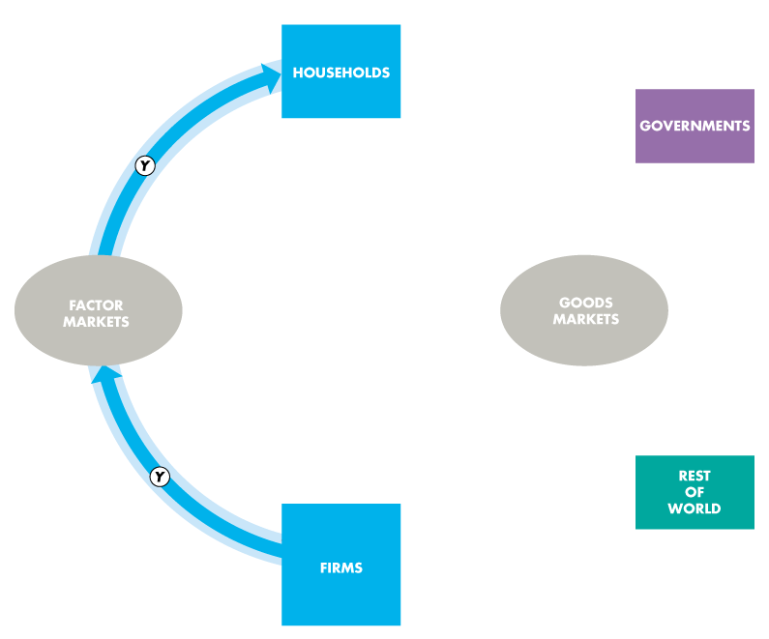
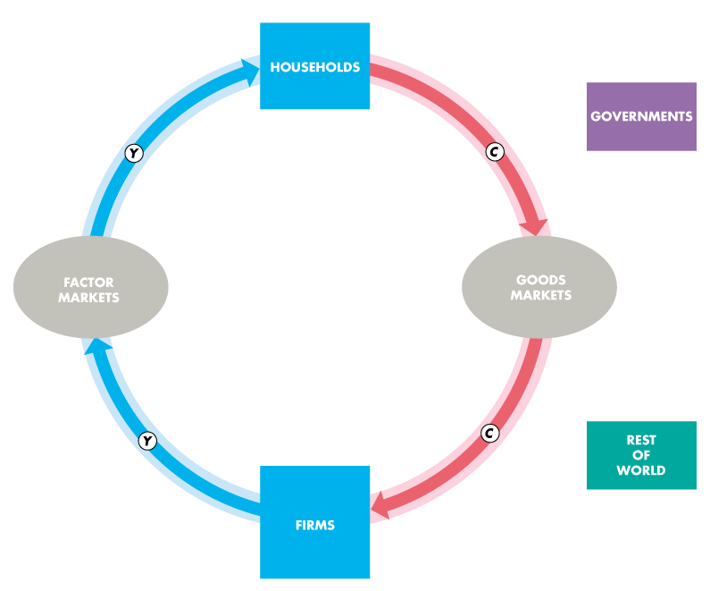
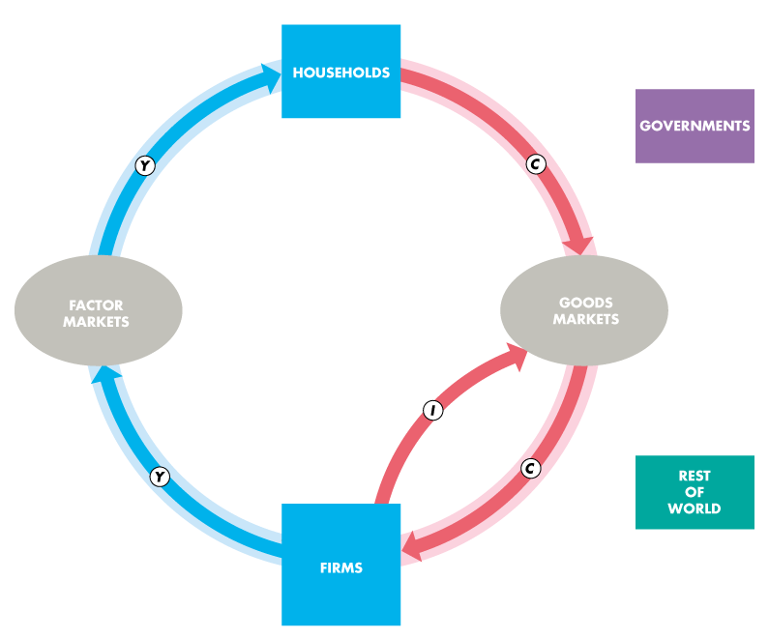
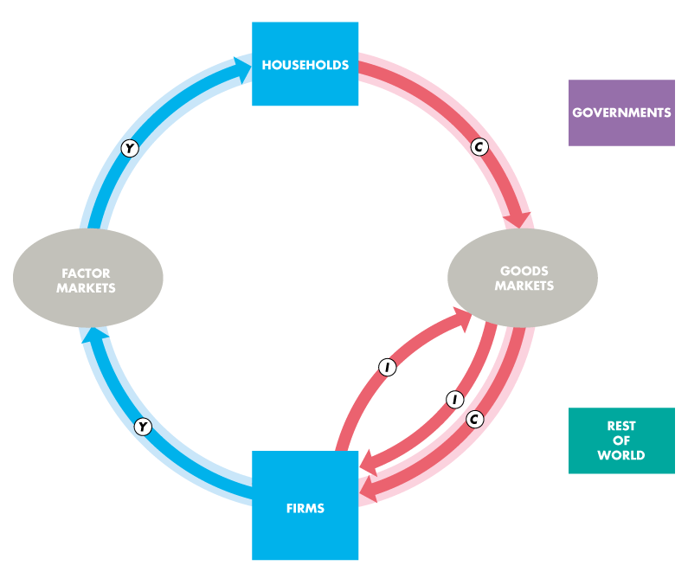
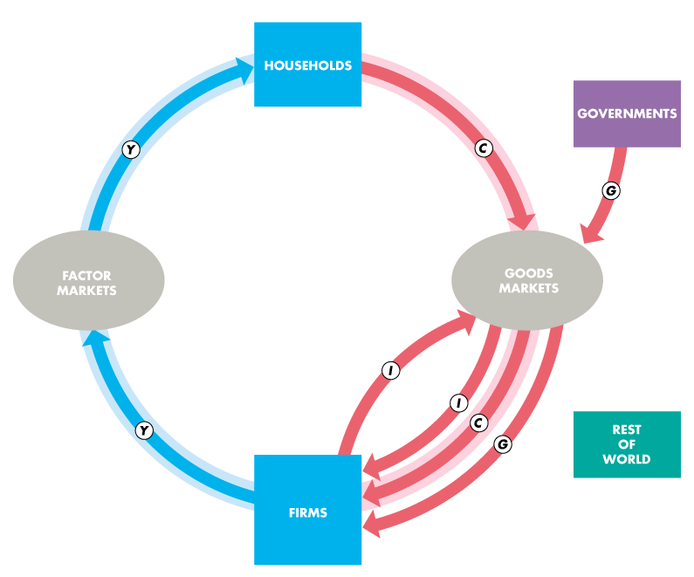

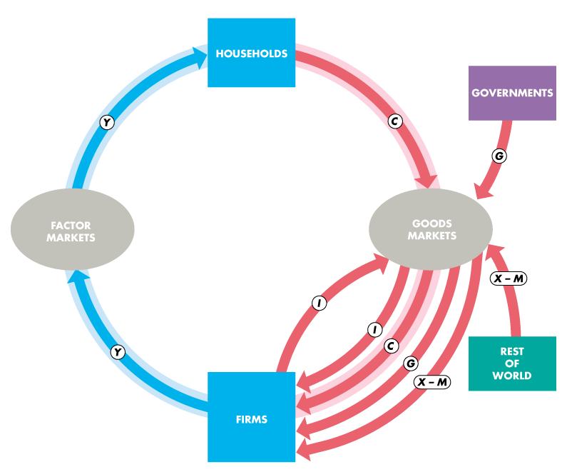

Slide 11
Gross Domestic Product
  Households and Firms
  Households sell and firms buy the services of labour, capital, and land in factor markets.
  For these factor services, firms pay income to households: wages for labour services, interest for the use of capital, and rent for the use of land. A fourth factor of production, entrepreneurship, receives profit.
  In the figure, the blue flow, Y, shows total income paid by firms to households.

Slide 12
Gross Domestic Product

Slide 13
Gross Domestic Product
  Firms sell and households buy consumer goods and services in the goods market.
  Consumption expenditure is the total payment for consumer goods and services, shown by the red flow labelled C .
  Firms buy and sell new capital equipment in the goods market and put unsold output into inventory.
  The purchase of new plant, equipment, and buildings and the additions to inventories are investment, shown by the red flow labelled I.

Slide 14
Gross Domestic Product

Slide 15
Gross Domestic Product
  Governments
  Governments buy goods and services from firms and their expenditure on goods and services is called government expenditure.
  Government expenditure is shown as the red flow G.
  Governments finance their expenditure with taxes and pay financial transfers to households, such as unemployment benefits, and pay subsidies to firms.
  These financial transfers are not part of the circular flow of expenditure and income.

Slide 16
Gross Domestic Product

Slide 17
Gross Domestic Product
  Rest of the World
  Firms in Canada sell goods and services to the rest of the world—exports—and buy goods and services from the rest of the world—imports.
  The value of exports (X ) minus the value of imports (M) is called net exports, the red flow X – M.
  If net exports are positive, the net flow of goods and services is from Canadian firms to the rest of the world.
  If net exports are negative, the net flow of goods and services is from the rest of the world to Canadian firms.

Slide 18
Gross Domestic Product

Slide 19
Gross Domestic Product
  The blue and red flows are the circular flow of expenditure and income.

Slide 20
Gross Domestic Product
  The sum of the red flows equals the blue flow.

Slide 21
Gross Domestic Product
  That is: Y = C + I + G + X – M

Slide 22
Gross Domestic Product
  The circular flow shows two ways of measuring GDP.
  GDP Equals Expenditure Equals Income
  Total expenditure on final goods and services equals GDP.
  GDP = C + I + G + X – M.
  Aggregate income equals the total amount paid for the use of factors of production: wages, interest, rent, and profit.
  Firms pay out all their receipts from the sale of final goods, so income equals expenditure,
  Y = C + I + G + (X – M).

Slide 23
Gross Domestic Product
Why Is Domestic Product “Gross”?
  “Gross” means before deducting the depreciation of capital.
  The opposite of gross is net.
  “Net” means after deducting the depreciation of capital.

Slide 24
Gross Domestic Product
  Depreciation is the decrease in the value of a firm’s capital that results from wear and tear and obsolescence.
  Gross investment is the total amount spent on purchases of new capital and on replacing depreciated capital.
  Net investment is the increase in the value of the firm’s capital.
  Net investment = Gross investment − Depreciation.

Slide 25
Gross Domestic Product
  Gross investment is one of the expenditures included in the expenditure approach to measuring GDP.
  So total product is a gross measure.
  Gross profit, which is a firm’s profit before subtracting depreciation, is one of the incomes included in the income approach to measuring GDP.
  So total product is a gross measure.

Slide 26
Measuring Canadian GDP
  The Bureau of Economic Analysis uses two approaches to measure GDP:
  The expenditure approach
  The income approach

Slide 27
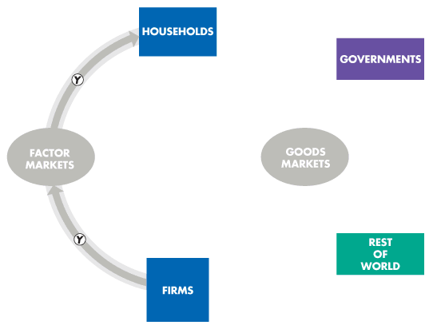
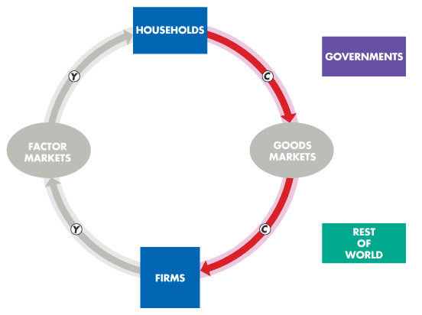
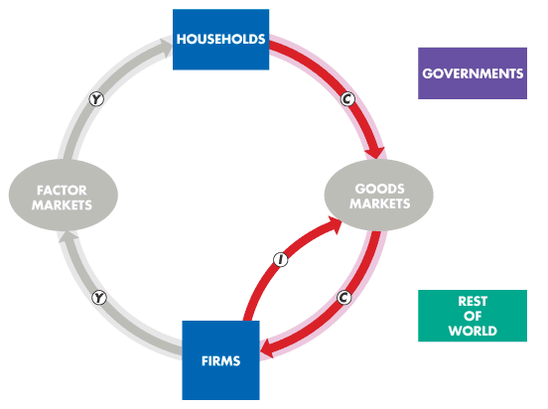
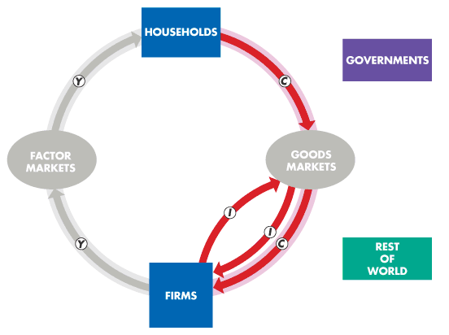
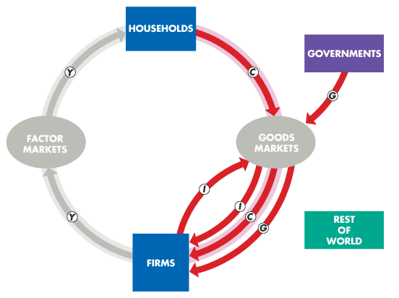
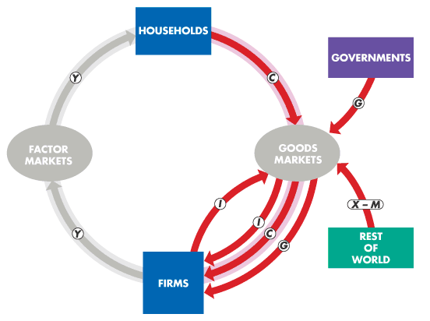
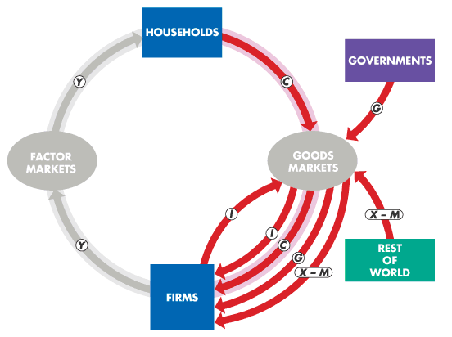
Measuring Canadian GDP
The Expenditure Approach
  The expenditure approach measures GDP as the sum of the red flow: consumption expenditure, investment, government expenditure on goods and services, and net exports.
  GDP = C + I + G + (X − M)
  Table 20.1 on the next slideshows the expenditure approach with 2013 data.

Slide 29
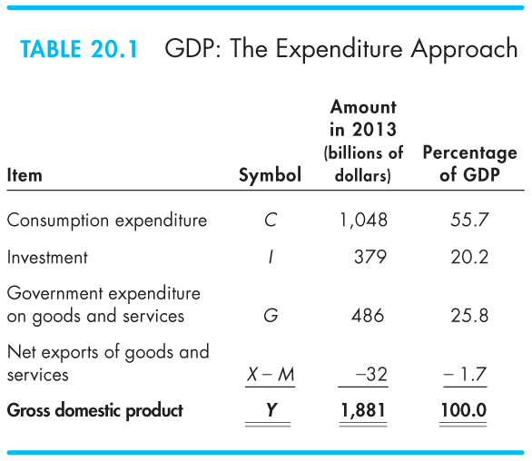

Slide 30
Measuring Canadian GDP
Nominal GDP and Real GDP
  Real GDP is the value of final goods and services produced in a given year when valued at valued at the prices of a reference base year.
  Currently, the reference base year is 2007 and we describe real GDP as measured in 2007 dollars.
  Nominal GDP is the value of goods and services produced during a given year valued at the prices that prevailed in that same year.
  Nominal GDP is just a more precise name for GDP.

Slide 31
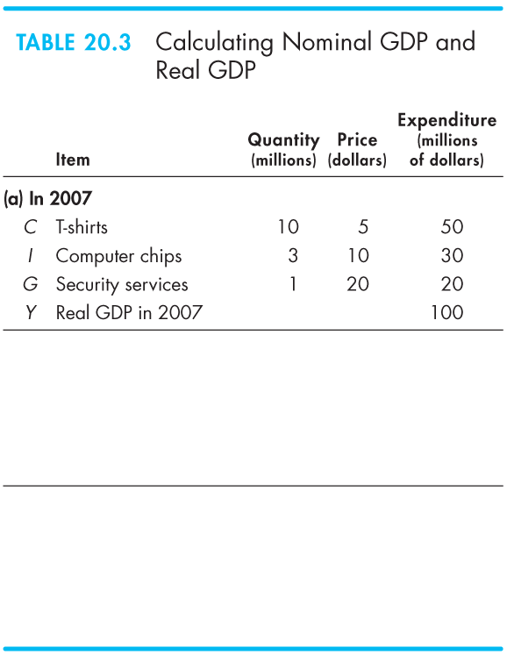
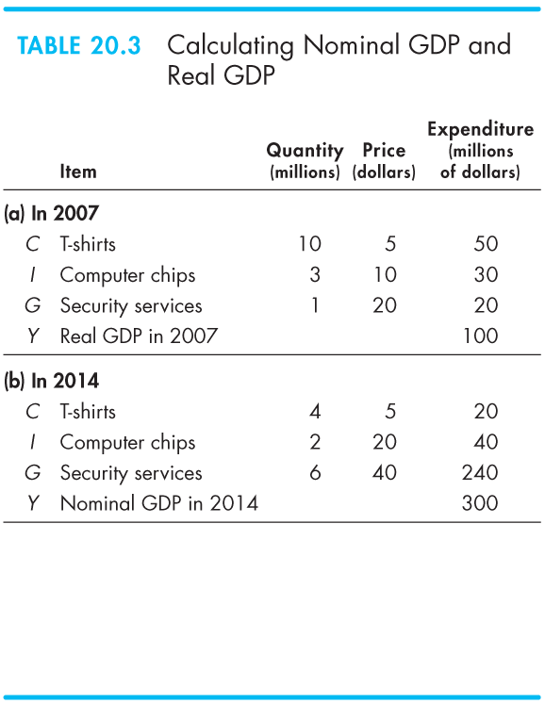
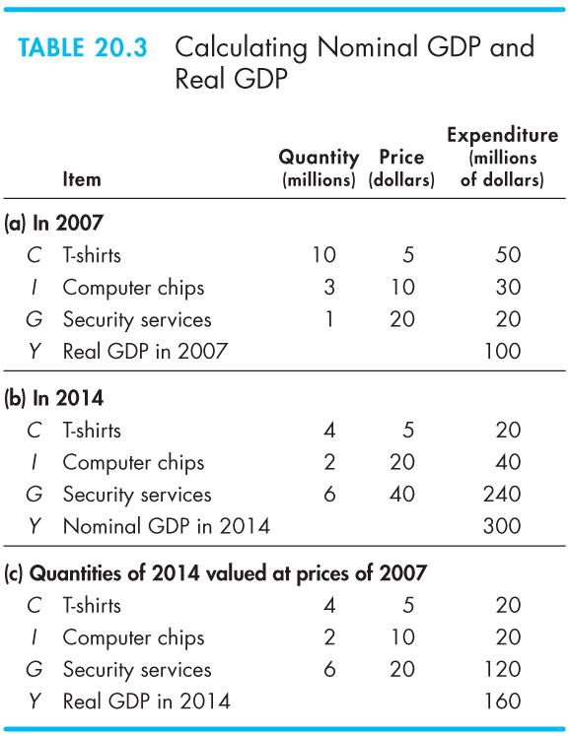
Measuring Canadian GDP
Calculating Real GDP
  Table 20.3(a) shows the quantities produced and the prices in 2007 (the base year).
  Nominal GDP in 2007 is $100 million.
  Because 2007 is the base year, real GDP and nominal GDP both are $100 million.

Slide 33
Measuring Canadian GDP
Table 20.3(b) shows the quantities produced and the prices in 2014.
Nominal GDP in 2014 is $300 million.
Nominal GDP in 2014 is three times its value in 2007.

Slide 34
Measuring Canadian GDP
In Table 20.3(c), we calculate real GDP in 2014.
The quantities are those of 2014, as in part (b).
The prices are those in the base year (2007) as in part (a).
The sum of these expenditures is real GDP in 2014, which is $160 million.

Slide 35
The Uses and Limitations of Real GDP
  Economists use estimates of real GDP for two main purposes:
  To compare the standard of living over time
  To compare the standard of living across countries

Slide 36
The Uses and Limitations of Real GDP
The Standard of Living Over Time
  Real GDP per person is real GDP divided by the population.
  Real GDP per person tells us the value of goods and services that the average person can enjoy.
  By using real GDP, we remove any influence that rising prices and a rising cost of living might have had on our comparison.

Slide 37
从这开始笔记记在ppt上

Slide 38
The Uses and Limitations of Real GDP
  Long-Term Trend
  A handy way of comparing real GDP per person over time is to express it as a ratio of some reference year.
  For example, in 1969, real GDP per person was $19,000 and in 2010, it was $38,000.
  So real GDP per person in 2010 was double its 1969 level—that is, $38,000 ÷ $19,000 = 2.

Slide 39
The Uses and Limitations of Real GDP
  Two features of our expanding living standard are
  The growth of potential GDP per person
  Fluctuations of real GDP around potential GDP
  The value of real GDP when all the economy’s labour, capital, land, and entrepreneurial ability are fully employed is called potential GDP.

Slide 40
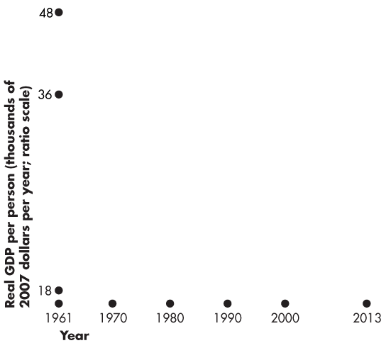
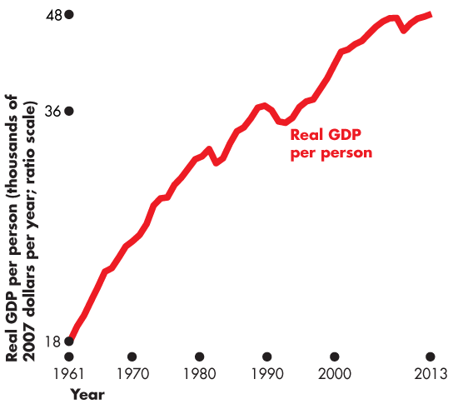
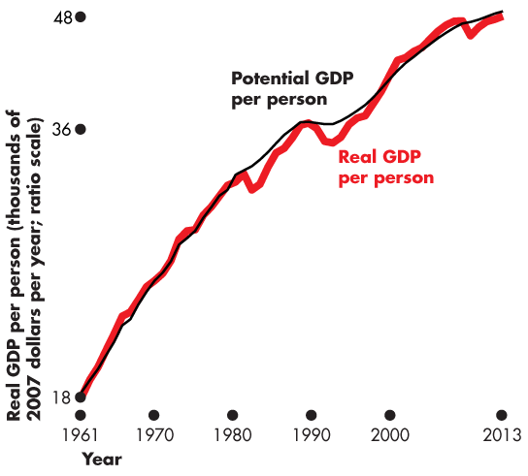
The Uses and Limitations of Real GDP
  Figure 20.2 shows Canadian real GDP per person.
  Potential GDP grows at a steady pace because the quantities of the factors of production and their productivity grow at a steady pace.
  Real GDP fluctuates around potential GDP.

Slide 41
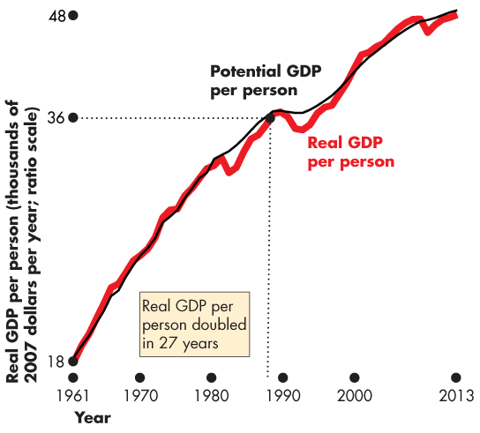
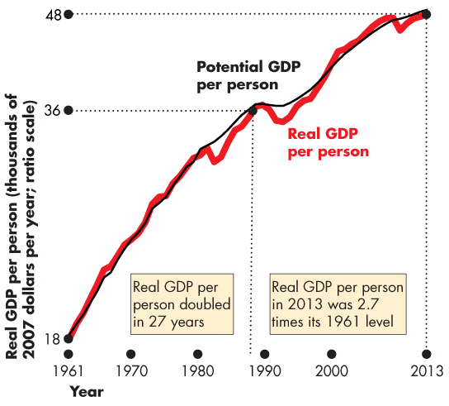

Slide 42
The Uses and Limitations of Real GDP
  Real GDP per person in Canada:
  Doubled between 1961 and 2010.
not sustainable in a long run---when real gdp is above potential gdp
(put on another shift, uses unemplyed resources)
why did productivity (the trend) slow down--next slide

Slide 43
The Uses and Limitations of Real GDP
  Productivity Growth Slowdown
  The growth rate of real GDP per person slowed after 1970. How costly was that slowdown?
  The answer is provided by a number:
  Lucas wedge is the dollar value of the accumulated gap between what real GDP per person would have been if the 1960s growth rate had persisted and what real GDP per person turned out to be.
  (if the trend continues, how rich we would have been )

Slide 44
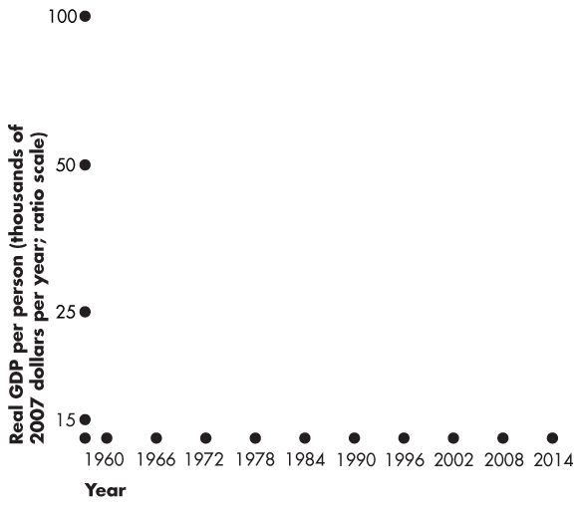
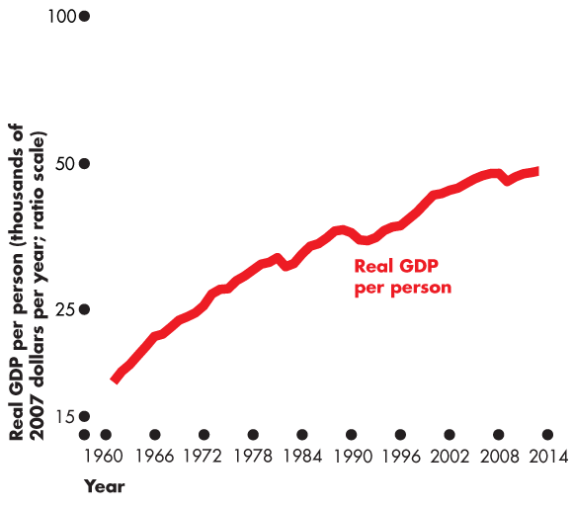
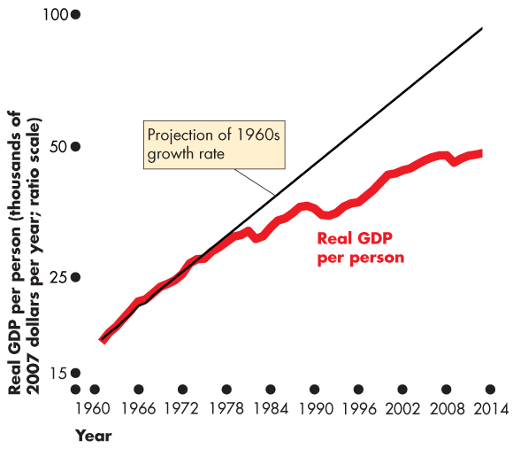
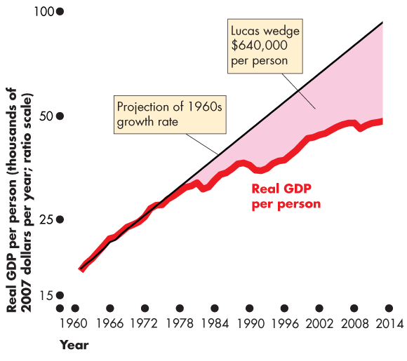
The Uses and Limitations of Real GDP
  Figure 20.3 illustrates the Lucas wedge.
  The red line is actual real GDP per person.
  The thin black line is the trend that real GDP per person would have followed
  if the 1960s growth rate of potential GDP had persisted.
  The shaded area is the Lucas wedge.

Slide 46
Figure 20.5 pg.473
-By 2013, real GDP per person was $45,000 per year lower than it would have been wiithout the productivity slowdown.
-The accumulated gap(1970-2013) was $ 640,000 per person

Slide 47
The Uses and Limitations of Real GDP
  Real GDP Fluctuations— The Business Cycle
  A business cycle is a periodic but irregular up-and-down movement of total production and other measures of economic activity.
  Every cycle has two phases:
  1. Expansion
  2. Recession
  and two turning points:
  1. Peak
  2. Trough

Slide 48
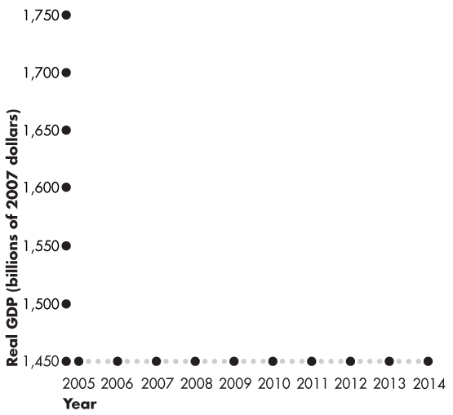
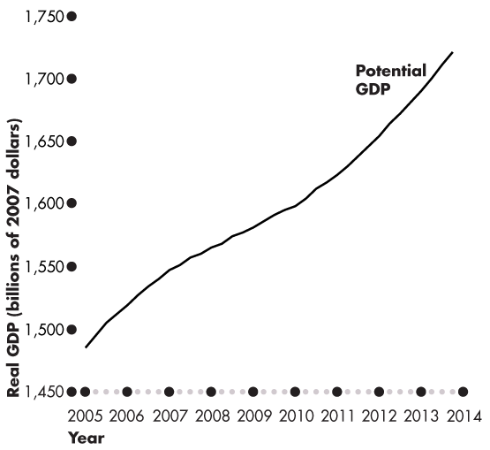
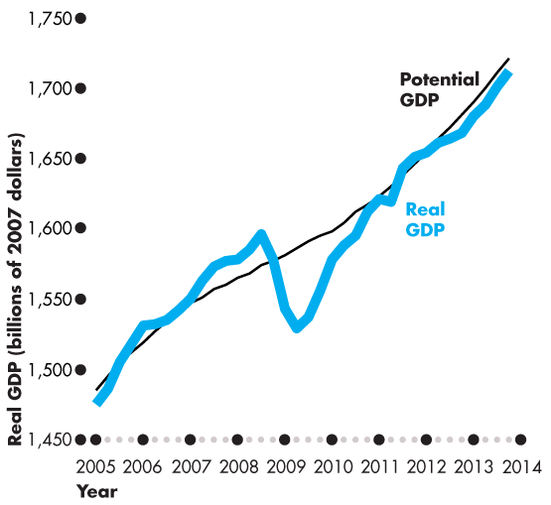
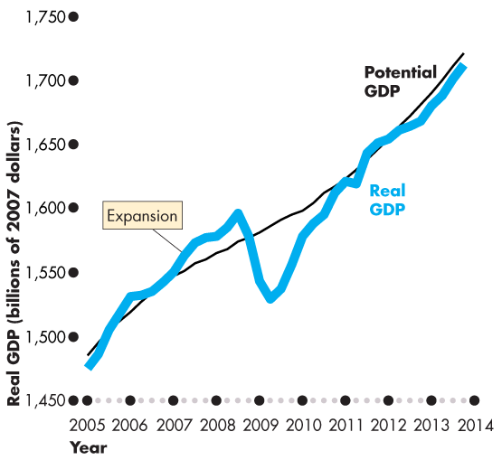
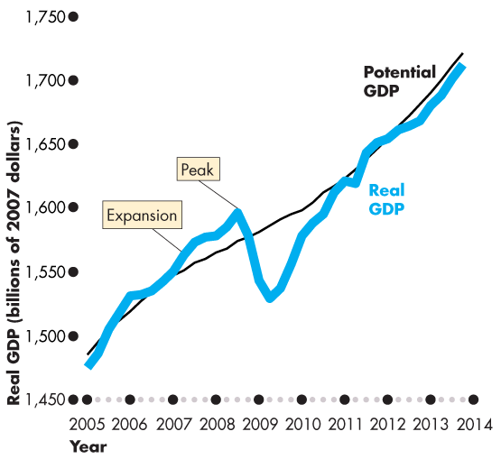

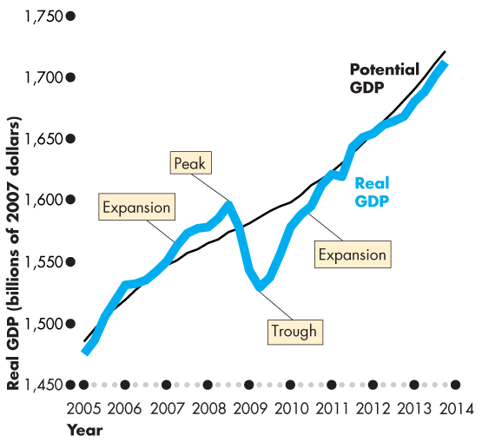
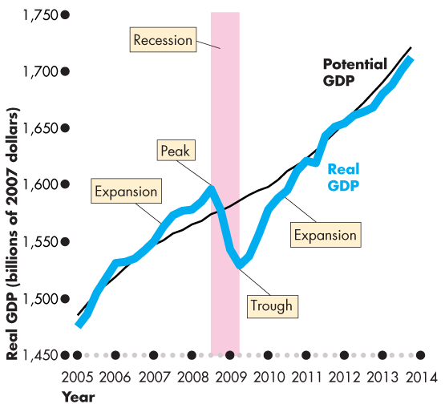
The Uses and Limitations of Real GDP
  Figure 20.4 illustrates the business cycle.
  Expansion is a period during which real GDP increases—from a trough to a peak.
  Recession is a period during which real GDP decreases—its growth rate is negative for at least two successive quarters.

Slide 50
The Uses and Limitations of Real GDP
The Standard of Living Across Countries
  Two problems arise in using real GDP to compare living standards across countries:
  1. The real GDP of one country must be converted into the same currency units as the real GDP of the other country.
  2. The goods and services in both countries must be valued at the same prices.
  ?

Slide 51
The Uses and Limitations of Real GDP
  Using the exchange rate to compare GDP in one country with GDP in another country is problematic because …
  prices of particular products in one country may be much less or much more than in the other country.
  The United States and China provide a striking example.
  For example, using the market exchange rate to value China’s GDP in U.S. dollars leads to an estimate that in 2013, GDP per person in the United States was 7.9 times GDP per person in China.
  ?

Slide 52
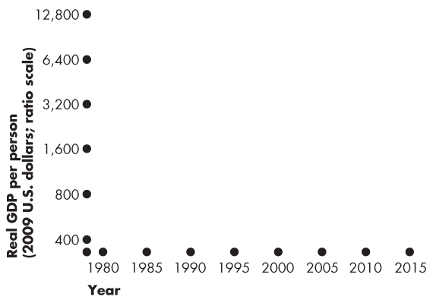
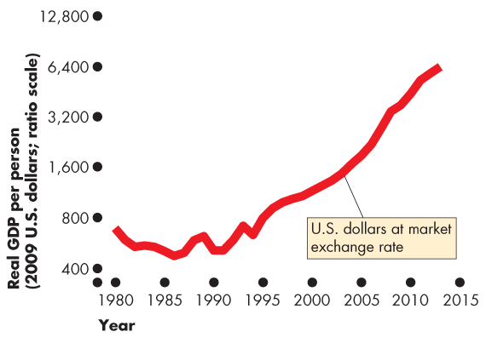
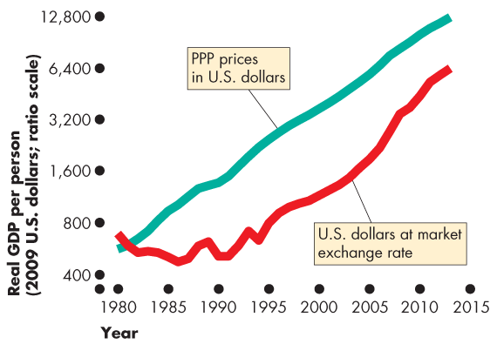
The Uses and Limitations of Real GDP
  Figure 20.5 illustrates the problem.
  Using the market exchange rate and domestic prices makes China look like a poor developing country.
  But when GDP is valued at purchasing power parity prices, U.S. income per person is only 5.6 times that in China.
  ?

Slide 54
The Uses and Limitations of Real GDP
  Using purchasing power parity prices …
  China’s real GDP per person is 6.5 percent of U.S. real GDP per person in 2010.
  ?

Slide 55
The Uses and Limitations of Real GDP
Limitations of Real GDP
  Real GDP measures the value of goods and services that are bought in markets.
  Some of the factors that influence the standard of living and that are not part of GDP are
  Household production
  Underground economic activity
  Health and life expectancy
  Leisure time
  Environmental quality
  Political freedom and social justice

Slide 56
Limitations of real GDP
  Household production
  productive activities not traded in markets (Eg.Housework
  Underground economic activity
  unreported economic activity(Eg. Avoiding taxes, illegal activity
  Health and life expectancy
  goood health and long life, although dsirable, do not show up directly in GDP
  Leisure time
  another desirable economic goal that is not valued in GDP

Slide 57
Limitations of real GDP
  Sucurity
  safety and security are valued on many levels, but not in GDP
  Environmental quality
  valuable aspect of life which, when present, is not added to GDP nor, when absent, is not subtracted from GDP
  Political freedom and social justice
  valued but very difficult to quantify

Slide 58
she ends ch20

Slide 60
The Uses and Limitations of Real GDP
The Bottom Line
  Do we get the wrong message about the level and growth of economic well-being and the standard of living by looking at the growth of real GDP?
  The influences that are omitted from real GDP are probably large.
  It is possible to construct broader measures that combine the many influences that contribute to human happiness.
  Despite all the alternatives, real GDP per person remains the most widely used indicator of economic well-being.

Slide 61
Mathematical Note: Chained-Dollar Real GDP
Statistics Canada uses a measure of real GDP called chained-dollar real GDP.
Three steps are needed to calculate this measure:
Value production in the prices of adjacent years
Find the average of two percentage changes
Link (chain) to the reference year

Slide 62
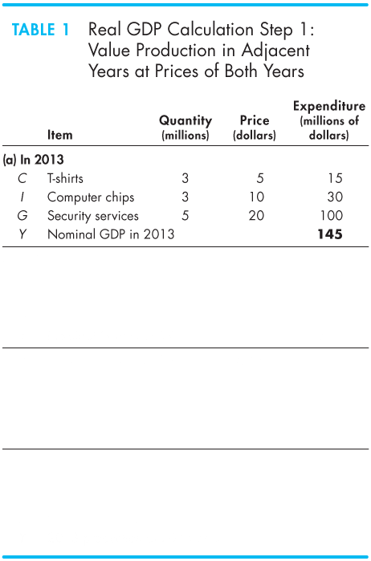
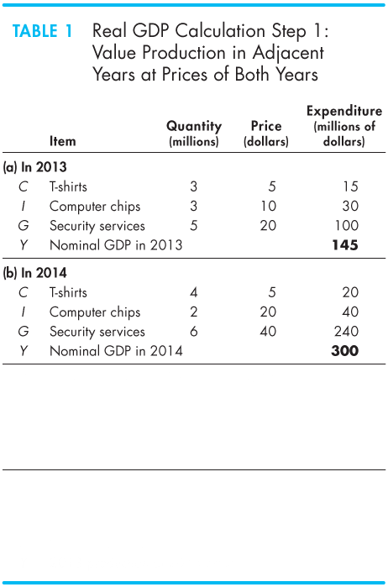
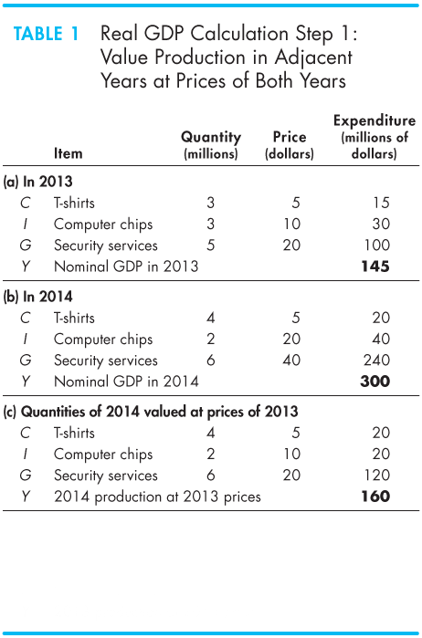
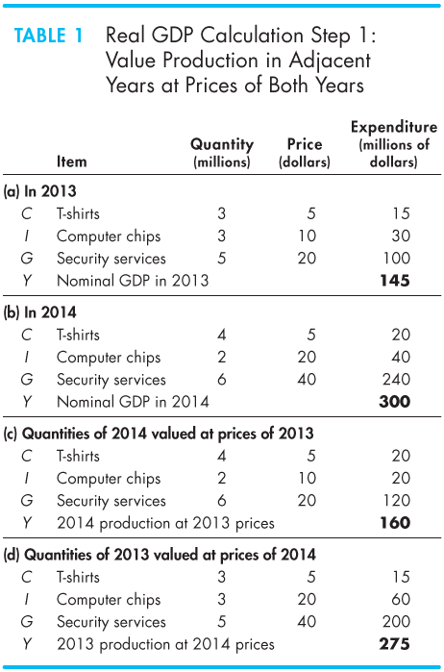
Mathematical Note: Chained-Dollar Real GDP
Value Production in Prices of Adjacent Years
  Part (a) shows the quantities and prices in 2013.
  Part (b) shows the quantities and prices in 2014.
  Part (c) the quantities of 2014 valued at 2013 prices.
  Part (d) the quantities of 2013 valued at prices of 2014.

Slide 64
Mathematical Note: Chained-Dollar Real GDP
  Parts (a) and (c) value the quantities of both years at 2013 prices.
  That is, valuing the goods and services at 2013 prices, real GDP increased from $145 million to $160 million.

Slide 65
Mathematical Note: Chained-Dollar Real GDP
  Parts (b) and (d) value the quantities in both years at 2014 prices.
  That is, valuing the goods and services at 2014 prices, real GDP increased from $275 million in 2013 to $300 million in 2014.

Slide 66
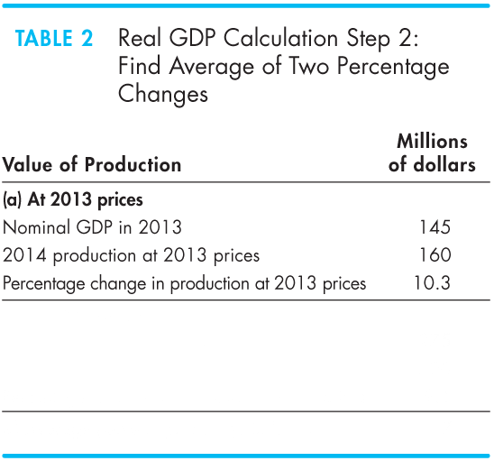
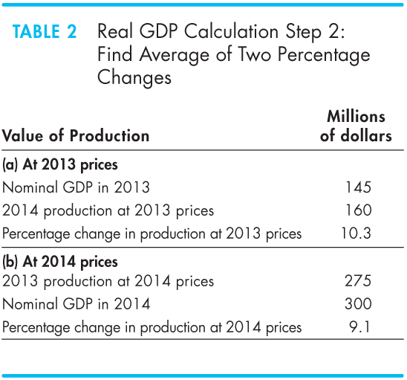
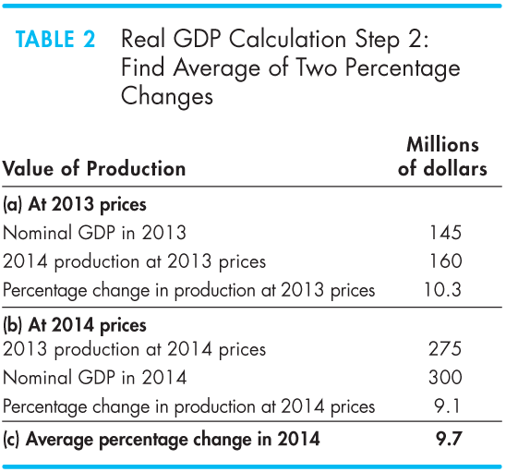
Mathematical Note: Chained-Dollar Real GDP
Find the Average of Two Percentage Changes
  Part (a) shows that at 2013 prices, production increased by 10.3 percent.
  Part (b) shows that at 2014 prices, production increased by 9.1 percent.
  The average percentage increase in production is 9.7.

Slide 68
Mathematical Note: Chained-Dollar Real GDP
Link (Chain) to the Base Year
  To find real GDP in 2014 in base-year prices (2007), we need to know the
  1. Real GDP in 2007
  2. Average growth rate each year from 2007 to 2014.

Slide 69
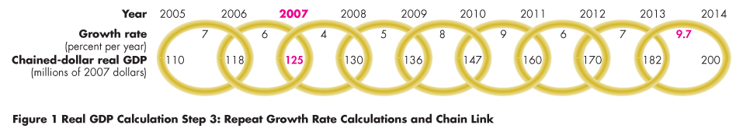
Mathematical Note: Chained-Dollar Real GDP
  Starting with real GDP in 2007 of $125 million and the growth rates shown in the figure, real GDP in each year since 2007 is calculated as follows:
  Real GDP in 2008 is 4 percent higher than the $125 million in 2007, which is $130 million.
  The figure illustrates the linking back to the base year.

Slide 70
Graphs in Macroeconomics

Slide 71
After studying this chapter, you will be able to:
Make and interpret a time-series graph
Make and interpret a graph that uses a ratio scale

Slide 72
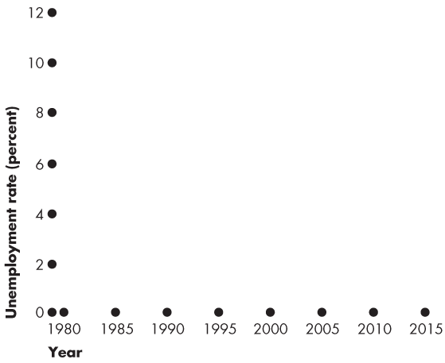
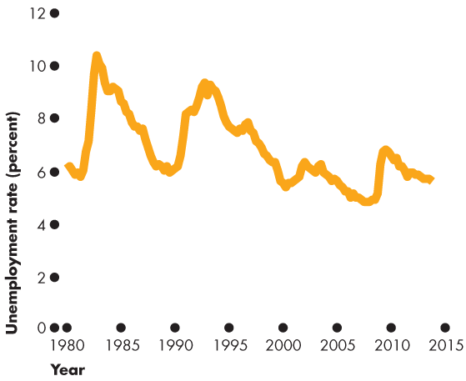
The Time-Series Graph
  Making a Time-Series Graph
  A time-series graph measures
  Time on the x-axis and
  The variable in which we are interested on the y-axis.

Slide 73

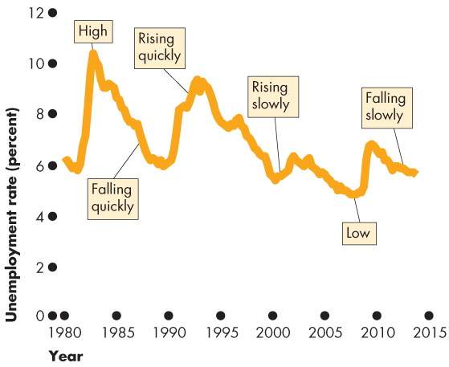

Slide 74
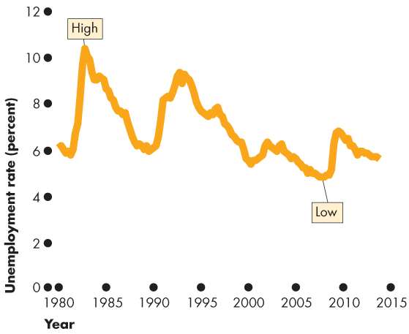
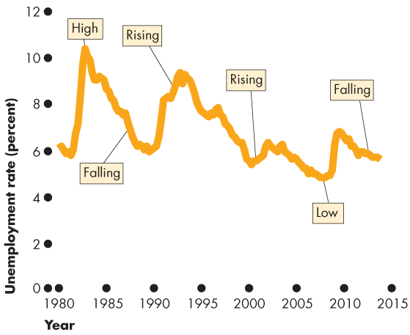

The Time-Series Graph
  Reading a Time-Series Graph
  A time-series graph shows the
  Level of the variable
  Change in the variable
  The speed of change in the variable

Slide 75
The Time-Series Graph
Ratio Scale Reveals Trend
A time-series graph also reveals whether a variable has a
Cycle—a tendency for a variable to alternate between upward and downward movements
Trend—a tendency for a variable to move in one general direction

Slide 76


The Time-Series Graph
  This time-series graph has
  A cycle
  No trend

Slide 77



The Time-Series Graph
A Time-Series with a Trend
  Figure A21.2(a) shows the average prices paid by consumers since 1970.
  In 1970, the price is set at 100.
  The price in other years is measured as a percentage of the 1970 level.
  Prices look as if they increased at a constant rate.

Slide 78



Slide 79





The Time-Series Graph
Using a Ratio Scale
  On the y-axis of a normal graph, the gap between 100 and 200 is the same as that between 300 and 400.
  On a graph with a ratio scale the gap between 100 and 200 is same as that between 200 and 400.
  The ratio of 200 to 100 equals the ratio of 400 to 200—a constant ratio gap.

Slide 80



The Time-Series Graph
  Graphing data on a ratio scale reveals the trend.
  The steeper the line, the faster is the growth rate of prices.
  Prices rose rapidly in the 1970s and more slowly in the 1980s, 1990s, and 2000s.

