Slide 1


Slide 2

21
MONITORING JOBS AND INFLATION

Slide 3
After studying this chapter, you will be able to:
Explain why unemployment is a problem and define the unemployment rate and other labour market indicators
Explain why unemployment is present even at full employment, and how its rate fluctuates over a business cycle
Explain why inflation is a problem and how we measure it using the CPI

Slide 4
Canadian unemployment rate:6.2%

Slide 5
Employment and Unemployment
Why Unemployment Is a Problem
  Unemployment results in
  Lost incomes and production
  Lost human capital (not learning anything)
  The loss of income is devastating for those who bear it. Unemployment benefits create a safety net but don’t fully replace lost wages, and not everyone receives benefits.
  Prolonged unemployment permanently damages a person’s job prospects by destroying human capital.

Slide 6
Employment and Unemployment
Labour Force Survey
Every month, Statistics Canada conducts a Labour Force Survey in which it asks 54,000 households.
  The population is divided into two groups:
  1. The working-age population—the total number of people aged 15 years and over
  2. People too young to work (under 15 years of age)

Slide 7
Employment and Unemployment
  The working-age population is divided into two groups:
  1. People in the labour force
  2. People not in the labour force
  The labour force is the sum of employed and unemployed workers.
  - employed: if you are working and getting paid
  -unemployed: next slide
  Not in labour force: retired group, stay-in-home moms anf dads, internship, volunteers,

Slide 8
Employment and Unemployment
  To be counted as unemployed, a person must be in one of the following three categories:
  1. On temporary layoff with an expectation of recall
  2. Without work but has made specific efforts to find a job within the previous four weeks
  3. Has a new job to start within four weeks
  ( you are ready,able, willing to work)

Slide 9
The Labour Force Survey excludes individuals in all of the following categories when calculating the national unemployment rate:
1. person younger than 15 years old
2. person residing in the Yukon, the NOorthwest Territories, Nunavut, and abriginal settlements
3. Full time members of the armed forces
4. INmates in institutions

Slide 10
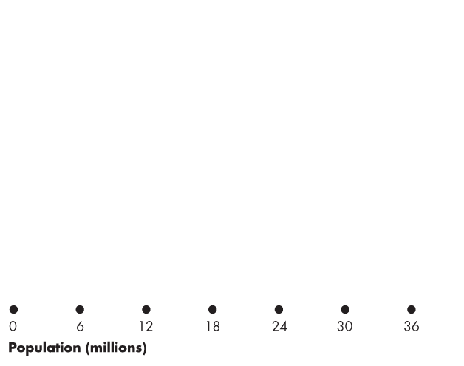
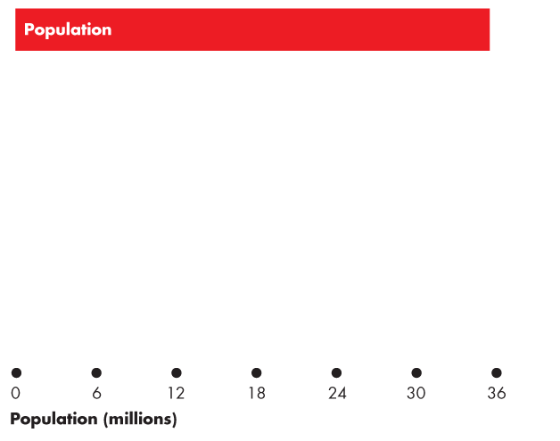
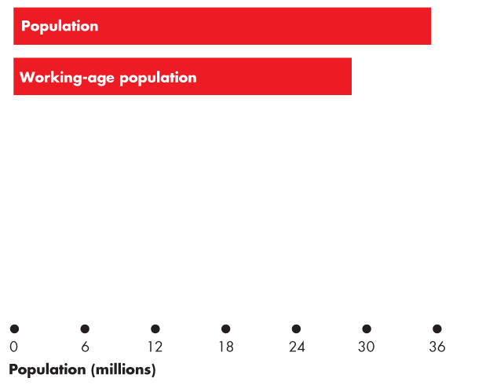
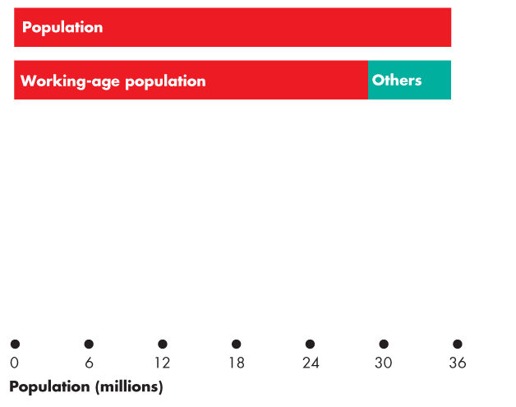
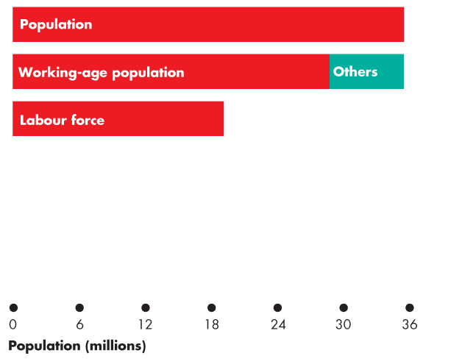
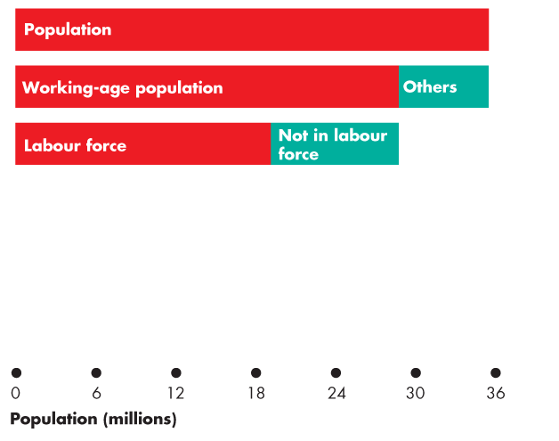
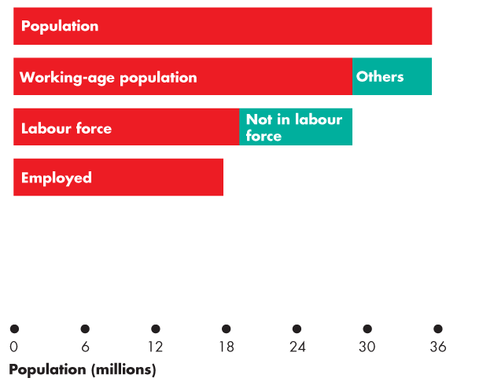
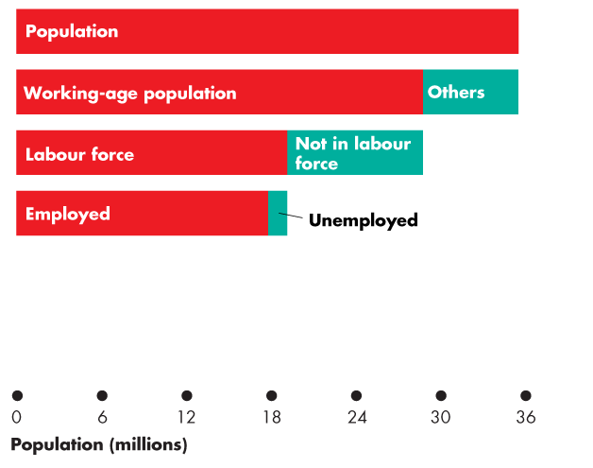
Employment and Unemployment
  Figure 21.1 shows the labour force categories.
  In 2013:
  Population: 35.4 million
  Working-age population: 28.7 million
  Labour force: 19.1 million
  Employment: 17.7 million
  Unemployment: 1.4 million

Slide 11
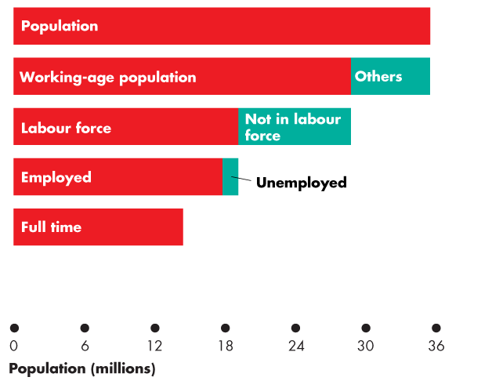
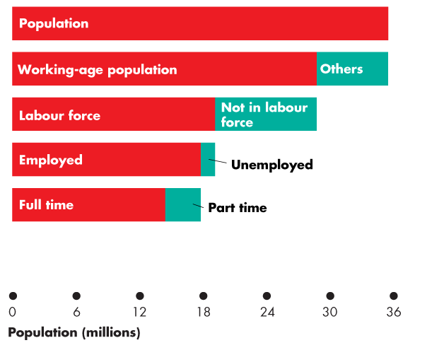
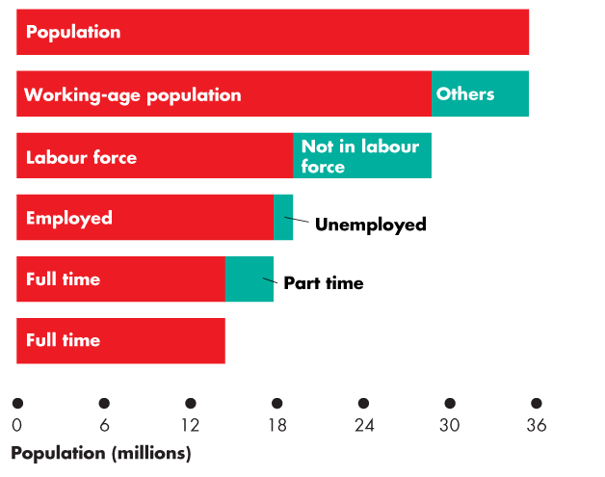
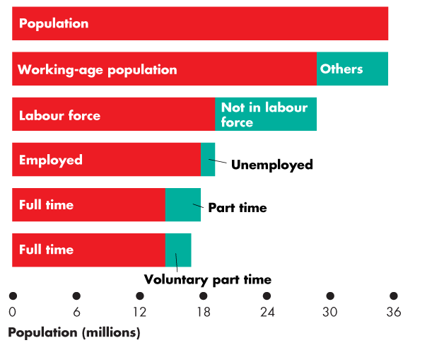
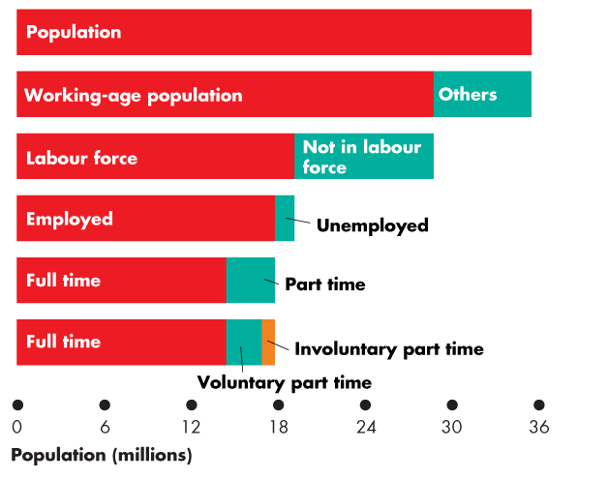

Slide 12
Employment and Unemployment
  Full-time employment: 14.3 million
  Part time: 3.4 million
  Voluntary part time: 2.5 million
  Involuntary part time: 0.9 million

Slide 13
Employment and Unemployment
Four Labour Market Indicators
  The unemployment rate
  Involuntary part-time rate(OMIT)
  The labour force participation rate
  The employment-to-population ratio(OMIT)

Slide 14
Employment and Unemployment
The Unemployment Rate----》important
  the percentage of the labour force that is unemployed.
  The unemployment rate is
  (Number of people unemployed ÷ labour force) × 100.
  In 2013, the labour force was 19.08 million and
  1.35 million were unemployed, so the unemployment rate was 7.1 percent.
  The unemployment rate increases in a recession and reaches its peak value after the recession ends.

Slide 15
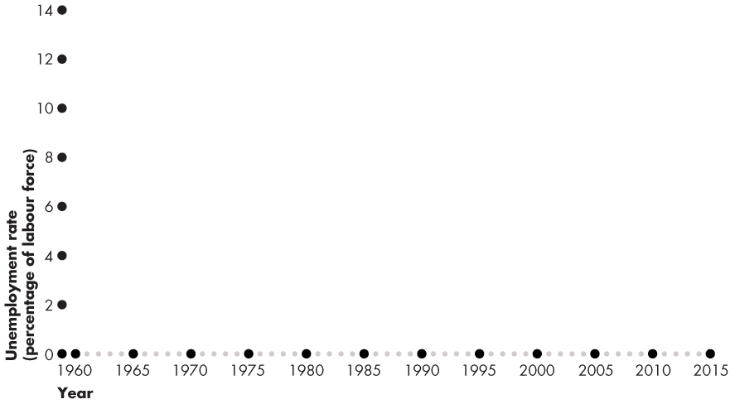
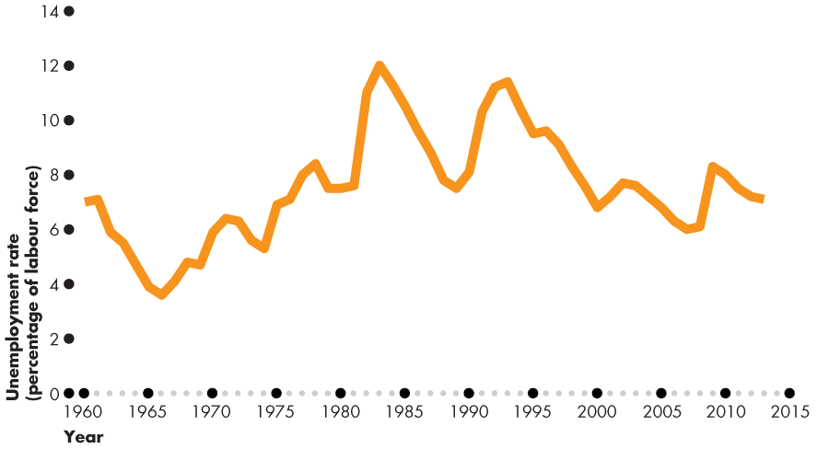
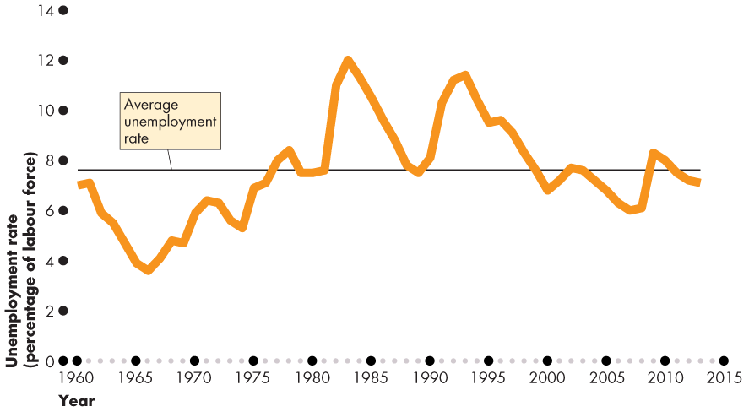
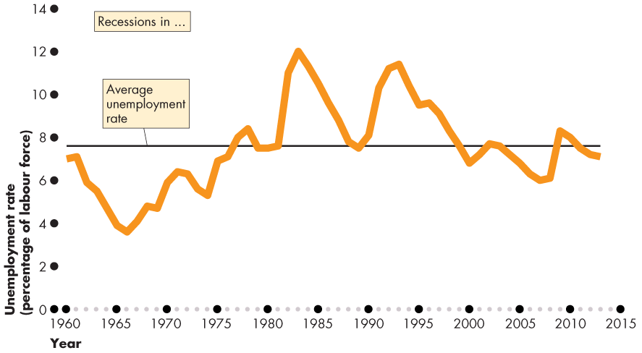
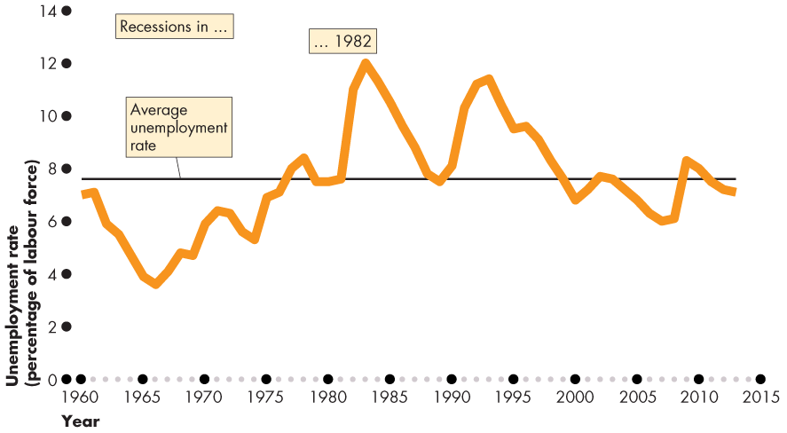
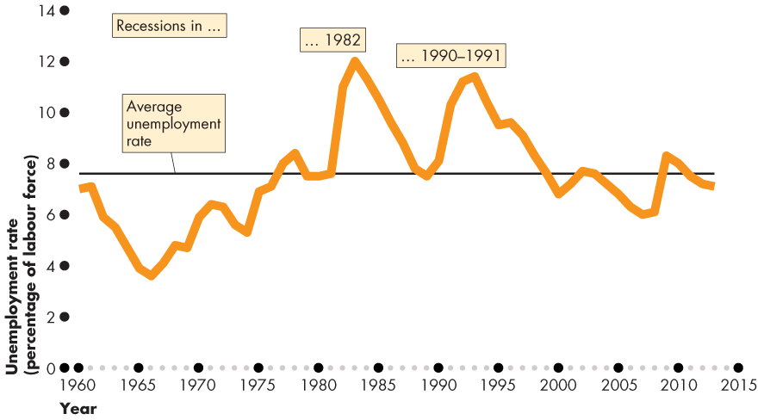
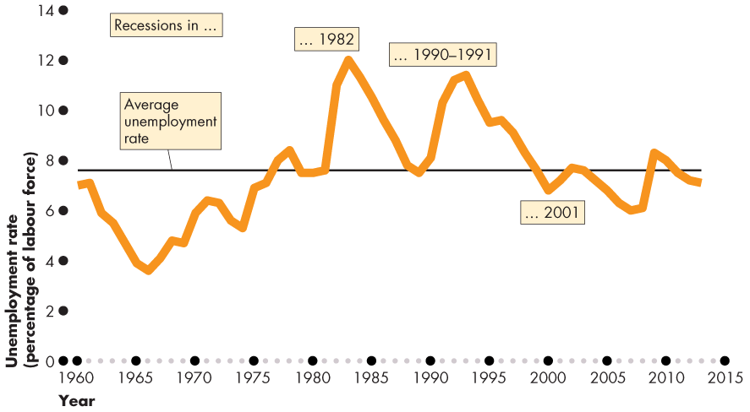
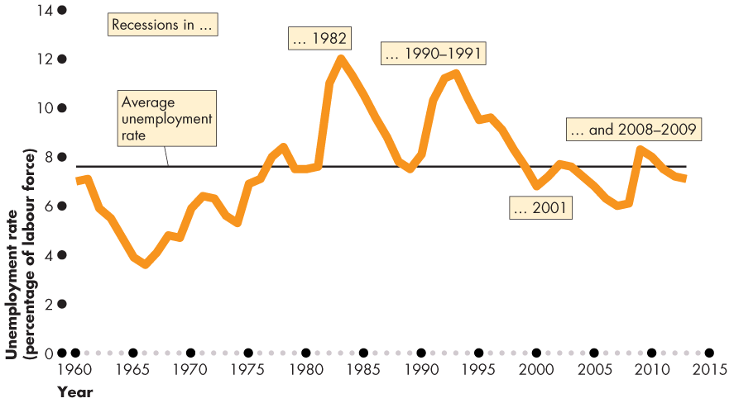
Employment and Unemployment
  Figure 21.2 shows the unemployment rate: 1960–2014.
  The unemployment rate increases in a recession.

Slide 17
Employment and Unemployment
The Labour Force Participation Rate----》important
  the percentage of the working-age population who are members of the labour force.
  The labour force participation rate is
  (Labour force ÷ Working-age population) × 100.
  In 2013, the labour force was 19.08 million and the working-age population was 28.67 million.
  The labour force participation rate was 66.5 percent.

Slide 18
Employment and Unemployment
  Other Definitions of Unemployment
  The purpose of the unemployment rate is to measure the underutilization of labour resources.
  Statistics Canada believes that the unemployment rate gives a correct measure.
  But the official measure is an imperfect measure because it excludes
  Discouraged searchers
  Long-term future starts
  Involuntary part-timers

Slide 19
Employment and Unemployment
  Discouraged Searchers
  A discouraged searcher is a person who currently is neither working nor looking for work but has indicated that he or she wants and is available for a job and has looked for work sometime in the recent past but has stopped looking because of repeated failure.
  (as soon as they stop, they are not in the labour force)
  Long-Term Future Starts
  A person with a job to start in more than four weeks is not counted as unemployed.

Slide 20
Employment and Unemployment
  Part-Time Workers Who Want Full-Time Jobs
  Part-time workers who want full-time jobs and can’t find them are not counted as unemployed.
  Most Costly Unemployment
  All unemployment is costly, but the most costly is long-term unemployment that results from job loss.

Slide 21
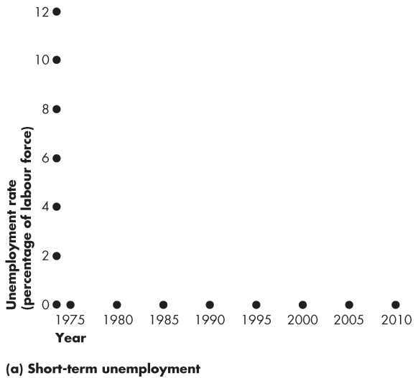
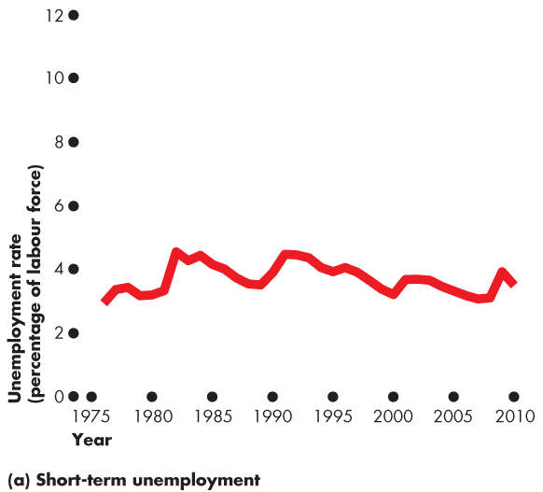
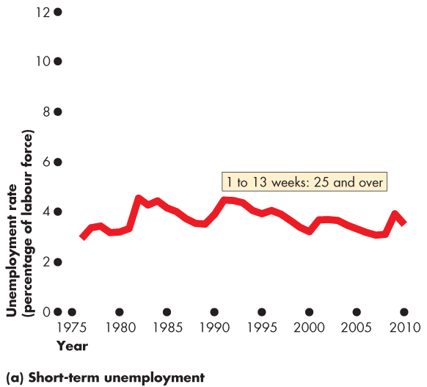
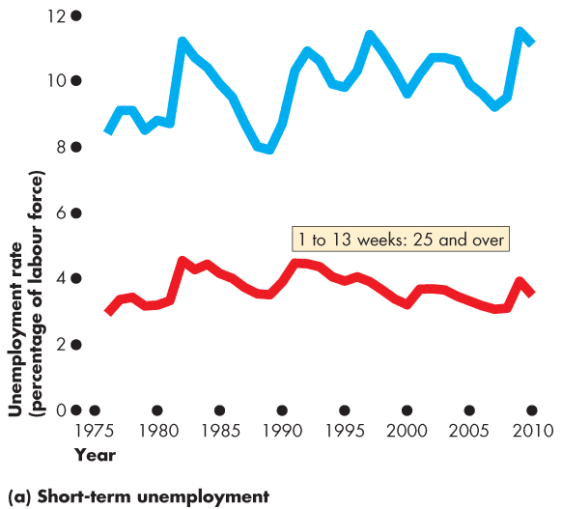
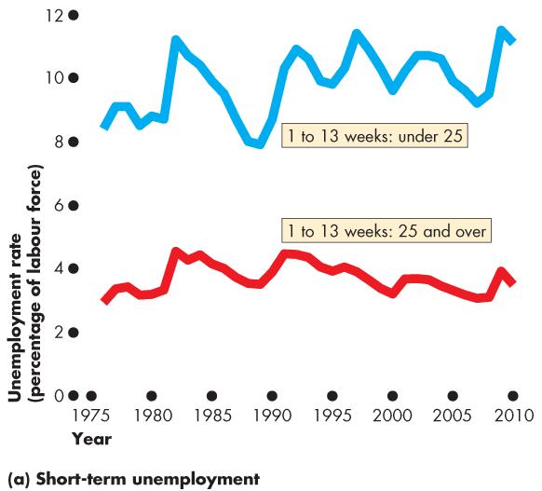
Unemployment and Full Employment
Figure 21.4(a) shows short-term unemployment.
For those over 25, short-term unemployment is around 4 percent and fluctuates only slightly over the business cycle.
For those under 25, short-term unemployment is high and fluctuates more strongly with the business cycle.

Slide 22
below ignored

Slide 24
Employment and Unemployment
  Alternative Measures of Unemployment
Statistics Canada reports eight alternative measures of the unemployment rate: three narrower than the official measure and four broader ones.
The narrower measures, R-1 and R-2, focus on the personal cost of unemployment.
R-4 is the official unemployment rate; R-3 is comparable to the U.S. rate.
The broader measures, R-4, R-5, and R-6, focus on assessing the full amount of underemployed labour resources.

Slide 25

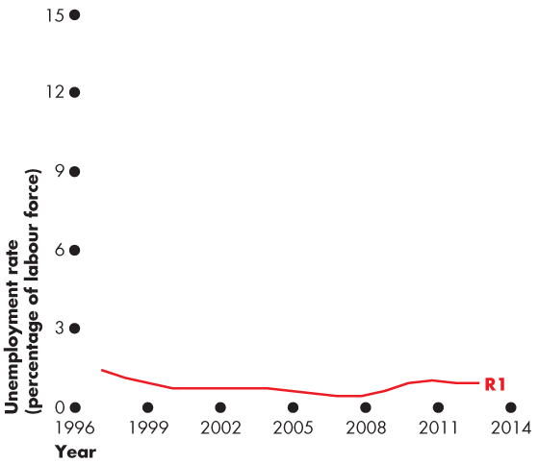
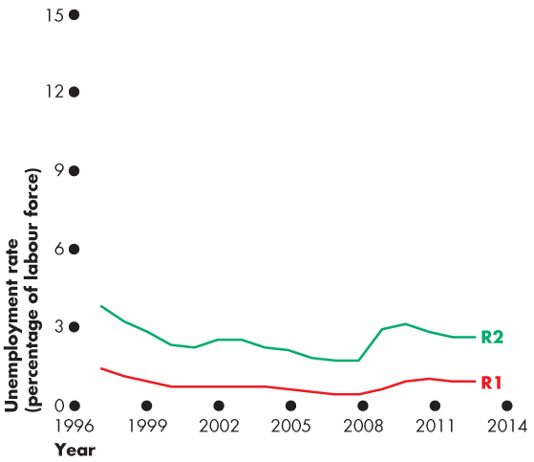
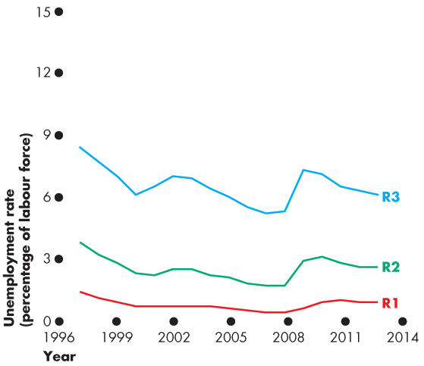
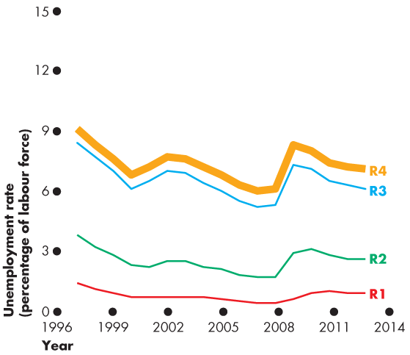
Employment and Unemployment
  Figure 22.4 shows eight alternative measures.
  R-1: Long-term unemployed (15 or more weeks)
  R-2: Short-term unemployed
  R-3: The unemployment rate comparable to the U.S. rate
  R-4: The official unemployment rate

Slide 26
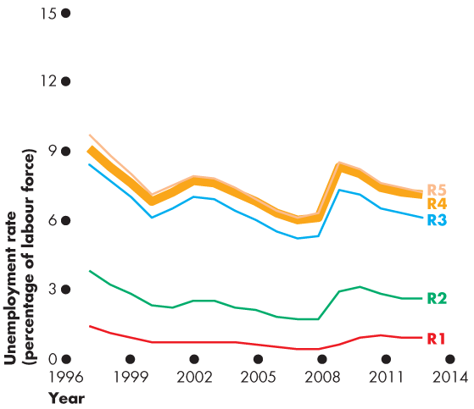
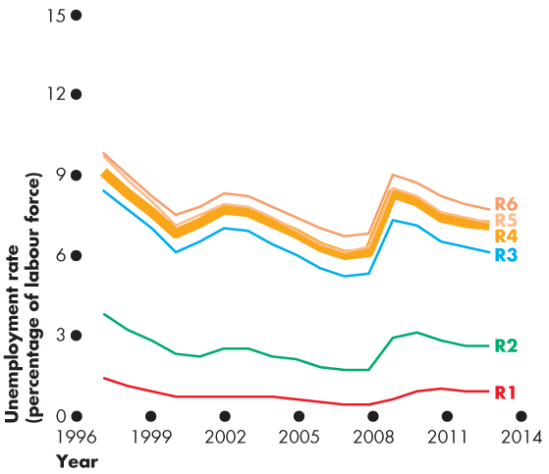
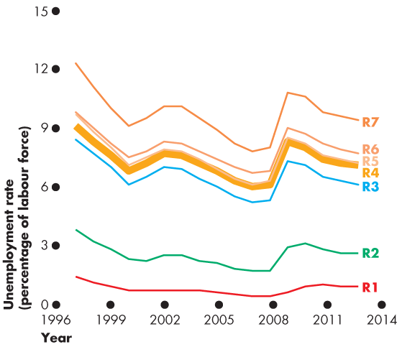
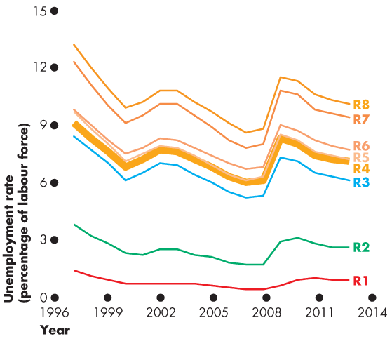
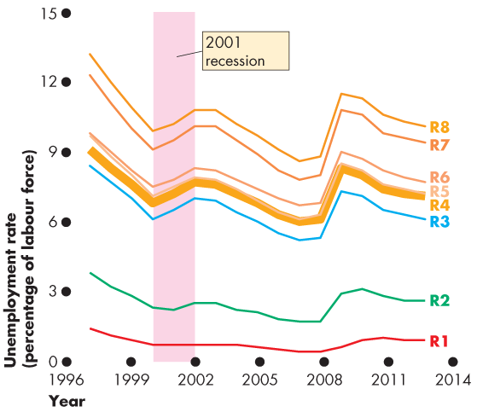
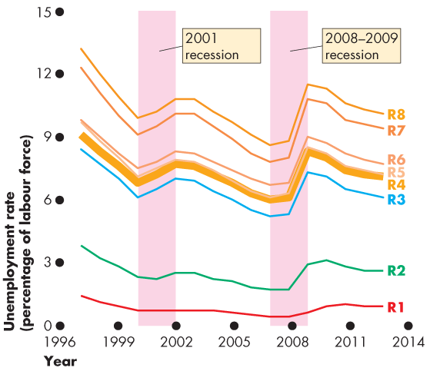

Slide 27
Employment and Unemployment
  Broader measures are
  U-5: U-4 + Discouraged searchers
  U-6: U-5 + Long-term future starts
  U-7: U-6 + involuntary part timers
  U-8: total underemployment
  All measures increase together in recession.

Slide 29
Unemployment and Full Employment
  Unemployment can be classified into three types:
  Frictional unemployment
  Structural unemployment
  Cyclical unemployment

Slide 30
Unemployment and Full Employment
  Frictional Unemployment
  Frictional unemployment is unemployment that arises from normal labour market turnover.
  The creation and destruction of jobs requires that unemployed workers search for new jobs.
  Increases in the number of people entering and reentering the labour force and increases in unemployment benefits raise frictional unemployment.
  Frictional unemployment is a permanent and healthy phenomenon of a growing economy.
  (people moving in and out of the labour force)

Slide 31
Unemployment and Full Employment
  Structural Unemployment
  Structural unemployment is unemployment created by changes in technology and foreign competition that change the skills needed to perform jobs or the locations of jobs.
  Structural unemployment lasts longer than frictional unemployment.

Slide 32
Unemployment and Full Employment
  Cyclical Unemployment
  Cyclical unemployment is the higher than normal unemployment at a business cycle trough and lower than normal unemployment at a business cycle peak.
  A worker laid off because the economy is in a recession and is then rehired when the expansion begins experiences cycle unemployment.

Slide 33
Unemployment and Full Employment
“Natural” Unemployment
Natural unemployment is the unemployment that arises from frictions and structural change when there is no cyclical unemployment.
Natural unemployment is all frictional and structural unemployment.
  The natural unemployment rate is natural unemployment as a percentage of labour force.
  (neither doing really well, nor doing really poor)

Slide 34
Unemployment and Full Employment
  Full employment is defined as the situation in which the unemployment rate equals the natural unemployment rate.
  When the economy is at full employment, there is no cyclical unemployment or, equivalently, all unemployment is frictional and structural.

Slide 35
Unemployment and Full Employment
  The natural unemployment rate changes over time and is influenced by many factors.
Key factors are
The age distribution of the population
The scale of structural change
The real wage rate
Unemployment benefits

Slide 36
natual unemployment rate:key factors
The age distribution of the population
A younger or older population will influence the number of new job seekers and the amount of frictional unemployment
The scale of structural change
If technological change is swift and foreign competition is fierce, structural unemployment will be high

Slide 37
natual unemployment rate:key factors
The real wage rate
the real wage rates that bring unemployment are:
-Minimum Wage: as mandated by the government
-Efficient Wages: as selected by the firm to attract a better applicant pool, encourage hard work and discourage worker turnover.
These wages will bring unemployment if they are set above the market equilibrium wage.
Unemployment benefits
- will increase unemplotment by lowering the cost of searching for work

Slide 38
The Labour Market
Real Wage (W/P)
Supply of labour
unemployment
supply>demand
Minimum wage OR efficiency wage
market equilibrium wage
Demand for labour
Quantity of labour
Q^{d}
Q^{s}
W: nominal wage in dollars
P: Price level(see slide #42)

Slide 39
Unemployment and Full Employment
Real GDP and Unemployment Over the Cycle
  Potential GDP is the quantity of real GDP produced at full employment.
  Potential GDP corresponds to the capacity of the economy to produce output on a sustained basis.
  Real GDP minus potential GDP is the output gap.
  Over the business cycle, the output gap fluctuates and the unemployment rate fluctuates around the natural unemployment rate.

Slide 40
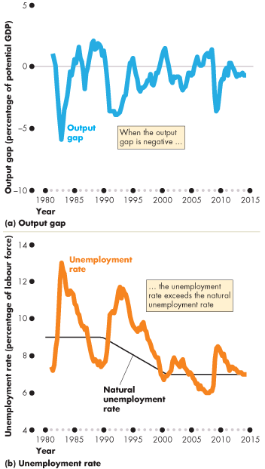
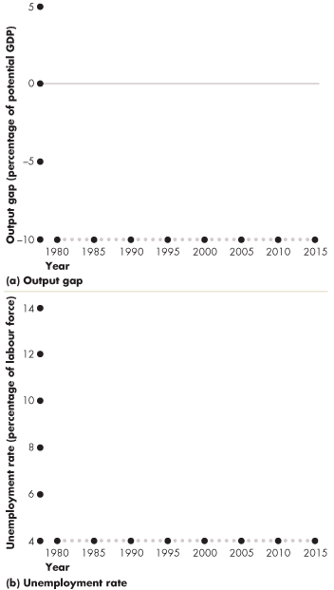
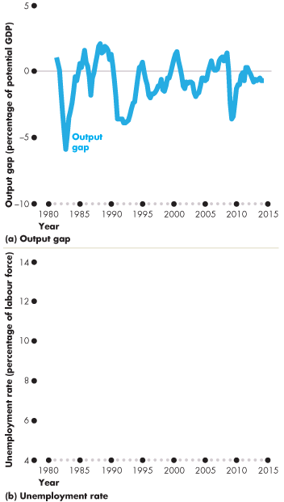
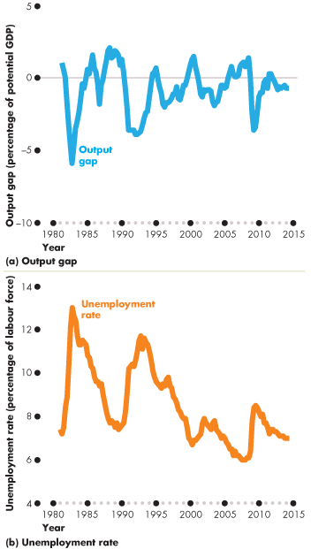
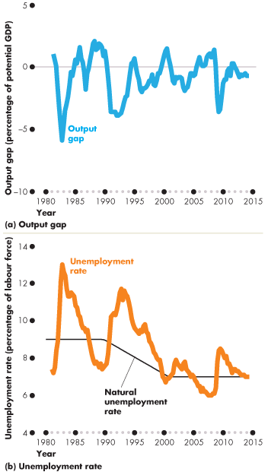
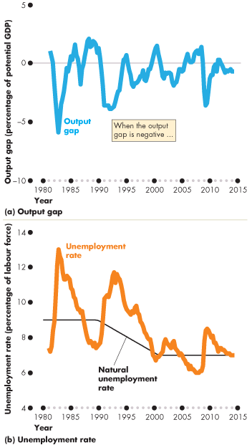
Unemployment and
Full Employment
  Figure 21.5 shows the output gap and …
  the fluctuations of unemployment around the natural rate.
  When the output gap is negative, unemployment exceeds the natural unemployment rate.

Slide 41
in a recession
output gap=real GDP - potential GDP
the unemployment rate increases

Slide 42
Price Level, Inflation, and Deflation
  The price level is the average level of prices and the value of money.
  A persistently rising price level is called inflation.
  A persistently falling price level is called deflation.
  We are interested in the price level because we want to
  1. Measure the inflation rate or the deflation rate
  2. Distinguish between money values and real values of economic variables.
  (money value are nominal, but real values will be adjusted)

Slide 43
Price Level, Inflation, and Deflation
  Why Inflation and Deflation Are Problems
  Low, steady, and anticipated inflation or deflation is not a problem.
  Unpredictable inflation or deflation is a problem because it
  Redistributes income and wealth
  Lowers real GDP and employment
  Diverts resources from production

Slide 44
Why Unpredictable Inflation and Deflation Are Problems
  Redistributes income
  Money wages will be reduced in inflationary periods so workers are worse off. The higher price is higher income for the employer.
  Redistribute wealth
  In a contract, unexpected inflation transfers purchasing power from creditors(lenders) to debtors(borrowers).
  Whith unexpected inflation, borrowers benefit, lender lose.
  (memory rules: BB LL)

Slide 45
  Lowers real GDP and employment
  Unexpected increase OR decreases in inflation disrupt the regular flow of production, and as a consequence, effect jobs.
  With inflation, inrease profits -> increase investment
  -> increase output -> increase employment temporarily.
  With deflation, decrease profits ->decrease spending ->decrease output -> increase unemployment and recession
  Diverts resources from production
  People are spending their time trying to protect their financial investment

Slide 46
Price Level, Inflation, and Deflation
  (NOT MENTIONED)
  Unpredictable changes in the inflation rate redistribute income in arbitrary ways between employers and workers and between borrowers and lenders.
  A high inflation rate is a problem because it diverts resources from productive activities to inflation forecasting.
  From a social perspective, this waste of resources is a cost of inflation.
  At its worse, inflation becomes hyperinflation—an inflation rate that is so rapid that workers are paid twice a day because money loses its value so quickly.

Slide 47
Price Level, Inflation, and Deflation
  The Consumer Price Index
  The Consumer Price Index, or CPI, measures the average of the prices paid by urban consumers for a “fixed” basket of consumer goods and services.

Slide 48
Price Level, Inflation, and Deflation
Reading the CPI Numbers
  The CPI is defined to equal 100 for the reference base period. (no need to calculate---always)
  Currently, the reference base period is 2002.
  That is, for the average CPI of the 12 months of 2002 equals 100.
  In June 2014, the CPI was 125.6.
  This number tells us that the average of the prices paid by urban consumers for a fixed basket of goods was 25.6 percent higher in June 2014 than it was during 2002.

Slide 49
Price Level, Inflation, and Deflation
Constructing the CPI
  Constructing the CPI involves three stages:
  Selecting the CPI basket
  Conducting a monthly price survey
  Calculating the CPI

Slide 50
1.The CPI Basket
  The CPI basket is based on a consumer expenditure survey conducted by Statistics Canada, which is undertaken infrequently.
  Today’s CPI basket today is based on data collected in the Consumer Expenditure Survey of 2011 and valued at prices in January 2013.

Slide 51
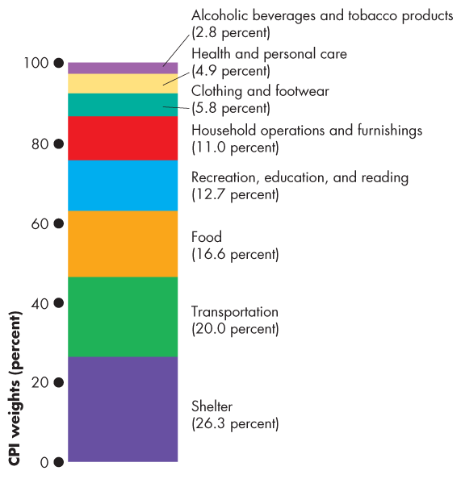
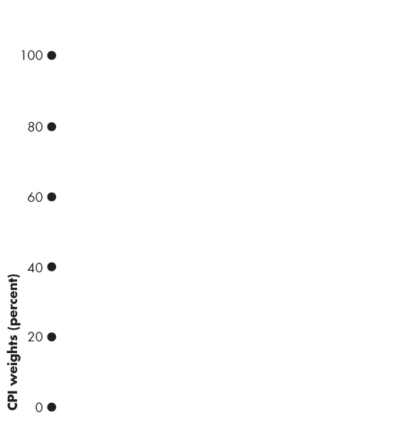
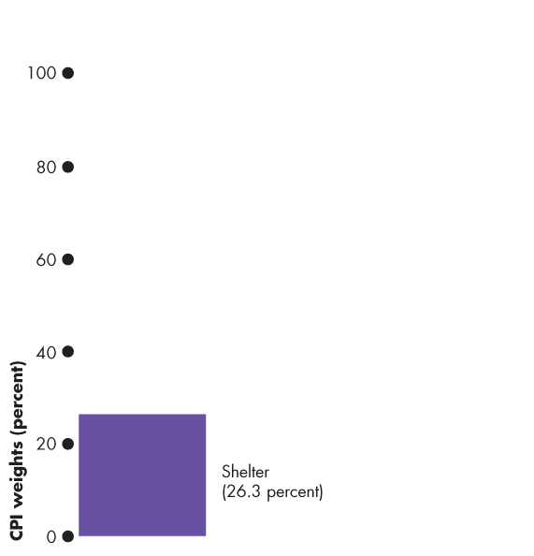
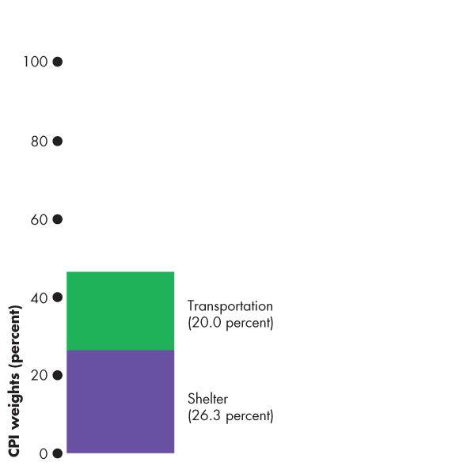
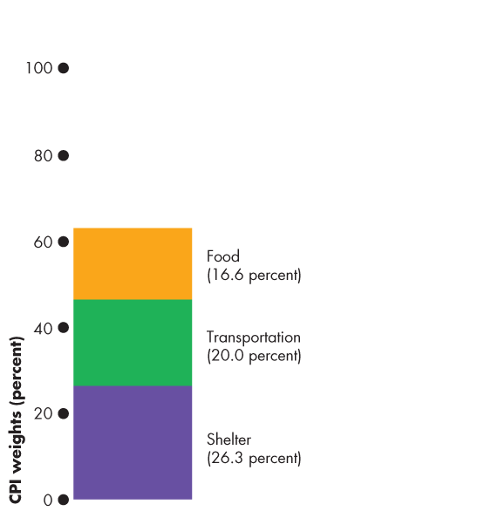
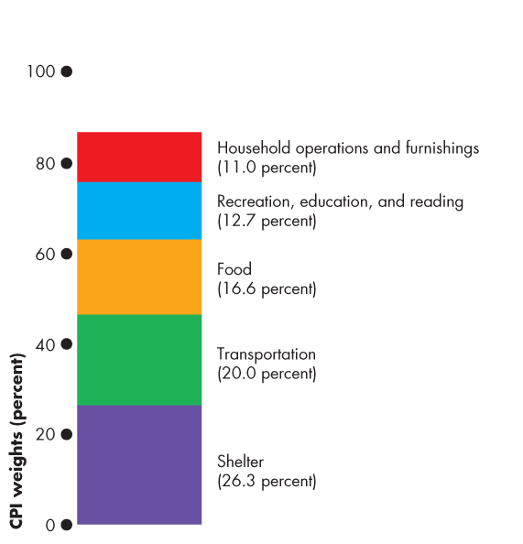
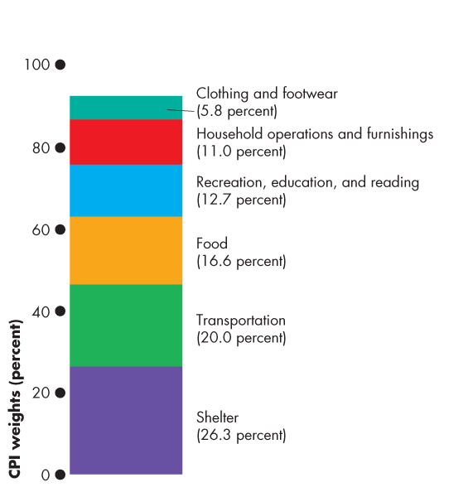
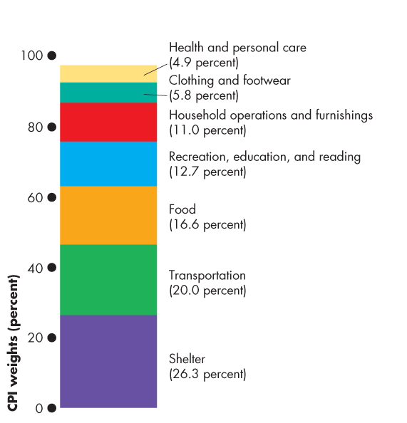
  Figure 21.6 illustrates the CPI basket.
  Shelter is the largest component.
  Transportation and food and beverages are the next largest components.
  The remaining components account for 37 percent of the basket.

Slide 52
2.The Monthly Price Survey
3.Calculating the CPI
  The Monthly Price Survey
  Every month, Statistics Canada employees check the prices of the goods and services in the CPI basket in the major cities.
  (the basket is fixed and the price of goods in the basket changes)
  Calculating the CPI
  1. Find the cost of the CPI basket at base-period prices.
  2. Find the cost of the CPI basket at current-period prices.
  3. Calculate the CPI for the current period.

Slide 53




Price Level, Inflation, and Deflation
  Let’s work an example of the CPI calculation.
  In a simple economy, people consume only oranges and haircuts.
  The CPI basket is 10 oranges and 5 haircuts.
  The table also shows the prices in the base period.
  The cost of the CPI basket in the base period was $50.

Slide 54




Price Level, Inflation, and Deflation
  Table 21.1(b) shows the fixed CPI basket of goods.
  It also shows the prices in the current period.
  The cost of the CPI basket at current-period prices is $70.
  -Quantity stays the same
  -the price of the basket changes

Slide 55
Calculating CPI--on midterm
  The CPI is calculated using the formula:
  CPI = (Cost of basket at current-period prices ÷ Cost of basket at base-period prices)  100.
  Using the numbers for the simple example,
  CPI = ($70 ÷ $50)  100 = 140.
  The CPI is 40 percent higher in the current period than it was in the base period.
  --no units

Slide 56
Price Level, Inflation, and Deflation
Measuring the Inflation Rate
  The major purpose of the CPI is to measure inflation.
  The inflation rate is the percentage change in the price level from one year to the next.
  The inflation formula is:
  Inflation rate = [(CPI this year – CPI last year) ÷ CPI last year] × 100.
  ---inflation is reported as percentage

Slide 57
Price Level, Inflation, and Deflation
The Biased CPI
  The CPI might overestate the true inflation for four reasons:
  New goods bias
  Quality change bias
  Commodity substitution bias
  Outlet substitution bias

Slide 58
Price Level, Inflation, and Deflation
  New Goods Bias
  New goods that were not available in the base year appear and, if they are more expensive than the goods they replace, they put an upward bias into the CPI.
  Quality Change Bias
  Quality improvements occur every year. Part of the rise in the price is payment for improved quality and is not inflation.
  The CPI counts all the price rise as inflation.

Slide 59
Price Level, Inflation, and Deflation
  Commodity Substitution Bias
  The market basket of goods used in calculating the CPI is fixed and does not take into account consumers’ substitutions away from goods whose relative prices increase.
  (if the price of apple goes up, consumer will buy pear instead, but this change is not include)
  Outlet Substitution Bias
  As the structure of retailing changes, people switch to buying from cheaper sources, but the CPI, as measured, does not take account of this outlet substitution.
  (online shopping )
  the nature of shopping is different than waht it used to be

Slide 60
Price Level, Inflation, and Deflation
The Magnitude of the Bias
Estimates say that the CPI overstates inflation by
0.6 percentage points a year.
Some Consequences of the Bias
  Distorts private contracts.
  Increases government outlays (close to a third of federal government outlays are linked to the CPI).
  A bias of 0.6 percent is small, but over a decade adds up to billions of dollars of additional expenditure.

Slide 61
Price Level, Inflation, and Deflation
Alternative Price Indexes
  Alternative measures of the price level are
  GDP deflator(a price index)
  Chained price index for consumption

Slide 62
the GDP Deflator
The GDP deflator measures the price of the output relative to its level in the base year
the GDP deflator is a price index which measures the overall price level.
The formulae: see next slide+ notes
In theses sums, all the quantity terms will be the same(numerator and denominator) for a given year, reflecting the effect of relative changes in prices only.

Slide 63
Price Level, Inflation, and Deflation
GDP Deflator
The GDP deflator equals
(Nominal GDP ÷ Real GDP)  100
GDP deflator is a broader measure of the price level than the CPI because it includes all consumption expenditure, investment, government expenditure on goods and services, and net exports.
But as a cost of living, the GDP deflator is too broad.
Over the period 2000 to 2014, the GDP deflator increased by an average rate of 2.2 percent a year, which is 0.3 percentage points above the CPI inflation rate.

Slide 64



Price Level, Inflation, and Deflation
Core Inflation Rate
The core inflation rate is an inflation rate excluding the volatile elements (of food and fuel).
(use braket but exclude something)
The core inflation rate attempts to reveal the underlying inflation trend.
The most common measure of core inflation is the core CPI inflation rate.

Slide 65
Price Level, Inflation, and Deflation
The Real Variables in Macroeconomics
  We can use the GPD deflator to deflate nominal variables to find their real values.
  For example,
  Real wage rate = (Nominal wage rate ÷ GDP deflator)  100
  But not the real interest rate! It is different.

