Slide 1


Slide 2

24
MONEY, THE PRICE LEVEL, AND INFLATION

Slide 3
After studying this chapter, you will be able to:
Define money and describe its functions
Explain the economic functions of banks
Describe the structure and functions of the Bank of Canada
Explain how the banking system creates money
Explain what determines the quantity of money and interest rates
Explain how the quantity of money influences the price level and the inflation rate

Slide 4
What is Money?
  Money is any commodity or token that is generally acceptable as a means of payment.
  A means of payment is a method of settling a debt.
  Money has three other functions:
  Medium of exchange
  Unit of account
  Store of value

Slide 5
What is Money?
Medium of Exchange
  A medium of exchange is an object that is generally accepted in exchange for goods and services.
  In the absence of money, people would need to exchange goods and services directly, which is called barter.
  Barter requires a double coincidence of wants, which is rare, so barter is costly.

Slide 6
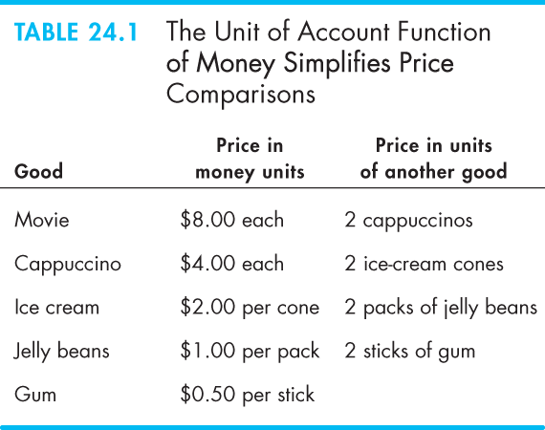
What is Money?
Unit of Account
  A unit of account is an agreed measure for stating the prices of goods and services.
  Table 24.1 illustrates how money simplifies comparisons.
Store of Value
  As a store of value, money can be held for a time and later exchanged for goods and services.

Slide 7
What is Money?
Money in Canada Today
  Money in Canada consists of
  Currency
  Deposits at banks and other depository institutions
  Currency is the notes and coins held by individuals and businesses.

Slide 8
What is Money?
Official Measures of Money
  The two main official measures of money in Canada are M1 and M2.
  M1 consists of currency held by individuals and businesses plus chequable deposits owned by individuals and businesses.
  M2 consists of M1 plus all other deposits─non-chequable deposits and fixed term deposits.

Slide 9
Two Measures if the Money Stock for the Canadian Economy
-Money consist of coins, bank notes, and chequeable deposits
M1=Currency (bank notes+coins) outside the banks + demand deposits located in chartered banks.
Demand deposit- funds accounts that can be removed without notice and usually pay little or no interest.
Examples: current accounts, personal chquable accounts.

Slide 10
M2 =M1+ Personal savings deposits +term deposits and non-personal notice deposits located in chartered banks
Savings deposits-bank deposits that typically earn a rate of return and require a stipulated amount of notice to be withdrawn, though rarely enforced.
Notice deposits-deposits which have a notice requirement in the contractual agreement with the client, although banks almost never enforce this clause.
Term deposits - bank deposits paying a market rate of return which are deposited for a fixed term and thus have limited liquidity.

Slide 11

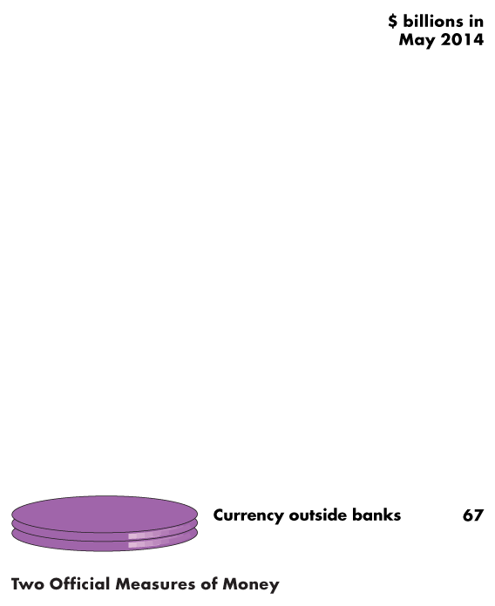
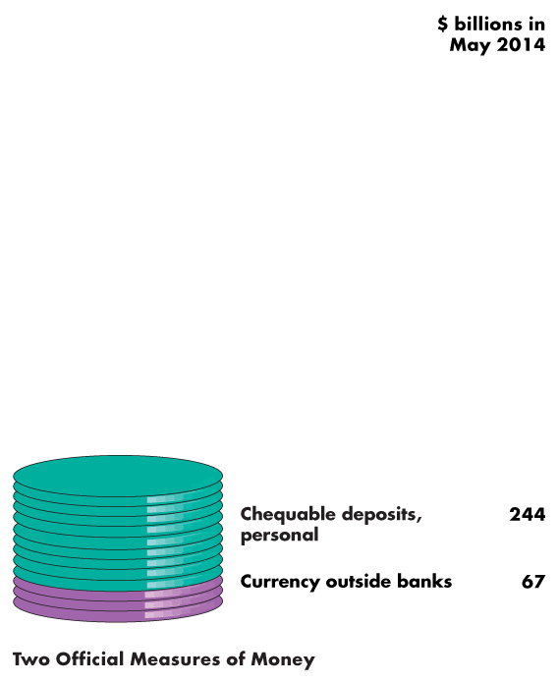
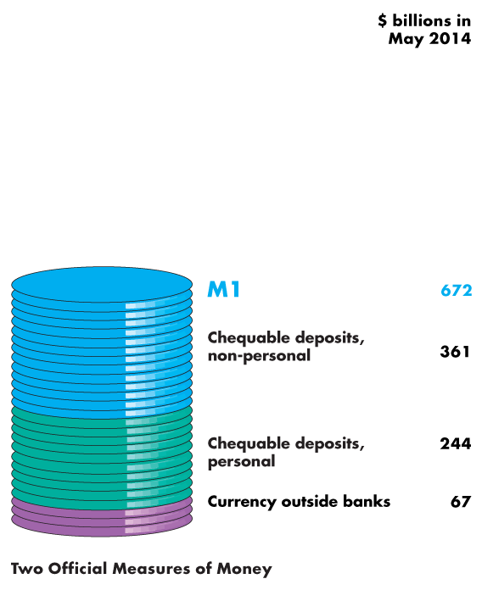
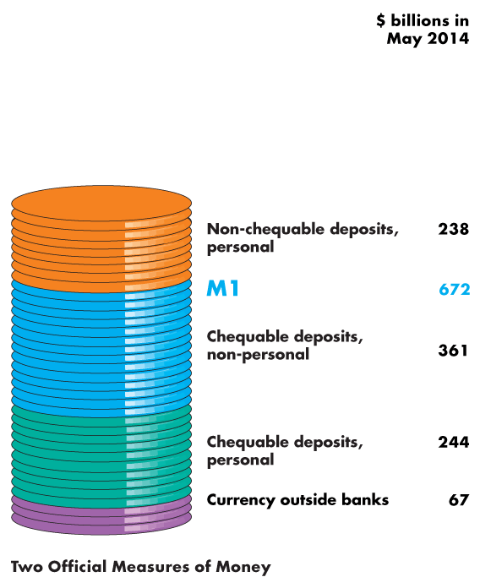
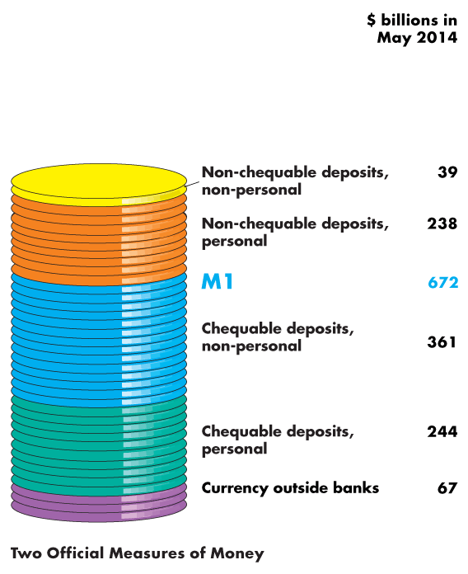
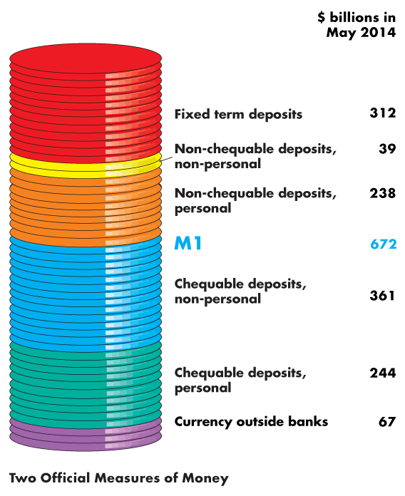
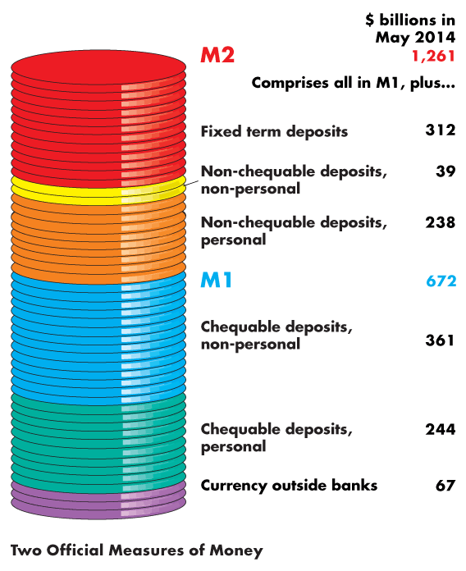
What is Money?
  The figure illustrates the composition of M1 …
  and M2.
  It also shows the relative magnitudes of the components.

Slide 13
  Are M1 and M2 Really Money?
  All the items in M1 are means of payment. They are money.
  Some savings deposits in M2 are not means of payments—they are called liquid assets.
  Liquidity is the property of being instantly convertible into a means of payment with little loss of value.
  Deposits are money, but cheques are not—a cheque is an instruction to a bank to transfer money.
  Credit cards are not money. A credit card enables the holder to obtain a loan, but it must be repaid with money.
  (a prieless painting is not liquid, they cannot be turned into money easily)

Slide 14
Depository Institutions
  A depository institution is a firm that takes deposits from households and firms and makes loans to other households and firms.
  Types of Depository Institutions
  Deposits at three institutions make up the nation’s money. They are:
  Chartered banks
  Credit unions and caisses populaires
  Trust and mortgage loan companies

Slide 15
Depository Institutions
Chartered Banks
  A chartered bank is a private firm private firm, chartered under the Bank Act of 1871 to receive deposits and make loans.
Credit Unions and Caisses Populaires
A credit union is a cooperative organization that operates under the Cooperative Credit Association Act of 1991 and that receives deposits from and makes loans to its members.
A caisse populaire is a similar type of institution that operates in Quebec.

Slide 16
Depository Institutions
What Depository Institutions Do
  To goal of any bank is to maximize the wealth of its owners.
  To achieve this objective, the interest rate at which it lends exceeds the interest rate it pays on deposits. [Interest Rate spread]
  But the banks must balance profit and prudence:
  Loans generate profit.
  Depositors must be able to obtain their funds when they want them.

Slide 17
Depository Institutions
  A chartered bank puts the depositors’ funds into four types of assets:
  Reserves—notes and coins in its vault or its deposit at the Bank of Canada
  Liquid assets—Canadian government Treasury bills and commercial bills
  Securities—longer–term Canadian government bonds and other bonds such as mortgage-backed securities
  Loans—commitments of fixed amounts of money for agreed-upon periods of time

Slide 18
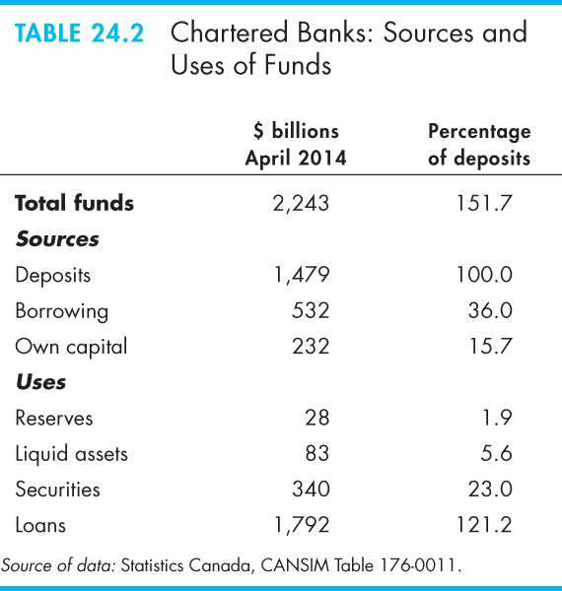
Depository Institutions
Table 24.2 shows the sources and uses of funds in all chartered banks in April 2014.

Slide 20
Depository Institutions
Economic Benefits Provided by Depository Institutions
  Depository institutions make a profit from the spread between the interest rate they pay on their deposits and the interest rate they charge on their loans.
  Depository institutions provide four benefits:
  Create liquidity
  Pool risk
  Lower the cost of borrowing
  Lower the cost of monitoring borrowers

Slide 21
Create Luquidity
-Take deposits and are ready to repay them in the short term
-make loans which can be repaid over longer periods of time
Pool Risk
-Depository insititutions are in the lending nusiness. An occasional default can be absorbed.
Lower the cost of borrowing
-Households and firms need not search for a source, or many sources, for loans
Lower the cost of monitoring borrowers
-Depository institutions can more easily monitor borrowers which allows institutions to make better decisions and reduce default risk

Slide 22
Depository Institutions
How Depository Institutions Are Regulated
  Depository institutions engage in risky business.
  To make the risk of failure small, depository institutions are required to hold levels of reserves and owners’ capital equal to or that surpass the ratios laid down by regulation.
  If a Canadian bank fails, deposits are guaranteed up to $100,000 per depositor per bank by the Canada Deposit Insurance Corporation.
  Provincial government agencies regulate credit unions and caisses populaires.

Slide 23
Depository Institutions
Financial Innovation
  The aim of financial innovation—the development of new financial products—is to lower the cost of deposits or to increase the return from lending.
  Two influences on financial innovation are:
  Economic environment
  Technology

Slide 24
The Bank of Canada
  The Bank of Canada is the central bank of Canada.
  A central bank is the public authority that regulates a nation’s depository institutions and control the quantity of money.
  The Bank of Canada is:
  Banker to other banks and government
  Lender of last resort
  Sole issuer of bank notes

Slide 25
The Bank of Canada
Banker to Banks and Government
  The Bank of Canada accepts deposits from depository institutions that make up the payments system and the government of Canada.
  Lender of Last Resort
  The Bank of Canada is the lender of last resort, which means that it stands ready to make loans when the banking system as a whole is short of reserves.(in a crisis)
  Banks lend and borrow reserves from other banks in the overnight loans market.(not a last redort, just a day-to-day business)

Slide 26
The Bank of Canada
Sole Issuer of Bank Notes
  The Bank of Canada is the only bank that is permitted to issue bank notes. The Bank of Canada has a monopoly on this activity(to print money).
  The Bank of Canada’s Balance Sheet
  The Bank of Canada’s assets are government securities and last-resort loans to banks.
  Its liabilities are Bank of Canada notes and deposits of banks and the government.

Slide 27
The Bank of Canada
The Bank of Canada’s Balance Sheet
  On the Bank’s balance sheet, the largest and most important asset is Canadian government securities.
  The most important liabilities are Bank of Canada notes in circulation and banks’ deposits.

Slide 28
The Bank of Canada
Monetary Base
  The liabilities of the Bank of Canada (plus coins issued by the Canadian Mint) form the monetary base.
  The monetary base is the sum of Bank of Canada notes outside the Bank of Canada, banks’ deposits at the Bank of Canada, and coins held by households, firms, and banks.
  To change the monetary base, the Bank of Canada conducts an open market operation, which is the purchase or sale of government of Canada securities by the Bank of Canada in the open market.

Slide 29
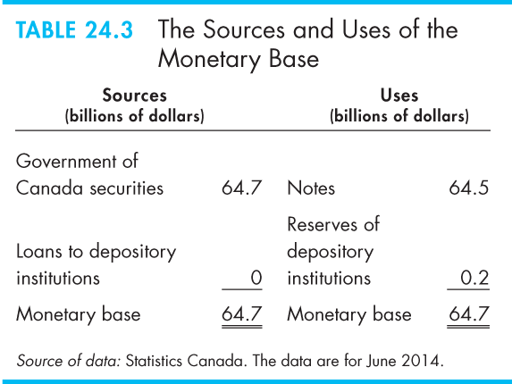
The Bank of Canada
  Table 24.3 shows the sources and uses of the monetary base in June 2014.
  The Bank of Canada’s assets are the sources of monetary base.
  The Bank of Canada’s liabilities are its uses of monetary base.

Slide 30
The Bank of Canada
  The Bank of Canada’s Policy Tools
  To achieve its objectives, the Bank uses three main policy tools:
  Open market operations
      Open Market Purchase
      Open Market Sale
  Bank rate

Slide 31
The Bank of Canada
Open Market Operations
  An open market operation is the purchase or sale of government securities by the Bank of Canada from or to a chartered bank or the public.
  When the Bank of Canada buys securities, it pays for them with newly created reserves held by the banks.
  When the Bank of Canada sells securities, they are paid for with reserves held by banks.
  So open market operations influence banks’ reserves.
  (defn on slide 16??)

Slide 32
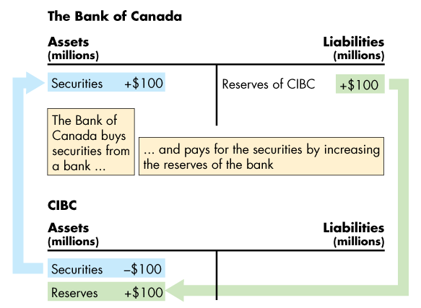
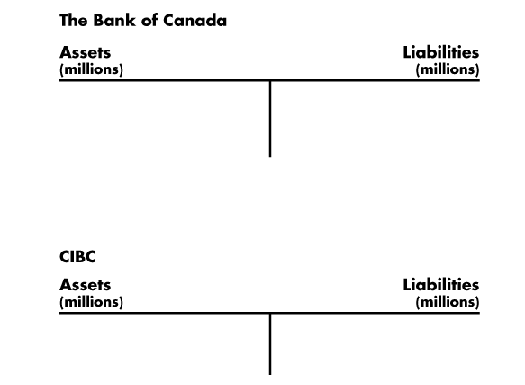
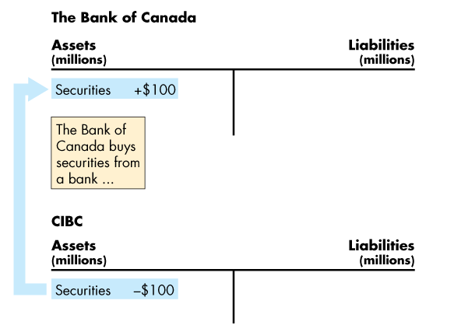
The Bank of Canada
  An Open Market Purchase
  Figure 24.2 shows the effects of an open market purchase on the balance sheets of the Bank of Canada and CIBC.
  The open market purchase increases bank reserves.

Slide 34

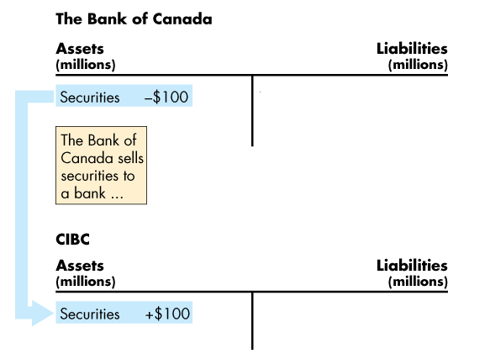
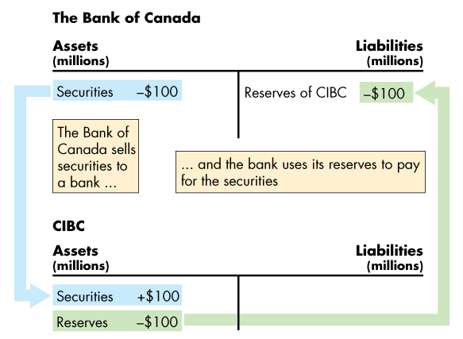
The Bank of Canada
  An Open Market Sale
  This figure shows the effects of an open market sale on the balance sheets of the Bank of Canada and CIBC.
  The open market sale decreases bank reserves.

Slide 36
The Bank of Canada
  Bank Rate
The Bank of Canada makes short-term loans, typically one-day loans, to major depository institutions when the banking system is short of reserves.
The interest rate on these loans is bank rate.
Bank rate acts as an anchor for other short-term interest rates and is closely related to the Bank’s target for the overnight loans rate.
***full discussion in Ch30

Slide 37
How Banks Create Money
Creating Deposits by Making Loans
  Banks create deposits when they make loans and the new deposits created are new money.
  The quantity of deposits that banks can create is limited by three factors:
  The monetary base (first described on slide 27)
  Desired reserves (of banks)
  Desired currency holding (of ppl and firms)

Slide 38
How Banks Create Money
The Monetary Base
  The monetary base is the sum of Bank of Canada notes, coins, and banks’ deposits at the Bank of Canada.
  The size of the monetary base limits the total quantity of money that the banking system can create because
  Banks have desired reserves
  Households and firms have desired currency holdings
  And both these desired holdings of monetary base depend on the quantity of money.

Slide 39
How Banks Create Money
Desired Reserves
  A bank’s actual reserves consists of notes and coins in its vault and its deposit at the Bank of Canada.
  The desired reserve ratio is the ratio of the bank’s reserves to total deposits that a bank plans to hold.
  The desired reserve ratio exceeds the required reserve ratio by the amount that the bank determines to be prudent for its daily business.
  (desired reserve is the money they choose to have as a proportion of the total deposit--they keep money for day-to-day business)

Slide 40
Reserve Requirements:
That portion of savings and chequeing deposits that banks are required by government regulation to set aside in order to meet the demand for withdrawals. Remaining funds are loaned out, or invested.

Slide 41
How Banks Create Money
Desired Currency Holding
  People hold some fraction of their money as currency.
  So when the total quantity of money increases, so does the quantity of currency that people plan to hold.
  Because desired currency holding increases when deposits increase, currency leaves the banks when they make loans and increase deposits.
  This leakage of reserves into currency is called the currency drain.
  The ratio of currency to deposits is the currency drain ratio.

Slide 42
Currency Drain
-An increase in currency held outside the banks
A currency drain decreases the amount of money that baks can create fro a given increase in the moneytary base because currency drains from their reserves and decreases te excess reservess available.
Currency Drain Ratio
-currency/total deposit

Slide 43
Reserves
Actual Reserves
-the notes and coins on hnad and deposits at the Bank Of Canada
Desired reserves
-the number of reserves the banks plans to hold
Desired reserve ratio
-desired reserves/total deposits
Required reserved
-the minimum amount of reserves that banks hold against deposits
Required reserve ratip
-required reserves/total deposits
Excess reservs=Actual Reserves-desired reserves

Slide 44
How Banks Create Money
The Money Creation Process
  Money creation process begins with an increase in the monetary base.
  The Bank of Canada conducts an open market operation in which it buys securities from banks.
  The Bank of Canada pays for the securities with newly created bank reserves.
  Banks now have more reserves but the same amount of deposits, so they have excess reserves.
  Excess reserves = Actual reserves – desired reserves.

Slide 45
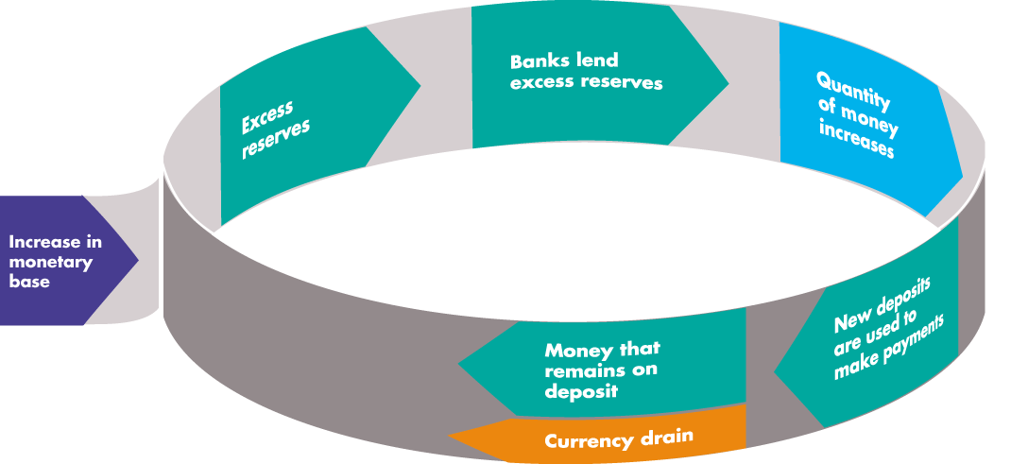
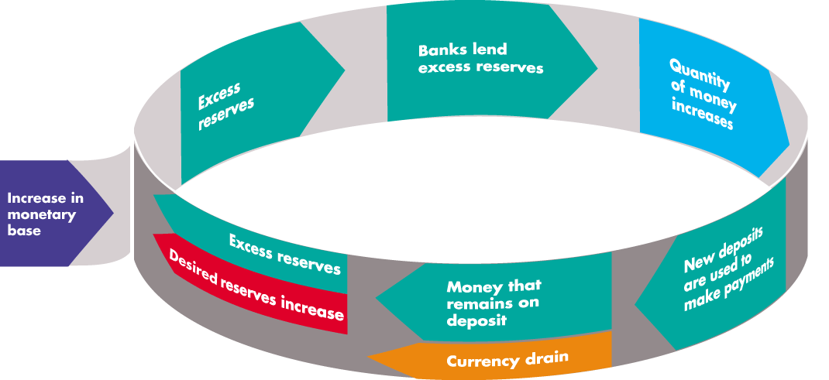
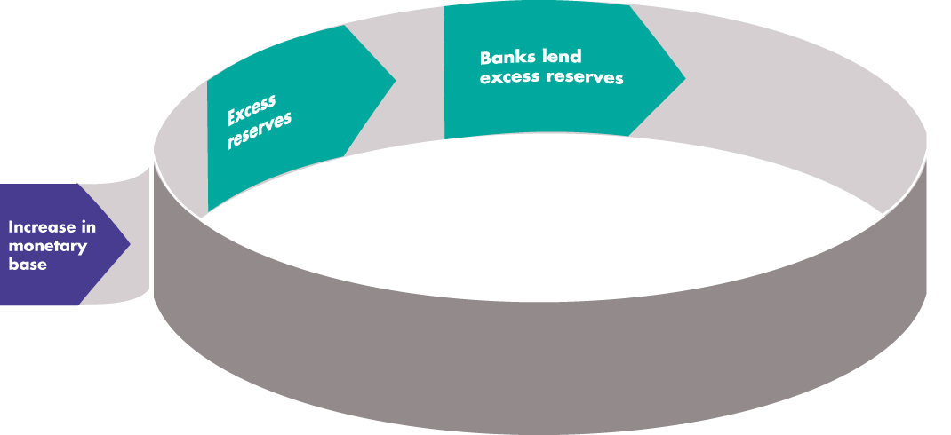
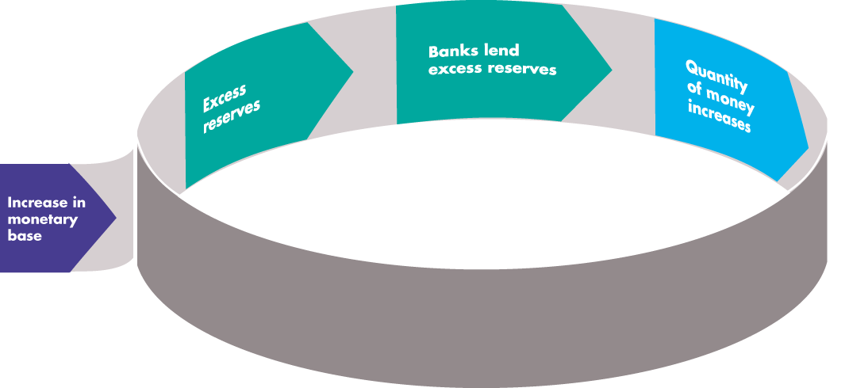
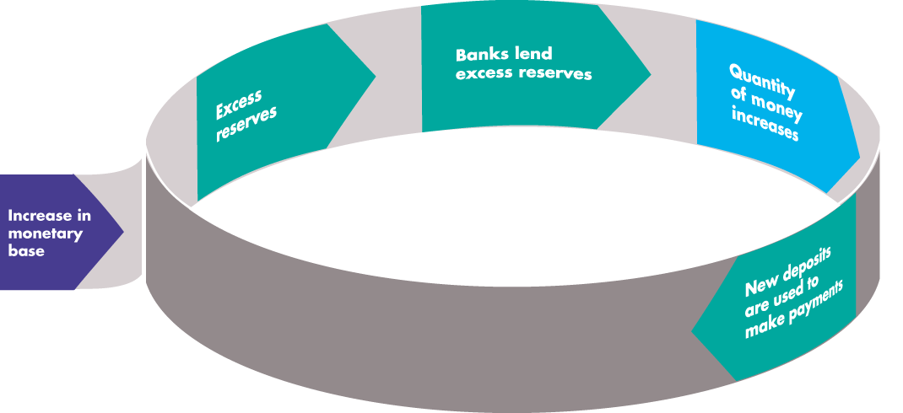
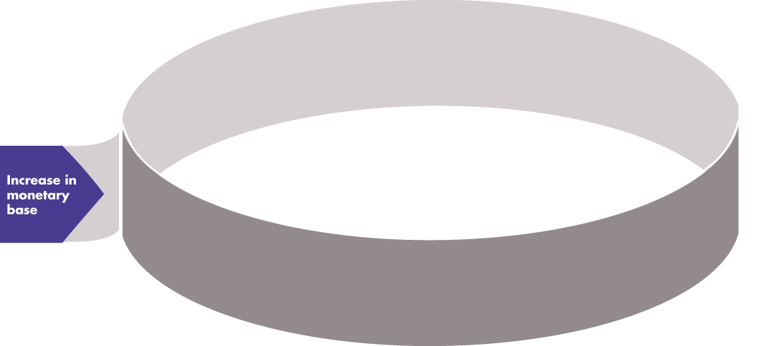
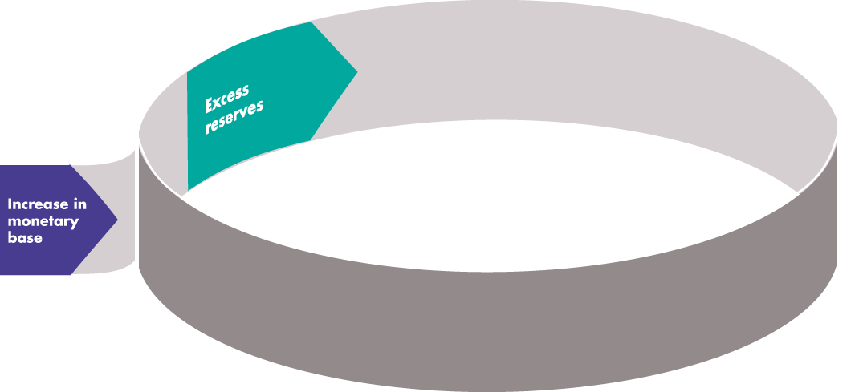
How Banks Create Money
they have excess reserves--eant to lend it out--
  Figure 24.3 illustrates one round in how the banking system creates money by making loans.

Slide 46
Finantial insitutions (chartered banks) have more money than they require
Finantial insitutions make loans with their excess reserves
START HERE
Create new deposits
OMO(open market operation) by the banks, bank buys bonds from banks
Finantial insititions may still have some excess reserves
Borrowers use the loans
Some money stays in the banking system

Slide 47
How Banks Create Money
The Money Multiplier
  The money multiplier is the ratio of the change in the quantity of money to the change in the monetary base.
  For example, if the Bank of Canada increases the monetary base by $100,000 and the quantity of money increases by $250,000, the money multiplier is 2.5.
  The quantity of money created depends on the desired reserve ratio and the currency drain ratio.
  The smaller these ratios, the larger is the money multiplier.

Slide 48
SHE LOVES DEF'N:Banking Terms
1. M1,M2
2. Liquidity
3. Reserves
4. Monetary base
5. Open market operation
6. Desired reserves, desireed reserve ratio
7. Desired currency holding
8. Currency drain, currency drain ratio
9. Excess reserves
10. Money multiplier

Slide 49
The Money Market
How much money do people want to hold?
The Influences on Money Holding
  The quantity of money that people plan to hold depends on four main factors:
  The price level [special case]
  The nominal interest rate (movement along the curve)
  Real GDP shift the curve
  Financial innovation

Slide 50
The Money Market
  The Price Level
  A rise in the price level increases the quantity of nominal money but doesn’t change the quantity of real money that people plan to hold.
  Nominal money is the amount of money measured in dollars.
  Real money equals Nominal money ÷ Price level.
  The quantity of nominal money demanded is proportional to the price level—a 10 percent rise in the price level increases the quantity of nominal money demanded by 10 percent.

Slide 51
The Money Market
  The Nominal Interest Rate
  The nominal interest rate is the opportunity cost of holding wealth in the form of money rather than an interest-bearing asset.
  A rise in the nominal interest rate on other assets decreases the quantity of real money that people plan to hold.
  Real GDP
  An increase in real GDP increases the volume of expenditure, which increases the quantity of real money that people plan to hold.

Slide 52
The Money Market
  Financial Innovation
  Financial innovation that lowers the cost of switching between money and interest-bearing assets decreases the quantity of real money that people plan to hold.
The Demand for Money
  The demand for money is the relationship between the quantity of real money demanded and the nominal interest rate when all other influences on the amount of money that people wish to hold remain the same.

Slide 53
havn't catch up

Slide 54
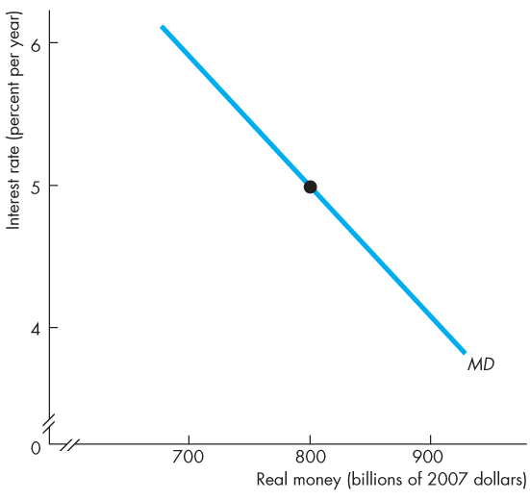
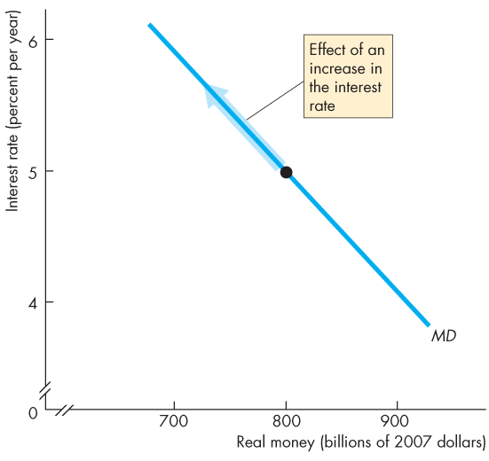
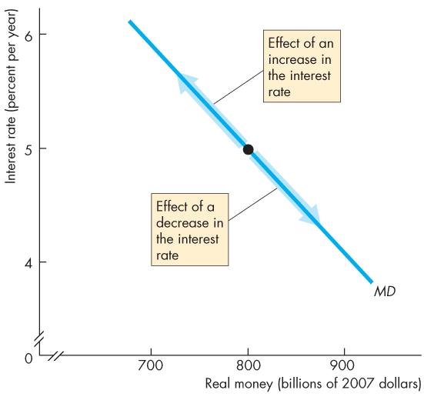
The Money Market
decreases the quantity of money demanded
  Figure 24.4 illustrates the demand for money curve.
  A rise in the interest rate brings a decrease in the quantity of real money demanded.
  A fall in the interest rate brings an increase in the quantity of real money demanded.
increases the quantity of money demanded

Slide 56
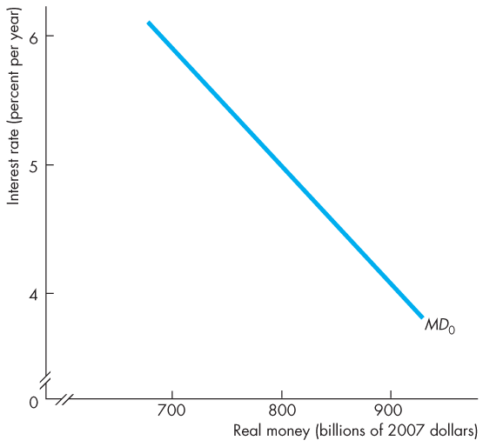
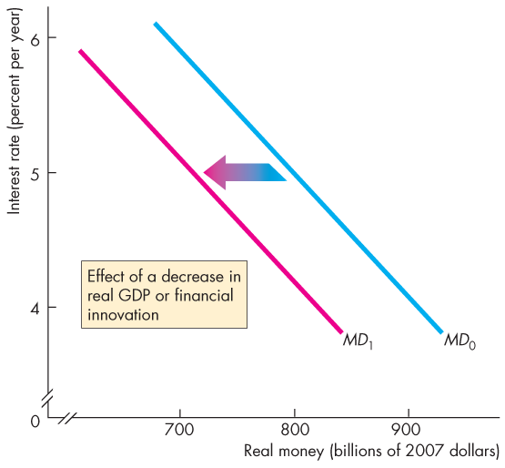
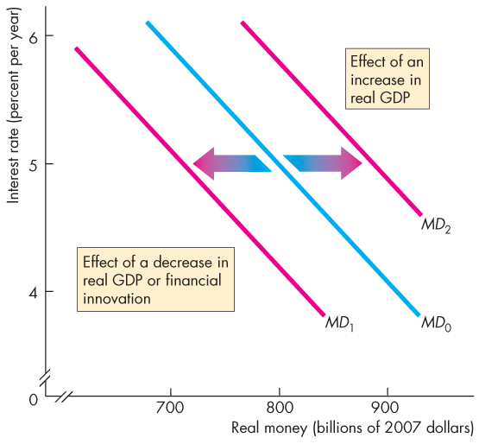
The Money Market
lower the cost for us to get the money (ATM, make it easier and you dont have to wait.)
  Shifts in the Demand for Money Curve
  Figure 24.5 shows that a decrease in real GDP or a financial innovation decreases the demand for money and shifts the demand curve leftward.
  An increase in real GDP increases the demand for money and shifts the demand curve rightward.

Slide 58
The Money Market
Money Market Equilibrium
  Money market equilibrium occurs when the quantity of money demanded equals the quantity of money supplied.
  Adjustments that occur to bring about money market equilibrium are fundamentally different in the short run and the long run.

Slide 59
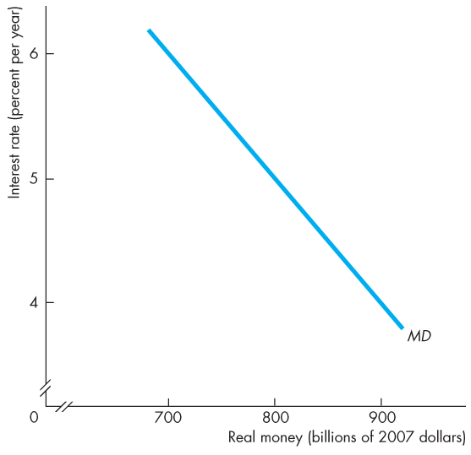
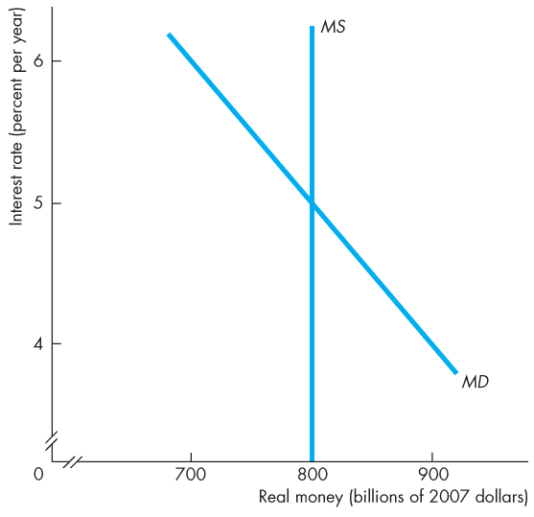
The Money Market
price level only changes in the long run
Short-Run Equilibrium
Figure 24.6 shows the demand for money.
Suppose that the Bank of Canada wants the interest rate to be 5 percent a year.
The Bank adjusts the quantity of money each day so that the quantity of real money is $800 billion.

Slide 60
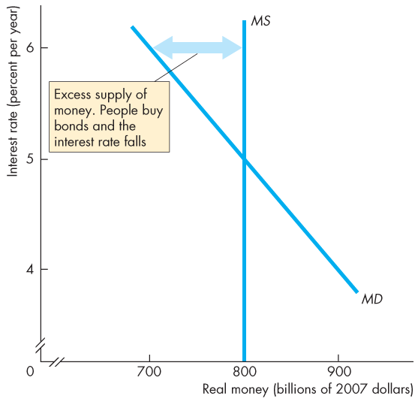
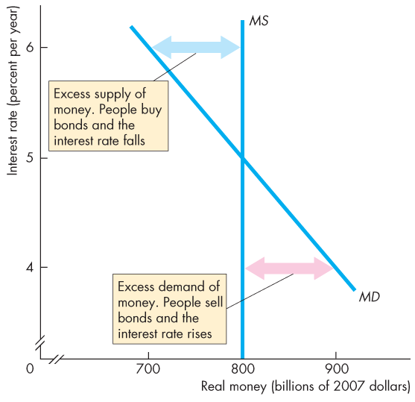


Slide 61
The Money Market
  If the interest rate exceeds the 5 percent a year, …
  the quantity of money that people are willing to hold is less than the quantity supplied. (money demand< money supply----too much liquidity) (ppl are holding excess money than they want to)
  They try to get rid of their “excess” money they are holding by buying bonds.
  This action lowers the interest rate.

Slide 62
The Money Market
  If the interest rate is below 5 percent a year, …
  the quantity of money that people want to hold exceeds the quantity supplied.(money demand > money supply)
  They try to get more money by selling bonds.(then the price will go down, and ---)
  This action raises the interest rate.

Slide 63
In the short-run
If the interest rate were higher than equilibrium, there would be more oney available than people require.
People would reallocate their potfolios and buy more financial assets, bid up the price and the interest rate would fall.
The opposite is true.
If the interest rate is below equilibrium
-->excess demand for money
--> sell bonds
--> bid down their prices
--> interest rate rises
Reminder: Interest Rate and Asset Prices--pg 546 in your text and ch23 slide 13 in your notes.

Slide 64
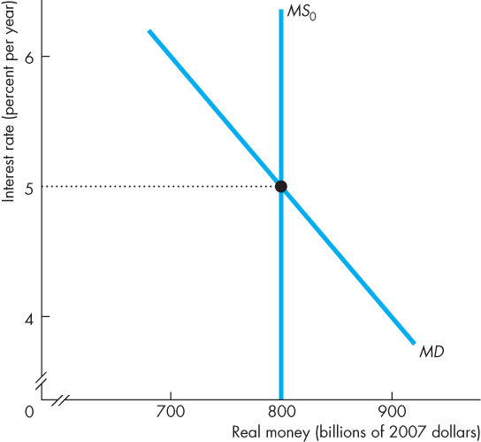
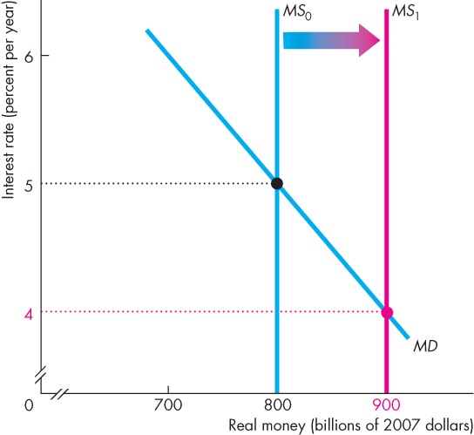
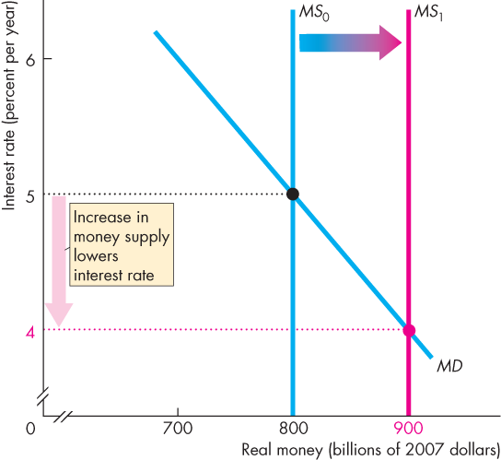
The Money Market
The Short-Run Effect of a Change in the Quantity of Money
Initially, the interest rate is
5 percent a year.
If the Bank increases the quantity of money, people will be holding more money than the quantity demanded.
So they buy some bonds.
The increased demand for bonds raises the bond price and lowers the interest rate.

Slide 65
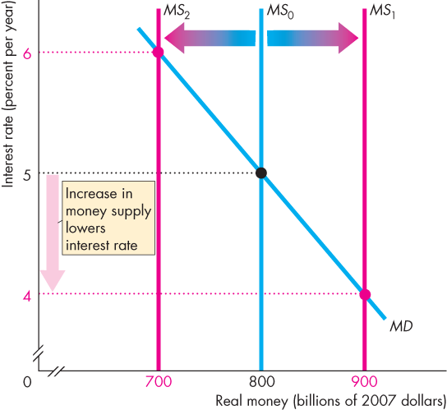
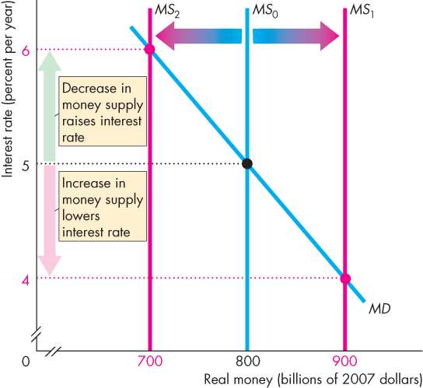

Slide 66
The Money Market
excess demand for money at 5%
Initially, the interest rate is 5 percent a year.
If the Bank decreases the quantity of money, people will be holding less money than the quantity demanded.
So they sell bonds.
The increased supply of bonds lowers the bond price and raises the interest rate.

Slide 67
The Short Run effect of changing money supply in equilibrium
Starting in quilibrium, if the Bank increses the money suppply, there is more money than people require. People will buy bonds, bid up the prices= of bonds abd the interest rate will fall.
The opposite is true.
Starting in equilibrium, if the Bank decreses the money supply
---> demand for money exceeds supply
---> sell bonds
---> bid down the price of bonds
---> the interest rate rises

Slide 68
The Money Market
Long-Run Equilibrium
In the long run, the loanable funds market determines the real interest rate.
Nominal interest rate equals the equilibrium real interest rate plus the expected inflation rate.
In the long run, real GDP equals potential GDP, so the only variable left to adjust in the long run is the price level.
--- see ch23 slide 18
--- real IR =Nominal IR - inflation rate

Slide 69
Long-run Equilibrium
When inflation is expected and real GDP=potential GDP, then all other markets are also in long-run equilibriu
- Money market deteremines the nominal interest rate.
-LOnable funds markets determines the real interesr rate
- Labour market determines the equilibrium real wage
- Goods market determiens the price level
If the BoC increases the money supply, we reach a new equilibrium in which nothing “real” has changes. Only the price level has changes.
THe Price level(P) will change by the same percentage as the change in money supply(M)

Slide 70
The Money Market
The price level adjusts to make the quantity of real money supplied equal to the quantity demanded.
If in long-run equilibrium, the Bank of Canada increases the quantity of money, the price level changes to move the money market to a new long-run equilibrium.
In the long run, nothing real has changed.
Real GDP, employment, quantity of real money, and the real interest rate are unchanged.
In the long run, the price level rises by the same percentage as the increase in the quantity of money.

Slide 71
The Money Market
The Transition from the Short Run to the Long Run
Start in full-employment equilibrium: real GDP=potential GDP
1. If the Bank of Canada increases the quantity of money by 10 percent, the nominal interest rate falls.
2. As people buy bonds, the real interest rate falls.
As the real interest rate falls, consumption expenditure and investment increase. Aggregate demand increases.
With the economy at full employment, the price level rises.

Slide 72
The Money Market
3. As the price level rises, the quantity of real money decreases, and the process begins to reverse itself.
The nominal interest rate and the real interest rate rise.
As the real interest rate rises, expenditure plans are cut back and eventually the original full-employment equilibrium is restored.
In the new long-run equilibrium, the price level has risen 10 percent but nothing real has changed.

Slide 73
Transition from shortto the long run
Stsrting in long-run equilibrium
Then, the BoC increases the quantity of money by 10%
1. Nominal interest rate decreases(SR reponse)
2. Real interese rate decreses as people reallocate therei portfolio(buy bonds)
3. When there is a decrease in interest rate, people and firms want to borrow and spend more
4. This results in an increasing demand for goods, but real GDP =potential GDP, so there are shortages
5. SHortagrs result in incresing price level
(once the price level changes, that changes the quantity of real money and you are on the way to long run??)
6. As P increases, M/P decreases (shifts left)

Slide 74
7. As the interest rate increases, spending mpans are cut back and eventually, long-run equilibrium is restore.
8. We have to gat back to the original equilibrium becuz, int he long run
NOminal IR= Real IR+ Infalation
Real IR is deteremined in the LF market
Price incerease by the same percentage as incresing MS
(did not finish copying down)

Slide 75
The Quantity Theory of Money
  The quantity theory of money is the proposition that, in the long run, an increase in the quantity of money brings an equal percentage increase in the price level.
  The quantity theory of money is based on the velocity of circulation and the equation of exchange.
  The velocity of circulation is the average number of times in a year a dollar is used to purchase goods and services in GDP.

Slide 76
The Quantity Theory of money
Definition of Velovity
V=PY/M=nominal GDP/nominal money supply
THe equation of exchange, or the quantityequation, is derived from the definition of velovity
MV=PV
Assumen velocity id constant. MV=PY
RecallL Y or real GDP, is determined by factors of production and technology.
Therefore, change in P is proportional to change in M.
P M

Slide 77
The equation of exchange expressed in growth rate terms:
% M+% V=% P+% Y
NOTE % V=0
% P=definition of the inflation rate
REWRITE solving fot the inflation rate
Meanings
in the long-run, inflation is caused by money growthin excess of what is required for grwoing economu. BUt is real GDP=potential GDP, this influence will be d=small abd is assumed to be equal to zero in theory, Therepfre, inflation is correlated the moneu grwoth rate

Slide 78
The Quantity Theory of Money
  Calling the velocity of circulation V, the price level P, real GDP Y, and the quantity of money M:
  V = PY ÷ M.
  The equation of exchange states that
  MV = PY.
  The equation of exchange becomes the quantity theory of money if M does not influence V or Y.
  So in the long run, the change in P is proportional to the change in M.
  (She replaced this with the previous slide)

Slide 79
The Quantity Theory of Money
  Expressing the equation of exchange in growth rates:
  Money growth rate + = Inflation rate + Rate of velocity change Real GDP growth
  Rearranging:
  Inflation rate = Money growth rate + Rate of velocity change − Real GDP growth
  In the long run, velocity does not change, so
  Inflation rate = Money growth rate − Real GDP growth

Slide 80
chapter ends here

Slide 81
Mathematical Note: The Money Multiplier
To see how the process of money creation works, suppose that the desired reserve ratio is 10 percent and the currency drain ratio is 50 percent of deposits.
The process starts when all banks have zero excess reserves and the Bank of Canada increases the monetary base by $100,000.
The figure in the next slide illustrates the process and keeps track of the numbers.

Slide 82
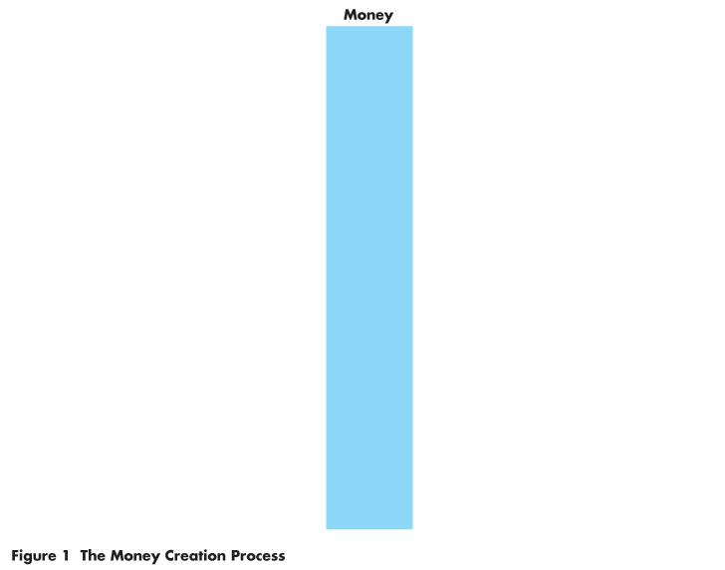
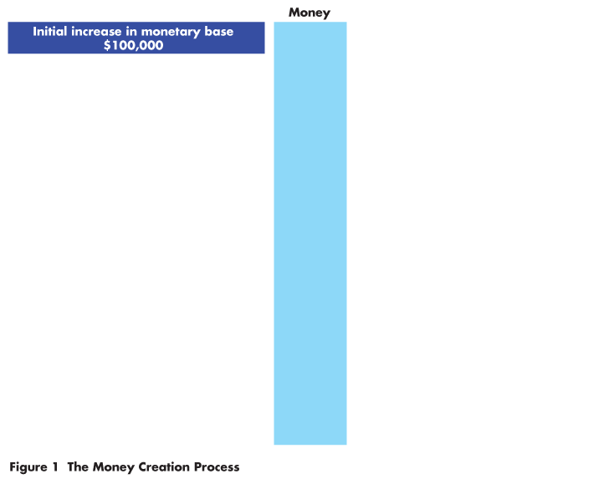
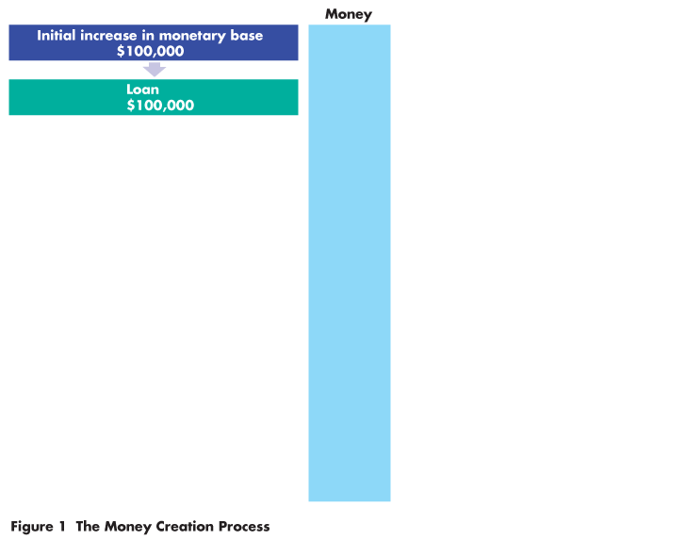
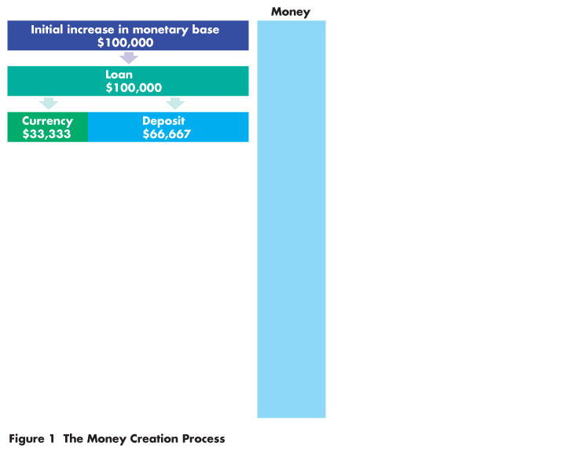
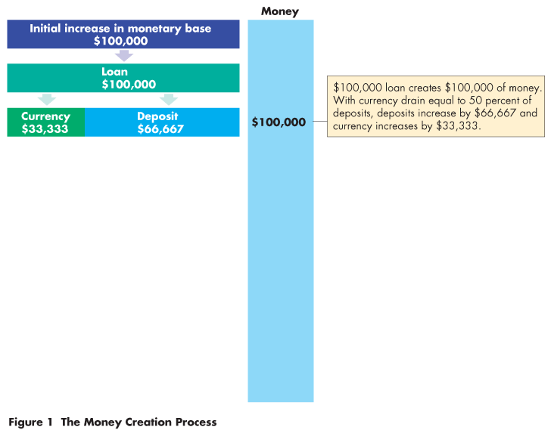
Mathematical Note: The Money Multiplier
The bank with excess reserves of $100,000 loans them.
Of the amount loaned, $33,333 drains from the bank as currency and $66,667 remains on deposit.
Currency drain is 50 percent of deposits.

Slide 83
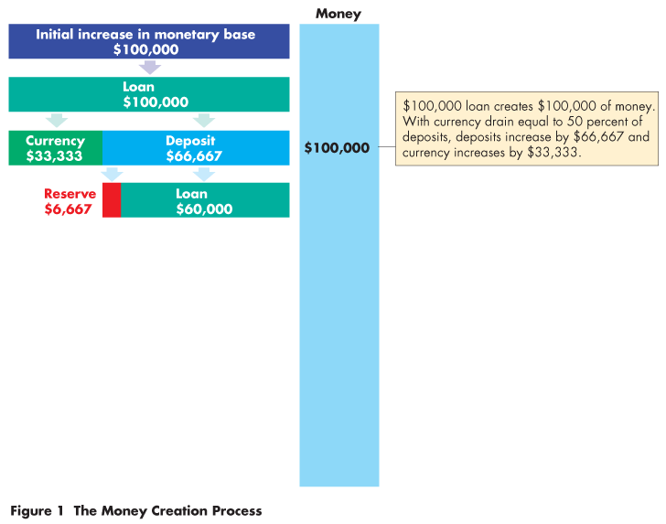
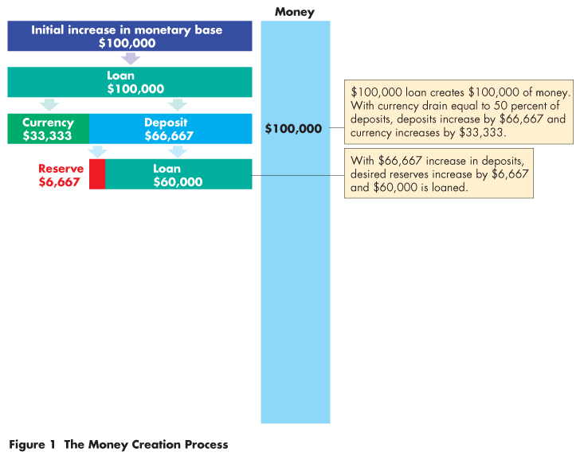
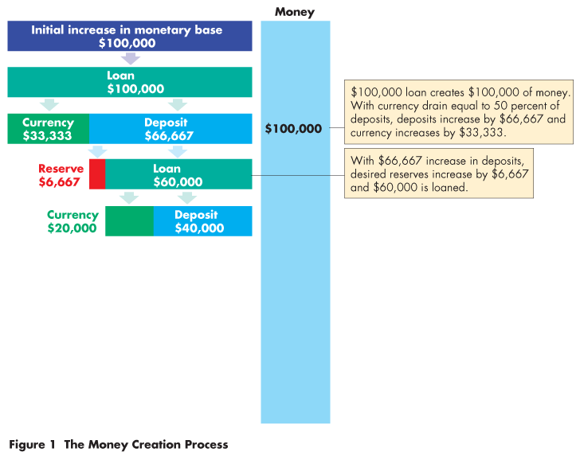
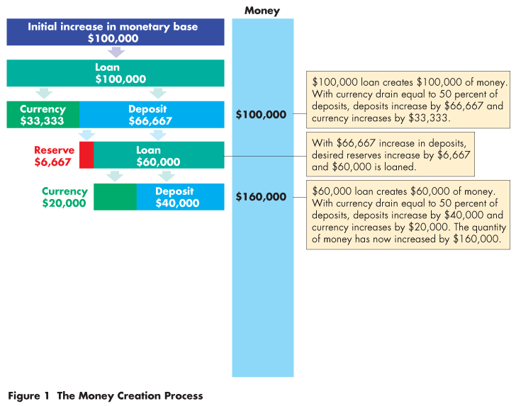

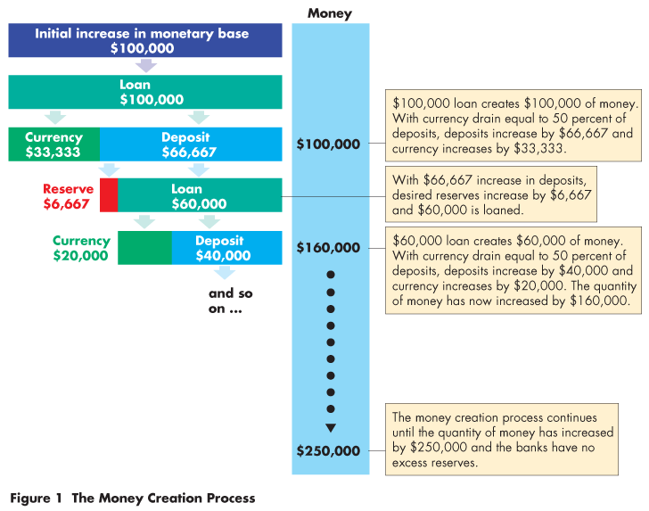

Slide 84
Mathematical Note: The Money Multiplier
The bank’s reserves and deposits have increased by $66,667,
so the bank keeps $6,667 (10 percent of deposits) as reserves and loans out $60,000.

Slide 85
Mathematical Note: The Money Multiplier
$20,000 drains off as currency and $40,000 remains on deposit.
Again, the currency drain is 50 percent of deposits.

Slide 86
Mathematical Note: The Money Multiplier
The process repeats until the banks have created enough deposits to eliminate the excess reserves.
The $100,000 increase in monetary base has created $250,000 of money.

Slide 87
Mathematical Note: The Money Multiplier
  The size of the money multiplier depends on
  The currency drain ratio (C/D)
  The desired reserve ratio (R/D)
  Money multiplier = (1 + C/D)/(C/D + R/D)
  In our example, C/D is 0.5 and R/D is 0.1, so
  Money multiplier = (1 + 0.5)/(0.1 + 0.5)
  = (1.5)/(0.6)
  = 2.5

