Slide 1


Slide 2
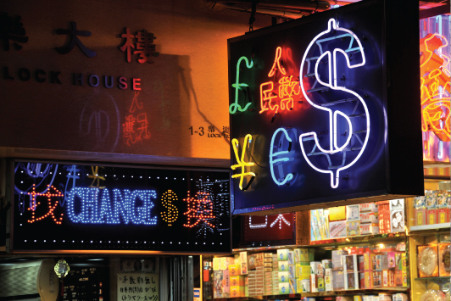
25
THE EXCHANGE RATE AND THE BALANCE OF PAYMENTS

Slide 3
After studying this chapter, you will be able to:
Explain how the exchange rate is determined
Explain the trends and fluctuations in the exchange rate
Explain the effects of alternative exchange rate policies
Explain what causes international deficits and surpluses

Slide 4
The Foreign Exchange Market
  To buy goods and services produced in another country we need money of that country.
  Foreign bank notes, coins, and bank deposits are called foreign currency.
  We get foreign currency in the foreign exchange market.

Slide 5
The Foreign Exchange Market
  Trading Currencies
  We get foreign currency and foreigners get Canadian dollars in the foreign exchange market.
  The foreign exchange market is the market in which the currency of one country is exchanged for the currency of another.

Slide 6
The Foreign Exchange Market
  Exchange Rates
  The price at which one currency exchanges for another is called a foreign exchange rate.
  A fall in the value of one currency in terms of another currency is called currency depreciation.
  A rise in value of one currency in terms of another currency is called currency appreciation.
  --These terms apply to an exchange rate which is flexible or floating.

Slide 7
The Foreign Exchange Market
  An Exchange Rate Is a Price
  An exchange rate is the price—the price of one currency in terms of another.
  Like all prices, an exchange rate is determined in a market—the foreign exchange market.
  The Canadian dollar is demanded and supplied by thousands of traders every hour of every day.
  With many traders and no restrictions, the foreign exchange market is a competitive market.

Slide 8
The Foreign Exchange Market
The Demand for One Money Is the Supply of Another Money
  When people who are holding one money want to exchange it for Canadian dollars, they demand Canadian dollars and they supply that other country’s money.
  So the factors that influence the demand for Canadian dollars also influence the supply of Canadian dollars, E.U. euros, U.K. pounds, and Japanese yen.
  And the factors that influence the demand for another country’s money also influence the supply of Canadian dollars.

Slide 9
The Foreign Exchange Market
Demand in the Foreign Exchange Market
  The quantity of Canadian dollars that traders plan to buy in the foreign exchange market during a given period depends on
  1. The exchange rate (movement along the curve)
  2. World demand for Canadian exports
  3. Interest rates in the United States and other countries
  4. The expected future exchange rate
  (2-4) shifts the curve

Slide 10
The Foreign Exchange Market
The Law of Demand for Foreign Exchange
  The demand for dollars is a derived demand.
  People buy Canadian dollars so that they can buy Canadian-produced goods and services or Canadian assets. And canadian people buy US dollars because they want ot buy US goods and services.
  Other things remaining the same, the higher the exchange rate, the smaller is the quantity of Canadian dollars demanded in the foreign exchange market.
  ex. 1 cad = 0.95 usd (high) 1 cad = 0.77 usd (low)
  --->1 usd = 1.05 cad --->1 usd = 1.30 cad

Slide 11
The Foreign Exchange Market
  The exchange rate influences the quantity of Canadian dollars demanded for two reasons:
  Exports effect
  Expected profit effect
  Exports Effect
  The larger the value of Canadian exports, the greater is the quantity of Canadian dollars demanded on the foreign exchange market.
  The lower the exchange rate, the greater is the value of Canadian exports, so the greater is the quantity of Canadian dollars demanded.

Slide 12
The Foreign Exchange Market
  Expected Profit Effect
  The larger the expected profit from holding Canadian dollars, the greater is the quantity of Canadian dollars demanded today.
  But expected profit depends on the exchange rate.
  The lower today’s exchange rate, other things remaining the same, the larger is the expected profit from buying Canadian dollars and the greater is the quantity of Canadian dollars demanded today.

Slide 13
Expected Profit Effect
If a person can buy s Canadian dollar for say, $0.77 USD today, they will so do if they expect the price to increase.
If the exchange rate rises to, day, $0.95 USD, they can sell the Canadian dollar and make a profit.

Slide 14
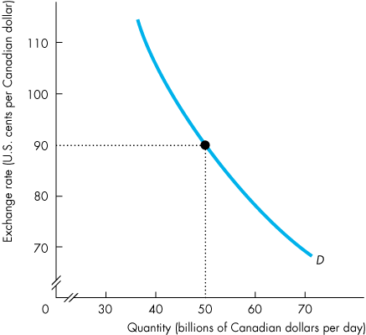
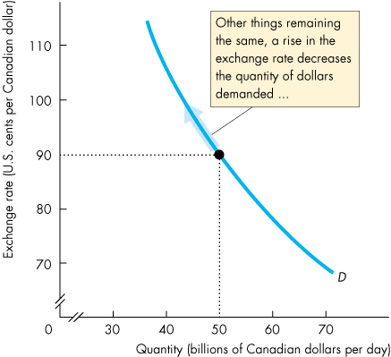
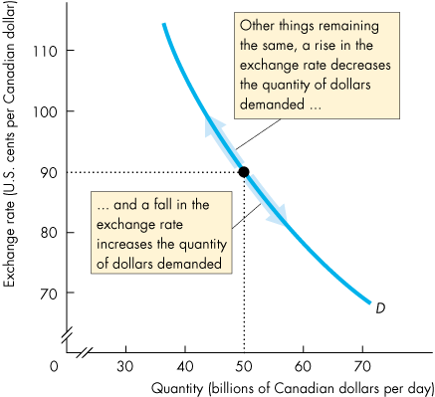
The Foreign Exchange Market
  The Demand Curve for Canadian Dollars
  Figure 25.1 illustrates the demand curve for Canadian dollars on the foreign exchange market.
  BE CAREFUL:
  the y-axis: US cents per Canadian dollars
  the x-axis: Canadian dollars
Demand for CAD

Slide 16
The Foreign Exchange Market
Supply in the Foreign Exchange Market
  The quantity of Canadian dollars supplied in the foreign exchange market is the amount that traders plan to sell during a given time period at a given exchange rate.
  This quantity depends on many factors but the main ones are
  1. The exchange rate --(movement along the curve)
  2. Canadian demand for imports
  3. Interest rates in Canada and other countries
  4. The expected future exchange rate
  ---(2-4, shifts the curve)

Slide 17
The Foreign Exchange Market
compare to slide 11
The Law of Supply of Foreign Exchange
  Other things remaining the same, the higher the exchange rate, the greater is the quantity of Canadian dollars supplied in the foreign exchange market.
  The exchange rate influences the quantity of Canadian dollars supplied for two reasons:
  Imports effect
  Expected profit effect

Slide 18
The Foreign Exchange Market
  Imports Effect
  The larger the value of Canadian imports, the larger is the quantity of Canadian dollars supplied on the foreign exchange market.
  The higher the exchange rate, the greater is the value of Canadian imports, so the greater is the quantity of Canadian dollars supplied.

Slide 19
The Foreign Exchange Market
  Expected Profit Effect
  For a given expected future Canadian dollar exchange rate, the lower the current exchange rate, …
  the greater is the expected profit from holding Canadian dollars, and the smaller is the quantity of Canadian dollars supplied on the foreign exchange market.

Slide 20
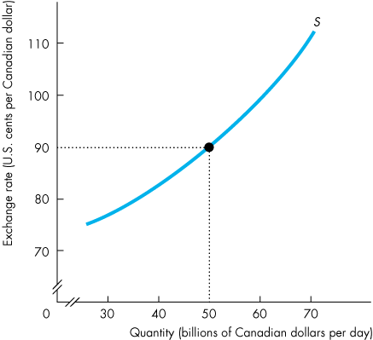
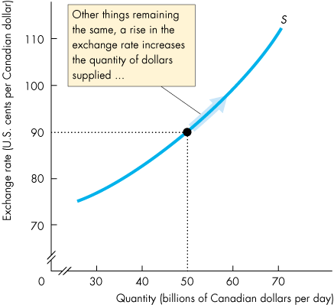
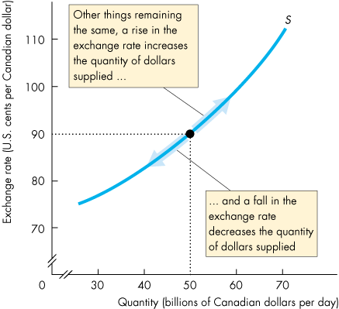
The Foreign Exchange Market
Supply of CAD
  Supply Curve for Canadian dollars
  Figure 25.2 illustrates the supply curve of Canadian dollars in the foreign exchange market.

Slide 22
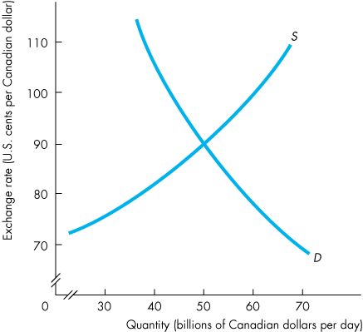
The Foreign Exchange Market
  supply of CAD > demand of CAD
Market Equilibrium
  Figure 25.3 shows how demand and supply in the foreign exchange market determine the exchange rate.
  supply of CAD < demand of CAD

Slide 23
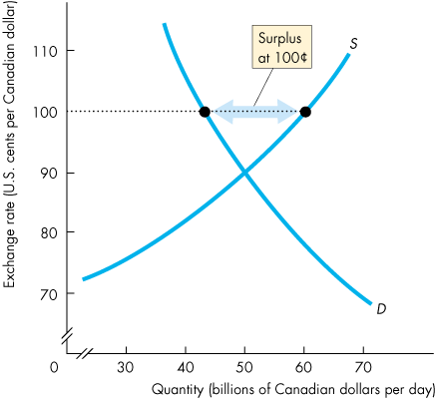
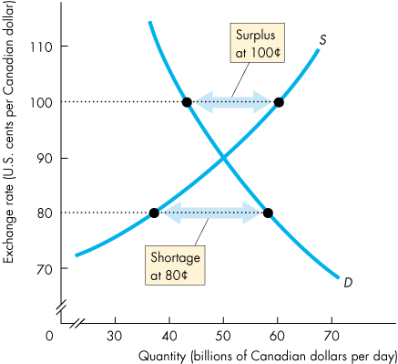
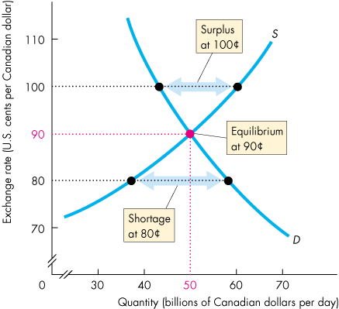
The Foreign Exchange Market
  If the exchange rate is too high, a surplus of Canadian dollars drives it down. Nobody wants to buy it whent the rate is high
  If the exchange rate is too low, a shortage of Canadian dollars drives it up. A lot of ppl want to buy,so ther is not enough
  The market is pulled (quickly) to the equilibrium exchange rate at which there is neither a shortage nor a surplus.

Slide 25
Exchange Rate Fluctuations
relate to the list from slide 10
Changes in the Demand for Canadian dollars
  A change in any influence on the quantity of Canadian dollars that people plan to buy, other than the exchange rate, brings a change in the demand for Canadian dollars.
  These other influences are
  World demand for Canadian exports
  Canadian interest rate relative to the foreign interest rate
  The expected future exchange rate

Slide 26
Exchange Rate Fluctuations
What will shift the demand curve?
  1. World Demand for Canadian Exports
  At a given exchange rate, if world demand for Canadian exports increases, the demand for Canadian dollars increases.
  2. Canadian Interest Rate Relative to the Foreign Interest Rate
  The Canadian interest rate minus the foreign interest rate is called the Canadian interest rate differential.
  If the Canadian interest differential rises, the demand for Canadian dollars increases.

Slide 27
Canadian Interest Rate Differential
Remember, financial capital flows to the highest return
If people want to buy Canadian assets, the demand for Canadian dollars will go up.
(Assets are different from goods and services, one example will be the Canadian bond. If foreign investors want to invest on Canadian bond, they need to buy Canadian dollars.)

Slide 28
Exchange Rate Fluctuations
  3. The Expected Future Exchange Rate
  At a given current exchange rate, if the expected future exchange rate for Canadian dollars rises, …
  the demand for Canadian dollars increases and the demand curve for Canadian dollars shifts rightward.
  People will buy Canadian dollars now, cheaply, and hold them until the exchange rate rises. Then, they can sell them at a profit.

Slide 29

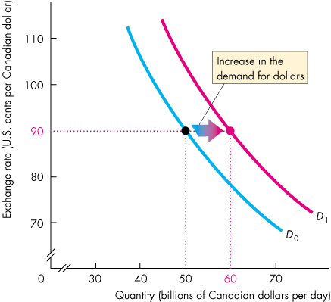
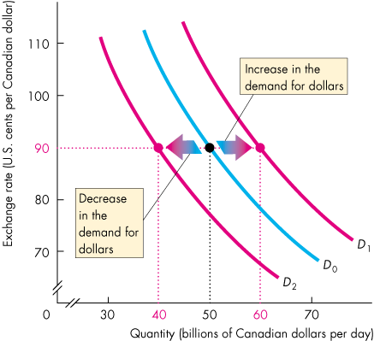
Exchange Rate Fluctuations
  Figure 25.4 shows how the demand curve for Canadian dollars shifts in response to changes in
  Canadian exports
  The Canadian interest rate differential
  The expected future exchange rate
shift right
Note:
at a given exchange rate
shift left

Slide 31
Exchange Rate Fluctuations
What will shift the supply curve?
Changes in the Supply of Canadian Dollars
  A change in any influence on the quantity of Canadian dollars that people plan to sell, other than the exchange rate, brings a change in the supply of dollars.
  These other influences are
  1. Canadian demand for imports
  2. Canadian interest rates relative to the foreign interest rate
  3. The expected future exchange rate

Slide 32
Exchange Rate Fluctuations
  1. Canadian Demand for Imports
  At a given exchange rate, if the Canadian demand for imports increases, the supply of Canadian dollars on the foreign exchange market increases and the supply curve of Canadian dollars shifts rightward.
  2. Canadian Interest Rate Relative to the Foreign Interest Rate
  If the Canadian interest differential rises, the supply for Canadian dollars decreases and the supply curve of Canadian dollars shifts leftward.

Slide 33
Exchange Rate Fluctuations
  The Expected Future Exchange Rate
  At a given current exchange rate, if the expected future exchange rate for Canadian dollars rises, …
  the supply of Canadian dollars decreases and the demand curve for dollars shifts leftward.

Slide 34

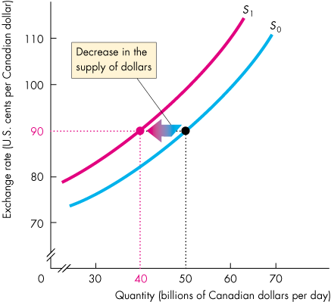
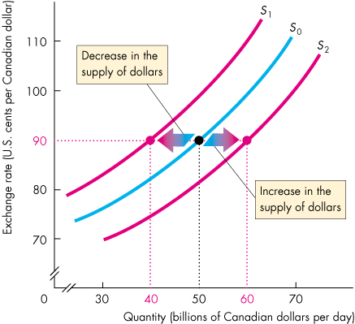
Exchange Rate Fluctuations
  Figure 25.5 shows how the supply curve of Canadian dollars shifts in response to changes in
  Canadian demand for imports
  The Canadian interest rate differential
  The expected future exchange rate
Note: at a given exchange rate

Slide 36
Exchange Rate Fluctuations
Changes in the Exchange Rate
  If demand for Canadian dollars increases and supply does not change, the exchange rate rises.
  If demand for Canadian dollars decreases and supply does not change, the exchange rate falls.
  If supply of Canadian dollars increases and demand does not change, the exchange rate falls.
  If supply of Canadian dollars decreases and demand does not change, the exchange rate rises.

Slide 38
Arbitrage, Speculation, and Market Fundamentals
  The Real Exchange Rate
  The real exchange rate is the relative price of
  Canadian-produced goods and services to foreign-produced goods and services.
  It measures the quantity of real GDP of other countries that a unit of Canadian real GDP buys.
  The equation that links the nominal exchange rate (E) and real exchange rate (RER) is
  RER = (E x P)/P*
  where P is the Canadian price level and P* is the Japanese price level.

Slide 39
Arbitrage, Speculation, and Market Fundamentals
  If both countries produce identical goods, then the price levels expressed in the same currency would be the same and RER would equal 1.
  In reality, countries produce different bundles of goods and the forces of demand and supply on goods markets determine P and P* and the real exchange rate equals
  RER = (E x P)/P*.
  So, if the nominal exchange rate changes, P and P* do not change and the change in E brings an equivalent change in RER.

Slide 40
Arbitrage, Speculation, and Market Fundamentals
  Price Levels and Money
  In the long run, RER is determined by the real forces of demand and supply in the markets for goods and services.
  So in the long run, E is determined by RER and the price levels. That is,
  E = RER x (P*/P).
  In the long run, the quantity of money in each country determines the price level in that country.
  For a given real exchange rate, a change in the quantity of money brings a change in the price level and a change in the exchange rate.

Slide 41
Exchange Rate Policy
Three possible exchange rate policies are
Flexible exchange rate
Fixed exchange rate
Crawling peg
Flexible Exchange Rate
A flexible exchange rate policy is one that permits the exchange rate to be determined by demand and supply with no direct intervention in the foreign exchange market by the central bank.

Slide 42
Exchange Rate Policy
Fixed Exchange Rate
A fixed exchange rate policy is one that pegs the exchange rate at a value decided by the government or central bank and is achieved by direct intervention in the foreign exchange market to block unregulated forces of demand and supply.
A fixed exchange rate requires active intervention in the foreign exchange market.

Slide 43
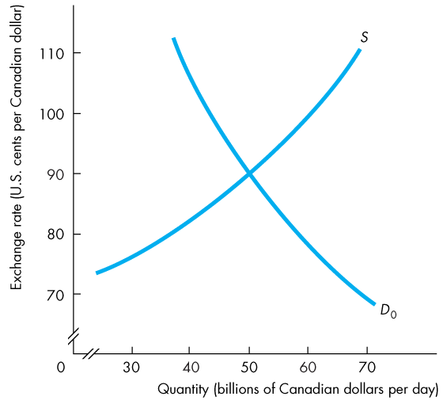
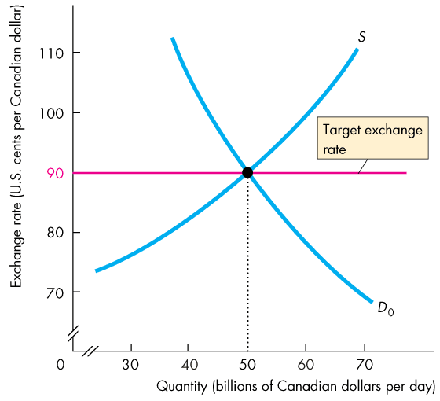
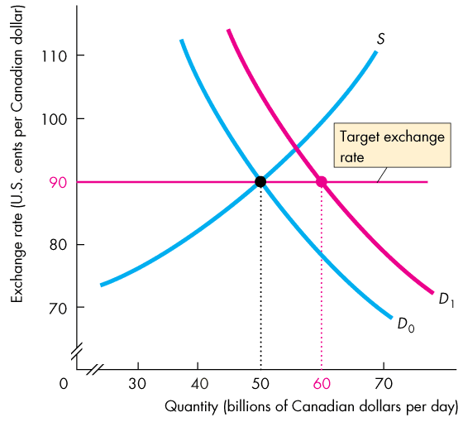
Exchange Rate Policy
  Figure 25.6 shows how the Bank of Canada can intervene in the foreign exchange market.
  Suppose that the target is 90 US cents per Canadian dollar.
  If the demand for Canadian dollars increases, the Bank sells Canadian dollars to increase supply.

Slide 44
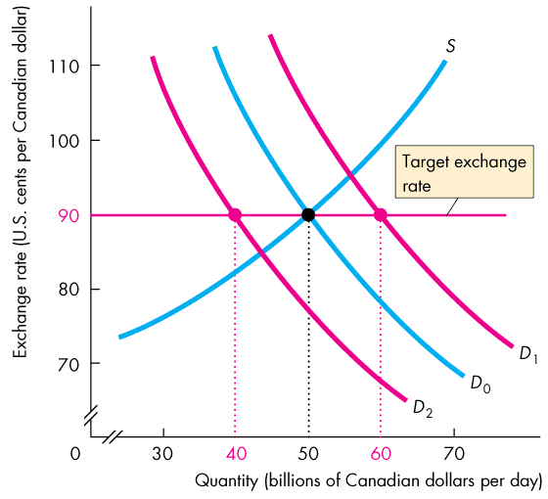

Slide 45
Exchange Rate Policy
  If demand for Canadian dollars decreases, the Bank of Canada buys Canadian dollars to decrease supply.
  Persistent intervention on one side of the foreign exchange market cannot be sustained.

Slide 46
Exchange Rate Policy
Crawling Peg
A crawling peg is an exchange rate that follows a path determined by a decision of the government or the central bank and is achieved by active intervention in the market.
China is a country that operates a crawling peg.
A crawling peg works like a fixed exchange rate except that the target value changes.
The idea behind a crawling peg is to avoid wild swings in the exchange rate that might happen if expectations became volatile and to avoid the problem of running out of reserves, which can happen with a fixed exchange rate.

Slide 47
Financing International Trade
  We’ve seen how the exchange rate is determined, but what is the effect of the exchange rate?
  How does currency appreciation or depreciation influence Canadian international trade?
  We record international transactions in the balance of payments accounts.

Slide 48
Financing International Trade
Balance of Payments Accounts
  A country’s balance of payments accounts records its international trading, borrowing, and lending.
  There are three balance of payments accounts:
  1. Current account
  2. Capital and financial account
  3. Official settlements account

Slide 49
Financing International Trade
  The current account records
  receipts from exports of goods and services sold abroad,
  payments for imports of goods and services from abroad,
  net interest paid abroad, and
  net transfers (such as foreign aid payments).
  The current accounts balance = exports − imports + net interest income + net transfers.

Slide 50
Financing International Trade
  The capital and financial account records foreign investment in Canada minus Canadian investment abroad.
  The official settlements account records the change in Canadian official reserves.
  Canadian official reserves are the government’s holdings of foreign currency.
  If Canadian official reserves increase, the official settlements account is negative.
  The sum of the balances of the three accounts always equals zero.

Slide 51
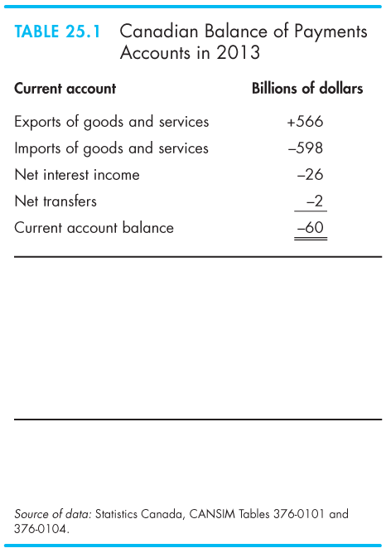
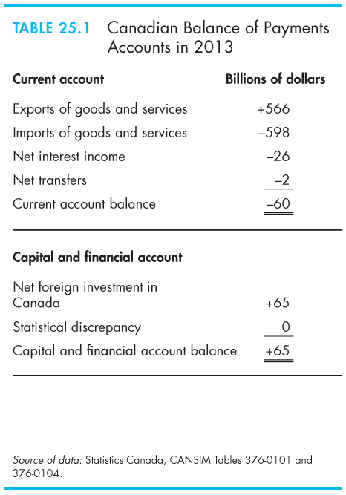
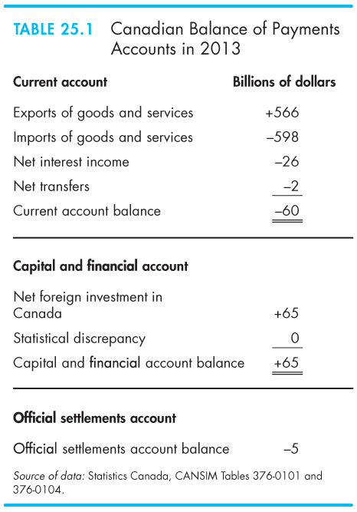

Slide 52
Financing International Trade
Borrowers and Lenders
  A country that is borrowing more from the rest of the world than it is lending to it is called a net borrower.
  A country that is lending more to the rest of the world than it is borrowing from it is called a net lender.
  In 2009 and 2010, Canada was a net borrower, but between 1999 and 2009, Canada was a net lender.
  Through most of the 1980s and 1990s, Canada was a net borrower from the rest of the world.

Slide 53
Financing International Trade
  The Global Loanable Funds Market
  The loanable funds market is global, not national.
  Lenders want to earn the highest possible real interest rate and they will seek it by looking around the world.
  Borrowers want to pay the lowest possible real interest rate and they will seek it by looking around the world.
  Financial capital is mobile: It moves to the best advantage of lenders and borrowers.

Slide 54
Financing International Trade
  Because lenders are free to seek the highest real interest rate and borrowers are free to seek the lowest real interest rate, the loanable funds market is a single, integrated, global market.
  Funds flow into the country in which the real interest rate is highest and out of the country in which the real interest rate is lowest.

Slide 55
Financing International Trade
  A country’s loanable funds market connects with the global market through net exports.
  If a country’s net exports are negative, the rest of the world supplies funds to that country and the quantity of loanable funds in that country is greater than national saving.
  If a country’s net exports are positive, the country is a net supplier of funds to the rest of the world and the quantity of loanable funds in that country is less than national saving.

Slide 56
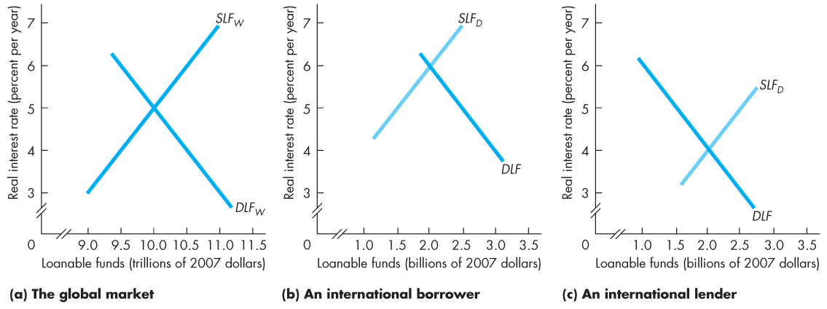
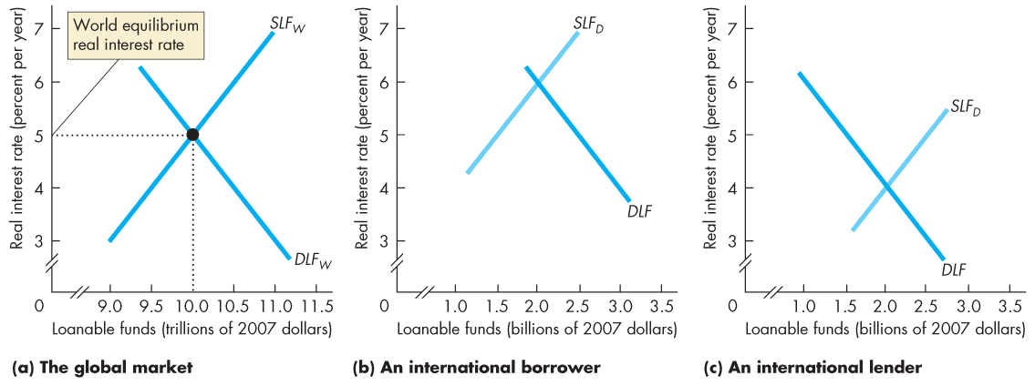
Financing International Trade
  Figure 25.7(a) illustrates the global market.
  The world equilibrium real interest rate is 5 percent a year.

Slide 57
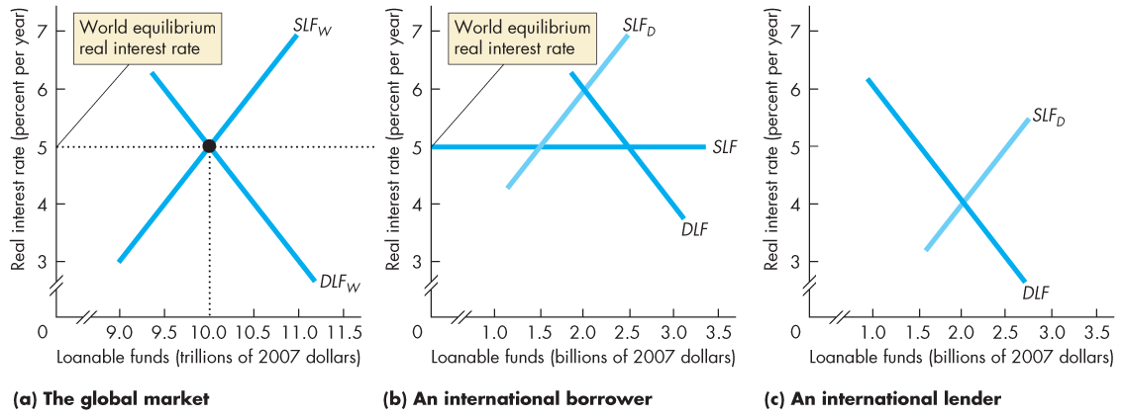
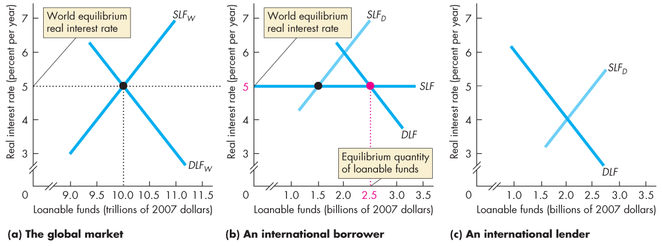
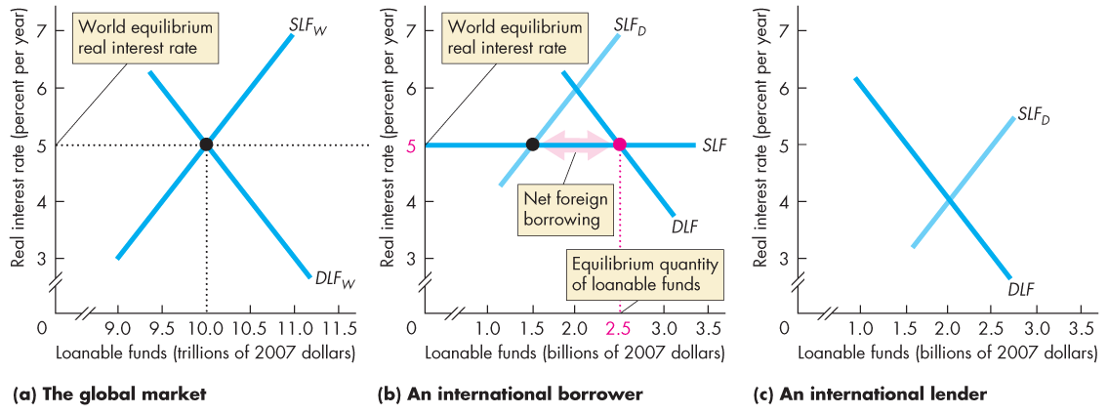
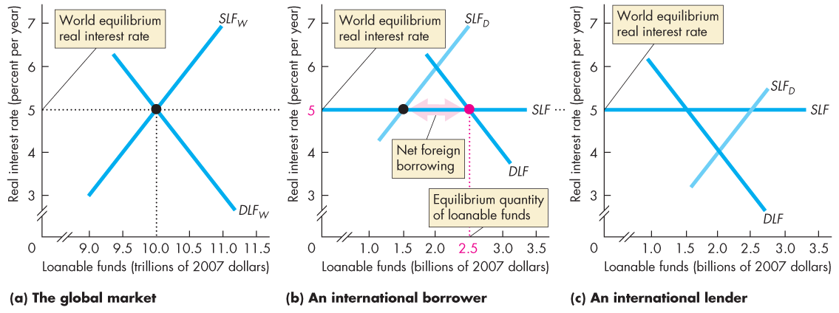
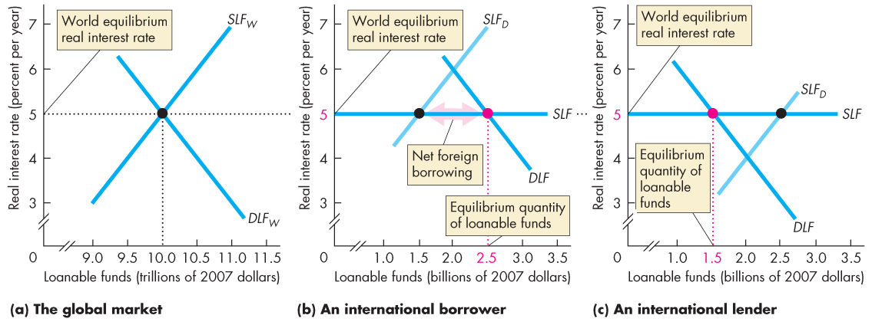
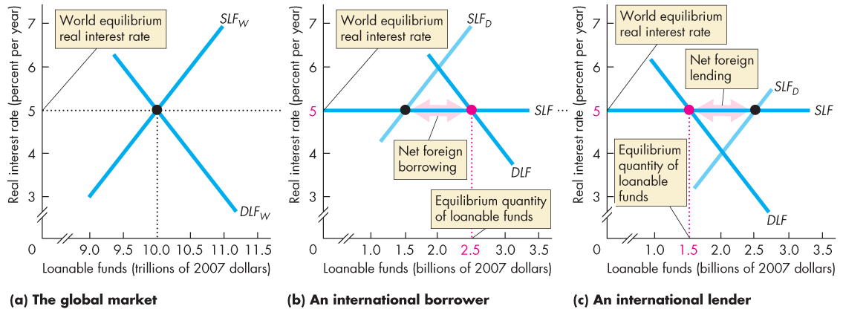

Slide 58
Financing International Trade
  In part (b), at the world real interest rate, borrowers want more funds than the quantity supplied by domestic lenders.
  The shortage of funds is made up by international borrowing.

Slide 59
Financing International Trade
  In part (c), at the world real interest rate, the quantity supplied by domestic lenders exceeds what domestic borrowers want.
  The excess quantity supplied goes to foreign borrowers.

Slide 60
Financing International Trade
  Debtors and Creditors
  A debtor nation is a country that during its entire history has borrowed more from the rest of the world than it has lent to it.
  Canada is a debtor nation, but the United States is the world’s largest debtor nation.
  A creditor nation is a country that has invested more in the rest of the world than other countries have invested in it.
  The difference between being a borrower/lender nation and being a creditor/debtor nation is the difference between stocks and flows of financial capital.

Slide 61
Financing International Trade
  Being a net borrower is not a problem provided the borrowed funds are used to finance capital accumulation that increases income.
  Being a net borrower is a problem if the borrowed funds are used to finance consumption.

Slide 62
Financing International Trade
Current Account Balance
  The current account balance (CAB) is
  CAB = NX + Net interest income + Net transfers
  The main item in the current account balance is net exports (NX).
  The other two items are much smaller and don’t fluctuate much.

Slide 63
Financing International Trade
  The government sector surplus or deficit is equal to net taxes, T, minus government expenditure on goods and services G.
  The private sector surplus or deficit is saving, S, minus investment, I.
  Net exports is equal to the sum of government sector balance and private sector balance:
  NX = (T – G) + (S – I)

Slide 64
Financing International Trade
  For Canada in 2013,
  Net exports were – $32 billion.
  Government sector balance was – $57 billion
  Private sector balance was $25 billion
  Net exports equals the sum of the government sector balance and the private sector balance.

Slide 65
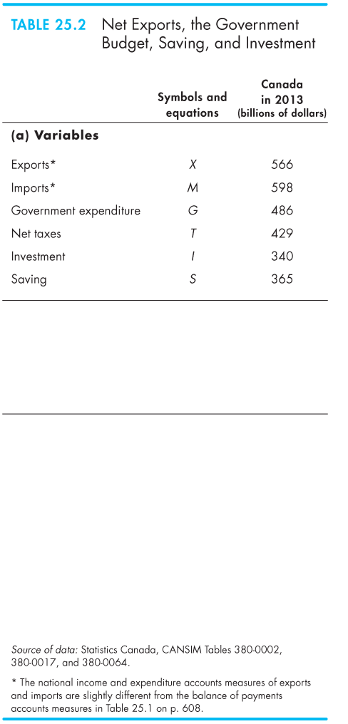
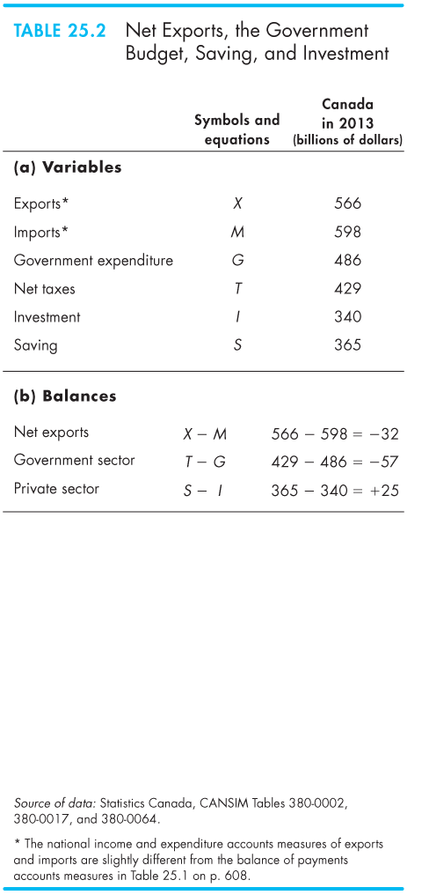
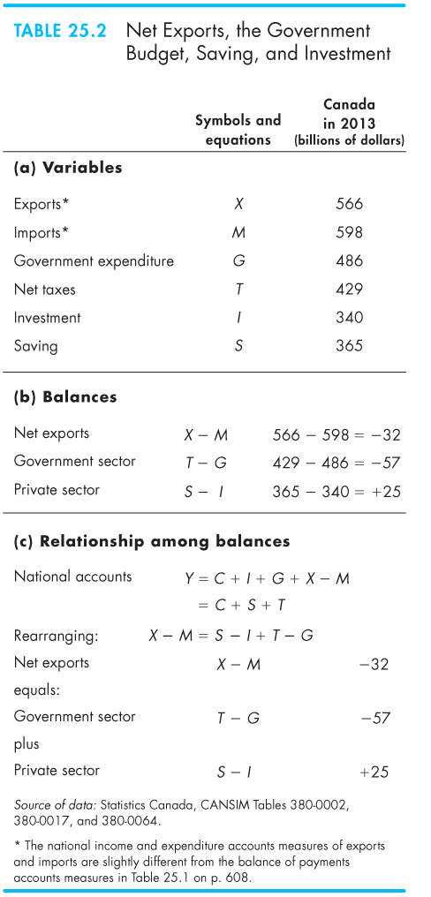

Slide 66
Financing International Trade
  Where is the Exchange Rate?
  In the short run, a fall in the nominal exchange rate lowers the real exchange rate, which makes our imports more costly and our exports more competitive.
  So in the short run, fall in the nominal exchange rate decreases the current account deficit.
  But in the long run, a change in the nominal exchange rate leaves the real exchange rate unchanged.
  So in the long run, the nominal exchange rate plays no role in influencing the current account balance.

