Slide 1
Predicting Fatal Heart Disease Using ML Models
Team 7b
Antonio Moral, Roozbeh Jafari, Xiang Zhou, Lai Zhang, Kai Guo

Slide 2

Heart failure: A major problem worldwide
Approximately:
17.9 million
People globally die each year from CVD
Approximately:
85%
Of these deaths are due to heart disease and stroke
Notes:
RJ
Explain which datasets we chose
Explain why we chose them
Explain what we wanted to achieve through this project.
Sources:
https://www.cdc.gov/heartdisease/facts.htm
https://www.who.int/news-room/fact-sheets/detail/cardiovascular-diseases-(cvds)

Slide 3
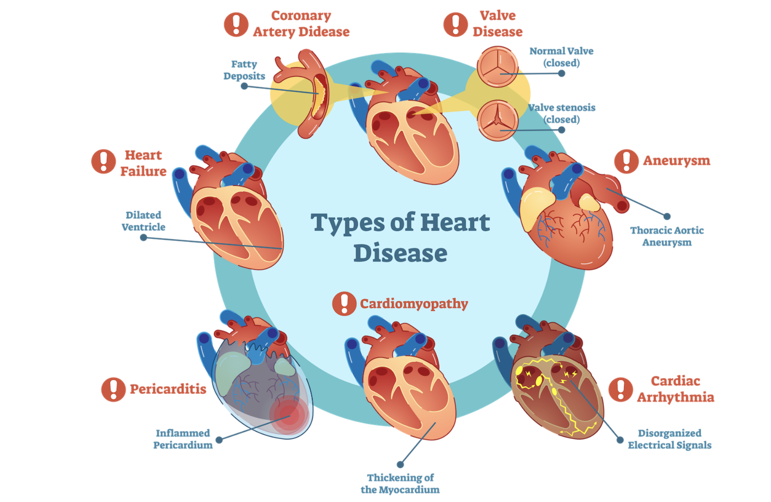
Abstract
Background
Methods
Results
Conclusions
Number 1 cause of death globally
31% of all deaths worldwide
EDA
Visualization
Three ML Models
Deducted-feature models
More accurate predictions
New supporting tool for physicians
Focus mainly on serum creatinine and ejection fraction.

Slide 4
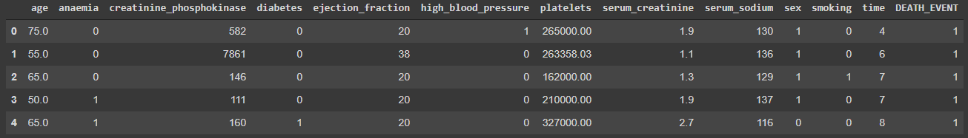
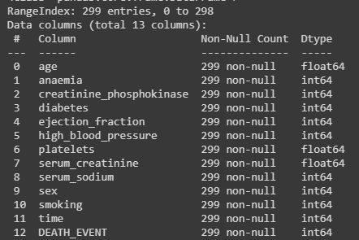
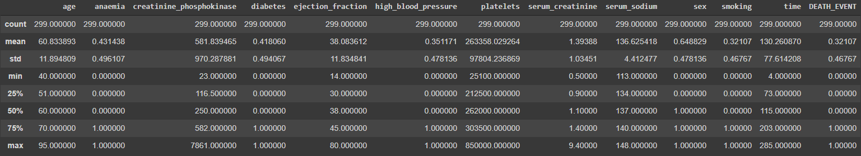
What data to analyze?
We chose the Heart Failure Clinical Records Dataset.
Notes:
As mentioned above, we chose Heart Failure Clinical Records Dataset as our dataset. In this dataset, there are 299 patients, and each row represents each patient’s information. Also there are 13 key features such as age and sex that contributed to heart failure
The following heatmap shows the correlation between each factors

Slide 5
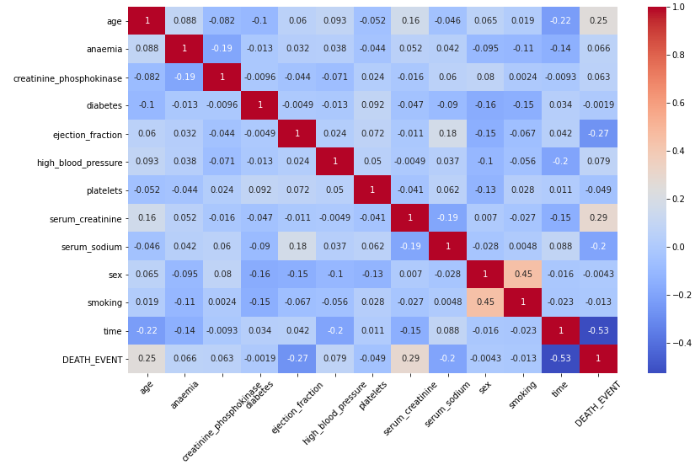
Correlation of Features
Notes:
Each square shows the correlation between the features on each axis. Correlation ranges from -1 to +1. Values closer to zero means there is no linear trend between the two features. The close to 1 the correlation is the more positively correlated they are; that is as one increases so does the other and the closer to 1 the stronger this relationship is. A correlation closer to -1 is similar, but instead of both increasing one variable will decrease as the other increases. The diagonals are all 1, dark red because those squares are correlating each variable to itself (so it's a perfect correlation). For the rest the larger the number and darker the color the higher the correlation between the two variables. The plot is also symmetrical about the diagonal since the same two variables are being paired together in those squares.
The higher the correlation coefficient means these two features are more dependent to each other
This will shows us which attribute pairs we should focus on more deeply later in the notebook.
Time, creatinine level, ejection fraction and age are mostly correlated

Slide 6
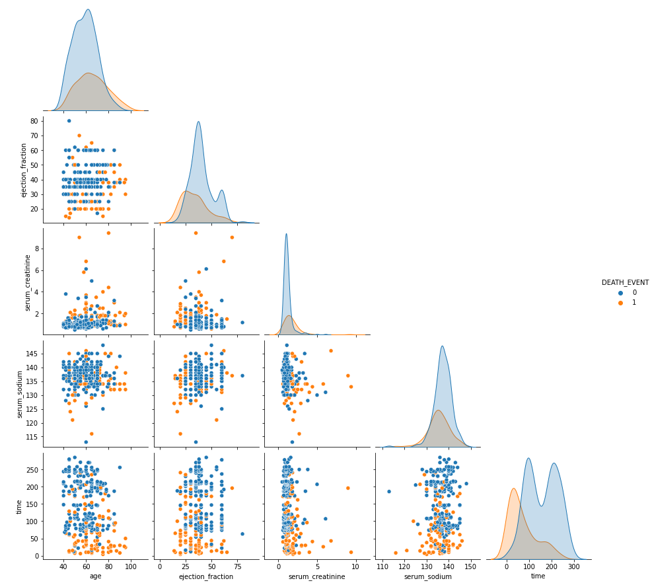
Understanding the features most correlated to fatal heart disease.
Findings:
We can see some initial tendencies such as age being a factor on whether a patient survives.
Heart failure patients with lower ejection fraction are more likely to die
The higher the serum creatinine value, patients are more likely to die
Patients with lower serum sodium value are more likely to die
Most death events occur during a short period of follow-up time
Notes:
Pairplot

Slide 7
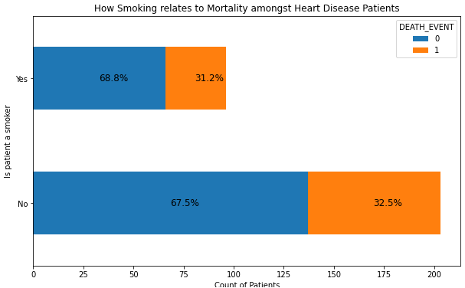
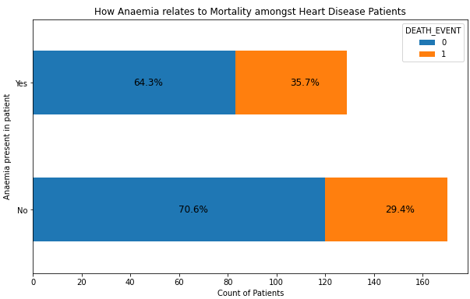
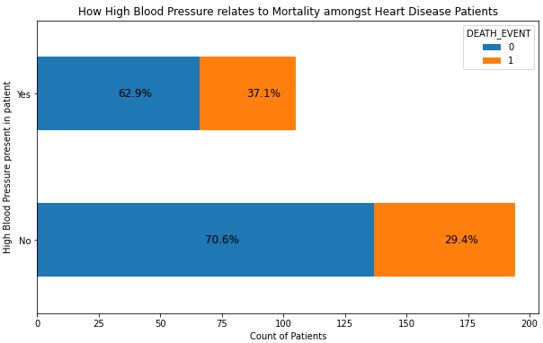
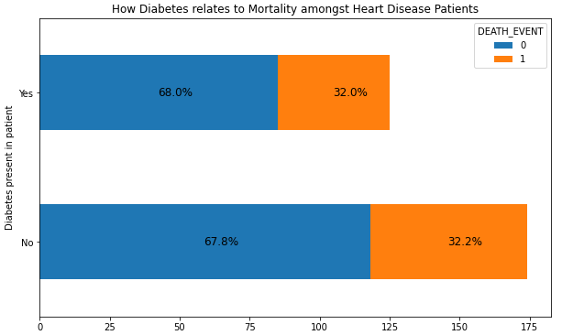
Understanding the binary attributes in the dataset
Notes:
Binary Attributes
Interestingly, we found that whether the patient was a smoker or not, has little impact on the mortality rate of heart failure, at least based on our dataset.

Slide 8
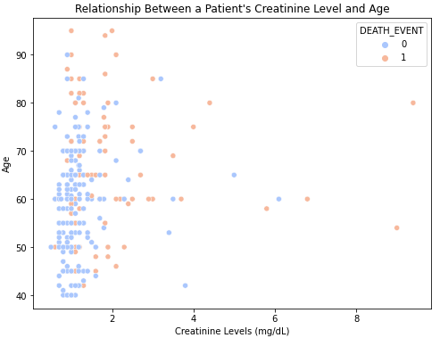
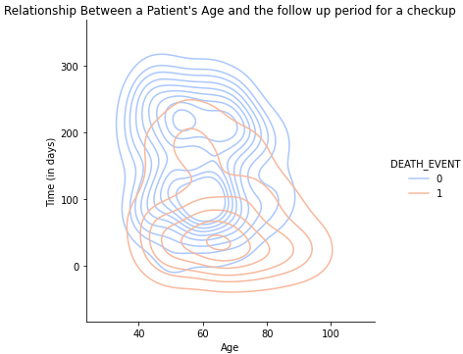
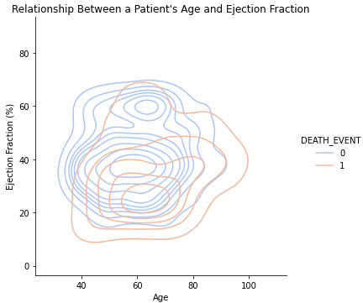
Examining other relationships between different attributes and a patients age.

Slide 9

Creating Machine Learning Models to Predict Fatal Heart Disease

Slide 10
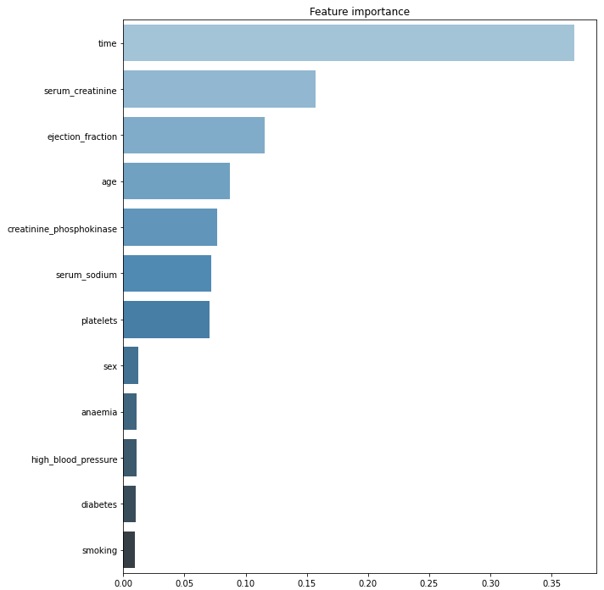
Feature Importance Ranking
Random Forest Classifier
Top features:
time
serum_creatinine
ejection_fraction
age
Notes:
ML - Feature Selection

Slide 11
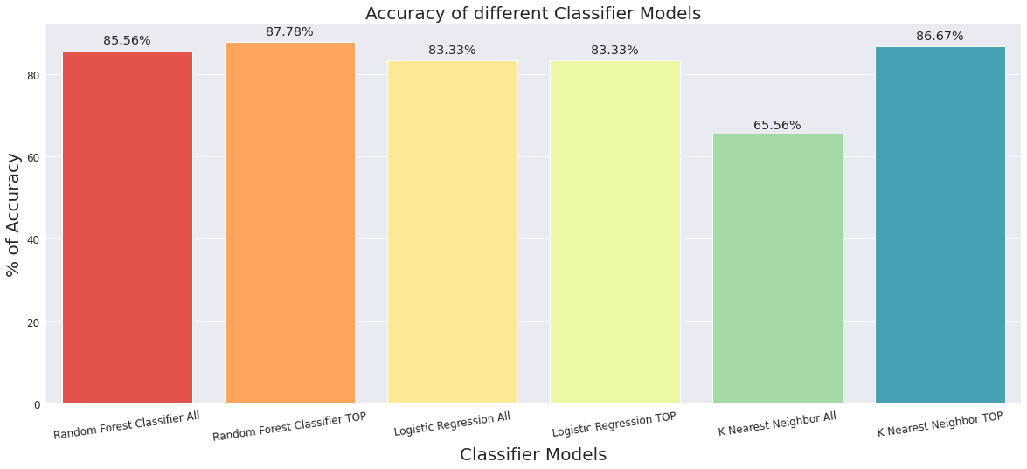
Accuracy of different classifier models
Notes:
ML - Model performance

Slide 12
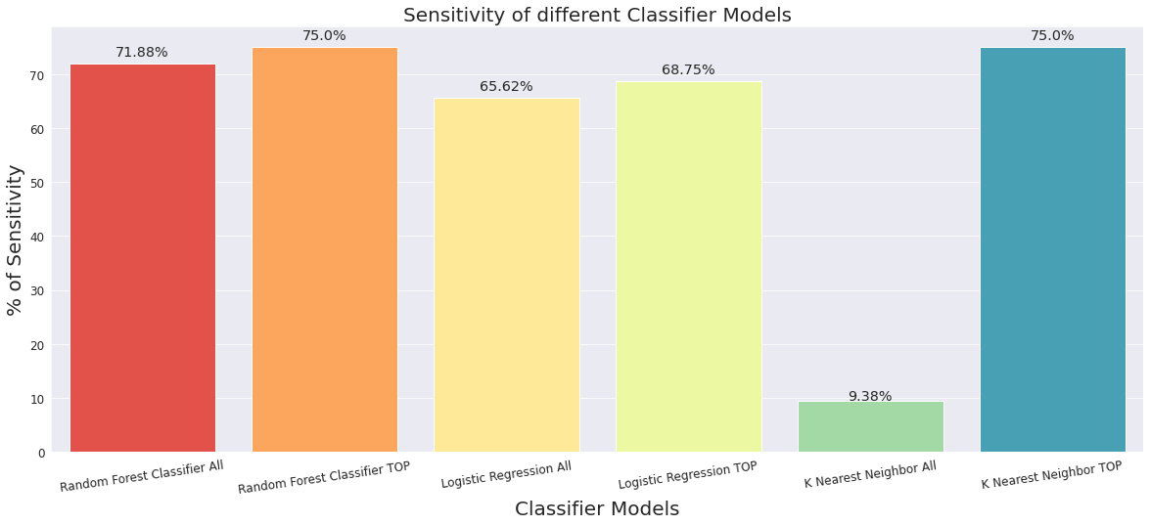
Sensitivity of different classifier models
TP/P
How many actually -died patients the model correctly identifies as died?

Slide 13
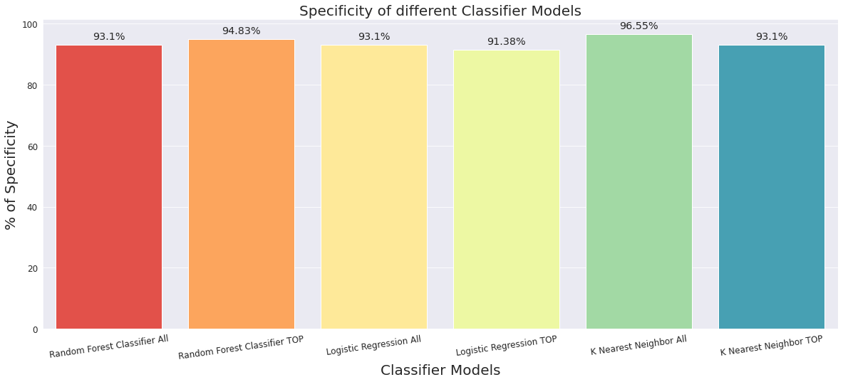
Specificity of different classifier models
TN/N
How many patients survived does the model correctly confirmed as survived?

Slide 14
Conclusion:
This discovery has the potential to impact on clinical practice, becoming a new supporting tool for physicians when predicting if a heart failure patient will survive or not.
Notes:
Conclusion

