Slide 1
Tennis Data Analytical Report
Answers to key questions and a few additional analytical reviews

Slide 2
01
02
03
Basic Information about players and countries :
There are 596 players present in this dataset in total.
There are 79 countries present in this dataset in total.
To calculate the success of a country, we have considered the number of wins per player from that country.
We’ve got three player with the highest number of wins:
Player 1: Milushev P.
Player 2: Kalina V.
Player 3: Panaras A.
04

Slide 3
01
Country Surveys
Information about the countries in the data and their success
You can enter a subtitle here if you need it

Slide 4
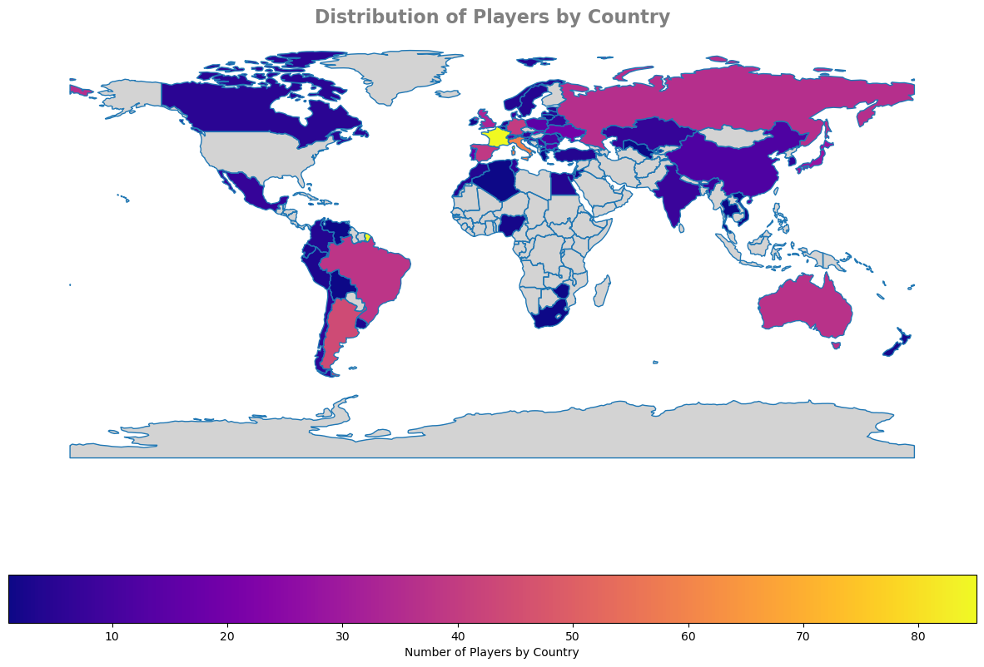
Distribution of Players By Country

Slide 5
The most and least successful countries in the data set :
Least Successful Country
Thailand, Chile, Ivory Coast, Nigeria, Peru, Ireland, Lithuania, Dominican Republic, Moldova, Jamaica, Greece, Zimbabwe and Belgium with only 1 win
Most Successful country
France with 55 wins

Slide 6
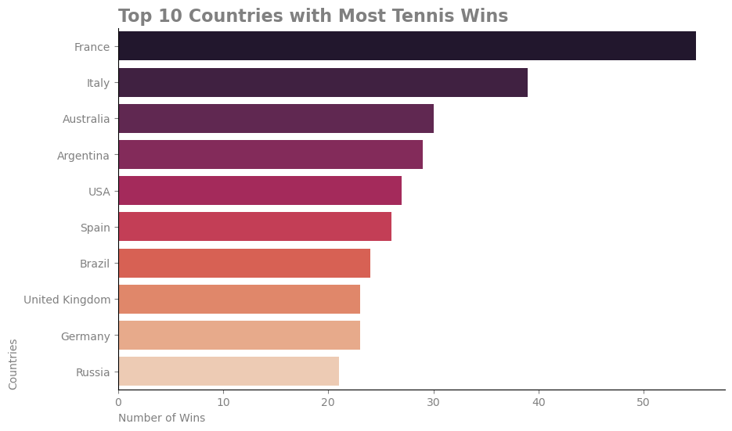
Top Ten Countries With Most Wins

Slide 7




Four countries with the highest number of successful players
Italy
Italy ranks second with 39 players
Argentina
With the closest possible distance, Argentina is in fourth place with 29 players
France
With more than 50 players France takes first place
Australia
30 players is enough to take third place

Slide 8
Match Analysis
Information about matches and statistics.

Slide 9
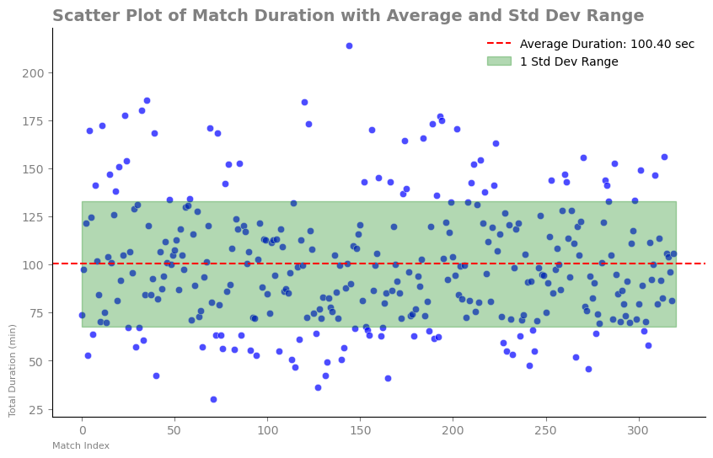
the longest match recorded in terms of duration :
Match with11699235 ID number is the longest match with a match time of: 213.916 minutes
Analysis:
Based on this scatter plot we can predict the time range of a match that could be held.

Slide 10
Based on the average match duration of 6023.89 seconds (approximately 1 hour and 40 minutes), the following analyses can be drawn
1
Appropriate Duration for Matches
Tennis matches typically last between 1 to 3 hours, and an average of 6023.89 seconds indicates that most matches are held within a reasonable time frame
2
Comparison with Other Sports
While tennis matches may be longer than some sports, they appear reasonable when contrasted with others like football or basketball.
Player Performance Analysis
Match duration can assist in analyzing player strategies and performance. For instance, do players who win matches typically spend less time on the court, or vice versa?
3
4
Impact on Spectators
The average duration of matches can influence the appeal of the events to spectators. Longer durations might lead to spectator fatigue, while shorter matches may be more engaging. An average time of 1 hour and 40 minutes seems suitable for maintaining audience attention.

Slide 11
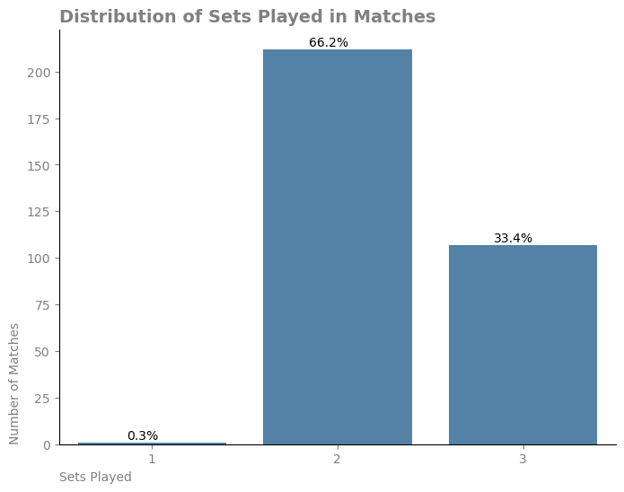
How many sets are typically played in a tennis match
Analysis:
By the first look at this plot, it is obvious that the average tennis match has 2 sets.

Slide 12
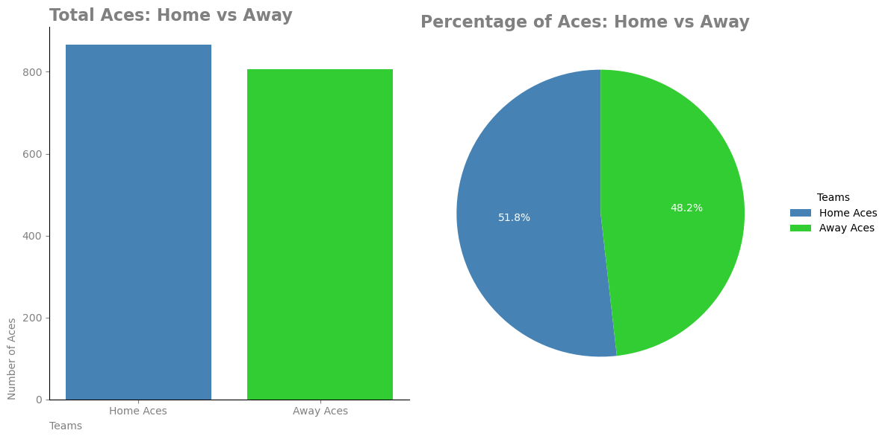
the average number of aces per match is 8

Slide 13
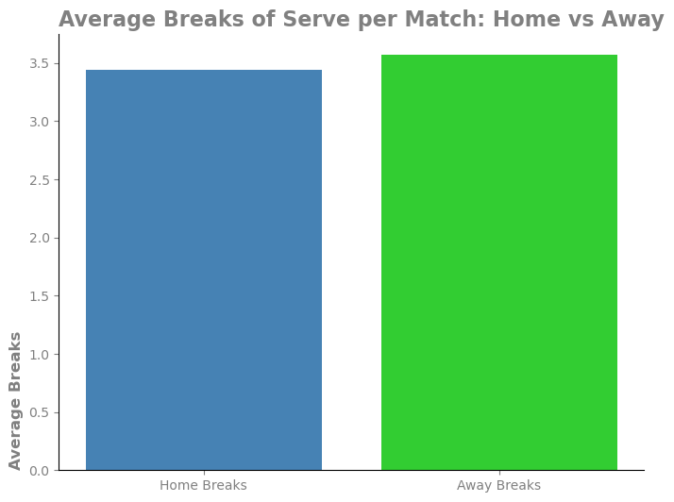
the average number of “breaks of serve” per match 7.01
Analysis:
This plot shows that although the visiting team breaks more than a dozen times, it is almost equal.

Slide 14
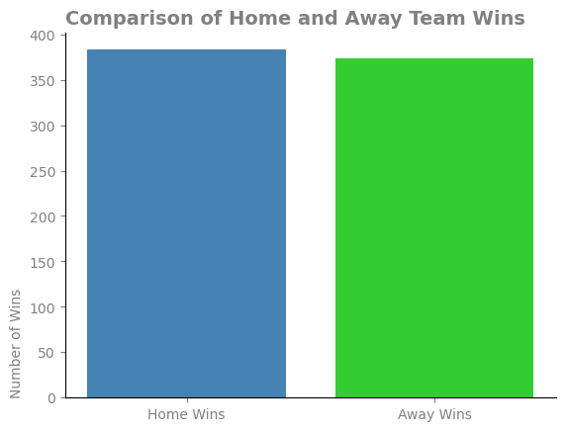
Comparison of the wins of the home and away teams throughout the season:
Analysis:
As we can see, we do not see a significant loss.

Slide 15
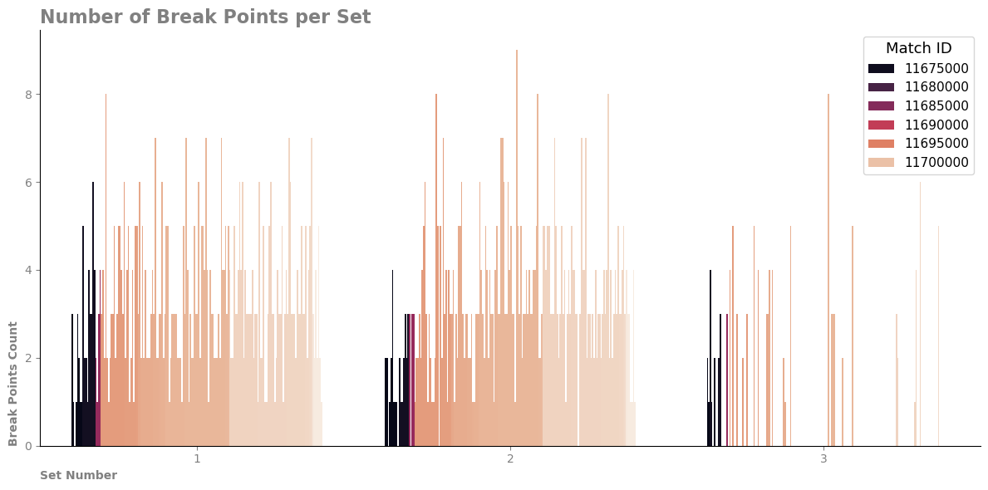

Slide 16
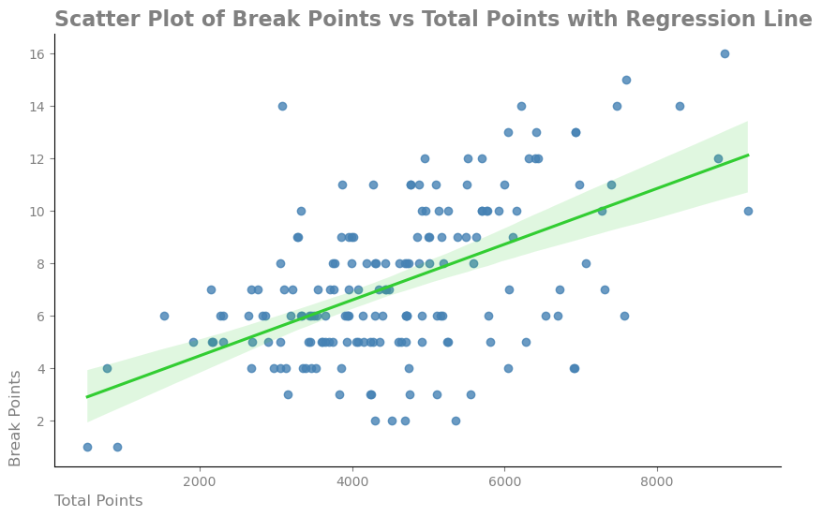

Slide 17
Analysis:
1
Positive Relationship
The regression line has a positive slope, indicating that as the total number of points in a match (Total Points) increases, the number of break points also tends to increase.
2
Data Scatter
Some points in the chart are far from the regression line, indicating that in certain matches, the relationship between Break Points and Total Points might not be very precise.
Data Range
The Total Points range is approximately between 1,000 and 8,000, and Break Points usually vary between 2 and 8. However, there are some outliers where matches show a higher number of break points or total points, indicating that certain matches had significantly higher break points or total scores.
3
4
Confidence Interval
The light green band around the regression line represents the confidence interval. It shows the degree of uncertainty in predicting Break Points for different Total Points values.

Slide 18
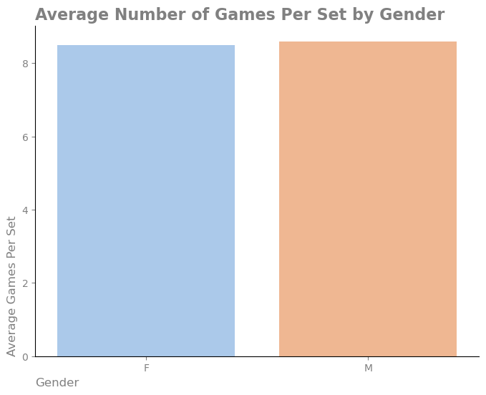
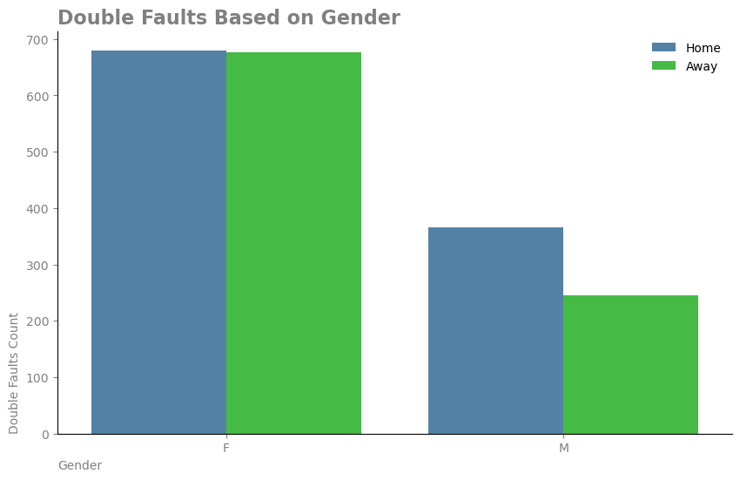
Some Gender Analysis:
Also, by examining the number of games in a set, we do not see a noticeable difference between men and women.
Also, by examining the number of games in a set, we do not see a noticeable difference between men and women. But the remarkable thing is the numbers of the double fault between men and women

Slide 19
Player Analysis
Exploring Some Player Characteristics

Slide 20
Information about players performance:
player who had the highest number of wins
( with 3 wins)
player who win the most tournaments
( with 2 wins)
player with the highest winning percentage against top 10
(with 2 wins)
Milushev P.
Kalina V.
Panaras A.
Kubka M.
Mannarino A
Ostapenko J.

Slide 21
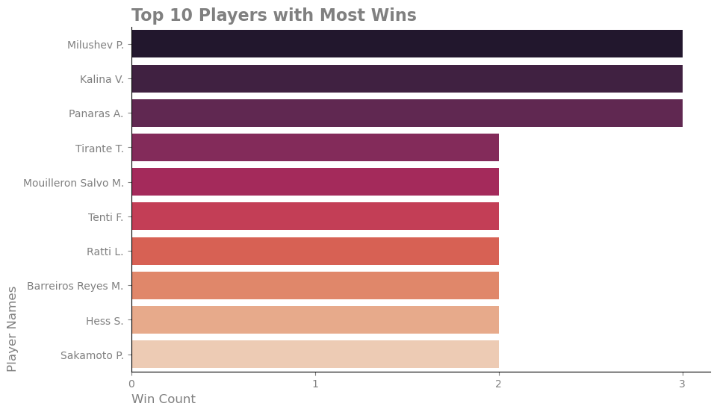

Slide 22

Physical Survey
-----------------------------------
Height, weight, Left/Right handed
Lets focus on players abilities
and Physical Properties

Slide 23
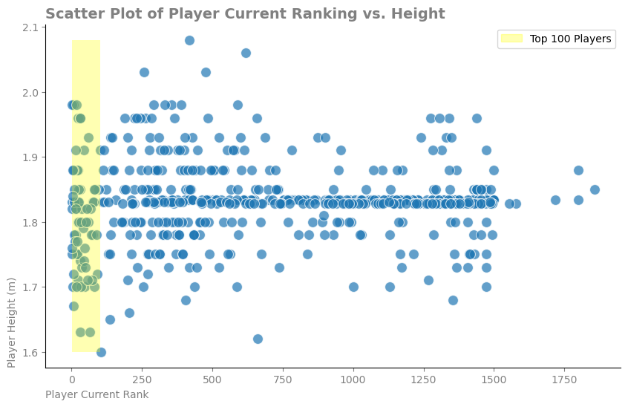
The correlation between a player's height and their ranking is 0.03
Interpretation:
Weak Relationship: A value of 0.03 indicates a very weak relationship between height and players' rankings.
Lack of Significant Relationship:
Since this number is near zero, we can conclude that there is no meaningful relationship between height and players' rankings.

Slide 24
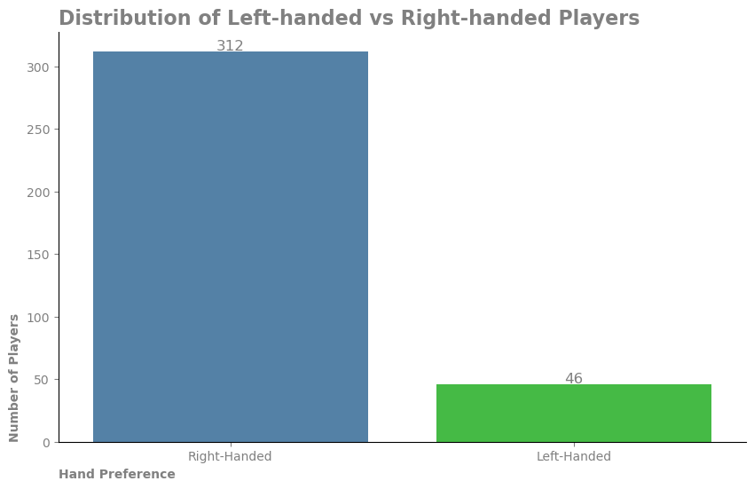
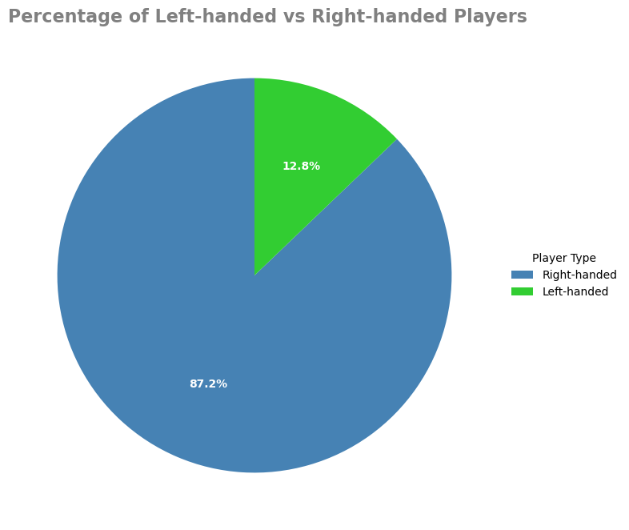
distribution of left-handed versus right-handed players :
Dominance of Right-handed Players: The overwhelming majority of players are right-handed, making up a large portion of the sample. This is consistent with general population statistics, where the majority of people are right-handed.
Significant Difference: The difference between left-handed and right-handed players is quite stark. Right-handed players outnumber left-handed players by a ratio of about 7:1.
This imbalance could be attributed to natural handedness distribution in the general population.

Slide 25
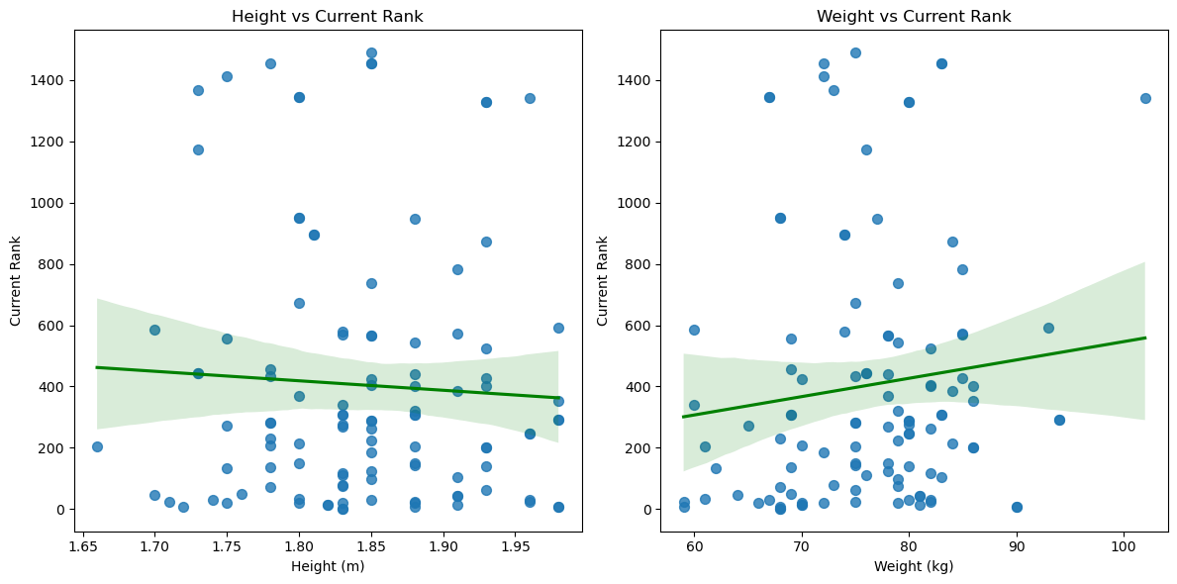
Investigating the relationship between height and weight with rank:

Slide 26
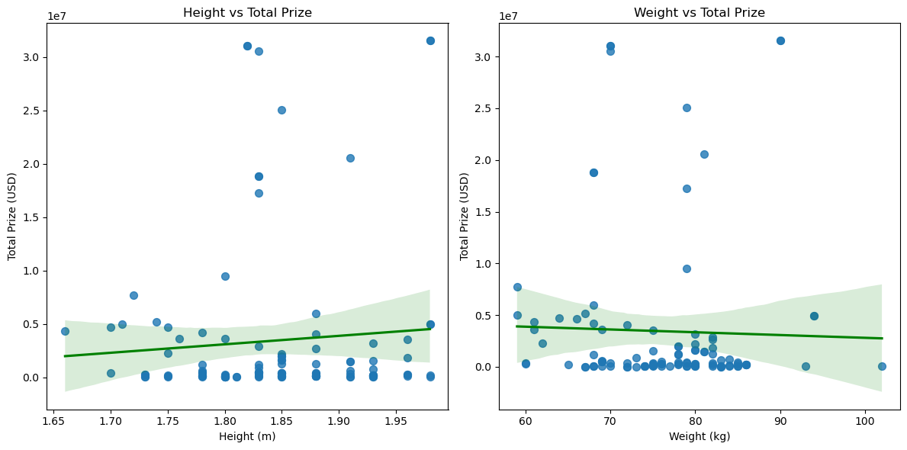
Investigating the relationship between height and weight with awards received:

Slide 27
Conclusion:
In all the charts, the regression lines have a slight slope, and the confidence intervals are relatively wide, indicating that the relationship between height and weight with total prize money is weak.
Predictions based on these variables come with considerable uncertainty, suggesting that height and weight may not be strong indicators of prize earnings in tennis. Other factors may play a more significant role in determining total prize money for players.

Slide 28
Tournament Analysis

Slide 29
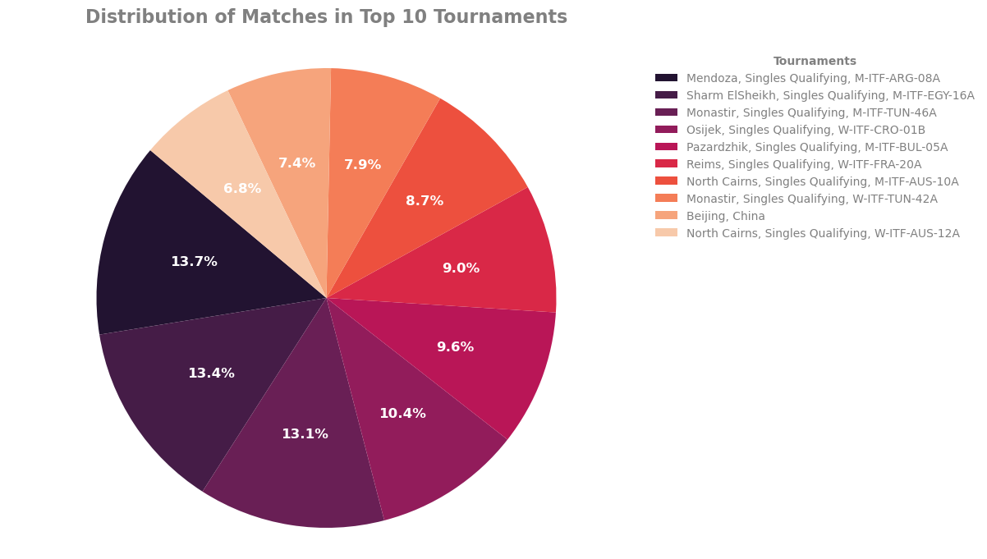

Slide 30
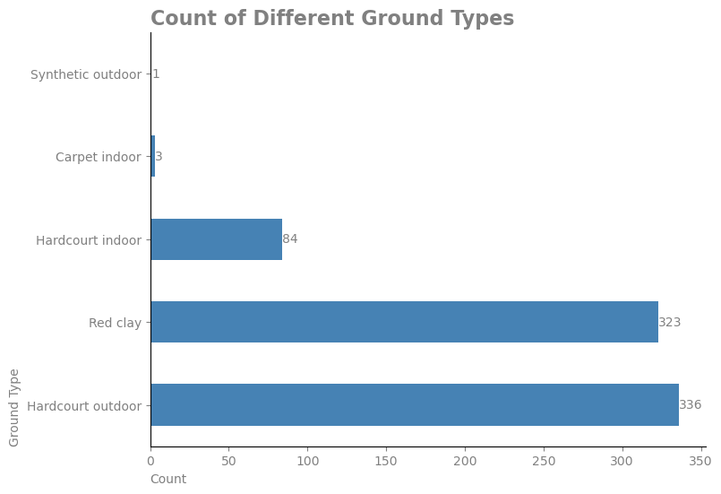
The most common type of surface used in tournaments:
Analysis:
Hardcourt Outdoor and Red Clay is the most used surface in all tournaments

Slide 31
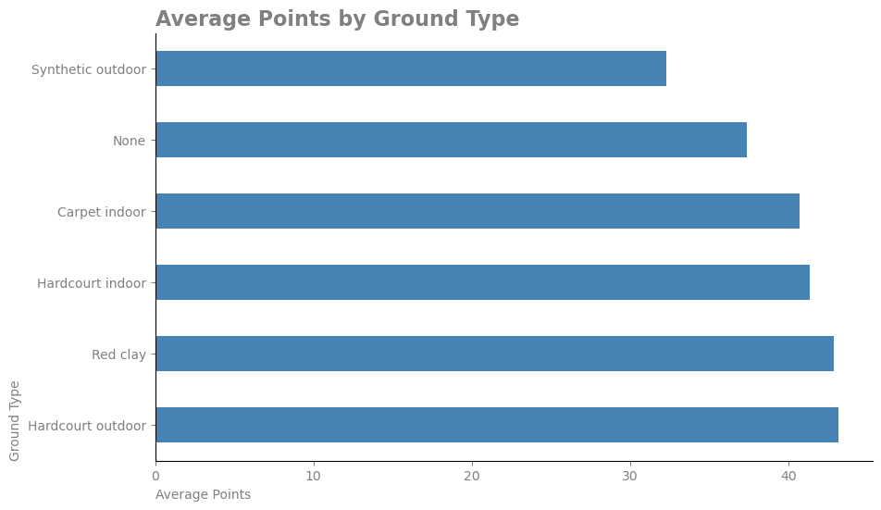
The impact of ground type on the number of match points:
Analysis:
Due to the more matches held in red clay and hardcore outdoor, the points scored in different fields are not much different.

Slide 32
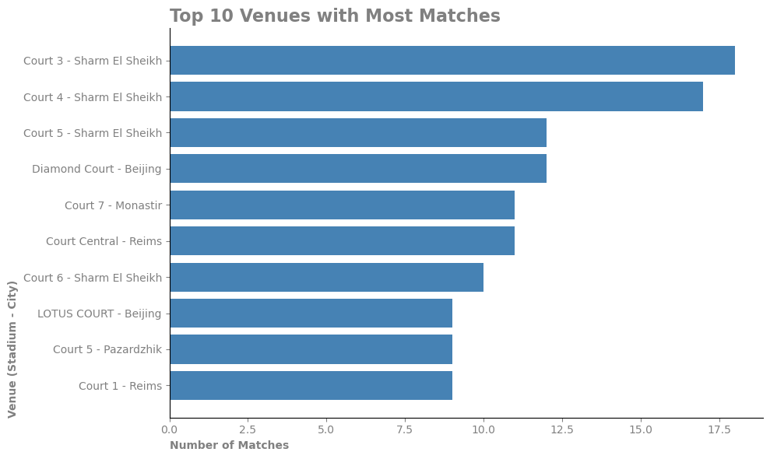
The number of matches held in each location

Slide 33
Thanks
Thanks for your attention

