Slide 1


NETFLIX DATA EXPLORATION
This presentation showcases an analysis of the Netflix_titles dataset. The goal was to gain insights into patterns and trends within Netflix's content library.
by Valentine Chebet

Slide 2

Dataset Overview
Netflix Titles
Variety of Data
Insights into Trends
The dataset contains information on movies and TV shows available on Netflix.
Information includes title, type, release year, directors, cast, ratings, release years and more.
This data helps us understand patterns and trends in Netflix content.

Slide 3
Data Import Process
1
2
3
Create Database
Create Table
Import Wizard
A new database was created in MySQL Workbench.
A table was created with the same name as the CSV file.
The Table Data Import Wizard was used to import the CSV data into the table.

Slide 4
Interesting Discovery: Limited African Content
1
Limited African Representation
2
Possible Reasons
3
Future Opportunities
This could be due to factors such as production costs, distribution challenges, or lack of investment in African film industries.
Our analysis revealed a surprisingly low number of movies listed in African countries.
There's a potential for Netflix to expand its African content library and provide greater representation of diverse storytelling.

Slide 5
Cool Fact #1: Title Length & Watch Hours
Title Length
Watch Hours
Short
Moderate
Medium
Moderate
Long
Low

Slide 6
Cool Fact #2: Top Directors
Top 10 Directors
Popularity Insights
Content Trends
This analysis revealed the 10 directors who appear most frequently in Netflix movies and TV shows.
This provides insights into the directors who have achieved significant success on the platform.
The data suggests popular genres, themes, and storytelling styles that resonate with Netflix audiences.

Slide 7




Data Analysis: SQL Queries and Findings
Distribution of Titles by Country
France and the United States led the list, with Africa not appearing in the top 10.
Count of Titles by Duration
Movies with shorter title lengths had moderate watch hours.
Top 10 Most Frequent Directors
This analysis identified the directors with the highest number of titles on Netflix.

Slide 8
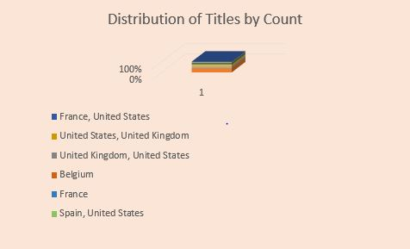
Data Analysis: SQL Queries and Findings
Distribution of Titles by Country

Slide 9
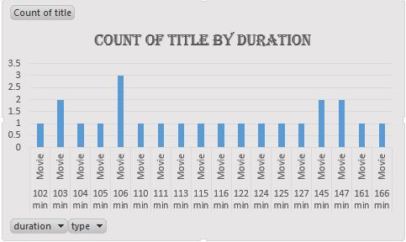
Data Analysis: SQL Queries and Findings
Count of Titles by Duration

Slide 10
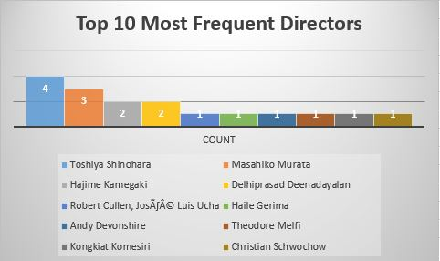
Data Analysis: SQL Queries and Findings
Top 10 Most Frequent Directors

Slide 11

Project Summary
This project analyzed the Netflix_titles dataset, revealing interesting patterns and trends within Netflix's content library. I discovered a limited number of African titles, a correlation between title length and watch hours, and identified the top 10 most frequent directors. The data provides valuable insights for understanding Netflix content strategy and potential opportunities for growth.

