Slide 1
Installing R
How to get started using the R Statistical Programming Language Chris Snyder, MPH

Slide 2
Goals
By the end of the Presentation, we will have learned:
What R and RStudio are and are not
How to download, install, and run R and RStudio

Slide 3

What is R?
High level, interpreted, programming language
Designed specifically for statistics and data science
Functionality is expanded by the R community (via packages) and by the user (via user-defined functions)
R Logo

Slide 4

What is RStudio?
Interactive Development Environment, software designed to make using R much easier
Tool to help manage R projects, packages, and environments
RStudio Logo

Slide 5
What is the difference?
R
Programming Language and Interpreter
Prerequisite for RStudio
RStudio
Interactive Development Environment
Provides a Graphical User Interface and project management tools.

Slide 6
Download and Install R
Download R from the Comprehensive R Archive Network (CRAN) at:
https://cloud.r-project.org/
Windows users will download an executable installer (.exe)
Mac users will download a package installer (.pkg)
Linux users have access via package management systems
R must be installed before RStudio

Slide 7
Download and Install RStudio
Download RStudio Desktop from the RStudio team at:
https://www.rstudio.com/products/rstudio/download/
Windows users will download an executable installer (.exe)
Mac users will download a disk image file (.dmg)
Linux users will download a package file (.deb, .rpm)

Slide 8
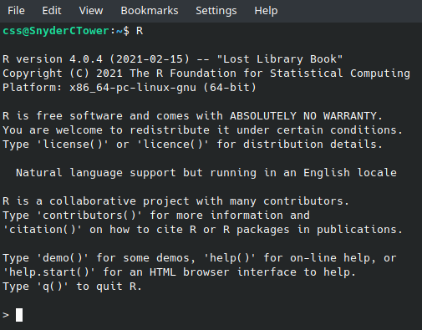
Launch R
R is run inside of your computer’s terminal, and can be accessed interactively via command line interface, or passively via scripting. R is launched via the R.exe application on Windows, or through the terminal via R, as a variable in your PATH.

Slide 9
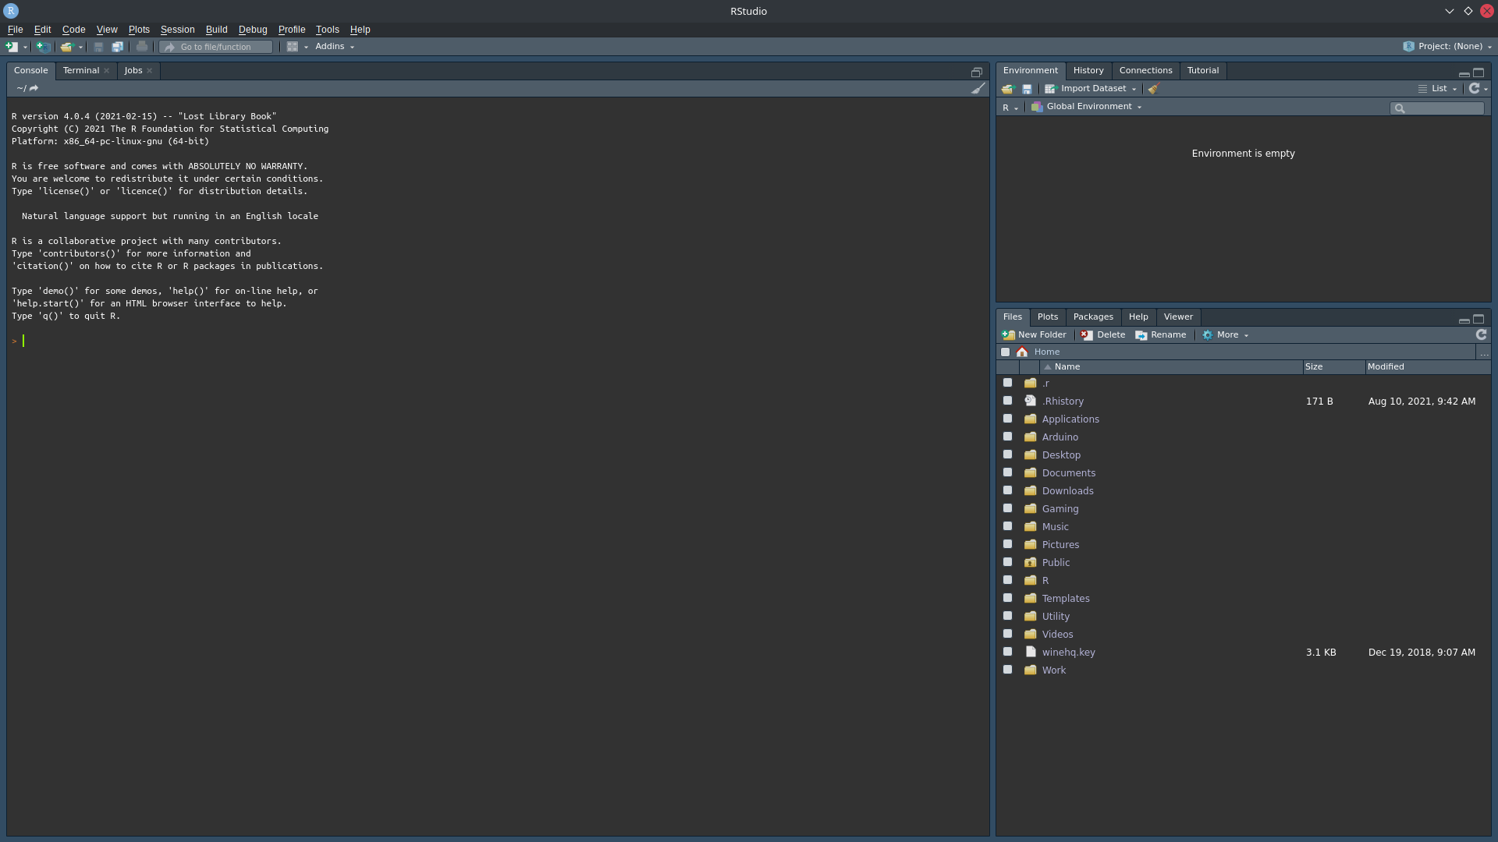
Launch RStudio
RStudio is run as a desktop application, which acts as an R project manager, and supports file management and version controlling features.

Slide 10
Run and Source R Code
Running R Code is the process of giving instructions to R one line (one complete instruction) at a time.
R code can be run interactively both in the R console and RStudio file editor.
Code is run one line or command at a time using Enter, when typed into the console.
The selected line, or one whole complete instruction, in an R source file open in RStudio can be run using Ctrl+Enter on Windows and Unix or Cmd+Enter on Mac.
Sourcing R Code is the process of giving many instructions to R at once from a specific file source.
R code can be saved as an R source file (.R) to use later
Source files can be run in their entirety using the source() function, or in RStudio, using Ctrl+Shift+S on Windows and Unix or Cmd+Shift+S on Mac.
Source files can be shared with partners, or used on different computers to create repeatable results.

Slide 11
Goals
At the end of the Presentation, we have learned:
What R and RStudio are and are not
How to download, install, and run R and RStudio

Slide 12
Questions?
If you have any trouble installing R or RStudio, please contact:
Chris Snyder at snyderc@montclair.edu.

