Slide 1
Introduction to R
How to get started using the R Statistical Programming Language Chris Snyder, MPH

Slide 2
Goals
By the end of the Presentation, we will have learned:
What R and RStudio are and are not
How to download, install, and run R and RStudio
How to install and load new R packages
How to start performing math operations in R
How to start graphing data in R

Slide 3

So what can R do for my project?

Slide 4
Sort and Tabulate Data
Make and Model | Miles per Gallon | Number of Cylinders | Displacement in Cubic Inches | Gross Horsepower
Toyota Corolla | 33.9 | 4 | 71.1 | 65
Fiat 128 | 32.4 | 4 | 78.7 | 66
Honda Civic | 30.4 | 4 | 75.7 | 52
Lotus Europa | 30.4 | 4 | 95.1 | 113
Fiat X1-9 | 27.3 | 4 | 79.0 | 66
Porsche 914-2 | 26.0 | 4 | 120.3 | 91
Top Six Fuel Efficient 4-Cylinder Engines

Slide 5
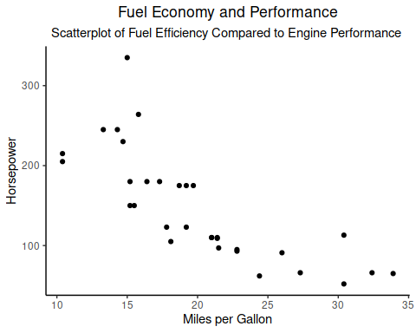
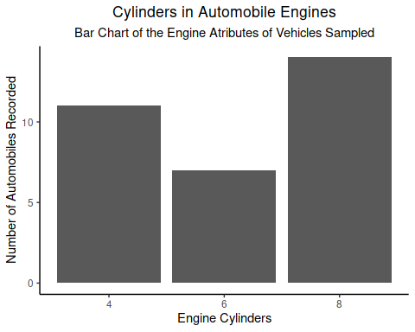
Plot Descriptive Statistics

Slide 6
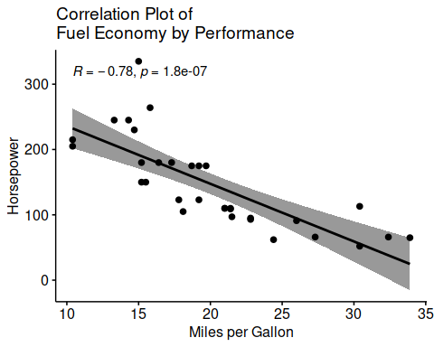
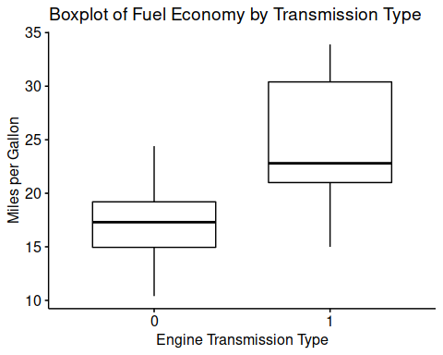
Plot Statistical Tests

Slide 7
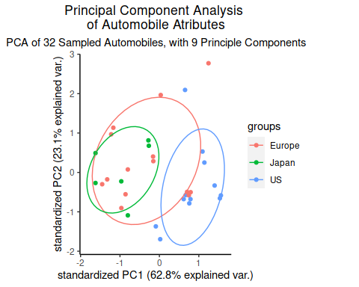
Plot Principal Component Analysis

Slide 8
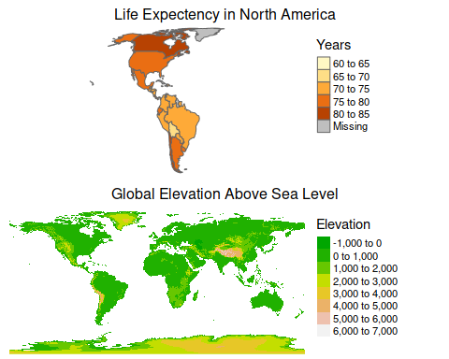
Map Choropleth and Geo-spatial Data

Slide 9
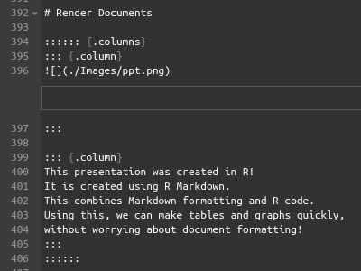
Render Documents
This presentation was created in R! It is created using R Markdown. This combines Markdown formatting and R code. Using this, we can make tables and graphs quickly, without worrying about document formatting!

Slide 10
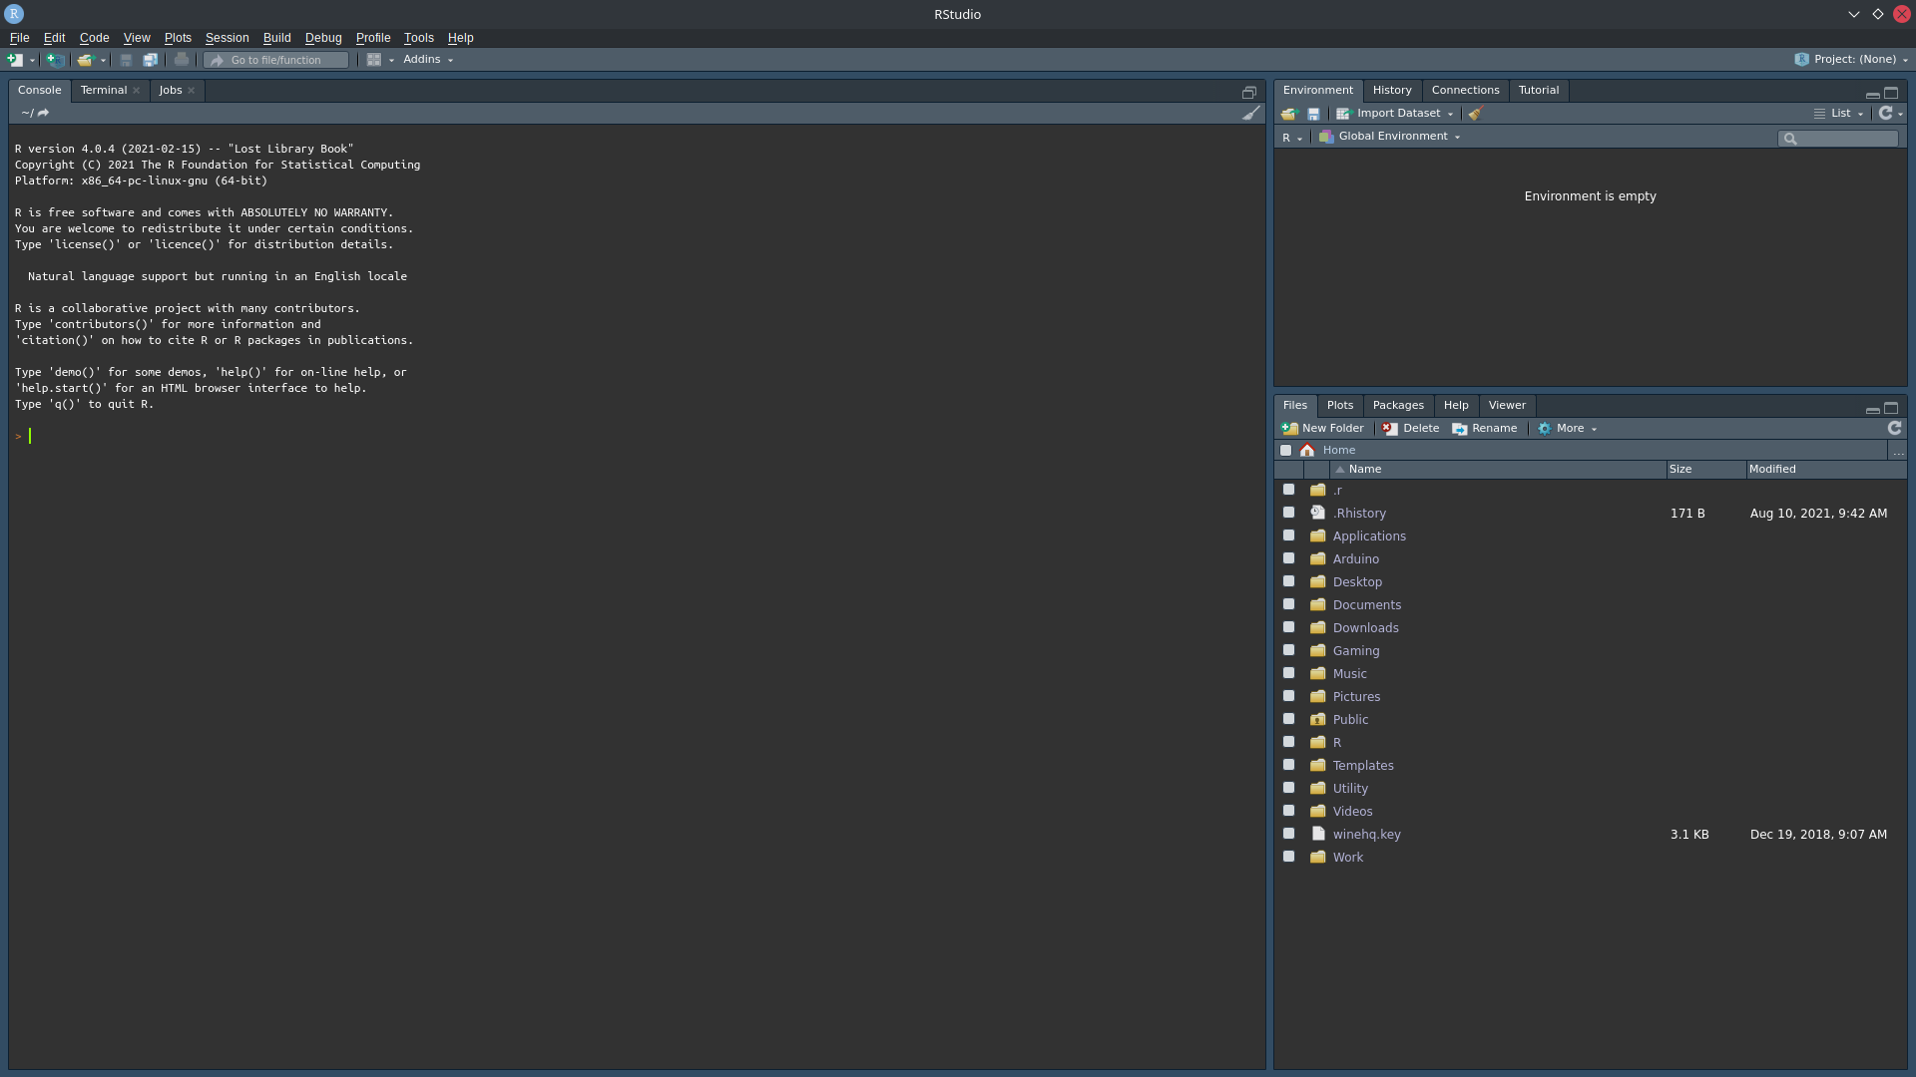
Lets Get Started Using R
This is the first guided lab section, and will act as a quick introduction to how to begin using R and its Interactive Development Environment (IDE) RStudio.
Launch RStudio now if you have not done so already. You should see a screen similar to the one below.

Slide 11
Goals
At the end of the Lab, we have learned:
What R and RStudio are and are not
How to download, install, and run R and RStudio
How to install and load new R packages
How to start performing math operations in R
How to start graphing data in R

