Slide 1
Graphing Your Data
How to make and export dynamic graphics using R Chris Snyder, MPH

Slide 2
Goals
By the end of the Presentation, we will have learned:
How to organize data for ease of graphing
How to generate graphs for descriptive statistics
How to add additional detail to graphs
How to save and export graphics

Slide 3
Recommended Package
R natively supports the creation of basic graphics. Additional packages allow for the creation of more advanced and presentation-ready graphics. We can use install.packages() to download or update these packages.
base, for creating statistical graphics
ggplot2, for creating advanced data visuals
ggpubr, supplement for ggplot2 for publication-ready graphs
tmap, for creation of GIS maps
numform, for displaying publication-ready data

Slide 4
Preparing the recommended packages
Once downloaded, use library() to load required packages into R. base is always loaded by R at start-up. We can check what packages are loaded using the function: loadedNamespaces()
library(ggplot2)
library(ggpubr)

Slide 5
Organizing Data for Graphing
Like most functions in R, graphing is performed using vectors of data. A check-list for graph-ready data is organized below:
Data are stored in a singular table
Data are organized such that:
Columns (vectors) represent different variables or attributes
Rows represent different observations, cases, etc.
No extra or empty rows are present

Slide 6
The mtcars data set
Make and Model | Miles per Gallon | Number of Cylinders | Displacement in Cubic Inches | Gross Horsepower
Toyota Corolla | 33.9 | 4 | 71.1 | 65
Fiat 128 | 32.4 | 4 | 78.7 | 66
Honda Civic | 30.4 | 4 | 75.7 | 52
Lotus Europa | 30.4 | 4 | 95.1 | 113
Fiat X1-9 | 27.3 | 4 | 79.0 | 66
Porsche 914-2 | 26.0 | 4 | 120.3 | 91
Top Six Fuel Efficient 4-Cylinder Engines

Slide 7
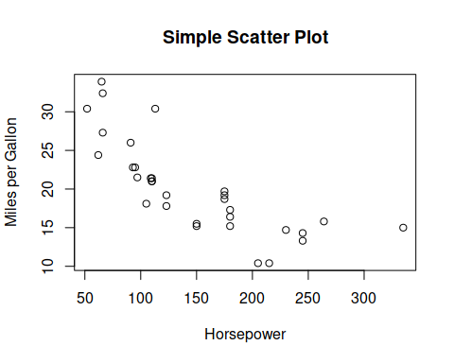
Scatter plots - base
Main Function Call:
plot(mtcars$mpg~mtcars$hp)

Slide 8
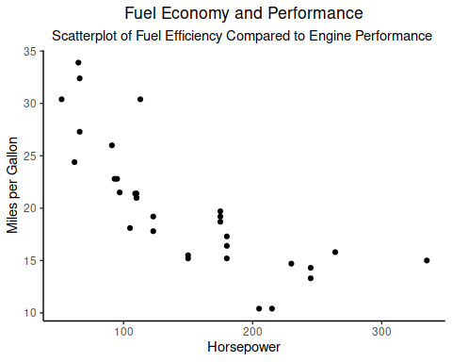
Scatter plots - ggplot2
Main Function Call:
ggplot(mtcars, mapping = aes(x = hp, y = mpg)) + geom_point()

Slide 9
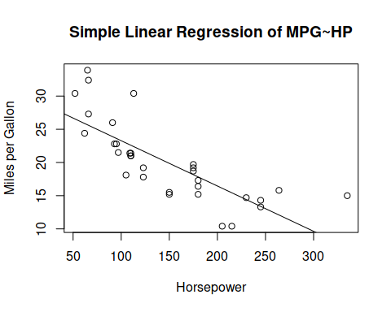
Linear Regression - base
Main Function Call:
plot(mtcars$mpg~mtcars$hp) abline(lm(mtcars$mpg~mtcars$hp))

Slide 10
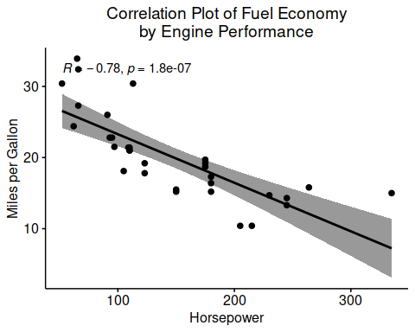
Linear Regression - ggpubr
Main Function Call:
ggscatter(mtcars, "hp", "mpg", add = "reg.line" )

Slide 11
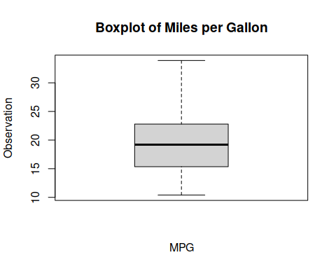
Boxplots - base
Main Function Call:
boxplot(mtcars$mpg)

Slide 12
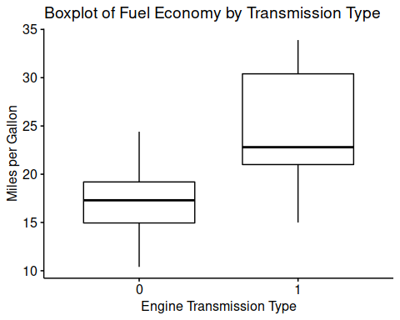
Boxplots - ggpubr
Main Function Call:
ggboxplot(mtcars, "am", "mpg")

Slide 13
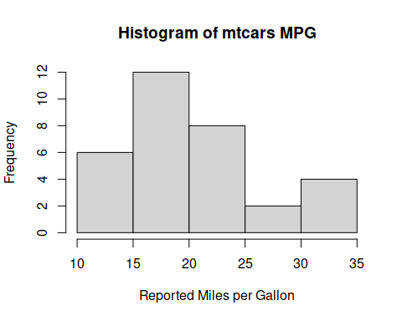
Histograms - base
Main Function Call:
hist(mtcars$mpg)

Slide 14
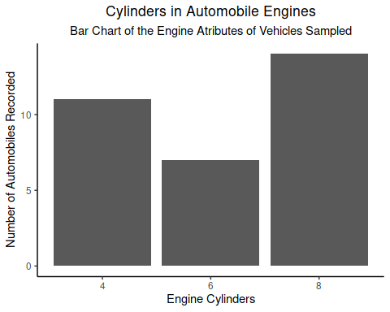
Bar Charts - ggplot2
Main Function Call:
ggplot(mtcars, mapping = aes(x = as.factor(cyl))) + geom_bar()

Slide 15
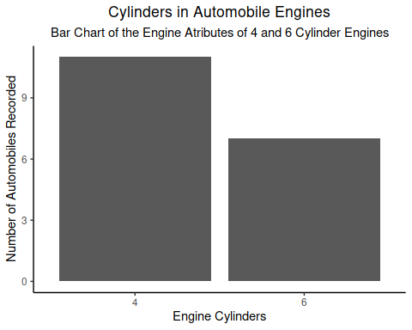
Bar Charts, Sorted - ggplot2
Main Function Call:
ggplot(mtcars[mtcars$cyl %in% c(4, 6),], mapping = aes(x = as.factor(cyl))) + geom_bar()

Slide 16
Saving Graphics - base
“Headless” method, without any graphical output
jpeg("mtcars-hpXmpg.jpg") plot(mtcars$hp~mtcars$mpg) dev.off()
Desktop method, with graphical output
plot(mtcars$hp~mtcars$mpg) dev.copy(png, "mtcars-hpXmpg.jpg") dev.off()

Slide 17
Saving Graphics - ggplot2
“Headless” method, without any graphical output
ggsave("scatterplot-hpXmpg.png", ggplot(mtcars, mapping = aes(x = hp, y = mpg)) + geom_point() )
Desktop method, with graphical output
ggplot(mtcars, mapping = aes(x = hp, y = mpg)) + geom_point() ggsave("scatterplot-hpXmpg.png")

