Slide 1
Introduction to R
How to get started using the R Statistical Programming Language Chris Snyder, MPH

Slide 2
Goals
By the end of the Presentation, we will have learned:
What R and RStudio are and are not
How to download, install, and run R and RStudio
How to install and load new R packages
How to start performing math operations in R
How to start graphing data in R

Slide 3

What is R?
High level, interpreted, programming language
Designed specifically for statistics and data science
Functionality is expanded by the R community (via packages) and by the user (via user-defined functions)
R Logo

Slide 4

What is RStudio?
Interactive Development Environment, software designed to make using R much easier
Tool to help manage R projects, packages, and environments
RStudio Logo

Slide 5
What is the difference?
R
Programming Language and Interpreter
Prerequisite for RStudio
RStudio
Interactive Development Environment
Provides a Graphical User Interface and project management tools.

Slide 6
So what can R do for my project?

Slide 7
Sort and Tabulate Data
Make and Model | Miles per Gallon | Number of Cylinders | Displacement in Cubic Inches | Gross Horsepower
Toyota Corolla | 33.9 | 4 | 71.1 | 65
Fiat 128 | 32.4 | 4 | 78.7 | 66
Honda Civic | 30.4 | 4 | 75.7 | 52
Lotus Europa | 30.4 | 4 | 95.1 | 113
Fiat X1-9 | 27.3 | 4 | 79.0 | 66
Porsche 914-2 | 26.0 | 4 | 120.3 | 91
Top Six Fuel Efficient 4-Cylinder Engines

Slide 8
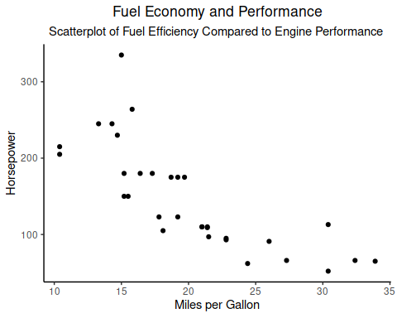
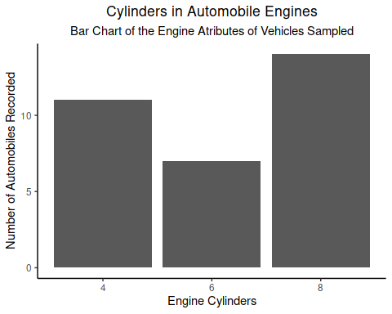
Plot Descriptive Statistics

Slide 9
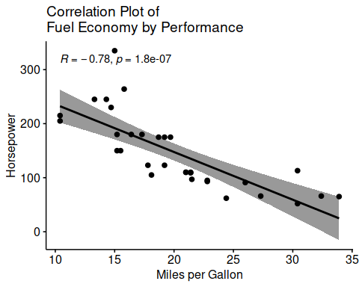
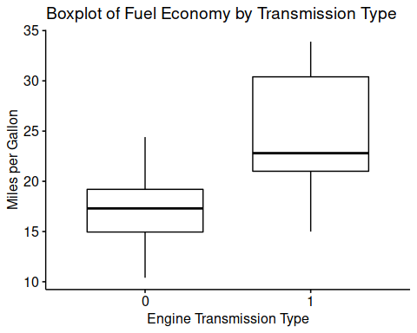
Plot Statistical Tests

Slide 10
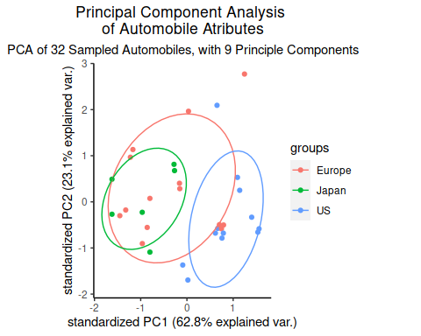
Plot Principal Component Analysis

Slide 11
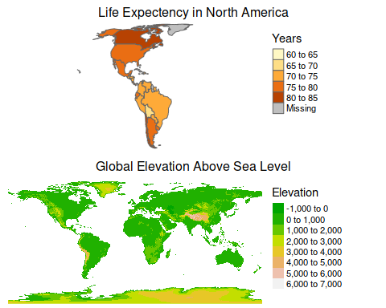
Map Choropleth and Geo-spatial Data

Slide 12
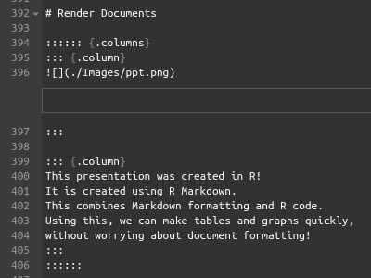
Render Documents
This presentation was created in R! It is created using R Markdown. This combines Markdown formatting and R code. Using this, we can make tables and graphs quickly, without worrying about document formatting!

Slide 13
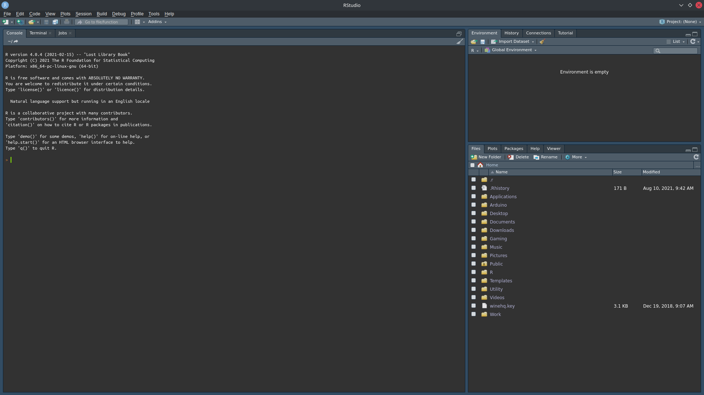
Lets Get Started Using R
This is the first guided lab section, and will act as a quick introduction to how to begin using R and its Interactive Development Environment (IDE) RStudio.
Launch RStudio now if you have not done so already. You should see a screen similar to the one below.

Slide 14
Goals
At the end of the Lab, we have learned:
What R and RStudio are and are not
How to download, install, and run R and RStudio
How to install and load new R packages
How to start performing math operations in R
How to start graphing data in R

