Slide 1
Graphing Your Data
How to make and export dynamic graphics using R Chris Snyder, MPH

Slide 2
Goals
By the end of the Presentation, we will have learned:
How to organize data for ease of graphing
How to generate graphs for descriptive statistics
How to add additional detail to graphs
How to save and export graphics

Slide 3
Recommended Package
R natively supports the creation of basic graphics. Additional packages allow for the creation of more advanced and presentation-ready graphics. We can use install.packages() to download or update these packages.
base, for creating statistical graphics
ggplot2, for creating advanced data visuals
ggpubr, supplement for ggplot2 for publication-ready graphs
tmap, for creation of GIS maps
numform, for displaying publication-ready data

Slide 4
Preparing the recommended packages
Once downloaded, use library() to load required packages into R. base is always loaded by R at start-up. We can check what packages are loaded using the function: loadedNamespaces()
library(ggplot2)
library(ggpubr)

Slide 5
Organizing Data for Graphing
Like most functions in R, graphing is performed using vectors of data. When making graphs, we will have the best and most reliable results when the following conditions are met:
Data are stored in a singular data frame (table)
We are able to sort or filter our data based on a given value
Columns (vectors) represent different variables or attributes of our data
Rows represent different observations, cases, responses, etc.

Slide 6
Graphing Lab
The rest of the presentation corresponds to the Graphing Lab.
Launch RStudio and open the lab now if you have not done so already.

Slide 7
Example Data Set mtcars
Make and Model | Miles per Gallon | Number of Cylinders | Displacement in Cubic Inches | Gross Horsepower
Toyota Corolla | 33.9 | 4 | 71.1 | 65
Fiat 128 | 32.4 | 4 | 78.7 | 66
Honda Civic | 30.4 | 4 | 75.7 | 52
Lotus Europa | 30.4 | 4 | 95.1 | 113
Fiat X1-9 | 27.3 | 4 | 79.0 | 66
Porsche 914-2 | 26.0 | 4 | 120.3 | 91

Slide 8
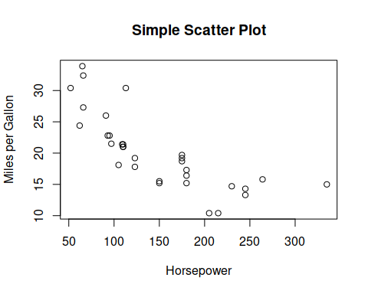
Scatter plots - base
Main Function Call:
plot(mtcars$mpg~mtcars$hp)

Slide 9
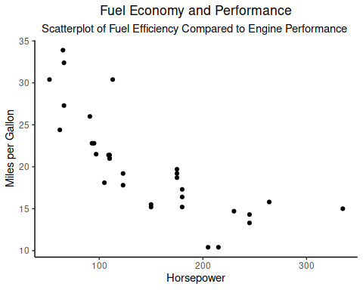
Scatter plots - ggplot2
Main Function Call:
ggplot(mtcars, mapping = aes(x = hp, y = mpg)) + geom_point()

Slide 10
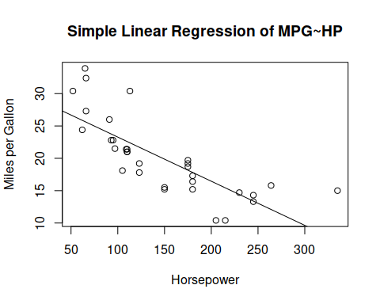
Linear Regression - base
Main Function Call:
plot(mtcars$mpg~mtcars$hp) abline(lm(mtcars$mpg~mtcars$hp))

Slide 11
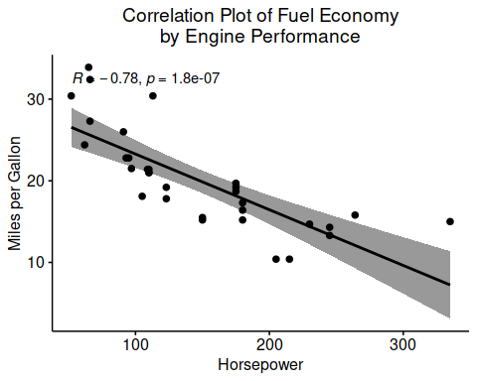
Linear Regression - ggpubr
Main Function Call:
ggscatter(mtcars, "hp", "mpg", add = "reg.line" )

Slide 12
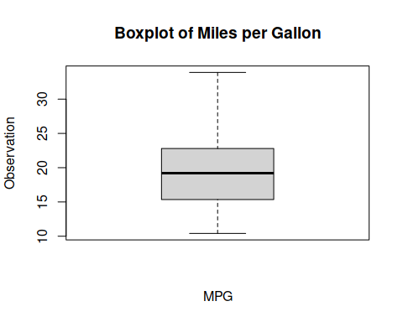
Boxplots - base
Main Function Call:
boxplot(mtcars$mpg)

Slide 13
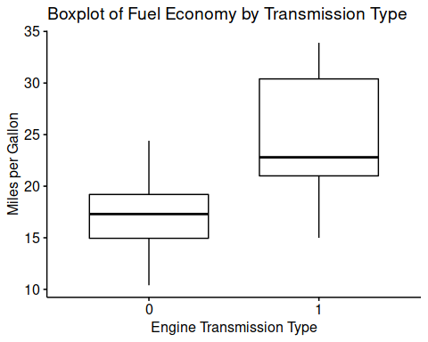
Boxplots - ggpubr
Main Function Call:
ggboxplot(mtcars, "am", "mpg")

Slide 14
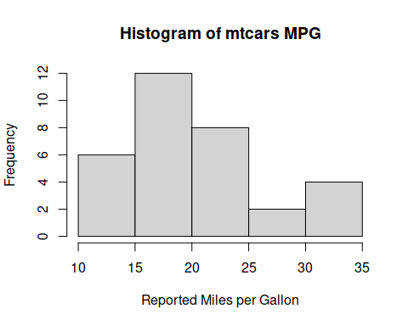
Histograms - base
Main Function Call:
hist(mtcars$mpg)

Slide 15
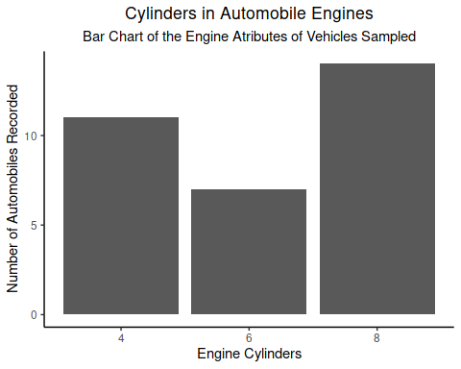
Bar Charts - ggplot2
Main Function Call:
ggplot(mtcars, mapping = aes(x = as.factor(cyl))) + geom_bar()

Slide 16
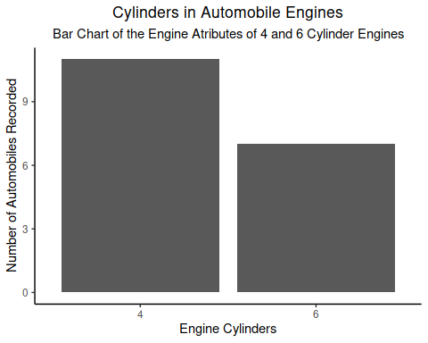
Bar Charts, Sorted - ggplot2
Main Function Call:
ggplot(mtcars[mtcars$cyl %in% c(4, 6),], mapping = aes(x = as.factor(cyl))) + geom_bar()

Slide 17
Saving Graphics - base
“Headless” method, without any graphical output
jpeg("mtcars-hpXmpg.jpg") plot(mtcars$hp~mtcars$mpg) dev.off()
Desktop method, with graphical output
plot(mtcars$hp~mtcars$mpg) dev.copy(png, "mtcars-hpXmpg.jpg") dev.off()

Slide 18
Saving Graphics - ggplot2
“Headless” method, without any graphical output
ggsave("scatterplot-hpXmpg.png", ggplot(mtcars, mapping = aes(x = hp, y = mpg)) + geom_point() )
Desktop method, with graphical output
ggplot(mtcars, mapping = aes(x = hp, y = mpg)) + geom_point() ggsave("scatterplot-hpXmpg.png")

Slide 19
Goals
By the end of the Presentation, we will have learned:
How to organize data for ease of graphing
How to generate graphs for descriptive statistics
How to add additional detail to graphs
How to save and export graphics

