Slide 1
Number Guessing Game

Slide 2
Introduction
Number Guessing game is a simple game which makes the user guess a number in between 1 and 100.
It has 2 levels, easy and hard.
Easy gives the user 10 attempts
Hard gives 5 attempts to the user

Slide 3
Algorithm
1)import random library for generating a random number using the in-built randint function(save it to a chosen_number variable).
2)OS library to clear screen to rerun the game
3)Create a function to take difficulty level from the user as input
4)Save it to a variable as attempts by calling the difficulty function.
5)Take guess of user as input to a variable.
6)In a while loop if guess is not equal to chosen_number:
a)if attempts==0:
print lose Statement
break
b)if guess>chosen_number:
print guess too high
decrement attempts by 1
c)if guess<chosen_number:
print guess too low
decrement attempts by 1
d)if guess==chosen_number:
print win_statement
break

Slide 4
Code
import random
import os
logo = """
_ _ _ _____
| \ | | | | / ____|
| \| |_ _ _ __ ___ | |__ ___ _ __ | | __ _ _ ___ ___ ___
| . ` | | | | '_ ` _ \| '_ \ / _ \ '__| | | |_ | | | |/ _ \/ __/ __|
| |\ | |_| | | | | | | |_) | __/ | | |__| | |_| | __/\__ \__ \
|_| \_|\__,_|_| |_| |_|_.__/ \___|_| \_____|\__,_|\___||___/___/
"""
os.system("clear")
print(logo)
def difficult(easy_or_hard):
if easy_or_hard == "easy":
return 10
elif easy_or_hard == "hard":
return 5
else:
again = input("Invalid syntax. Please enter 'easy' or 'hard': ")
return difficult(again)
chosen_number = random.randint(1, 100)
print("Welcome to the Number Guessing Game!")
print("I'm thinking of a number between 1 and 100.")
difficulty = input("Choose a difficulty. Type 'easy' or 'hard': ")
attempts = difficult(difficulty)
print(f"You have {attempts} attempts remaining to guess the number.")
guess=0
while guess!=chosen_number:
guess = int(input("Make a guess: "))
attempts -= 1
if attempts == 0:
print(f"You've run out of guesses, you lose! The answer was {chosen_number}.")
break
if guess > chosen_number:
print("Too high.")
elif guess < chosen_number:
print("Too low.")
elif guess == chosen_number:
print(f"You got it!. The answer was {chosen_number}.")
break
else:
print(f"You lose the game!. The answer was {chosen_number}.")
break
print("Guess again.")
print(f"You have {attempts} attempts remaining to guess the number.")

Slide 5
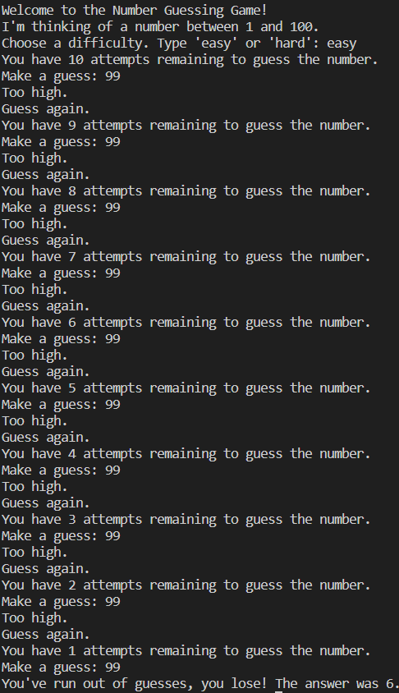
Output

Slide 6
Github
https://github.com/RoquaSpartan95/Ryan_Scifor/tree/main/Project

