Slide 1
Number Guessing Game and EDA using dataset

Slide 2
Introduction
Number Guessing game is a simple game which makes the user guess a number in between 1 and 100.
It has 2 levels, easy and hard.
Easy gives the user 10 attempts
Hard gives 5 attempts to the user

Slide 3
Algorithm
1)import random library for generating a random number using the in-built randint function(save it to a chosen_number variable).
2)OS library to clear screen to rerun the game
3)Create a function to take difficulty level from the user as input
4)Save it to a variable as attempts by calling the difficulty function.
5)Take guess of user as input to a variable.
6)In a while loop if guess is not equal to chosen_number:
a)if attempts==0:
print lose Statement
break
b)if guess>chosen_number:
print guess too high
decrement attempts by 1
c)if guess<chosen_number:
print guess too low
decrement attempts by 1
d)if guess==chosen_number:
print win_statement
break

Slide 4
Code
import random
import os
logo = """
_ _ _ _____
| \ | | | | / ____|
| \| |_ _ _ __ ___ | |__ ___ _ __ | | __ _ _ ___ ___ ___
| . ` | | | | '_ ` _ \| '_ \ / _ \ '__| | | |_ | | | |/ _ \/ __/ __|
| |\ | |_| | | | | | | |_) | __/ | | |__| | |_| | __/\__ \__ \
|_| \_|\__,_|_| |_| |_|_.__/ \___|_| \_____|\__,_|\___||___/___/
"""
os.system("clear")
print(logo)
def difficult(easy_or_hard):
if easy_or_hard == "easy":
return 10
elif easy_or_hard == "hard":
return 5
else:
again = input("Invalid syntax. Please enter 'easy' or 'hard': ")
return difficult(again)
chosen_number = random.randint(1, 100)
print("Welcome to the Number Guessing Game!")
print("I'm thinking of a number between 1 and 100.")
difficulty = input("Choose a difficulty. Type 'easy' or 'hard': ")
attempts = difficult(difficulty)
print(f"You have {attempts} attempts remaining to guess the number.")
guess=0
while guess!=chosen_number:
guess = int(input("Make a guess: "))
attempts -= 1
if attempts == 0:
print(f"You've run out of guesses, you lose! The answer was {chosen_number}.")
break
if guess > chosen_number:
print("Too high.")
elif guess < chosen_number:
print("Too low.")
elif guess == chosen_number:
print(f"You got it!. The answer was {chosen_number}.")
break
else:
print(f"You lose the game!. The answer was {chosen_number}.")
break
print("Guess again.")
print(f"You have {attempts} attempts remaining to guess the number.")

Slide 5
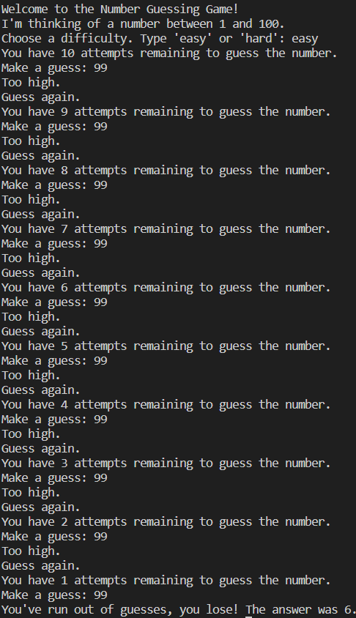
Output

Slide 6
EDA using Python libaries
I have taken a small dataset which contains all the names of babies in the Usa,I Want to find the most popular baby name.
To do so I have plotted some graphs and passed some queries to get the desired result.

Slide 7
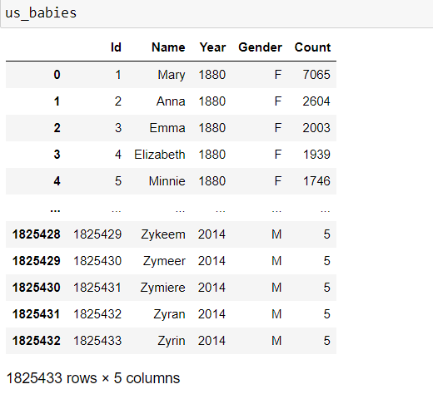
What was done in Eda?
Display the data set which contains the the record of names in the USA from the years 1880 to 2014

Slide 8
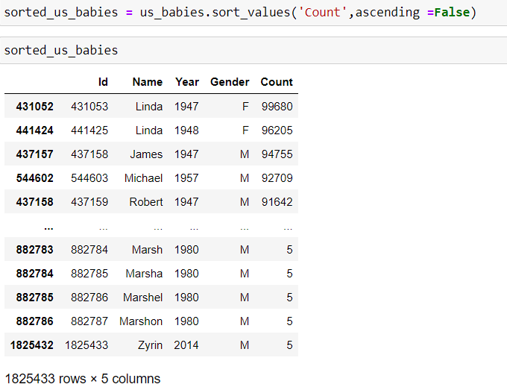
Eda contd..
Find out the most popular baby names and sorting them in descending to display the most popular baby names on top

Slide 9
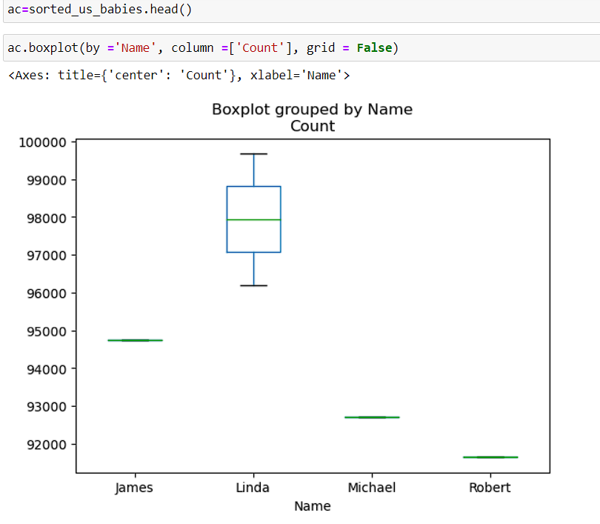
Eda contd..
Plotting the first 5 rows using the head command in a boxplot

Slide 10
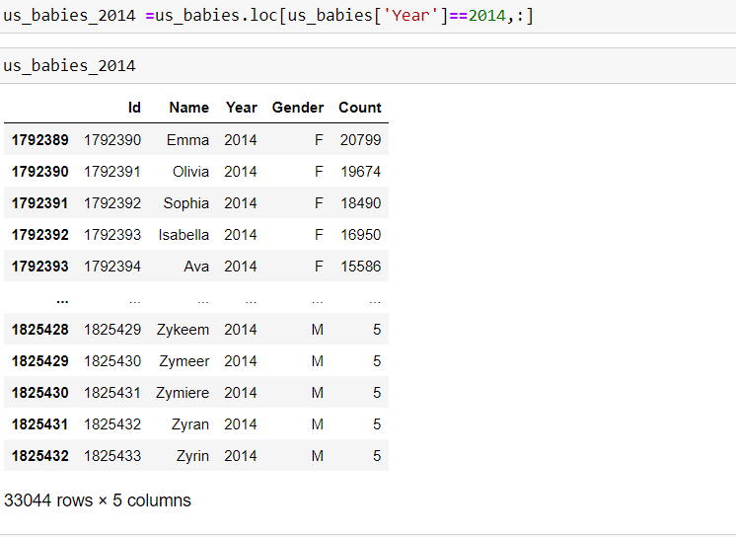
Eda contd..
Analysing the data in the year 2014

Slide 11
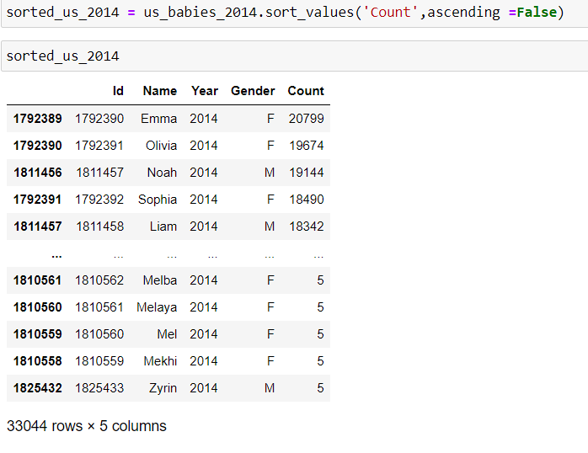
Eda Contd..
Sorting the data in Descending as I want only the most poplar names in the year 2014

Slide 12
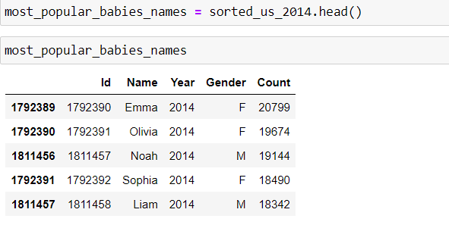
Eda contd..
I am going tto plot the data so I Need only the top 5 rows,obtained using head Function

Slide 13
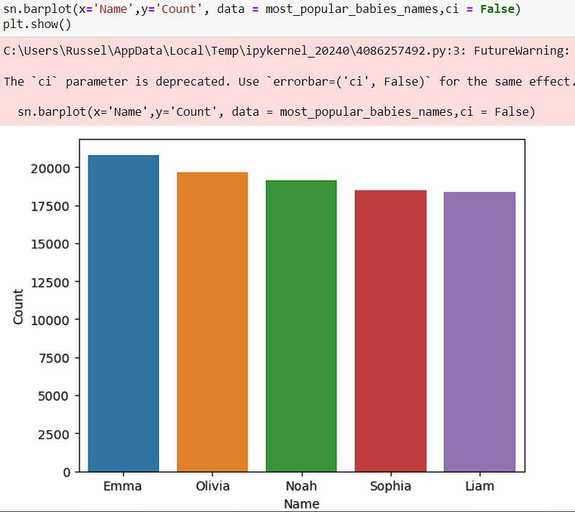
Eda contd..
Plotting the data using barplot(We can see that Emma is the most popular name in the year 2014).

Slide 14
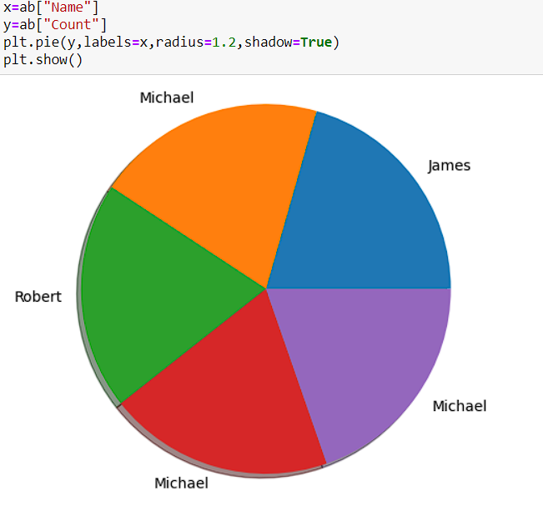
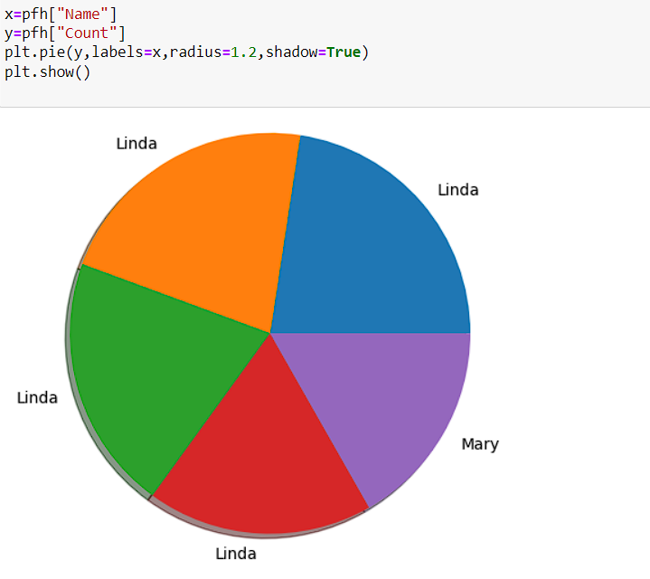
Eda Contd..
Similarly,done the same using gender column in the data and setting it to both male and female and getting the most popular male name and the most popular female name from the dataset and plotted them using piechart.

Slide 15
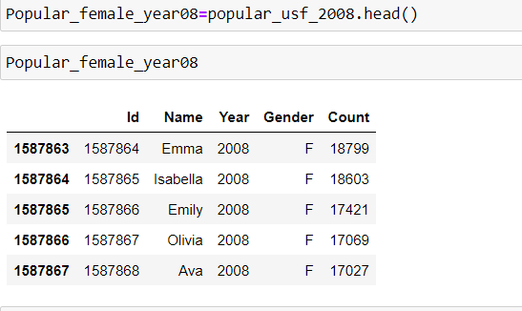
Eda contd..
As Michael was the most popular name in the records for males in 3 of the 5 years and Linda was the most popular record for females in 4 of the 5 years,we will take the year as 2008 and check for most popular male and female names.
We Found the most popular female in the year 2008 as:Emma

Slide 16
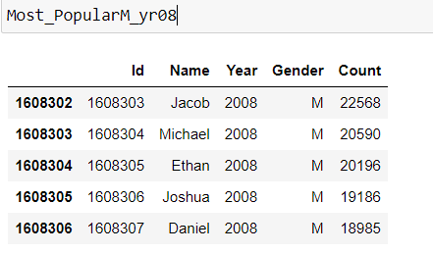
Eda contd..
Most popular male name in the year 2008 is:Jacob

Slide 17
Github And LinkedIn
https://github.com/RoquaSpartan95/Ryan_Scifor/tree/main/Project
https://www.linkedin.com/posts/ryan-christi-roque-baptista-96707b75_i-have-completed-my-first-project-at-scifor-activity-7157234176990097408-Bh3u?utm_source=share&utm_medium=member_desktop

Slide 18
Thank you

