Slide 1


BTL Concentrator Card
Slow Buses
November 21, 2019
Presented By Russell Taylor

Slide 2
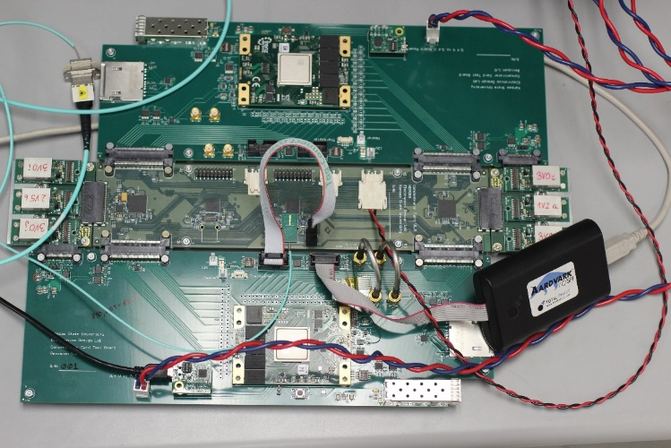
Concentrator Card Slow Buses Overview
I2C for LpGBT configuration.
1.2v
Speed not specifically detailed in LpGBT manual.
I2C_SC pin must be asserted high
SW1 line 3 ON for L1 LpGBT.
SW1 Line 4 ON for L0 LpGBT.
IC for LpGBT configuration.
80 Mb/s link speed.
PUSMState should have value WAIT_DLLS_CONFIG.
EC for GBT-SCA configuration.
80 Mb/s link speed.
HDLC based. (https://espace.cern.ch/GBT-Project/GBT-SCA/Manuals/HDLC_ISO-IEC13239.pdf)
Elink channel for GBT-SCA configuration
Elink Downlink at 80 Mb/s.
Elink Uplink at 160 Mb/s => every bit repeated.
VTRX+ I2C connected to its LpGBT I2C port M1.
LpGBT Address space detailed in manual (Read/Write/Fuse, Read/Write, Read only). https://lpgbt.web.cern.ch/lpgbt/manual/
GBT-SCA commands detailed in manual (https://espace.cern.ch/GBT-Project/GBT-SCA/Manuals/GBT-SCA_Manual_2019.002.pdf).

Slide 3
Concentrator Card
I2C Configuration Write
L1 LpGBT default address 7’b1110000.
L0 LpGBT default address 7’b1110001.
Write Sequence:
I2C Start
1st byte LpGBT address + 0
2nd byte LSB register address
3rd byte MSB register address
4th byte register data
.
. Can write multiple bytes, address auto-increments.
.
I2C Stop

Slide 4
Concentrator Card
I2C Configuration Read
L1 LpGBT default address 7’b1110000.
L0 LpGBT default address 7’b1110001.
Read Sequence:
I2C Start
1st byte LpGBT address + 0
2nd byte LSB register address
3rd byte MSB register address
I2C repeated start
4th byte LpGBT address + 1
^{5th} byte register data
.
. Can read multiple bytes, address auto-increments.
.
I2C Stop

Slide 5
Concentrator Card LpGBT
IC Configuration Write
L1 LpGBT default address 7’b1110000.
L0 LpGBT default address 7’b1110001.
IC Write structure:
ID | Description | Parity check
A | Frame delimiter 8’b 01111110 | No
B | Reserved (8’b 00000000) | No
C | lpGBT address (7 bits) + R/W bit = 0 | No
D | Command [7:0] (ignored) | Yes
E | Number of data words n[7:0] | Yes
E | Number of data words n[15:8] | Yes
F | Memory address [7:0] | Yes
F | Memory address [15:8] | Yes
G | 1st data (8 bits) | Yes
G | . . . | Yes
G | nth data (8 bits) | Yes
H | Parity word (8 bits) | Yes
A | Frame delimiter 8’b 01111110 | No

Slide 6
Concentrator Card LpGBT
IC Configuration Read
L1 LpGBT default address 7’b1110000.
L0 LpGBT default address 7’b1110001.
sequence
ID | Description | Parity check
A | Frame delimiter 8’b 01111110 | No
B | Reserved (8’b 00000000) | No
C | lpGBT address (7 bits) + R/W bit = 1 | No
D | Command [7:0] (ignored) | Yes
E | Number of data words n[7:0] | Yes
E | Number of data words n[15:8] | Yes
F | Memory address [7:0] | Yes
F | Memory address [15:8] | Yes
H | Parity word (8 bits) | Yes
A | Frame delimiter 8’b 01111110 | No

Slide 7
Concentrator Card LpGBT
IC Configuration Response
L1 LpGBT default address 7’b1110000.
L0 LpGBT default address 7’b1110001.
IC Write structure:
ID | Description | Parity check
A | Frame delimiter 8’b 01111110 | No
B | lpGBT address (7 bits) + R/W bit = 0 | No
C | Reserved (8’b 00000000) | No
D | Command [7:0] (7’b0000000 + previous parity check result) | Yes
E | Number of data words n[7:0] | Yes
E | Number of data words n[15:8] | Yes
F | Memory address [7:0] | Yes
F | Memory address [15:8] | Yes
G | 1st data (8 bits) | Yes
G | . . . | Yes
G | nth data (8 bits) | Yes
H | Parity word (8 bits) | Yes
A | Frame delimiter 8’b 01111110 | No

Slide 8
Concentrator Card GBT-SCA
EC Interface
LpGBT L1 GBT-SCA Controls:
GBT-SCA (Reference designator IC1) via EC channel on primary port.
GBT-SCA (Reference designator IC4) via E-links on primary port.
E-link out 30.
E-link in 51.
E-link clock 12.
LpGBT L0 GBT-SCA Controls:
GBT-SCA (Reference designator IC4) via EC channel on AUX port.
GBT-SCA (Reference designator IC1) via E-links on AUX port.
E-link out 10.
E-link in 12.
E-link clock 0.
Port desiring control sends HDLC SABM/CONNECT command.
Inactive port can receive supervisory commands (SABM, TEST and RESET).

Slide 9
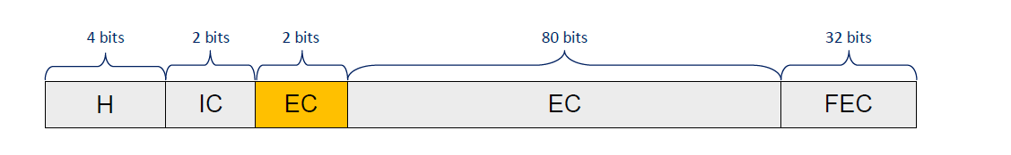
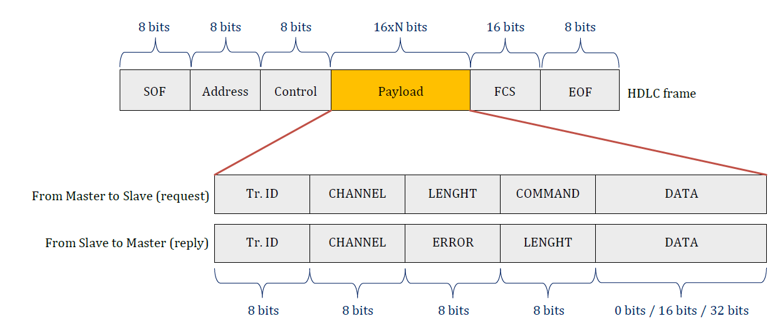
Concentrator Card GBT-SCA
EC Interface

Slide 10
Concentrator Card GBT-SCA
EC Interface HDLC Frame
SOF 0x7e.
GBT-SCA Address: 0x00.
Control:
SABM/Connect: 8’b11111100.
TEST: 8’b11001111.
RESET: 8’b11111001.
Information:
1’b0 + 3’b(send transaction number) + 1’b1 + 3’b(previous received transaction number).
Cannot initiate new transaction until previous transaction response received.
Payload (0, 16 or 32 bits).
FCS: CRC 𝐺(𝑥) = 𝑥16+ 𝑥12+ 𝑥5+ 1 of address, control and payload fields.
EOF 0x7e (can also be a SOF).

Slide 11
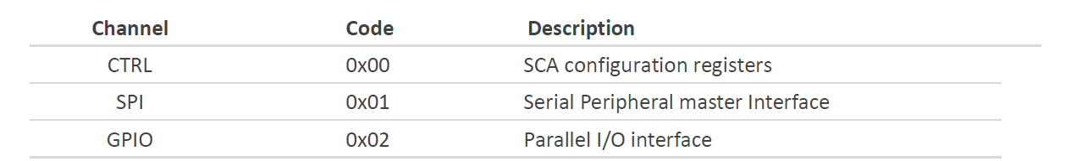
Concentrator Card GBT-SCA
EC Interface Payload
TR-ID unique ID for transaction on a channel. Need not be in order.
Channel:
Length: number of bytes in the DATA field.
Command: operation to be performed.
Error: 0x00 no errors found.

Slide 12
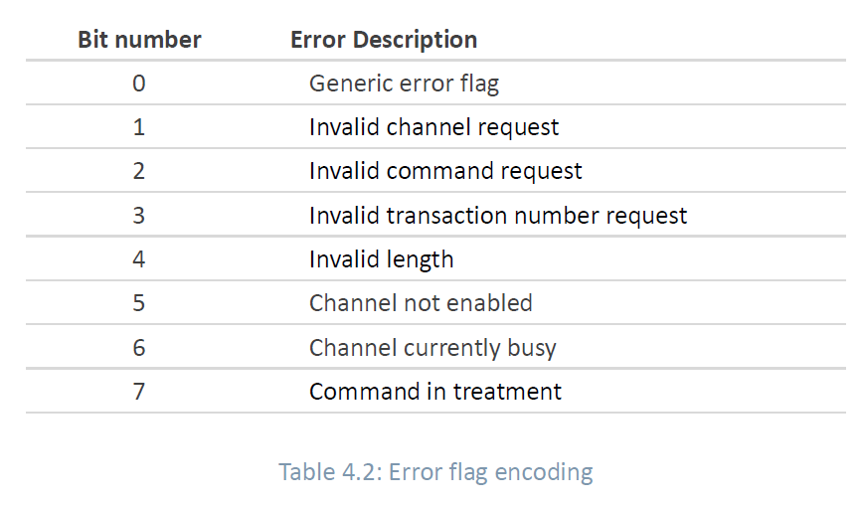
Concentrator Card GBT-SCA
EC Interface Payload Errors

Slide 13
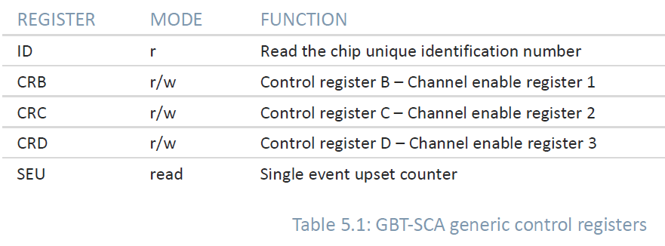
Concentrator Card GBT-SCA
EC Interface Payload Control Registers

Slide 14
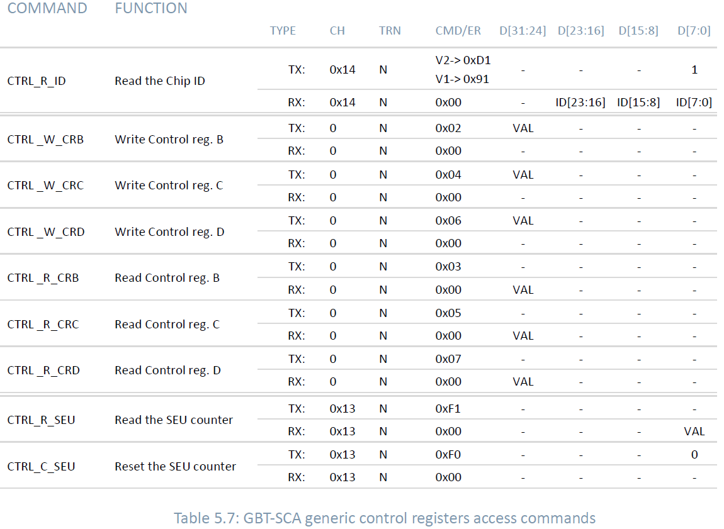
Concentrator Card GBT-SCA
EC Interface Payload Control Registers

Slide 15
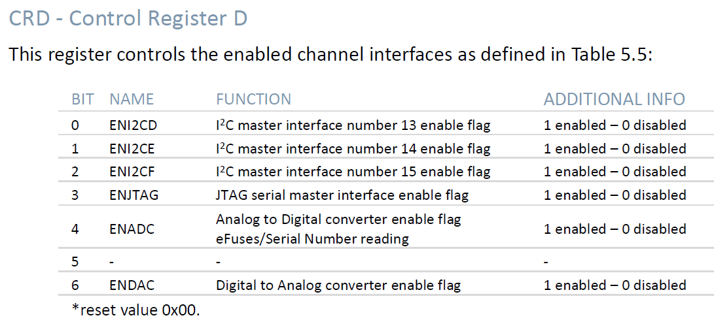
Concentrator Card GBT-SCA
EC Interface Payload Control Registers

