Slide 1
Response for Project 3
FINTECH 590 Rora Zhu

Slide 2
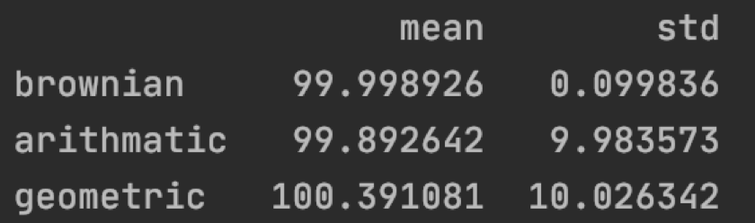
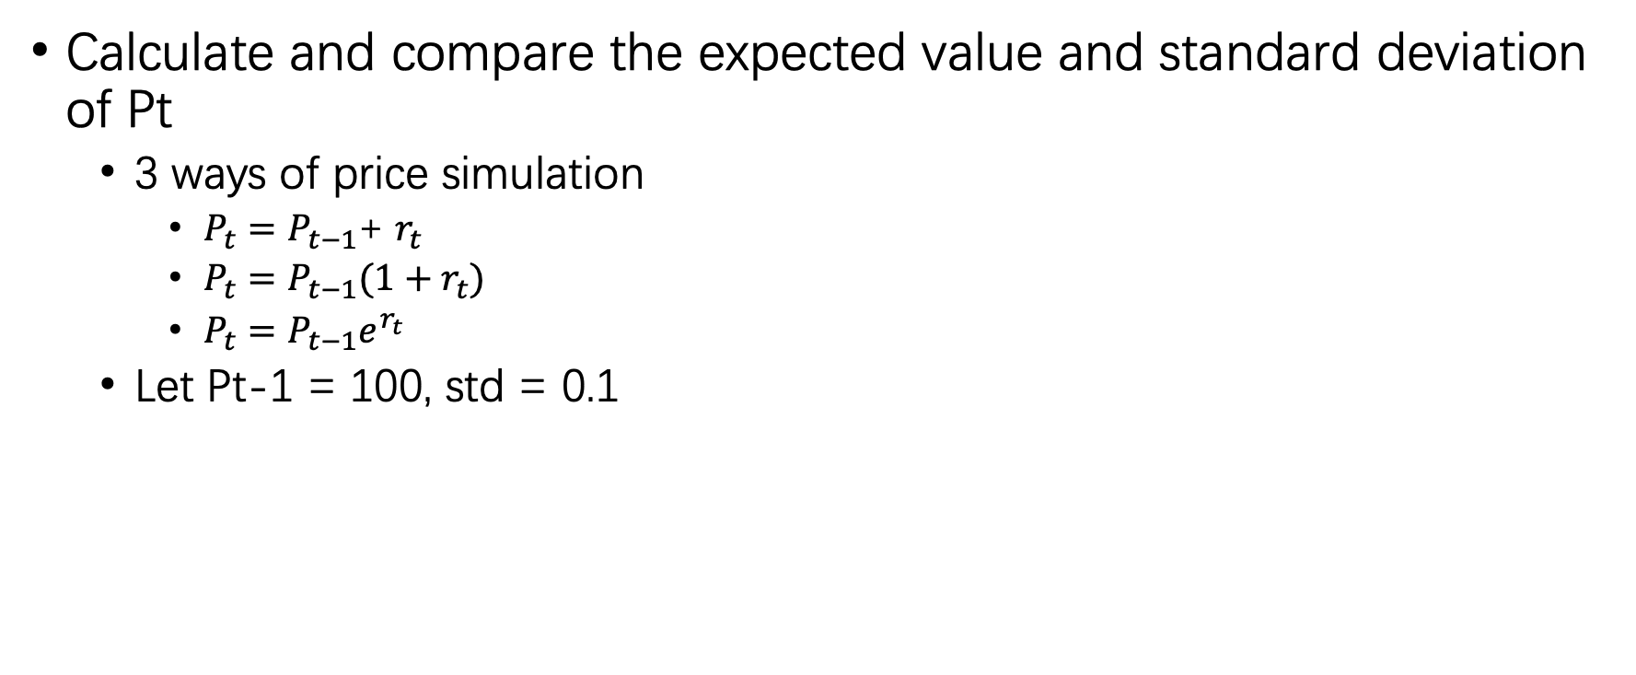
Problem 1
Calculate and compare the expected value and standard deviation of Pt
3 ways of price simulation
$P_{t}=P_{t−1}$+ $r_{t}$
$P_{t}=P_{t−1}(1+r_{t})$
$P_{t}=P_{t−1}e^{r_{t}}$
Let Pt-1 = 100, std = 0.1

Slide 3
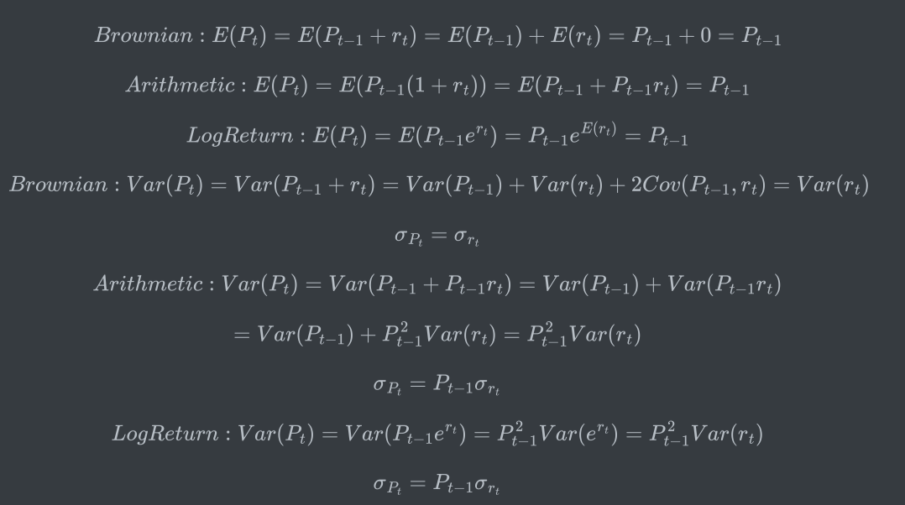
Problem 1
Show the mean and standard deviation match my expectations

Slide 4
Problem 1
Show the mean and standard deviation match my expectations
Since I set the initial price to be 100, and the sigma to be 0.1, the expectation of Pt should be around 100, the standard deviation of Brownian motion Pt should be around 0.1, and the standard deviation of arithmetic and geometric Pt should be around 10. Therefore, the means and standard deviations match my expectations.

Slide 5
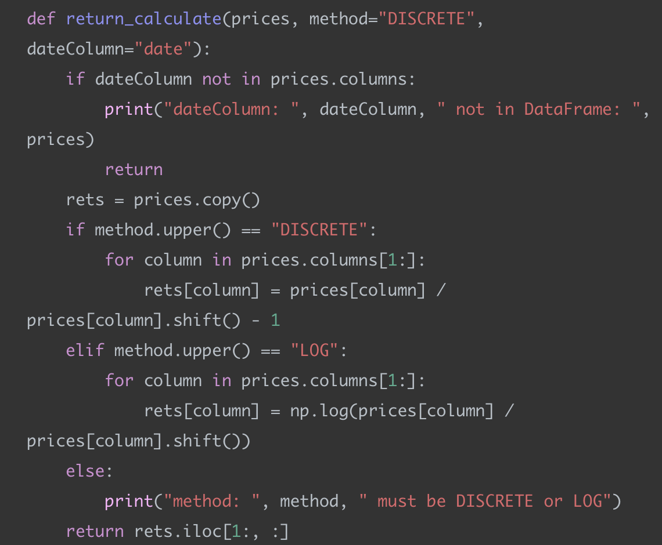
Problem 2
Implement a function similar to the “return_calculate()” in this week’s code

Slide 6
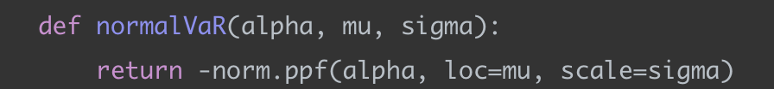
Problem 2
Calculate VaR using a normal distribution, a normal distribution with an Exponentially Weighted variance, a MLE fitted T distribution, and a Historic Simulation
VaR with a normal distribution is basically the percentile of a normal distribution given the significance level, mean, and standard deviation.

Slide 7
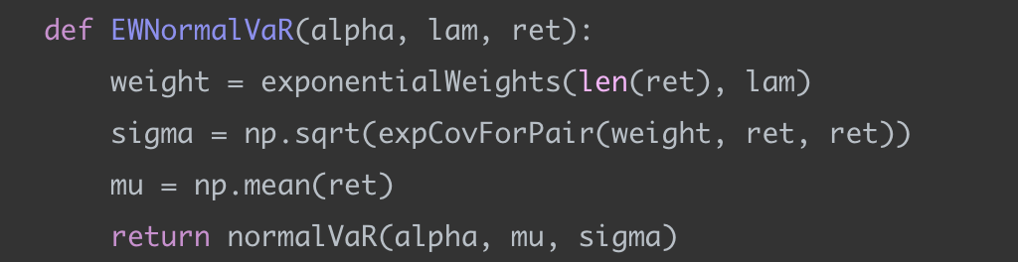
Problem 2
Calculate VaR using a normal distribution, a normal distribution with an Exponentially Weighted variance, a MLE fitted T distribution, and a Historic Simulation
VaR with a exponentially weighted variance normal distribution is the percentile of a normal distribution given the significance level, mean, and a exponentially weighted standard deviation.

Slide 8
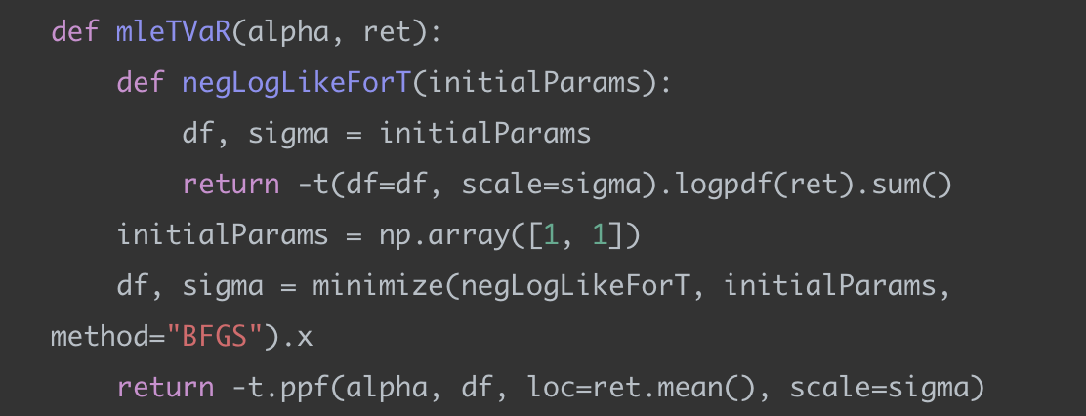
Problem 2
Calculate VaR using a normal distribution, a normal distribution with an Exponentially Weighted variance, a MLE fitted T distribution, and a Historic Simulation
VaR with MLE fitted T distribution is the percentile of a generalized T distribution given the MLE estimated degree of freedom and standard deviation.

Slide 9
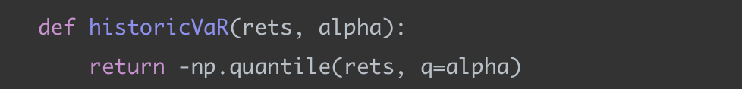
Problem 2
Calculate VaR using a normal distribution, a normal distribution with an Exponentially Weighted variance, a MLE fitted T distribution, and a Historic Simulation
VaR with a historical simulation is basically the quantile of all the historical data given a significance level.

Slide 10
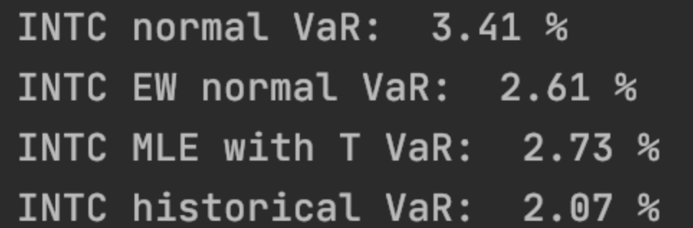
Problem 2
Compare the 4 values

Slide 11
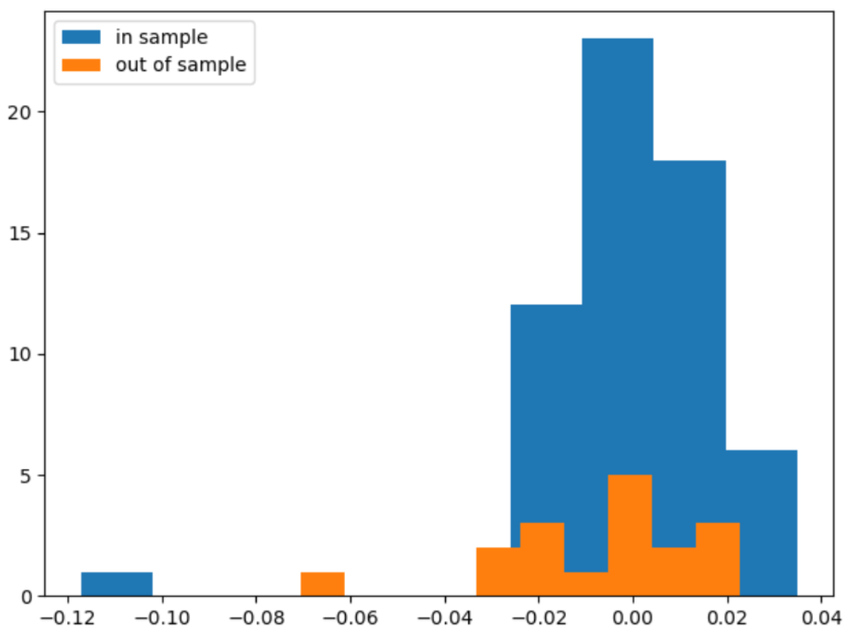
Problem 2
Look at the empirical distribution of returns, in sample and out of sample

Slide 12
Problem 2
Discuss the ability of these models to describe the risk in this stock
From the graph I can observe two outliers in the in-sample data and the out-of-sample data. However, all VaR models do not capture these two extreme loss. In this case, VaR with normal distribution performs the best since it has the largest VaR. VaR with historical simulation performs the worst since historical data may not represent out-of-sample data very well.

Slide 13
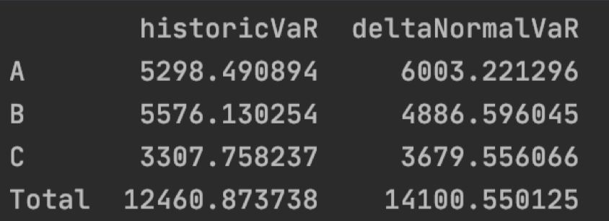
Problem 3
Calculate the VaR of each portfolio as well as your total VaR (VaR of the total holdings)
I choose delta normal and historical simulation to calculate VaR.

Slide 14
Problem 3
Discuss your methods, why you chose those methods, and your results
Delta normal method assumes that all asset returns are normally distributed. It gives each stock a weight based on its position in a portfolio. The normality assumption is also the drawback since in reality stock returns are fat-tailed. Historical simulation method has almost no assumption. The distribution of returns can be nonnormal, and securities can be non-linear. One drawback is that the distribution of historical data may not represent the future distribution.
I choose these two methods because I want to compare the prediction power of parametric and nonparametric methods.
Generally speaking, my result shows that delta normal method gives higher VaRs compared to those given by the historical-simulation method. Considering the fat-tail characteristics of the distributions of stock returns, I think deltaNormalVaR does a better job than the historicVaR.

